Slide 1

  Offloading Media Traffic to
  P4 Programmable Data Plane Switches
  Elie Kfoury¹, Jorge Crichigno¹, Elias Bou-Harb², Vladimir Gurevich³
  ¹University of South Carolina, Columbia, SC
  ²University of Texas, San Antonio, TX
  ³Barefoot Networks, an Intel Company
  CI Lab @ UofSC: http://ce.sc.edu/cyberinfra
  CI Engineering Brown Bag
  Friday, February 28, 2020

Slide 2
Agenda
Introduction
Background Information
  Session Initiation Protocol (SIP) and Real Time Protocol (RTP)
  Network Address Translation (NAT) traversal problem
  P4 switches
Proposed solution
Evaluation
Lessons learned

Slide 3
Introduction
According to estimations, media traffic represents approximately 80% of the total traffic over the Internet¹
Much media traffic is generated by end users communicating with each other
Media services (voice, video) running alongside the data network in campuses are becoming standard
1. H. W. Barz and G. A. Bassett, Multimedia networks: protocols, design and applications, John Wiley and Sons, 2016.

Slide 4
Voice and video
Conversational Voice- and Video-over-IP are widely used today
  Open and proprietary (Skype, WhatsApp) solutions
Supporting protocols are divided into two main categories
    Session control protocols (signaling)
      Session Initiation Protocol (SIP)
    Establish and manage the session
    Media protocols (media)
      Real Time Protocol (RTP)
    Transfer audio and video streams between the end-users
Desirable Quality-of-Service (QoS) characteristics
  Delay- and jitter-sensitive, low values
  Occasional losses are tolerated

Slide 5
Signaling and Media Protocols
SIP initiates, maintains, and terminates multimedia sessions between endpoints
  User agent client (UAC)
  User agent server (UAC)
RTP transports real-time data, such as audio and video
SIP server, registrar
SIP
SIP
Media (RTP)
UAC
UAS

Slide 6
Network Address Translation
Network Address Translation (NAT)
  Maps ports, private IP addresses to public IP addresses
Used in campus / enterprise networks, operators¹
NAT introduces various issues
    Violation of the end-to-end principle
    Traversal of end-to-end sessions
¹I. Livadariu et al., “Inferring carrier-grade NAT deployment in the wild,” in IEEE 2018 INFOCOM, 2018.

Slide 7
Network Address Translation
NAT prevents a user from outside from initiating a session
If both users have NATs, then neither can accept a call
  IP translation is recorded by a SIP registrar server
SIP carries the IP addresses and ports to be used by RTP to send/receive media
  NAT-translated IP, ports are unknown until RTP traffic starts
Several solutions proposed for NAT traversal
  STUN - RFC 5389¹, TURN - RFC 7566², ICE - RFC 8445³
1. D. Wing, P. Matthews, R. Mahy, and J. Rosenberg, “RFC 5389 - STUN: Session traversal utilities for NAT,” 2008.
2. M. Petit-Huguenin, S. Nandakumar, G. Salgueiro, and P. Jones, “RFC 7566 - TURN: Traversal using relays around NAT (TURN) uniform resource identifiers,” 2013.
3. J. Rosenberg and C. Holmberg, “RFC 8445 - ICE: Interactive connectivity establishment: a protocol for Network Address Translator (NAT) traversal,” 2018.
Notes:
If both users have NATs, then neither can accept a call ‘by the other

Slide 8
Relay Server
Intermediary device
SIP server
Relay server
RTP Information at relay server
 | Device IP - port | Allocated IP - port
A
B
A
B
Notes:
If both users have NATs, then neither can accept a call ‘by the other

Slide 9
Relay Server
Intermediary device
SIP establishes the session
  RTP ports are unknown
  The relay server allocates one port for each device
SIP server
Relay server
RTP Information at relay server
IP_{R}
 | Device IP - port | Allocated IP - port
A | -- -- | IP_{R} - p_{R-A}
B | -- -- | IP_{R} - p_{R-B}
IP_{A} - p_{A}
IP_{B} - p_{B}
Notes:
If both users have NATs, then neither can accept a call ‘by the other

Slide 10
Relay Server
Intermediary device
SIP establishes the session
  RTP ports are unknown
  The relay server allocates one port for each device
The relay server receives and relays the RTP traffic
SIP server
Relay server
RTP Information at relay server
IP_{R}
 | Device IP - port | Allocated IP - port
A | IP_{A’} - p_{A’} | IP_{R} - p_{R-A}
B | IP_{B’} - p_{B’} | IP_{R} - p_{R-B}
IP_{A’} - p_{A’}
IP_{B’} - p_{B’}
IP_{A} - p_{A}
IP_{B} - p_{B}
Notes:
If both users have NATs, then neither can accept a call ‘by the other

Slide 11
Relay Server
Intermediary device
SIP establishes the session
  RTP ports are unknown
  The relay server allocates one port for each device
The relay server receives and relays the RTP traffic
SIP server
Relay server
RTP Information at relay server
IP_{R}
 | Device IP - port | Allocated IP - port
A | IP_{A’} - p_{A’} | IP_{R} - p_{R-A}
B | IP_{B’} - p_{B’} | IP_{R} - p_{R-B}
IP_{A’} - p_{A’}
IP_{B’} - p_{B’}
IP_{A} - p_{A}
IP_{B} - p_{B}
Notes:
If both users have NATs, then neither can accept a call ‘by the other

Slide 12
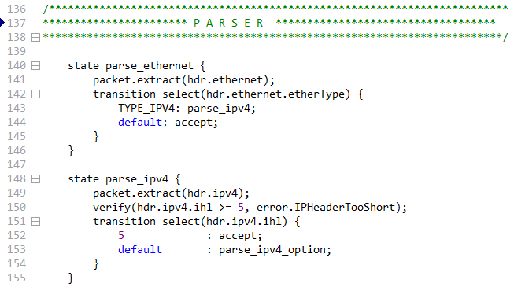
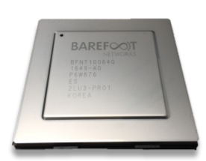
Overview P4 Switches
P4 switches permit programmer to program the data plane
Add proprietary features
  Parse packet headers, including UDP
  Header inspection; identify media session using the 5-tuple
  Modify fields; IP addresses and ports
P4 code
Programmable chip

Slide 13
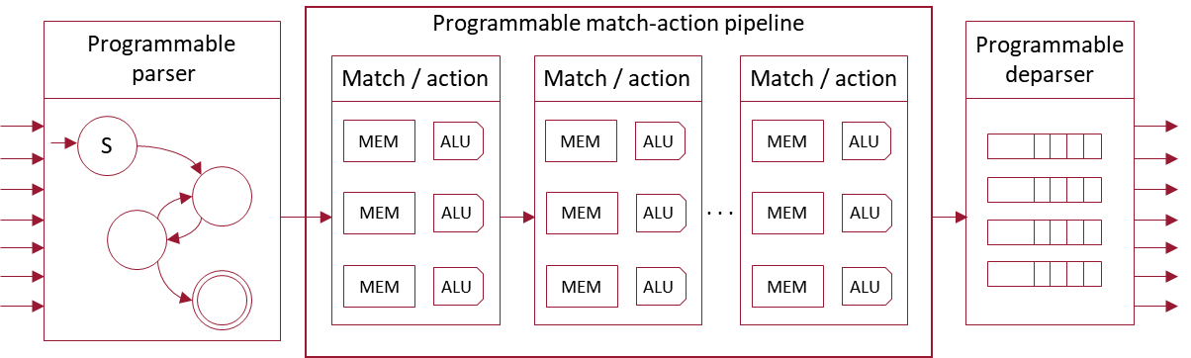
PISA Architecture
Several programmable switches implement the Protocol Independent Switch Architecture (PISA)
    Abstract processing model
    Programmers specify how a packet should be parsed and processed through match-action tables
If the P4 program compiles, it runs on the chip at line rate

Slide 14
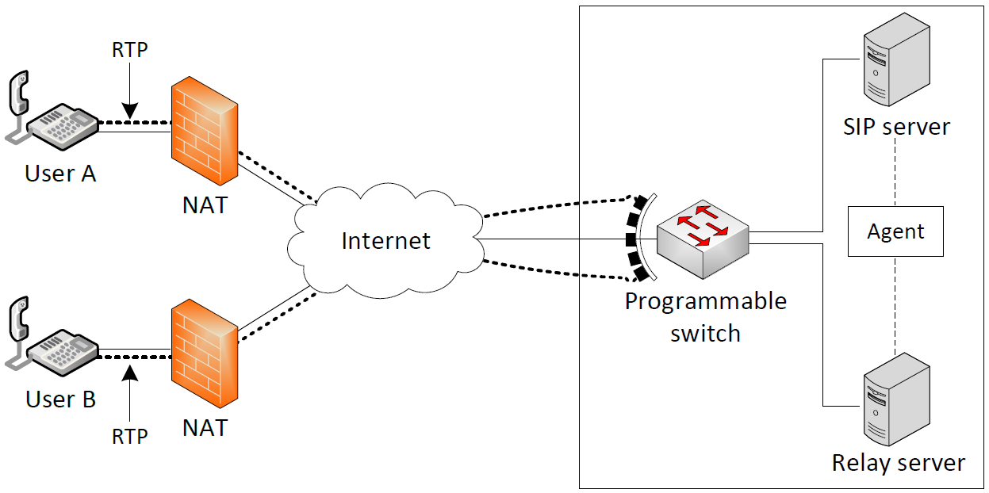
Proposed System
The proposed architecture uses programmable switches to emulate the behavior of the relay server:
  Parse the incoming packet carrying media traffic from the first party, say user A
  Identify the session this packet belongs to by using the 5-tuple
  Replace the source IP with that of the relay server, and the source port with that used by the relay server to receive traffic from user A
  Replace the destination IP and the destination port with those of user B
  Recalculate both IPv4 and UDP checksums
  Forward the packet to user B

Slide 15
Proposed System (cont’d)
A custom software (agent) learns the ports allocated to a media session by the relay server
The Rule Generator uses the 5-tuple allocated to the media session to construct a unique session identifier
It stores identifiers of the media sessions and the new headers’ values in the switch
It also clears media sessions allocated in the switch when a call is teared down

Slide 16
IMPLEMENTATION AND EVALUATION
System components
    OpenSIPS, an open source implementation of a SIP server
    RTPProxy, a high-performance relay server for RTP streams
    SIPp: an open source SIP traffic generator that can establish multiple concurrent sessions and generate media (RTP) traffic
    Iperf3: traffic generator used to generate background UDP traffic
    Edgecore Wedge100BF-32X: programmable switch
Edgecore w/
Tofino Chip
Intel Xeon
4 cores, 2.20GHz
Intel Xeon
4 cores, 2.20GHz

Slide 17
IMPLEMENTATION AND EVALUATION
Two scenarios are considered:
  “Server-based relay”: relay server is used to relay media between end devices, without the intervention of the switch
  “Switch-based relay”: the switch is used to relay media
UAC (SIPp) generates 900 media sessions
The rate at which sessions arrive is 30 per second
The test lasts for 300 seconds
G.711 media encoding codec (160 bytes every 20ms)

Slide 18
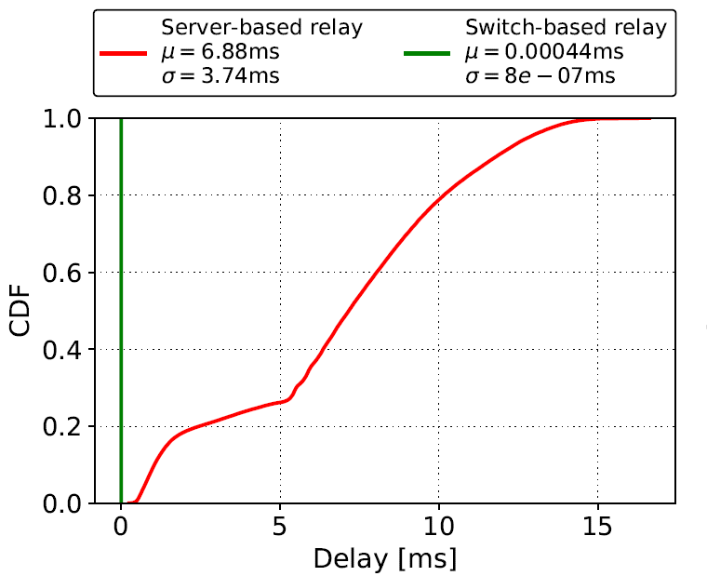
Results
Delay: the time interval starting when a packet is received from the UAC by the switch’s ingress port and ending when the packet is forwarded by the switch’s egress port to the UAS
  Delay contributions of the switch and the relay server

Slide 19
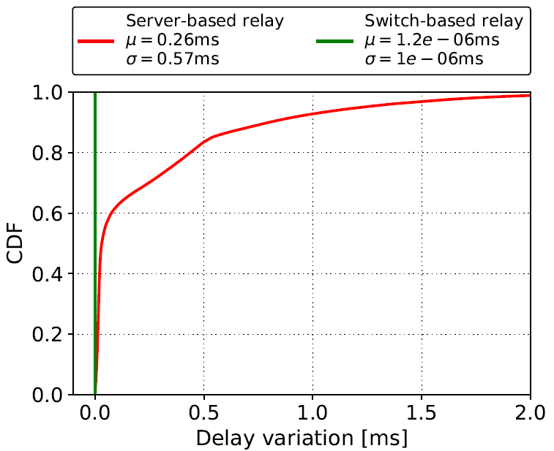
Results
Delay variation: the absolute value of the difference between the delay of two consecutive packets
  Analogous to jitter, as defined by RFC 4689

Slide 20
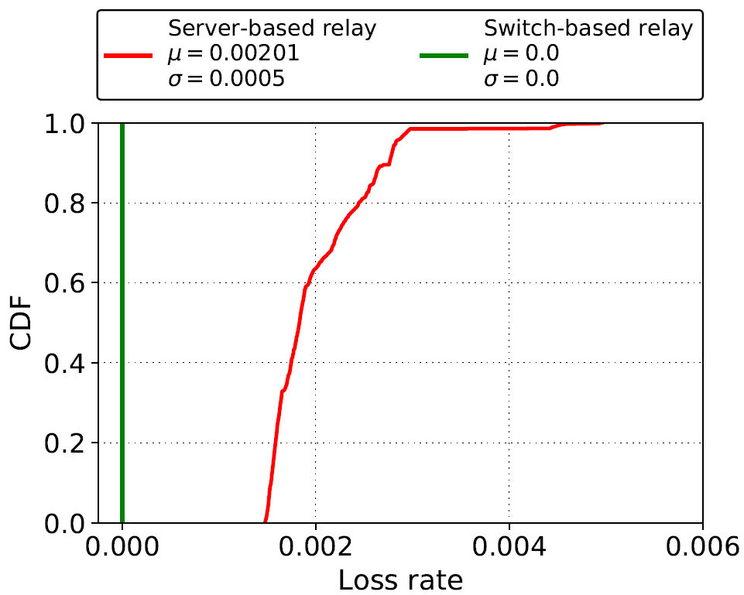
Results
Loss rate: number of packets that fail to reach the destination
  Calculation is based on the sequence number of the RTP header

Slide 21
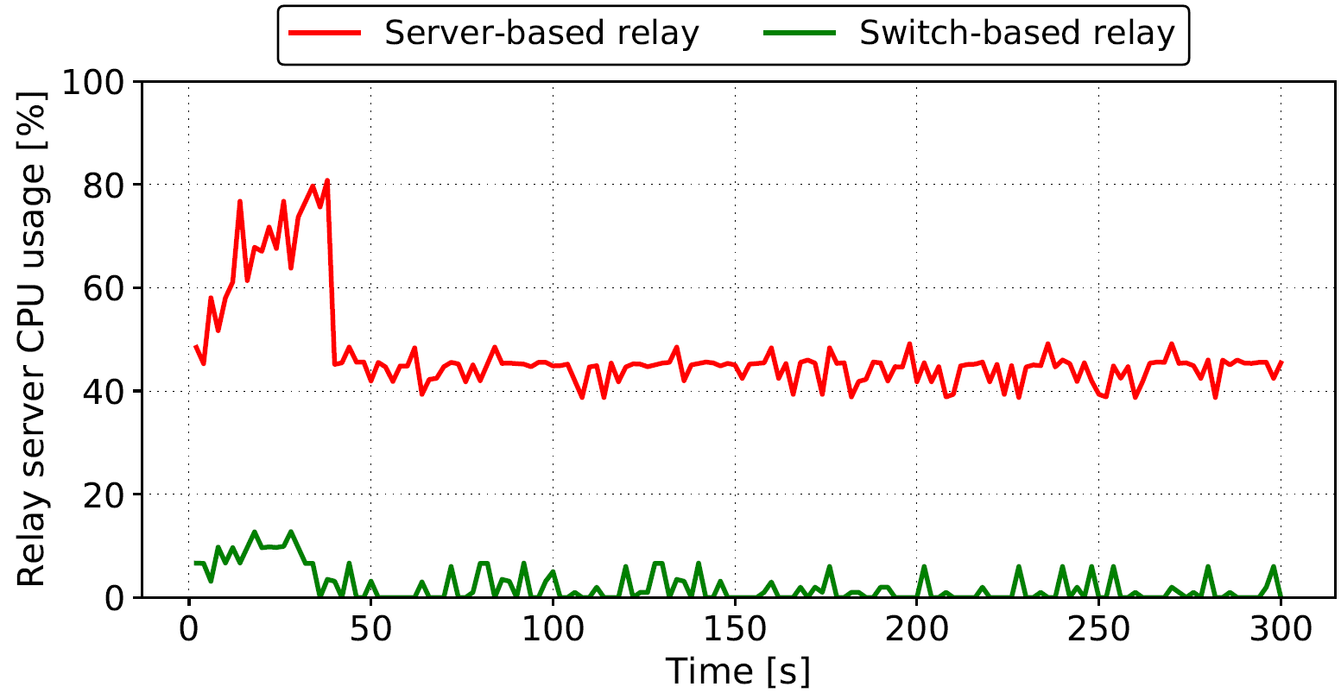
Results
CPU usage: the percentage of the CPU’s capacity used by the relay server

Slide 22
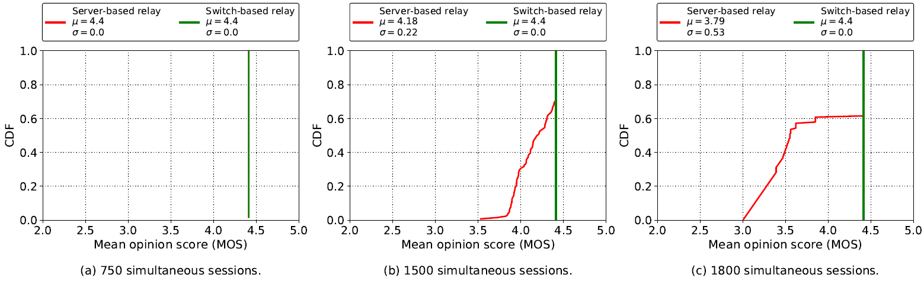
Results
Mean Opinion Score (MOS): estimation of the quality of the media session
  A reference quality indicator standardized by ITU-T
  Maximum for G.711 is ~4.4

Slide 23
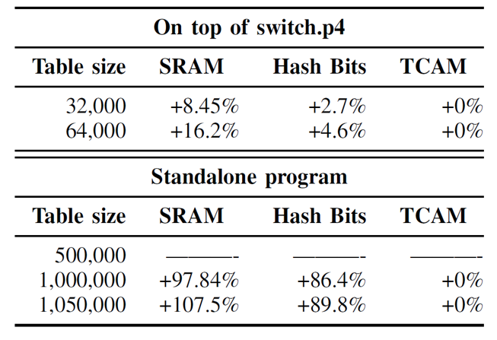
Resource Consumption
The prototype is implemented in two different scenarios:
    On top of the baseline switch program (switch.p4)
        Implements various features including Layer 2/3 functionalities, ACL, QoS, etc.
    Standalone implementation
Additional hardware resources used when the solution is deployed on top of switch.p4 and as a standalone program

Slide 24
Lessons Learned
Advantages of using a switch-based relay:
    Performance
      ~1,000,000 sessions vs ~1,000 sessions per core
    QoS
      Optimal QoS parameters: delay, delay variation, packet loss rate
    Flexibility
      The switch permits to modify / forward packets using non-standard fields
    Timing information
      Measuring delay and its variation on the P4 switch results in precise high-resolution timing information
  Programmer can free unused resources and customize program
      Accommodate additional sessions
Limited resources
Avoid complex application logic

Slide 25

ACKNOWLEDGEMENT
Thanks to the National Science Foundation (NSF)!
Activities in the CI Lab at the University of South Carolina are supported by NSF, Office of Advanced Cyberinfrastructure (OAC)

Slide 26
Additional Slides

Slide 27
Design Requirements
Quality of Service (QoS) parameters
  Bandwidth
  Delay
  Jitter
  Loss
QoS requirements; stringency of applications¹
Application | Bandwidth | Delay | Jitter | Packet Loss
VoIP | Low | High | High | Low
Video conference | High | High | High | Low
Data (e.g., file transfer) | High | Low | Low | Medium
¹A. Tanenbaum, D. Wetherall, “Computer Networks,” Pearson, 5th Edition, p. 405, 2011

Slide 28
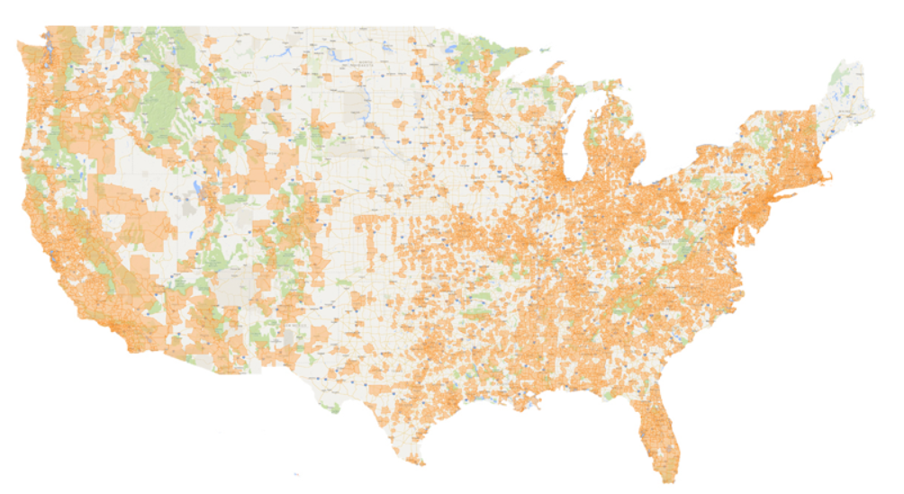
Motivation
According to estimations, media traffic represents approximately 80% of the total traffic over the Internet
  Much of it is generated by end users communicating with each other
Media services (voice, video) running alongside the data network in campuses are becoming standard
Wide Area Networks (WANs) connect centers, campuses
  E.g., SIP Trunk Network CenturyLink; 10,000 centers, 10,000 centers, 3 billion minutes of voice over IP (VoIP) conversations per month
SIP Trunk Network, CenturyLink
https://tinyurl.com/som38qv

