Slide 1
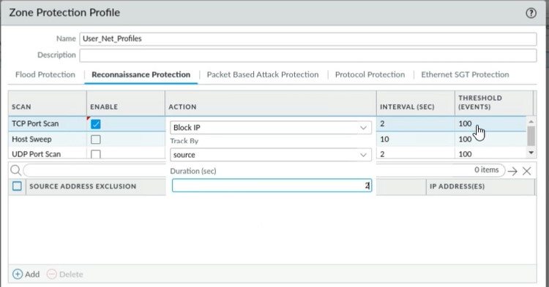
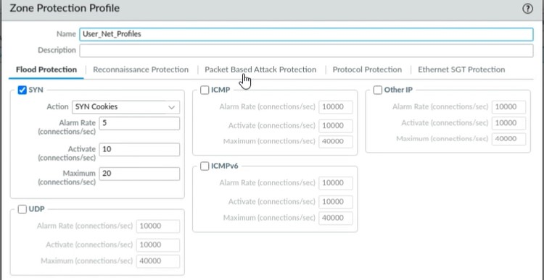
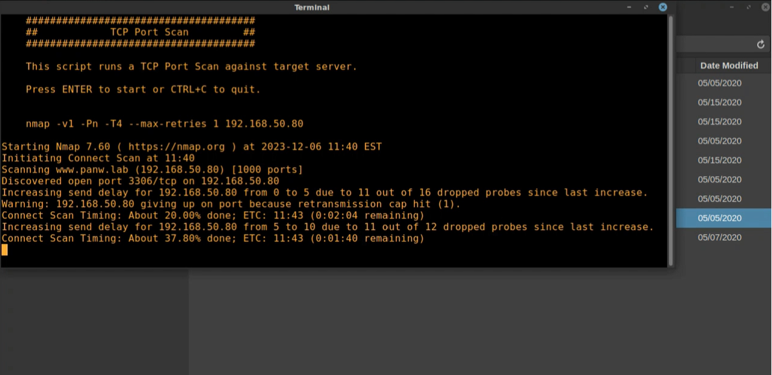
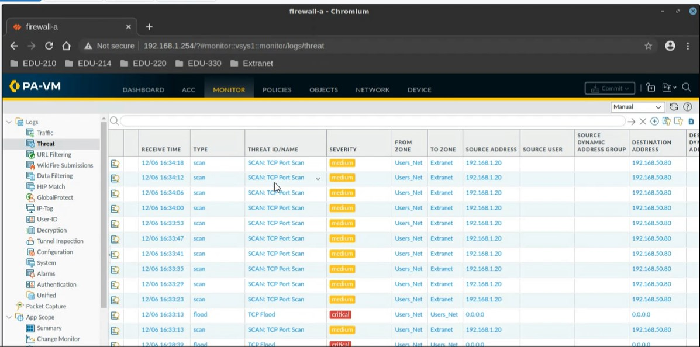
RECONNAISSANCE MITIGATION ​
THROUGH NGFW (NEXT GENERATION FIREWALL)
BY: Denzel Martin, Favour Agho
Advisor: Jorge Crichigno, Ali Mazloum
Integrated Information Technology Department, University of South Carolina, Columbia, South Carolina
Abstract
Threat Prevention Profiles:
Results
Network reconnaissance, a precursor to cyber attacks, involves systematic probing and intelligence gathering.
Passive and active techniques are employed, ranging from information gathering to probing network resources.
Palo Alto's Next-Generation Firewall (NGFW) serves as a robust defense, leveraging threat intelligence, deep packet inspection, and application visibility to thwart reconnaissance attempts.
Mitigation strategies extend beyond technology, encompassing regular audits, employee training, and prompt vulnerability patching.
Collaborative efforts between administrators, security teams, and NGFW capabilities establish a resilient defense against evolving cyber threats.
The high-level architecture of the proposed approach shown can be summarized in the following steps:
The P4 PDP switch collects and stores the context-aware features of the hosts
When an NXD response is received, the
Security Policy Implementation
Threat Prevention Profiles:
Threat Prevention Profiles play a pivotal role in enhancing the overall security posture of a network, particularly in the context of reconnaissance mitigation through a Next-Generation Firewall (NGFW). To fortify the defense against reconnaissance attempts, it is crucial to leverage comprehensive Threat Prevention profiles that incorporate advanced security measures. Two key components of these profiles, namely Anti-Spyware and Vulnerability Protection, contribute significantly to detecting and blocking malicious activities associated with reconnaissance techniques.
Anti-Spyware Protection:
Purpose: Anti-Spyware functionality within Threat Prevention profiles is designed to identify and eliminate spyware, which is often employed during reconnaissance to collect sensitive information.
Detection Mechanisms: Utilizing sophisticated detection algorithms, Anti-Spyware modules scan incoming and outgoing traffic for known spyware signatures and behavioral patterns.
Vulnerability Protection:
Purpose: Vulnerability Protection is instrumental in mitigating reconnaissance attempts by identifying and addressing vulnerabilities in software, systems, or applications that could be exploited by attackers.
Signature-Based Detection: Vulnerability Protection employs a signature-based approach to recognize known vulnerabilities, ensuring that the NGFW is equipped to counteract specific threats associated with reconnaissance activities.
Security Policy Implementation:
Establishing robust security policies is crucial in preventing reconnaissance activities.
Clear and stringent rules govern various aspects of network communication, acting as the first line of defense against unauthorized probing.
Traffic Flow Regulation:
Dictates controlled ingress and egress traffic.
Specifies rules to allow or restrict traffic based on origin, destination, and purpose.
Prevents suspicious reconnaissance attempts.
Addressing Rules:
Manages IP addresses (source and destination).
Restricts access from unknown or unauthorized sources.
Minimizes the risk of reconnaissance by defining precise addressing rules.
Service Control:
Manages permitted services on network devices.
Controls service interaction to limit potential vulnerabilities.
Restricts exposure during reconnaissance.
Continuous Review and Adjustment:
Dynamic adaptation to evolving threats.
Regular updates to address emerging risks effectively.
Ensures a resilient defense against reconnaissance activities.
Acknowledgment
This work was supported by the Office of Naval Research (ONR),

