Slide 1
P4 and the Portable NIC Architecture (PNA)
Andy Fingerhut
Aug 8, 2024

Slide 2
Who am I?
Got a doctorate in Computer Science in 1993
Then spent first 5 years of career doing ASIC design at my alma mater.
Since then, have always worked close to the hardware/software boundary of systems.
Often with a focus on programmable data planes.
Have worked at a couple of computer networking startups, both bought by Cisco Systems
Worked at Cisco for a total of 19 years since 2000, Intel for 3
Have left Cisco 3 times, and returned to Cisco 3 times ☺
Got involved in P4 in 2017
Have served as co-chair of the P4 Architecture Work Group since 2018.

Slide 3
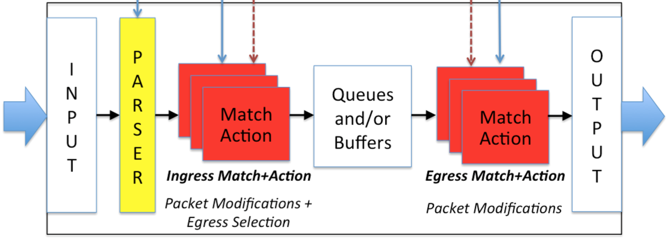
A little background
The P4_14 spec (published 2014) defined both of these things:
A programming language, and
How packets flowed through one kind of network switch architecture (figure)
With specific places where packets could be dropped, mirrored, multicast, resubmitted, or recirculated.

Slide 4
P4_16
Before I became involved with P4 in 2017, work on the P4_16 specification was nearly complete.
Its authors realized that “baking in” a particular kind of packet flow would limit its usefulness.
Other switches or routers might not have exactly the same packet flow as each other.
Other categories of network devices, e.g. NICs, would be even less likely to match.
They decided the P4_16 language specification would provide mechanisms for defining a P4 “architecture”
And include a simple toy example of one, called Very Simple Switch
But other architectures would be defined outside of the language spec.

Slide 5
v1model architecture
The v1model architecture was the first architecture supported by P4.org
Intended primarily as a way to auto-translate P4_14 programs into P4_16
No one has ever written a specification document for v1model.
It is effectively defined by its implementation in the open source projects p4c and BMv2 (aka behavioral-model)
I have written some detailed articles describing v1model, describing at least part of how the implementation behaves.

Slide 6
Portable Switch Architecture (PSA)
NU, NM
NFP
Ingress Parser
Ingress
Ingress Deparser
Packet Buffer
Egress Parser
Egress
Egress Deparser
NTP
NFCPU
CI2E
NTCPU
RESUBMIT
CE2E
RECIRCULATE
The Portable Switch Architecture was the first P4 architecture published by P4.org
Most discussions happened in 2018-2019, with no substantive changes since then.
Main differences from v1model:
Ingress has a deparser, and egress has a parser
There are murky corners of v1model’s precise behavior that I believe are caused, in part, by not having these.
Precise specification that tries to be explicit what happens to packets in all cases (data plane programmers need this).

Slide 7
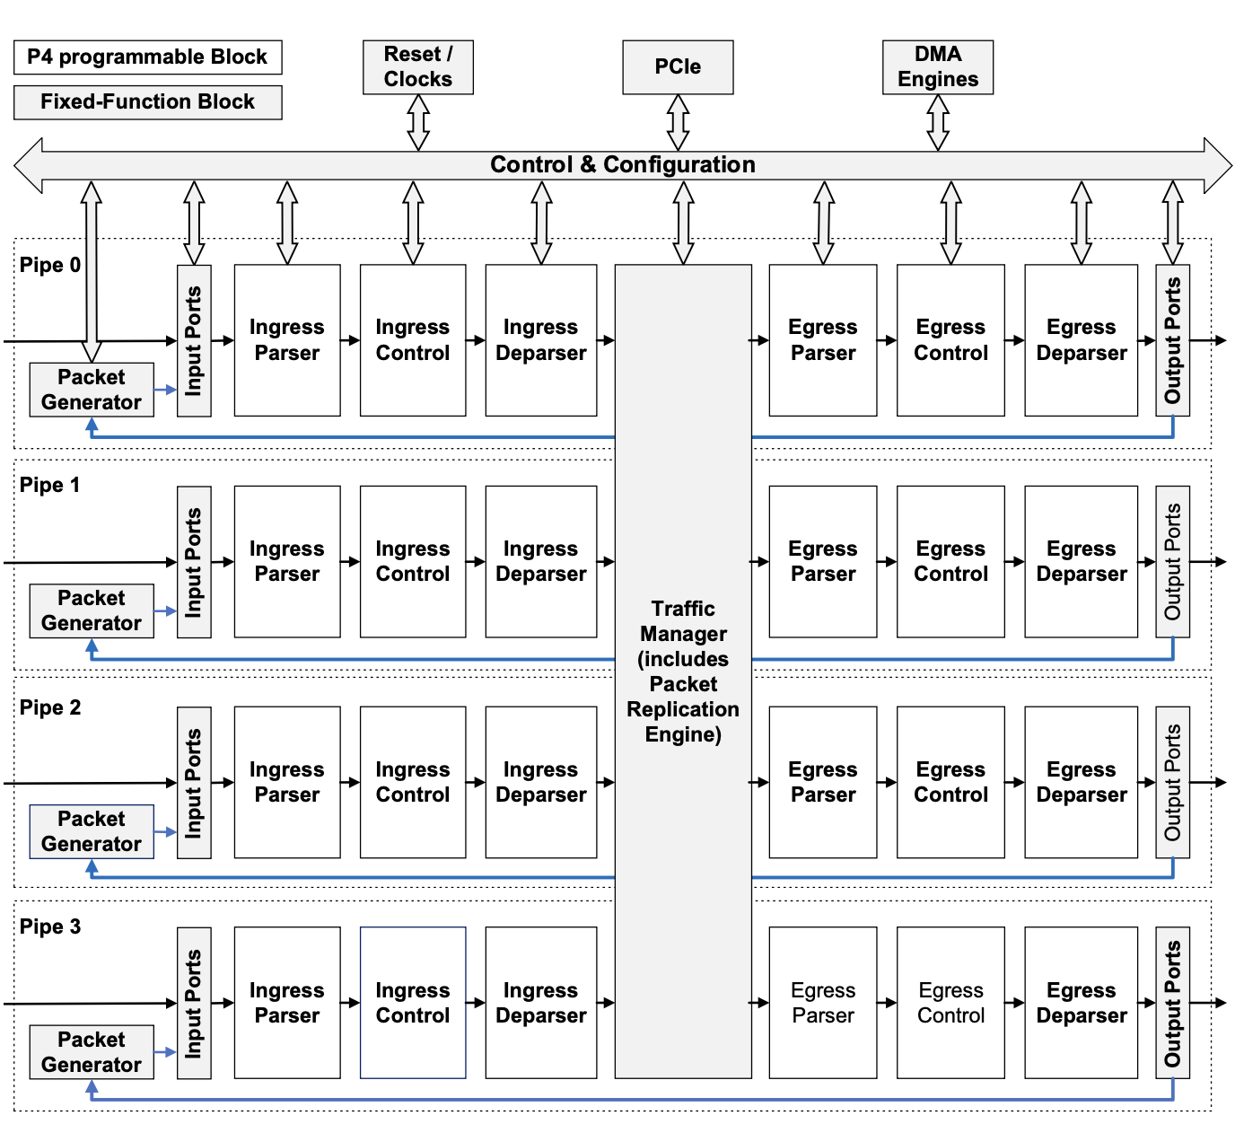
Tofino Native Architecture
Defined by Barefoot / Intel
Like PSA, also has ingress deparser and egress parser
Many small and large differences with PSA. Some examples:
DirectRegister extern, enabling read-modify-write state to be associated one-to-one with entries of a table
Fancier multicast replication in the Traffic Manager.
Implemented on a real product ☺

Slide 8
NICs
I joined Intel in 2020, the part of the company that was the Barefoot Networks acquisition.
Intel was in the process of developing a programmable NIC (the Intel IPU), with a highly programmable data plane.
Two of the first assignments I was given were:
Work with Intel’s P4 compiler team to advise them on P4-related topics, e.g. how best to represent various hardware features in P4.
Work with engineers from other companies working on programmable NICs on a “Portable NIC Architecture” specification, to be published by P4.org.

Slide 9
Just reuse PSA?
PSA was considered, but there are some notable differences between programmable NICs vs. switches:
About half of the I/O bandwidth of the device is for Ethernet ports, and the other half is a big PCI express interface with one (or more) host CPU complexes.
Packet flows host->NIC->Ethernet and Ethernet->NIC->host are common.
Most devices also support host->NIC->host and Ethernet->NIC->Ethernet
Some features are very rare on switches, but common on NICs:
Calculation of full payload checksums for TCP, UDP
Encryption
Highly stateful features like TCP connection tracking, with many variations
Segmentation and reassembly
TCP/UDP Large Receive Offload (LRO), TCP Segmentation Offload (TSO)
RDMA

Slide 10
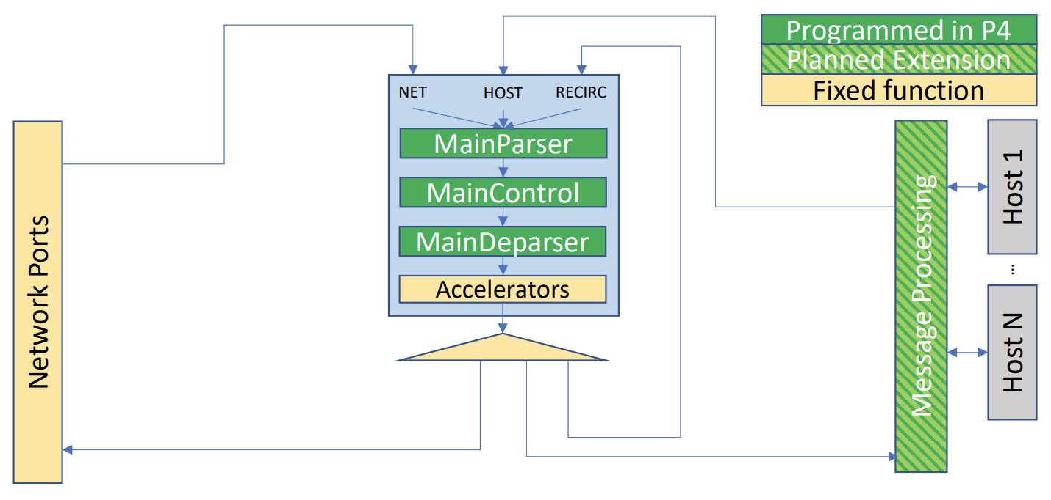
PNA packet flows
Packets arriving from network port or host arrive at a common pipeline, with common parser, control, and deparser.
send_to_port(dest_port_id) can be used to direct packet either to network port, or vport, regardless of where it came from.

Slide 11
PNA packet flows (2)
Common case is Port->NIC->Host or Host->NIC->Port
But Port->NIC->Port is often desired, e.g. for a NIC deployed as a network service shared by many hosts.

Slide 12
Encryption support
Accelerators will typically include encryption/decryption support
P4 code identifies whether to encrypt/decrypt packet, and which security association to use.
Assign values to metadata fields that controls the accelerator’s behavior.
Can optionally recirculate the packet after encrypt/decrypt is complete.

Slide 13
TCP connection tracking (1)
One simple variation:
For arriving TCP packet from host, look up (SA, DA, protocol, src port, dest port) in an exact match table.
On miss, add a new entry
With high sustained insertion rate (millions/second), so ideally no control plane involvement required.
PNA defines add-on-miss capability.
In default action (i.e. miss action) of table, can call ‘add_entry’ extern function that causes a new entry to be added to that table, with lookup key that just missed.
Restrictions make it easier for vendors to implement, while covering the common use cases.

Slide 14
TCP connection tracking (2)
Fancier variants:
Sequence number tracking: Record last sequence number seen in each packet, independently per flow, for millions of flows.
Drop packets that are not in expected range relative to last packet of same flow.
Plan soon to extend P4 language so that actions can have parameters that can be modified, which updates the table entry.
A more natural-looking way to write this kind of action, as compared to DirectRegister extern object in TNA.

Slide 15
A difficulty
It is far easier to define a “native” P4 architecture for a network device made by one vendor …
… than it is to define a common architecture that is usable across devices from multiple vendors.
Why?
Data plane programmers care a LOT about performance. One extra recirculation can be a deal-breaker for performance.
A network operator buys these devices because for their desired set of features, they want the best price/power/performance tradeoffs they can get.
If price/power/performance do not matter, everything can be done with general purpose CPUs (e.g. x86_64, arm64)

Slide 16
Benefits of a Portable NIC Architecture
Even if no vendor implements exactly what the published PNA specification says, I believe there are still benefits.
For at least a subset of new features, we can define new P4 language or architecture features to encompass them.
Vendors will implement those features in that way, if they can, just to avoid being unnecessarily different.
In other cases, define some common terminology that can be used and more widely understood.
An open source implementation enables people learning the concepts to practice with them.

Slide 17
Some observations
Some people claim it is extremely important to achieve portability of code across devices.
e.g. to avoid ”vendor lock in”
If you are someone in charge of deploying a network with programmable devices …
… and you want to avoid vendor lock-in …
Note that a large P4 program is 10K lines of code.
A small control plane system is 100K+ lines of code.
Most of your salary expenditure will go to developing control plane code.
Writing a separate P4 program per target device is relatively cheap, as long as it is done in a way that keeps the control plane code common.

