Slide 1

P4Tune: Enabling Programmability
in a non-Programmable Network
Elie Kfoury, Jorge Crichigno
University of South Carolina
http://ce.sc.edu/cyberinfra
ekfoury@email.sc.edu, jcrichigno@cec.sc.edu
CI Engineering Lunch and Learn – Online
April 15, 2022
Notes:
Session time: 12:15-1:45pm

Slide 2
Agenda
Non-programmable Networks
Background on SDN and P4 programmable switches
P4 switches adoption challenges
P4Tune framework
Use case 1: Dynamic buffer sizing
Use case 2: Size-aware flow separation
Use case 3: SYN flood mitigation
Use case 4: DNS amplification
Discussions
Conclusion

Slide 3
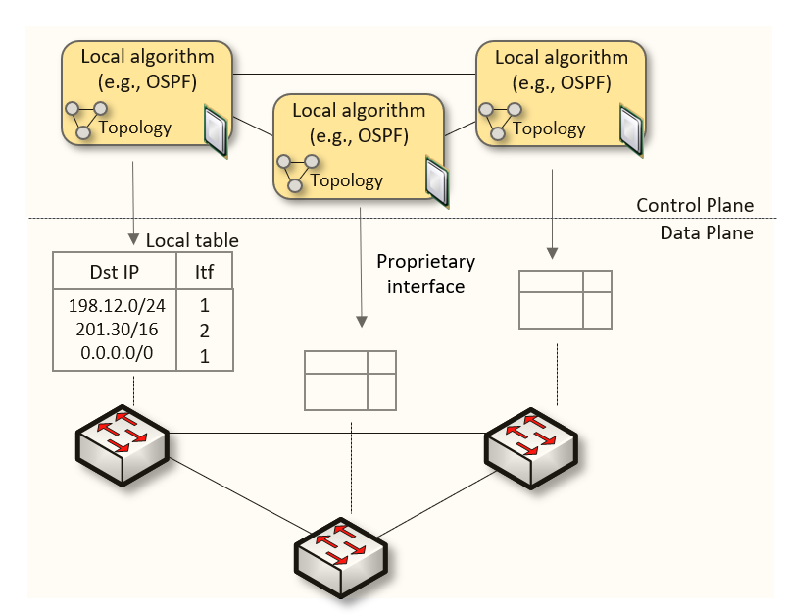
Non-programmable Networks
Since the explosive growth of the Internet in the 1990s, the networking industry has been dominated by closed and proprietary hardware and software
The interface between control and data planes has been historically proprietary
  Vendor dependence: slow product cycles of vendor equipment, no innovation from network owners
  A router is a monolithic unit built and internally accessed by the manufacturer only

Slide 4
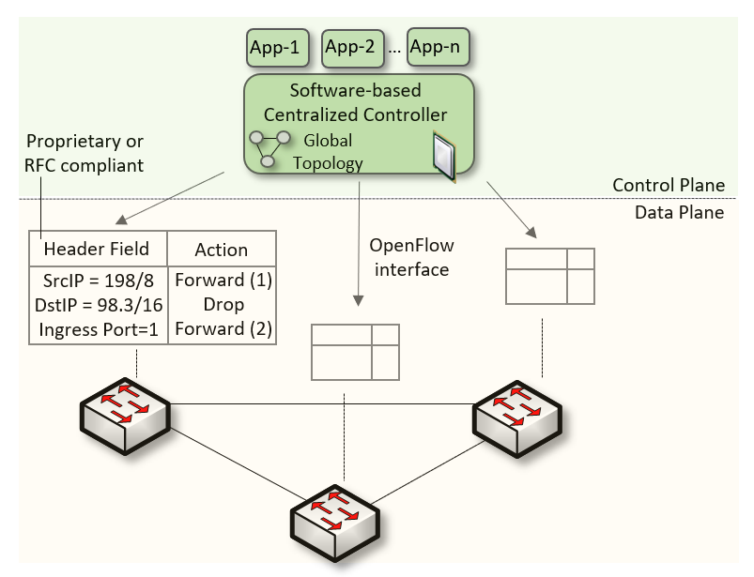
SDN
Protocol ossification has been challenged first by SDN
SDN explicitly separates the control and data planes, and implements the control plane intelligence as a software outside the switches
The function of populating the forwarding table is now performed by the controller
SDN is limited to the OpenFlow specifications

Slide 5
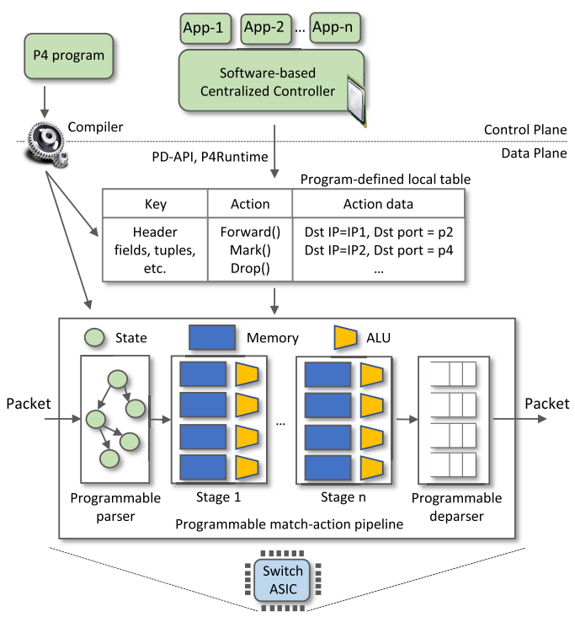
P4 Programmable Switches
P4¹ programmable switches permit a programmer to program the data plane
  Define and parse new protocols
  Customize packet processing functions
  Measure events occurring in the data plane with
  high precision
  Offload applications to the data plane
1. P4 stands for stands for Programming Protocol-independent Packet Processors

Slide 6
P4 Switches Deployment Challenges
Data plane programmability knowledge by operators
  Operators only configure legacy devices (e.g., modify routing configuration, updating ACL)
  Programming P4 targets is complex¹
Cost of replacing the existing infrastructure
  Significant costs, time, and efforts spent in building the network and the existing equipment
  Replacing these devices with P4 switches would incur significant costs
Vendor support
  The support in legacy devices is readily available
  P4 switches are whiteboxes, with little to no support from vendors
Network disruption
  P4 programs might be potential sources of packet-processing error
  Bugs can lead to network disruption, affecting the availability of the services
¹ The switch.p4 program, which contains the standard switch capabilities, has more than 10³⁰ control paths
Notes:
Despite the improvements brought by P4 switches, the majority of nowadays networks are still using legacy devices

Slide 7
P4Tune Overview

Slide 8
P4Tune Overview
Notes:
Despite the improvements brought by P4 switches, the majority of nowadays networks are still using legacy devices

Slide 9
P4Tune Overview
Notes:
Despite the improvements brought by P4 switches, the majority of nowadays networks are still using legacy devices

Slide 10
P4Tune Overview
Notes:
Despite the improvements brought by P4 switches, the majority of nowadays networks are still using legacy devices

Slide 11

Use Case 1: Dynamic Buffer Sizing

Slide 12
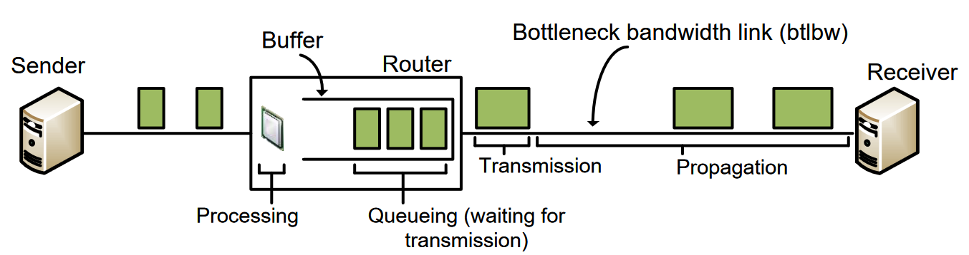
Buffer Sizing Problem
Routers and switches have a memory referred to as packet buffer
The size of the buffer impacts the network performance
  Large buffers -> excessive delays, bufferbloat
  Small buffers -> packet drops, potential low link utilization

Slide 13
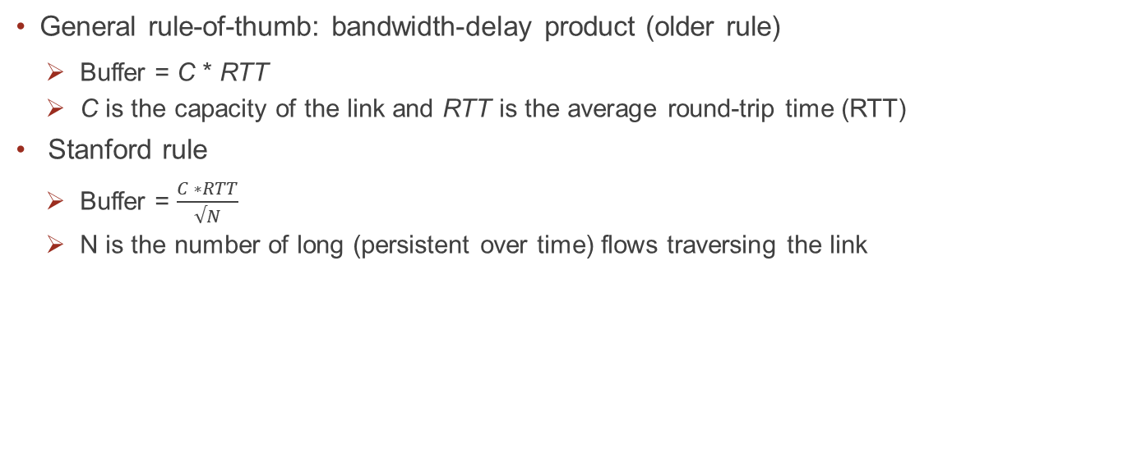
Buffer Sizing Rules
General rule-of-thumb: bandwidth-delay product (older rule)
  Buffer = C * RTT
  C is the capacity of the link and RTT is the average round-trip time (RTT)
Stanford rule
  Buffer = $\frac{C ∗RTT}{√N}$
  N is the number of long (persistent over time) flows traversing the link

Slide 14
Stanford Rule Applicability
Setting the router’s buffer size to BDP/√N would require determining the current average RTT and the number of flows
A general-purpose CPU cannot cope with high traffic rates
Sampling techniques (e.g., NetFlow) are not accurate enough¹
¹Spang, Bruce, and Nick McKeown. "On estimating the number of flows." Stanford Workshop on Buffer Sizing. 2019.

Slide 15
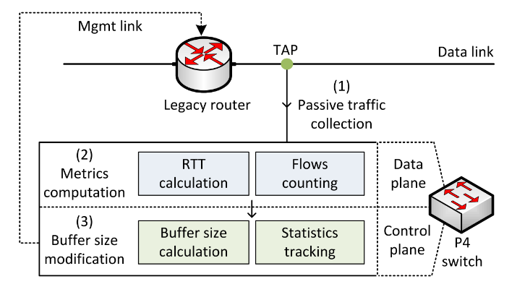
Proposed System
Dynamically modify the buffer size of routers based on measurements collected on programmable switches
  Copy of the traffic is forwarded to a programmable switch by passively tapping router’s ports
  The programmable switch identifies, tracks, and computes the RTT of long flows
  The programmable switch modifies the legacy router’s buffer size

Slide 16
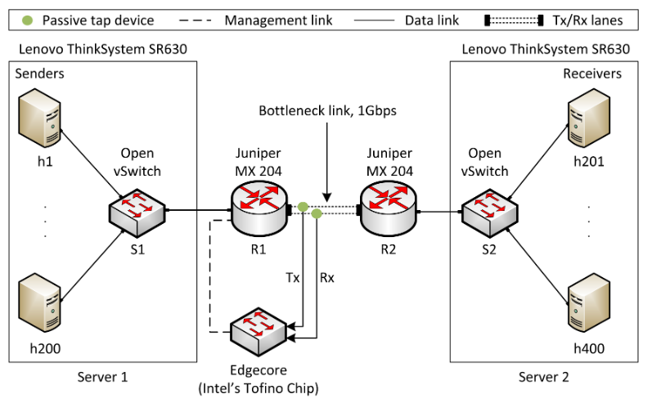
Implementation and Evaluation
Different congestion control algorithms¹
iPerf3
Default buffer size of the router is 200ms²
¹Mishra et al. “The great Internet TCP congestion control census,” ACM on Measurement and Analysis of Computing Systems, 2019
²N. McKeown et al. “Sizing router buffers (redux),” ACM SIGCOMM Computer Communication Review, vol. 49, no. 5

Slide 17
Implementation and Evaluation
Two scenarios are considered:
    Default buffer size on the router, without any dynamic modification
    P4 switch measures and modifies the buffer size of the router

Slide 18
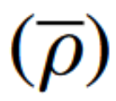


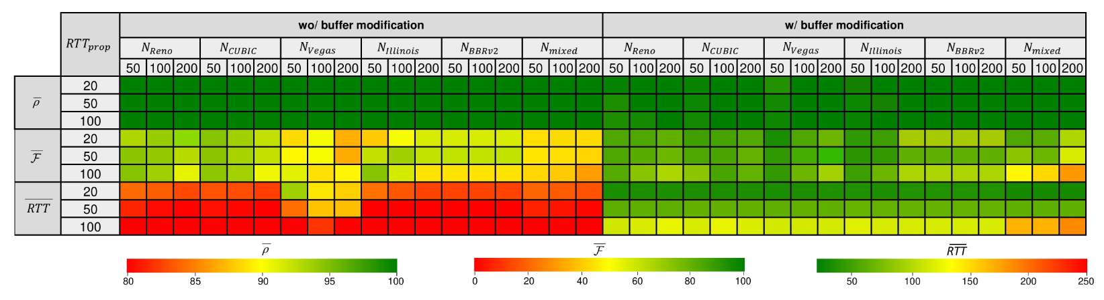
Results
Multiple long flows, CCAs, and propagation delays
Average link utilization
Average fairness index
Average RTT

Slide 19
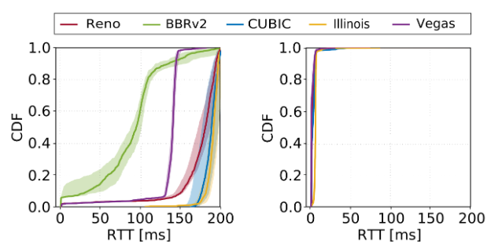
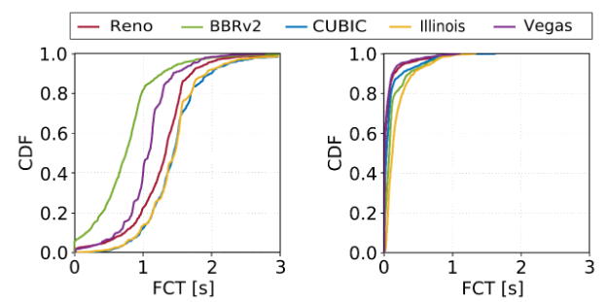
Results
Performance of short flows sharing the bottleneck with long flows
1000 short flows are arriving according to a Poisson process
Flow size distribution resembles a web search workload (10KB to 1MB)
Background traffic: 200 long flows, propagation delay = 50ms

Slide 20
Use Case 2: Traffic Separation based on Flow Size

Slide 21
Size-Aware Flow Separation
The FCT of short flows sharing a router queue with long flows is significantly impacted when the network is busy
A possible solution to prevent the increase of FCT is to separate short flows from long flows

Slide 22
Classification in Legacy Devices
Typical classifiers available in commercial routers:
  Behavior aggregate (BA): Inspect the fixed-length fields in the packet header (e.g., DSCP)
  Multifield classifier (MF): examines multiple fields in the packet (e.g., source/destination addresses/port, TCP flags, protocol, packet length) based on firewall filter rules
Traffic rarely uses DSCP fields¹
Multifield classifier are used with hardcoded rules set by the operators
  ¹Roddav et al. "On the Usage of DSCP and ECN Codepoints in Internet Backbone Traffic Traces for IPv4 and IPv6." ISNCC 2019

Slide 23
P4-Assisted Flow Classification
P4 can identify large flows at line rate (e.g., count-min sketch to track packet counts)
The 5-tuple of the large flows are created added as a firewall filter
Flows in the firewall filter are assigned to a separate queue (Long flows queue)

Slide 24
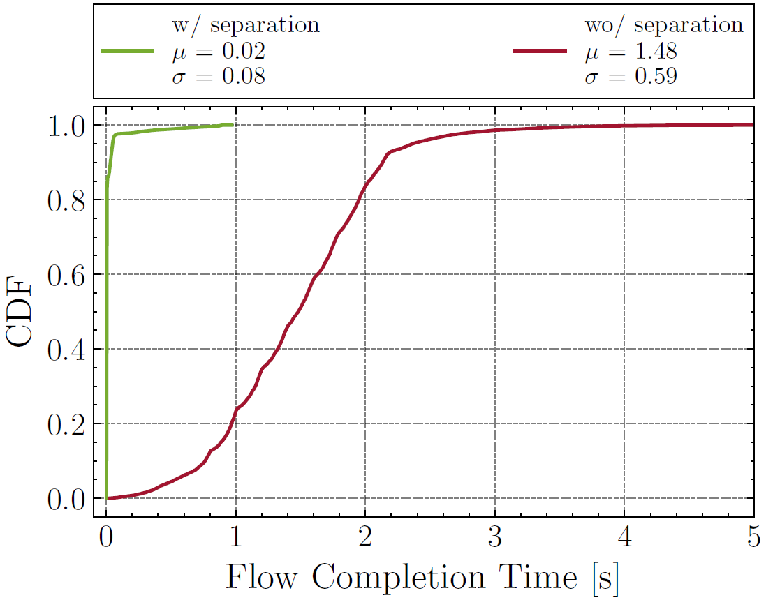
Results
Performance of short flows sharing the bottleneck with long flows
10,000 short flows are arriving according to a Poisson process
Flow size distribution resembles a web search workload (10KB to 1MB)
Background traffic: 10 long flows, random starting time over the test duration

Slide 25
Use Case 3: SYN Flood Detection and Mitigation

Slide 26
SYN Flood Attack
Massive amount of TCP SYN requests with spoofed IP addresses are sent to the server
These connections consume the server’s resources, making it unresponsive to legitimate traffic

Slide 27
Detecting SYN Flood with P4
Count the number of SYN packets per second in the programmable data plane
Implement the Random Early Discard (RED) method
Construct a rule that makes the router drops with a probability

Slide 28
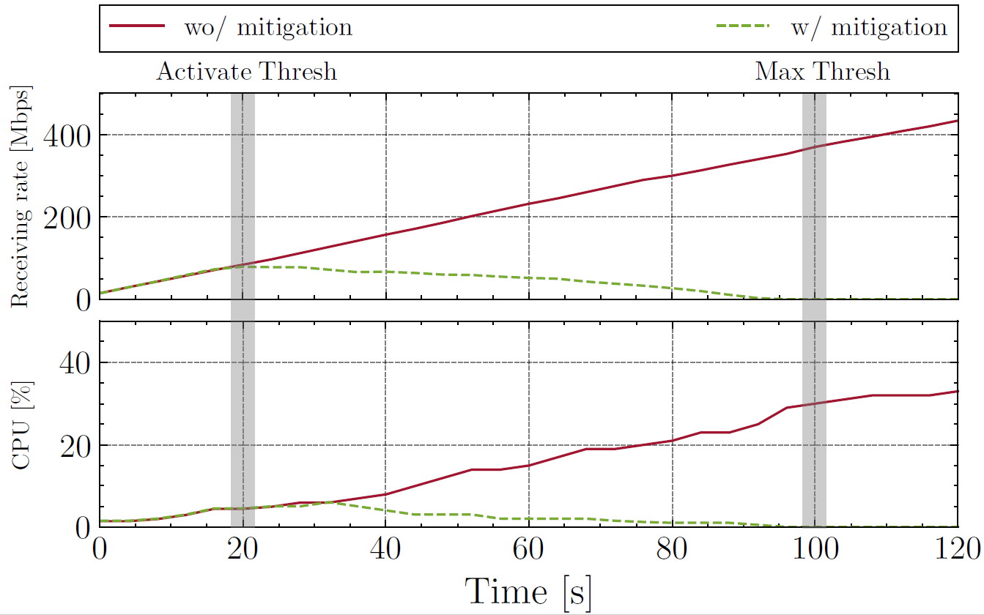
Results
SYN flood synthetically generated
The attack rate increases every 2 seconds
Rate measured at the receiver side (victim)
SYN flood traffic was successfully mitigated

Slide 29
Use Case 4: DNS Amplification Detection and Mitigation

Slide 30
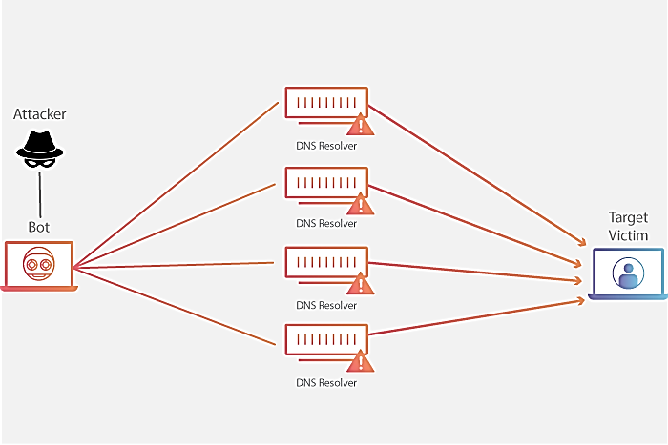
DNS Amplification
An attack where a massive amount of DNS response packets is sent to a victim’s server
Attacker sends requests with “ANY” keyword to gather as much zone information as possible to maximize the amplification effect

Slide 31
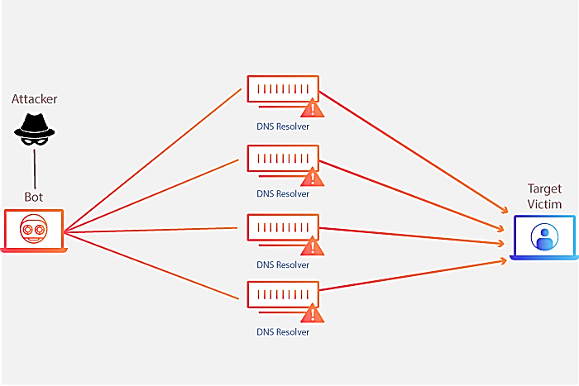
DNS Amplification
An attack where a massive amount of DNS response packets is sent to a victim’s server
Attacker sends requests with “ANY” keyword to gather as much zone information as possible to maximize the amplification effect
Request: 64 bytes
Response: 3876 bytes

Slide 32
Detecting DNS Amplification with P4
Count the number of DNS responses received without a DNS request/s/reflector
Calculate the amplification factor
Use machine learning to identify thresholds used for attack detection
Install a rule that matches on the reflector IP and the DNS response packet length
Allow/drop packet

Slide 33
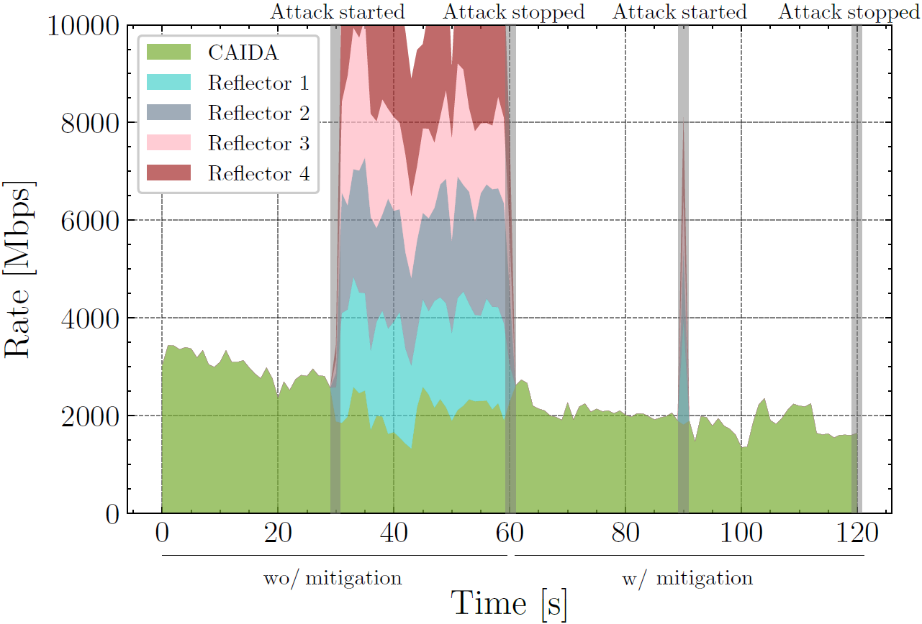
Detecting DNS Amplification with P4
CAIDA traffic replayed
> 10Gbps DNS amplification attack generated
Attack was mitigated in < 1s

Slide 34
Discussions
P4Tune is cost-efficient as TAPs and programmable data planes are relatively cheap
While P4Tune is not applying the configuration rules at line rate, the P4 switches are still performing packet processing at line rate
P4Tune can be used in other applications including:
  Traffic rerouting, load balancing
  Traffic steering
  Fine-grained measurements and telemetry
  etc.
P4Tune does not support applications that send feedback to the clients (e.g., HPCC)¹
  ¹Li, Yuliang, et al. "HPCC: High precision congestion control." Proceedings of the ACM Special Interest Group on Data Communication. 2019. 44-58.

Slide 35
Conclusion
P4Tune, a cost-efficient architecture that uses passive programmable data planes to run custom packet processing on the traffic traversing the legacy network
Configuration rules are constructed and pushed to the legacy devices
The architecture creates a closed control loop
Four use cases were implemented, namely, dynamic buffer sizing, flow separation, SYN flood mitigation, DNS amplification mitigation
For future work, we plan to implement more applications using the framework and possibly test them in a production network

Slide 36

Acknowledgement
Thanks to the National Science Foundation (NSF)
This work was supported by NSF, Office of Advanced Cyberinfrastructure (OAC), award 2118311

Slide 37


Slide 38
Identifying Long Flows in P4
N = N+1
N = N-1
w
async
(1)
(6)
Control plane
digest (F_ID₁)
(7)
Control plane
F_ID₁
F_ID₂
F_ID_{d}
h₁
(2)
R₁
add (F_ID₁, TTL)
Y
on_idle (F_ID₁)
5-tuple
+1
c > T
h₂
R₂
F_ID
TTL
F_ID
TTL
+1
(4)
500ms
miss
del (F_ID₁)
500ms
…
…
match
(key=F_ID₁)
(5)
h_{d}
R_{d}
+1
Match-action table
(idle_timeout=True)
Match-action table
(idle_timeout=True)
c = min (R_{i}[F_ID_{i}])
(3)
(a)
(b)
(c)

