Slide 1


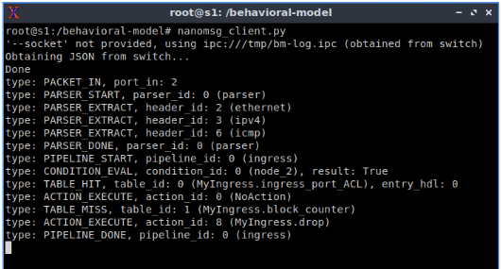
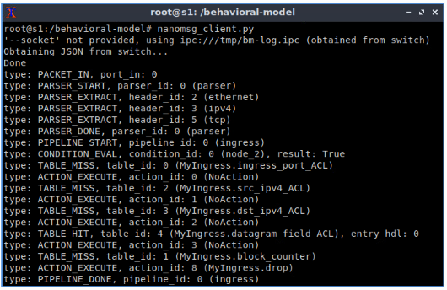

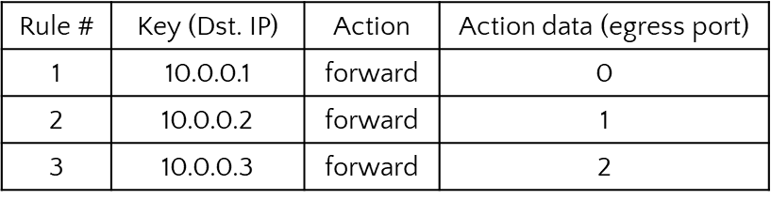
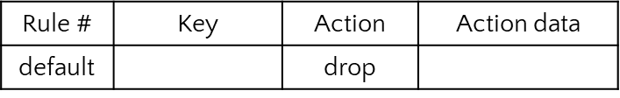
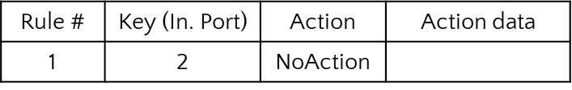
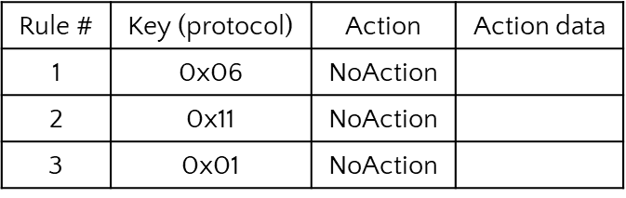
Implementing a Packet Filter using a P4
Programmable Switch
Andrew Smith
Advisors: Ali Mazloum, Jose Gomez, Jorge Crichigno
Integrated Information Technology Department, University of South Carolina, Columbia, South Carolina
Abstract
Test System
Results
This project presents a packet filter implemented using a P4 programmable switch.
P4 is a programming language to describe the behavior of the data plane.
The data plane is structured as a pipeline that processes a stream of bits.
With P4, the programmer specifies how the pipeline will manipulate the information contained in packet headers to make decisions.
In this project, a P4 programmable switch inspects the content of packet headers to decide whether to drop or allow them to pass.
This decision is based on predefined rules that the network administrator established as security policies.
The P4 programmable switch will implement a counter to store the number of times a packet is dropped based on these predefined rules.
Results show that P4 facilitates implementing a packet filter that allows the network administrator to configure security policies.
Moreover, this project displays that P4 facilitates implementing counters to record statistics of interest at runtime.
This project implements a packet filter and direct counter using the behavioral model version 2 (BMv2) software switch that implements the V1 model.
The topology comprises three hosts and a P4 switch that acts as the packet filter.
Host h1 represents a device in a company’s headquarters (Zone 3), host h2 is a device in a branch office (Zone 2), and host h3 represents a device that is not managed by the company (Zone 3).
Packets going from host h1 to host h2 and vice versa are subject to different security policies than packets going to host h3.
Switch s1 leverages match-action tables to drop and count packets based on the physical ingress port and the protocol in the IP datagram field(e.g., TCP, UDP, ICMP).
The P4 program implemented in switch S1 blocks traffic from port 2 and leaves the channel between the Headquarters and Branch Office open.
Results show that packets were successfully filtered.
The ping command was used to verify the first scenario.
Packets originating from physical port 2 (Danger) were dropped.
The nanolog tool also corroborated that the match-action table was applied correctly.
In the second scenario, Host h2 was configured with a simple HTTP server, and Host h1 used the wget command to try to connect over tcp.
The nanolog tool displayed that request packets using TCP were dropped.
Finally, the counter was verified using the P4 runtime CLI.
The output confirmed that 4 ping packets were dropped and counted and 4 wget attempts were dropped and counted.
Project Description
A packet filter is a network device that examines each datagram in isolation and determines whether the datagram should be allowed to pass or dropped based on administrator-specific rules.
Filtering decisions are typically based on:
  IP source or destination address.
  Protocol type in IP datagram field: TCP, UDP, ICMP, and others.
  TCP or UDP source and destination port.
  TCP flag bits: SYN, ACK, and other flags.
  ICMP message type.
  Different rules for datagrams leaving and entering the network.
  Different rules for the different router interfaces.
This project aims at implementing a packet filter on a programmable switch using the P4 language, as well as a counter to record the number of disallowed packets.
The packet filter will enable the network administrator to count and block packets based on physical ingress and/or egress interfaces, IP source or destination address, protocol type in the IP datagram field (TCP, UDP, ICMP), and TCP or UDP source and destination port.
Experimentation
Background on P4 programmable switches
For simplicity, full connectivity will be allowed by default using the forwarding match-action table:
First implement a match-action table to simultaneously block and count a packet when called. This is done in the following steps.
  Establish a direct counter to count on a per-packet basis:
  Create the table block_counter and supply it with the above counter and default action of drop:
  This table will be called via the Ingress apply logic whenever a packet hits on another specific table. Thus, if a hit occurs on the other table, block_counter will iterate, blocking and counting the packet. Otherwise, forwarding will proceed.
The following scenarios were implemented using match-action tables to test the packet filter:
Scenario 1: Dropping packets from physical ingress port 2 (Danger).
  The table ingress_port_ACL is populated with the following rules:
  Packets that entering through switch port 2 will hit on ingress_port_ACL.
Scenario 2: Dropping packets based on protocol type in IP datagram field.
  The table datagram_field_ACL is populated with the following rules:
  The table matches for the protocol numbers, written in hexadecimal. TCP (0x06), UDP (0x11), ICMP (0x01). Thus, all TCP, UDP, and ICMP packets will hit on datagram_field_ACL.
Note: the tables that define the desired packet trait to be dropped (e.g., ingress_port_ACL and datagram_field_ACL) do not have actions. This is because the apply logic will call the block_counter when a packet hits on either table, allowing the packet to be dropped and counted
Table name: forwarding.
P4 programmable data planes emerge as a natural evolution of Software-Defined Networking (SDN).
In the SDN context, the software describes how packets are processed, conceived, tested, and deployed in a much shorter time span by operators, engineers, researchers, and practitioners in general.
SDN fostered significant advances by separating the switch into two logical components: the control and data planes.
The control plane implements the switch intelligence, for instance, computing the states of a routing protocol (e.g., BGP, OSPF), running a machine learning algorithm (e.g., classifiers), and processing digests from the data plane.
The data plane governs the forwarding behavior of a P4 switch by manipulating packets at line rate.
This project uses the V1 model, a P4 programming model comprising a programmable parser, an ingress pipeline, an egress pipeline, a deparser, and a non-programmable component, the traffic manager (TM).
The parser extracts the information from packet headers so that the other following stages can make decisions.
The ingress and egress pipelines execute actions with match-action tables.
Examples of actions in the data plane can be modifying the destination IP address and decrementing the time-to-live (TTL) field in the IPv4 header.
The deparser reassembles and emits the packet processed by the previous stages.
The traffic manager handles operations related to the switch’s queue and the sending rate.
Lessons Learned
Learned how to implement a packet filter using P4.
Leveraged match-action tables to implement security policies.
Implemented a direct counter to record the number of blocked packets.
Validated the implementation of the security policies in the Netlab environment.
Understood the flexibility of P4 programmable switches in implementing security features.
Understood the ability of P4 programmable switches to track and store useful data at line rate.
Table name: block_counter.
Conclusion
This project implemented a packet filter and direct counter using the P4 programming language.
P4 provides the tools to define how packets are processed in the data plane.
With P4, the programmer can implement custom security policies.
Match-action tables are valuable constructs to perform actions on a per-packet basis.
P4 offers pathways to export important statistics (e.g., counters)
Future works can include more complex packet processing and statistic gathering using other constructs available in P4.
Table name: ingress_port_ACL.
Table name: datagram_field_ACL.
Acknowledgement
This work was supported by the Office of Naval Research, under Award N00014-23-1-2245.

