Slide 1
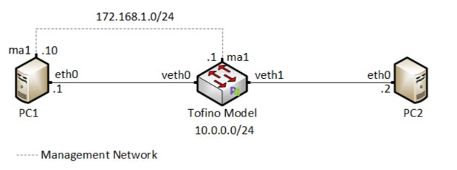
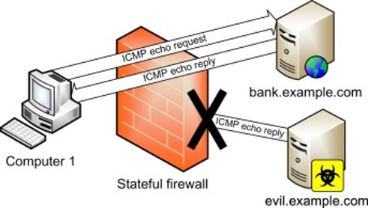
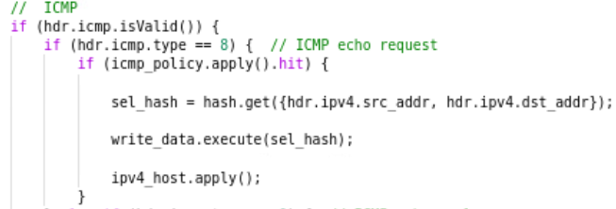
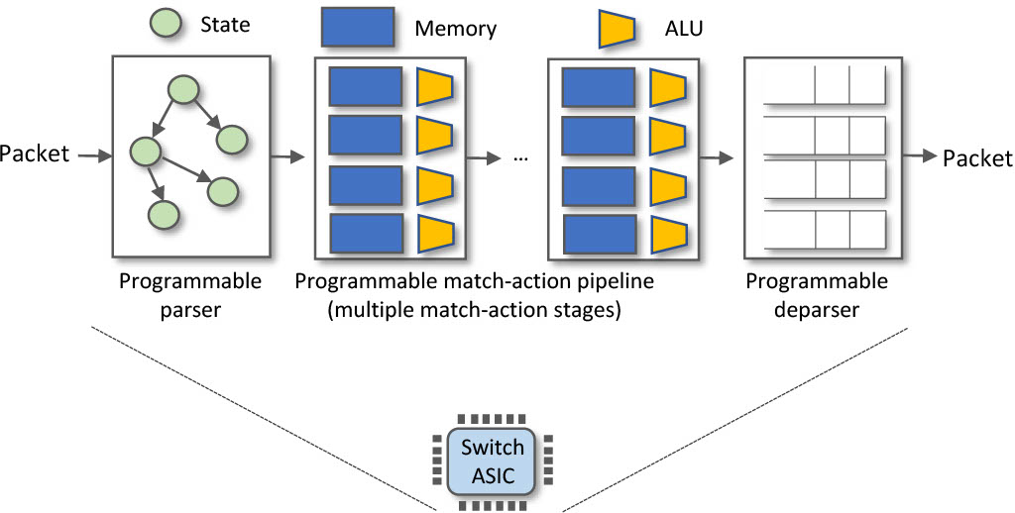
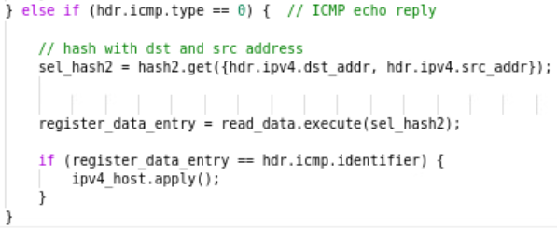
Implementing a Stateful Packet Filter using a P4
Programmable Switch
Andrew Smith & Nolan Pelino
Advisors: Ali AlSabeh, Jorge Crichigno
Integrated Information Technology Department, University of South Carolina, Columbia, South Carolina
Abstract
Test System
Results
This project presents a stateful packet filter implemented using a P4 programmable switch.
P4 is a programming language to describe the behavior of the data plane.
The data plane is structured as a pipeline that processes a stream of bits.
With P4, the programmer specifies how the pipeline will manipulate the information contained in packet headers to make decisions.
In this project, a P4 programmable switch inspects, stores, and compares the content of packet headers to make decisions on whether to drop or forward packets.
This decision is based on predefined rules that the network administrator established as security policies.
The P4 programmable switch will implement registers and hashes to store header data at different indices.
Results show that P4 facilitates implementing a stateful packet filter that allows the network administrator to configure security policies.
Moreover, this project displays that P4 facilitates using registers and hashes to store and retrieve values at run time.
This project implements a stateful packet filter on a P4 programmable switch equipped with the Intel Tofino chip.
The topology comprises of two hosts and a P4 switch that acts as the packet filter.
Host PC1 represents our trusted device and PC2 represents our untrusted device.
Packets going from PC1 to PC2 will be allowed; however, packets originating from PC2, destined for PC1 will be dropped unless they are part of a flow initiated by PC1.
The Tofino Model switch leverages match-action tables to inspect packets for destination and source IP addresses and keep track of flows (ICMP and TCP.)
The P4 program implemented in the Tofino Model stores connection information in registers (ICMP identifiers & TCP ports) and uses this information to forward or drop traffic.
Results show that packets were successfully filtered.
The ping command was used to verify the first scenario.
Packets originating from PC1 were successfully forwarded and received by PC2.
Pinging PC1 from PC2 to test forwarding table rules.
The ping command results in a lost packet, signifying that the Tofino switch dropped the packet, which is in accordance with our apply logic.
Project Description
A stateful packet filter is a network device that examines and keeps track of connections then determines whether a given datagram should be allowed to pass or be dropped based on administrator-specific rules.
Filtering decisions are typically based on:
IP source or destination address.
Protocol type in IP datagram field: TCP, UDP, ICMP, and others.
TCP or UDP source and destination port.
TCP flag bits: SYN, ACK, and other flags.
ICMP message type.
Different rules for datagrams leaving and entering the network.
Different rules for the different router interfaces.
This project aims at implementing a stateful packet filter on a programmable switch using the P4 language.
The packet filter will enable the network administrator to block packets based on IP datagram type (TCP & ICMP), source and destination IP address, and the state of the connection (ICMP response type & TCP connection state.)
In scenario two, we attempt to test our TCP stateful filtering.
The established application rules and forwarding tables should allow PC1 to connect to PC2 via iPerf, but not vice versa.
Below we see that PC1 connected to PC2, which was set up as the server in the client-server relationship.
In the opposite scenario, we see that PC2's attempt to connect to PC1, which is set up as the server fails.
This signifies that our apply logic establishes a 1-way TCP connection.
Experimentation
Background on P4 programmable switches
The ipv4_host match-action table implements our forwarding policy. It matches on the destination IP address and forwards it out of the corresponding port.
The ICMP filtering logic was implemented as follows:
Create a 16 bit register to store ICMP identifiers:
Create the table icmp_policy , supplying it with the rules to hit only on packets with source port 10.0.0.1 (PC1) and destination port 10.0.0.2 (PC2)
The apply logic first checks if a packet has a valid ICMP header. If so, it then examines the ICMP response type:
If the ICMP type field has a value of 8 (request), the code above shows that a hash value is derived from the source and destination IP, then the ICMP identifier is stored in the icmp_ids register at the hashed index. Finally, the ipv4_host table is called to forward the packet.
Otherwise, the apply logic checks for an echo reply which is represented by value 0, shown below:
The logic will now only forward if it can retrieve a matching ICMP ID from the register, indicating that the packet is in response to an already permitted flow.
Table name: ipv4_host
P4 programmable data planes emerge as a natural evolution of Software-Defined Networking (SDN).
In the SDN context, the software describes how packets are processed, conceived, tested, and deployed in a much shorter time span by operators, engineers, researchers, and practitioners in general.
SDN fostered significant advances by separating the switch into two logical components: the control and data planes.
The control plane implements the switch intelligence, for instance, computing the states of a routing protocol (e.g., BGP, OSPF), running a machine learning algorithm (e.g., classifiers), and processing digests from the data plane.
The data plane governs the forwarding behavior of a P4 switch by manipulating packets at line rate.
This project uses the PISA architecture, a P4 programming model comprising a programmable parser, programmable match-action pipeline, and a programmable deparser.
The parser defines and extracts the information from packet headers so that the other following stages can make decisions.
The programmable match-action pipeline executes the operations over the packet headers.
Examples of actions in the data plane can be modifying the destination IP address and decrementing the time-to-live (TTL) field in the IPv4 header.
The deparser reassembles and emits the packet processed by the previous stages.
Lessons Learned
Table name: icmp_policy
Learned how to implement a stateful packet filter using P4.
Leveraged match-action tables to implement security policies.
Utilized registers and hashing functions to store and retrieve data across multiple packets.
Validated the implementation of the security policies in the Netlab environment.
Understood the ability of P4 programmable switches to implement security policies and track and store useful data at line rate.
Conclusion
We implemented a stateful packet filter on a BMv2 software switch and on Tofino hardware switch.
Our P4 code successfully demonstrates the packet filter in accordance with environment configuration and forwarding tables.
We tested our code to allow connections originating from the internal network only.
For future work, we plan on implementing timeout on stale entries and collision resolving on flows that produce the same hash value.
Acknowledgement
This work was supported by the Office of Naval Research, under Award N00014-23-1-2245.

