Slide 1
Policy-Based Forwarding
CDT Matthew Driver
CDT Jack Sadle
Integrated Information Technology
ROTC
University of South Carolina
April 22nd, 2021

Slide 2
Agenda
Introduction
Policy Based Forwarding
Scenario Description
Solution
Conclusion

Slide 3
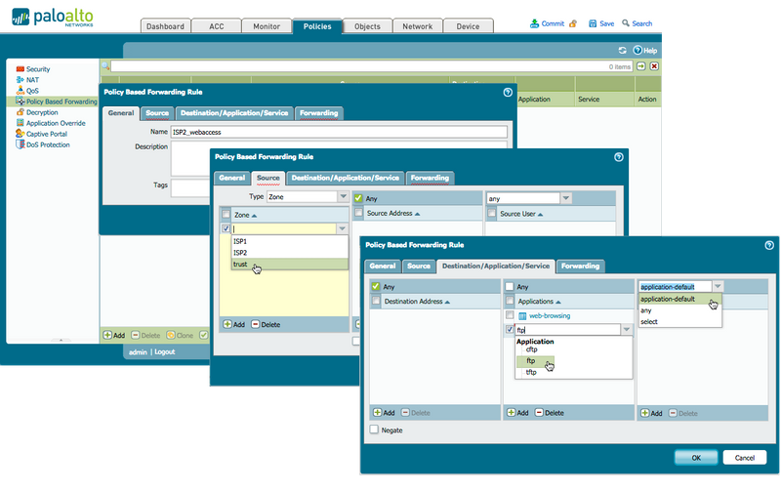
Policy Based Forwarding
Under normal circumstances, a security device (firewall, Next-generation Firewall (NGFW)) uses the destination IP address in the packet header to determine the egress interface. Policy-based Forwarding (PBF) allows a network / security engineer to override the routing table, and to specify the egress interface based on specific parameters such as source or destination IP address, or type of traffic.

Slide 4
Scenario Description
Large company infrastructure with high traffic volumes
Company has access to two ISP’s
Company uses FTP to transfer files between locations
Company accesses an offsite FTP server
Company would like to utilize the second ISP to securely transport FTP traffic

Slide 5
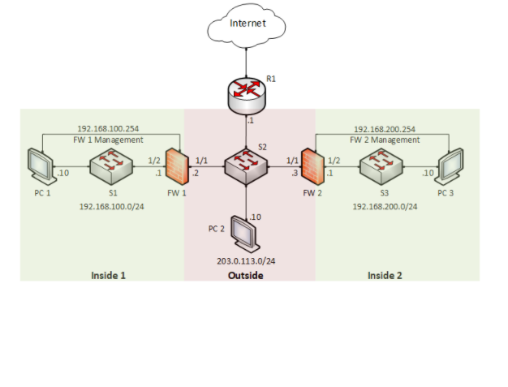
Proposed Solution and Implementation
Establish a Policy-based Forwarding rule to separate the FTP traffic
Non-FTP traffic will continue through ISP 1 which is the default route
Verify connectivity to the external FTP server throughout

Slide 6
Conclusion
Policy-Based Forwarding is utilized to filter traffic at the NGFW
Establishing a Policy-Based Forwarding rule will allow a company to separate traffic by type of traffic and or source or destination
This strategy will allow the company to utilize Policy-Based Forwarding to increase security of FTP traffic to their external server

