Slide 1

NSF CC* Networking Infrastructure:
Building a Science DMZ for Data-intensive Research and
Computation at the University of South Carolina
Jorge Crichigno
College of Engineering and Computing
University of South Carolina
http://ce.sc.edu/cyberinfra
2022 NSF CC* PI Workshop
September 19 – 22, 2022
Minneapolis, MN

Slide 2

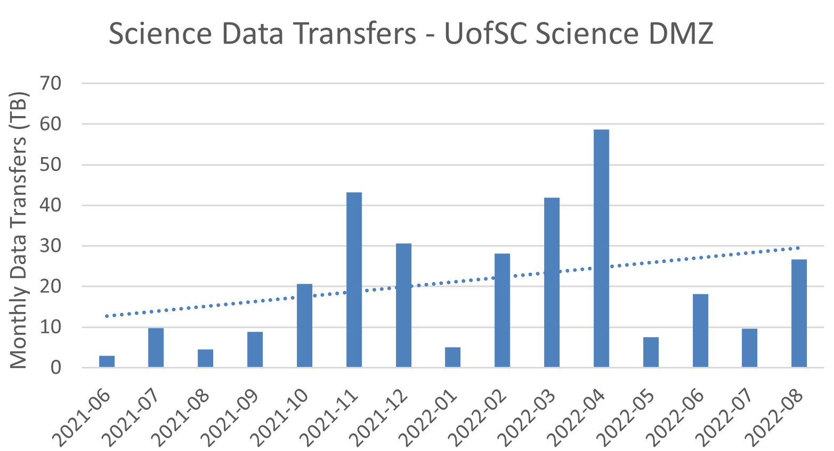
NSF CAMPUS CYBERINFRASTRUCTURE PI WORKSHOP
SEPTEMBER 19 – 22, 2022
Minneapolis, MN
Quad Chart for:
Building a Science DMZ for Data-intensive Research and Computation at the University of South Carolina
Challenge Project Seeks to Address:
35,000 students on main campus and 50,000 statewide
Very high research activity: external and internal science data transfers
Limited capacity to Internet and Internet2, approximately 10 Gbps
Research and commodity traffic on the same network
Need for an efficient approach to move big science data
Scientific Impact:
Enhanced research capability
Increased number of science data transfers
Research activities on areas including cognitive processes, WWII film digitization, chemical engineering, nuclear physics, environmental nanoscience, genomics data mining, digital image processing, and others
Four UofSC XSEDE campus champions
Findings related to the project published in journals, conferences, and a book
Solutions and Deliverable:
A 100 Gbps Science DMZ, co-located to campus network
Increased bandwidth to Internet2 from ~10 Gbps to 100 Gbps
Increased bandwidth from key research laboratories on campus to Science DMZ, 1 Gbps to 40-100 Gbps
Faculty members and IT’s Research Computing (RC) group now participate in the CC* community
Workforce Development:
Research testbed deployed for proof-of-concept ideas, prior to production deployment
43 undergraduate students completed one or more semesters working on CI topics
Dissemination of best practices via workshops conducted with ESnet, EPOC, RENs
Agreements with industry, e.g., Barefoot Networks / Intel, VMware, Palo Alto Networks, Cisco Systems
Notes:
NOTE: We recommend you download this document in order to make changes and then email your final version to be published. Click on the “File” tab at the top left and then click “Download”. - best, tracey@thequilt.net

Slide 3

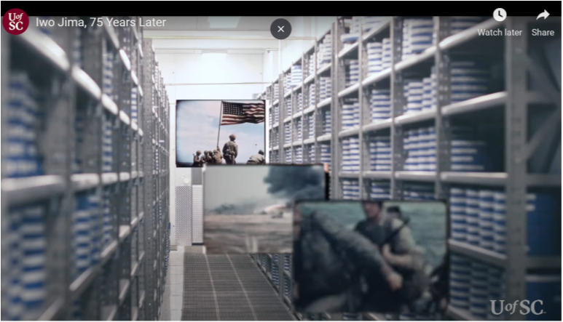
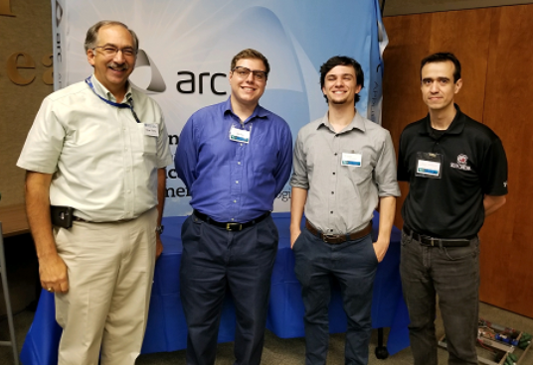
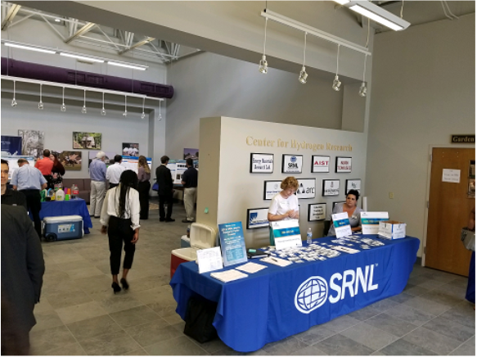
NSF CAMPUS CYBERINFRASTRUCTURE PI WORKSHOP
SEPTEMBER 19 – 22, 2022
Minneapolis, MN
Outcomes arising from CC* award
Increased number of science data transfers
Research activities on areas including cognitive
processes, WWII film digitization, chemical
engineering, nuclear physics, and others
Campus infrastructure suitable for an R1 institution
  100 Gbps Science DMZ
  100 Gbps connection to Internet2
  Direct connection to providers (AWS)
Strengthened collaboration between IT and
faculty
Partnership with agencies
  National Laboratories
  SC State Administration
WWII film digitization 14,000+ cans of film
https://tinyurl.com/59cwtbs3
CIO SRNL, interns, PI
Notes:
NOTE: We recommend you download this document in order to make changes and then email your final version to be published. Click on the “File” tab at the top left and then click “Download”. - best, tracey@thequilt.net

Slide 4
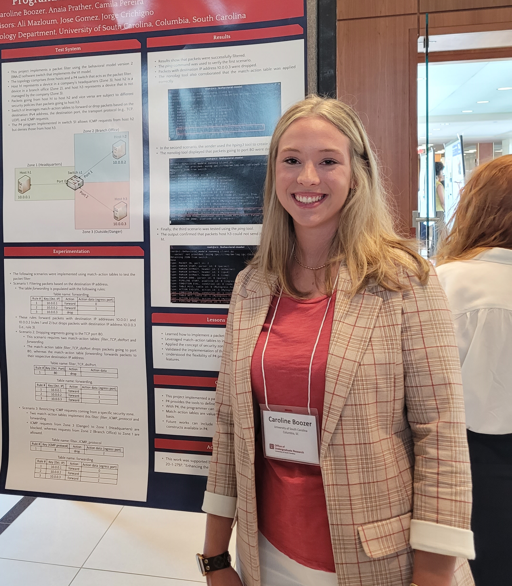
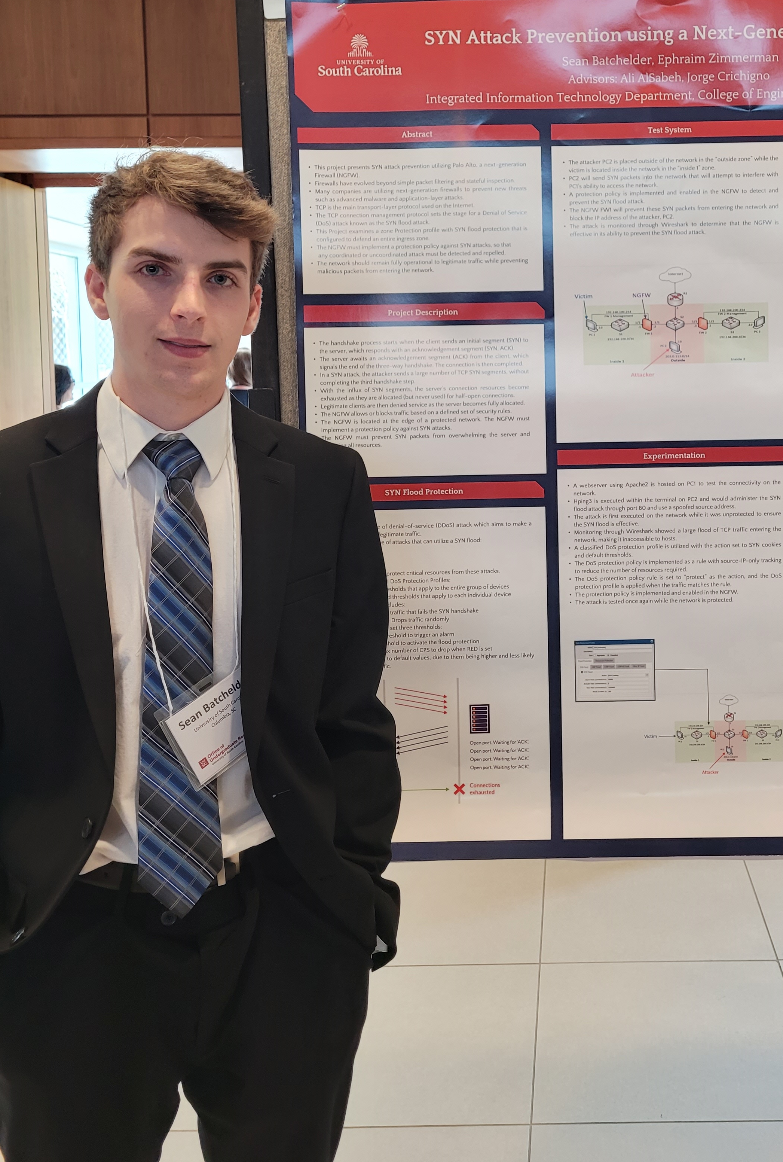
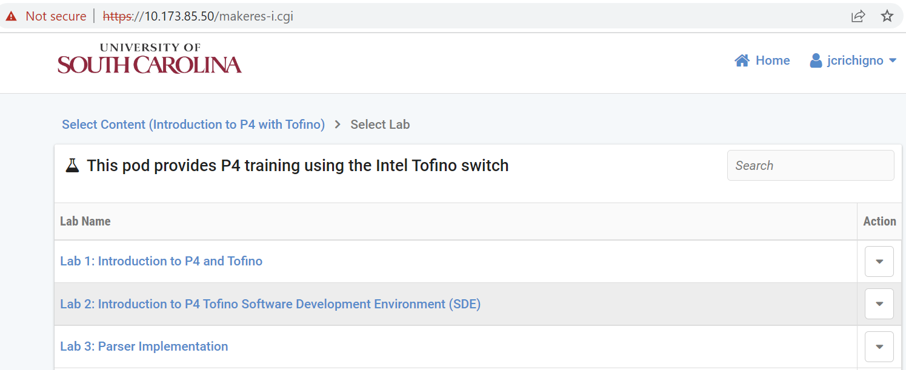
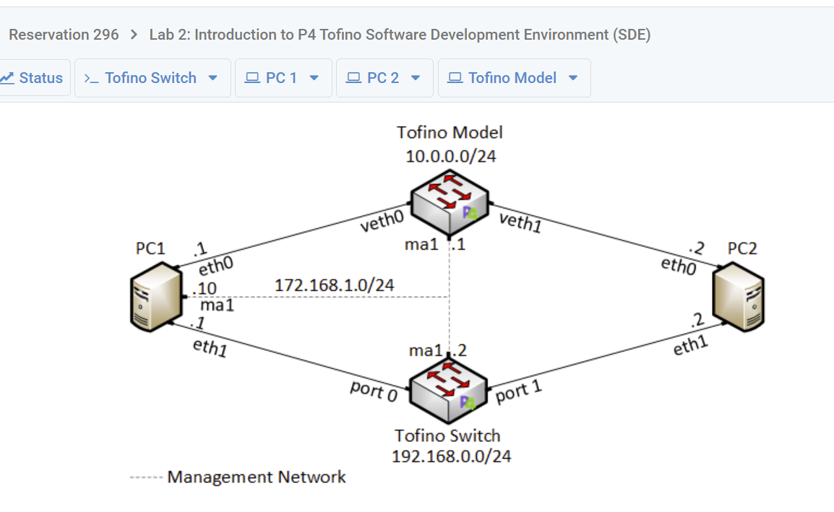

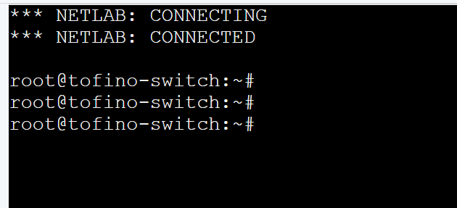
NSF CAMPUS CYBERINFRASTRUCTURE PI WORKSHOP
SEPTEMBER 19 – 22, 2022
Minneapolis, MN
Outcomes arising from CC* Award – workforce development
Research testbed was deployed for proof-of-concept ideas
Undergraduate research on CI: 43
undergraduate students completed one
or more semesters working on CI topics
Undergraduate
researchers - Summer Research Symposium
Testbed – 100 Gbps programmable network accessible via regular browser
Notes:
NOTE: We recommend you download this document in order to make changes and then email your final version to be published. Click on the “File” tab at the top left and then click “Download”. - best, tracey@thequilt.net

Slide 5
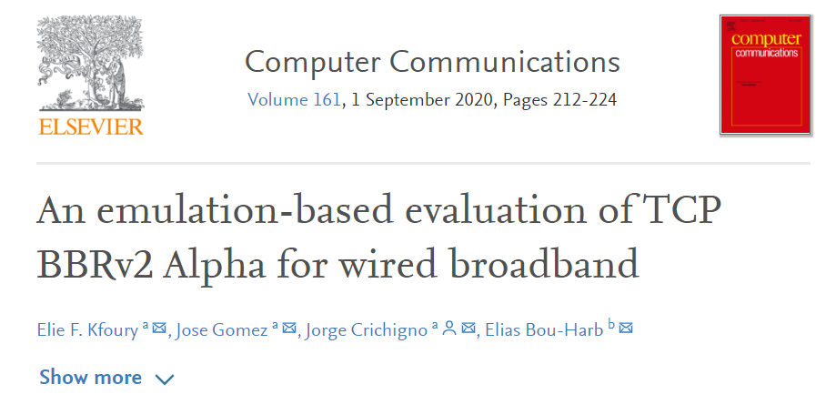
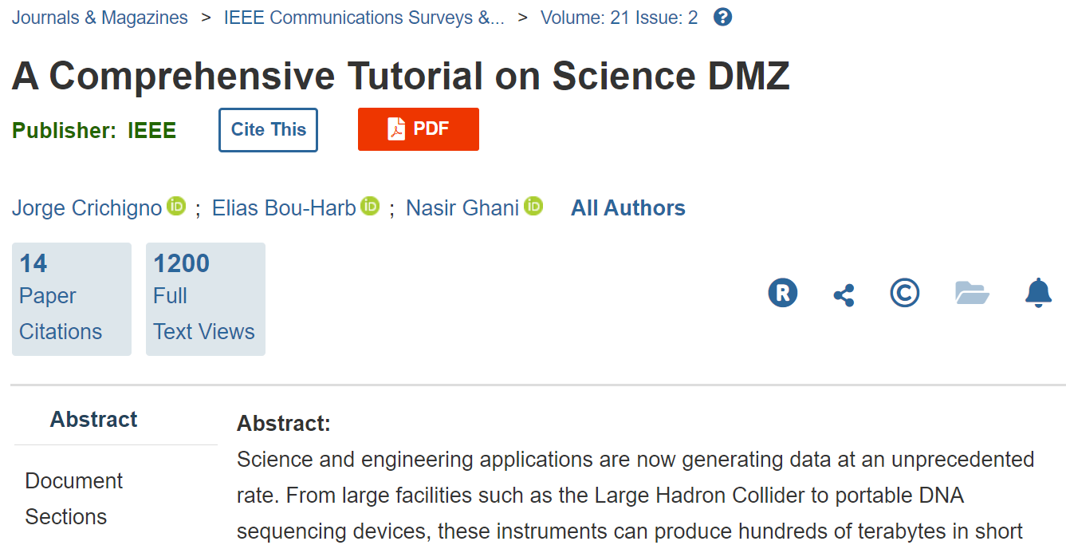
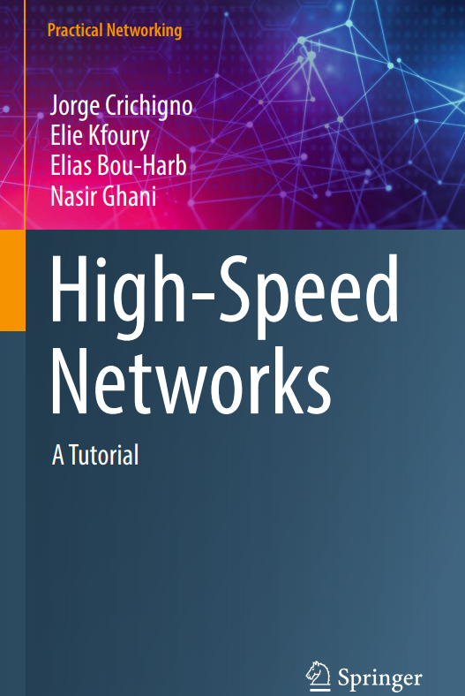
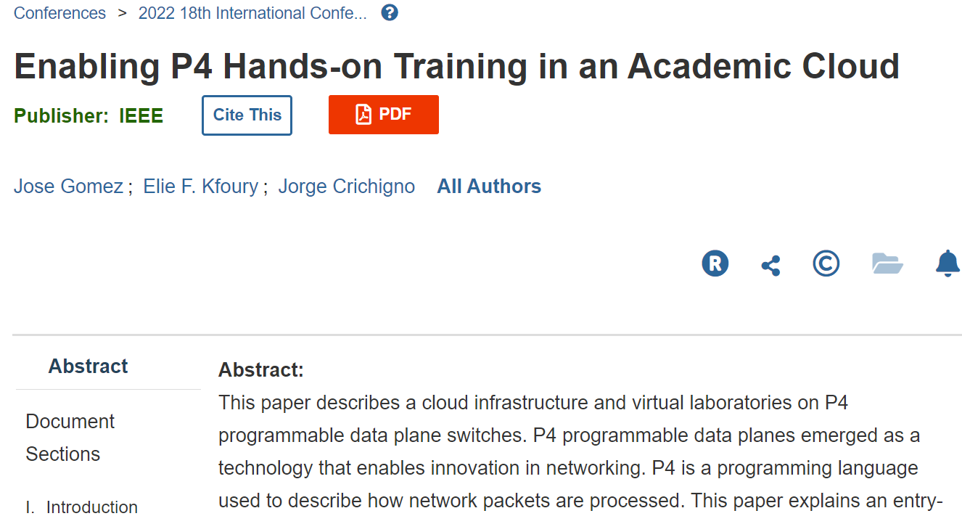
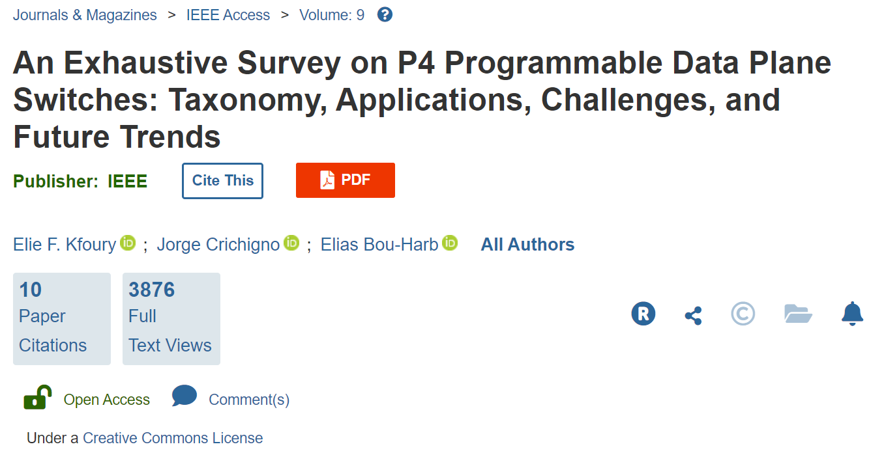
NSF CAMPUS CYBERINFRASTRUCTURE PI WORKSHOP
SEPTEMBER 19 – 22, 2022
Minneapolis, MN
Outcomes arising from CC* Award – workforce development
Graduate research on CI: 3 conference papers,
3 journal articles, and 1 book were published
during the 3-year project
New relations were established
  Amazon – AWS “Direct Connect” to resources (via I2)
  Barefoot Networks / Intel
  Juniper Networks
  VMware
Notes:
NOTE: We recommend you download this document in order to make changes and then email your final version to be published. Click on the “File” tab at the top left and then click “Download”. - best, tracey@thequilt.net

Slide 6
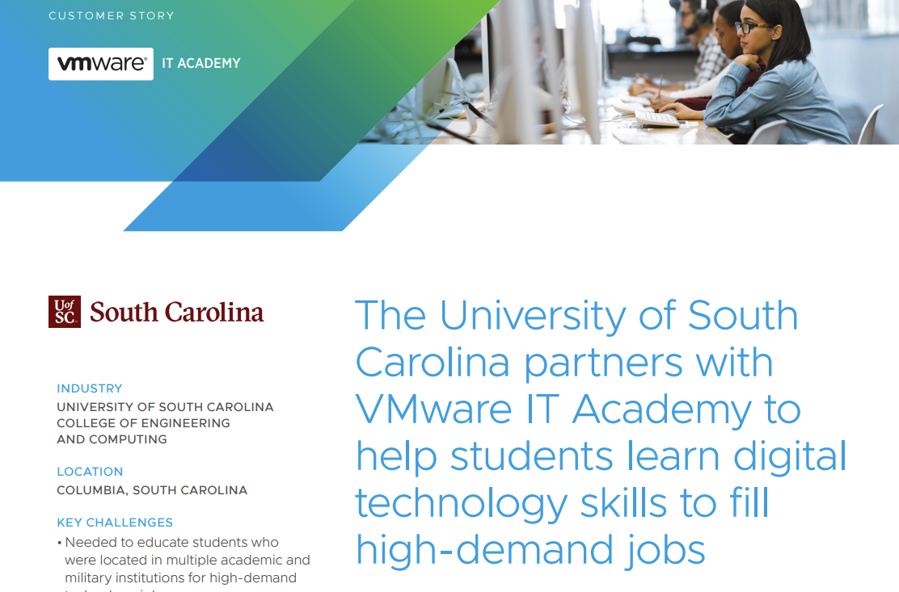
NSF CAMPUS CYBERINFRASTRUCTURE PI WORKSHOP
SEPTEMBER 19 – 22, 2022
Minneapolis, MN
Sustainability
Strengthen relation among faculty, Research Computing (RC), and IT leadership
RC, IT: communicate continuously with faculty, researchers: webinars, trainings
Faculty, researchers: provide input to RC/IT on research needs, opportunities
RC, IT, faculty: implement work study and undergraduate research positions at RC/IT
Faculty: promote positions and recruit students early –freshman, sophomore
Share ideas with the community, receive feedback,
learn best practices. E.g., CI Lunch and Learn Series;
Intel’s Connectivity Research Program, FABRIC
Proactively seek funding opportunities, donations,
common projects with industry, agencies
Notes:
NOTE: We recommend you download this document in order to make changes and then email your final version to be published. Click on the “File” tab at the top left and then click “Download”. - best, tracey@thequilt.net

