Slide 1

Performance Evaluation of TCP BBRv2 Alpha for Wired Broadband, considering Buffer Sizes, Packet Loss Rates, RTTs, and Number of Flows
Elie Kfoury, Jose Gomez, Jorge Crichigno
University of South Carolina
http://ce.sc.edu/cyberinfra
ekfoury@email.sc.edu, gomezgaj@email.sc.edu, jcrichigno@cec.sc.edu
CI Engineering Lunch and Learn - Online
March 26, 2021
We want to recognize Neal Cardwell for his helpful comments and suggestions

Slide 2
Agenda
TCP loss-based congestion control
Bottleneck Bandwidth and Round-trip propagation time (BBR)
BBRv1
BBRv2 and design goals
Experimental setup
Results and evaluations
Conclusions

Slide 3
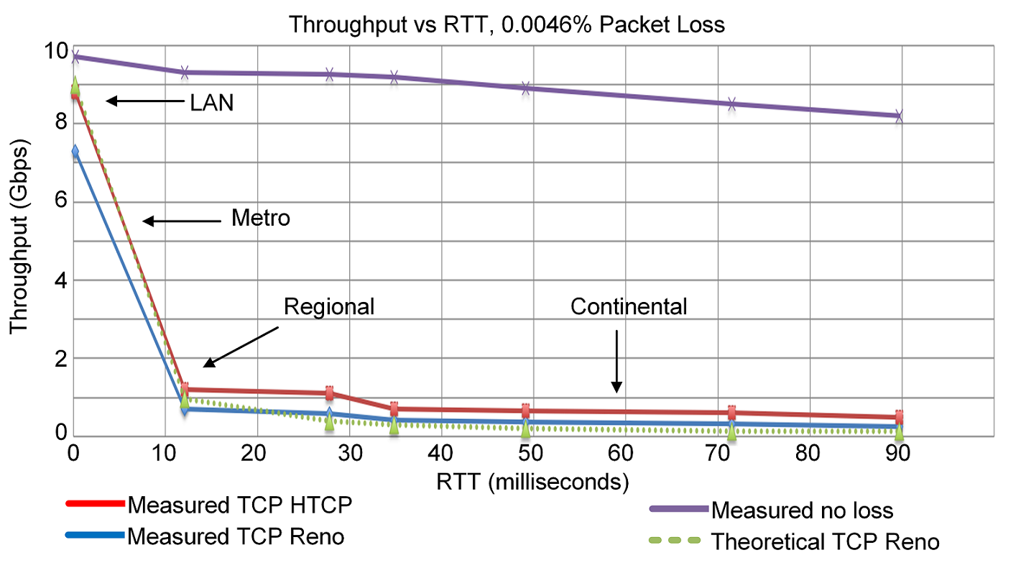
TCP Loss-based Congestion Control (CC)
The principles of loss-based CC were described in the 1980s¹
Traditional CC algorithms follow the additive-increase multiplicative-decrease (AIMD) form of congestion control
1. V. Jacobson, M. Karels, Congestion avoidance and control, ACM SIGCOMM Computer Communication Review 18 (4) (1988).

Slide 4
BBRv1
BBRv1 was published in 2016
It produces high throughput in the presence of packet losses
However, it shows some performance issues
  Unfairness with loss-based CC (e.g., Reno, CUBIC)
  Low throughput for loss-based CC
  High packet loss rates when the buffer is smaller than 1.5 bandwidth-delay product (BDP)
  Throughput variation
1. N. Cardwell et al. "BBR v2, A Model-based Congestion Control." IETF 104, March 2019.

Slide 5
BBRv2 Design Goals
Improving co-existence with loss-based when sharing a bottleneck link
Avoiding the bufferbloat problem
Minimizing the time to reach an equilibrium point (fairness)
Reducing the variation of the throughput
Producing high throughput, even with moderate packet losses
1. N. Cardwell et al. "BBR v2, A Model-based Congestion Control." IETF 104, March 2019.

Slide 6
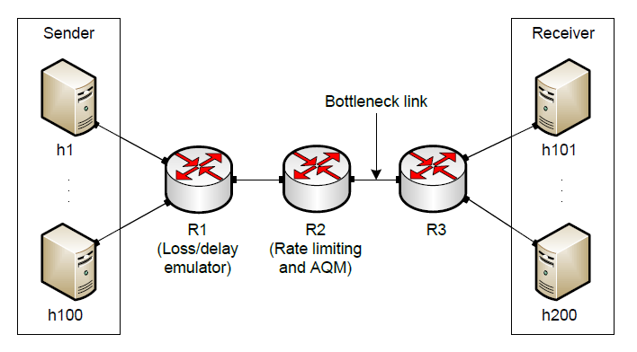
Experimental Setup
Up to 100 simultaneous flows
Mininet network, Linux protocol stack, Tail drop AQM policy (default)
300 seconds experiment duration, average results are reported
CPU cores (8 Xeon 6130) are overprovisioned (below 50% utilization); idle CPU time is a good fidelity indicator, as it indicates that a host is not starved for CPU resources¹
¹N. Handigol et al., “Reproducible Network Experiments Using Container-Based Emulation,” ACM CoNEXT ‘12.

Slide 7
Experimental Setup
BBRv2 version: v2alpha-2019-07-28
Bottleneck link = 1Gbps
All other links = 40Gbps
Tools: iPerf3, netstat, ss, tc [tbf | netem | fq_codel | cake]
1Gbps
iPerf3
iPerf3
NETEM
TBF

Slide 8
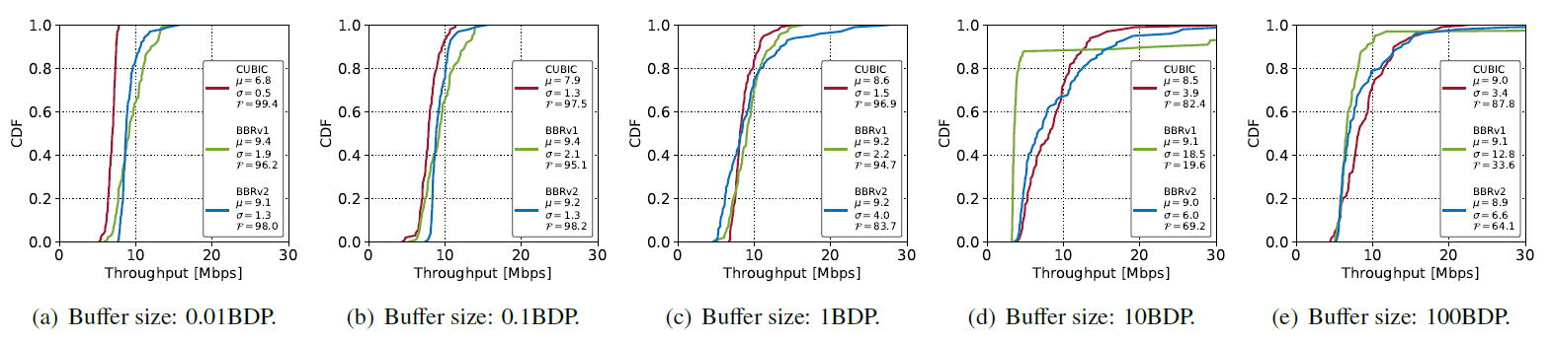
﻿Multiple Flows and Buffer Sizes
100 simultaneous flows, 20ms propagation delay, same CC
Bottleneck is 1Gbps (ideal allocation is 10Mbps per flow)
Cumulative distribution function, mean, standard deviation, and fairness
No emulated packet losses

Slide 9
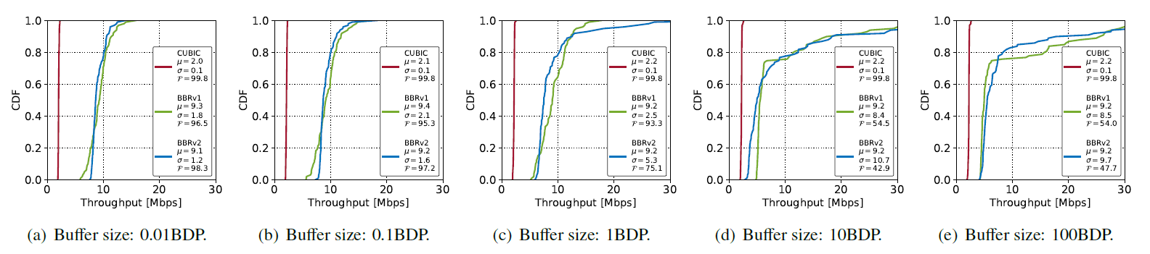
﻿Multiple Flows and Buffer Sizes
100 simultaneous flows, 20ms propagation delay, same CC
Bottleneck is 1Gbps (ideal allocation is 10Mbps per flow)
Cumulative distribution function, mean, standard deviation, and fairness
1% packet loss rate

Slide 10
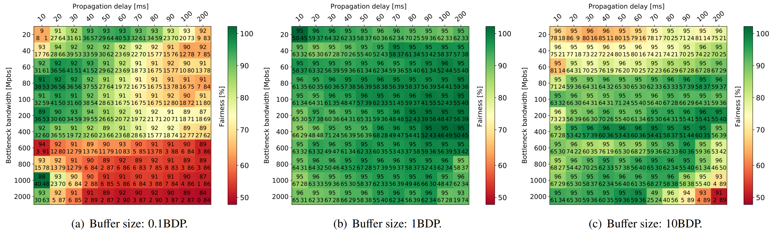
﻿Coexistence and Fairness with CUBIC
Fairness index visualized in a heatmap for CUBIC and BBRv2 flows
1 CUBIC vs. 1 BBRv2
Each entry has 3 numbers (in percentage): link utilization (center top), bandwidth used by CUBIC (bottom left value), and bandwidth used by BBRv2 (bottom right)
﻿No emulated packet losses

Slide 11
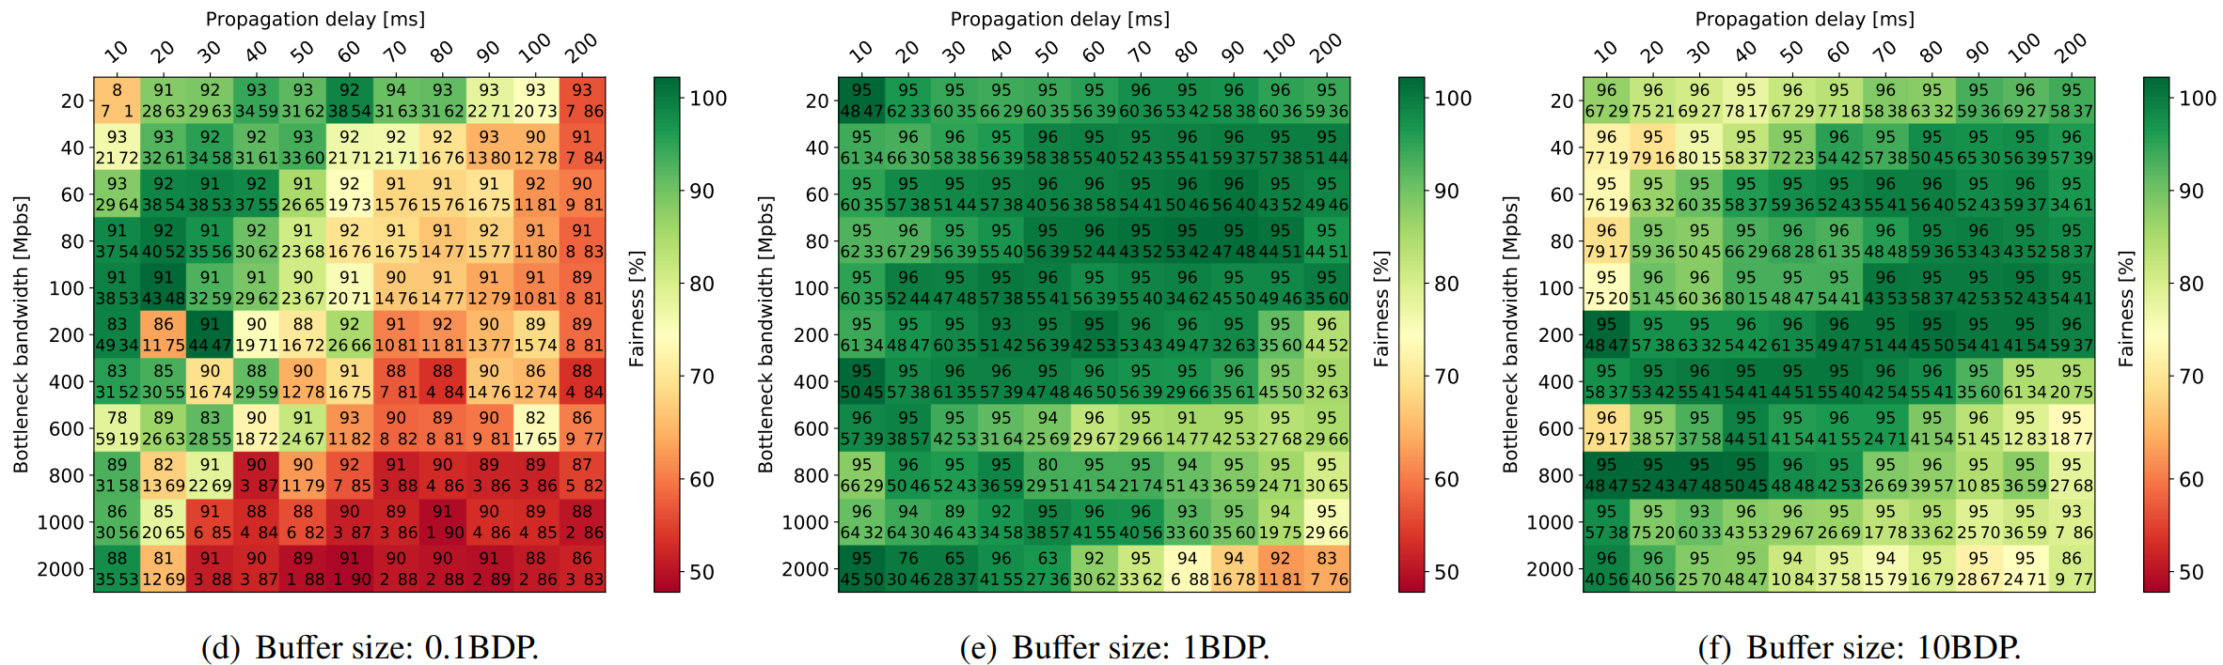
﻿Coexistence and Fairness with CUBIC
Fairness index visualized in a heatmap for CUBIC and BBRv2 flows
1 CUBIC vs. 1 BBRv2
Each entry has 3 numbers (in percentage): link utilization (center top), bandwidth used by CUBIC (bottom left value), and bandwidth used by BBRv2 (bottom right)
0.01% packet losses

Slide 12
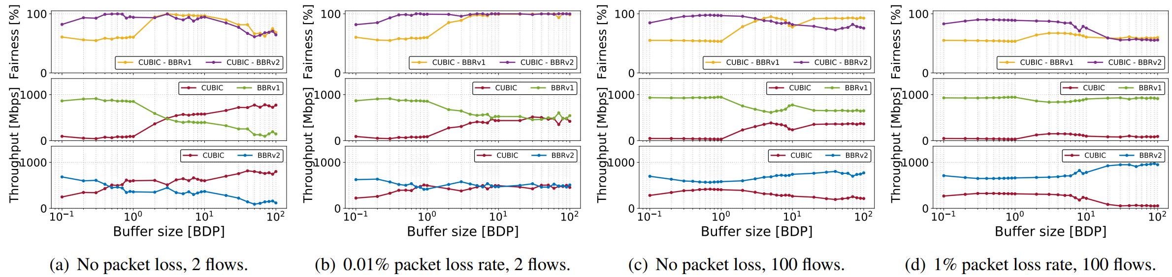
﻿Coexistence and Fairness with CUBIC
Bottleneck is 1Gbps, 20ms propagation delay
﻿Competing flows sharing the same bottleneck link
﻿BBRv2 shows a better coexistence with CUBIC than BBRv1
﻿Throughput and fairness as functions of the buffer size

Slide 13
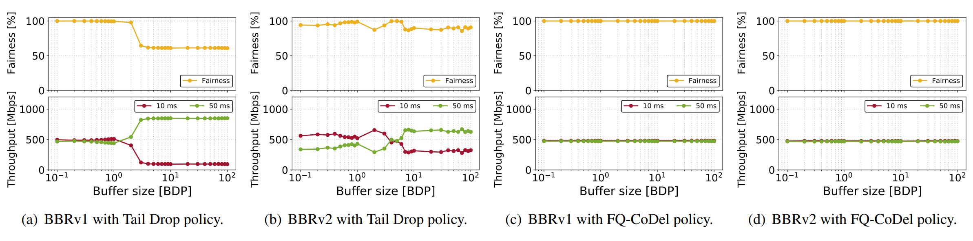
﻿Round-trip Time Unfairness
Two simultaneous flows, one with 10ms propagation delay, and the other with 50ms
Bottleneck is 1Gbps
﻿Tail Drop and FQ-CoDel AQMs
FQ-CoDel mitigates the RTT unfairness

Slide 14
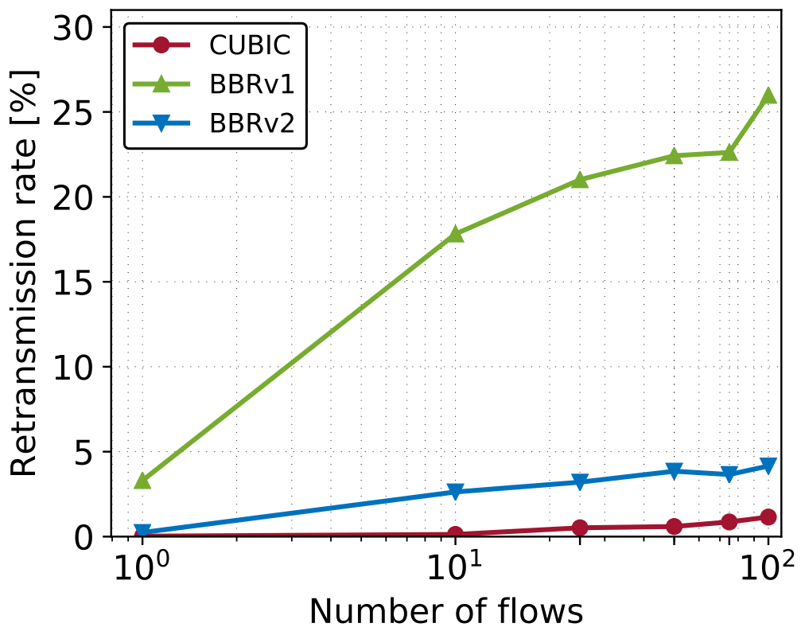
Retransmissions – Number of Flows
The buffer size is 0.02BDP (i.e., 2.5MB, ~1,666 packets)
Bottleneck is 1Gbps, 100ms propagation delay
﻿BBRv1: high retransmission rate with any number of flows (2.5%-25%)
BBRv2: lower retransmission rate (~2.5%)

Slide 15
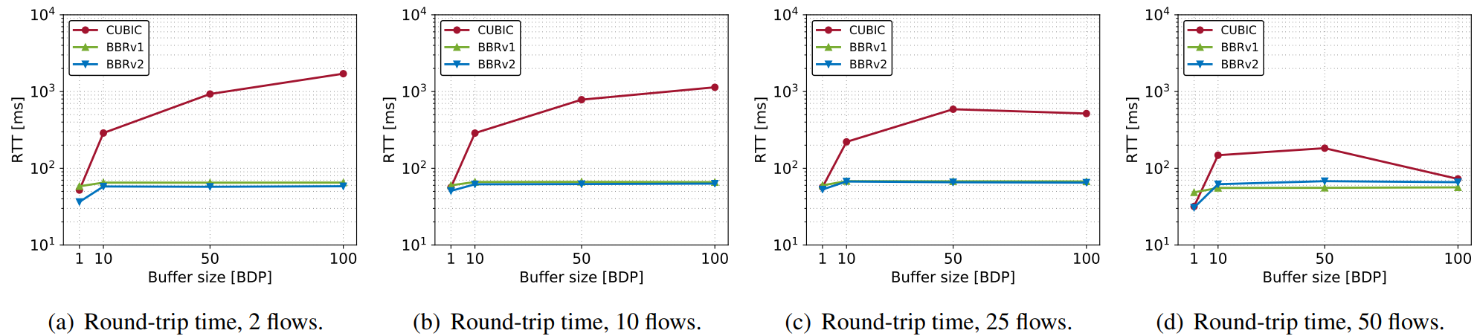
﻿Queueing Delay with Large Buffers
2, 10, 25, and 50 simultaneous flows, same CC
Bottleneck is 1Gbps, 30ms propagation delay
RTT: queueing delay + propagation delay
﻿BBRv1 and BBRv2 have low queuing delay independently of the number of flows
Round-trip time experienced with simultaneous flows

Slide 16
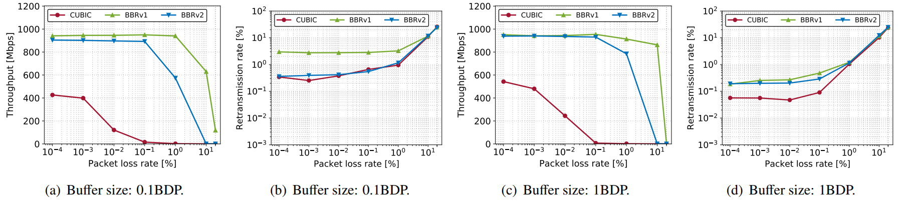
Throughput, Retransmissions – Packet Loss Rate
Single flow
Bottleneck is 1Gbps, 100ms propagation delay
﻿BBRv1 is loss-agnostic, which leads to a higher retransmission rate
﻿Throughput and retransmission rate as functions of the packet loss rate

Slide 17
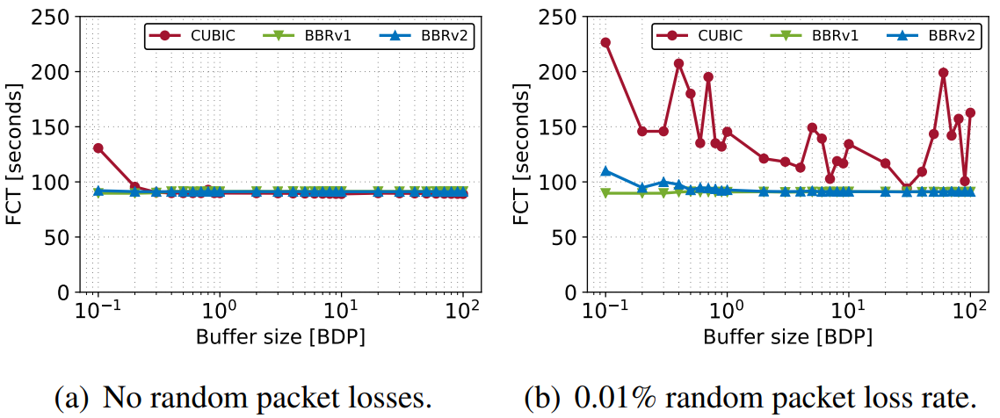
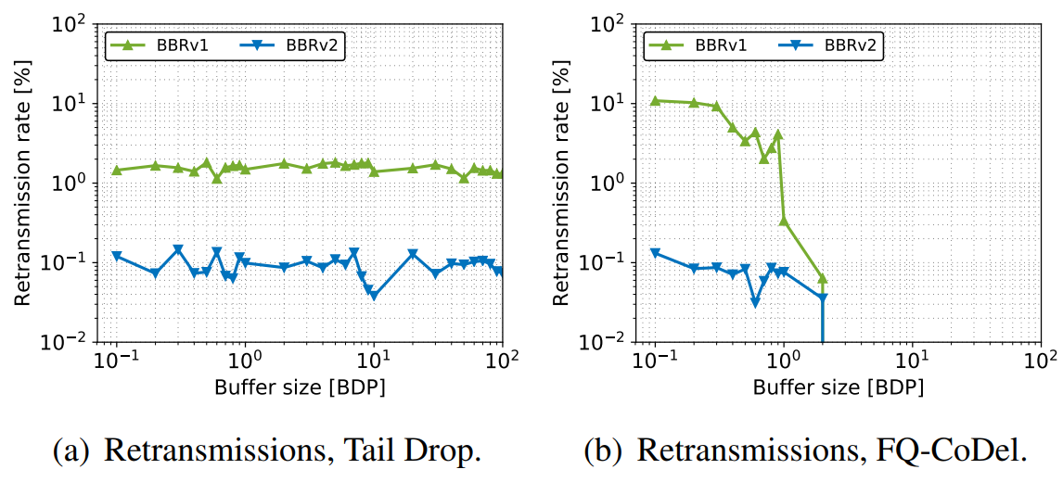
Flow-Completion Time (FCT)
100 simultaneous flows, same CC
Bottleneck is 1Gbps, 20ms propagation delay
Data transfer of 10 GB
﻿Flow completion time as a function of the buffer size

Slide 18
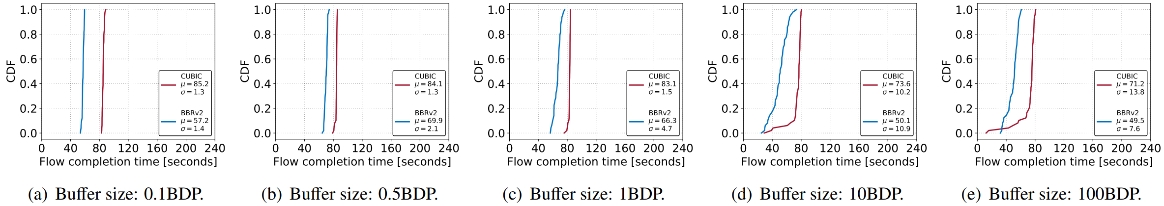
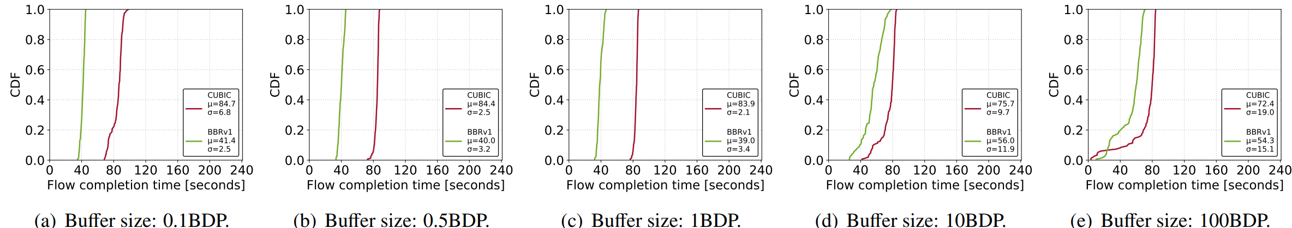
Flow-Completion Time (FCT)
Bottleneck is 1Gbps, 20ms propagation delay, ﻿100 simultaneous flows
50 CUBIC, 50 BBRv1/BBRv2, each flow completing 100MB of data transfer
No losses

Slide 19
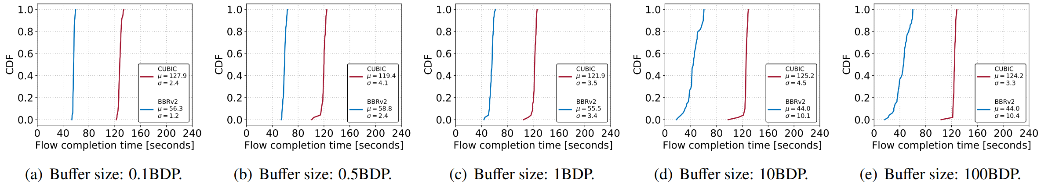
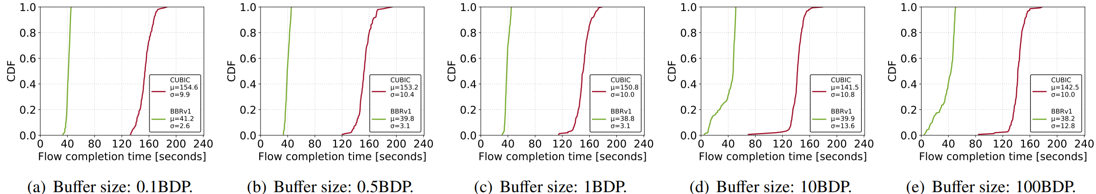
Flow-Completion Time (FCT)
Bottleneck is 1Gbps, 20ms propagation delay, ﻿100 simultaneous flows
50 CUBIC, 50 BBRv1/BBRv2, each flow completing 100MB of data transfer
1% packet losses

Slide 20
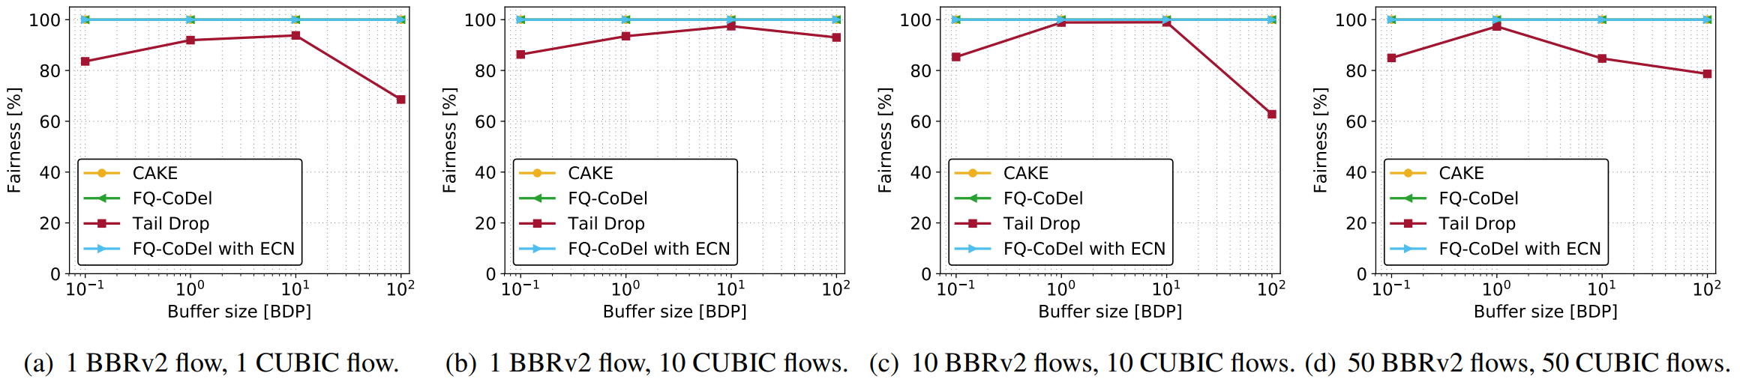
Impact of AQM on Fairness
Bottleneck is 1Gbps, 20ms propagation delay
2, 11, 50 and 100 simultaneous flows, uneven composition
Tail drop, CAKE, FQ_CoDel, FQ_CoDel w/ ECN
No losses

Slide 21
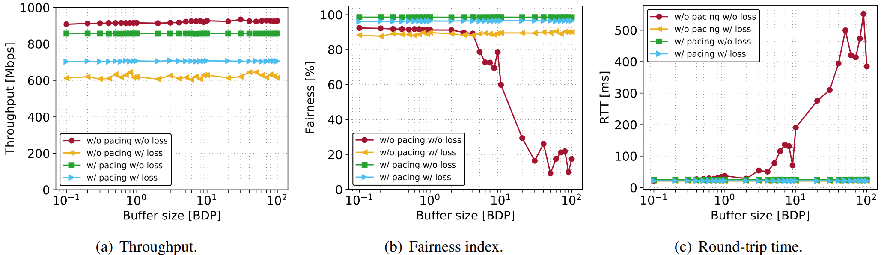
﻿The Effects of Fixed-rate Pacing on TCP CUBIC
100 simultaneous flows
Bottleneck is 1Gbps, 20ms propagation delay
﻿Pacing rate per flow is 8.5Mbps, 85% link utilization
No losses and with 1% packet losses

Slide 22
Conclusions
BBRv2 addressed the limitations of BBRv1
Tolerates much higher packet loss rates than CUBIC, lower than BBRv1
Mitigates the unfairness problem
Has better coexistence with CUBIC than BBRv1
Produces lower retransmission rates than BBRv1
Exhibits low queueing delay, even with bloated buffers
Coexistence / fairness problem with CUBIC is not solved but mitigated

Slide 23
Resources
Full paper: https://www.sciencedirect.com/science/article/pii/S014036642030092X
The scripts for emulation are available in the following GitHub repository https://github.com/gomezgaona/bbr2
BBRv2 version: v2alpha-2019-07-28
Cyberinfrastructure website:
htttp://ce.sc.edu/cyberinfra/
BBRv2 GitHub repository:
https://github.com/google/bbr/tree/v2alpha

Slide 24


Slide 25
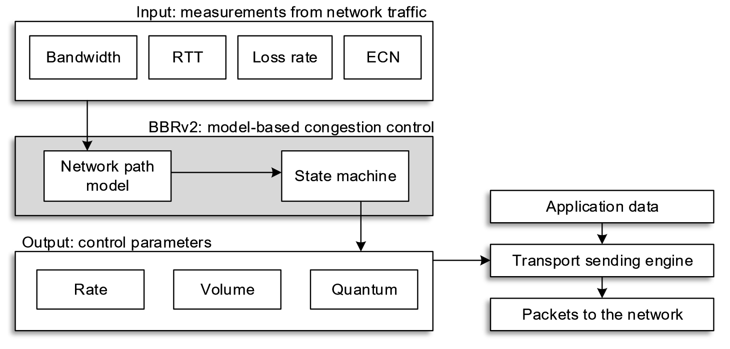
BBRv2
BBRv2 architectural diagram¹
1. N. Cardwell et al. "BBR v2, A Model-based Congestion Control." IETF 104, March 2019.

Slide 26
﻿Retransmission Rate
Two simultaneous flows, one with 10ms prop delay, and the other with 50ms
Bottleneck is 1Gbps
BBRv2 produces a low retransmission rate, (e.g., ~0.1%)
﻿Retransmission rate generated by BBRv1 and BBRv2

Slide 27
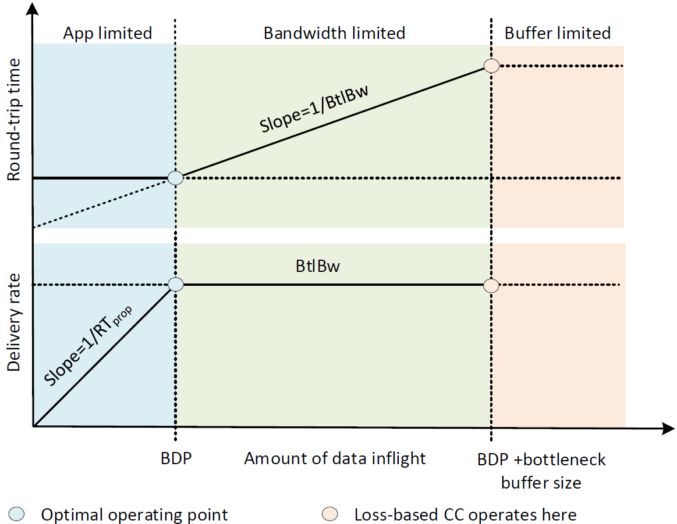
BBR- Model-based Congestion Control
BBR: Bottleneck Bandwidth and Round-trip propagation time¹
Dynamically estimates windowed max BW and min RTT on each ACK
1. N. Cardwell et al. "BBR: Congestion-Based Congestion Control: Measuring bottleneck bandwidth and round-trip propagation time." Queue 14.5 (2016): 20-53..

