Slide 1
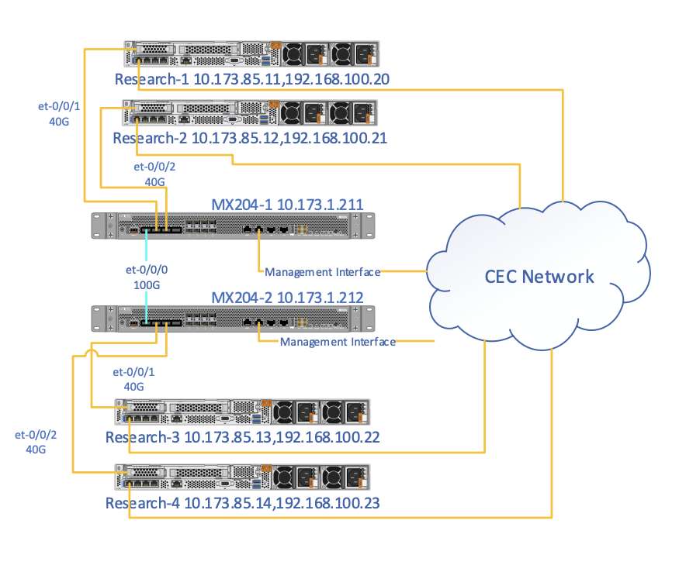
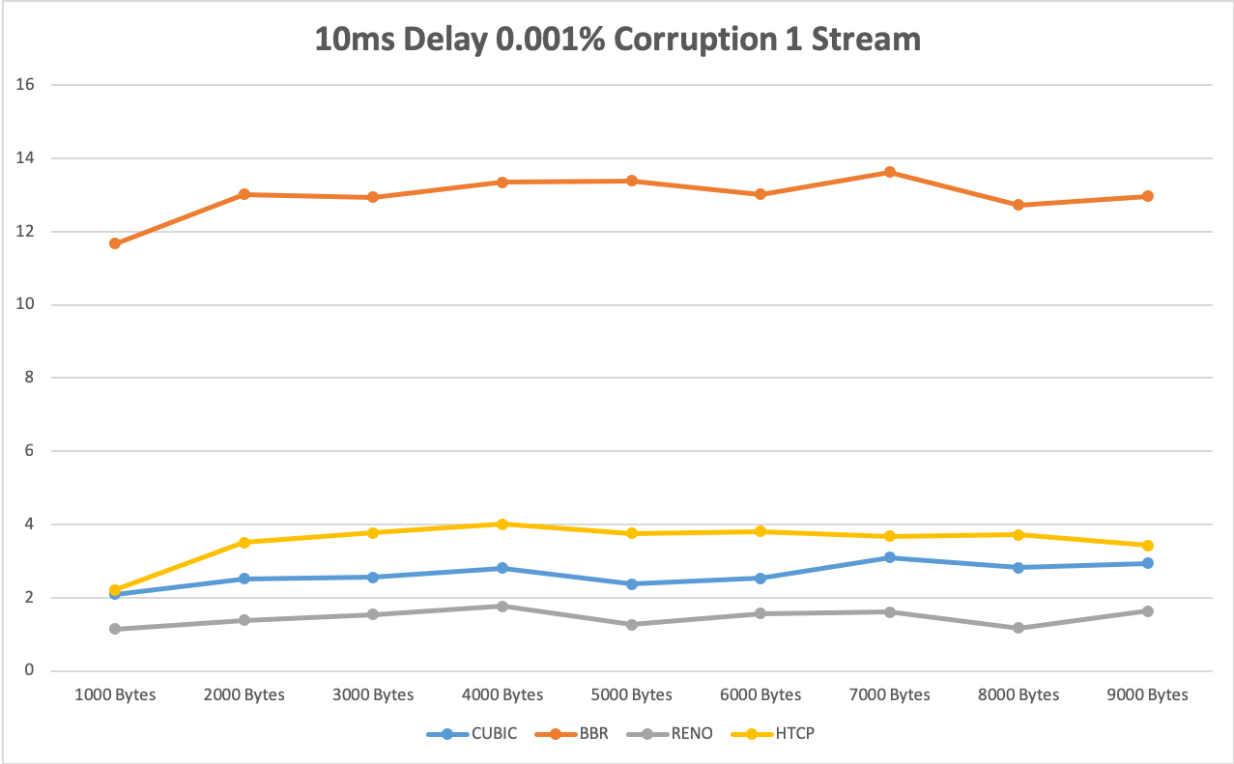
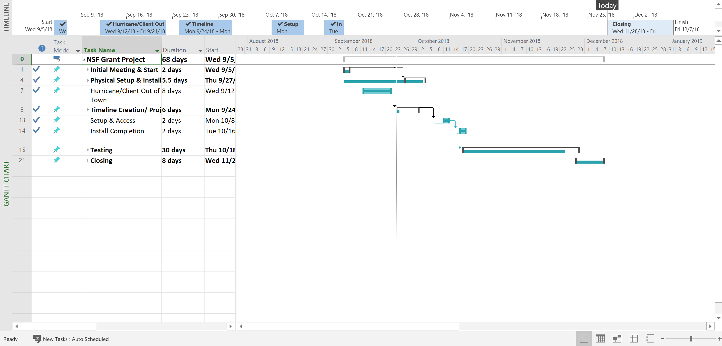
NSF Grant – Network Performance Testing
Adam Wellner
Christos Belegrinos
Grant Sharpe
Integrated Information Technology Department
ITEC 564 -
IT Capstone Projects
Fall 2018
Project Description
Specific Client Needs
Product Development & Deliverables
Technologies Used
This project compares the throughput performance of four different TCP congestion control protocols: Reno, HTCP, BBR, and Cubic. The project studies the impact of maximum segment size and parallel streams on big flows, in the presence of packet losses and latency. Results will provide novel findings related to moving big data across a 40 Gbps network.
Access to a high-speed 100 Gbps network
Access to specialized compute devices capable of transmit/receive data at 40 Gbps
Remote connectivity to conduct testing
Clearly written findings and procedures
Timely results
Cyberinfrastructure required for tests
100 Gbps network
Specialized end devices, referred to as Data Transfer Nodes (DTNs)
Software emulator running on DTNs to vary corruption rate, latency, maximum segment size, and number of parallel streams
Tests
Performance results (throughput) of the four TCP congestion control algorithms:
Reno
Cubic
HTCP
BBR
Control variables for testing include:
Corruption rate
Number of parallel streams
Maximum segment size
Final Report – Report summarizing findings
Unix command line for interacting with server operating systems
Juniper switches implemented within University of South Carolina network infrastructure
Netem – Allows network emulation across different devices
iPerf – Used to monitor, conduct, and rune network performance
Other standards involved with the project include:
TCP
Python
Congestion control algorithms.
Project Success Factors
Ability to perform testing accurately
Successful network emulation
Sufficient amount of data to create comparisons of test configurations conducted
Able to draw conclusion from documented results and comparisons
Project Mission Statement
This project will compare throughput performance of different TCP congestion-control algorithms on a 40 Gbps network, under packet losses and latency. Iperf tests will provide throughput results on HTCP, Cubic, Reno, and BBR to be compared and evaluated, thus drawling conclusions.
Project Results and Future Recommendations
Project Results – A large number of tests were conducted on the four available servers with multiple configurations implemented to generate valuable data that can be interpreted, potentially improving the testing conditions and future configurations of the testing environment.
Future Recommendations – The project should proceed by conducting additional tests with the four available servers, and generating and recording valuable data that can be compared to other data sets of similar origin.
Lessons Learned
“It’s critical to spend your time generating a set of basic, main goals so that the project timeline stays organized.” – Christos Belegrinos
“Always leave room for potential mishaps, it can save you in the long run.” – Adam Wellner
“Don’t forget to have fun!” – Grant Sherman
Project Budget
Anticipated (Time) Budget: 33 hours per team member
Actual Project (Time) Budget: 123.5 hours total (roughly 41 hours per team member)
Chart & Deliverable
PMBOK Project Processes Used
MS Project Gantt Chart of Major Project Milestones (Key Deliverables)
During this project, we developed a project charter, planned our resources and what was needed to conduct the tests, and managed communications and prolonged stakeholder engagement by meeting frequently with the stakeholder.
Key Stakeholders
Jorge Crichigno, Ph.D.
jcrichigno@cec.sc.edu
University of South Carolina

