Slide 1
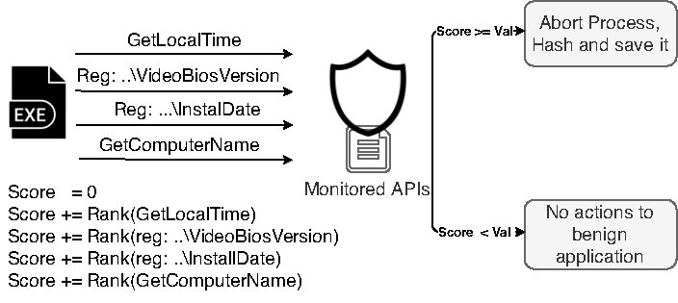
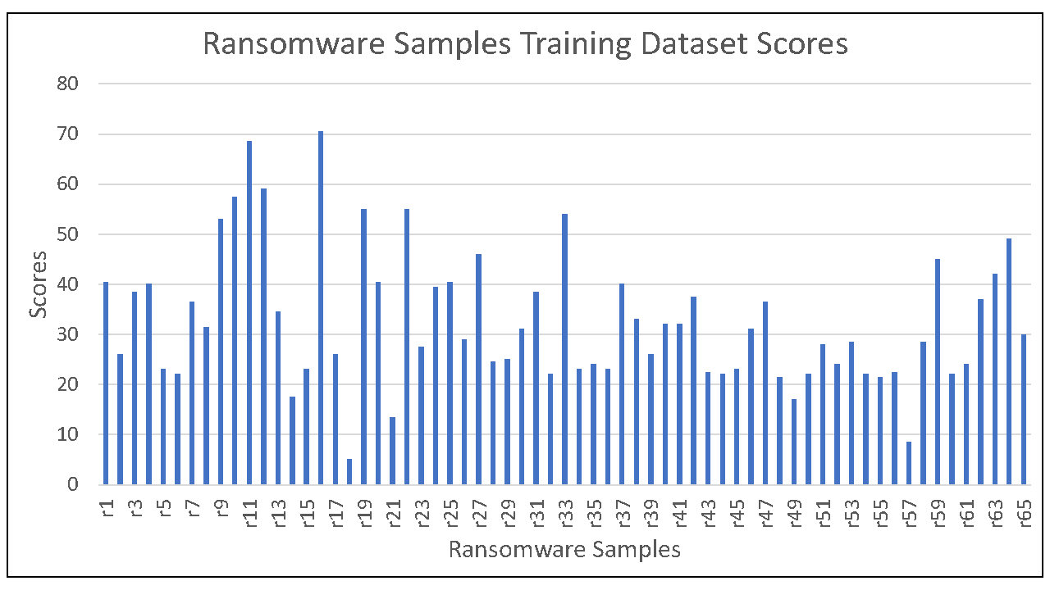
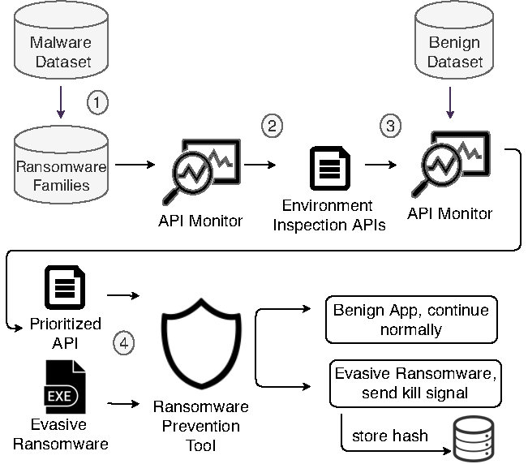
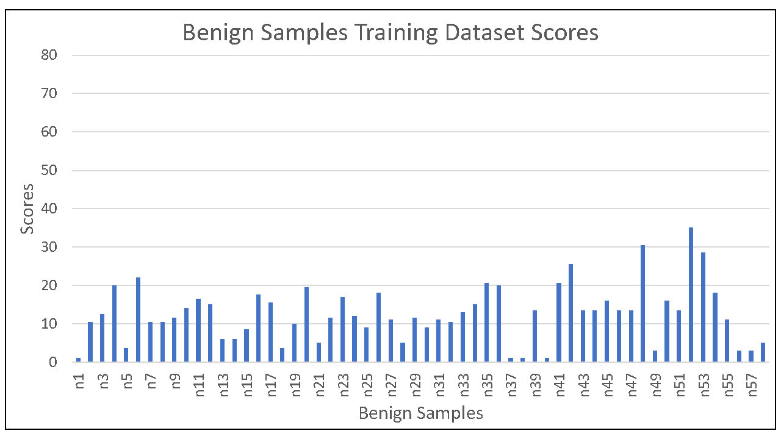
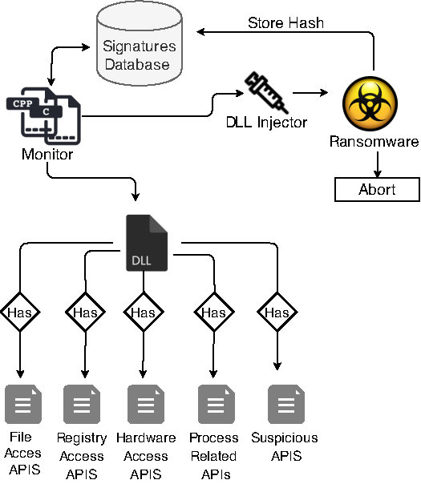
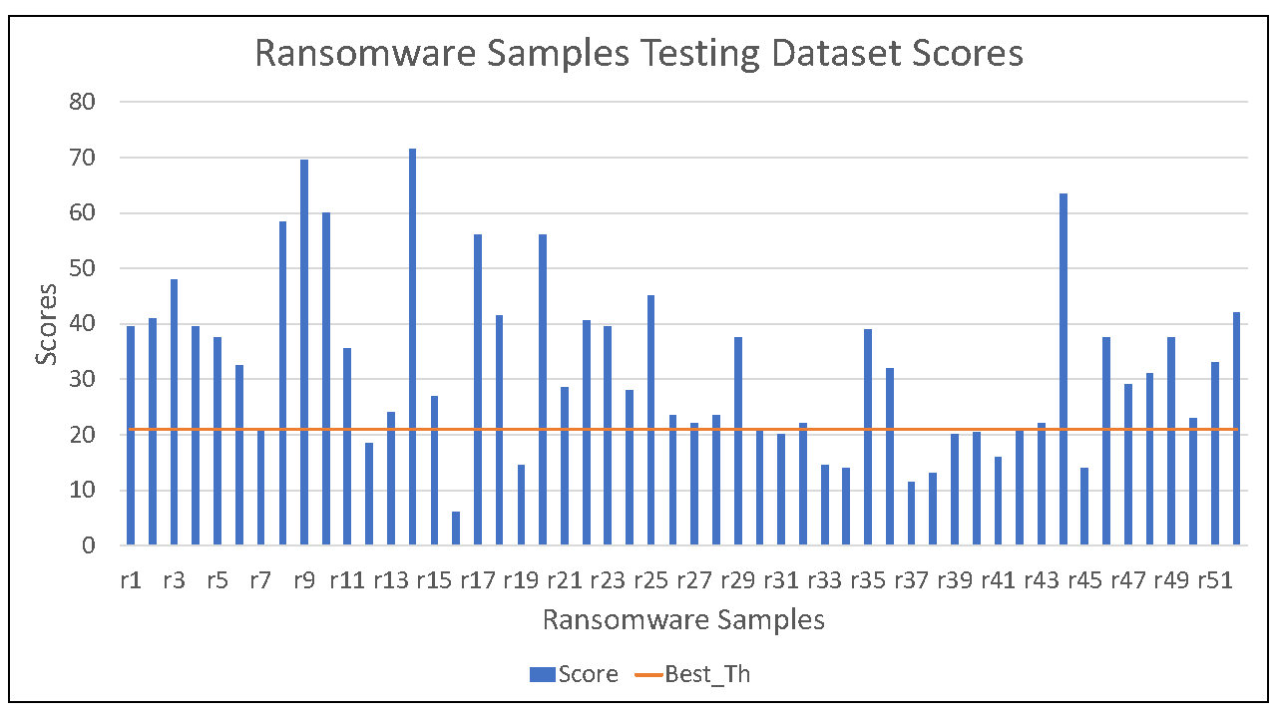
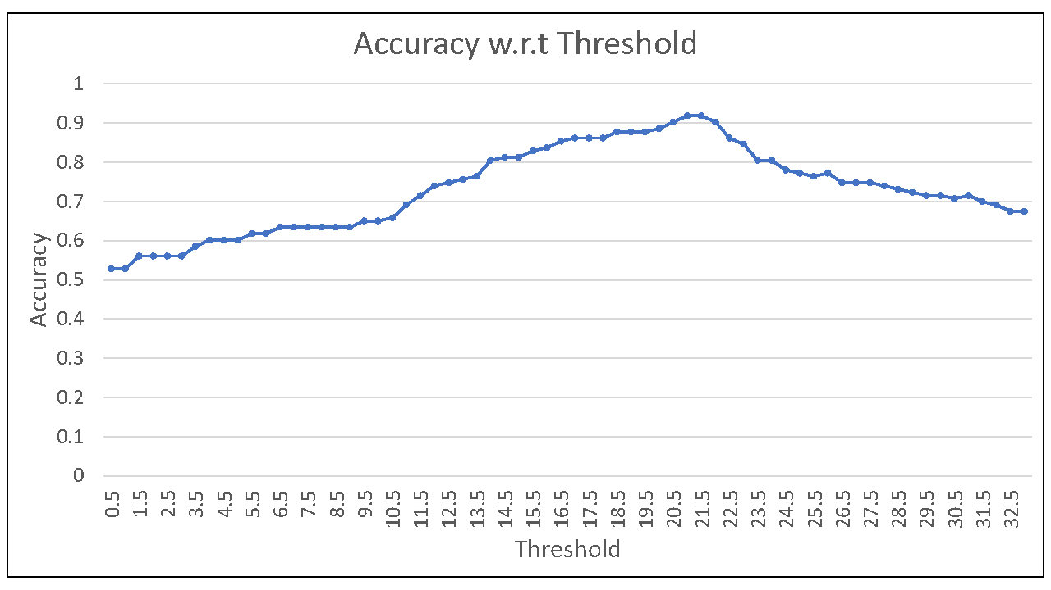
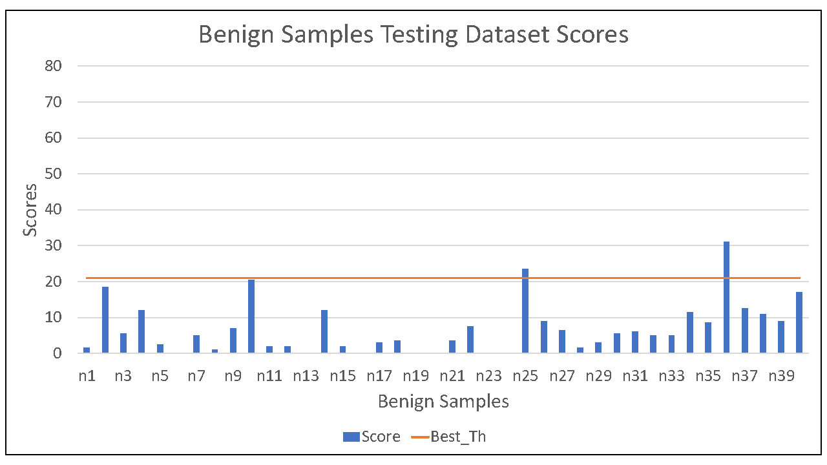
Exploiting Ransomware Paranoia For
Execution Prevention
Ali AlSabeh, Jorge Crichigno, Elias Bou-Harb
Integrated Information Technology Department, University of South Carolina, Columbia, South Carolina
The Cyber Center For Security and Analytics, University of Texas at San Antonio, USA
Abstract
A holistic hierarchy of the
proposed approach
API interception and score adjustment
Empirical evaluation
Several ransomware detection approaches have been proposed in the literature that interchange between static and dynamic analysis.
Recently, ransomware attacks were shown to fingerprint the execution environment before they attack the system to counter dynamic analysis.
In this project, we exploit the behavior of contemporary ransomware to prevent its attack on real systems and thus avoid the loss of any data.
We explore a set of ransomware-generated artifacts that are launched to sniff the surrounding and develop an approach that monitors the behavior of a program by intercepting the called APIs.
The approach determines in real-time if the program is trying to inspect its surrounding before the attack and abort it immediately prior to the initiation of any malicious encryption or locking.
Through empirical evaluations, we study how ransomware and benign programs inspect the environment and demonstrate how to prevent ransomware with a low false positive rate.
Scores reported by our implemented approach when measuring the evasiveness of ransomware training samples
Empirical evaluation
Contributions
Methodology
Scores reported by our implemented approach when measuring the evasiveness of benign training samples
Exploring the behavior of contemporary ransomware by collecting relevant artifacts related to fingerprinting the execution environment, such as inspecting running processes, system files, registries, and CPU performance.
Designing and developing a host-based approach which can detect contemporary ransomware through monitoring their “paranoia” (i.e., generated behavior targeting the execution environment) to prevent it from encrypting/locking the host machine through investigation techniques rooted in API interception methods.
Executing empirical evaluations using real ransomware datasets, and achieving an accuracy of 91% on training data, and 84% on testing data.
Collect diverse set of malware samples, and filter the ones related to ransomware.
Among the collected ransomware samples, perform ransomware family labeling to assure that the samples are representative and diverse.
Collect a set of APIs that are related to environment inspection (executed by different ransomware samples prior to enumerating and encrypting the target’s files)
Tune the ratio of false positives by assigning a rank/priority that shows how likely this API is to be launched by evasive ransomware samples for sniffing the environment.
Integrate the collected APIs inside a DLL and monitor programs’ execution by injecting this DLL into the address spaces of the executing processes.
The proposed monitoring mechanism will begin the moment a program is executed.
If the monitored program attempts to fingerprint the environment through reaching a certain threshold where it is considered evasive ransomware, then a kill signal is sent to abort its execution.
Else, it is deemed as a benign operation and its execution is uninterrupted.
Scores reported by our implemented approach when measuring the evasiveness of ransomware testing samples
Ransomware detection techniques gaps
Focusing on detection rather than prevention.
Detection is mainly based on ransomware’s high level behavior (encryption/locking).
Lack of considering contemporary ransomware behavior.
The variation of the accuracy value with respect to the threshold
Scores reported by our implemented approach when measuring the evasiveness of benign testing samples
Methodological considerations
Acknowledgement
Concluding remarks and future direction
Environment fingerprinting techniques.
Preventing contemporary ransomware.
Addressing false positives when monitoring a program.
Real-time, fast, and efficient monitoring technique.
This work was supported by the National Science Foundation (NSF), Grants 1829698 and 1907821.
The proposed approach addresses evasive ransomware attacks that perform fingerprinting to check if they are being executed in a real or monitored environment, and prevents them from executing their intended encryption/locking behavior.
The gathered prioritized artifacts were able to identify evasive ransomware samples from benign ones with a low false-positive rate.
The approach can be enhanced by exploring deferring techniques to delay the execution of contemporary ransomware, and make it generic to operate on various operating systems.

