Slide 1

Processing Network Traffic at Line Rate
Jorge Crichigno
Presentation to the Department of Information Technology
at University of South Carolina
Online
October 21, 2020

Slide 2
Streaming Analytics
Streaming analytics of a campus network at line rate (100 Gbps)
The topology consists of a Barefoot’s Tofino switch that receives traffic from two taps reading traffic to/from Internet and Internet2
An analyzer and storage server are also attached to the Tofino switch to collect the data processed by the switch

Slide 3
Streaming Analytics
The Barefoot’s Tofino switch will process packet headers only; payload is discarded
The switch will track and store flow information only (for example, src-dst IPs, src-dst ports, application layer protocol, TCP flags, number of bytes, inter-packet arrival time, flow duration, latency between src-dst pair)
The system can anonymize traffic to feed to streaming analytics (analyzer), if needed (for example, anonymizing src / dst IP or portions of them)
Switch can remove all Personally Identifiable Information (PII) at line rate

Slide 4
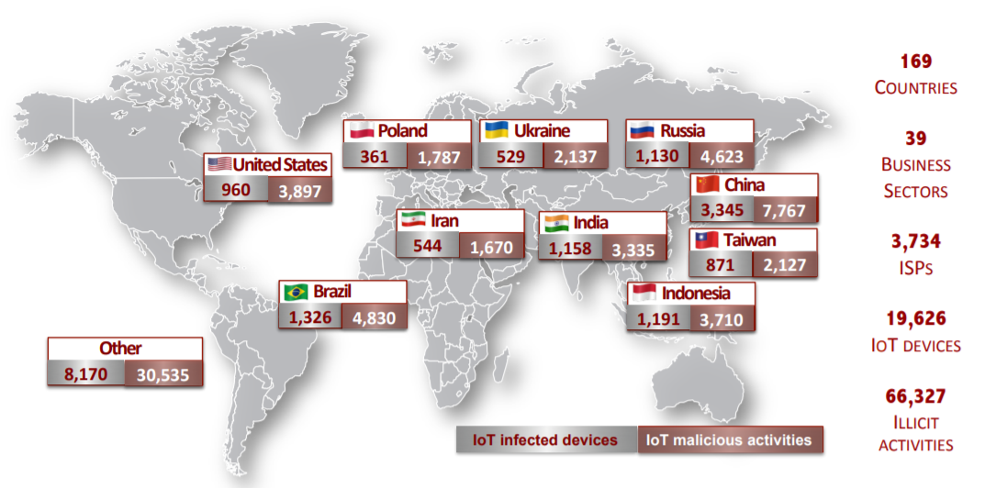
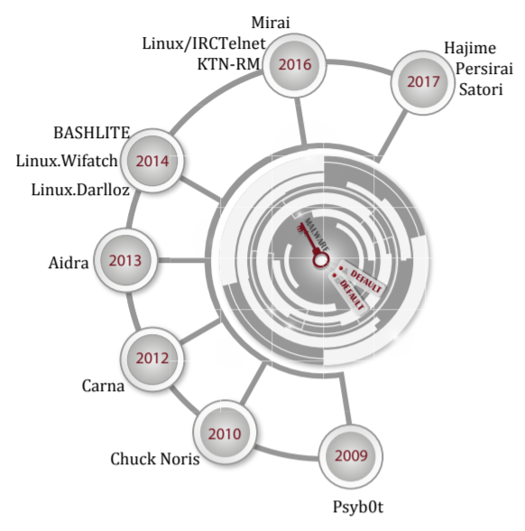
Streaming Analytics
There is no campus network doing data analytics at line rate
The following is an example of the type of work that can be executed
  Detect compromised devices on campus at line rate, using passive data
  Similar work has been conducted on non-real time, using traffic from the Center and Center for Applied Internet Data Analysis (CAIDA, www.caida.org) (University of California San Diego)
Global distribution of exploited IoT devices; results from UofSC research
Malware exploiting default credentials

Slide 5
Streaming Analytics
Global distribution of exploited IoT devices by passively analyzing packet headers from CAIDA
  Exploited IoT devices: these devices are contacting ‘unavailable’ IP addresses (this IP block is referred to as ‘Darknet.’ No healthy device would contact this IP block)
Global distribution of exploited IoT devices; results from UofSC research
Malware exploiting default credentials

Slide 6
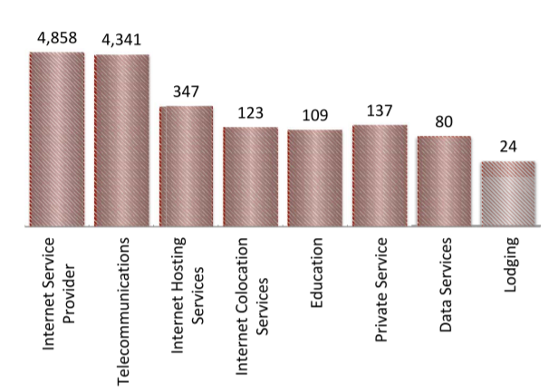
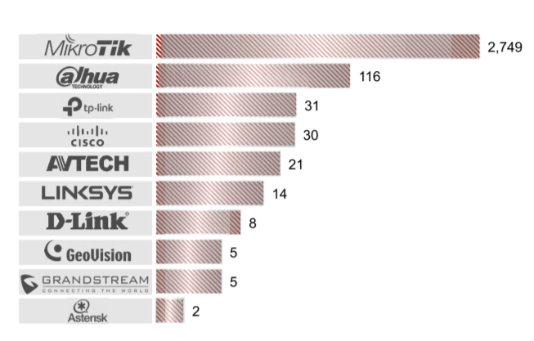
Streaming Analytics
Global distribution of exploited IoT devices by passively analyzing packet headers from CAIDA
  Exploited IoT devices: these devices are contacting ‘unavailable’ IP addresses (this IP block is referred to as ‘Darknet.’ No healthy device would contact this IP block)
Top sectors hosting exploited IoT devices
Top ten manufacturers of exploited IoT devices

Slide 7
Streaming Analytics
This data will enable undergraduate and graduate research work
Novel results regarding the type of threats faced by a large campus network
Processing and detection at line rate or near line rate
Strengthen the results of current funded project
Funding opportunities

Slide 8
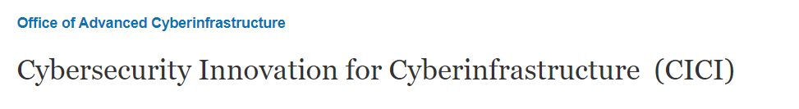
Streaming Analytics
This data will enable undergraduate and graduate research work
Novel results regarding the type of threats faced by a large campus network
Processing and detection at line rate or near line rate
Strengthen the results of current funded project
Funding opportunities

Slide 9
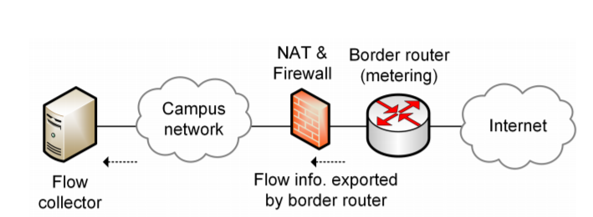
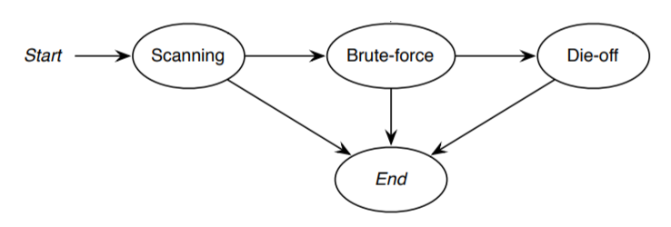
Honeypot
Flow-based intrusion detection uses flow information to detect malicious activities
Payload is not used
Some legacy networks use Netflow to collect flow statistics; for example, SSH compromise detection

Slide 10
Honeypot
The main idea is to use the programmable switch as an instrument to detect malicious activities in real time or near real time
Customized processing (no dependency on Netflow implementations)
Granular time resolution

Slide 11
Honeypot + Streaming Analytics
Network topology

