Slide 1
Protection From Reconnaissance and Scan Attack Through NGFW (Next Generation Firewall)
Kyle Radzak
Christopher Ngo
Advisor: Jorge Crichigno, Ali Alsabeh
Department of Integrated Information Technology
University of South Carolina
December 2020

Slide 2
Agenda
Introduction to Network Security and Reconnaissance attacks
Background Information
Reconnaissance and Scan Attacks
Palo Alto Firewall Systems
Implementation of Reconnaissance Protection to prevent port and host sweeps
NMAP and hping3 Use
Proposed Solution and Implementation
Conclusion

Slide 3
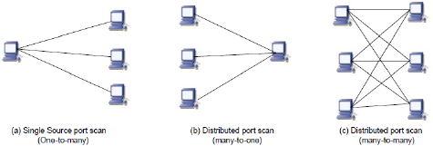
Introduction
Reconnaissance is the practice of information gathering. How this is applied to network security is when attackers attempt to gain information about the network’s topology and vulnerabilities.
A modern-day firewall is designed to monitor incoming and outgoing traffic in order to decide whether to allow or block specific based off rules.
In order to prevent attackers from gaining information about a network, zone protection profiles using Reconnaissance Protection can be used to defend against port scans and host sweeps.

Slide 4
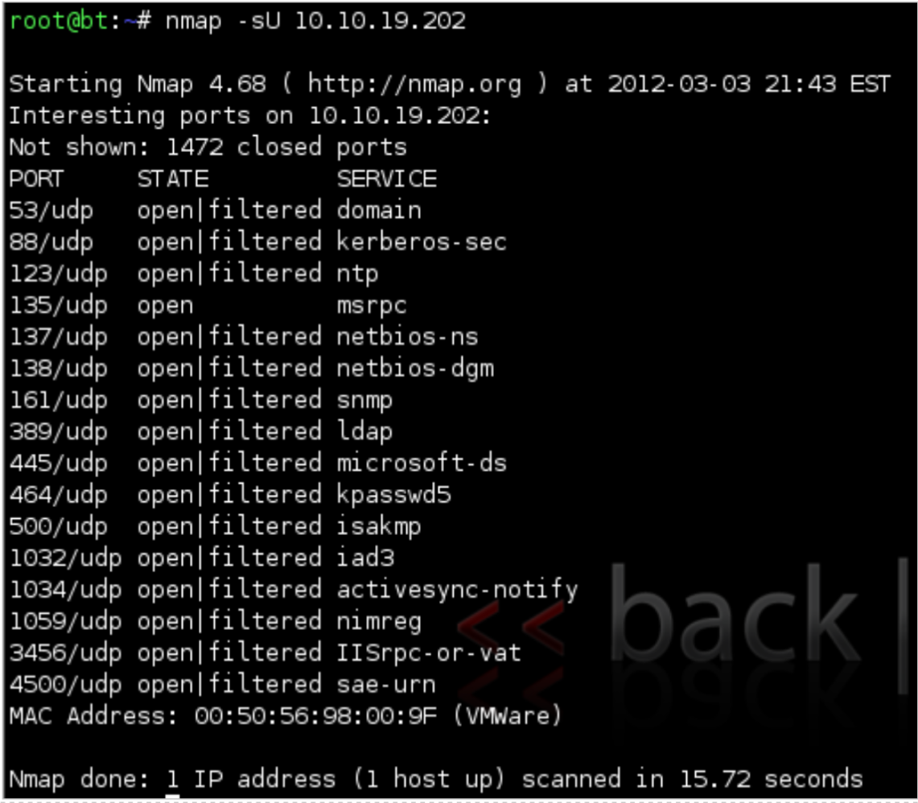
Background Information
Reconnaissance (or recon) attacks is the action of unauthorized discovery and mapping of networks and vulnerabilities
When directed at an endpoint, such as a PC, a recon attack is also called host profiling.
If successful, an attacker can see which ports are active and open.
Recon attacks are more than likely accompanied by a more intrusive attack such as DoS attack.
NetLab lab 14: Discovering Security Threats and Vulnerabilities

Slide 5
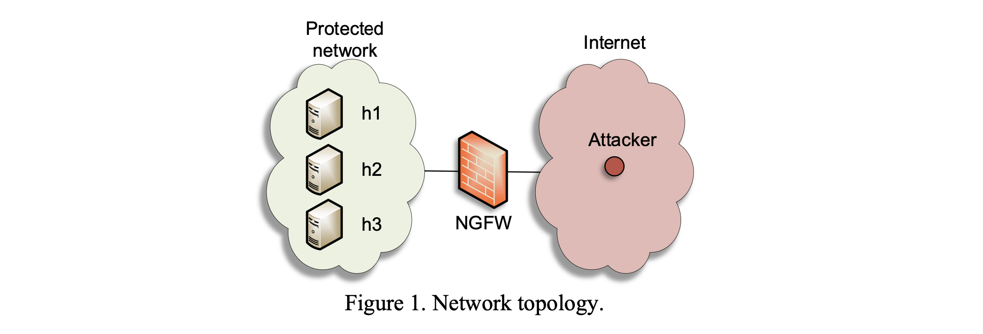
Background Information
Next Generation Firewall System
Zones protect the network by segmenting it into smaller, more easily managed areas.
Zones also prevent uncontrolled traffic from flowing through the firewall. This is because each interface has to be assigned a Zone. Therefore, this prevents inappropriate traffic from entering a zone it does not belong

Slide 6
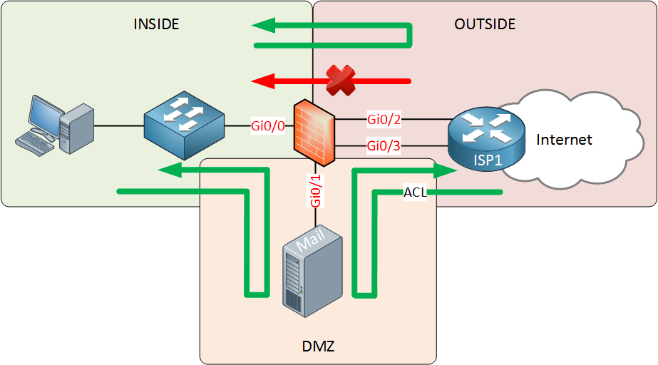
Proposed Solution and Implementation
Creating a zone protection and vulnerability protection profile are critical to protecting the network and are the best methods of fending off a Reconnaissance and Scan Attack.
Zone protection and vulnerability protection have created a net of defense from external sources gaining valuable information on the network.
We will be creating unique profiles on our Next Generation Firewall to ward off these types of attacks as well as ensuring the proper ports are sealed off to these types of attacks.

Slide 7
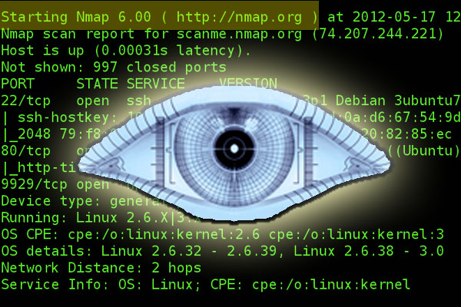
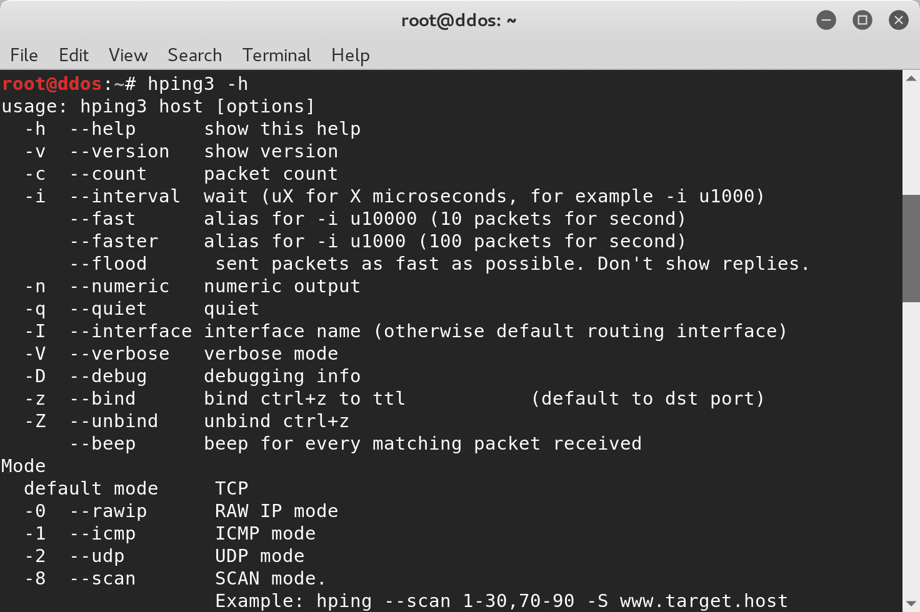
NMAP and hping3 Use
Nmap and Hping3 are open-source tools used for cyber defense and attacks
Nmap scans for network devices and open ports
We used Nmap to identify tcp/udp ports that could be flooded and attacked
Hping3 was used to perform a flood attack on open ports of the network and was an exemplary of how the firewall was able to deny the pings
Nmap and Hping3 commands are tools that can be used by any hacker to get into the targeted network

Slide 8
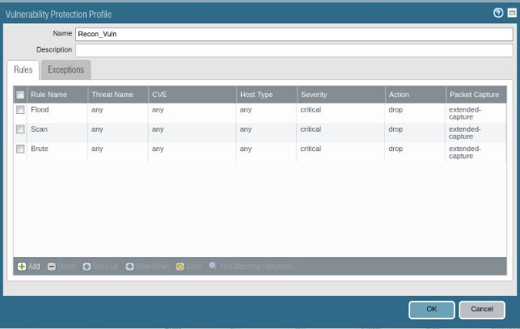
Conclusion
With the implementation of a zone and vulnerability protection profiles, we can ensure a high level of security and safety are maintained. The probability that information behind the firewall will be breached, altered, or compromised by malicious external actors will be greatly reduced.

