Slide 1
UCF / FLR Workshop on Networking Topics
SDN concepts, Open vSwitch and Open Flow
Jorge Crichigno, Elie Kfoury
University of South Carolina
http://ce.sc.edu/cyberinfra
University of Central Florida (UCF)
Florida LambdaRail (FLR)
The Engagement and Performance Operations Center (EPOC)
Energy Sciences Network (ESnet)
University of South Carolina (USC)
Orlando, Florida
February 17th, 2023

Slide 2
Agenda
SDN fundamentals – data and control planes
SDN operation
Flow / Forwarding tables
OpenFlow protocol
Limitations of SDN and OpenFlow

Slide 3
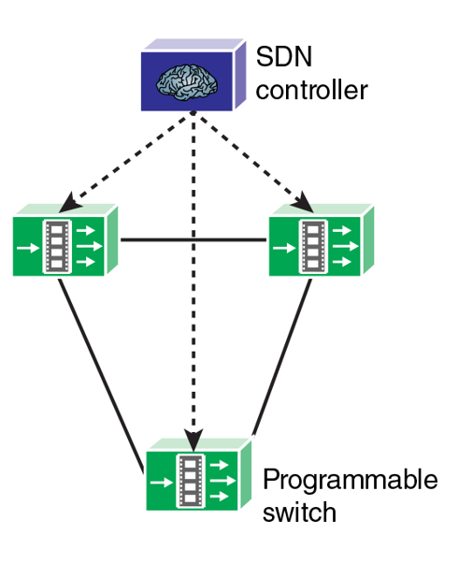
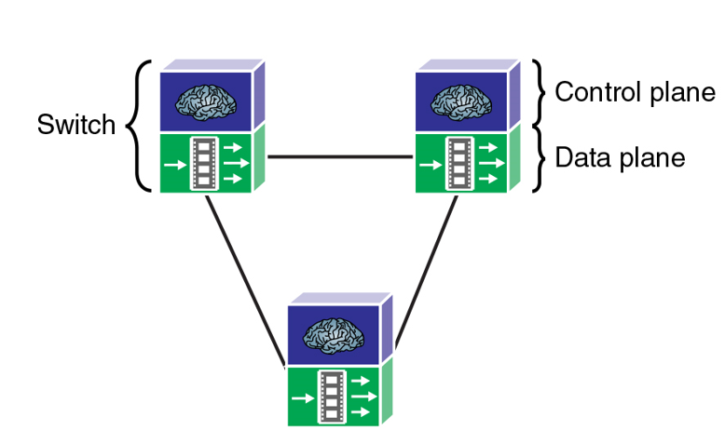
Plane Separation
The first fundamental characteristic of SDN is the separation of planes
Data plane, implemented in the device
Control plane, implemented by a centralized controller
Traditional network
SDN network
W. Stallings, “Foundations of Modern Networking: SDN, NFV, QoE, IoT, and Cloud” Addison Wesley, 2017.

Slide 4
Plane Separation – Data Plane
The data plane implements forwarding functionality (logic and tables for choosing how to deal with incoming packets)
Forwarding based on MAC address, IP address, VLAN ID, etc.
Dropping, replicating an incoming packet
Traditional networks
W. Stallings, “Foundations of Modern Networking: SDN, NFV, QoE, IoT, and Cloud” Addison Wesley, 2017.

Slide 5
Plane Separation – Data Plane
Special-case packets (e.g., routing advertisements) that require processing by the control plane are passed to that plane
Traditional networks
W. Stallings, “Foundations of Modern Networking: SDN, NFV, QoE, IoT, and Cloud” Addison Wesley, 2017.

Slide 6
Plane Separation – Control Plane
The control plane is moved off the switching device, onto a centralized controller
The algorithms used to program the data plane (populate tables) reside in the control plane (e.g., OSPF, BGP)
Traditional networks
W. Stallings, “Foundations of Modern Networking: SDN, NFV, QoE, IoT, and Cloud” Addison Wesley, 2017.

Slide 7
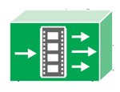
SDN Operation
Basic components (bottom-up)
SDN switches (e.g., Open vSwitch)
Controller (e.g., ONOS controller)
Applications (e.g., BGP app, IDS app)
Global view app
BGP app
IDS app
Business app
Northbound (REST, JSON)
Control plane
SDN Controller
Data plane
Southbound (OpenFlow)
Flow table

Slide 8
SDN Operation – Switches
SDN devices contain forwarding functionality
Forwarding information is stored in flow tables
If it does not find a match, it can either drop the packet or pass it to the controller
Global view app
BGP app
IDS app
Business app
Northbound (REST, JSON)
Control plane
SDN Controller
Data plane
Southbound (OpenFlow)
Flow table

Slide 9
SDN Operation – Controller
SDN controller implements control plane functionality
It presents an abstraction of the network to the SDN applications running above
It allows the SDN applications to define flows on devices
It maintains a view of the entire network (global network view)
Global view app
BGP app
IDS app
Business app
Northbound (REST, JSON)
Control plane
SDN Controller
Data plane
Southbound (OpenFlow)
Flow table

Slide 10
SDN Operation – Applications
SDN applications are built on top of the controller
Software applications can implement forwarding, routing, overlay, multipath, access control, etc.
Application are driven by events coming from the controller and from external inputs
Global view app
BGP app
IDS app
Business app
Northbound (REST, JSON)
Control plane
SDN Controller
Data plane
Southbound (OpenFlow)
Flow table

Slide 11
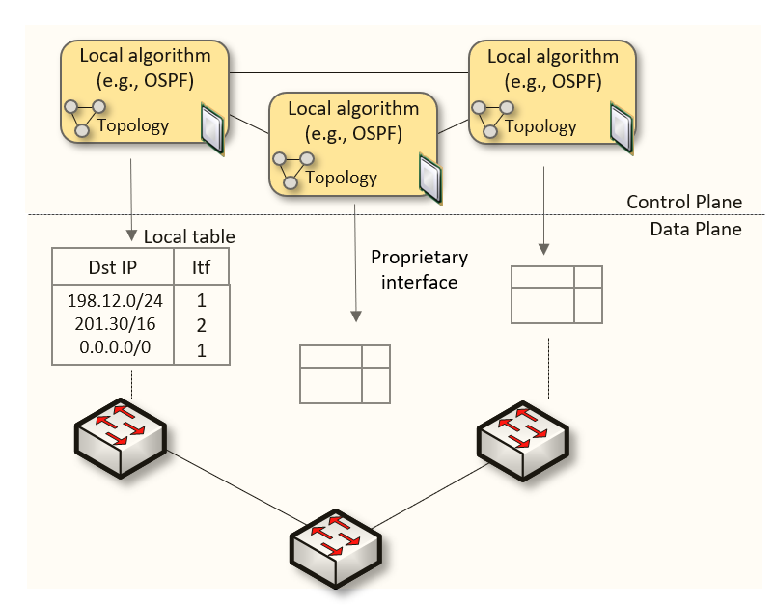
Forwarding Tables
The interface between the control and data planes has been historically proprietary
Vendor dependence: slow product cycles of vendor equipment, standardization
Legacy network

Slide 12
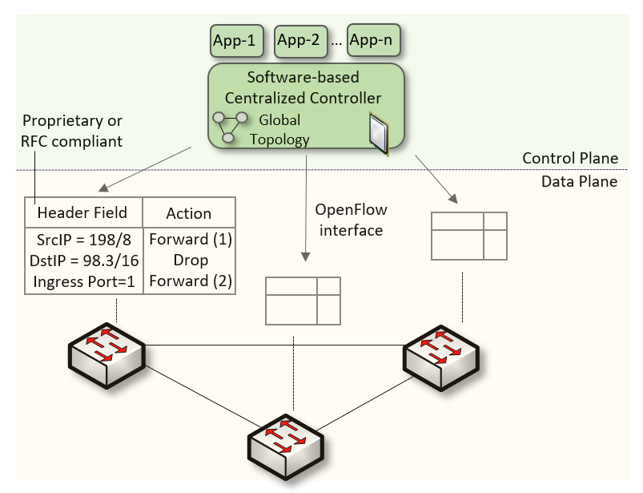
Forwarding Tables
In SDN networks, that function is now performed by the controller
The controller is responsible for programming packet-matching and forwarding rules
Legacy network
SDN network

Slide 13
Advantages of SDN Networks vs. Legacy Networks
Ease of network management
“More customized” network behavior
Possibility of experimentation and innovation (custom policies, apps can be deployed)
Packets can be forwarded based on other fields, such as TCP port number
Legacy network
SDN network

Slide 14
Overview of OpenFlow
OpenFlow is a protocol specification that describes the communication between OpenFlow switches and an OpenFlow controller
The consortium responsible for the OpenFlow specification is the Open Networking Foundation (ONF), which was created in 2011
SDN network

Slide 15
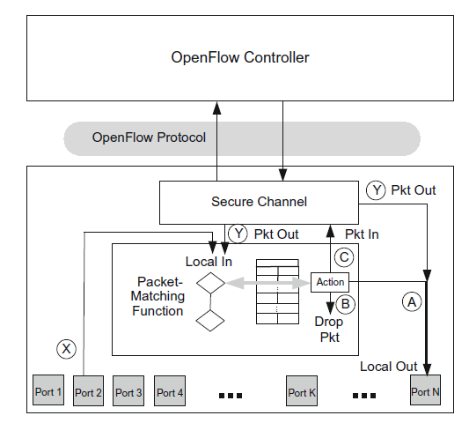
Overview of OpenFlow
A switch receives packets on one port and forward it through another
Example: port 2 -> port N
Potential actions
(A) Forward the packet out a local port
(B) Drop the packet
(C) Pass the packet to the controller via a PKT_IN message
When the controller has a data packet to
forward out through the switch, it uses the
PACKET_OUT message (e.g., route advertisements)

Slide 16
Overview of OpenFlow
The protocol consists of a set of messages from the controller to the switch and a corresponding set of messages in the opposite direction
Basic ops: defining, modifying, and deleting flows

Slide 17
Overview of OpenFlow
The secure channel is the path used for communications between the OpenFlow controller and the OpenFlow device
This communication is secured by
TLS-based encryption, though unencrypted
TCP connections are allowed
Connections may be in-band or out-of-band

Slide 18
Overview of OpenFlow – Flow Table
The flow table lies at the core of the definition of an OpenFlow switch
A flow table consists of flow entries
A flow entry consists of header fields, counters, and actions associated with that entry

Slide 19
Overview of OpenFlow – Flow Table
The header fields are used as match criteria
The counters are used to track statistics relative to this flow, such as how many packets have been forwarded or dropped for this flow
The actions fields prescribe what to do with a packet matching this entry

Slide 20
Overview of OpenFlow – Flow Table
The header fields are used as match criteria
The counters are used to track statistics relative to this flow, such as how many packets have been forwarded or dropped for this flow
The actions fields prescribe what to do with a packet matching this entry
Flow table, switch s1

Slide 21
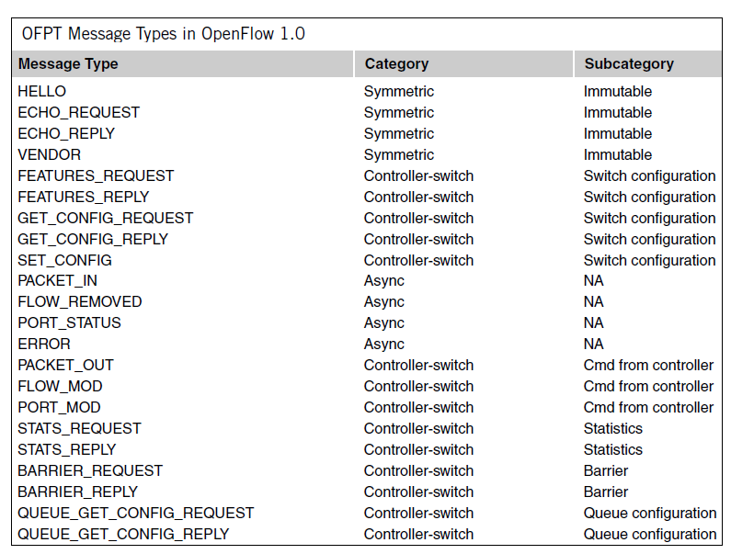
Overview of OpenFlow
Each message between controller and switch starts with the OpenFlow header
The header specifies the OpenFlow version, message type, message length, and transaction ID of the message
Three categories
Symmetric: sent by controller or switch w/o solicitation
Controller-switch: sent by controller to switch
Async: sent by switch to controller when there is any state change in the system

Slide 22
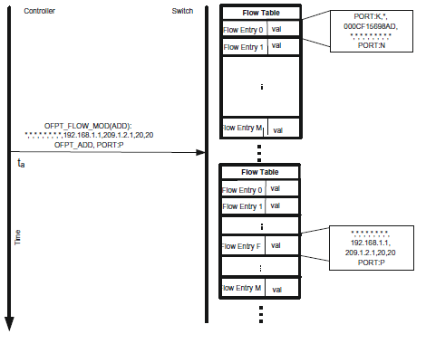
Overview of OpenFlow
Example: Controller Programming (populating) Flow Table
At ta, the controller sends a FLOW_MOD (ADD) command
A flow is added for packets entering the switch on any port
Source IP: 192.168.1.1
Destination IP: 209.1.2.1
Source TCP port: 20
Destination TCP port: 20
All other match fields have been wildcarded
The outport port is specified as P

Slide 23
Overview of OpenFlow
Example: Controller Programming (populating) Flow Table
A packet arrives at the switch through port 2 with source IPv4 192.168.1.1 and destination IPv4 209.1.2.1
The packet-matching function scans the flow table starting at flow entry 0 and finds a match in flow entry F
Flow entry F stipulates that a matching packet should be forwarded out port P

Slide 24
OpenFlow Additions
The OpenFlow interface started simple, with few protocols that could be matched against incoming packets
Over few years, the specification has been extended with many more header fields and new protocols
Version | Date | Header fields
OpenFlow 1.0 | Dec. 2009 | 12 (Ethernet, TCP, IPv4)
OpenFlow 1.1 | Feb. 2011 | 15 (MPLS, …)
OpenFlow 1.2 | Dec. 2011 | 36 (ARP, ICMP, IPv6, …)
OpenFlow 1.3 | Jun. 2012 | 40
OpenFlow 1.4 | Oct. 2013 | 41
OpenFlow 1.5 | Mar. 2015 | 44
Bossart et al. “P4: Programming Protocol-Independent Packet Processors”
OpenFlow Switch Specs v1.5.1. Online https://tinyurl.com/y4j4a5eh

Slide 25
Limitations of SDN / OpenFlow
SDN
Fixed number of header fields
OpenFlow repeatedly extends the specification
Long standardization cycles
Fixed protocols / header fields
Fixed parser
Devices still in control of manufacturers
Operators / programmers limited to functionality specified in the OpenFlow specification
Match+action stages are in series
P4 switches (see p4.org)
Operators / programmers can define their own protocols and header fields
Immediate implementation
Customized protocols / header fields
Devices in control of operators / programmers
Match+action stages are in series or in parallel
Actions are composed of protocol-independent primitives (switch is not tight to specific protocols)
More future-proof

Slide 26
Programmable Switch ASICs
We now have the technology that permits CI engineers to run customized functions
CI Engineer
Switch
P4 Code
CPU-based control plane
Control Plane
compiler
Data Plane
Programmable parser, tables, arithmetic logic
units (ALUs), programmable deparser, …
Switch
ASIC

Slide 27
Programmable Switch ASICs
We now have the technology that permits CI engineers to run customized functions
Designed for packet processing operations
CI Engineer
Switch
P4 Code
CPU-based control plane
Control Plane
compiler
Data Plane
Programmable parser, tables, arithmetic logic
units (ALUs), programmable deparser, …
Switch
ASIC

Slide 28
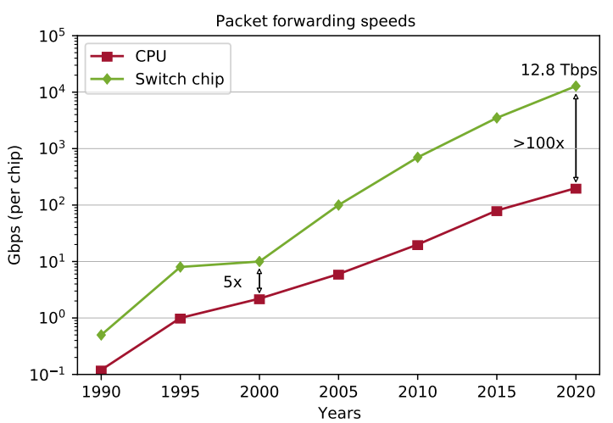
Programmable Switch ASICs
We now have the technology that permits CI engineers to run customized functions
Designed for packet processing operations
Much faster than general-purpose CPUs for processing packets
N. McKeown, “Creating an End-to-End Programming Model for Packet Forwarding,” Netdev 0x14 Conference 2020, https://www.youtube.com/watch?v=fiBuao6YZl0&t=619s.

Slide 29
Workshop on Networking Topics
Webpage with PowerPoint presentations:
http://ce.sc.edu/cyberinfra/workshop_2023_feb.html
Hands-on sessions: to access labs for the hands-on sessions, use the following link:
https://netlab.cec.sc.edu/
Username: email used for registration
Password: nsf2023

