Slide 1
SYN Attack Prevention
Sean Batchelder and Ephraim Zimmerman
Advisor: Ali AlSabeh
Department of Integrated Information Technology
University of South Carolina

Slide 2
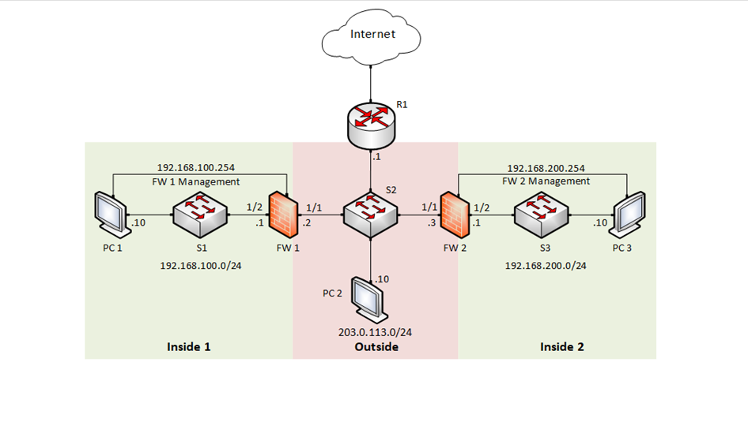
Objective
Victim
Understand and utilize a next-generation Firewall
Implement a protection policy against SYN attacks
Protect a network against SYN and similar attacks
Attacker

Slide 3
SYN Flooding
A SYN flood is a type of denial-of-service (DDoS) attack which aims to make a server unavailable to legitimate traffic.

Slide 4
Types of SYN Floods
Direct Attack
Attacker does not mask their IP address
Spoofed Attack
IP address is masked to hide the attacker's identity
Distributed Attack
Attack created using a botnet

Slide 5
Flood Protection
SYN Cookies
Drops only traffic that fails the SYN handshake
Random Early Drop
Drops all traffic randomly

Slide 6
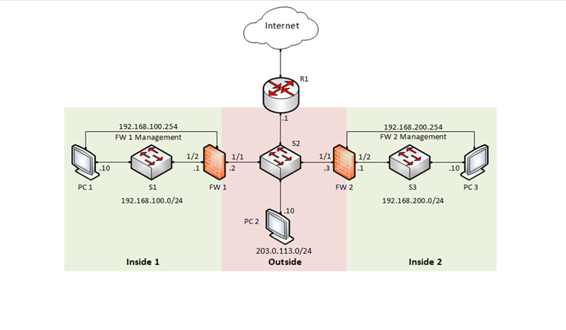
Solution
Classified DoS protection is used with source-IP-only tracking to reduce resources
Set the action to SYN cookies
Implement the profile into the security policy to block PC2
Victim
Attacker

Slide 7
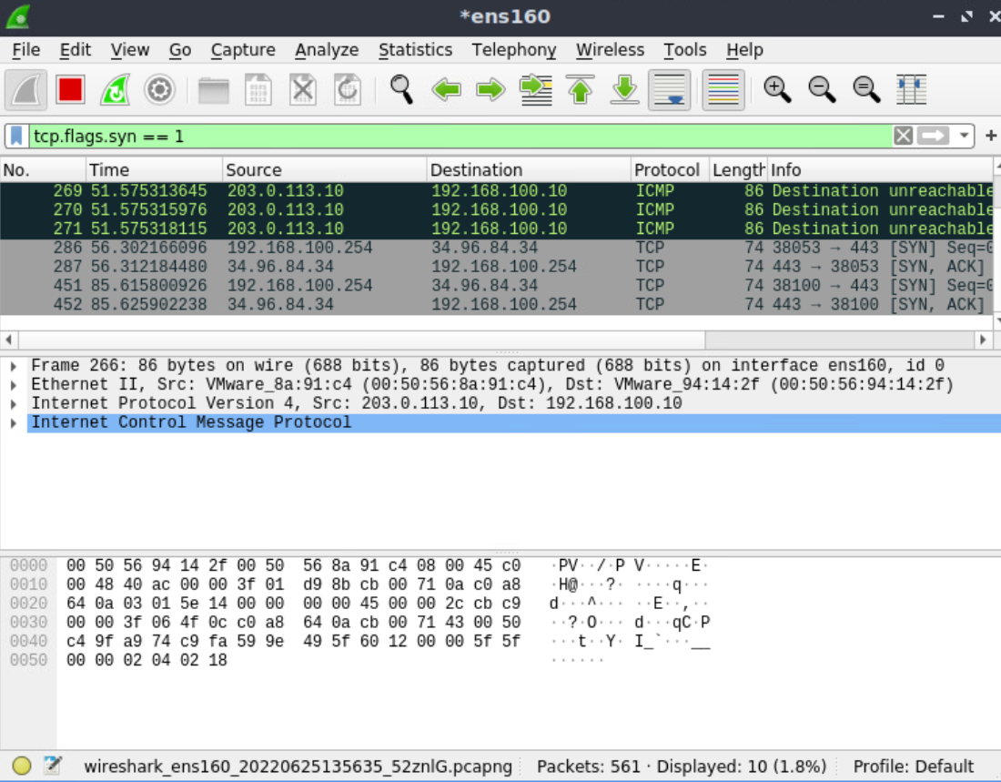
Results
Policy OFF
Policy ON
The classified profile blocks the appropriate source IP
Wireshark and Palo monitors show the network is protected
PC1 can access the network

Slide 8
Conclusion
Create a policy utilizing SYN cookies to allow legitimate traffic
Protect a network against SYN and similar attacks
Effectively prevented the SYN attack
Future Work

