Slide 1
2023 Internet2 Technology Exchange
Science DMZs and Networking for All
Science DMZ concepts, campus
network deployments, perfSONAR
Jorge Crichigno
University of South Carolina
https://research.cec.sc.edu/cyberinfra/
University of South Carolina (USC)
Energy Sciences Network (ESnet)
September 18, 2023

Slide 2
Workshop Website
All material is posted on the website of the tutorial
https://research.cec.sc.edu/cyberinfra/workshop-techex2

Slide 3
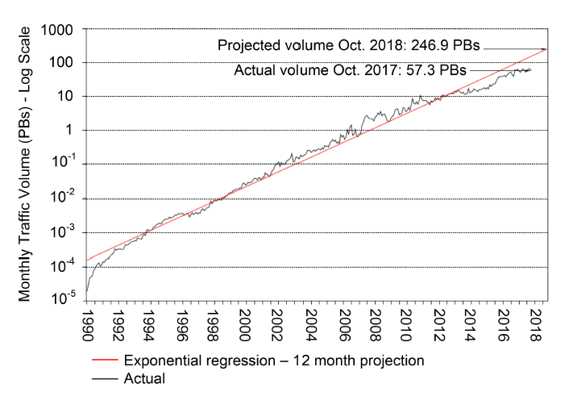
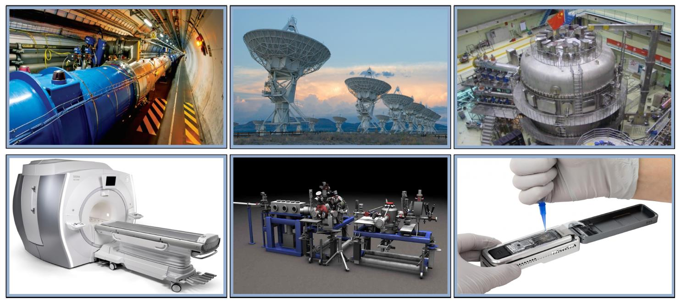
Motivation for a High-Speed Science Architecture
Science and engineering applications are generating data at an unprecedented rate
Instruments produce hundreds of terabytes in short time periods (“big science data”)
Data must be typically transferred across high-bandwidth high-latency Wide Area Networks (WANs)
The Energy Science Network (ESnet) is the backbone connecting U.S. national laboratories and research centers
Notes:
Very Large Array

Slide 4
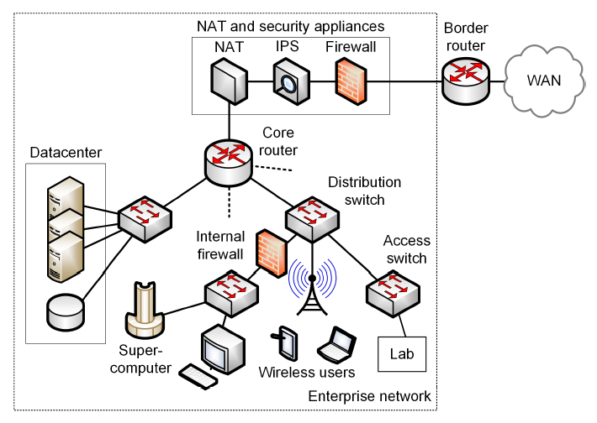
Enterprise Network Limitations
Security appliances (IPS, firewalls, etc.) are CPU-intensive
Inability of small-buffer routers/switches to absorb traffic bursts
End devices incapable of sending/receiving data at high rates
Lack of data transfer applications to exploit available bandwidth
Many of the issues above relate to TCP

Slide 5
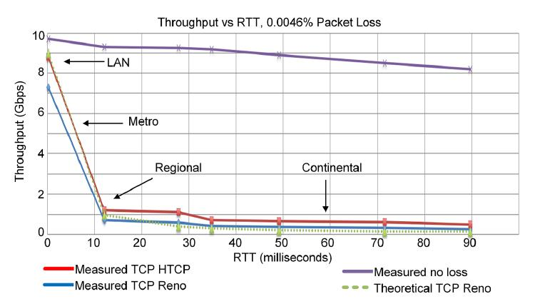
Enterprise Network Limitations
Effect of packet loss and latency on TCP throughput
E. Dart, L. Rotman, B. Tierney, M. Hester, J. Zurawski, “The science dmz: a network design pattern for data-intensive science,” International Conference on High Performance Computing, Networking, Storage and Analysis, Nov. 2013.

Slide 6
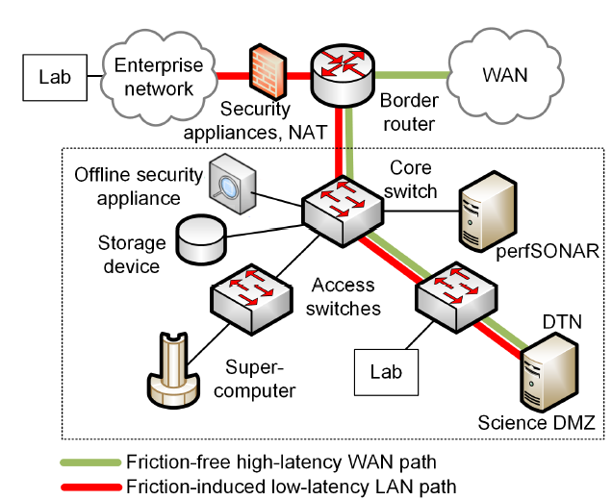
Science DMZ
The Science DMZ is a network designed for big science data
Main elements
High throughput, friction free WAN paths
Data Transfer Nodes (DTNs)
End-to-end monitoring = perfSONAR
Security tailored for high speeds

Slide 7
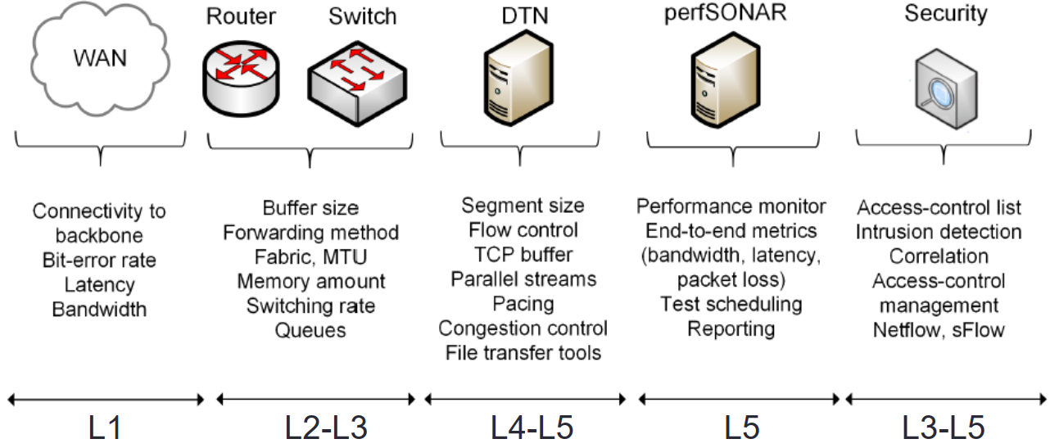
Science DMZ
The Science DMZ is a network designed for big science data
Main elements
High throughput, friction free WAN paths
Data Transfer Nodes (DTNs)
End-to-end monitoring = perfSONAR
Security tailored for high speeds

Slide 8
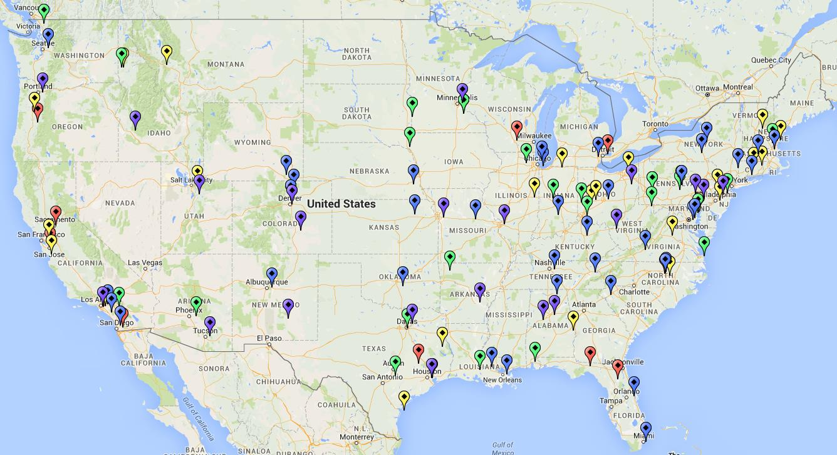
Science DMZ
Science DMZ deployments, U.S.

Slide 9
perfSONAR
The components of the Science DMZ can eventually fail
Networks and systems comprise many components that can experience bugs, misconfigurations, and other problems
Such problems result in total failure or the underutilization of resources

Slide 10
perfSONAR
These network issues are classified as:
Hard network failures: when a component stops working (e.g., fiber cut, power outage, hardware malfunction)
Soft network failures: performance issues that cause performance degradation (e.g., long delays and packet losses)
Hard network failures are easy to detect, whereas soft network failures can remain undetected for a long time

Slide 11
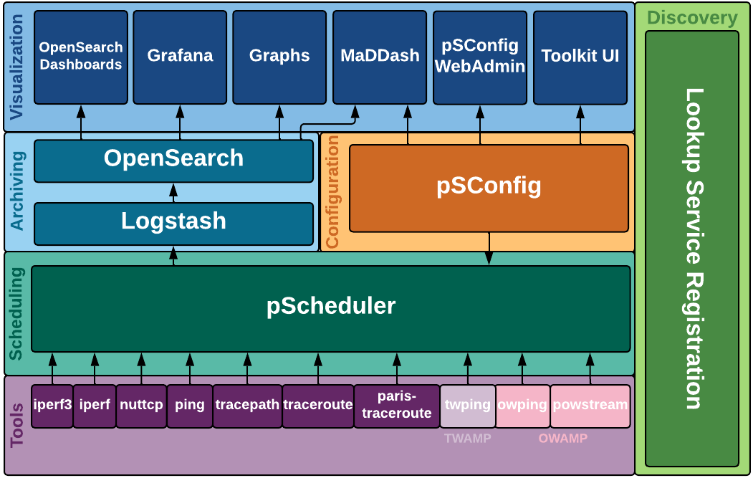
perfSONAR
perfSONAR is a network measurement tool designed to provide federated coverage of paths and help achieve end-to-end usage expectations
It facilitates diagnosing, visualizing, and troubleshooting network performance issues such as soft failures and hard failures
perfSONAR is a key component of the Science DMZ

Slide 12
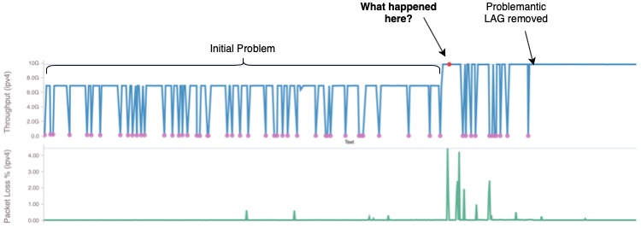
perfSONAR
perfSONAR consists of a suite of tools that facilitate running, storing, and visualizing network measurements
Network administrators can schedule regular tests and display them on a dashboard
perfSONAR provides information about network failures (where, when, what)
perfSONAR Use Cases. “Pan-STARRS Hawaii to Queen’s University Belfast.” [Online]. Available: https://tinyurl.com/3jjtypfr

Slide 13
Summary
The Science DMZ is an efficient approach to enable large data transfers
Such data transfers experience limitations over regular enterprise networks
Key elements of a Science DMZ: friction-free WAN path, DTNs, perfSONAR, security tailored for the Science DMZ
Problems may occur within a Science DMZ
perfSONAR offers the resources to visualize and troubleshoot network problems

Slide 14
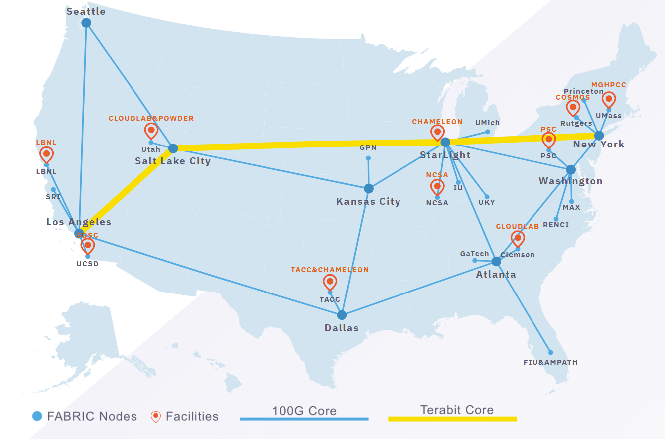
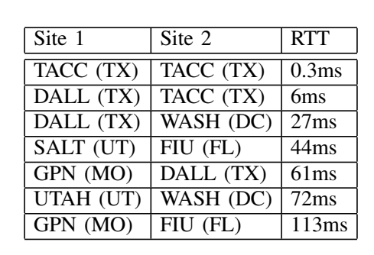
Additional Slides
BBR performance on FABRIC
Performance measurements for a single flow, 0.0046% packet loss rate

Slide 15
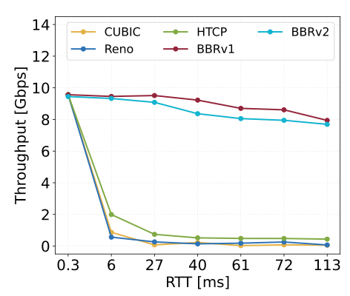
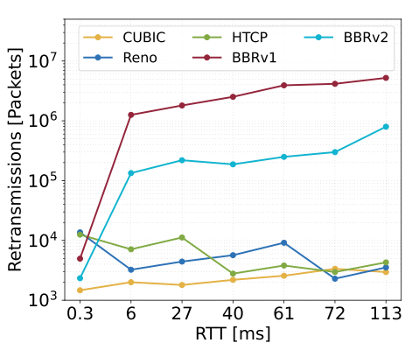
Additional Slides
BBR performance on FABRIC
Performance measurements for a single flow, 0.0046% packet loss rate

Slide 16
BDP
Bandwidth = 1Gbps
RTT = 30ms
BDP (bytes) = 3,750,000 bytes
BDP (MB) = 3.57MB

