Slide 1



Virtual Labs for Security and Next-generation Programmable Devices
Jorge Crichigno
University of South Carolina
https://research.cec.sc.edu/cyberinfra
Seminar at the University of South Florida
Tampa, Florida
Friday February 9, 2024

Slide 2
Agenda
Introduction and motivation for cybersecurity
Review “Cybersecurity Fundamentals” lab series
Describe a cyber-attack
  Infiltrate a victim’s machine using a Remote Access Trojan (RAT)
  Perform a malware attack (spyware)
  Collect keystrokes, monitors the victim’s camera, and record the victim’s microphone
Review “Intro to P4” lab series
Execute lab experiments / cyber-attacks (self-paced)

Slide 3
Introduction and motivation for cybersecurity

Slide 4
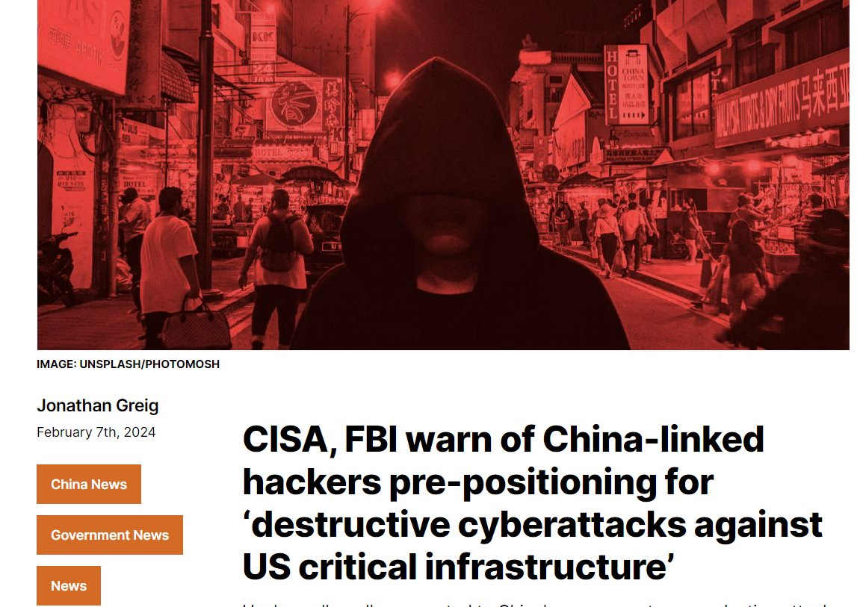
Introduction
Widespread attacks on desktops, laptops, smartphone, tablets, servers, etc.
Information security is focused on protecting electronic information of organizations and users

Slide 5
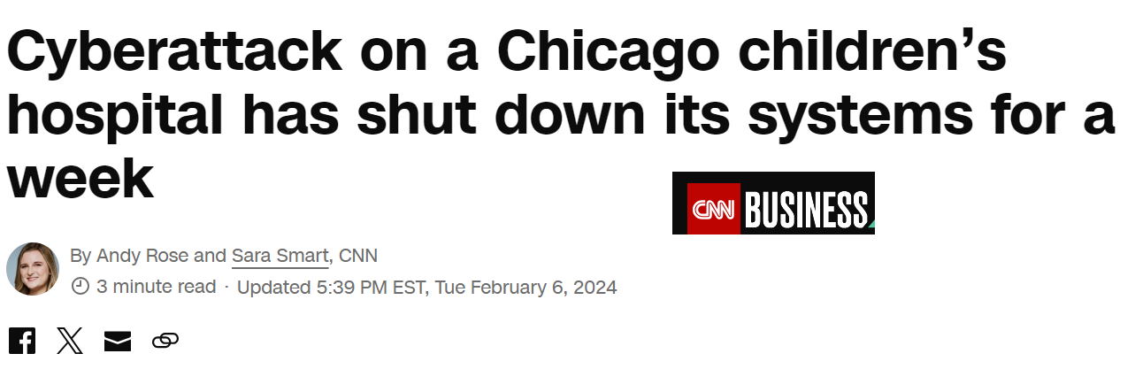
Introduction
Widespread attacks on desktops, laptops, smartphone, tablets, servers, etc.
Information security is focused on protecting electronic information of organizations and users

Slide 6
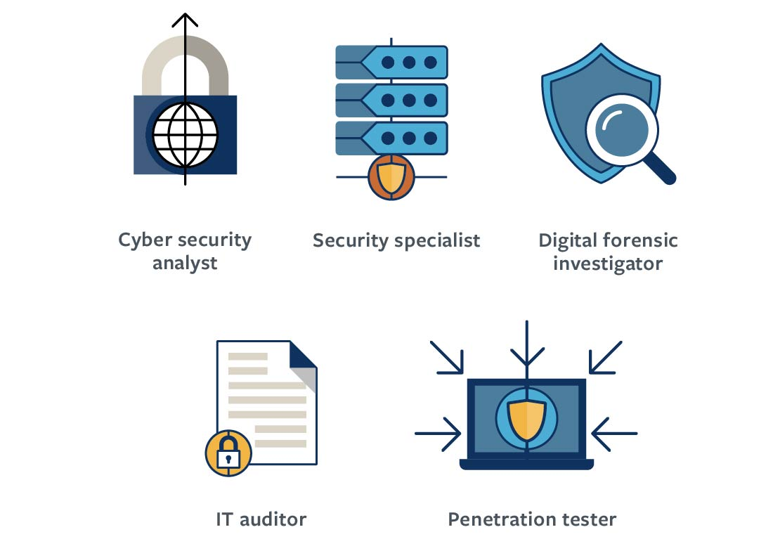
Information Security Employment
Security is rarely outsourced
U.S. Bureau of Labor Statistics (BLS)
  Job outlook for information security analysts through end of decade expected to grow by more than 32%, much faster than average

Slide 7
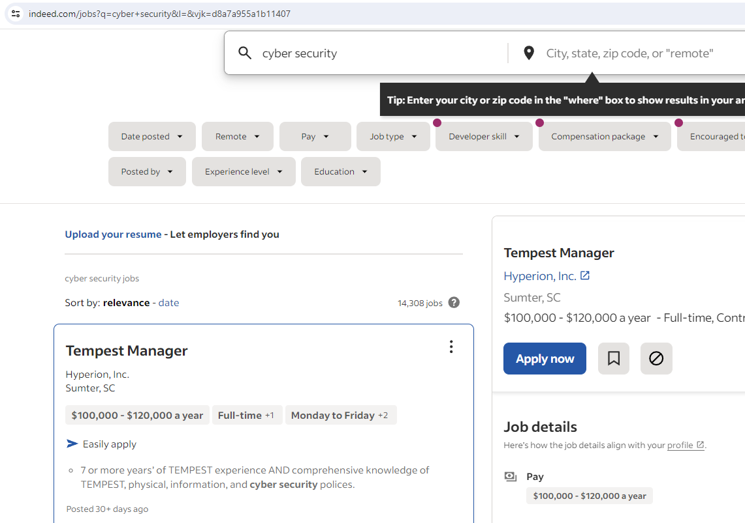
Information Security Employment
www.indeed.com

Slide 8
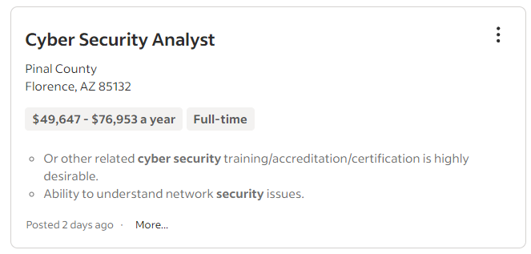
Information Security Employment
www.indeed.com

Slide 9
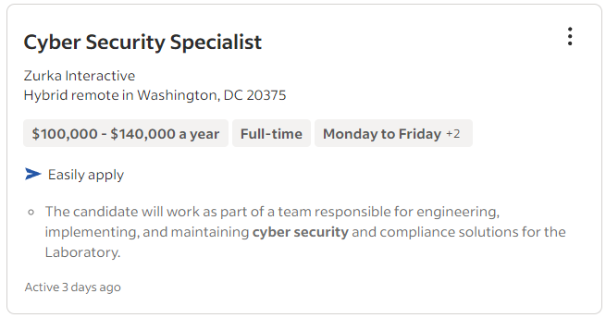
Information Security Employment
www.indeed.com

Slide 10
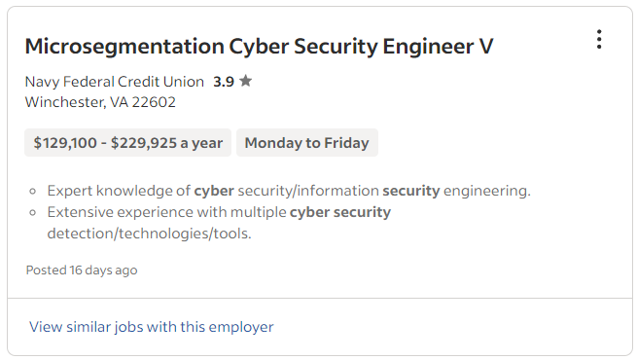
Information Security Employment
www.indeed.com

Slide 11
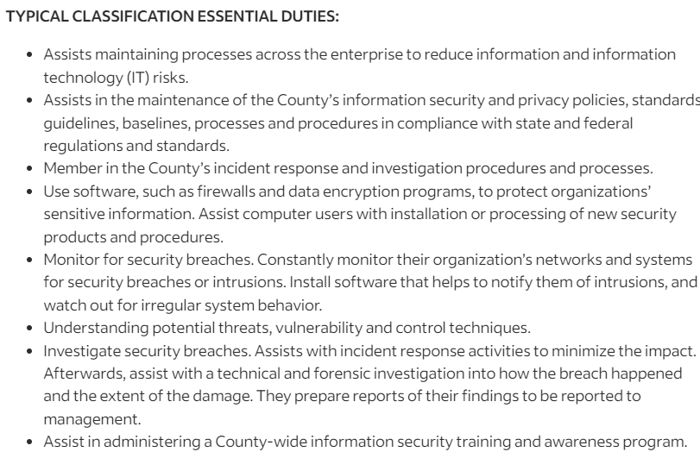
Information Security Employment
www.indeed.com

Slide 12
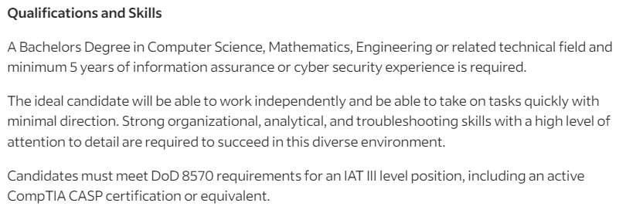
Information Security Employment
www.indeed.com

Slide 13
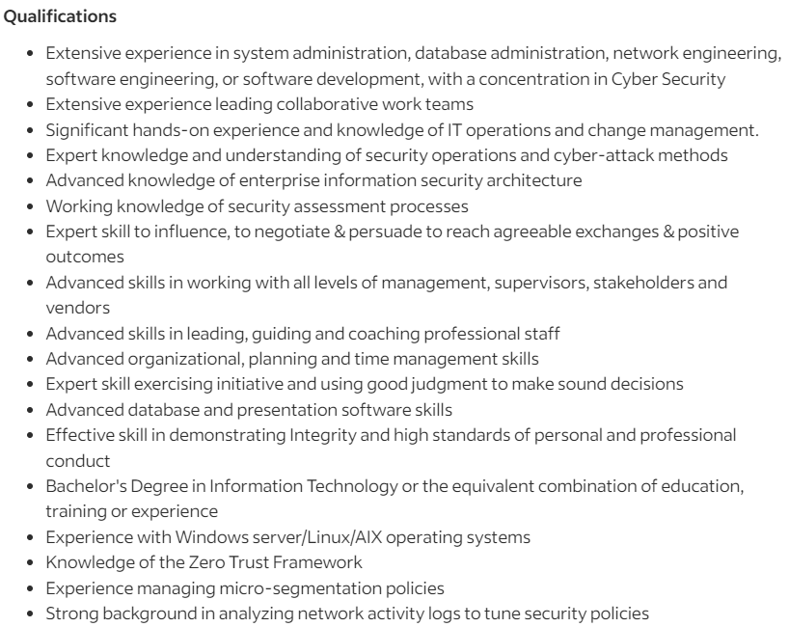
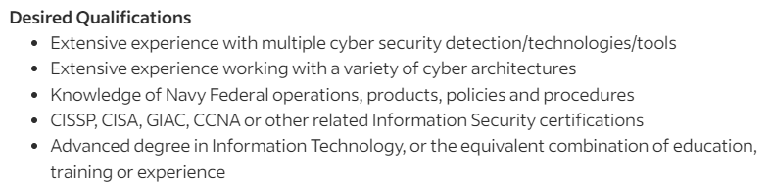
Information Security Employment
www.indeed.com

Slide 14
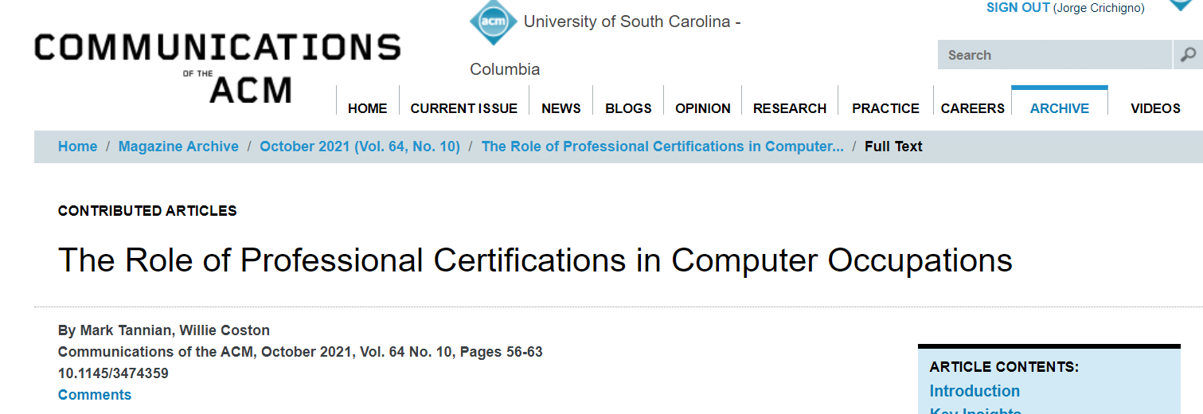
The Role of Professionals Certs in Comp. Occupations
1. M. Tannian, W. Coston, “The Role of Professional Certifications in Computer Occupations,” Communications of the ACM, Vol. 64, No. 10, October 2021.

Slide 15
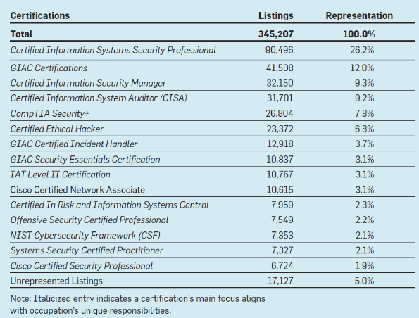
The Role of Professionals Certs in Comp. Occupations
Top 15 requested certs for Info Security Analysts (15-1212)
1. M. Tannian, W. Coston, “The Role of Professional Certifications in Computer Occupations,” Communications of the ACM, Vol. 64, No. 10, October 2021.

Slide 16
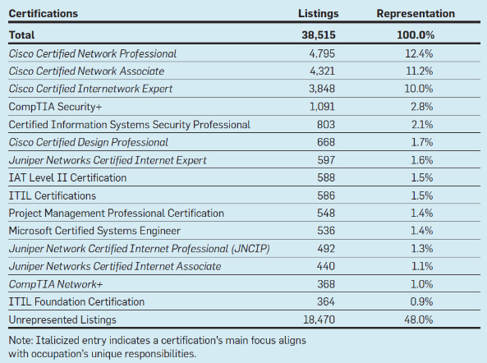
The Role of Professionals Certs in Comp. Occupations
Top 15 requested certs for Comp. Network Architects (15-1241)
1. M. Tannian, W. Coston, “The Role of Professional Certifications in Computer Occupations,” Communications of the ACM, Vol. 64, No. 10, October 2021.

Slide 17
The Role of Professionals Certs in Comp. Occupations
The U.S. job market indicates that the level of demand of certificates for ISA is over 95% (i.e., 95% of more than 345,000 job listings prefer professionals with industry certificates¹)
Similarly, the level of demand of certificates for CNA is 52% (i.e., 52% of more than 38,000 job listings prefer professionals with industry certificates¹)
ISA: Information Security Analyst
CNA: Computer Network Architect
1. M. Tannian, W. Coston, “The Role of Professional Certifications in Computer Occupations,” Communications of the ACM, Vol. 64, No. 10, October 2021.

Slide 18
Review “Cybersecurity Fundamentals” lab series

Slide 19
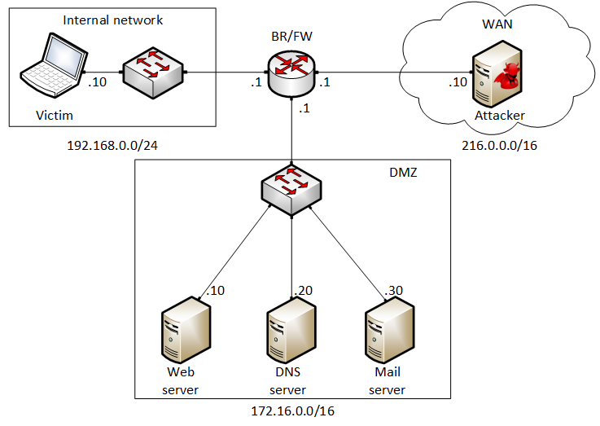
Cybersecurity Fundamentals - POD
Attacker in the WAN running Kali
Victim in the internal network running Windows 10
Web, DNS, and Mail servers in the DMZ zone
Border router interconnect the networks
Border router implements basic security policy:
  Attacker cannot initiate connections to devices in the internal network

Slide 20
Cybersecurity Fundamentals Lab Series
The labs provide learning experiences on cybersecurity topics
Lab 1: Reconnaissance: Scanning with NMAP, Vulnerability Assessment with OpenVAS
Lab 2: Remote Access Trojan (RAT) using Reverse TCP Meterpreter
Lab 3: Escalating Privileges and Installing a Backdoor
Lab 4: Collecting Information with Spyware: Screen Captures and Keyloggers
Lab 5: Social Engineering Attack: Credentials Harvesting and Remote Access through Phishing Emails
Lab 6: SQL Injection Attack on a Web Application
Lab 7: Cross-site Scripting (XSS) Attack on a Web Application
Lab 8: Denial of Service (DoS) Attacks: SYN/FIN/RST Flood, Smurf attack, and SlowLoris
Lab 9: Cryptographic Hashing and Symmetric Encryption
Lab 10: Asymmetric Encryption: RSA, Digital Signatures, Diffie-Hellman
Lab 11: Public Key Infrastructure: Certificate Authority, Digital Certificate
Lab 12: Configuring a Stateful Packet Filter using iptables
Lab 13: Online Dictionary Attack against a Login Webpage
Lab 14: Intrusion Detection and Prevention using Suricata
Lab 15: Packet Sniffing and Relay Attack
Lab 16: DNS Cache Poisoning
Lab 17: Man in the Middle Attack using ARP Spoofing
Lab 18: Understanding Buffer Overflow Attacks in a Vulnerable Application
Lab 19: Conducting Offline Password Attacks

Slide 21
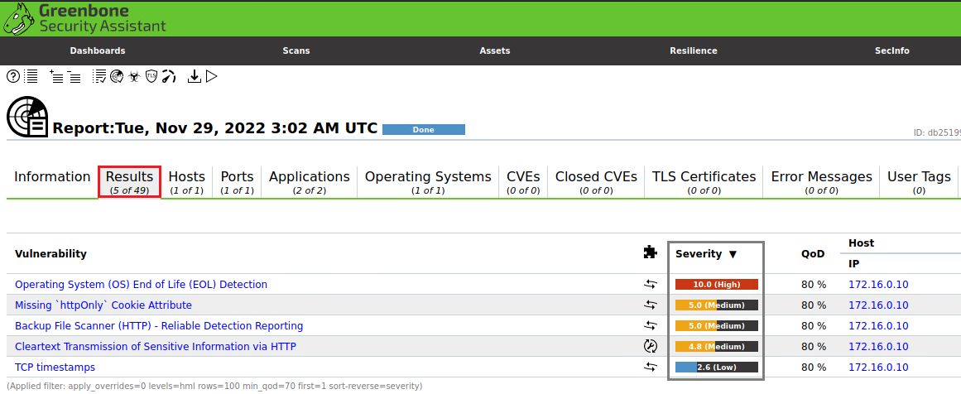
Examples
Vulnerability assessment using OpenVAS

Slide 22
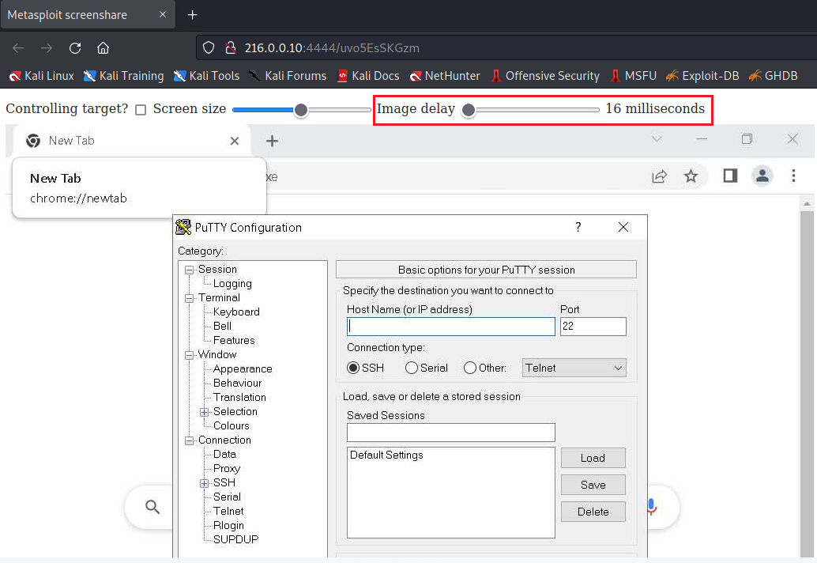
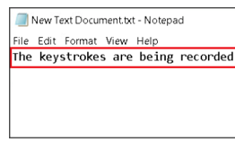
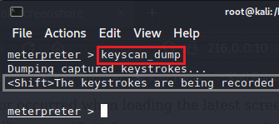
Examples
Keylogger
Deploying a Spyware
Victim
Attacker
Screen capture

Slide 23
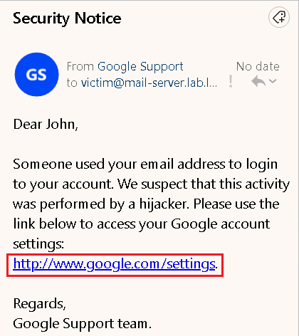
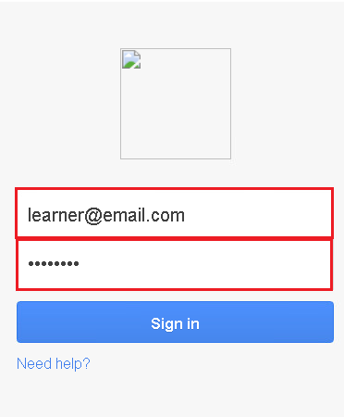
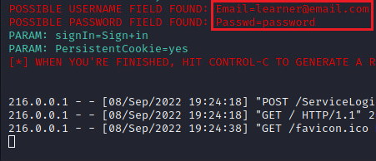
Examples
Social engineering and phishing emails
Victim
Attacker

Slide 24
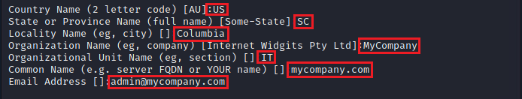
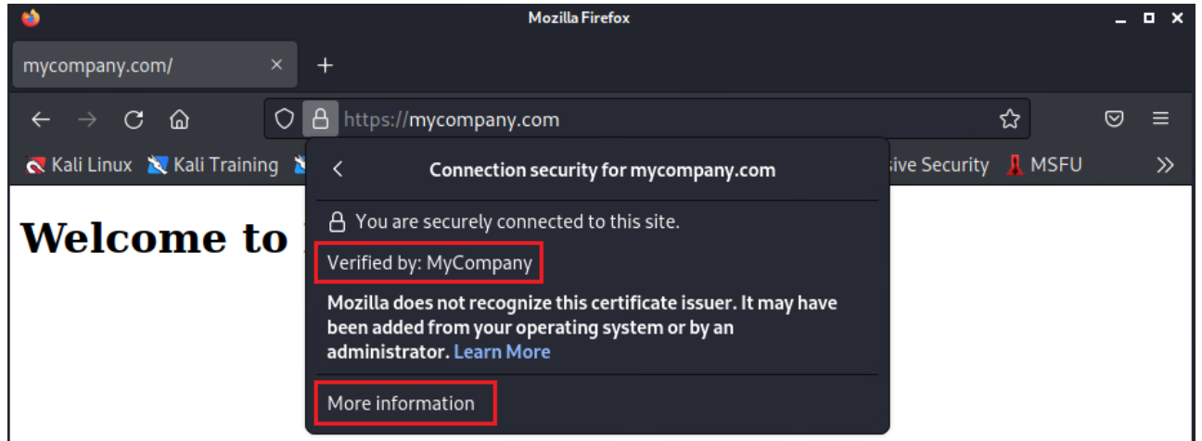
Examples
Creating a digital certificate and deploying it on an Apache web server
X.509 certificate
Certificate deployed on a production grade web server

Slide 25
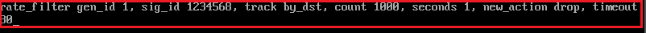
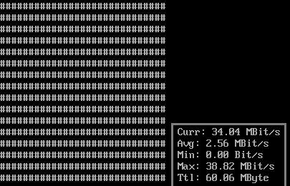
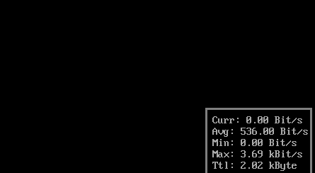
Examples
Detecting and blocking SYN Flood attack using Suricata IDS/IPS
Incoming rate before mitigation
Incoming rate after mitigation

Slide 26
Describe a cyber-attack

Slide 27
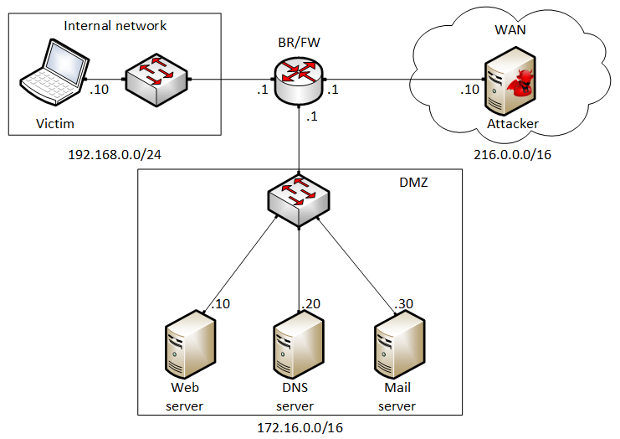
Typical Network Security Policy
Firewalls / border routers prevent an external device to communicate with an internal device
An internal device can initiate communication to an external device
If there is information that must be shared with an external user, the information is placed in the Demilitarized Zone (DMZ)

Slide 28
Spyware Example
The attacker creates a “payload” and attaches it to a valid program (for example, “putty.exe”)
The attacker uploads the program to his website
The attacker starts the “command and control server,” listening to incoming connection
The victim downloads the program
The victim executes the program
  The program starts
  At the same time, the malware connects to the attacker
The attacker starts the spyware
  Takes screen captures of the victim’s computer
  Transmits the view of the victim’s computer in real time
  Controls the victim’s computer
  Monitors the victim’s camera
  Monitors the victim’s microphone
  Records the keystrokes…

Slide 29
DEMO 1 – Spyware https://youtu.be/x_7jsXsn_YU

Slide 30
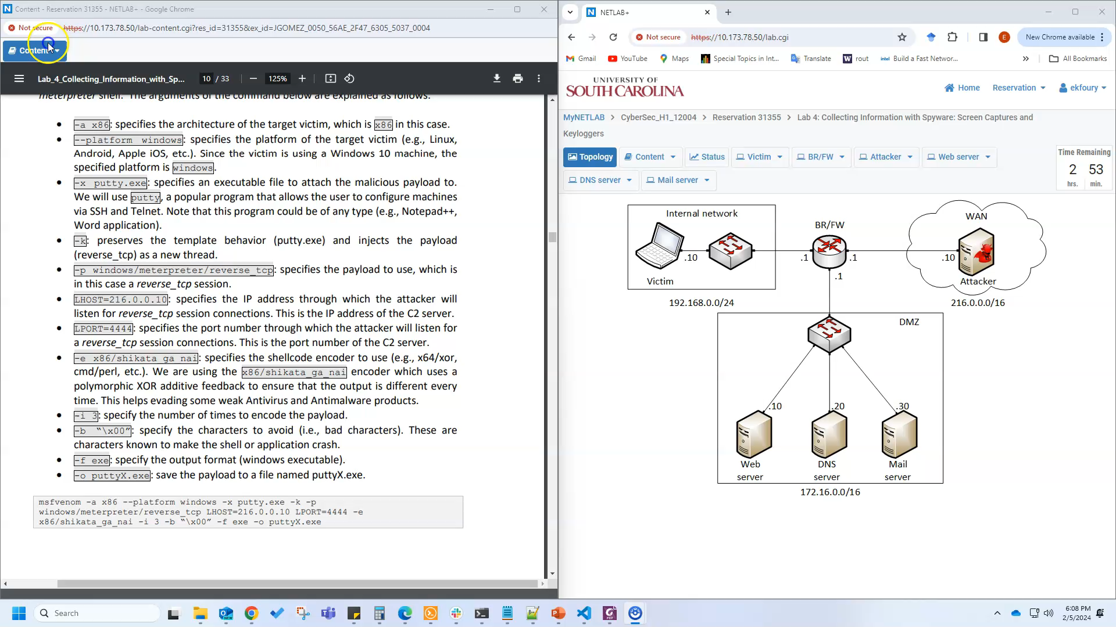
Demo

Slide 31
Review “Intro to P4” lab series

Slide 32
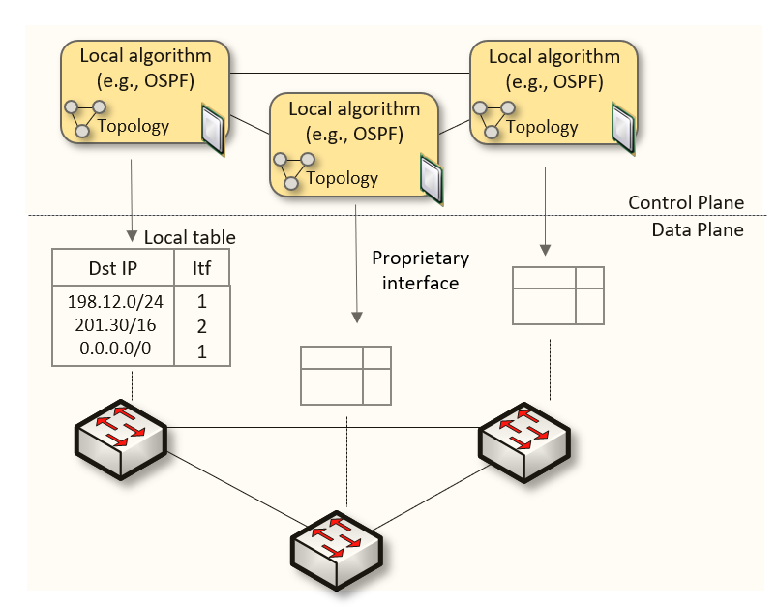
Traditional (Legacy) Networking
In “traditional” devices, the interface between the control plane and the data plane is proprietary
  No innovation from network owners
  A router is a monolithic unit built and internally accessed by the manufacturer only

Slide 33
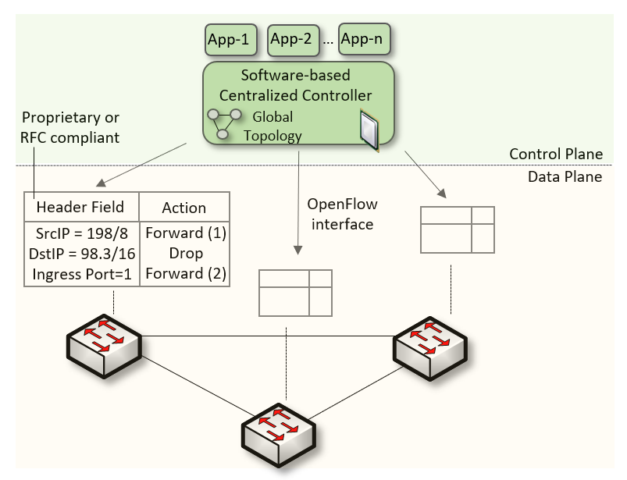
Software-defined Networking
SDN (1) explicitly separates the control and data planes, and (2) enables the control plane intelligence to be implemented as a software outside the switches
The function of populating the forwarding table is now performed by the controller

Slide 34
Software-defined Networking
SDN is limited to the OpenFlow specifications
  Forwarding rules are based on a fixed number of protocols / header fields (e.g., IP, Ethernet)
The data plane is designed with fixed functions (hard-coded)
  Functions are implemented by the chip designer

Slide 35
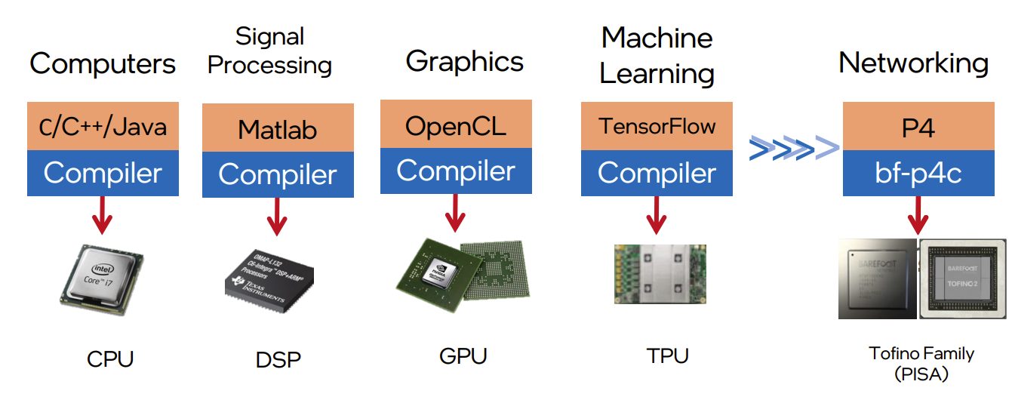
Can the Data Plane be Programmable?
Evolution of the computing industry
1970s 1970s-80s 1990s-2000s 2010s 2017
1. Vladimir Gurevich, “Introduction to P4 and Data Plane Programmability,” https://tinyurl.com/2p978tm9.
35

Slide 36
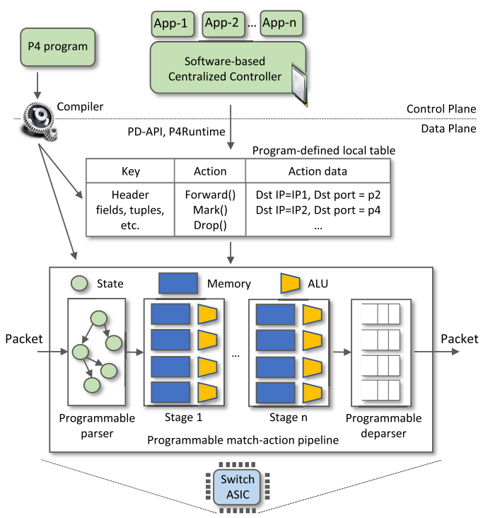
P4 Programmable Switches
P4¹ programmable switches permit a programmer to program the data plane
  Define and parse new protocols
  Customize packet processing functions
  Measure events occurring in the data plane with
  high precision
  Offload applications to the data plane
1. P4 stands for stands for Programming Protocol-independent Packet Processors
36

Slide 37
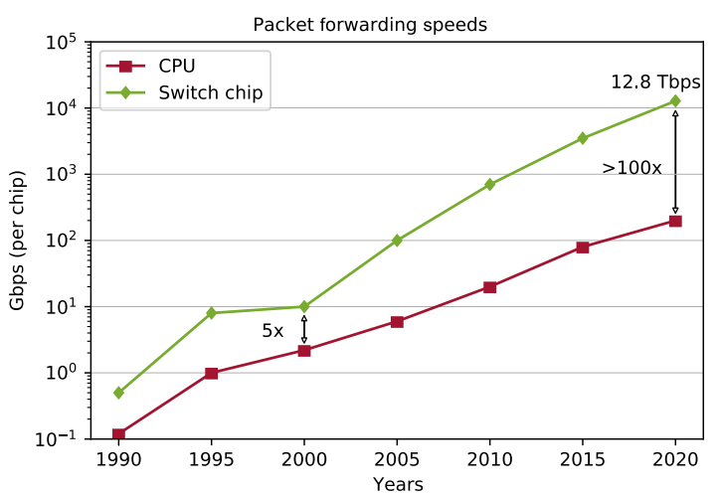
P4 Programmable Switches
P4¹ programmable switches permit a programmer to program the data plane
  Define and parse new protocols
  Customize packet processing functions
  Measure events occurring in the data plane with
  high precision
  Offload applications to the data plane
Reproduced from N. McKeown. Creating an End-to-End Programming Model for Packet Forwarding. Available: https://www.youtube.com/watch?v=fiBuao6YZl0&t=4216s
37

Slide 38
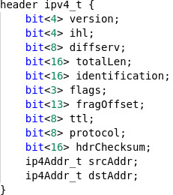
P4 Programmable Switches
P4 switches permit programmer to program the data plane
Add proprietary features; e.g., emulate RTP relay server
Parse packet headers, including UDP packets carrying RTP traffic
Header inspection, identifying media sessions using the 5-tuple
Modify fields, IP addresses and ports
38

Slide 39
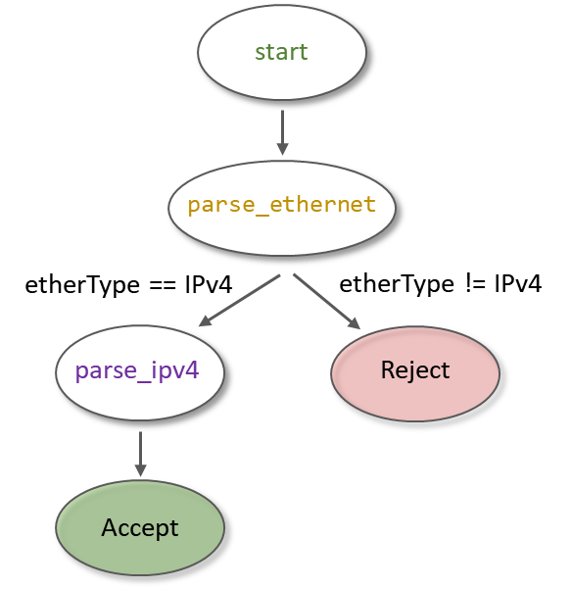
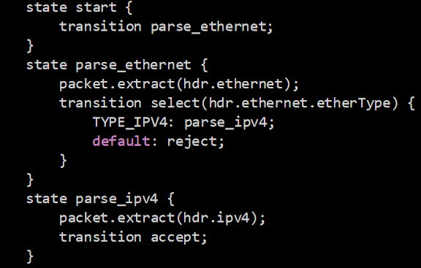
P4 Programmable Switches
P4 switches permit programmer to program the data plane
Add proprietary features; e.g., emulate RTP relay server
Parse packet headers, including UDP packets carrying RTP traffic
Header inspection, identifying media sessions using the 5-tuple
Modify fields, IP addresses and ports
39

Slide 40
P4 Programmable Switches
The relay server makes it possible for two devices behind NAT to connect with each other relays the RTP
RTP Information at relay server
Relay server
 | Device IP - port | Allocated IP - port
A | IP_{A’} - P_{A’} | IP_{R} - P_{RA}
B | IP_{B’} - P_{B’} | IP_{R} - P_{RB}
IP_{A’} - p_{A’}
IP_{B’} - p_{B’}
A
B
40

Slide 41
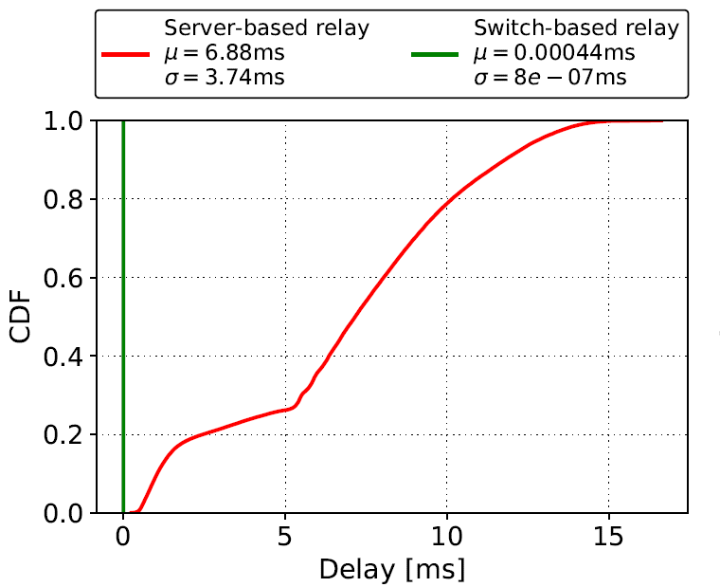
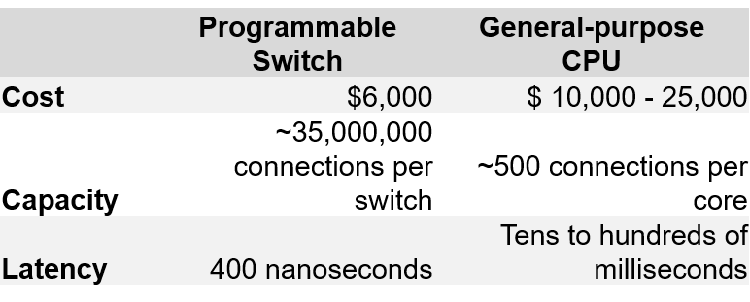
P4 Programmable Switches
P4 switches permit programmer to program the data plane
Add proprietary features; e.g., emulate RTP relay server
Parse packet headers, including UDP packets carrying RTP traffic
Header inspection, identifying media sessions using the 5-tuple
Modify fields, IP addresses and ports
Application example: media (voice) relay server
41

Slide 42
Library on Security Applications with P4

Slide 43
Security Applications with P4
These labs provide a hands-on experience on implementing cybersecurity applications on P4 programmable data planes
The lab library explains topics such as implementing stateful packet filters, devising mitigation schemes for TCP SYN flood, DNS amplification, and others
This library uses the BMv2 software switch (open source)

Slide 44
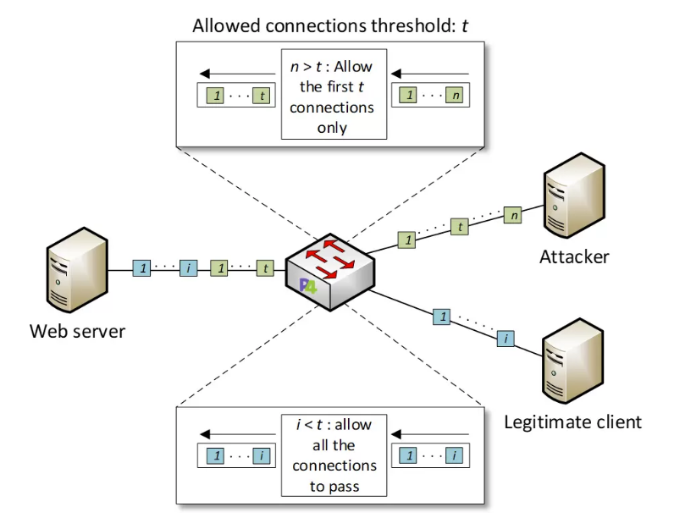
Security Applications with P4
Example: DoS detection

Slide 45
Library on Security Applications with P4
Experiments
Lab 1: Introduction to Mininet
Lab 2: Introduction to P4 and BMv2
Lab 3: P4 Program Building Blocks
Lab 4: Parser Implementation
Lab 5: Introduction to Match-action Tables
Lab 6: Implementing a Stateful Packet Filter for the ICMP protocol
Lab 7: Implementing a Stateful Packet Filter for the TCP protocol
Lab 8: Detecting and Mitigating the DNS Amplification Attack
Lab 9: Identifying Heavy Hitters using Count-min Sketches (CMS)
Lab 10: Limiting the Impact of SYN Flood by Probabilistically Dropping Packets
Lab 11: Blocking Application Layer Slow DDoS Attack (Slowloris)
Lab 12: Implementing URL Filtering through Deep Packet Inspection and String Matching

Slide 46
P4 Programmable Data Plane Switches based on Intel’s Tofino Chip

Slide 47
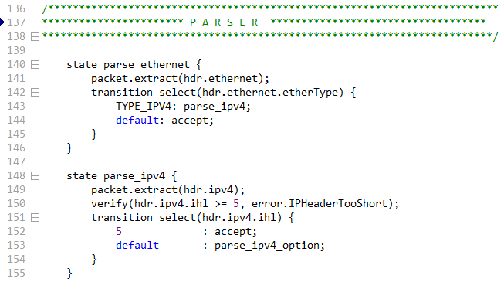
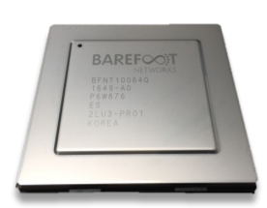
P4 PDP Switches based on Intel’s Tofino Chip
These labs provide a hands-on experience on P4 programming running on a production chip
The lab library describes the architecture of the “Tofino” chip, the software development environment (SDE), and how to use them
The lab library presents several real examples
Programmable chip
P4 code

Slide 48
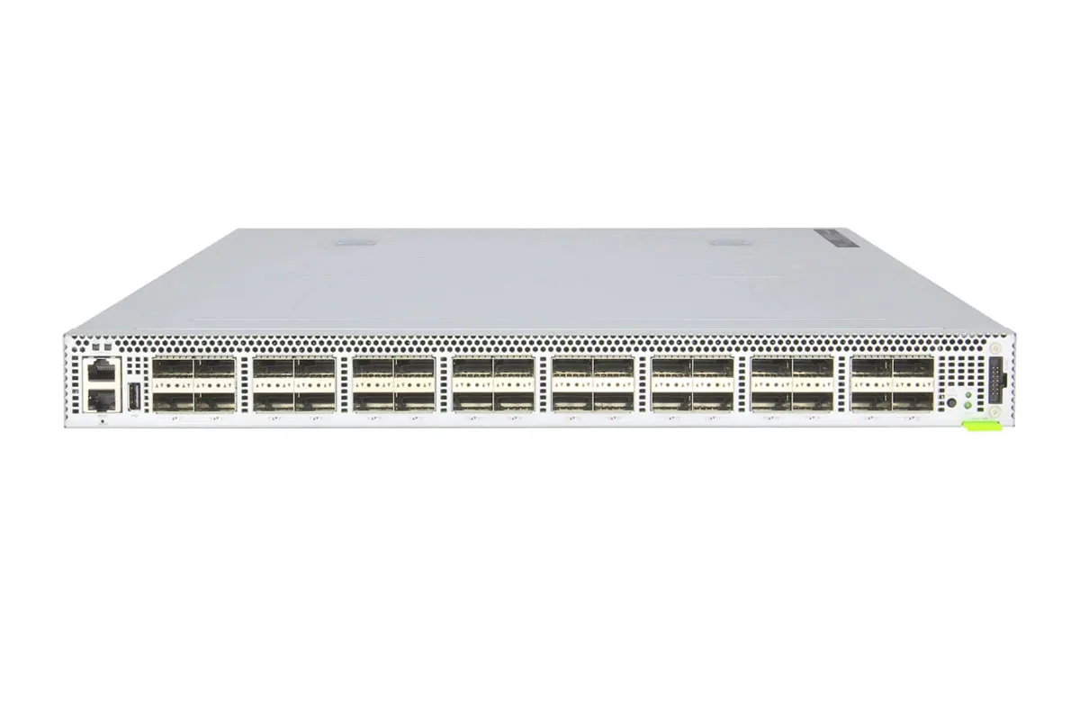
P4 PDP Switches based on Intel’s Tofino Chip
The switch model is Wedge 100BF-32X from Edgecore
This switch has 32 x 100G QSFP28 switch ports

Slide 49
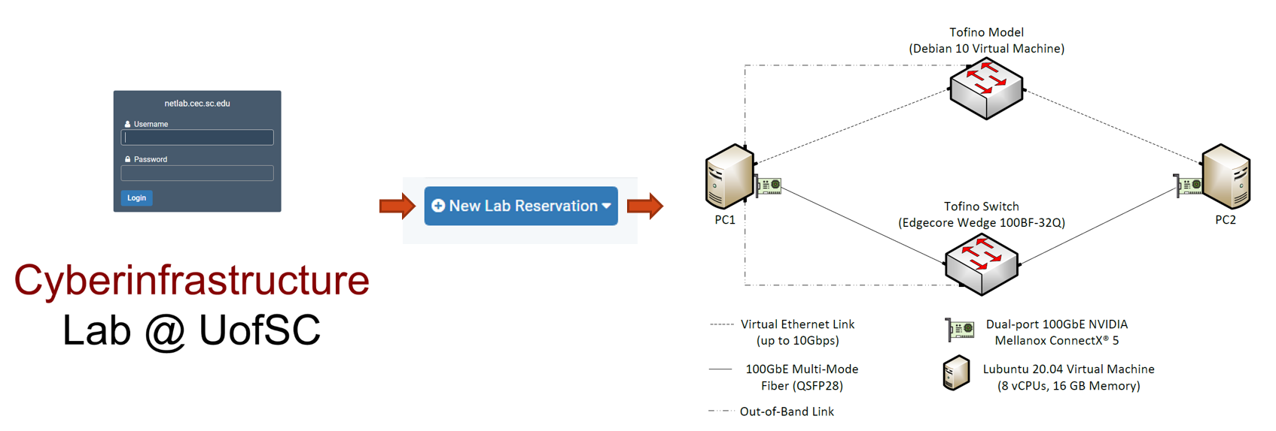
P4 PDP Switches based on Intel’s Tofino Chip
POD design

Slide 50
P4 PDP Switches based on Intel’s Tofino Chip
Lab experiments
Exercises
Lab 1: Introduction to P4 and BMv2
Lab 2: P4 Program Building Blocks
Lab 3: Parser Implementation
Lab 4: Introduction to Match-action Tables (Part 1)
Lab 5: Introduction to Match-action Tables (Part 2)
Lab 6: Populating and Managing Match-action Tables
Lab 7: Checksum Recalculation and Packet Deparsing
Exercise 1: Compiling and Testing a P4 Program
Exercise 2: Parsing UDP and RTP
Exercise 3: Building a Simplified NAT
Exercise 4: Configuring Tables at Runtime
Exercise 5: Building a Packet Reflector

Slide 51
DEMO 2 – High-resolution Measurements https://youtu.be/cWaWxsqVAgc

Slide 52

P4 PDP Switches based on Intel’s Tofino Chip - Demo

Slide 53
DEMO 3 – DoS https://youtu.be/EGQHUdrQ80M

Slide 54
P4 PDP Switches based on Intel’s Tofino Chip - Demo

Slide 55
P4 PDP Switches based on Intel’s Tofino Chip
Lab experiments
Exercises
Lab 1: Introduction to P4 and BMv2
Lab 2: P4 Program Building Blocks
Lab 3: Parser Implementation
Lab 4: Introduction to Match-action Tables (Part 1)
Lab 5: Introduction to Match-action Tables (Part 2)
Lab 6: Populating and Managing Match-action Tables
Lab 7: Checksum Recalculation and Packet Deparsing
Exercise 1: Compiling and Testing a P4 Program
Exercise 2: Parsing UDP and RTP
Exercise 3: Building a Simplified NAT
Exercise 4: Configuring Tables at Runtime
Exercise 5: Building a Packet Reflector

Slide 56
Other P4 Libraries

Slide 57
Introduction to P4 Lab Series
Lab Experiments
  Lab 1: Introduction to Mininet
  Lab 2: Introduction to P4 and BMv2
  Lab 3: P4 Program Building Blocks
  Lab 4: Parser Implementation
  Lab 5: Introduction to Match-action Tables (Part 1)
  Lab 6: Introduction to Match-action Tables (Part 2)
  Lab 7: Populating and Managing Match-action Tables
  Lab 8: Checksum Recalculation and Packet Deparsing
Lab Exercises
  Exercise 1: Building a Basic Topology
  Exercise 2: Compiling and Testing a P4 Program
  Exercise 3: Parsing UDP and RTP
  Exercise 4: Building a Simplified NAT
  Exercise 5: Configuring Tables at Runtime
  Exercise 6: Building a Packet Reflector

Slide 58
Execute lab experiments / cyber-attacks (self-paced)

Slide 59
Access to Virtual Labs
Slides:
https://research.cec.sc.edu/cyberinfra/seminar-february-2024
Virtual lab libraries:
http://ce.sc.edu/cyberinfra/cybertraining.html

Slide 60
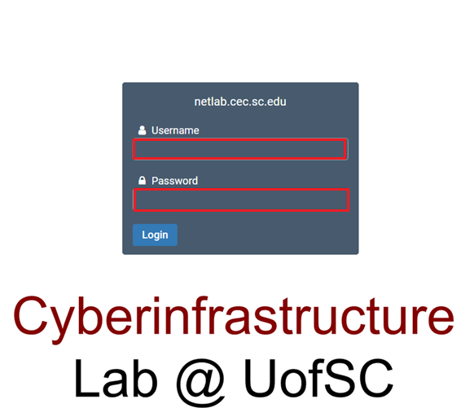
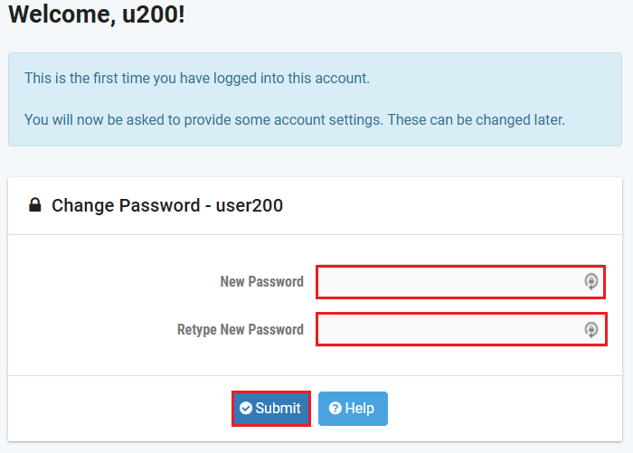
Accessing the Platform
Please use the following link to access the platform:
  https://netlab.cec.sc.edu/
Login using the following credentials:
Username: usf_user1, usf_user2, …., usf_user40
Temporary Password:

Slide 61
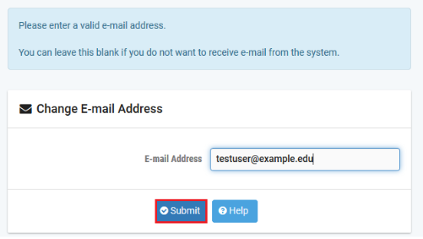
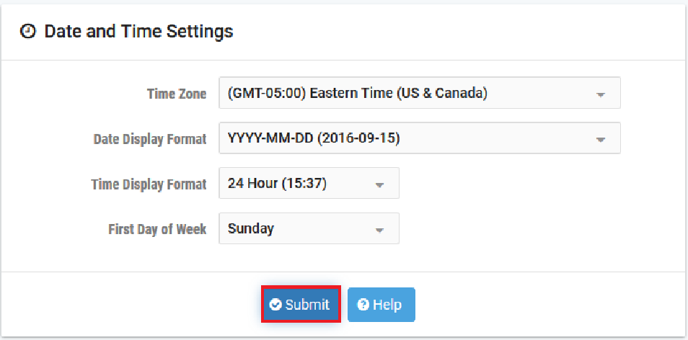
Accessing the Platform
Please use the following link to access the platform:
  https://netlab.cec.sc.edu/
Login using the following credentials:
Username: usf_user1, usf_user2, …., usf_user40
Temporary Password:

Slide 62
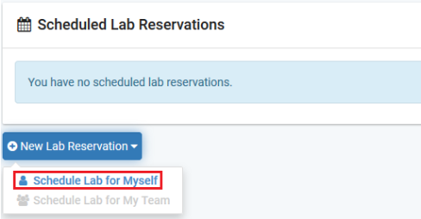
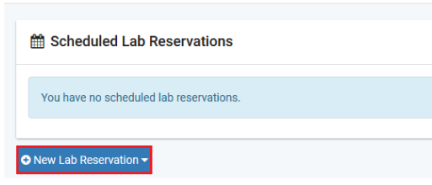
Accessing the Platform
Click on New Lab Reservation
Click on Schedule Lab for Myself

Slide 63

Accessing the Platform
Select the course
For this session, we will use “Cybersecurity Fundamentals”

Slide 64

Accessing the Platform
Select the Lab
For this session, we will run:
  Lab 4: Collecting Information with Spyware: Screen Captures and Keyloggers

Slide 65


Accessing the Platform
Select the next available POD and allocate time

Slide 66
Accessing the Platform
We will use the NETLAB virtual platform:
URL: https://netlab.cec.sc.edu/
Username: usf_user1, usf_user2, …., usf_user40
Temporary Password:

