Slide 1
SoX Virtual Training Workshop
Hands-on Session 2: perfSONAR Monitoring and Debugging Dashboard (MaDDash)
Jorge Crichigno, Jose Gomez
University of South Carolina
http://ce.sc.edu/cyberinfra
Southern Crossroads (SoX)
The Engagement and Performance Operations Center (EPOC)
National Science Foundation (NSF)
University of South Carolina (USC)
Online
March 22nd, 2023

Slide 2
SoX Virtual Training Workshop
Webpage with PowerPoint presentations:
http://ce.sc.edu/cyberinfra/sox_workshop_2023.html
Hands-on sessions: to access labs for the hands-on sessions, use the following link:
https://netlab.cec.sc.edu/
Username: email used for registration
Password: nsf2023

Slide 3
perfSONAR Lab Series
Lab experiments
Lab 1: Configuring Admin. Information Using perfSONAR Toolkit GUI
Lab 2: PerfSONAR Metrics and Tools
Lab 3: Configuring Regular Tests Using perfSONAR GUI
Lab 4: Configuring Regular Tests Using pScheduler CLI Part I
Lab 5: Configuring Regular Tests Using pScheduler CLI Part II
Lab 6: Bandwidth-delay Product and TCP Buffer Size
Lab 7: Configuring Regular Tests Using a pSConfig Template
Lab 8: perfSONAR Monitoring and Debugging Dashboard
Lab 9: pSConfig Web Administrator
Lab 10: Configuring pScheduler Limits

Slide 4
Organization of the Lab Manuals
Each lab starts with a section Overview
Objectives
Lab topology
Lab settings: passwords, device names
Roadmap: organization of the lab
Section 1
Background information of the topic being covered (e.g., fundamentals of perfSONAR)
Section 1 is optional (i.e., the reader can skip this section and move to lab directions)
Section 2… n
Step-by-step directions

Slide 5
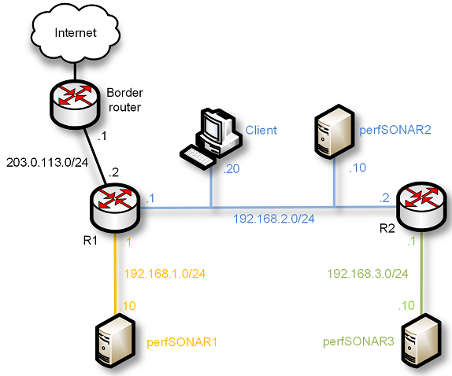
Pod Design
perfSONAR Toolkit + Central Management
PWA
perfSONAR Toolkit
perfSONAR installation options

Slide 6
Lab 8: perfSONAR Monitoring and Debugging Dashboard (MaDDash)

Slide 7
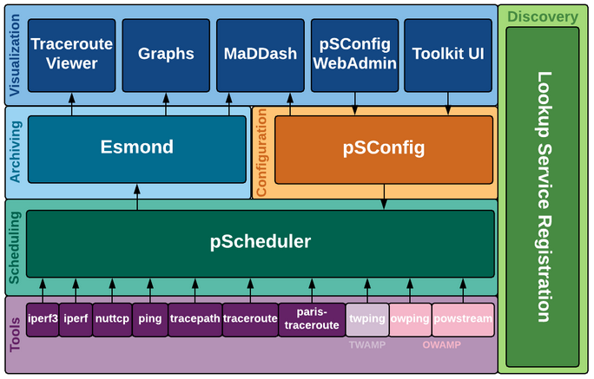
MaDDash
MaDDash display the result of regular tests (i.e., throughput, latency, loss, and traceroute) in a dashboard
Lab topology
perfSONAR layers

Slide 8
MaDDash
The user configures MaDDash through the Client machine
Lab topology
Results displayed with MaDDash

