Slide 1
Connecting Remote Sites Securely using
IPSec Virtual Private Network and Next-generation Firewalls
Nathan Bohmer, Josue Hernandez
Advisor: Jorge Crichigno
Department of Integrated Information Technology
University of South Carolina
December 2020

Slide 2
Agenda
Introduction
Problem description
Background information
Next-generation Firewalls (NGFWs)
IPSec Virtual Private Networks (VPNs)
Proposed solution and implementation
Conclusion

Slide 3
Introduction
Secure, encrypted, and private data transmission is important when connecting between two separate sites
Virtual Private Networks or VPNs are used to achieve this
IPSec Protocol is one method for making site-to-site VPNs
The Office of Naval Research and Integrated Information Technology’s project is the framework for why this project is being conducted
Creating coursework to train the next generation of cyber security professionals

Slide 4
Problem Description
Connecting two sites to one another directly is a common practice
Data transmission between two sites needs to be secure, encrypted, and private
Configuring a functioning Virtual Private Network with the IPSec Protocol
Testing the Virtual Private Network utilizing the IPSec Protocol

Slide 5
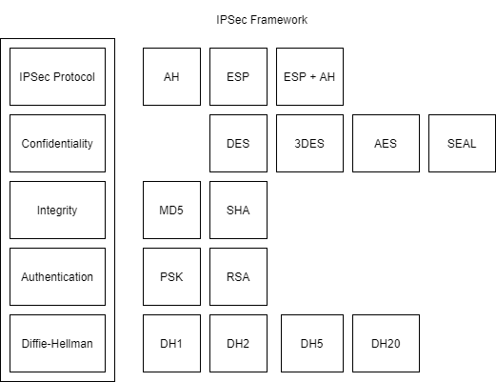
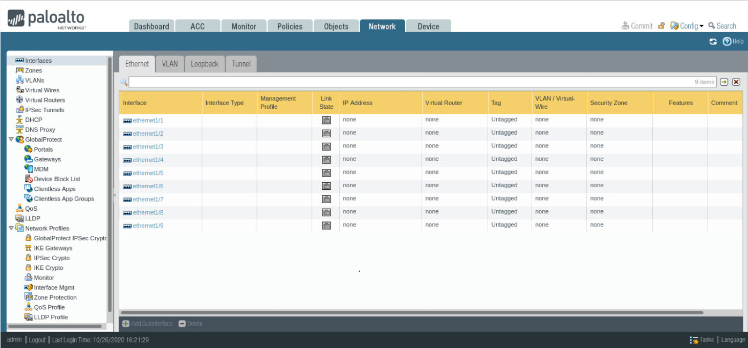
Background Information
Next-Generation Firewalls (NGFWs)
IPSec Protocol components
IPSec VPN Testing

Slide 6
Proposed Solution and Implementation
Develop a VPN using IPSec to connect two sites to one another through an IPSec tunnel
Utilize IPSec components to configure the tunnel
Develop a lab manual with the concept and configuration of the IPSec tunnel and testing its effectiveness.

Slide 7
Conclusion
Why is this work important?
Future projects/concepts with this knowledge
Questions?

