Slide 1
DMZ Exercises
TCP Congestion Control, Buffer Sizing
Elie Kfoury, Jorge Crichigno
University of South Carolina
2021 NSF Campus Cyberinfrastructure (CC*) Workshop
April 15, 2021

Slide 2
Content
NTP lab series
Organization of lab manuals
Exercise 1: TCP congestion control
Exercise 2: Buffer sizing

Slide 3
NTP Lab Series
The lab series provides learners an emulated WAN infrastructure operating at high speeds and devices running real protocol stacks
It helps students to acquire hands-on skills on
Performance and measurement tools
Configuration of devices for high-speed networks
Emulate scenarios using real protocol stacks

Slide 4
NTP Lab Series
The lab series can be partitioned into three parts
Measurement (throughput, latency, packet loss) and emulation (link bandwidth, buffer size, delay) tools
TCP features for high-speed transfers, router buffer size
Active Queue Management (AQM) algorithms

Slide 5
NTP Lab Series
Lab experiments
Lab 1: Introduction to Mininet
Lab 2: Introduction to iPerf
Lab 3: WANs with latency, Jitter
Lab 4: WANs with Packet Loss, Duplication, Corruption
Lab 5: Setting WAN Bandwidth with Token Bucket Filter (TBF)
Lab 6: Traditional TCP Congestion Control (HTCP, Cubic, Reno)
Lab 7: Rate-based TCP Congestion Control (BBR)
Lab 8: Bandwidth-delay Product and TCP Buffer Size
Lab 9: Enhancing TCP Throughput with Parallel Streams
Lab 10: Measuring TCP Fairness
Lab 11: Router’s Buffer Size
Lab 12: TCP Rate Control with Pacing
Lab 13: Impact of Maximum Segment Size on Throughput
Lab 14: Router’s Bufferbloat
Lab 15: Hardware Offloading on TCP Performance
Lab 16: Random Early Detection
Lab 17: Stochastic Fair Queueing
Lab 18: Controlled Delay (CoDel) Active Queue Management
Lab 19: Proportional Integral Controller-Enhanced (PIE)
Lab 20: Classifying TCP traffic using Hierarchical Token Bucket (HTB)

Slide 6
Organization of Lab Manuals
Each lab starts with a section Overview
Objectives
Lab settings: passwords, device names
Roadmap: organization of the lab
Section 1
Background information of the topic being covered (e.g., fundamentals of TCP congestion control)
Section 1 is optional (i.e., the reader can skip this section and move to lab directions)
Section 2… n
Step-by-step directions

Slide 7
Exercise 1: TCP Congestion Control

Slide 8
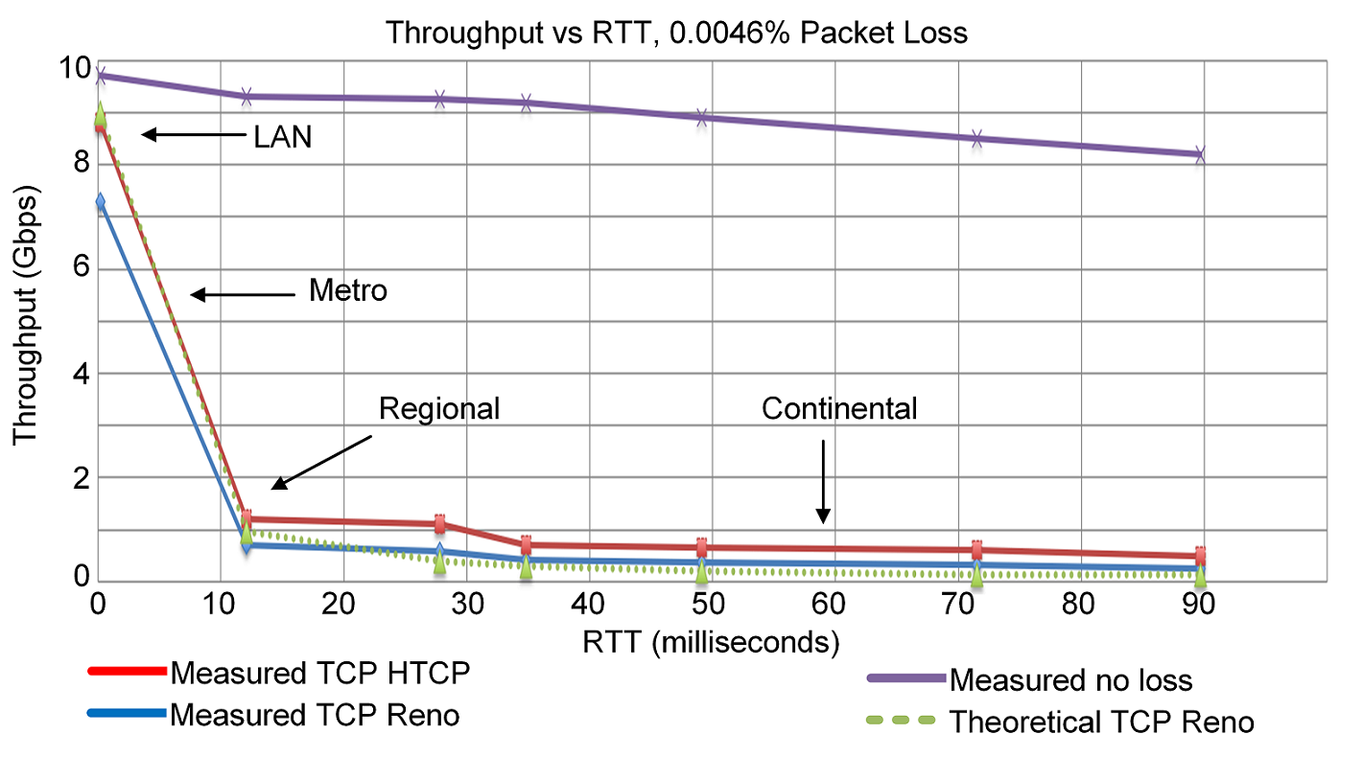
TCP Traditional Congestion Control
The principles of window-based CC were described in the 1980s¹
Traditional CC algorithms follow the additive-increase multiplicative-decrease (AIMD) form of congestion control
1. V. Jacobson, M. Karels, Congestion avoidance and control, ACM SIGCOMM Computer Communication Review 18 (4) (1988).

Slide 9
BBR: Model-based CC
TCP Bottleneck Bandwidth and RTT (BBR) is a rate-based congestion-control algorithm¹
BBR represented a disruption to the traditional CC algorithms:
is not governed by AIMD control law
does not the use packet loss as a signal of congestion
At any time, a TCP connection has one slowest link bottleneck bandwidth (btlbw)
1. N. Cardwell et al. "BBR v2, A Model-based Congestion Control." IETF 104, March 2019.

Slide 10
Lab Goal and Topology
Modify the TCP congestion control algorithm in Linux using sysctl tool
Deploy emulated WANs in Mininet
Compare the performance of TCP Reno and TCP BBR in high-throughput high-latency networks
Lab topology:

Slide 11
TCP Buffer Size
In many WANs, the round-trip time (RTT) is dominated by the propagation delay
To keep the sender busy while ACKs are received, the TCP buffer must be:
Traditional congestion controls:
BBRv1 and BBRv2:
TCP buffer size ≥ 2BDP
TCP buffer size must be considerable larger than 2BDP

Slide 12
Exercise 2: Buffer Sizing

Slide 13
Buffer Size
The router’s buffer plays an important role in absorbing traffic fluctuations
Buffers avoid losses by momentarily buffering packets as transitory bursts dissipate

Slide 14
Buffer Size
The rule of thumb has been that the amount of buffering (in bits) in a router’s port should equal the RTT (in seconds) multiplied by the capacity C (in bits per seconds) of the port¹:
Router’s buffer size = C ⋅ RTT
C. Villamizar, C. Song, “High performance TCP in ansnet,” ACM Computer Communications Review, vol. 24, no. 5, pp. 45-60, Oct. 1994.

Slide 15
Buffer Size
The rule of thumb has been that the amount of buffering (in bits) in a router’s port should equal the RTT (in seconds) multiplied by the capacity C (in bits per seconds) of the port¹:
When there is a large number of TCP flows passing through a link, say N, the amount of buffering can be reduced to²:
Router’s buffer size = C ⋅ RTT
Router’s buffer size = C ⋅ RTT / √ (N)
C. Villamizar, C. Song, “High performance TCP in ansnet,” ACM Computer Communications Review, vol. 24, no. 5, pp. 45-60, Oct. 1994.
G. Appenzeller, I. Keslassy, N. McKeown, “Sizing router buffers,” in Proceedings of the 2004 conference on Applications, technologies, architectures, and protocols for computer communications, pp. 281-292, Oct. 2004.

Slide 16
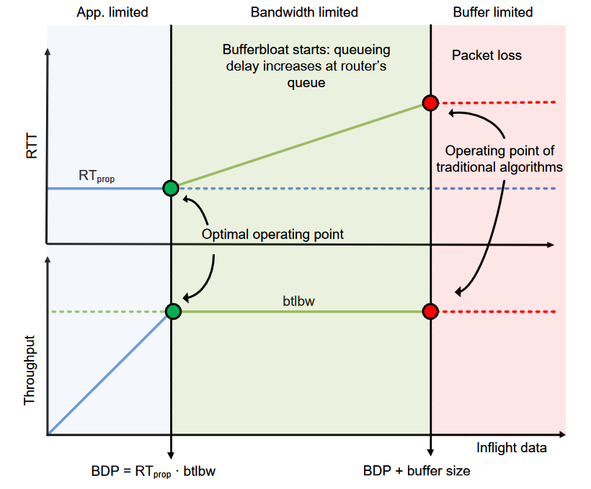
Bufferbloat
Bufferbloat is a condition that occurs when the router buffers too much data, leading to excessive delays
N. Cardwell, Y. Cheng, C. Gunn, S. Yeganeh, V. Jacobson, “BBR: congestion-based congestion control,” Communications of the ACM, vol 60, no. 2, pp. 58-66, Feb. 2017.

Slide 17
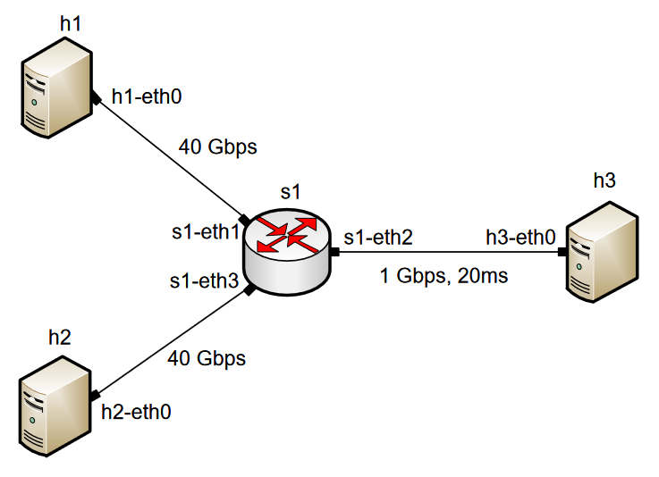
Lab Goal and Topology
Understand the buffering process in a router and buffer sizing
Explain the concept of Bufferbloat
Modify routers’ buffer size to solve the bufferbloat problem
Lab topology:

