Slide 1
“Teaming Together on Information Security and National Defense Research”
Defense Innovation Board
Georgia Cyber Center
November 20, 2019
Jorge Crichigno
Department of Integrated Information Technology
University of South Carolina
Columbia, SC

Slide 2
University of South Carolina
Contact Information
  Jorge Crichigno, Associate Professor
  Department of Integrated Information Technology (IIT)
  University of South Carolina (UofSC)
  jcrichigno@cec.sc.edu
Departmental Information
  Bachelor of Science in IIT
  Networks, cyber, business aspects, web, cloud, programming, HCI
  ABET accredited
  Minor in IIT, advisement tracks
    Cyberoperations
    IT Business Operations
    Databases
    Web
    Project Management
    Networks

Slide 3

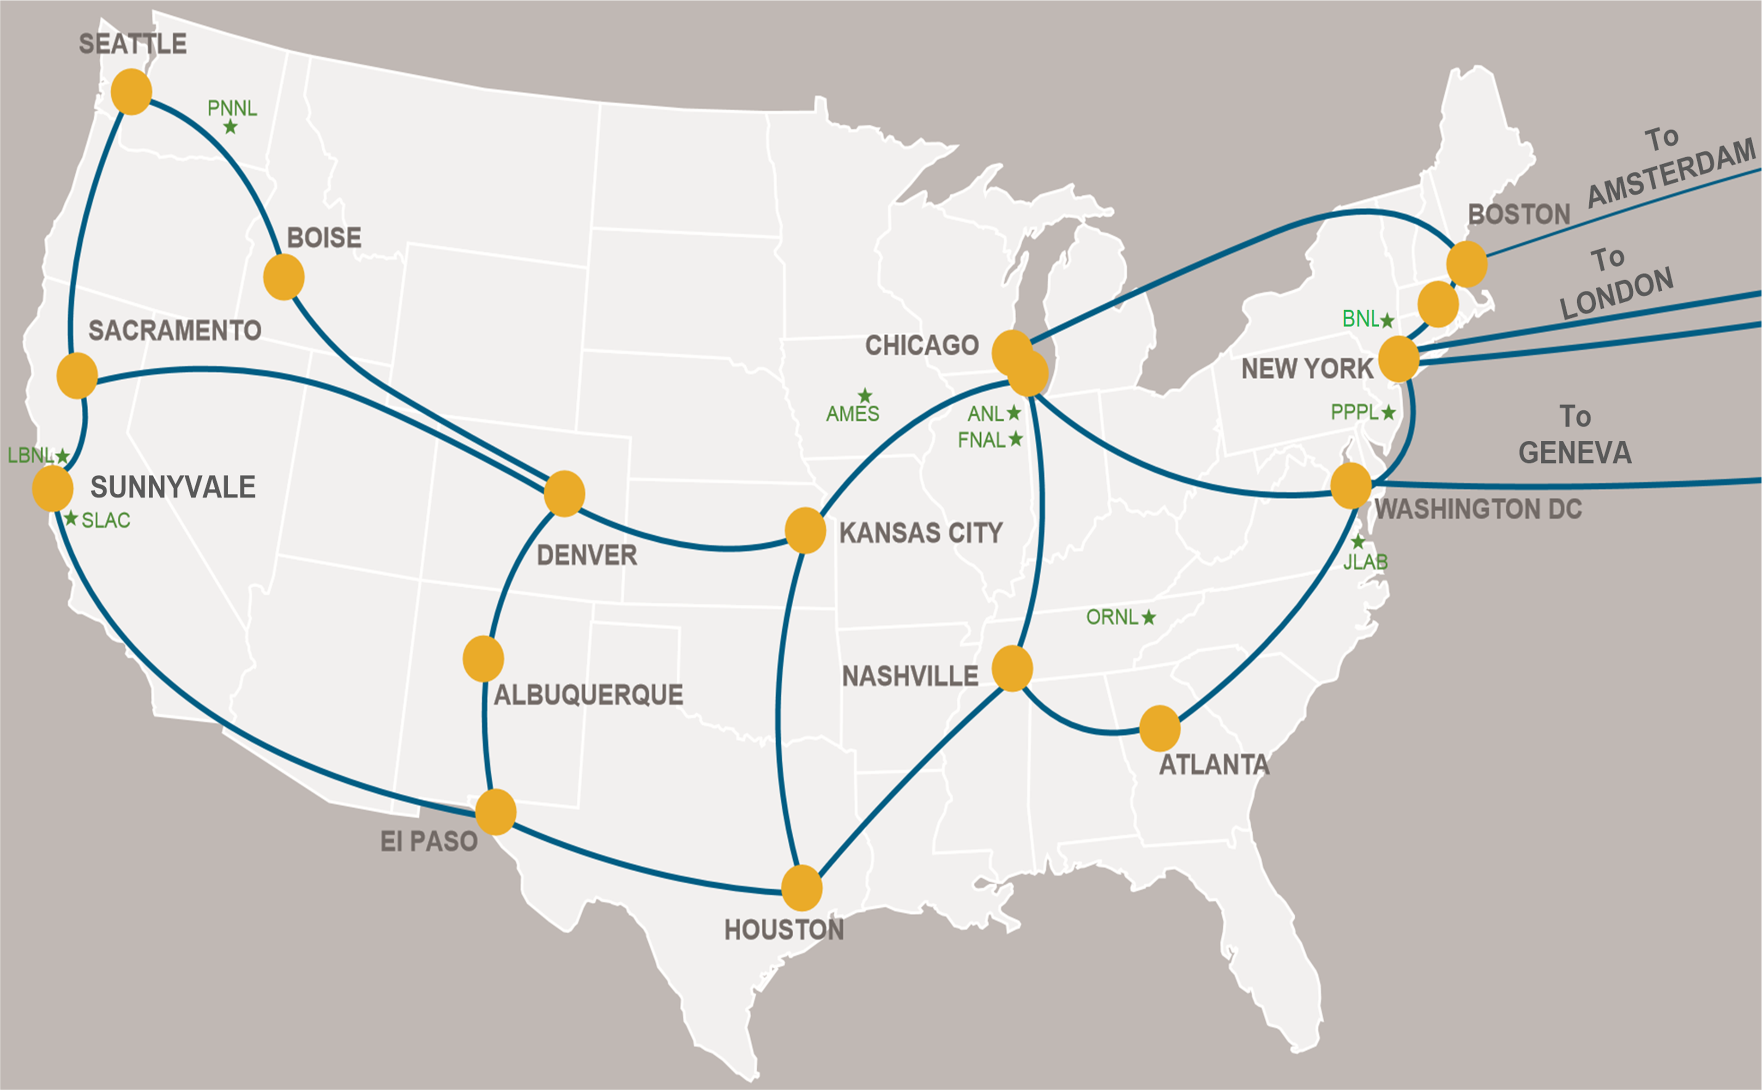





Training
“Cyberinfrastructure Expertise on High-throughput Networks for Big Science Data Transfers”
  UofSC is the anchor institution of the “Cyberinfrastructure Network of Expertise”
  UofSC, University of South Florida, University of Texas at San Antonio, Florida Atlantic University
  Enhancing and securing cyberinfrastructure for big science data transfers
  Technologies / collaborators / academies: Department of Energy (ESnet), Juniper Networks, Cisco Systems, Tofino’s Barefoot Networks

Slide 4
Training
Cyber training for IT professionals
Self-pace, summer training
  South Carolina, Arizona, California, Florida, Texas
  2019 / 2020:
Dates | Workshop | Place | Attendance
July 22-23, 2019 | Training Workshop SC | UofSC, Columbia, SC | 77
July 25-26, 2019 | Developing Workshop SC | UofSC, Columbia, SC | 69
July 30-Aug. 1, 2019 | Training Workshop AZ | ASU, Tempe, AZ | 62
 |  |  | Total: 208

Slide 5
Workforce
“Multi-state Community College, University and Industry Collaboration to Prepare Learners for 21st Century Information Technology Jobs”
  Professional development for high-school teachers, technical college and university professors, and IT professionals
  Focus on instruction, workforce development for IT
    Networks
    Cybersecurity
    Cloud
    Operating Systems

Slide 6
Workforce
Week-long instructor trainings (Summer)
Statewide platform
Connection with job market
  SC and NC Chambers of Commerce
  Cisco, Palo Alto, VMware
DoD 8470 Information Assurance workforce technical personnel (IAT):
  Level 1: Computing environment information assurance
  Level 2: Network environment information assurance
  Level 3: Enclave, advanced network and computer information assurance
Course | IAT 1 | IAT 2 | NICE framework
ITEC 233 Intro to HW/SW | P
ITEC 245 Intro Networks | P
ITEC 293 Cyberoperations - SOCs
ITEC 445 Advanced Networks |  | P
ITEC 493 IT Security / Next-gen FW |  |  | P
NICE: National Initiative for Cybersecurity Education

Slide 7
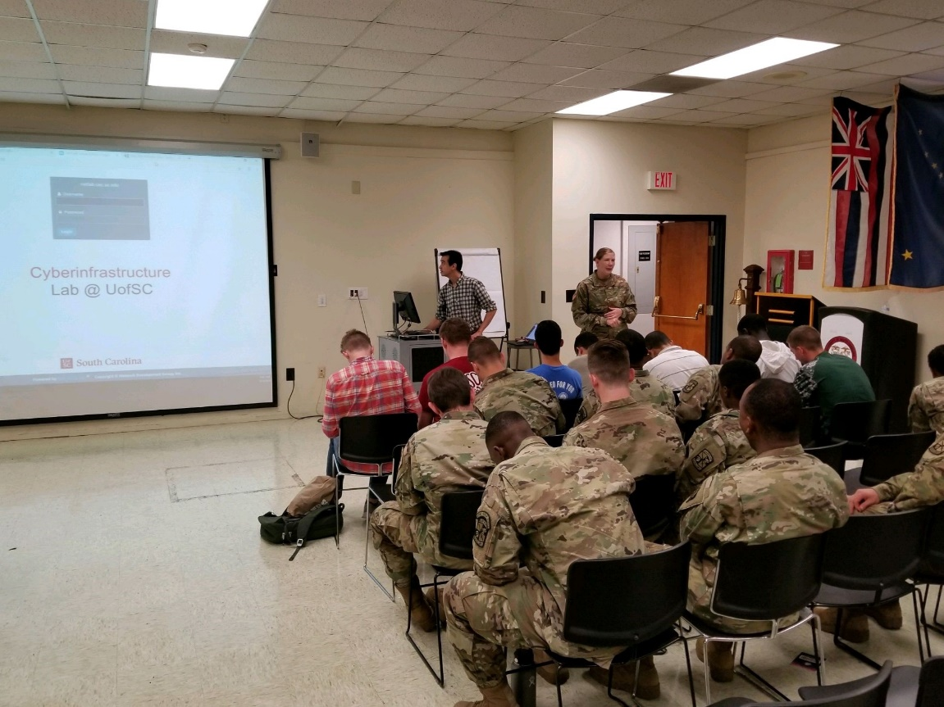
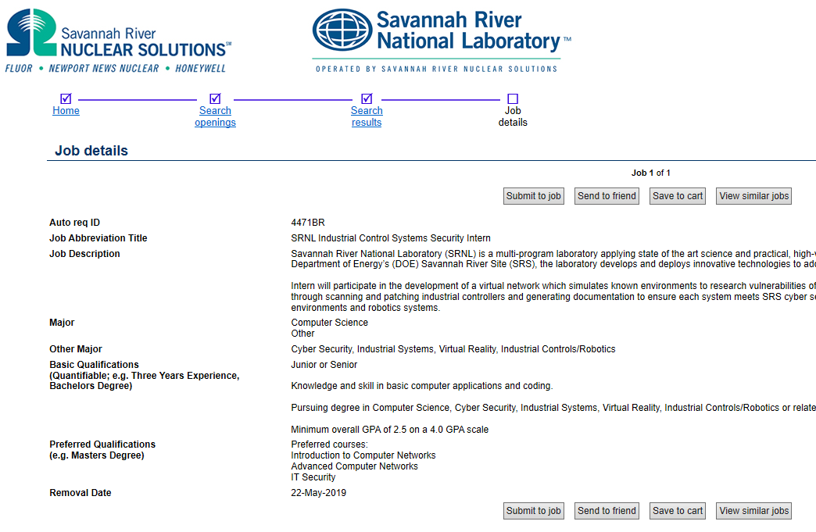
Workforce
3
USC ROTC, Minor in Information Technology – Cyber (1)
Internships – Cyber (2, 3)
1
2

Slide 8
Research
“Building a Science DMZ for Data-intensive Research and Computation at the University of South Carolina”
“Small: Devising Data-driven Methodologies by Employing Large-scale Empirical Data to Fingerprint, Attribute, Remediate and Analyze Internet-scale IoT Maliciousness”

Slide 9
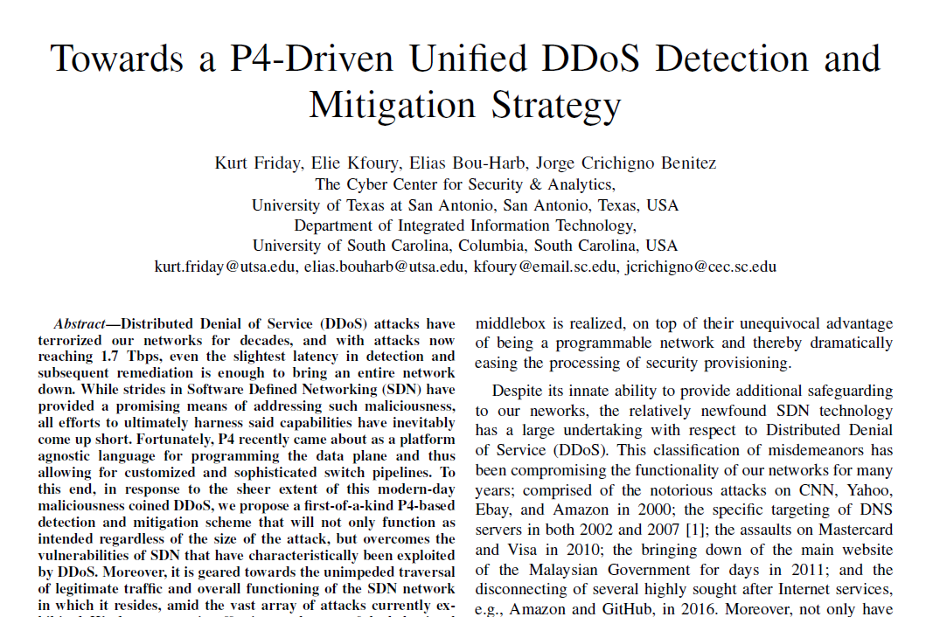
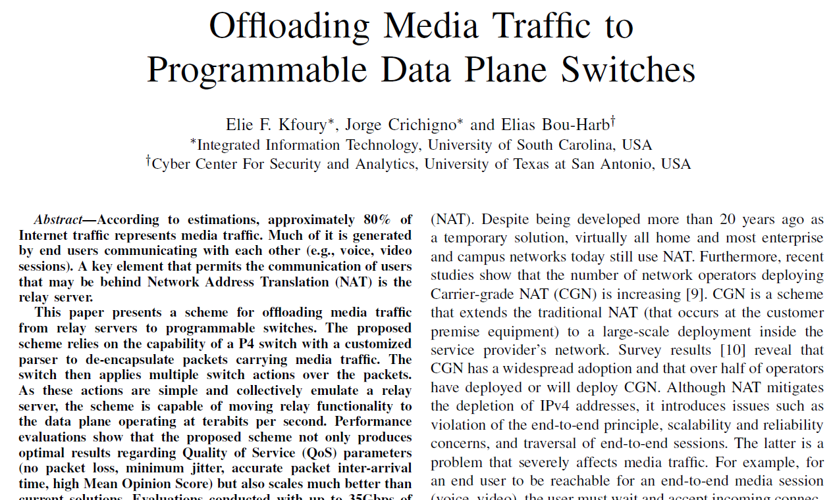
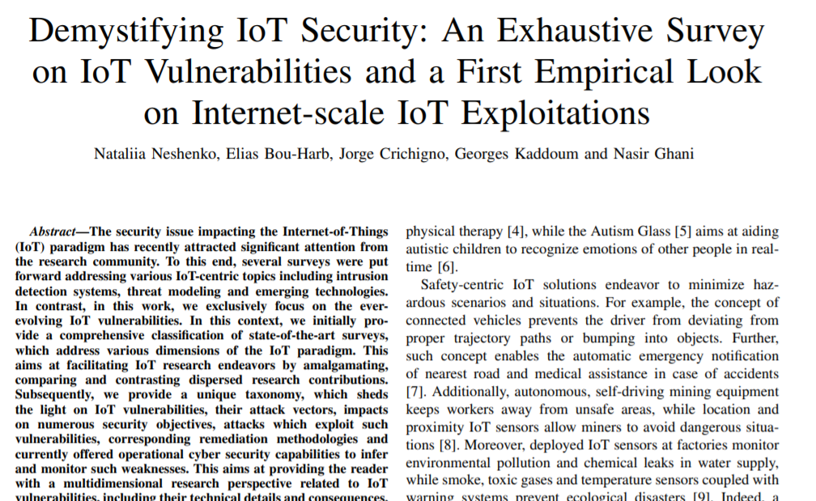
Research
Adoption of latest technology for a variety of applications
  In-network computation
  In-network cache
IT security, rapid DDoS detection using advanced switching capabilities
6-node 100 Gbps testbed, programmable switches and associated development kit (Barefoot agreement)

Slide 10

Research
Key idea
  In today’s world, most computational tasks are executed in general-purpose computers (PCs, cloud computing)
  Some tasks may be “offloaded” (executed) in switch hardware operating at terabits per second rates
  Speed (precise maximum latency) and volume (terabits per second)
Application example: media (voice) relay server
 | Programmable Switch | General-purpose CPU
Cost | $6,000 | $ 10,000 - 25,000
Capacity | ~35,000,000 connections per switch | ~500 connections per core
Latency | 400 nanoseconds | Tens to hundreds of milliseconds
Outcomes
Orders of magnitude throughput improvements Customized network behavior

