Slide 1

UofSC – Trident Tech Meeting
Information Technology Programs
Department of Integrated Information Technology (IIT)
College of Engineering and Computing
University of South Carolina
Online
August 6, 2020

Slide 2
Agenda
Cybersecurity
Cybertraining
ATE with NDG

Slide 3
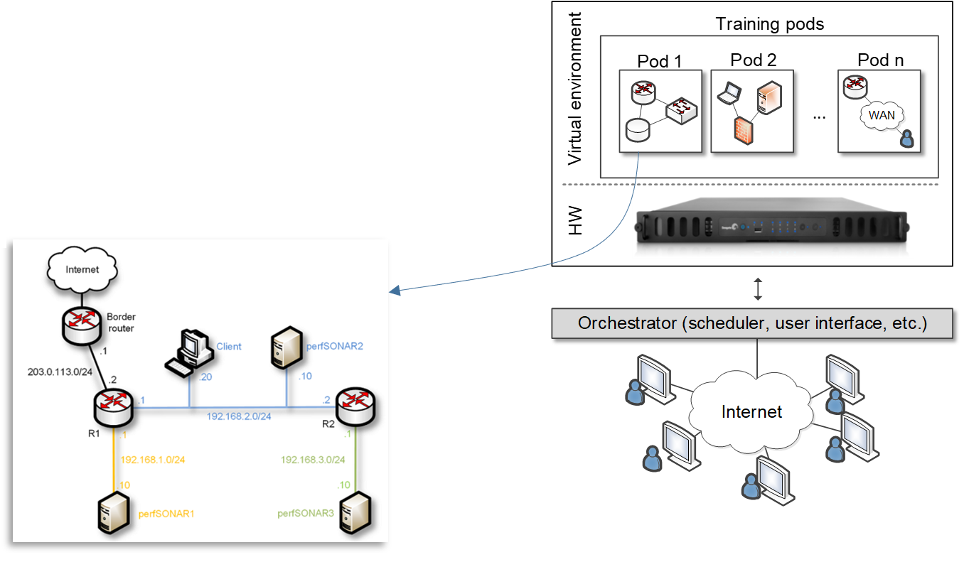
Cybersecurity Project
Cybersecurity project started in 2018
Local private cloud for teaching and research in cyber at UofSC
Build custom pods
Real protocol stacks and live traffic experimentation
Network emulation with NETEM and Mininet

Slide 4
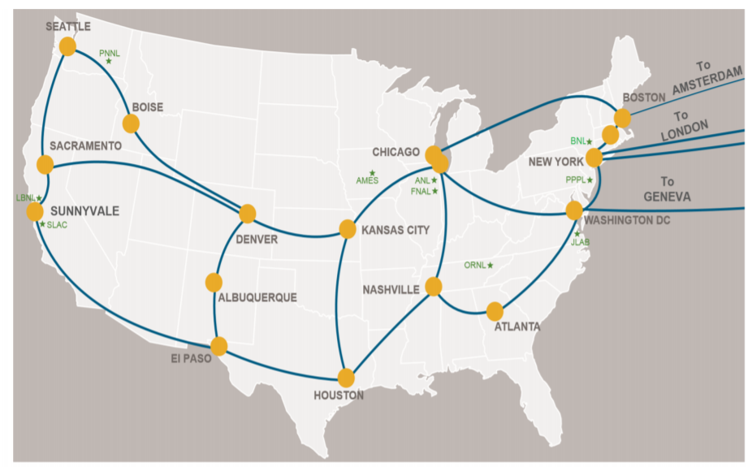
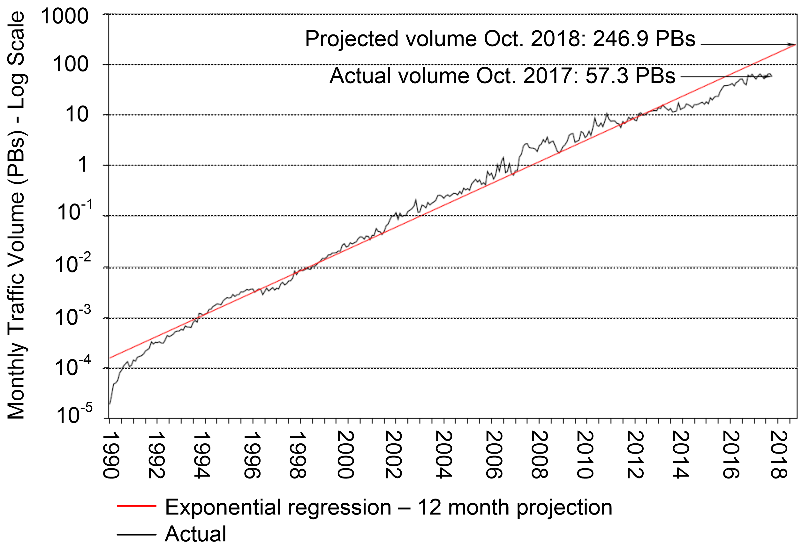
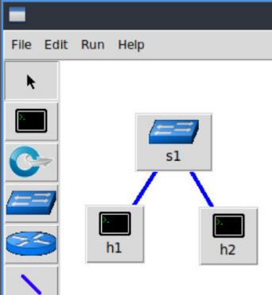
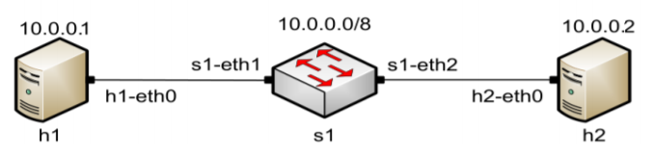
Cybertraining Project
Cybertraining project started in 2019: Cyberinfrastructure for moving big data
There is a need for IT technical expertise country-wide
E.g., ESnet is the network connecting national labs, research institutions
  Managed by the Department of Energy (Berkeley National Lab)
Rates of 50 Gbps, emulation of high-performance systems
Intel Xeon Gold 6130 CPU, 2.1 GHz
ESnet
Monthly average traffic volume, ESnet
Three-node network emulation

Slide 5
ATE and CC Projects
Advanced Technical Education (ATE) and Campus Cyberinfrastructure (CC) (2019)
Development of a multi-state distributed cloud to support teaching, research
2+2+2 program (HS + College + University)
Distributed cloud pools resources from SC and NC, serves institutions seamlessly
Requests to use the platform, NDG + UofSC
  Berkeley National Lab
  SANS institute (“girlsgocyber”)
  Multiple higher-ed institutions
  International Networks at Indiana
  Fort Gordon (2 cyber courses)
  Texas’ Lonestart Education and Research

Slide 6
Status: Platform + Expertise on vLabs
UofSC vLabs series
  Network Tools and Protocols (high-speed networks)
  Software Defined Networking
  Zeek Intrusion Detection
  perfSONAR
  Intro to BGP
  MPLS and Advanced BGP Topics
NDG vLabs series
  Cisco, Palo Alto, Red Hat
  Cybersecurity
  Linux
  Custom series
IT professionals,
4-year, grad. degrees
P4, SDN, Advanced Topics
Technical colleges, 4-year universities, certs, ROTC
Cisco, Palo Alto, Linux, certs
High schools, dual credit, certs
Entry-level, intro to virtualization, intro to nets,
intro to cybersecurity

Slide 7
Private Cloud Use
Private vs public cloud
Feature | Private Cloud | Public Cloud (e.g., AWS)
Granularity to allocate physical resources | Very granular | Not granular (access to the physical resources requires additional fees)
Easy to create custom pods | Easy | More difficult; hard to design complex topologies
Cost | Cost effective when used extensively | Cost effective for individual / small virtual machines; costly for large virtual machines over time
IT Staff | Higher cost | Lower cost
Application layer for pedagogy and presentation of virtual scenarios | Very flexible | Not flexible; limited to providers’ interface, e.g., command-line interface
Time-sharing compute resources | The owner controls who can access resources. Easy to implement time-sharing policies | Cloud provider controls who can access resources (typically, a fee is required per user accessing resources)

Slide 8
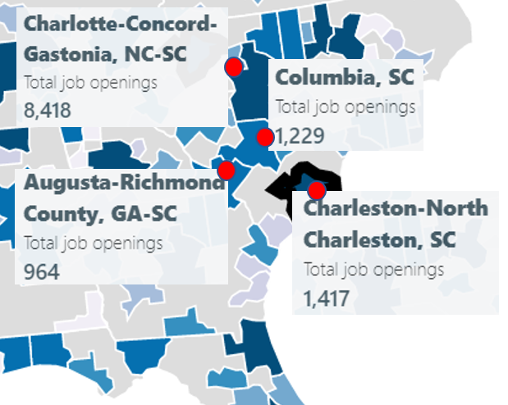
ONR’s Cyber Project
“Enhancing the Preparation of Next-generation Cyber Professionals” (2020)
South Carolina cybersecurity needs
  NIWC Atlantic, SRNL, Fort Jackson, Shaw Air Force Base, private industry
Recruiting the American military’s cyber force is more difficult than ever
  DoD has been struggling to hire more than 8,000 cyber positions (2018)¹
  Shortage of cybersecurity professionals
The College of Engineering and Computing is addressing the workforce needs:
  Encourage STEM, ROTC students to obtain a minor in IT
  Undergraduate applied research
  Private cloud
  Collaboration among industry, government, education institutions
Cybersecurity job openings in four metro areas near Columbia, Feb. 2020
1. J. Lynch, “Inside the Pentagon’s Struggle to Build a Cyber Force,” Fifth Domain publication, October 29, 2018. Online: https://tinyurl.com/yyelqomp
Notes:
Reserve Officers' Training Corps (ROTC))

Slide 9
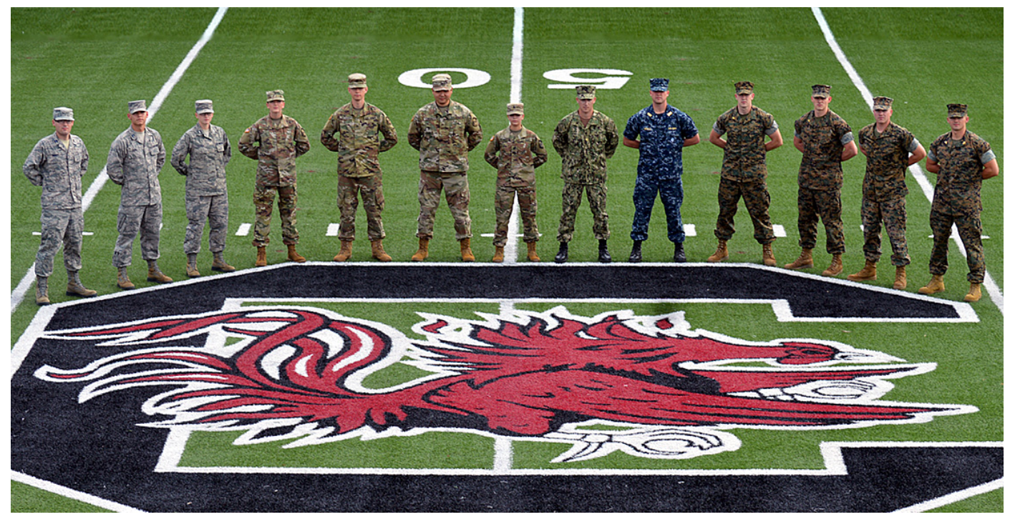

ONR’s Cyber Project
Minor in IT – Cyber specialization
  Option to earn DoD’s approved baseline certificates for Information Assurance Technical (IAT)
  Self-contained specialization; no pre-req for other STEM majors / ROTC
Undergraduate applied research
  CEC faculty, graduate student mentors
  Advisory entity by NIWC Atlantic, project guidelines
Private cloud with professional tools and platforms
  Hands-on applied research with physical and virtual equipment
Collaboration
  Partnership with Intel, Cisco Systems, Palo Alto Networks, VMware, Juniper
Minor in IT and undergraduate research

Slide 10
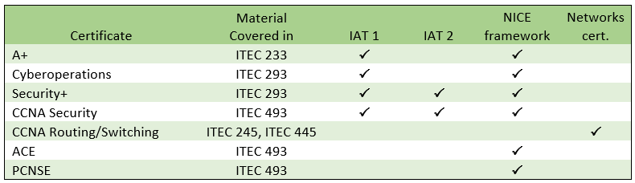
ONR’s Cyber Project
DoD’s Information Assurance (IA) workforce is classified in IA technical (IAT):
  Level 1 (IAT 1): Computing environment information assurance
  Level 2 (IAT 2): Network environment information assurance
  Level 3 (IAT 3): Enclave, advanced network & computer information assurance
It requires partnership
  Cisco Systems, Palo Alto Networks, VMware, Juniper, Intel
NICE: National Initiative for Cybersecurity Education (NIST)

Slide 11
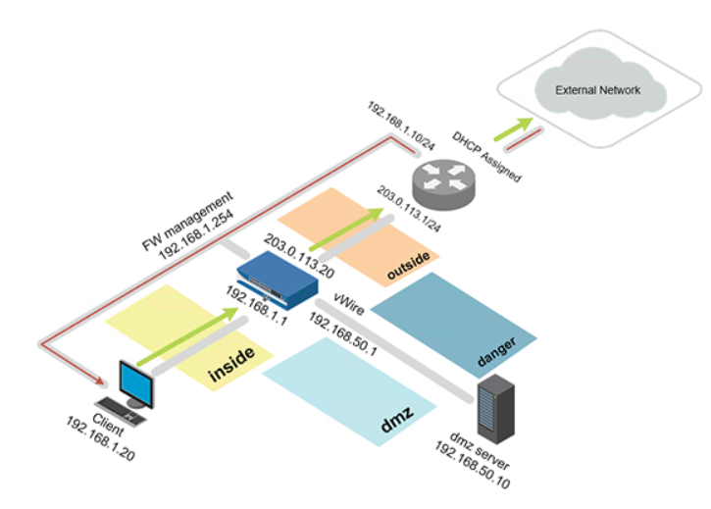
ONR’s Cyber Project
Collaboration
  Applied teaching and research -> professional tools, platforms, market validation
  Cisco Systems, Palo Alto Networks, VMware, Juniper, Intel
Next-generation Firewall Virtual Machine + licenses
Pod deployed in private cloud

Slide 12
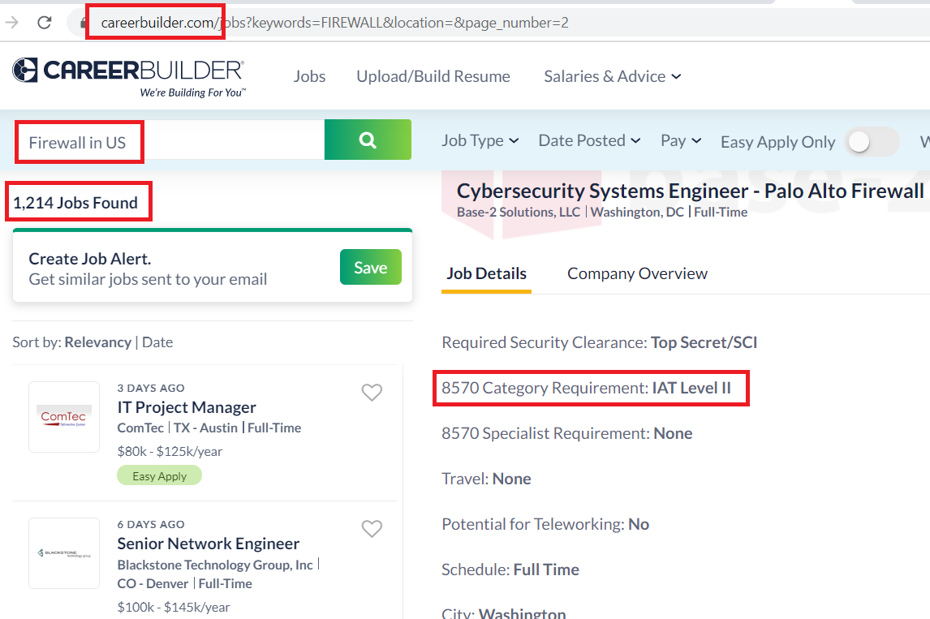
ONR’s Cyber Project
Collaboration
  Applied teaching and research -> professional tools, platforms, market validation
  Cisco Systems, Palo Alto Networks, VMware, Juniper, Intel
 Bachelor’s degree
 IAT
 Theory
 Hands-on expertise Palo Alto
Pod deployed in private cloud
Job search

Slide 13
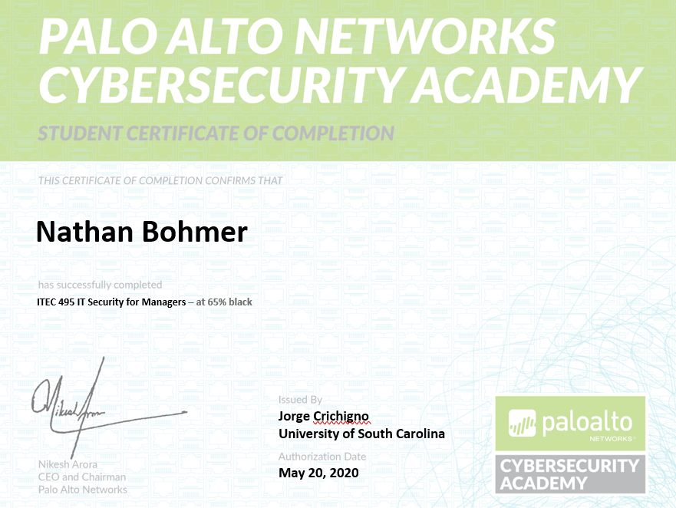
ONR’s Cyber Project
Collaboration
  Applied teaching and research -> professional tools, platforms, market validation
  Cisco Systems, Palo Alto Networks, VMware, Juniper, Intel
 Bachelor’s degree
 IAT
 Theory
 Hands-on expertise Palo Alto
Additional credentials
Job search

Slide 14
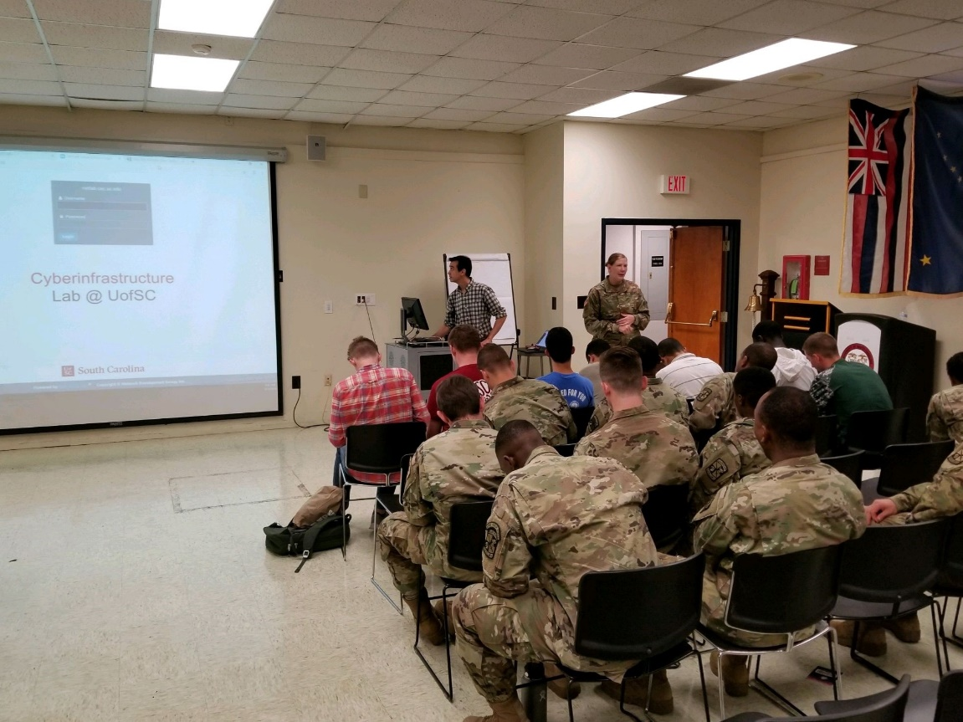
ONR’s Cyber Project
Collaboration
  Applied teaching and research -> professional tools, platforms, market validation
  Cisco Systems, Palo Alto Networks, VMware, Juniper, Intel
 Bachelor’s degree
 IAT
 Theory
 Hands-on expertise Palo Alto
Additional credentials
UofSC’s ROTC

Slide 15
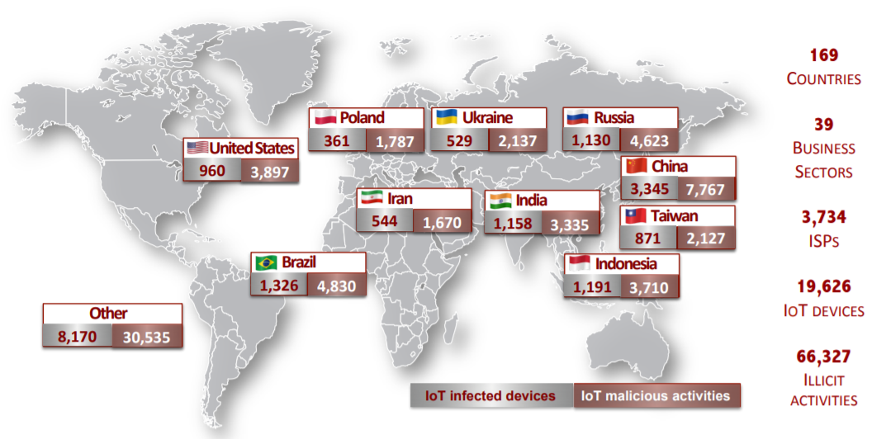
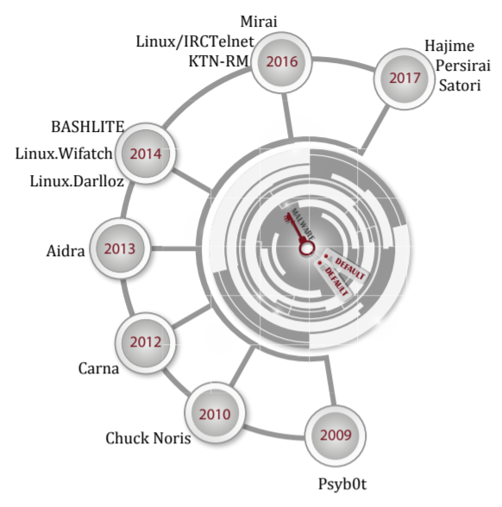
Graduate Projects
Development of new techniques against attacks targeting “Internet-of-Things” devices
Agreement with the Center for Applied Internet Data Analysis (CAIDA) (San Diego)
Global distribution of exploited IoT devices; results from this research project
Malware exploiting default credentials

Slide 16
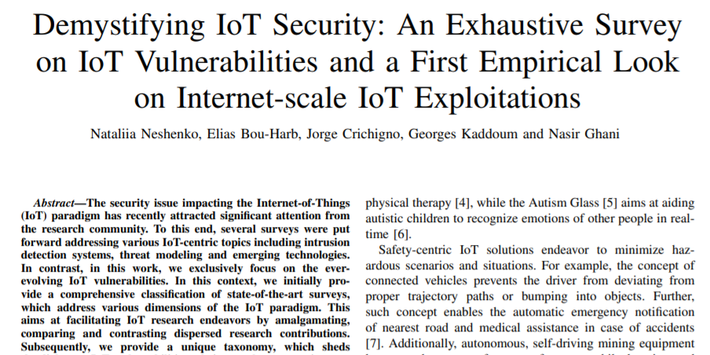
Graduate Projects
Development of new techniques against attacks targeting “Internet-of-Things” devices
Agreement with the Center for Applied Internet Data Analysis (CAIDA) (San Diego)

Slide 17
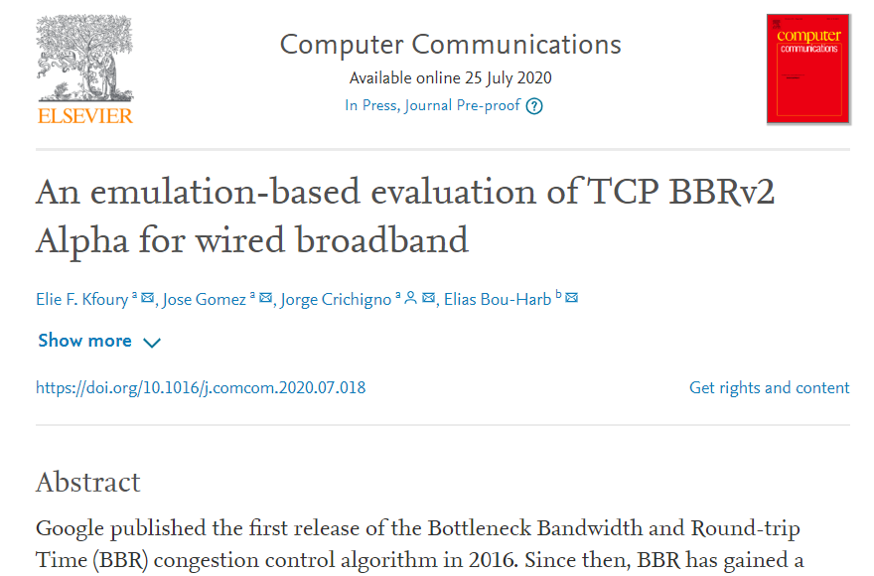
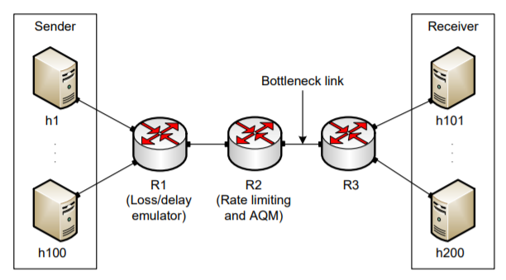
Graduate Projects
Performance testing Google’s new communication protocol
Feedback to Google (used in Youtube, Chrome, and other apps)
Emulating behavior in private cloud before Google’s protocol public release

Slide 18
Graduate Projects
Improving system’s performance using next-generation switches
Offloading computational tasks to network switches
  Orders of magnitude faster than general-purpose CPU
  Very limited instructions set (e.g., no multiplication, no division, simple operations)
Agreement with Intel (chips, software development environment)
Application example: media (voice) relay server
 | Programmable Switch | General-purpose CPU
Cost | $6,000 | $ 10,000 - 25,000
Capacity | ~35,000,000 connections per switch | ~500 connections per core
Latency | 400 nanoseconds | Tens to hundreds of milliseconds

Slide 19
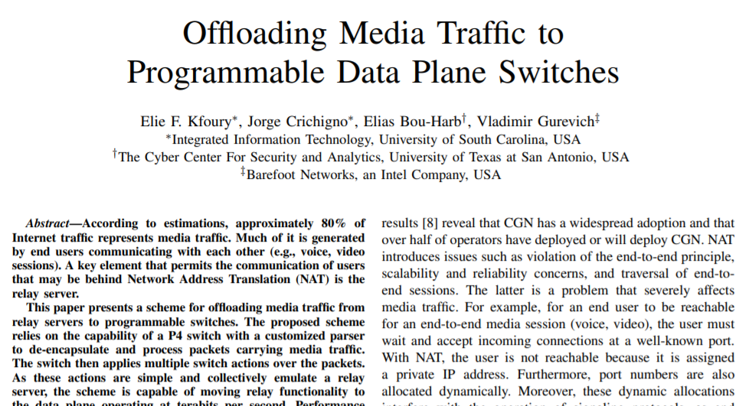
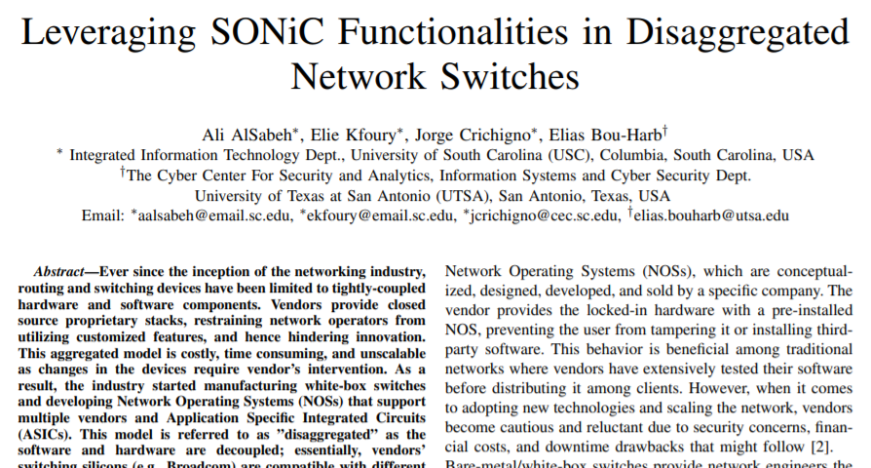
Graduate Projects
Improving system’s performance using next-generation switches
Offloading computational tasks to network switches
  Orders of magnitude faster than general-purpose CPU
  Very limited instructions set (e.g., no multiplication, no division, simple operations)
Agreement with Intel (chips, software development environment)

Slide 20
NIWC Atlantic
Collaboration with NIWC Atlantic is essential
  We want to acknowledge Michael Merriken and Captain Sanders
Advisory entity to the project
Provide input for undergraduate research projects
Coordination with UofSC’s ROTC
  Navy
  Army
  Air Force

