Slide 1

Cybersecurity Operation Program at UofSC
Jorge Crichigno
Department of Integrated Information Technology (IIT)
College of Engineering and Computing
University of South Carolina
USC’s ROTC
May 7, 2021

Slide 2
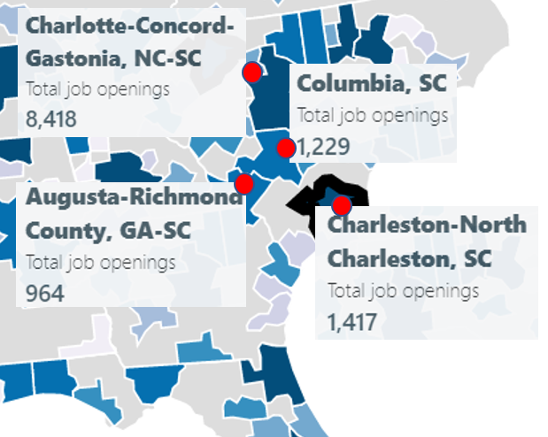
ONR’s Cyber Project – July 2020-Dec 2021
“Enhancing the Preparation of Next-generation Cyber Professionals” (2020)
South Carolina cybersecurity needs
  NIWC Atlantic, SRNL, Fort Jackson, Shaw Air Force Base, private industry
Recruiting the American military’s cyber force is more difficult than ever
  DoD has been struggling to hire more than 8,000 cyber positions (2018)¹
  Shortage of cybersecurity professionals
The College of Engineering and Computing is addressing the workforce needs:
  Encourage STEM, ROTC students to obtain a minor in IT
  Undergraduate applied research
  Private cloud
  Collaboration among industry, government, education institutions
Cybersecurity job openings in four metro areas near Columbia, Feb. 2020
1. J. Lynch, “Inside the Pentagon’s Struggle to Build a Cyber Force,” Fifth Domain publication, October 29, 2018. Online: https://tinyurl.com/yyelqomp
Notes:
Reserve Officers' Training Corps (ROTC))

Slide 3


ONR’s Cyber Project
Minor in IT – Cyber specialization
  Option to earn DoD’s approved baseline certificates for Information Assurance Technical (IAT)
  Self-contained specialization; no pre-req for other STEM majors / ROTC
Undergraduate applied research
  CEC faculty, graduate student mentors
  Advisory entity by NIWC Atlantic, project guidelines
Private cloud with professional tools and platforms
  Hands-on applied research with physical and virtual equipment
Collaboration
  Partnership with Intel, Cisco Systems, Palo Alto Networks, VMware, Juniper
Minor in IT and undergraduate research

Slide 4
ONR’s Cyber Project
DoD’s Information Assurance (IA) workforce is classified in IA technical (IAT):
  Level 1 (IAT 1): Computing environment information assurance
  Level 2 (IAT 2): Network environment information assurance
  Level 3 (IAT 3): Enclave, advanced network & computer information assurance
DoD also defines roles of Cybersecurity Service Provider (CSSP)
It requires partnership
  Cisco Systems, Palo Alto Networks, VMware, Juniper, Intel
NICE: National Initiative for Cybersecurity Education (NIST)

Slide 5
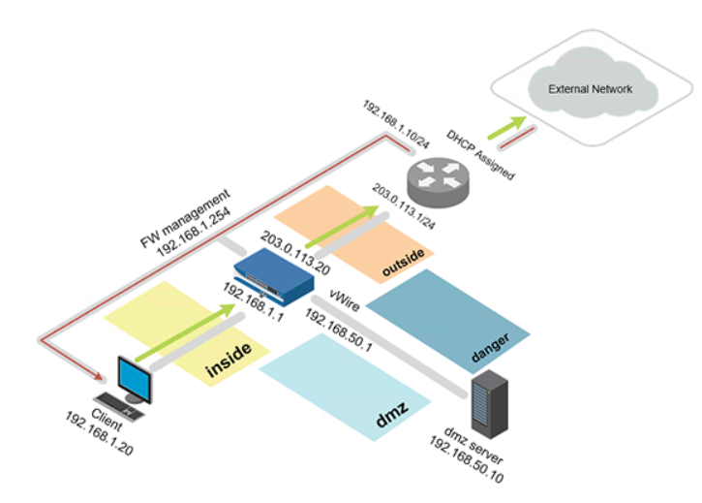
ONR’s Cyber Project
Collaboration
  Applied teaching and research -> professional tools, platforms, market validation
  Cisco Systems, Palo Alto Networks, VMware, Juniper, Intel
Next-generation Firewall Virtual Machine + licenses
Pod deployed in private cloud

Slide 6
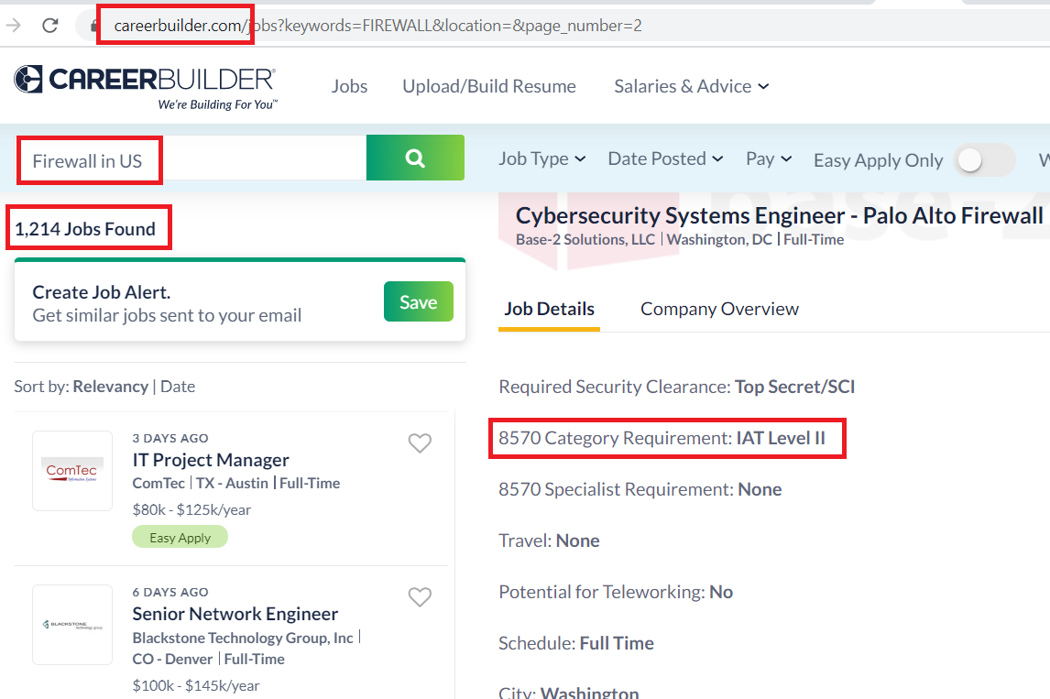
ONR’s Cyber Project
Collaboration
  Applied teaching and research -> professional tools, platforms, market validation
  Cisco Systems, Palo Alto Networks, VMware, Juniper, Intel
 Bachelor’s degree
 IAT
 Theory
 Hands-on expertise Palo Alto
Pod deployed in private cloud
Job search

Slide 7
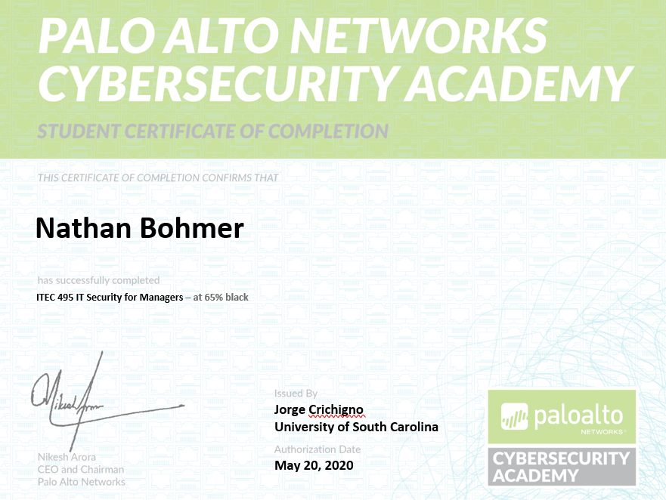
ONR’s Cyber Project
Collaboration
  Applied teaching and research -> professional tools, platforms, market validation
  Cisco Systems, Palo Alto Networks, VMware, Juniper, Intel
 Bachelor’s degree
 IAT
 Theory
 Hands-on expertise Palo Alto
Additional credentials
Job search

Slide 8
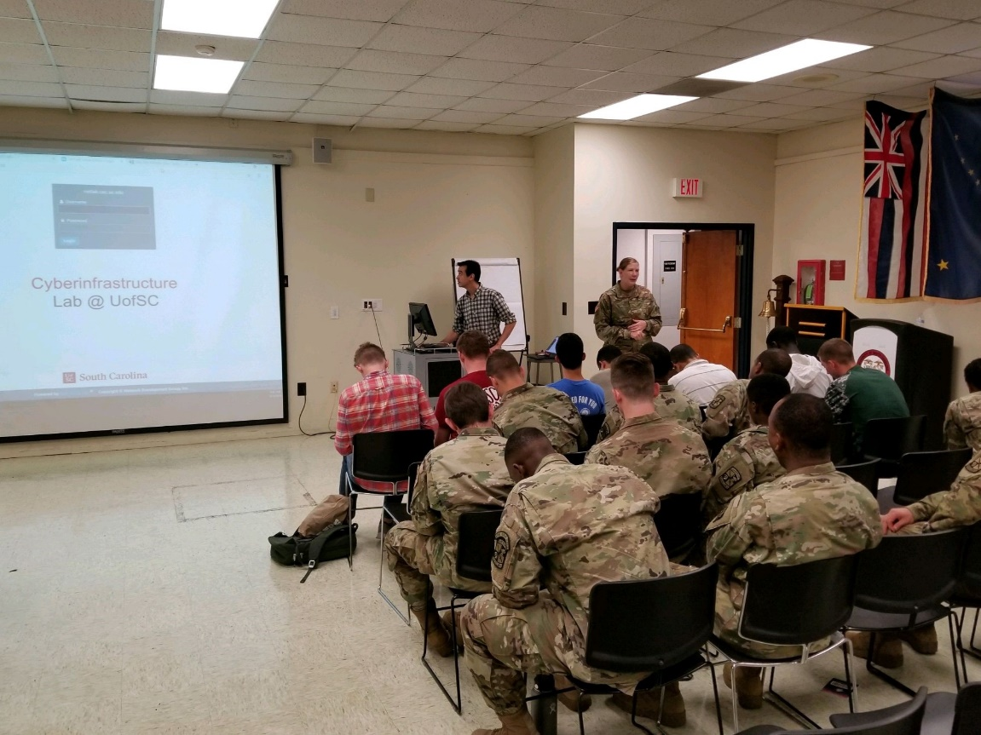
ONR’s Cyber Project
Collaboration
  Applied teaching and research -> professional tools, platforms, market validation
  Cisco Systems, Palo Alto Networks, VMware, Juniper, Intel
 Bachelor’s degree
 IAT
 Theory
 Hands-on expertise Palo Alto
Additional credentials
UofSC’s ROTC

Slide 9
Scholarship for Service
UofSC plans to extend the current ONR project to a Scholarship for Service (SFS) program
Support of two years (BSc) and three years (PhD) of stipends, tuition, and allowances for students in cybersecurity
  $25,000 per year for undergraduate students
  $34,000 per year for graduate students
Support of two years (BSc) and three years (PhD) of stipends, tuition, and allowances for students in cybersecurity
Students must complete a summer internship and obtain a permanent placement (after graduation) in an executive agency (as defined in 5 U.S. Code § 105)

Slide 10
Scholarship for Service
Elements of the project

Slide 11
Scholarship for Service
Program

Slide 12
Scholarship for Service
Cybersecurity courses with embedded DoD’s Approved 8750 baseline certifications
NICE: National Initiative for Cybersecurity Education (NIST)

Slide 13
Scholarship for Service
Program

