Slide 1

Virtual Labs for Training, Teaching, and Research on Networks and Cybersecurity Topics
Jorge Crichigno, Elie Kfoury
University of South Carolina
http://ce.sc.edu/cyberinfra
jcrichigno@cec.sc.edu, ekfoury@email.sc.edu
CI Engineering Lunch and Learn - Online
February 19, 2021

Slide 2
Agenda
Motivation virtual labs
Local cloud at UofSC
Design of virtual labs – POD design
Virtual lab libraries
Industry partnership
Distributed Academic Cloud
Other topics – research

Slide 3
Motivation for Virtual Labs
Information Technology (IT) programs are more practical than theoretical
The IT discipline distinguishes from other computing disciplines by being more applied than theoretical and by addressing infrastructure systems and application technologies¹
The Department of Integrated Information Technology at UofSC has over 250 undergraduate students and over 50 Master students
How to include authentic practice, professional tools and platforms, access to computing technology in the work environment in a scalable way?
  Limited labor, equipment, and space
  Easy to setup the experimental environment
1. Information Technology Curricula 2017, ACM/IEEE Joint Committee. Online: https://tinyurl.com/4nqqwa5m.

Slide 4
Local Cloud at UofSC
UofSC cloud; https://netlab.cec.sc.edu
Hosts 1-3 store virtual machines (VMs) for virtual labs
Management server runs vCenter, Management Software (NETLAB+)
Partnership with Network Development Group (NDG)¹
Network Development Group (NDG). Online: https://netdevgroup.com

Slide 5
Local Cloud at UofSC
Servers’ specifications
Device | Cores | Storage (TB) | RAM (GB)
Server 1 (management server) | 20 | 4.8 | 128
Server 2 (VMs for vLabs) | 32 | 4.8 | 512
Server 3 (VMs for vLabs) | 32 | 1.92 | 768
Server 4 (VMs for vLabs) | 32 | 1.92 | 768
Total | 116 | 8.08 | 2,176

Slide 6
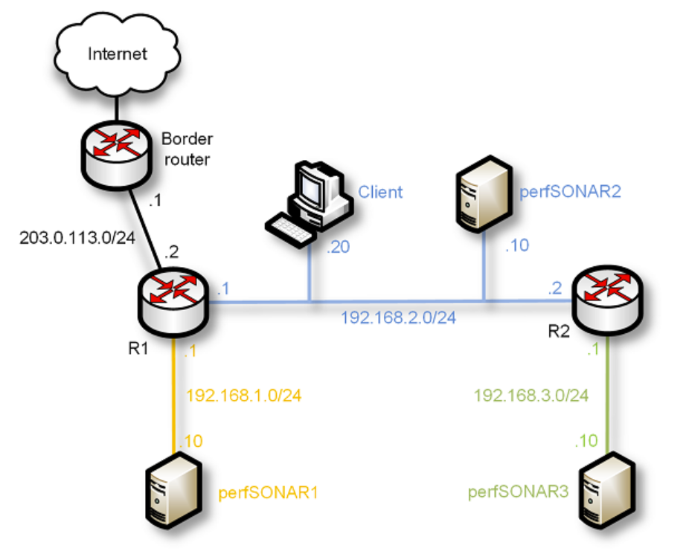
POD Design
A virtual laboratory experiment requires a pod of devices, or simply pod
Example: perfSONAR library
POD for perfSONAR labs

Slide 7
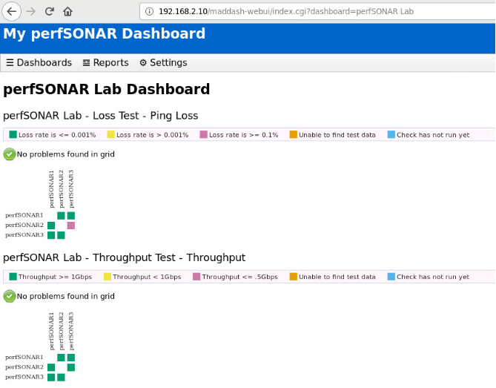
POD Design
A virtual laboratory experiment requires a pod of devices, or simply pod
Example: perfSONAR library
POD for perfSONAR labs

Slide 8
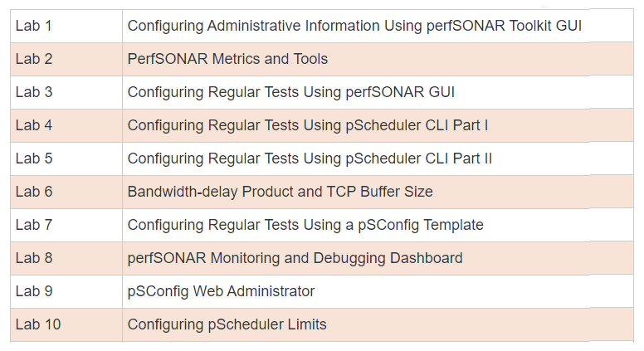
POD Design
A virtual laboratory experiment requires a pod of devices, or simply pod
Example: perfSONAR library
POD for perfSONAR labs
perfSONAR labs

Slide 9
POD Design
Details of perfSONAR pod
  Four networks
  Three servers
  One client
  Three routers
  Connectivity to the Internet
  Total of 7 heterogeneous VMs

Slide 10
POD Design
Details of perfSONAR pod
  PODs running simultaneously use the same block of IP addresses
  Lab manuals are uniform
  “Local NAT” is performed by the device connected to the campus network
  There is a master pod in the system
  Linked clone VMs are created from the master pod VMs
Notes:
A linked clone (or linked virtual machine) is a virtual machine that shares virtual disks with the parent (or master) virtual machine in an ongoing manner. This conserves disk space and allows multiple virtual machines to use the same software installation. Linked clones can be created very quickly because most of the disk is shared with the parent VM.
See https://www.netdevgroup.com/content/aplus/documentation/netlab_aplus_v4_pod_install_guide.pdf

Slide 11
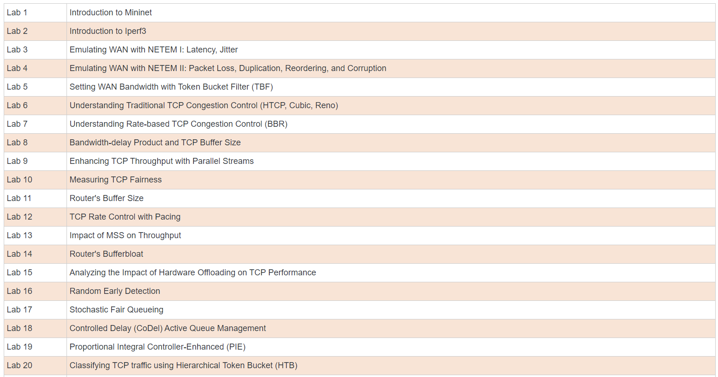
Lab Libraries
Network Tools and Protocols

Slide 12
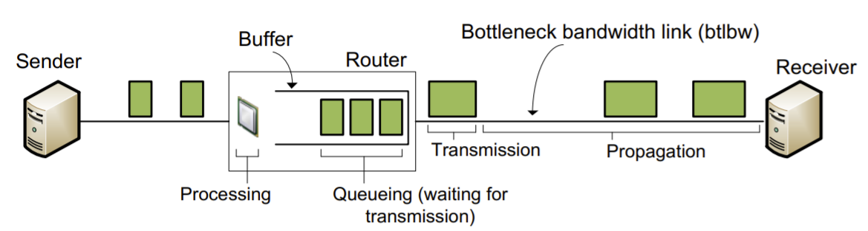
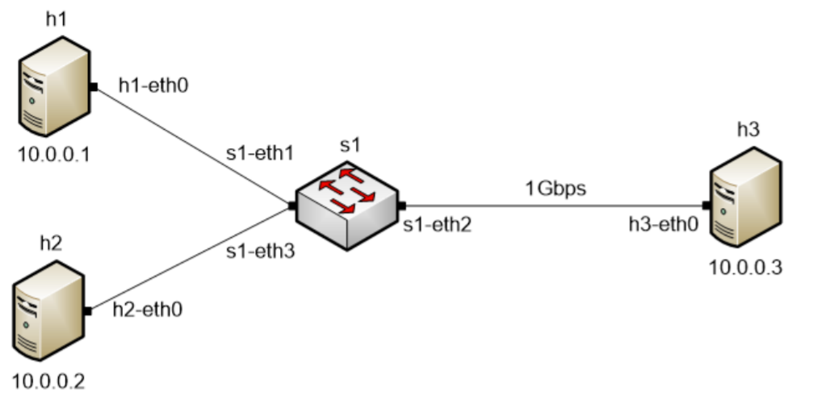
Lab Libraries
Network Tools and Protocols, Lab 14: “Router’s Bufferbloat”
Description of the problem
40Gbps
Topology
40Gbps

Slide 13
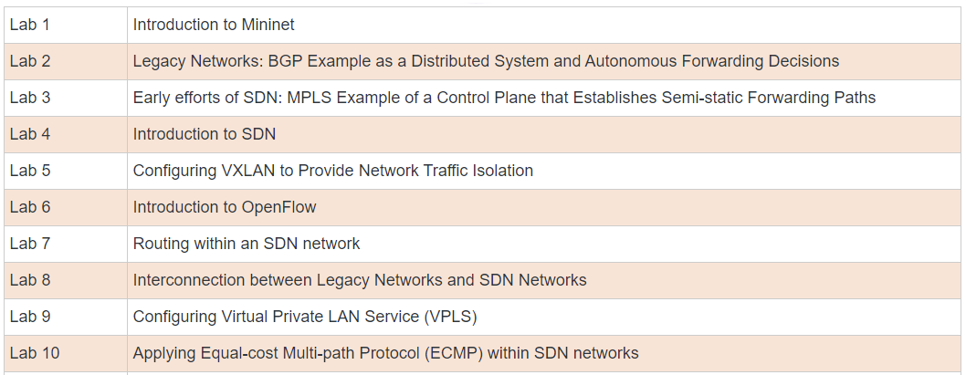
Lab Libraries
Introduction to SDN

Slide 14
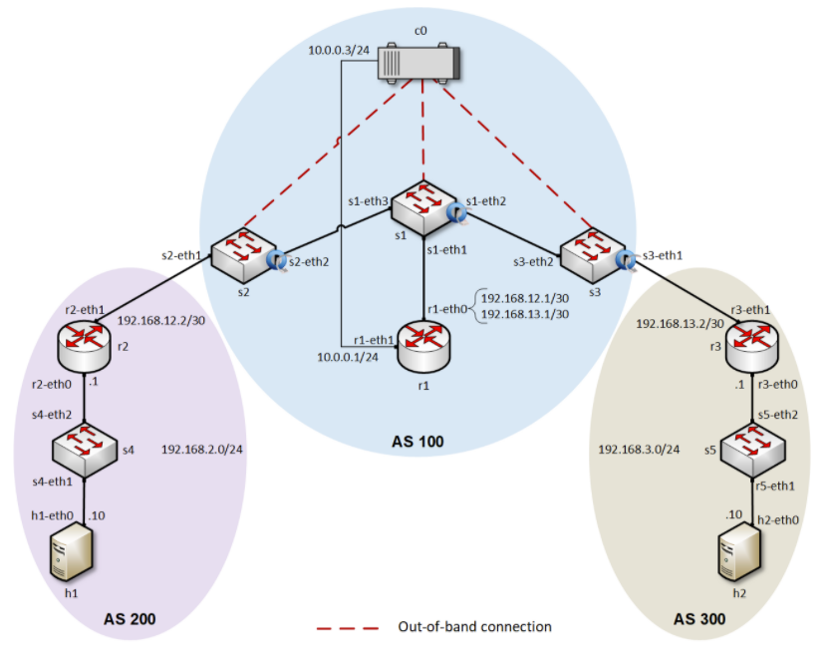
Lab Libraries
Introduction to SDN, Lab 8: “Interconnection between Legacy Networks and SDN Networks”

Slide 15
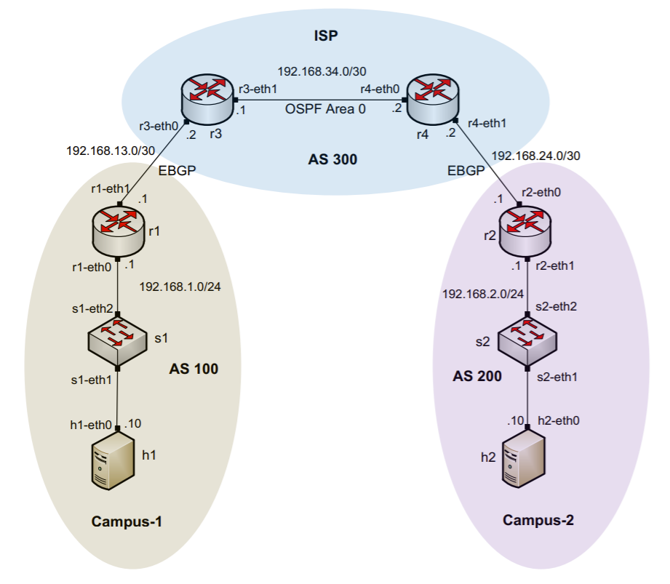
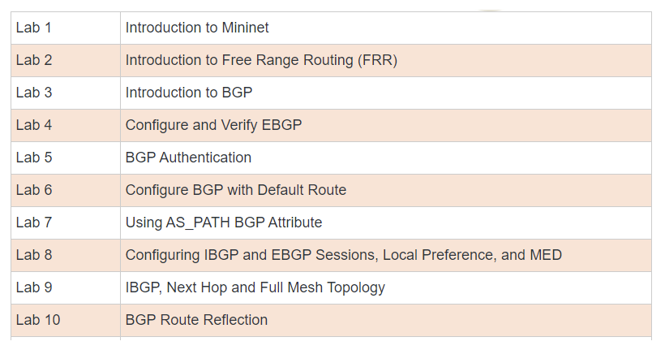
Lab Libraries
Introduction to BGP
Topology for Lab 4

Slide 16
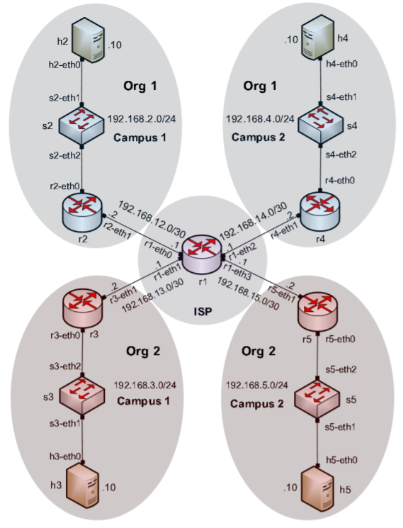
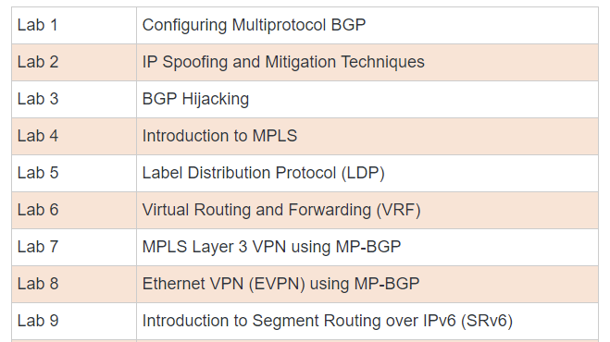
Lab Libraries
MPLS and Advanced BGP Topics
Topology for Lab 6

Slide 17
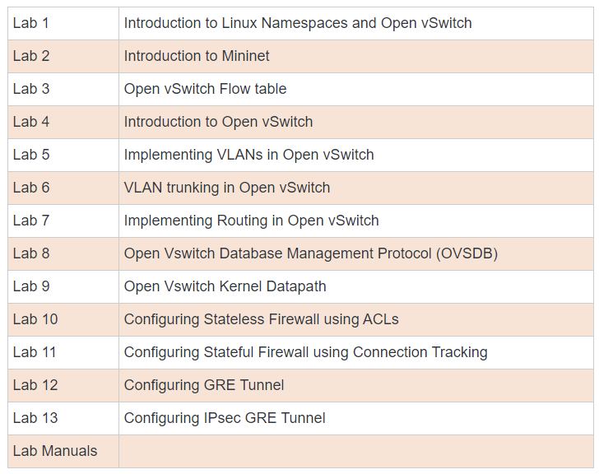
Lab Libraries
Open Virtual Switch

Slide 18
Lab Libraries
perfSONAR
Topology for perfSONAR labs

Slide 19
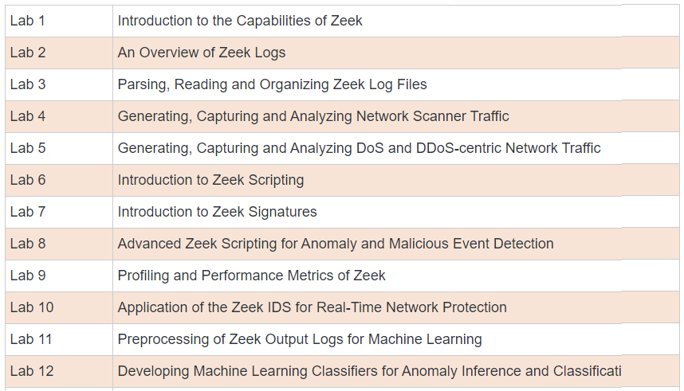
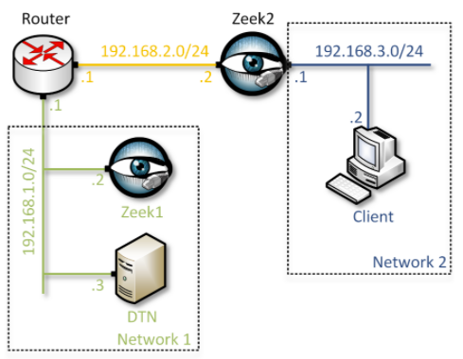
Lab Libraries
Zeek Intrusion Detection
Topology for Zeek labs

Slide 20
Cloud Features
Feature | Comments
Allocation of resources | Granular allocation of physical resources
Custom pods | Easy to create custom pods
Cost | Cost-effective when used extensively
Presentation layer for pedagogy | Topology is graphically presented to the learner using a regular browser
Time sharing | The owner controls who can access resources; easy to implement time-sharing policies
IP addresses | Pods (and learners) can have the same topology and IP addresses (overlapping addresses w/o conflict)
Functional realism | Virtual labs have the same functionality as real IT hardware in a real deployment, and execute the same code
Traffic realism | Devices generate/receive real, interactive network traffic to/from the Internet, or to/from other devices within the lab environment

Slide 21
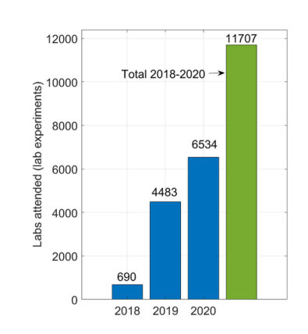
Cloud Usage at UofSC – IIT Department
Total labs experiments in 2020: 6,534
Total hours: 25,158.03
Hours per lab: 3.85

Slide 22
Partnership with Industry
The IEEE and ACM are the main societies which guide IT education
  IT curriculum should emphasize “learning IT core concepts combined with authentic practice” and “use of professional tools and platforms”¹
UofSC works with the Network Development Group (NDG)², VMware, Palo Alto Cybersecurity Academy, Cisco, Juniper, and others to virtualize labs
“Information Technology Curricula Guideline 2017 (IT2017),” report by the ACM / IEEE Task Force on Information Technology Curricula, Dec. 2017. Online: https://tinyurl.com/yxauot8w
Network Development Group (NDG). Online: https://netdevgroup.com

Slide 23
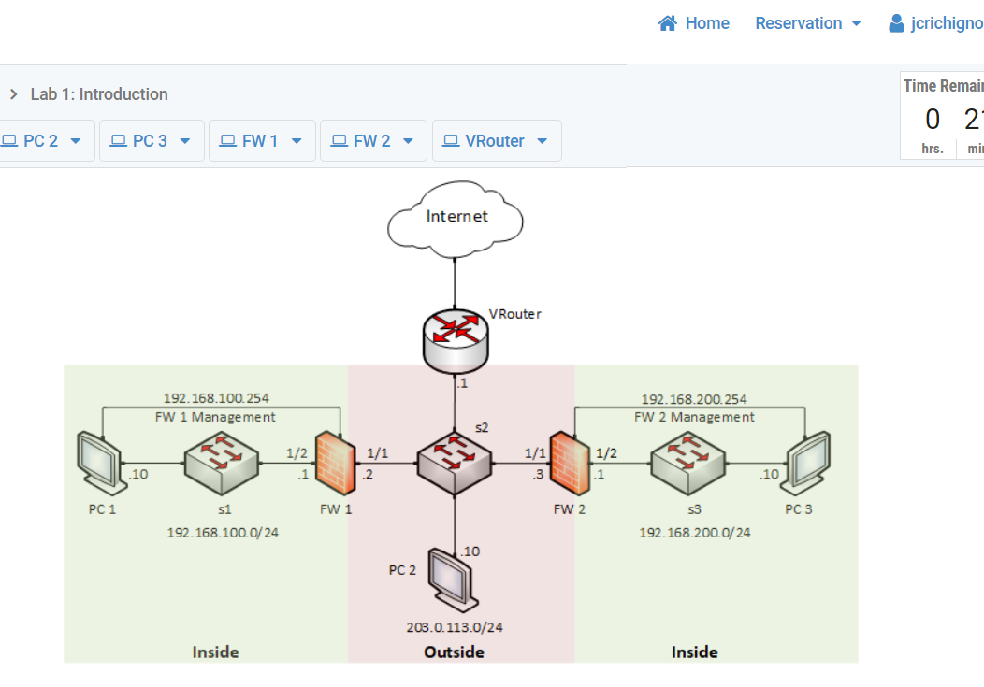
Partnership with Industry
These labs enhance the student’s understanding of how modern firewalls work, referred to as Next-generation Firewalls (NGFWs)
Next-generation Firewall Virtual Machine + licenses
Pod deployed in private cloud

Slide 24
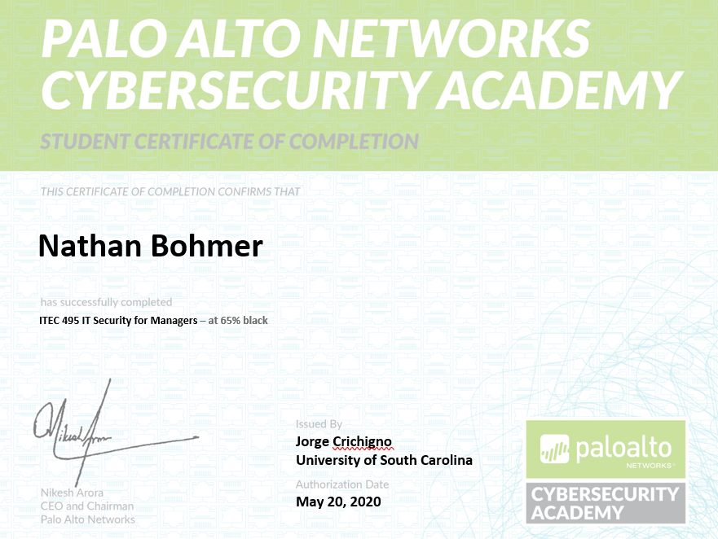
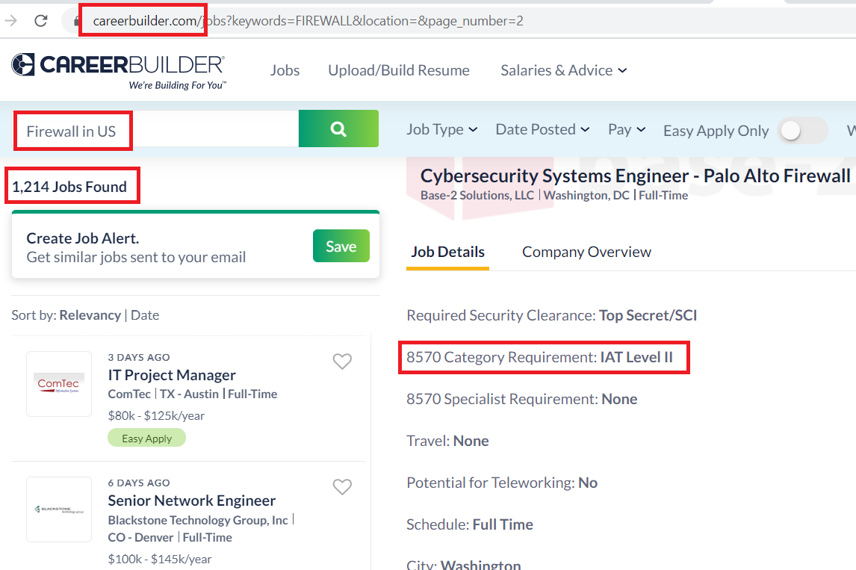
Partnership with Industry
These labs enhance the student’s understanding of how modern firewalls work, referred to as Next-generation Firewalls (NGFWs)
Additional credentials
Job search

Slide 25
Partnership with Industry
DoD’s Information Assurance (IA) workforce is classified in IA technical (IAT):
  Level 1 (IAT 1): Computing environment information assurance
  Level 2 (IAT 2): Network environment information assurance
Covered in | IAT 1 | IAT 2 | NICE framework | Networks cert.
ITEC 233 Hw/Sw | P
ITEC 293 Cybersec Ops | P
ITEC 293 Cybersec Ops | P | P
ITEC 493 IT Security | P | P
ITEC 245, ITEC 445 |  |  |  | P
ITEC 493 IT Security |  |  | P
ITEC 493 IT Security |  |  | P
NICE: National Initiative for Cybersecurity Education

Slide 26
Distributed Academic Cloud
University of South Carolina (SC), Stanly Community College (NC), and the Network Development Group are building a Distributed Academic Cloud
  NSF Advanced Technology Education: “Multi-state Community College, University and Industry Collaboration to Prepare Learners for 21st Century Information Technology Jobs”
The goal is scalability, using the resources available on campus networks
Industry partnership
Platform use
  Community Colleges
  Universities
  High Schools
  SANS institute (“girlsgocyber”)
  Fort Gordon (U.S. Army Signal School)

Slide 27
Distributed Academic Cloud
Academic Cloud as of January 2021

Slide 28
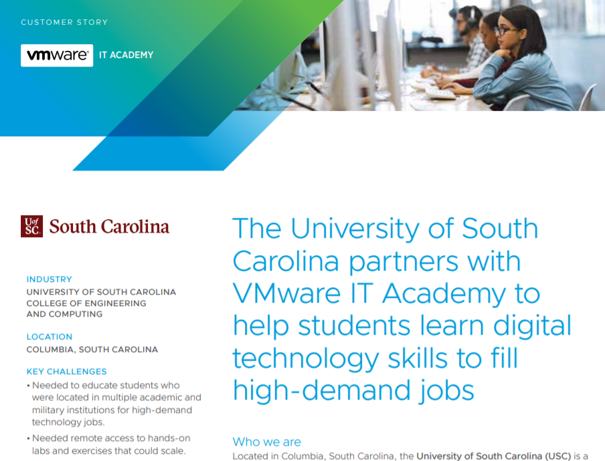
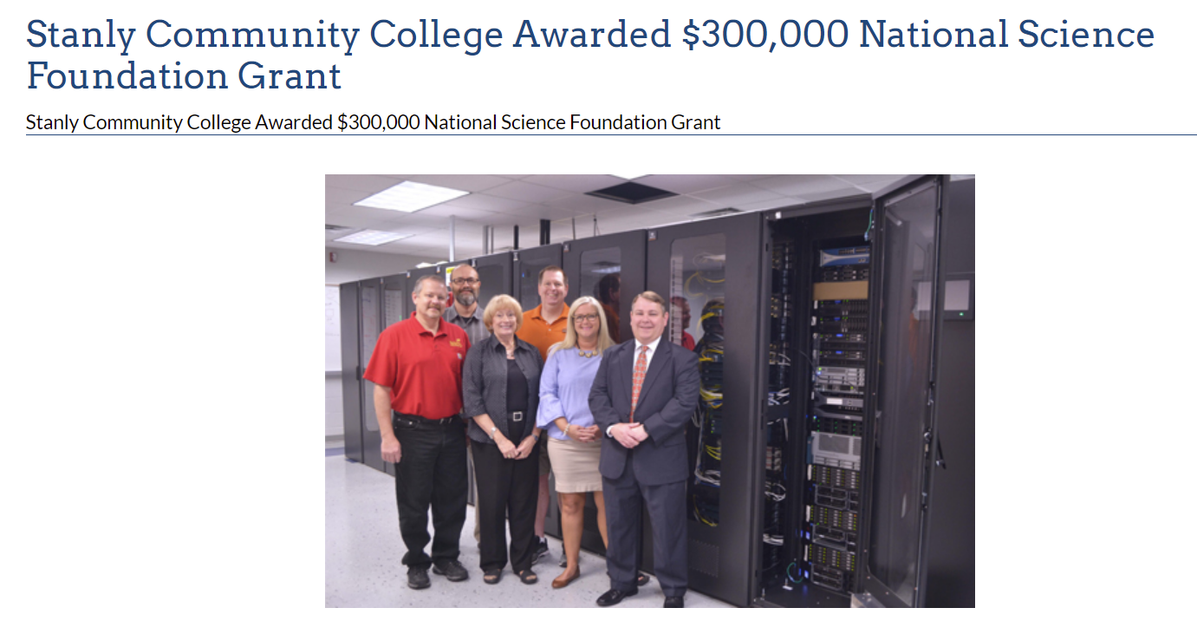
Distributed Academic Cloud
News

Slide 29
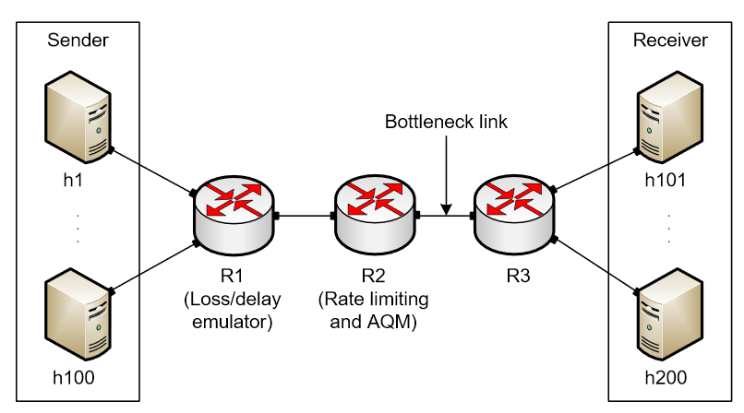
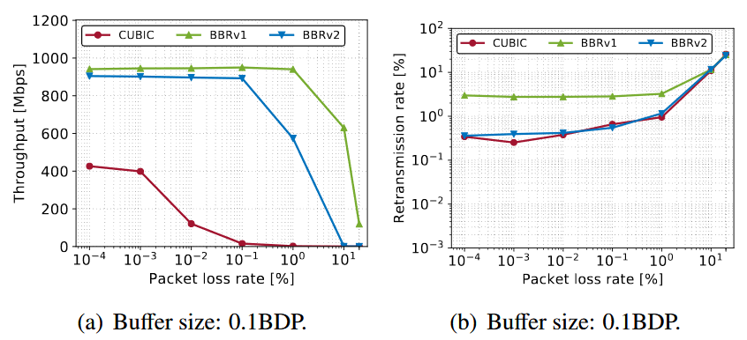
Using Pods for Research
Pods in the virtual platform can be used to conduct experiments
Useful for parallelizing tests
For example, comparing the performance of CUBIC, BBRv1, and BBRv2¹
  Experiments were executed 10 times and the results were averaged
  Each pod is used to execute a single experiment
E. Kfoury, J. Gomez, J. Crichigno, E. Bou-Harb, "An Emulation-based Evaluation of TCP BBRv2 Alpha for Wired Broadband", Computer Communications, July 2020.

Slide 30
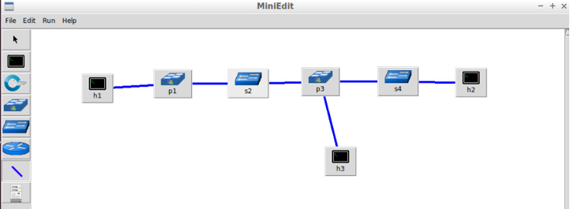
Using Pods for Research
Pods can also be used to enhance the collaboration on a research project
Multiple researchers working in the same environment
Example projects:
  Prototyping an in-network defense scheme using P4 programmable switches
  Offloading conversational media traffic to P4 switches
  Using P4 switches as passive instruments to analyze traffic in a legacy network
Tofino model
software switch

Slide 31


