Slide 1



VIRTUAL LABS ON SDN, Open Virtual
Switches (OvS), CYBERSECURITY, and others
Jorge Crichigno
University of South Carolina
2021 Winter ICT Educators Conference
January 7-8, 2021

Slide 2



Welcome!
I am a faculty member at the University of South Carolina (UofSC)
This session will review labs for NETLAB developed at UofSC using open-source technology

Slide 3
Agenda
Motivation, NETLAB environment
Software-Defined Networking (SDN) labs
Open Virtual Switch (OvS) labs
Zeek Intrusion Detection Systems labs

Slide 4
Motivation
Science, engineering, mobile applications are generating data at an unprecedented rate
From large facilities to portable devices, instruments can produce hundreds of terabytes in short periods of time
Data must be typically transferred across high-throughput high-latency Wide Area Networks (WANs)
The Energy Science Network (ESnet) is the backbone connecting U.S. national laboratories and research centers
Applications
ESnet traffic

Slide 5
Motivation
A biology experiment using the U.S. National Energy Research Scientific Computing Center (NERSC) resources
SnapChat Data produced per day worldwide by millions of people
= 38 TB
One Biology experiment by a team of nine scientists:
= 114 TB
(Photosystem II X-Ray Study)
http://www.nature.com/articles/ncomms5371

Slide 6
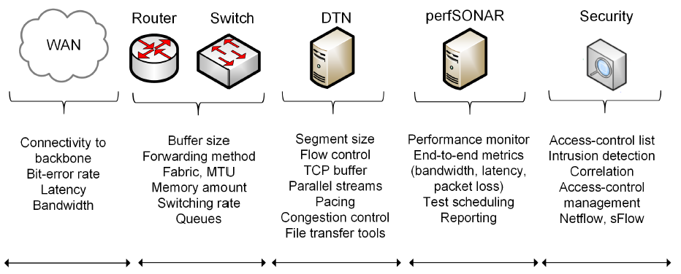
Motivation
There are features in network devices that are important for high performance
L1 L2 / L3 L4/L5 L5 L3/L5

Slide 7
Motivation
How can we teach these topics using a scalable environment?
Requirements
High performance; speeds of ~50 Gbps
Scalability; platform must be capable of cloning pods and expand capacity easily
Real protocol stack, no simulation
Free tools

Slide 8
Motivation
Partnering with the Network Development Group (NDG)
Feature | Private Cloud | Public Cloud
Granularity to allocate physical resources | Very granular | Not granular (access to the physical resources requires additional fees)
Easy to create custom pods | Easy | More difficult; hard to design complex topologies
Cost | Cost effective when used extensively | Cost effective for individual / small virtual machines; costly for large virtual machines over time
Application layer for pedagogy, presentation of virtual scenarios | Very flexible | Not flexible; limited to providers’ interface, e.g., command-line interface
Time-sharing compute resources | The owner controls who can access resources. Easy to implement time-sharing policies | Cloud provider controls who can access resources (typically, a fee is required per user accessing resources)

Slide 9
Environment: Mininet

Slide 10
Mininet
Mininet is a virtual testbed for developing and testing network tools and protocols
It creates a realistic virtual network on any type of machine (VM, cloud-hosted, or native)
Inexpensive solution running in line with production networks
Mininet offers the following features
  Fast prototyping for new networking protocols
  Simplified testing for complex topologies without the need of buying expensive hardware
  Realistic execution as it runs real code on the Unix and Linux kernels
  Open-source environment

Slide 11
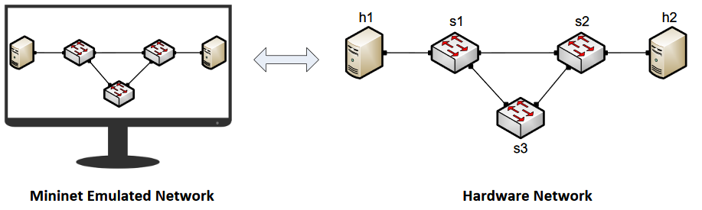
Mininet
Mininet provides network emulation opposed to simulation, allowing all network software at any layer to be simply run as is
Mininet’s logical nodes can be connected into networks
Nodes are sometimes called containers, or more accurately, network namespaces
Containers consume sufficiently few resources that networks of over a thousand nodes have been created, running on a single laptop

Slide 12
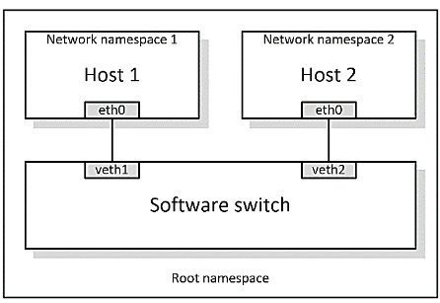
Mininet Nodes
A Mininet container is a process (or group of processes) that no longer has access to all the host system’s native network interfaces
Containers are then assigned virtual Ethernet interfaces, which are connected to other containers through a virtual switch
Mininet connects a host and a switch using a virtual Ethernet (veth) link
The veth link is analogous to a wire connecting two virtual interfaces

Slide 13
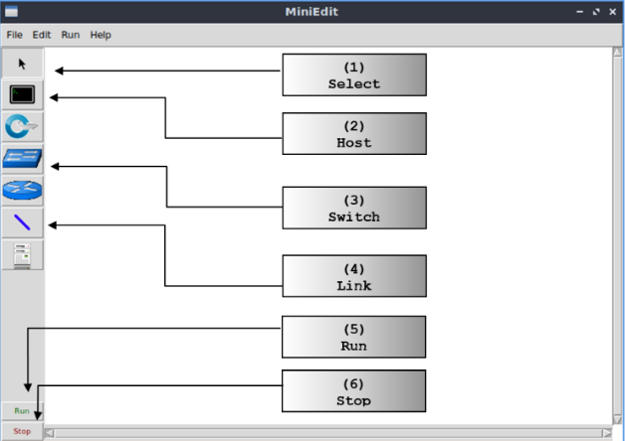
MiniEdit
MiniEdit is a simple GUI network editor for Mininet

Slide 14
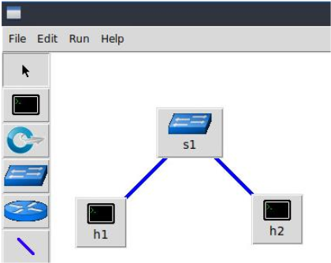
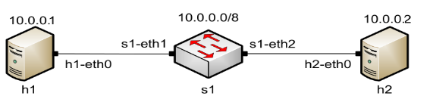
MiniEdit
To build Mininet’s minimal topology, two hosts and one switch must be deployed

Slide 15
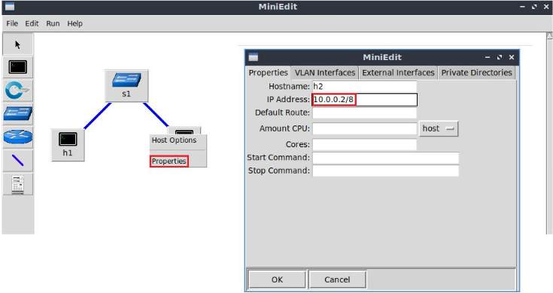
Host Configuration
Configure the IP addresses at host h1 and host h2
A host can be configured by holding the right click and selecting properties on the device

Slide 16
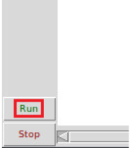
Starting Emulation
Before testing the connection between host h1 and host h2, the emulation must be started
Click on the Run button to start the emulation
The emulation will start and the buttons of the MiniEdit panel will gray out, indicating that they are currently disabled

Slide 17
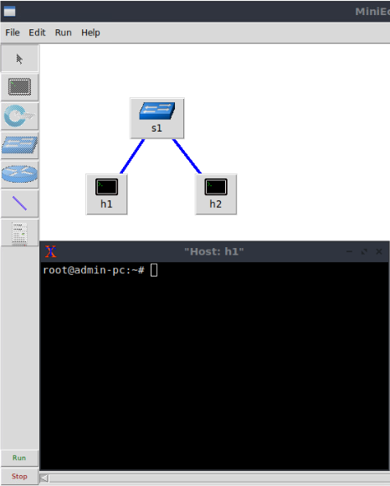
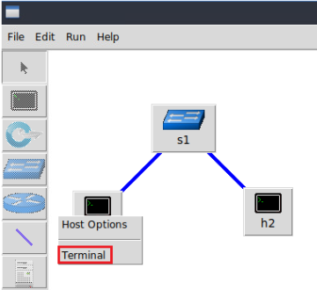
Executing Commands on Hosts
Open a terminal on host by holding the right click and selecting Terminal

Slide 18
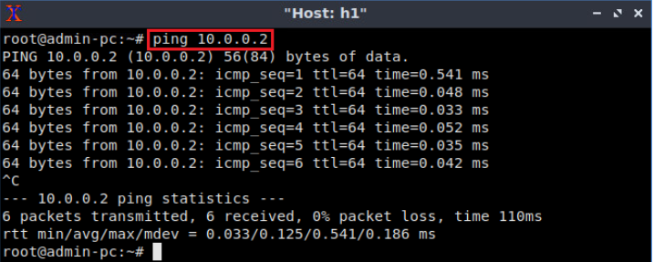
Testing Connectivity
On host h1’s terminal, type the command ping 10.0.0.2

Slide 19
Overview SDN Lab Series

Slide 20
SDN Lab Series
The labs provide learning experiences on essential SDN topics
Mininet
Legacy networks, Border Gateway Protocol (BGP)
FRR routing, an open routing implementation
MPLS networks – early efforts toward SDN
SDN fundamentals – controllers, switches
  ONOS controller
  Open Virtual Switch (OVS)
Traffic isolation with VXLAN
OpenFlow
Interconnection between SDN and legacy Networks

Slide 21
SDN Lab Series
Lab experiments
Lab 1: Introduction to Mininet
Lab 2: Legacy Networks: BGP Example as a distributed system and autonomous forwarding decisions
Lab 3: Early efforts of SDN: MPLS example of a control plane that establishes semi-static forwarding paths
Lab 4: Introduction to SDN
Lab 5: Configuring VXLAN to provide network traffic isolation
Lab 6: Introduction to OpenFlow
Lab 7: SDN-routing within an SDN network
Lab 8: Interconnection between legacy networks and SDN networks
Lab 9: Configuring Virtual Private LAN Services (VPLS) with SDN networks
Lab 10: Appling Equal-Cost Multi-Path (ECMP) within SDN networks

Slide 22
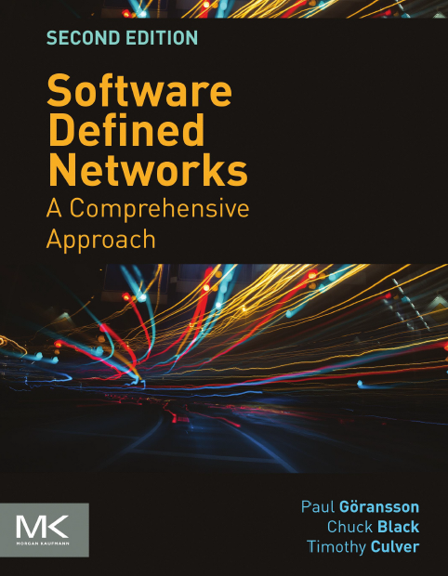
SDN Lab Series
The goal of the SDN Lab Series is to provide a practical experience to students and IT practitioners
The labs provide background information which is reinforced with hands-on activities
A good book on SDN network (which matches the SDN Lab Series) is “Software Defined Networking, A Comprehensive Approach”

Slide 23
Organization of Lab Manuals
Each lab starts with a section Overview
  Objectives
  Lab settings: passwords, device names
  Roadmap: organization of the lab
Section 1
  Background information of the topic being covered (e.g., fundamentals of TCP congestion control)
  Section 1 is optional (i.e., the reader can skip this section and move to lab directions)
Section 2… n
  Step-by-step directions

Slide 24
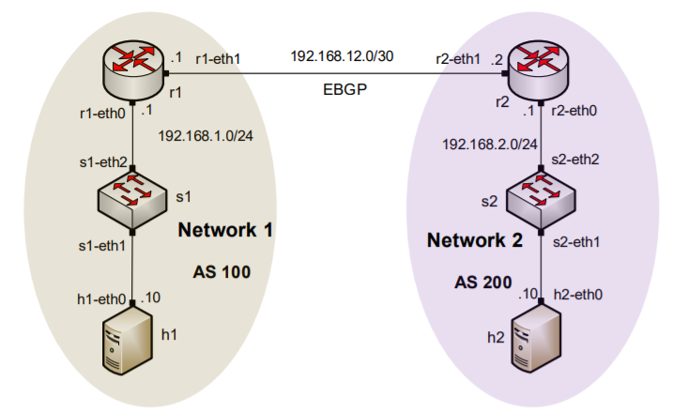
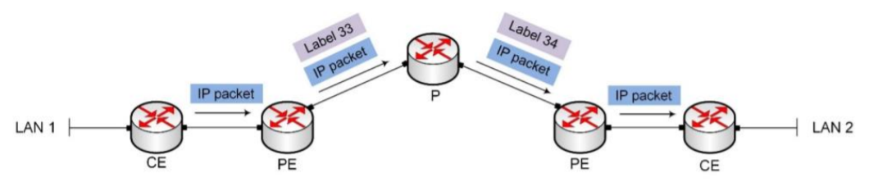
Examples
Legacy networks
BGP scenario
MPLS scenario

Slide 25
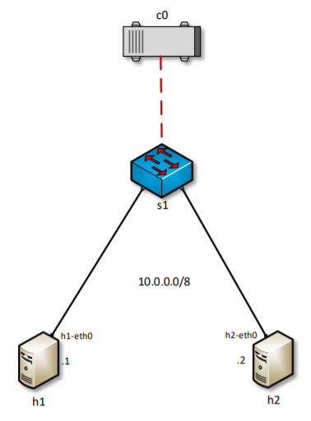
Examples
SDN networks

Slide 26
Examples
Interconnection of SDN
and legacy networks

Slide 27
Overview Open Virtual Switch Lab Series

Slide 28
Open vSwitch Lab Series
Open vSwitch (OvS), is an open-source implementation of a distributed virtual multilayer switch
The main purpose of OvS is to provide a switching stack for hardware virtualization environments, while supporting multiple protocols and standards
The lab series provides a practical experience on Open vSwitch features
  Linux Namespaces
  OpenFlow
  Traffic isolation with VLAN
  Open vSwitch Kernel Datapath

Slide 29
Open vSwitch Lab Series
Lab experiments
Lab 1: Introduction to Linux namespaces and Open vSwitch
Lab 2: Introduction to Mininet
Lab 3: Open vSwitch Flow table
Lab 4: Introduction to Open vSwitch
Lab 5: Implementing VLANs in Open vSwitch
Lab 6: VLAN trunking in Open vSwitch
Lab 7: Implementing Routing in Open vSwitch
Lab 8: Open vSwitch Database Management Protocol (OVSDB)
Lab 9: Open vSwitch Kernel Datapath
Lab 10: Configuring Stateless Firewall using ACLs
Lab 11: Configuring Stateful Firewall using Connection Tracking
Lab 12: Configuring GRE Tunnel

Slide 30
Organization of Lab Manuals
Each lab starts with a section Overview
  Objectives
  Lab settings: passwords, device names
  Roadmap: organization of the lab
Section 1
  Background information of the topic being covered (e.g., fundamentals of TCP congestion control)
  Section 1 is optional (i.e., the reader can skip this section and move to lab directions)
Section 2… n
  Step-by-step directions

Slide 31
Overview Zeek Intrusion Detection Lab Series

Slide 32
Zeek Lab Series
The lab series introduces learners to an emulated Intrusion Detection System (IDS) that actively monitors live networks for malicious traffic, policy violations and unidentified anomalies
It helps students to acquire hands-on skills on
  Understanding Network Intrusion Detection Systems
  Creating scripts to identify network traffic signatures
  Emulating scenarios to detect Denial of Service (DoS) attacks
  Developing Machine Learning classifiers for anomaly inference and classification

Slide 33
Zeek Lab Series
The lab series can be partitioned into four parts
Overview of the basic features of Zeek such as parsing, reading and organizing Zeek log files
Generating, capturing and analyzing network traffic using open-source tools (e.g., nmap, tcpdump, Wireshak)
Introduction to Zeek scripting
Using Machine Learning features to infer and classify anomalies

Slide 34
Zeek Lab Series
Lab experiments
Lab 1: Introduction to the Capabilities of Zeek
Lab 2: An Overview of Zeek Logs
Lab 3: Parsing, Reading and Organizing Zeek Log Files
Lab 4: Generation, Capturing and Analyzing Network Scanner Traffic
Lab 5: Generation, Capturing and Analyzing DoS and DDoS-centric Network Traffic
Lab 6: Introduction to Zeek Scripting
Lab 7: Introduction to Zeek Signatures
Lab 8: Advanced Zeek Scripting for Anomaly and Malicious Event Detection
Lab 9: Profiling and Performance Metrics of Zeek
Lab 10: Application of the Zeek IDS for Real-Time Network Protection
Lab 11: Preprocessing of Zeek Output Logs for Machine Learning
Lab 12: Developing Machine Learning Classifiers for Anomaly Inference and Classification

Slide 35
Organization of Lab Manuals
Each lab starts with a section Overview
  Objectives
  Lab settings: passwords, device names
  Roadmap: organization of the lab
Section 1
  Background information of the topic being covered (e.g., creating Zeek scripts for anomaly detection)
  Section 1 is optional (i.e., the reader can skip this section and move to lab directions)
Section 2… n
  Step-by-step directions

Slide 36

Thank you
www.wastc.org

