Slide 1





Available Lab Libraries for
Science DMZ Topics
Elie Kfoury
University of South Carolina (USC)
https://research.cec.sc.edu/cyberinfra
University of South Carolina (USC)
The Engagement and Performance Operations Center (EPOC)
Minority Serving - Cyberinfrastructure Consortium (MS-CC)
Hands-on Workshop on Science DMZ and P4-DPDK
Tuesday, April 15, 2025.

Slide 2
Network Tools and Protocols Lab Series
The CI-Lab at the University of South Carolina (USC) developed a set of hands-on labs for Science DMZ topics
Lab experiments
Lab 1: Introduction to Mininet
Lab 2: Introduction to iPerf
Lab 3: WANs with latency, Jitter
Lab 4: WANs with Packet Loss, Duplication, Corruption
Lab 5: Setting WAN Bandwidth with Token Bucket Filter (TBF)
Lab 6: Traditional TCP Congestion Control (HTCP, Cubic, Reno)
Lab 7: Rate-based TCP Congestion Control (BBR)
Lab 8: Bandwidth-delay Product and TCP Buffer Size
Lab 9: Enhancing TCP Throughput with Parallel Streams
Lab 10: Measuring TCP Fairness
Lab 11: Router’s Buffer Size
Lab 12: TCP Rate Control with Pacing
Lab 13: Impact of Maximum Segment Size on Throughput
Lab 14: Router’s Bufferbloat
Lab 15: Hardware Offloading on TCP Performance
Lab 16: Random Early Detection
Lab 17: Stochastic Fair Queueing
Lab 18: Controlled Delay (CoDel) Active Queue Management
Lab 19: Proportional Integral Controller-Enhanced (PIE)
Lab 20: Classifying TCP traffic using Hierarchical Token Bucket (HTB)
Lab 21: Enabling Large Data Transfers across a Science DMZ
Lab 22: Understanding UDP Abuses

Slide 3
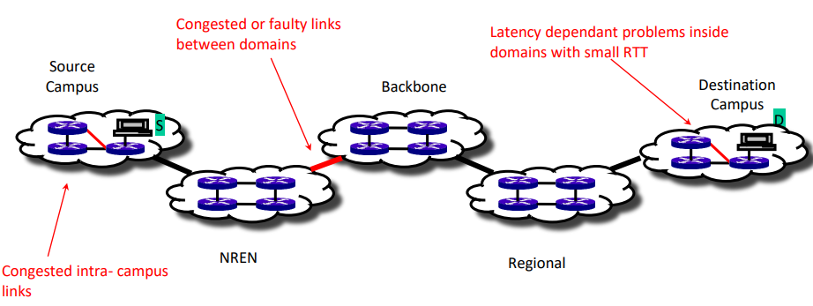
End-to-end Monitoring with perfSONAR
perfSONAR provides a snapshot of the network performance
  Throughput, latency, packet losses, etc.

Slide 4
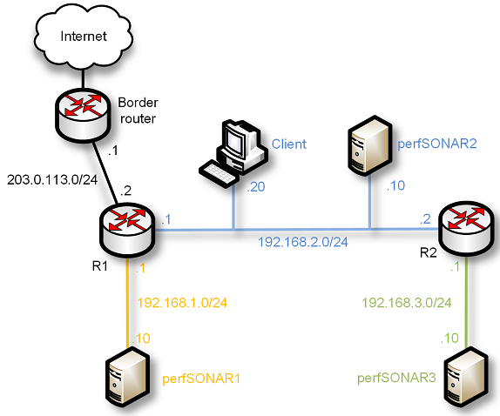
perfSONAR 5 Lab Library
The CI-Lab at the University of South Carolina (USC) developed a set of hands-on labs that navigate through the components of perfSONAR
perfSONAR Toolkit + Central Management
PWA
perfSONAR Toolkit
perfSONAR installation options

Slide 5
perfSONAR 5 Lab Library
Lab 1: Introduction to Mininet
Lab 2: Setting Administrative Information via perfSONAR Toolkit GUI
Lab 3: Scheduling Regular Tests Using perfSONAR GUI
Lab 4: Configuring Regular Tests Using pScheduler CLI Part I (throughput, latency, and traceroute)
Lab 5: Configuring Regular Tests Using pScheduler CLI Part II (repeat, store, monitor, and cancel)
Lab 6: Defining Regular Tests with a pSConfig Template
Lab 7: Configuring pScheduler Limits
Lab 8: Visualizing pScheduler Measurements using Grafana
Lab 9: Observing the Impact of TCP Window Scaling and Small TCP Buffer Sizes
Lab 10: Investigating the Effects of MTU Mismatch

Slide 6
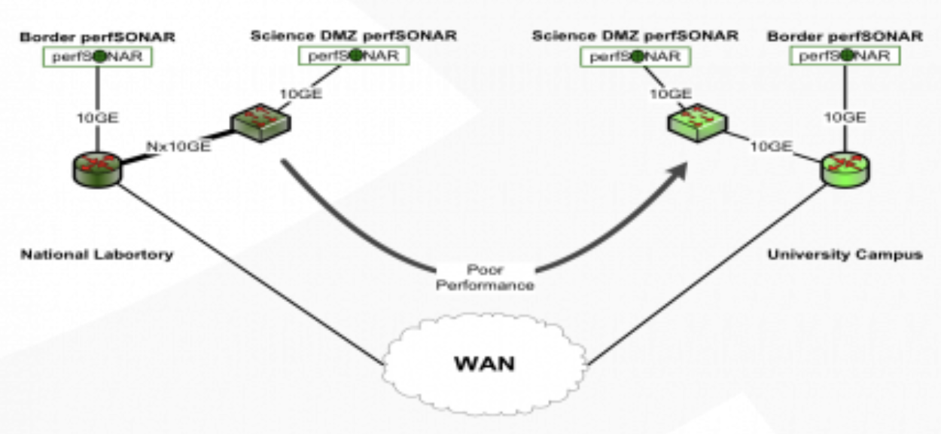
Long Distance Troubleshooting
Poor performance from a National Lab to the university campus
The WAN is 10Gbps, the university’s link capacity is 5Gbps

Slide 7
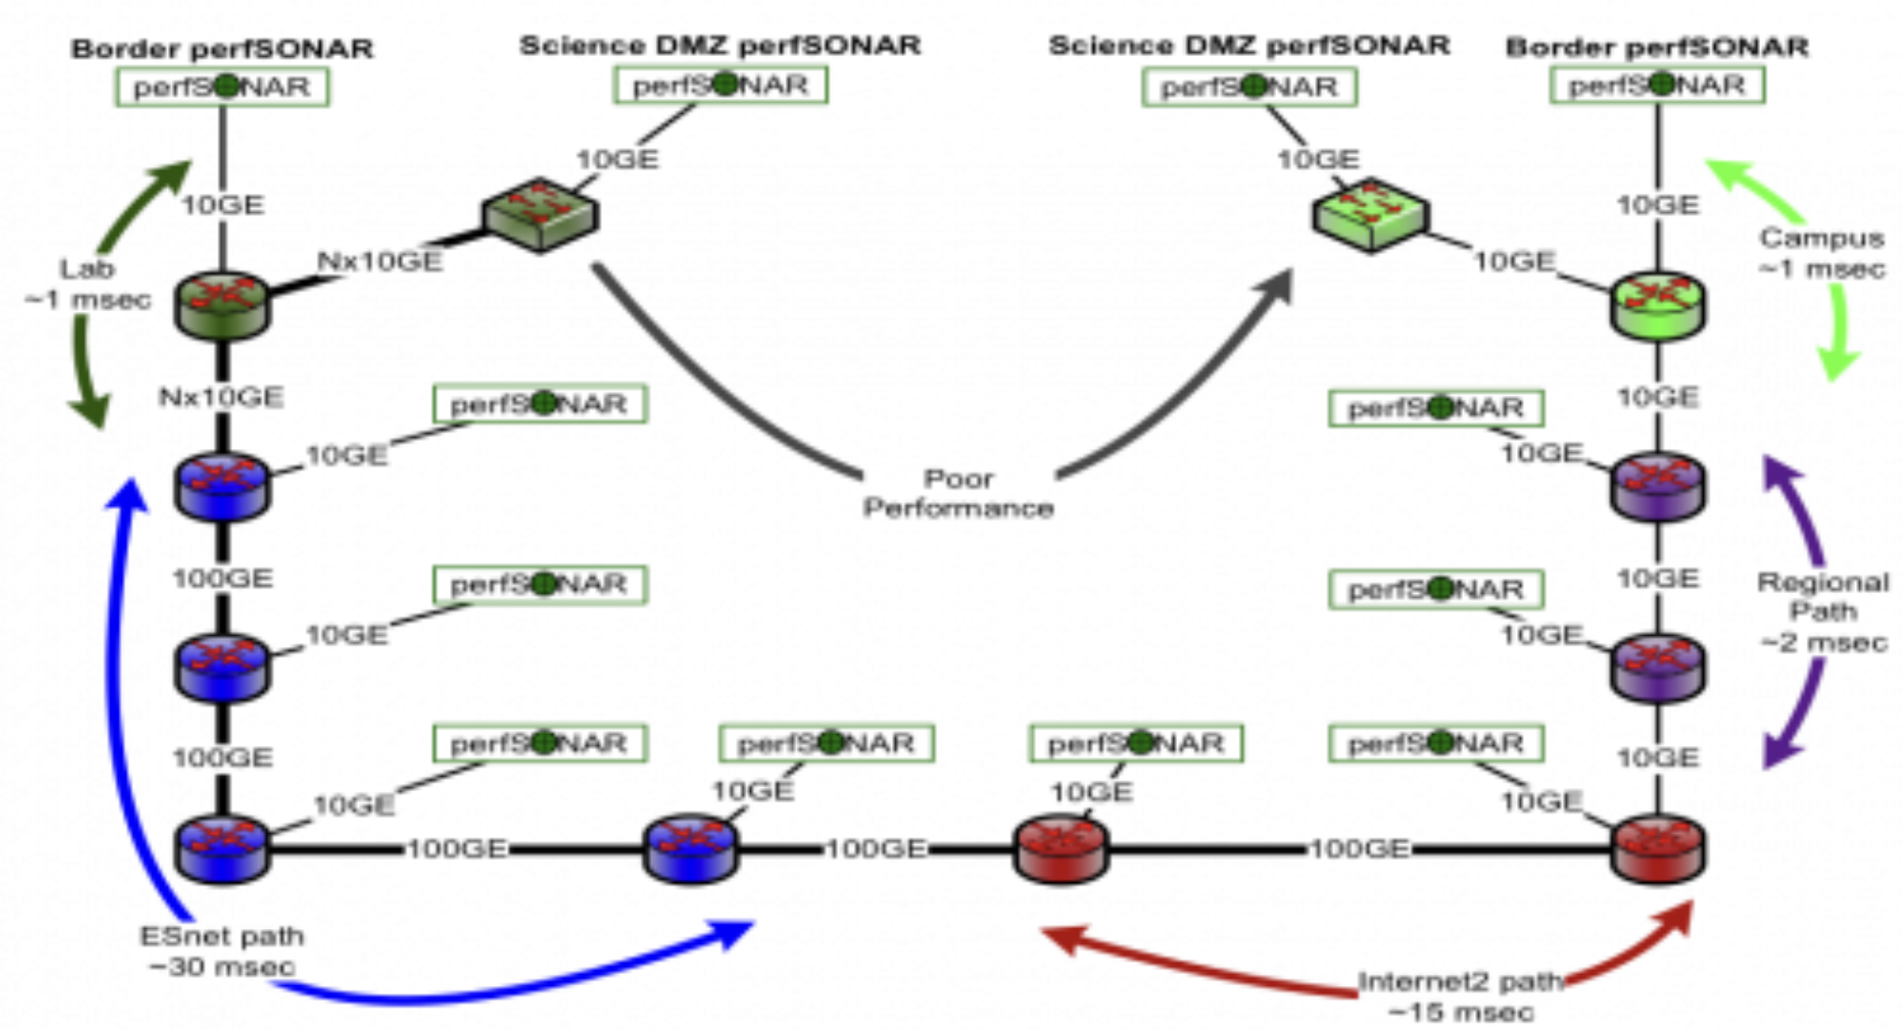
Long Distance Troubleshooting
Traceroute revealed the path hops
perfSONAR tests helped localizing the problem

Slide 8
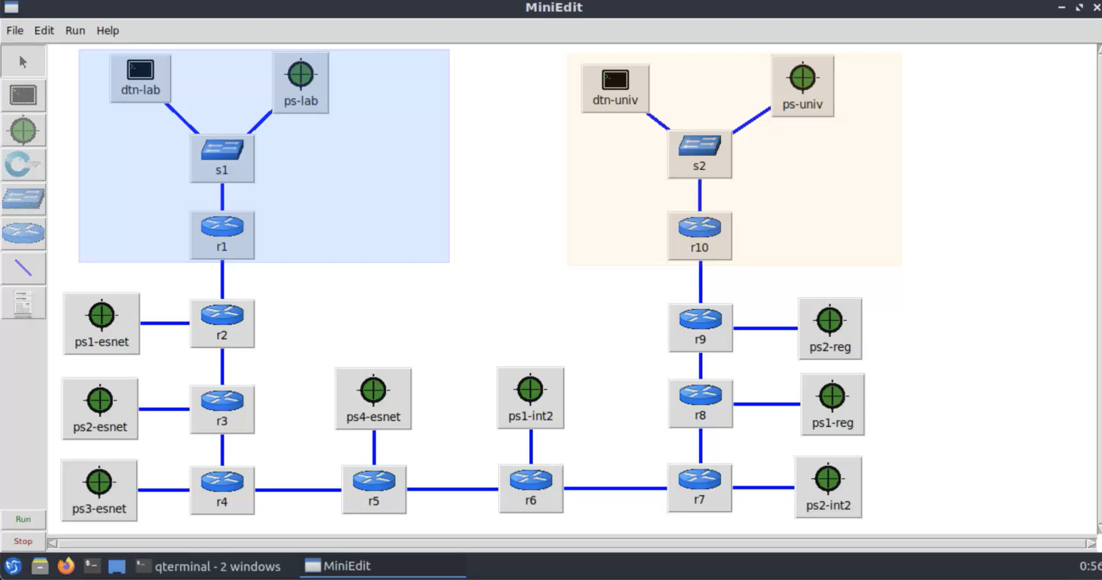
Demo

