Slide 1

Network Performance and Measurements
Jorge Crichigno
College of Engineering and Computing
University of South Carolina
http://ce.sc.edu/cyberinfra
NSF Workshop - Navajo Technical University
Arizona State University
January 30, 2023

Slide 2
Agenda
Review – Science DMZ
Network performance and measurements
  Importance
  Examples
Lessons learned and observations – FABRIC
Trends
  Programmable switch ASICs
  Fine-grained measurements
Opportunities and challenges
Notes:
NOTE: We recommend you download this document in order to make changes and then email your final version to be published. Click on the “File” tab at the top left and then click “Download”. - best, tracey@thequilt.net

Slide 3
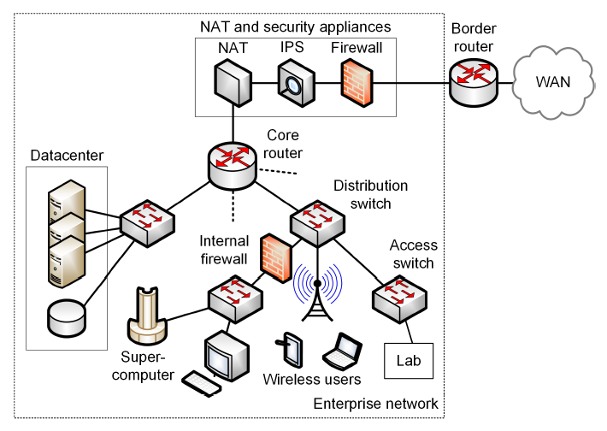
Review – Science DMZ
Security appliances (IPS, firewalls, etc.) are CPU-intensive
Small-buffer routers and switches are incapable of absorbing traffic bursts
Even a small packet loss rate reduces throughput
Transfers of big science data may last days or even weeks
¹E. Dart, L. Rotman, B. Tierney, M. Hester, J. Zurawski, “The science dmz: a network design pattern for data-intensive science,” International Conference on High Performance Computing, Networking, Storage and Analysis, Nov. 2013.
Notes:
NOTE: We recommend you download this document in order to make changes and then email your final version to be published. Click on the “File” tab at the top left and then click “Download”. - best, tracey@thequilt.net

Slide 4
Review – Science DMZ
The Science DMZ is a network designed for big science data¹
Main elements
  High throughput, friction free WAN paths (no inline security appliances)
  Switches with large buffer size
  Data Transfer Nodes (DTNs)
  Security = Access-Control List (ACLs) + offline
  appliance/s (IDS)
  End-to-end measurements = perfSONAR
¹E. Dart, L. Rotman, B. Tierney, M. Hester, J. Zurawski, “The science dmz: a network design pattern for data-intensive science,” International Conference on High Performance Computing, Networking, Storage and Analysis, Nov. 2013.
Notes:
NOTE: We recommend you download this document in order to make changes and then email your final version to be published. Click on the “File” tab at the top left and then click “Download”. - best, tracey@thequilt.net

Slide 5
Review – Science DMZ
The Science DMZ is a network designed for big science data¹
Main elements
  High throughput, friction free WAN paths (no inline security appliances)
  Switches with large buffer size
  Data Transfer Nodes (DTNs)
  Security = Access-Control List (ACLs) + offline
  appliance/s (IDS)
  End-to-end measurements = perfSONAR
¹E. Dart, L. Rotman, B. Tierney, M. Hester, J. Zurawski, “The science dmz: a network design pattern for data-intensive science,” International Conference on High Performance Computing, Networking, Storage and Analysis, Nov. 2013.
Notes:
NOTE: We recommend you download this document in order to make changes and then email your final version to be published. Click on the “File” tab at the top left and then click “Download”. - best, tracey@thequilt.net

Slide 6
Network Performance and Measurements
The following metrics are often used to measure network performance:
  Packet loss
  Throughput (e.g., “how much can I get out of the network”)
  Latency / round-trip time (RTT)
Notes:
NOTE: We recommend you download this document in order to make changes and then email your final version to be published. Click on the “File” tab at the top left and then click “Download”. - best, tracey@thequilt.net

Slide 7
Network Performance and Measurements
Soft failures are those failures that do not disrupt connectivity, but may prevent high performance
  Critical in high-throughput high-latency networks
Notes:
https://www.ietf.org/rfc/rfc793.txt (1981)

Slide 8
Network Performance and Measurements
perfSONAR provides information that reflects the state of the network, in a multi-domain basis
perfSONAR = Measurement Middleware
Notes:
NOTE: We recommend you download this document in order to make changes and then email your final version to be published. Click on the “File” tab at the top left and then click “Download”. - best, tracey@thequilt.net

Slide 9
Network Performance and Measurements
Measurements allow us to:
  Learn the performance limits (e.g., maximum throughput, minimum delay)
  Discover the current state of the network
  Modify configuration rules
  Implement a control loop
Notes:
NOTE: We recommend you download this document in order to make changes and then email your final version to be published. Click on the “File” tab at the top left and then click “Download”. - best, tracey@thequilt.net

Slide 10
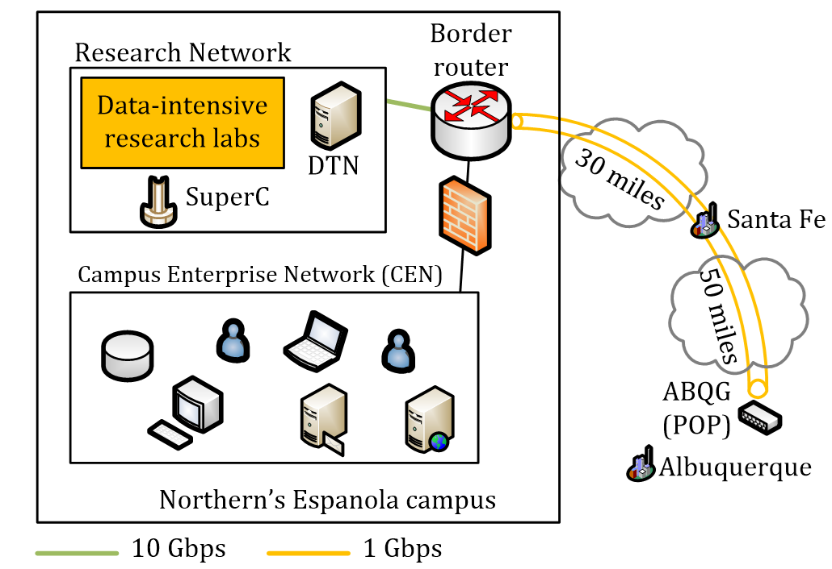
Network Performance and Measurements
Example 1: connection from Northern New Mexico College (Espanola, NM) to Albuquerque GigaPop (Albuquerque, NM)
Notes:
NOTE: We recommend you download this document in order to make changes and then email your final version to be published. Click on the “File” tab at the top left and then click “Download”. - best, tracey@thequilt.net

Slide 11
Network Performance and Measurements
Example 1: connection from Northern New Mexico College (Espanola, NM) to Albuquerque GigaPop (Albuquerque, NM)
perfSONAR measured a throughput of ~50 Mbps, latency > 30ms
Notes:
NOTE: We recommend you download this document in order to make changes and then email your final version to be published. Click on the “File” tab at the top left and then click “Download”. - best, tracey@thequilt.net

Slide 12
Network Performance and Measurements
Example 1: connection from Northern New Mexico College (Espanola, NM) to Albuquerque GigaPop (Albuquerque, NM)
perfSONAR measured a throughput of ~50 Mbps, latency > 30ms
Notes:
NOTE: We recommend you download this document in order to make changes and then email your final version to be published. Click on the “File” tab at the top left and then click “Download”. - best, tracey@thequilt.net

Slide 13
Network Performance and Measurements
Example 2: 10 Gbps WAN, 50ms RTT, TCP CUBIC (default TCP algorithm in Linux)
Notes:
NOTE: We recommend you download this document in order to make changes and then email your final version to be published. Click on the “File” tab at the top left and then click “Download”. - best, tracey@thequilt.net

Slide 14

Network Performance and Measurements
Example 2: 10 Gbps WAN, 50ms RTT, TCP CUBIC (default TCP algorithm in Linux)
Notes:
NOTE: We recommend you download this document in order to make changes and then email your final version to be published. Click on the “File” tab at the top left and then click “Download”. - best, tracey@thequilt.net

Slide 15
Network Performance and Measurements
Example 2: 10 Gbps WAN, 50ms RTT, TCP BBR
Notes:
NOTE: We recommend you download this document in order to make changes and then email your final version to be published. Click on the “File” tab at the top left and then click “Download”. - best, tracey@thequilt.net

Slide 16
Network Performance and Measurements
Example 2: 10 Gbps WAN, 50ms RTT, TCP BBR
Notes:
NOTE: We recommend you download this document in order to make changes and then email your final version to be published. Click on the “File” tab at the top left and then click “Download”. - best, tracey@thequilt.net

Slide 17
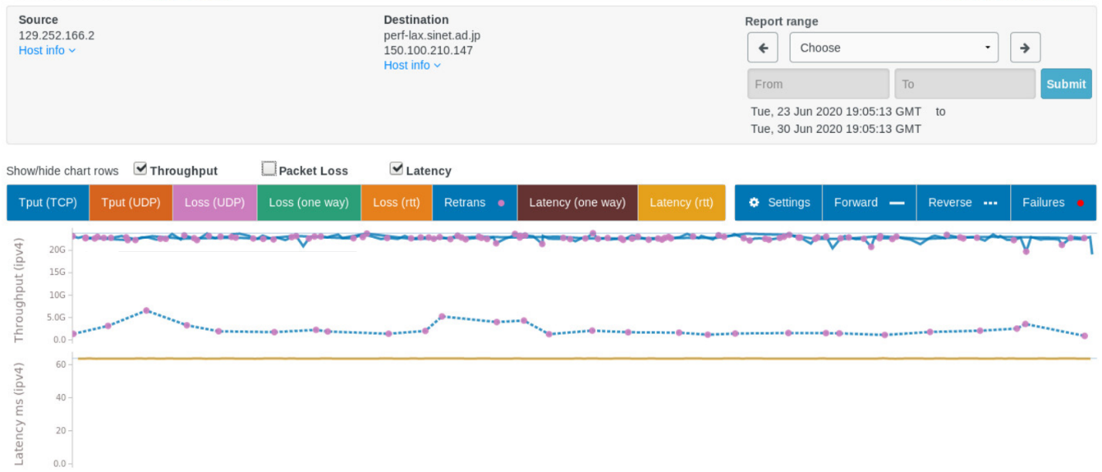
Network Performance and Measurements
Example 2: 60ms RTT path from Columbia (SC) to Los Angeles (CA)
Notes:
NOTE: We recommend you download this document in order to make changes and then email your final version to be published. Click on the “File” tab at the top left and then click “Download”. - best, tracey@thequilt.net

Slide 18
Lessons Learned
Network measurements are essential for performance
  Classic monitoring systems are good at alerting hard failures (e.g., SNMP, NOC tools indicate when hardware ceases to function, a power failure occurs)
  perfSONAR helps identify soft failures
There is training periodically offered by the CI community
  Are there new alternatives to the Science DMZ model?
Notes:
NOTE: We recommend you download this document in order to make changes and then email your final version to be published. Click on the “File” tab at the top left and then click “Download”. - best, tracey@thequilt.net

Slide 19
Lessons Learned
Measurements illustrated in the original Science DMZ paper
Notes:
NOTE: We recommend you download this document in order to make changes and then email your final version to be published. Click on the “File” tab at the top left and then click “Download”. - best, tracey@thequilt.net

Slide 20
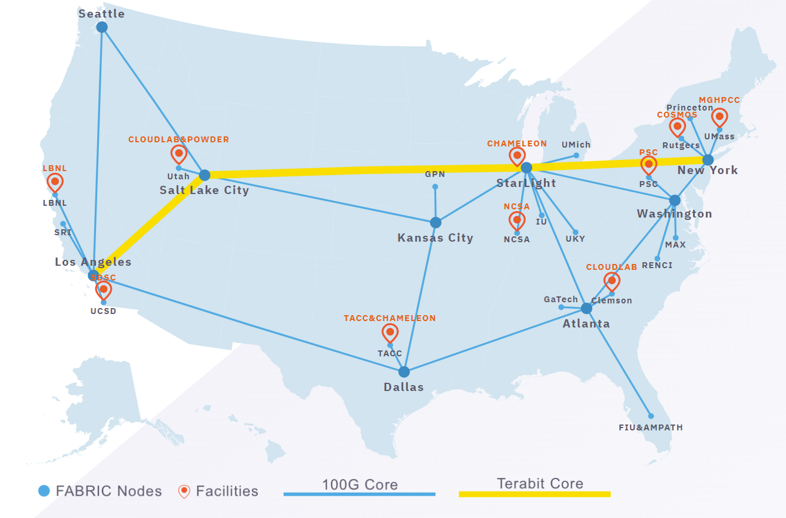
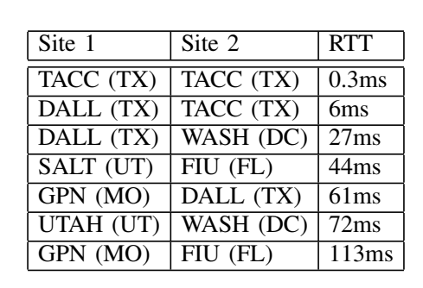
Lessons Learned
Some measurements on FABRIC
Notes:
NOTE: We recommend you download this document in order to make changes and then email your final version to be published. Click on the “File” tab at the top left and then click “Download”. - best, tracey@thequilt.net

Slide 21
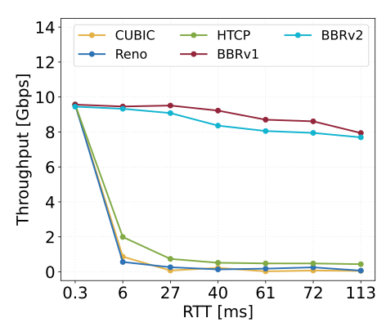
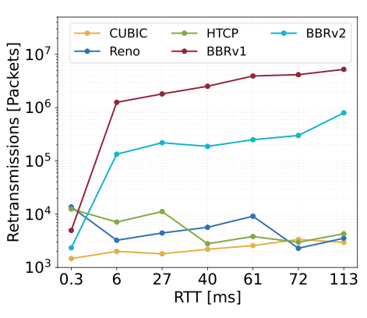
Lessons Learned
Performance measurements for a single flow, 0.0046% packet loss rate
Notes:
NOTE: We recommend you download this document in order to make changes and then email your final version to be published. Click on the “File” tab at the top left and then click “Download”. - best, tracey@thequilt.net

Slide 22
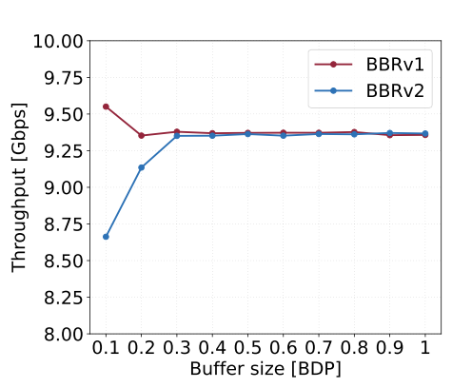
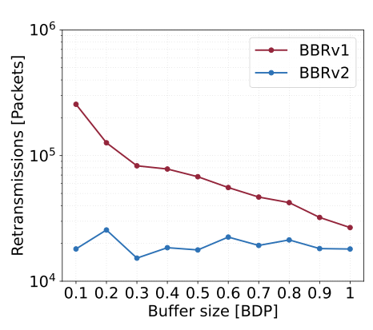
Lessons Learned
Performance measurements for a single flow, 0.0046% packet loss rate
Notes:
NOTE: We recommend you download this document in order to make changes and then email your final version to be published. Click on the “File” tab at the top left and then click “Download”. - best, tracey@thequilt.net

Slide 23
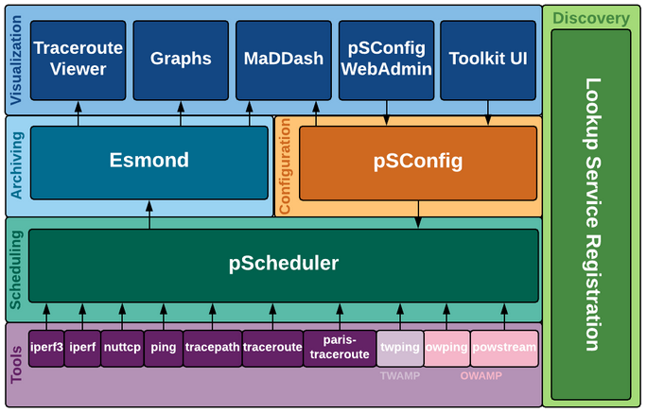
Trends in Network Performance and Measurements
The networking community has been using the same measurement tools for years
  Ping: initially released in 1983
  Traceroute: initially released in 1987
  SNMP: the original RFC appeared in 1988
perfSONAR layers
Notes:
NOTE: We recommend you download this document in order to make changes and then email your final version to be published. Click on the “File” tab at the top left and then click “Download”. - best, tracey@thequilt.net

Slide 24
Trends in Network Performance and Measurements
The networking community has been using the same measurement tools for years
  Ping: initially released in 1983
  Traceroute: initially released in 1987
  SNMP: the original RFC appeared in 1988
They produce measurements over long time periods (coarse-grained measurements)
Traceroute packets may follow a different path than the data packets

Slide 25
Trends in Network Performance and Measurements
Can we obtain fine-grained measurements?
Barrier: the CI engineer is limited by what the equipment vendor implements
  The switch ASIC is designed with fixed functions (hard-coded) by the chip designer

Slide 26


Programmable Switch ASICs
We now have the technology that permits CI engineers to run customized functions
CI Engineer
Switch
P4 Code
CPU-based control plane
Control Plane
compiler
Data Plane
Programmable parser, tables, arithmetic logic
units (ALUs), programmable deparser, …
Switch
ASIC

Slide 27
Programmable Switch ASICs
We now have the technology that permits CI engineers to run customized functions
  Designed for packet processing operations
CI Engineer
Switch
P4 Code
CPU-based control plane
Control Plane
compiler
Data Plane
Programmable parser, tables, arithmetic logic
units (ALUs), programmable deparser, …
Switch
ASIC

Slide 28
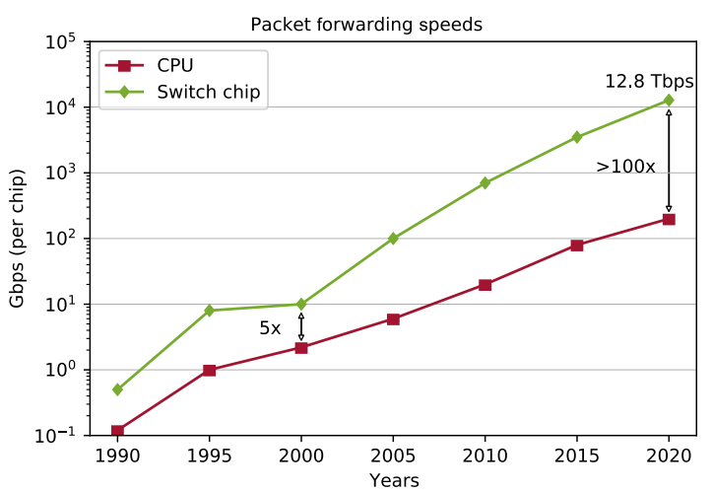
Programmable Switch ASICs
We now have the technology that permits CI engineers to run customized functions
  Designed for packet processing operations
  Much faster than general-purpose CPUs for processing packets
N. McKeown, “Creating an End-to-End Programming Model for Packet Forwarding,” Netdev 0x14 Conference 2020, https://www.youtube.com/watch?v=fiBuao6YZl0&t=619s.

Slide 29
Programmable Switch ASICs
We now have the technology that permits CI engineers to run customized functions
  Designed for packet processing operations
  Much faster than general-purpose CPUs for processing packets
  Limited SRAM memory capacity
CI Engineer
Switch
P4 Code
CPU-based control plane
Control Plane
compiler
Data Plane
Programmable parser, tables, arithmetic logic
units (ALUs), programmable deparser, …
Switch
ASIC

Slide 30
Programmable Switch ASICs
We can track flows in the data plane
  Science DMZs do not need to track millions of flows (enough SRAM memory available)
  NOTE: legacy CPU-based appliances (e.g., firewalls, IDS) cannot process packets fast enough; need large DRAM memory to track millions of flows; eject large flows’ control connections prematurely

Slide 31
Programmable Switch ASICs
Can we exploit the visibility provided by programmable ASICs on non-programmable networks? Solution would:
  Be less disruptive
  Foster incremental use of programmable ASICs
  Not need to deploy complex code at once

Slide 32
Programmable Switch ASICs
Traditional Science DMZ with optical passive taps feeding a programmable ASIC

Slide 33
Fine-grained Measurements
Granular RTT calculation

Slide 34
Fine-grained Measurements

Slide 35
Fine-grained Measurements
Granular RTT calculation - Applications
  Calculating the optimal buffer size (a function of the average RTT of all large flows crossing the switch)
  Detecting bad routing decisions, hijacking, reflected in large RTTs

Slide 36
Fine-grained Measurements
Customized firewall, without adding any additional processing on Science DMZ devices

Slide 37
Fine-grained Measurements
Customized firewall, without adding any additional processing on Science DMZ devices

Slide 38
Fine-grained Measurements
Fine-grained measurements of buffer occupancy of legacy devices
  Legacy measurements (e.g., SNMP) provide only coarse-grained measurements
  E.g., Juniper MX-204 router provides one SNMP sample per minute

Slide 39
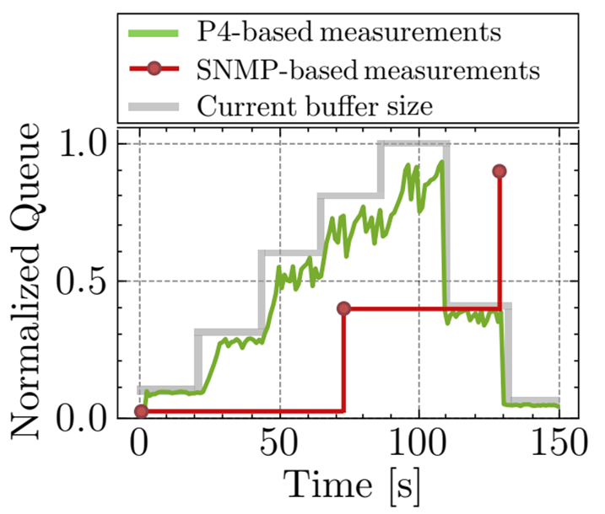
Fine-grained Measurements
Fine-grained measurements of buffer occupancy of legacy devices
  Legacy measurements (e.g., SNMP) provide only coarse-grained measurements
  E.g., Juniper MX-204 router provides one SNMP sample per minute
  Programmable switches provide a high precision timer, full visibility of all packets

Slide 40
Fine-grained Measurements
Fine-grained measurements of packet loss of legacy devices
  Legacy measurements (e.g., SNMP) provide only coarse-grained measurements (often erroneous)

Slide 41
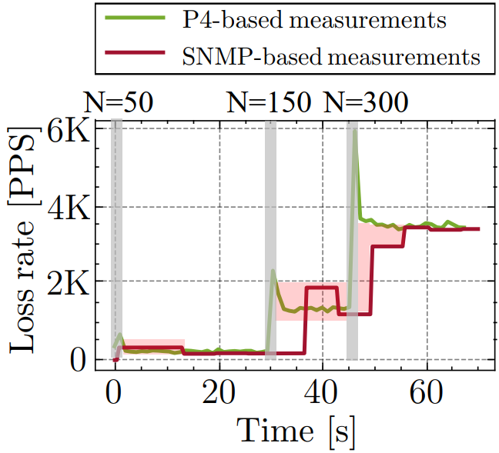
Fine-grained Measurements
Fine-grained measurements of packet loss of legacy devices
  Legacy measurements (e.g., SNMP) provide only coarse-grained measurements (often erroneous)
  Programmable switches can compute packet loss rates accurately and promptly
50 / 150 / 300 flows enter the network

Slide 42
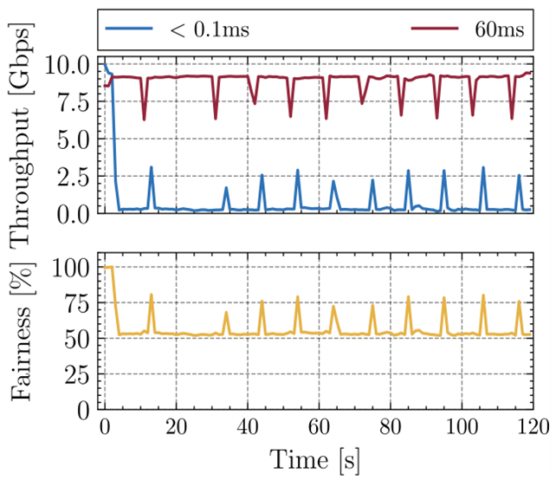
Fine-grained Measurements
Traffic separation based on RTT
  If multiple flows with different RTTs compete, TCP favors one flow over the other
RTT unfairness in a 10 Gbps network. Two BBRv2 flows sharing the network.

Slide 43
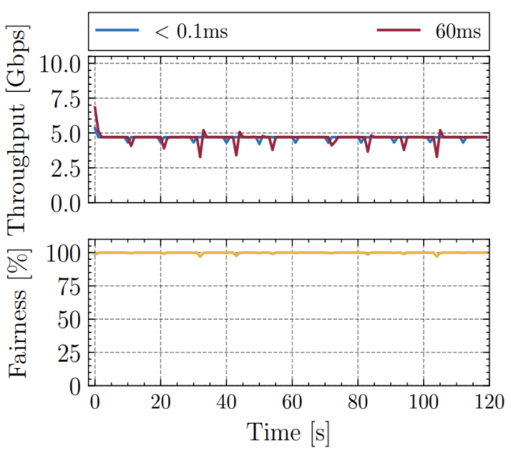
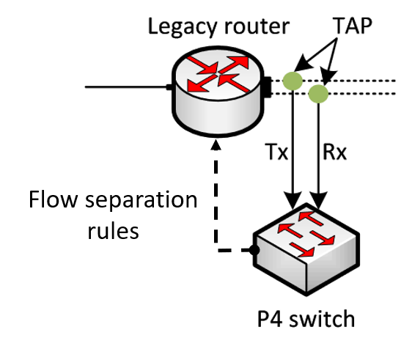
Fine-grained Measurements
Traffic separation based on RTT
  By accurately measuring RTT in real time, flows can be classified and separated in different queues
RTT unfairness in a 10 Gbps network. Two BBRv2 flows sharing the network.

Slide 44
Programmable ASICs – Opportunities and Challenges
Fine-grained measurement tools can complement current tools
P4 code is open
  Reusing code is simple
Designing and testing new ideas can be accomplished faster
There can be more opportunities for collaboration
  Code can be downloaded from the open-source community, tailored in house

Slide 45
Programmable ASICs – Opportunities and Challenges
CI engineers are not yet (fully) familiar with these technologies
Deploying a fully programmable network is unrealistic
  Deployment models are still being investigated
There is no readily available technical support
  There are few forums, but they focus more on research (e.g., Intel Connectivity Research Program)

Slide 46
Thank you

Slide 47
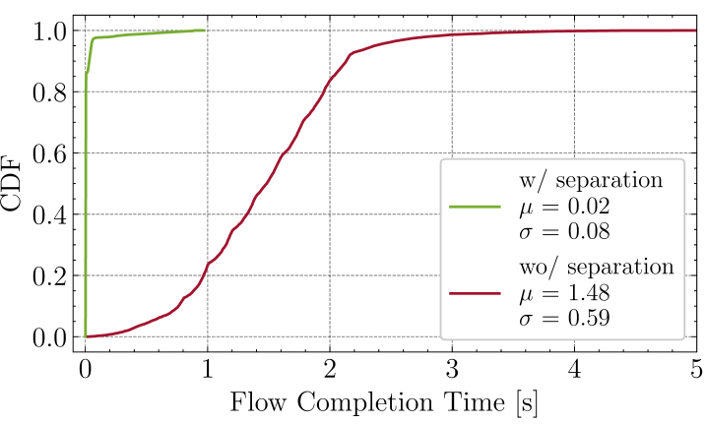
Fined-grained Measurements
Applications of programmable switches to enhance the performance of Science DMZ
Traffic separation based on flow size
  The flow completion time (FCTs) of small flows is significantly impacted when the network is busy
  A possible solution to prevent the increase of FCTs is to separate small flows from large flows
  Programmable switches can identify long flows
  10,000 small flows whose inter-connection times are generated from an exponential distribution with a mean of one second
  10 large flows were started, each with a random starting time over the test duration
Notes:
NOTE: We recommend you download this document in order to make changes and then email your final version to be published. Click on the “File” tab at the top left and then click “Download”. - best, tracey@thequilt.net

Slide 48
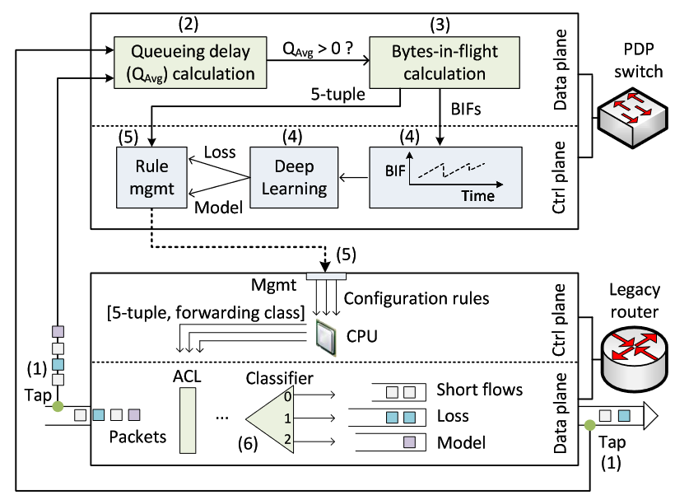
Fined-grained Measurements
Applications of programmable switches to enhance the performance of Science DMZ
Traffic separation based on Congestion Control Algorithms (CCA)
  When flows using different CCAs co-exist on a link, the fairness is significantly impacted
  One solution is to separate flows into different queues on the router based on their CCAs
  Programmable switches compute the bytes-in-flight and use Deep Learning algorithms to identify the CCA
  Flows are then allocated into different queues based on their CCAs
Notes:
NOTE: We recommend you download this document in order to make changes and then email your final version to be published. Click on the “File” tab at the top left and then click “Download”. - best, tracey@thequilt.net

Slide 49
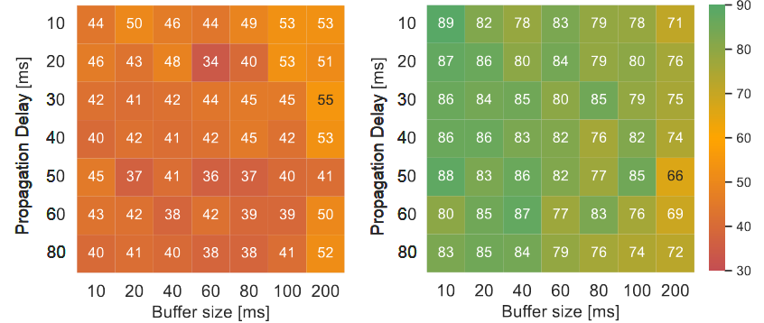
Fined-grained Measurements
Applications of programmable switches to enhance the performance of Science DMZ
Traffic separation based on Congestion Control Algorithms (CCA)
  10 long flows started at the same time, with alternating CCAs (i.e., Flow1 uses CUBIC, Flow2 uses BBR, Flow3 uses CUBIC, etc.)
  The figure below shows the fairness index (0 -> unfair, 100 -> fair)
    Left -> without separation
    Right -> with separation
Notes:
NOTE: We recommend you download this document in order to make changes and then email your final version to be published. Click on the “File” tab at the top left and then click “Download”. - best, tracey@thequilt.net

Slide 50
Fined-grained Measurements
Applications of programmable switches to enhance the performance of Science DMZ
Bottleneck estimation for traffic policing
  During a large data transfer, a link can get fully utilized and its router’s buffer gets filled
  This increases the latency for short flows sharing the bottleneck link
  Programmable switches can compute the throughput of flows and identify those that are bottlenecked
  Such information can be used to force flows to slow their rate, which avoids filling the queues
Notes:
NOTE: We recommend you download this document in order to make changes and then email your final version to be published. Click on the “File” tab at the top left and then click “Download”. - best, tracey@thequilt.net

Slide 51
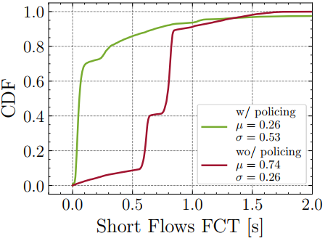
Fined-grained Measurements
Bottleneck estimation for traffic policing
  Flow Completion Time (FCT) of 10,000 short flows whose inter-connection times are generated from an exponential distribution with a mean of one second
  Long flows which transmitted 75Gbytes:
    Completed in approximately 85 seconds when policing is not configured
    Completed in approximately 87 seconds when policing is configured
  While the FCT of the long flow slightly increased when policing is configured, this increase is acceptable since the flow is not interactive
Notes:
NOTE: We recommend you download this document in order to make changes and then email your final version to be published. Click on the “File” tab at the top left and then click “Download”. - best, tracey@thequilt.net

Slide 52
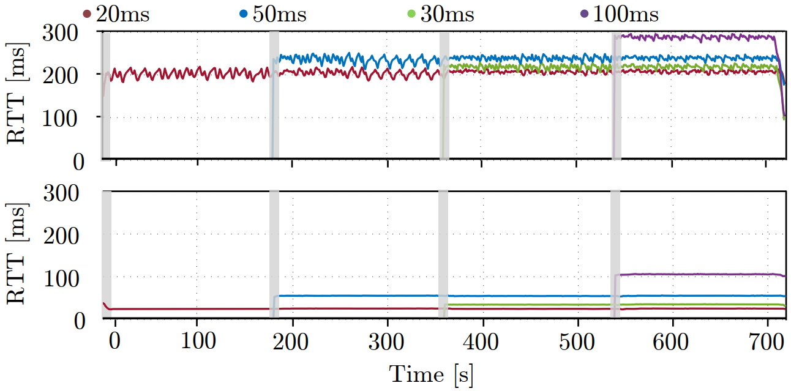
Fined-grained Measurements
Applications of programmable switches to enhance the performance of Science DMZ
Dynamic buffer sizing
  By leveraging measurements from programmable switches, the buffer size can be dynamically modified
Propagation delays
Static buffer
Dynamic buffer
Notes:
NOTE: We recommend you download this document in order to make changes and then email your final version to be published. Click on the “File” tab at the top left and then click “Download”. - best, tracey@thequilt.net

Slide 53
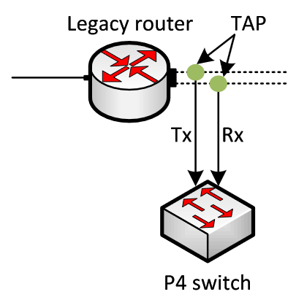
Fined-grained Measurements
Applications of programmable switches to enhance the security of Science DMZ
Detecting DDoS attacks and applying mitigations through ACLs
  Deploying a firewall or an Intrusion Prevention System (IPS) inline affects the throughput of data transfers in Science DMZ
  Programmable switches can be deployed passively
  DDoS detection algorithms are executed in the programmable switches
  Access Control List (ACL) rules are pushed to the non-programmable router
ACL rules
Notes:
NOTE: We recommend you download this document in order to make changes and then email your final version to be published. Click on the “File” tab at the top left and then click “Download”. - best, tracey@thequilt.net

Slide 54
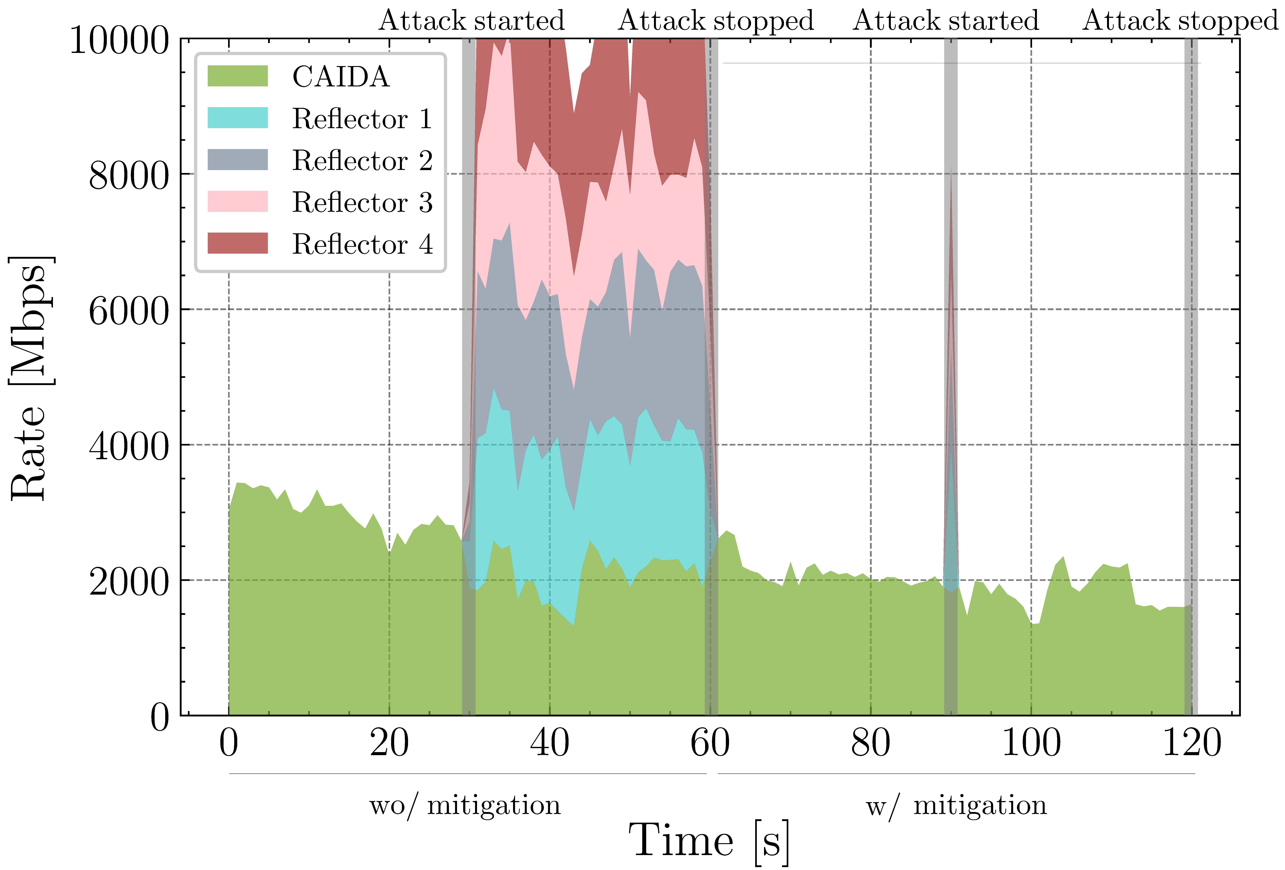
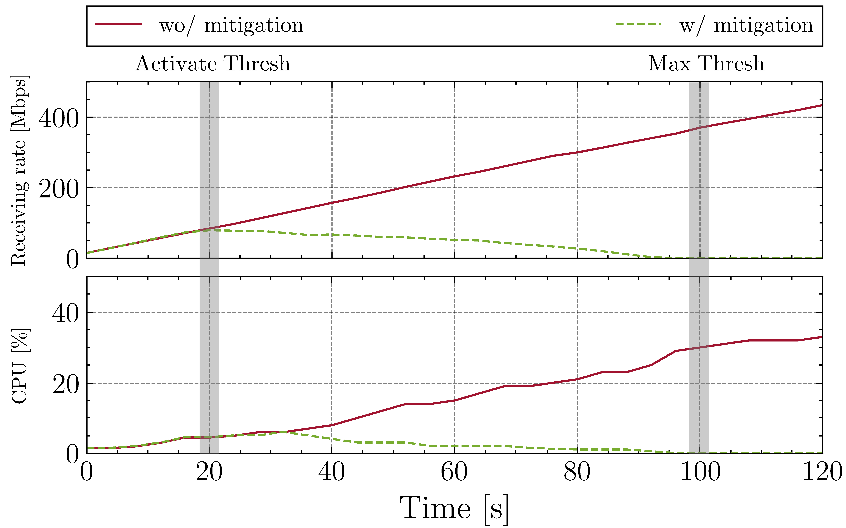
Fined-grained Measurements
Applications of programmable switches to enhance the security of Science DMZ
Detecting DDoS attacks and applying mitigations through ACLs
DNS amplification attack
SYN flood attack
Notes:
NOTE: We recommend you download this document in order to make changes and then email your final version to be published. Click on the “File” tab at the top left and then click “Download”. - best, tracey@thequilt.net

Slide 55
Fined-grained Measurements
Traffic separation based on RTT
  If multiple flows with different RTTs compete, TCP favors one flow over the other
RTT unfairness in a 10 Gbps network. (a) Two BBRv2 flows sharing the network. (b) Two CUBIC flows sharing the network.

Slide 56
Fined-grained Measurements
Traffic separation based on RTT
  By accurately measuring RTT in real time, flows can be classified and separated in different queues
RTT unfairness in a 10 Gbps network. (a) Two BBRv2 flows sharing the network. (b) Two CUBIC flows sharing the network.

Slide 57
Network Performance and Measurements
Notes:
NOTE: We recommend you download this document in order to make changes and then email your final version to be published. Click on the “File” tab at the top left and then click “Download”. - best, tracey@thequilt.net

Slide 58
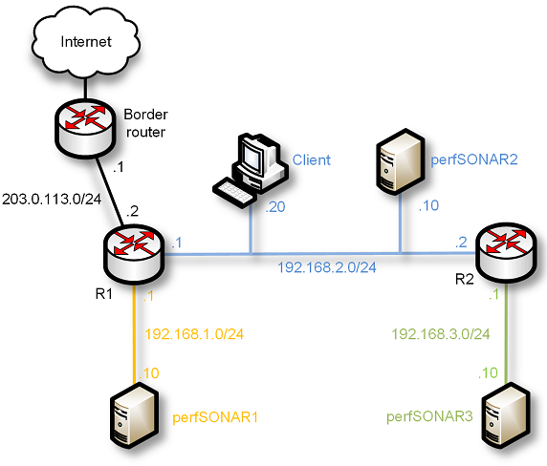
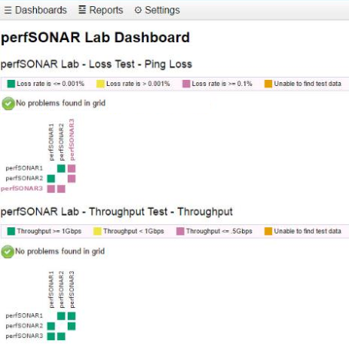
Network Performance and Measurements
perfSONAR provides information that reflects the state of the network, in a multi-domain basis
perfSONAR = Measurement Middleware
Notes:
NOTE: We recommend you download this document in order to make changes and then email your final version to be published. Click on the “File” tab at the top left and then click “Download”. - best, tracey@thequilt.net

