Slide 1


Border Gateway Protocol: Concepts and Implementation
Session 1 - BGP and Research and Education Networks
University of South Carolina (USC)
Texas Advanced Computing Center (TACC)
Energy Sciences Network (ESnet)
Lawrence Berkeley National Laboratory (LBNL)
Internet2 Technology Exchange
Sheraton Denver Downtown - Denver, CO
December 8, 2025

Slide 2





Organizers
Jorge Crichigno
(USC)
Jason Zurawski
(ESnet / EPOC)
Ali AlSabeh
(USCA)
Elie Kfoury
(USC)
Corey Eichelberger
(TACC)

Slide 3
Agenda
Time | Topic | Presenter
08:00 - 08:30 | BGP and Research and Education Networks (RENs) | Corey Eichelberger, Jason Zurawski
08:30 - 09:30 | Hands-on Session BGP 1: Essentials of BGP, EBGP, IBGP | Ali AlSabeh (USCA), Jorge Crichigno (USC)
09:30 - 10:00 | Break
10:00 - 10:30 | Brief Overview of BGP Attributes | Corey Eichelberger, Jason Zurawski
10:30 - 11:20 | Hands-on Session 2: Local Preference and MED attributes | Ali AlSabeh (USC), Jorge Crichigno (USC)
11:20 – 11:30 | Summary
Notes:
Need to fix speaker names.

Slide 4
BGP Fundamentals – Basic Terminology

Slide 5
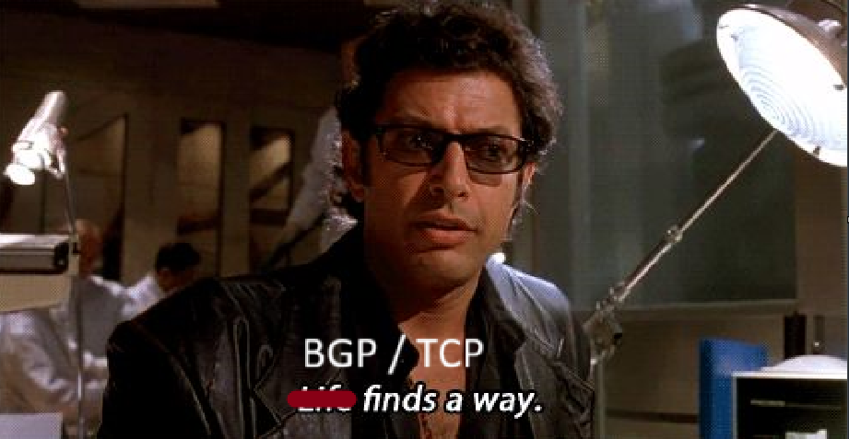
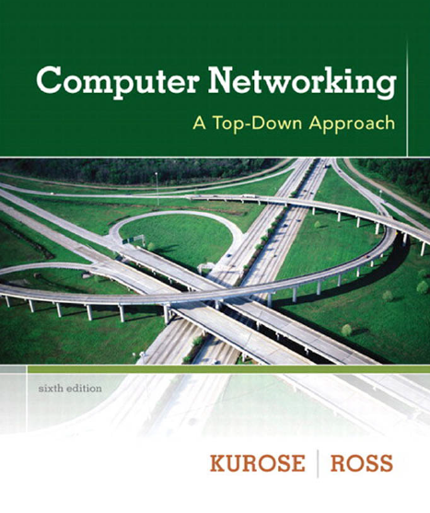
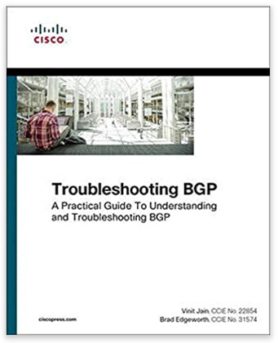
Introduction to BGP
BGP (Border Gateway Protocol) is complex and is at the heart of what makes the internet work
BGP was created to “Just work” like TCP. It was not created for performance.
  35 years ago - June 1989
Even after having read books and RFCs, students (instructors) may find it difficult to fully master BGP without having practiced it
As critical protocol for the Internet, it is important to understand

Slide 6
What is BGP
BGP or Border Gateway Protocol is protocol used between routers to exchange routing information and reachability information between or inside AS on the Internet.
BGP makes the Internet work, and in most cases it just works
  Needs to be tuned for best performance
BGP makes routing decisions based on paths, network policies and rule-sets, communities and more. Lots of configuration choices. Also, will just work out of the box.
Security was not a concern and not baked into the protocol
Believes (without help) all advertisements from peers with no checks.
It also by default can re-advertise to other peers what it learns.

Slide 7
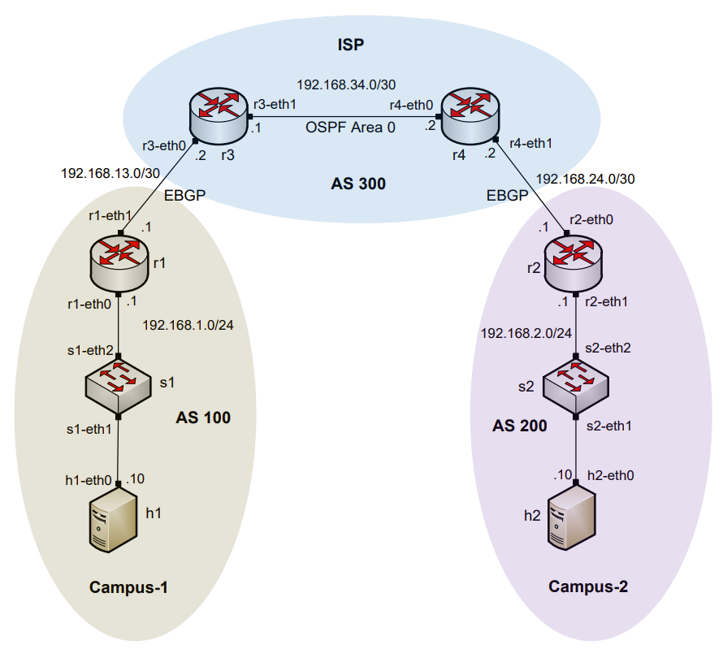
AS, IGP, EGP
Routers are organized into Autonomous Systems (ASes or ASs)
What is an AS (RFC 1771)?
What is an Interior Gateway Protocol (IGP)?
What is an Exterior Gateway Protocol (EGP)?
“A set of routers under the single technical administration, using an IGP and common metrics to route packets within the AS, and using an EGP to route packets to other ASs.”
A routing protocol used to exchange routing information within an AS (e.g., RIP, OSPF)
A routing protocol used to exchange routing information between AS

Slide 8
BGP In The Wild
Over 76,000 Autonomous Systems (ASN).
Over 1,000,000 IPv4 routes advertised.
Over 272,000 IPv6 routes advertised.
Each Router running BGP builds its own routing table with best path information to a subset of the internet.
Data from: https://bgp.he.net/report/prefixes#_prefixes

Slide 9
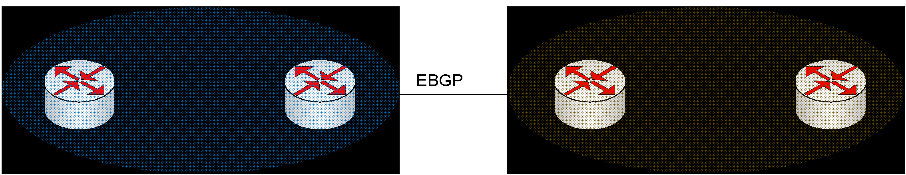
BGP Route Advertisements within an AS
BGP advertisements from an AS to another is referred to as External BGP (EBGP)
BGP advertisements within an AS is referred to as internal BGP (IBGP)

Slide 10
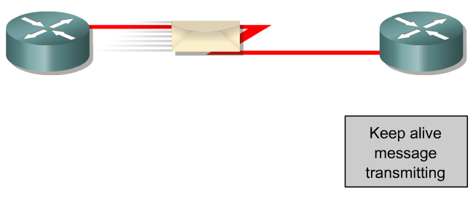
BGP – Best Path
The main goal is to provide interdomain routing
BGP selects one path as the best path
It places the selected path in its routing table and propagates the path to its neighbors
Is this the best path? Does it meet the path selection criteria? If so, add to routing table.
BGP Update
BGP Table
Routing Table
Network
Network
Rick Graziani, “Implementing Cisco IP Routing,” Cisco Press, 2015

Slide 11
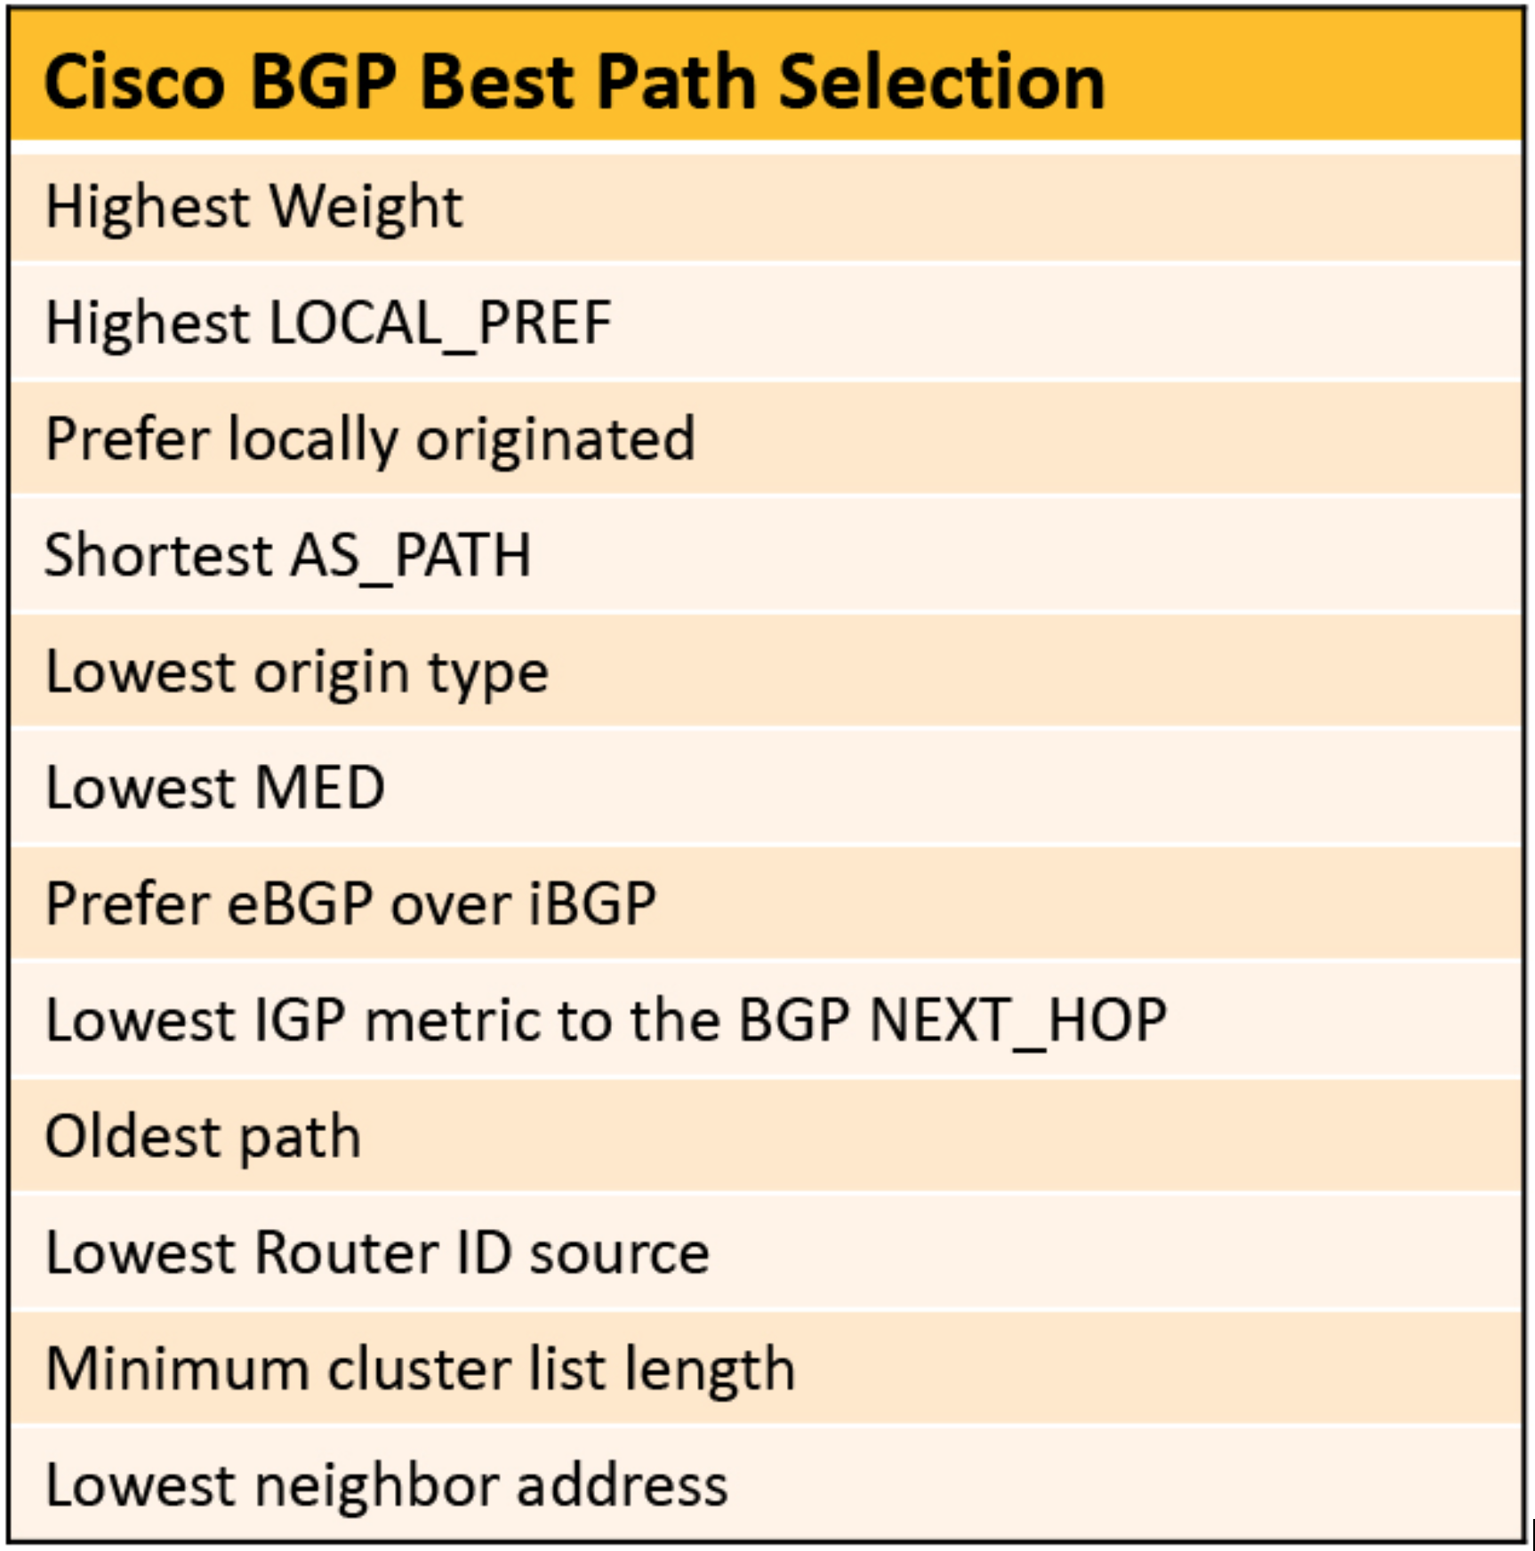
BGP - Best Path Care and feeding
BGP just works in many cases but needs tuned for performance
Best path selection is a 10+ step process!
Common steering mechanisms:
  Localpref
  Communities
  AS Padding
  MEDs

Slide 12
BGP Neighbor States
Idle:
  In this state, the router has not yet established a TCP connection with its BGP neighbor. The router is not actively attempting to establish a connection.
Connect:
  After the Idle state, the router transitions to the Connect state. In this state, the router initiates a TCP 3-way handshake connection with its neighbor by sending an initial TCP SYN packet and the other end responds to it with a TCP ACK packet and sends its own TCP SYN packet.
  In the last initiator responds with a TCP ACK packet and TCP connections are established. Once the TCP 3-way handshake connection is established, the BGP router moves to the next state.
Active:
  If the TCP connection fails to establish within a certain timeout period, the router enters the Active state. In this state, the router repeatedly attempts to establish a TCP connection with its neighbor. This state indicates that the router is actively trying to connect but has not yet succeeded.
OpenSent:
  When the TCP connection is successfully established, the router transitions to the OpenSent state.
  In this state, the router sends an Open message to its neighbor, which includes its BGP capabilities and other information. The router waits for an Open message from its neighbor to proceed to the next state.
OpenConfirm:
  After receiving the Open message from its neighbor, the router enters the OpenConfirm state. In this state, the router waits for a Keepalive message from its neighbor to confirm that the neighbor has also reached the OpenConfirm state. Once the Keepalive message is received, the router moves to the next state.
Established:
  The router enters the Established state when it has received a Keepalive message from its neighbor. In this state, the routers can exchange BGP updates, such as routing information and path attributes. In the BGP established state, the router is now fully operational and actively exchanging routing information with its neighbor.
  If there is a disruption or issue in the BGP session, the router may transition back to the Idle state and repeat the process of establishing the neighbor relationship.

Slide 13
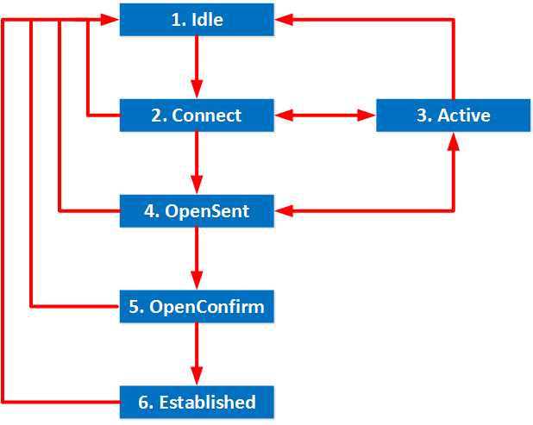
BGP State Diagram
Notes:
https://networklessons.com/bgp/bgp-neighbor-adjacency-states

Slide 14
BGP Use in R&E Networks (generalities)

Slide 15
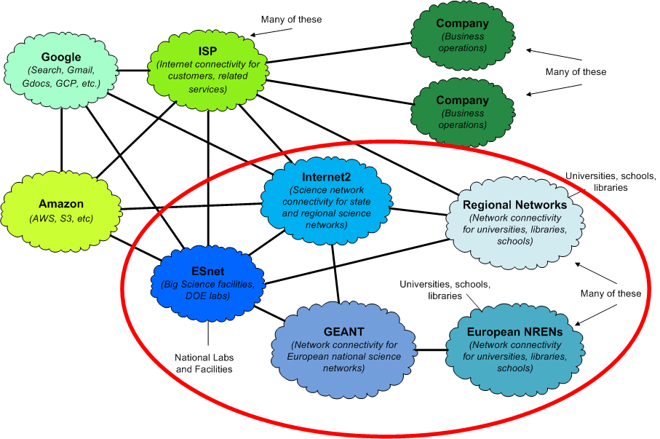
R&E vs. Commodity
Multiple cloud providers

Slide 16
R&E Routing Architecture
Research and Education Networks
  Bandwidth
  Performance Engineering
  Deterministic behavior
  Community
Commodity Networks
  Traffic shaping
  DoS protections
  Unknown architecture
R&E networks are engineered to support science while commodity networks are not
  Keep the science traffic on the science networks!

Slide 17
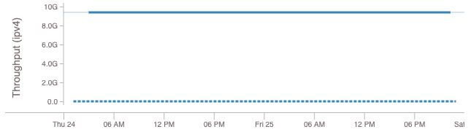
Why does this matter? Example 1 - OSC
Data transfers between Ohio Supercomputer Center and NERSC were slow
Turns out they were going over commodity instead of R&E paths
Commodity networks often throttle high-speed flows
  What does a multi-gigabit traffic spike mean?
  Commodity: another DoS attack - this should be stopped!
  R&E: another scientist doing normal things - this is core mission!

Slide 18
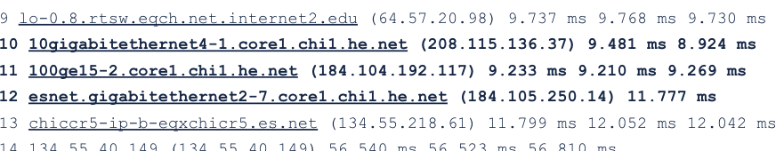
Commodity vs R&E OSC Troubleshooting 2
OSC Engineer found a memory allocation issue on border router causing the routing table to not fully populate.
  This kept the best path to ESnet out of the table
ESnet engineer found an out of date routing configuration as well
These fixes allowed for a R&E symmetric path for the transfer

Slide 19
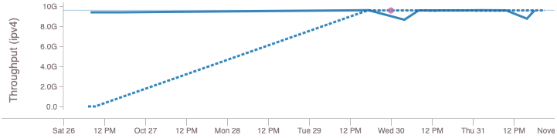
Commodity vs R&E: OSC Results
Performance improved substantially
Another example of the need for a Routing Working Group

Slide 20
Example 2
2 peerings to Regional provider.
  1x100G, 1x10G
Asymmetrical traffic to coming back into campus via the congested 10G
Before
Interval Throughput
0.0 - 10.0 27.97 Mbps
After
Interval Throughput
0.0 - 10.0 717.75 Mbps

Slide 21
Example 3
Routing Asymmetry
  Preferring comercial path out
  R&E path in
1 University 1 1.103 ms mtu 9000 bytes
2 Regional 2.163 ms mtu 1500 bytes
3 Regional to ISP link 5.425 ms mtu 1500 bytes
4 Hurricane Electric (206.223.118.37) 13.309 ms mtu 1500 bytes
5 Hurricane Electric (184.105.81.205) AS6939 17.328 ms mtu 1500 bytes
6 Hurricane Electric (184.105.65.166) AS6939 21.361 ms mtu 1500 bytes
7 Hurricane Electric to University 2(184.105.48.246) AS6939 24.856 ms mtu 1500 bytes
8 University 2 mtu 1500 bytes
9 University 2 perfSONAR node mtu 1500 bytes
University 2 Route *[BGP/170] 9w6d 05:38:46, MED 0, localpref 150
University 2 Route *[BGP/170] 1w2d 09:49:01, MED 0, localpref 100
Multiple Routing tables advertised from Regional to Campus

Slide 22
Other examples
https://connect.geant.org/2017/05/15/taking-it-to-the-limit-testing-the-performance-of-re-networking
  Commodity path showed two problems
    Packet loss
    DoS mitigation killed high-speed flows
  Configure-before-use or test-before-use model impedes science
https://indico.geant.org/event/1/contributions/11/attachments/47/207/190521_-_PT_TNC2019_v8.pdf
  Multi-nation testing of R&E vs. commodity
  Results indicate R&E paths perform better, even with more hops
    Key point - hop count is a legacy metric because modern routers are ASIC-based
Common theme: R&E networks are engineered to support science while commodity networks are not
  This shouldn’t surprise us - high speed science is what we’ve been doing for years
  But this means we have to keep the science traffic on the science networks!

Slide 23
So what do we do?
To first order, this means we need to use BGP policy to keep R&E traffic on R&E networks
  Announcements attract traffic
  Routing determines the path the traffic takes through the network - BGP gives us the tools
BGP is a path vector protocol
  For a given prefix, the shorter AS path is preferred
  If AS path length is the same, then other criteria are used, in order (“BGP path selection algorithm”)
Override BGP’s use of AS path length when choosing between R&E and commodity paths
  R&E path will be longer in the general case (more organizations involved)
  Use normal BGP route selection between R&E routes, and between commodity routes
  Remember - hop count is a legacy metric

Slide 24
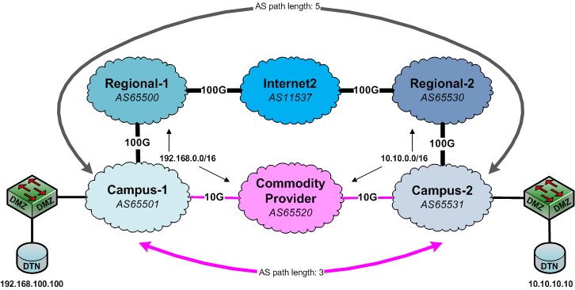
BGP AS Path Length Illustrated
Notes:
You’re paying for Internet2 already - this sort of transfer is what science networks are built to handle

Slide 25
BGP Use in ESnet

Slide 26
ESnet Routing Architecture (High-Level, Simplified)
Routing policy applied at ingress (import policy on peerings)
  Routing policy sets communities based on peering type
  Routing policy sets localpref set based on peering type - simplified version:
    ESnet site - high
    R&E peering - medium
    Commercial Peering - low
    Transit - very low
  Communities control route announcement behavior to sites and peers
  Localpref controls forwarding behavior within ESnet network
This allows us to group routes based on connectivity capability and type of peer organization, and use normal BGP route selection within those groups
  Forwarding is sane and high performance
  This is more complex than a campus needs (we’re a national backbone), but ideas still hold

Slide 27
Site Or Campus Routing Isn’t Backbone Routing
Many of the tools are the same (e.g. BGP policy)
Goals are sometimes different
  Backbone: multiple peers, resilience to route leaks, BCP38 filters, etc.
  Campus: support security policy, keep transit costs down, etc.
  High performance for science: common goal
  Cost reduction: common goal (flat rate vs. charge by the bit)
Don’t try to replicate ESnet’s policy on your campus perimeter
  Not necessarily a good fit
  Know Your Network
Make sure you understand the tools you have, and use them to get as much as you can out of the infrastructure you’ve got
Keep science traffic on science networks - every site has to do this unless your provider is explicitly doing it for you

Slide 28
BGP Use at TACC

Slide 29
TACC Routing Architecture
Routing policy applied at ingress (import policy on peerings)
  Routing policy sets communities based on peering type
  Routing policy sets localpref set based on peering type - simplified version:
    Direct Peering - High
    R&E peering - Medium
    Commercial Peering - Low
  Routes tagged with direct or R&E communities re-announced into iBGP mesh
    Allows us to better steer traffic to the correct exit router and peerings
  Localpref steers traffic to preferred peerings

Slide 30
FRGP Routing Architecture
Front Range GigaPoP is a regional R&E network in Colorado / Wyoming / New Mexico
Compact routing core consisting of 4 Juniper MX routers in Denver-area exchanges and strategic carrier locations.
Dark fiber, DWDM and Metro Ethernet technologies to aggregate customer access
We use a very similar BGP policy to Esnet
  Localpref groups – same idea (Customer > Research > Commercial Peer > Transit )
  On a Campus, you may only be concerned with Research and Transit
We also use BGP Communities to tag groups of routes as they are learned
  This helps us with announcements (export policy)
Two explicit routing instances : research (vrf) and commercial Internet (global routing table)
  These are implemented as MPLS/BGP Layer3 VPNs
  Most customers using BGP have two VLAN tags and two BGP sessions, for each table
We have a blended VRF for customers that prefer the simplicity of default routing only
  This consists of the research VRF plus a default route that points to the commercial table

Slide 31
Internet DFZ routing vs Campus / LAN
Routing asymmetry is commonly observed, expected feature of the multihomed AS
This is because each AS makes independent routing decisions
A step further- if you announce the same route to two external peer ASes, you should not assume a specific distribution of inbound traffic across those two connections. It will probably be unbalanced.
In this scenario, we can try to influence what happens by making suggestions to the neighboring ASes. We will discuss some of these techniques later.
When thinking BGP, it is useful to think about unidirectional concepts:
  Received / Learned routes are used to send (transmit) packets
  Advertised routes will influence where you receive traffic. – “Announcements attract traffic”

Slide 32
BGP Hygiene - Preventing routing leaks and hijacks
Default policy = readvertise all routes among external peers (disallowing AS loops)
This is a reasonable policy for Internet backbone routers. The rest of us must have policy in place for proper routing behavior!
If you are an end-site, at a minimum, you should have policy in place to ensure that you’re only advertising your own route(s) to all neighbors.
For many networks, BGP policy can be nuanced and complex. This can lead to unintended advertisements.

Slide 33
EXTRA STUFF

Slide 34
Why BGP rather than an IGP?
An IGP moves packets as efficiently as possible within an AS
A IGP does not worry about politics (not many routing policies can be enforced)
  A corporate AS is not willing to carry (transit) traffic originating from a foreign AS
  A Research and Education Network (REN) may not want to carry commercial traffic
  Traffic starting or ending at Apple should not transit Google, etc.
BGP is designed to handle all these cases and enforce routing policies between ASes

