Slide 1

Overview of the Cyberinfrastructure Lab (CI) at USC
https://research.cec.sc.edu/cyberinfra
Jorge Crichigno
Department of Integrated Information Technology
College of Engineering and Computing
University of South Carolina
jcrichigno@cec.sc.edu
Meeting USC – Savannah River National Laboratory
College of Engineering and Computing
University of South Carolina
Columbia, South Carolina
April 24, 2024

Slide 2
Introduction to P4 Programmable Switches

Slide 3
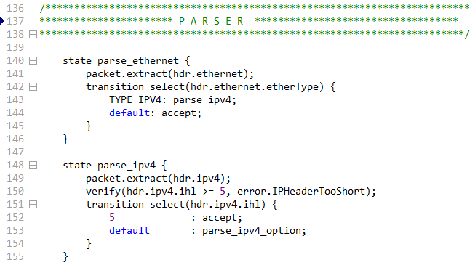
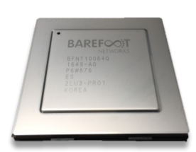
P4 Programmable Switches
P4¹ programmable switches permit programmers to program the data plane
P4 code
Programmable chip
1. P4 stands for stands for Programming Protocol-independent Packet Processors
Notes:
A programmer can program the ASIC (application-specific integrated circuit)

Slide 4
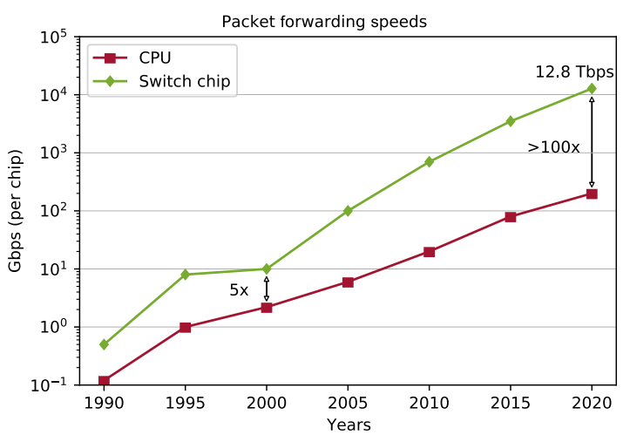
P4 Programmable Switches
P4¹ programmable switches permit programmers to program the data plane
  Define and parse new protocols
  Customize packet processing functions
  Measure events occurring in the data plane with
  high precision
  Offload applications to the data plane
Reproduced from N. McKeown. Creating an End-to-End Programming Model for Packet Forwarding. Available: https://www.youtube.com/watch?v=fiBuao6YZl0&t=631s

Slide 5

NSF Cybertraining 2403360: “OAC Core: Enhancing Network Security by Implementing an ML Malware Detection and Classification Scheme in P4 Programmable Data Planes and SmartNICs”
July 1, 2024 – June 30, 2027

Slide 6
Introduction to DGAs
Attackers often use a Command and Control (C2) server to establish communication between infected host/s and bot master
Domain Generation Algorithms (DGAs) are the de facto dynamic C2 communication method used by malware, including botnets, ransomware, and many others

Slide 7
Introduction to DGAs
DGAs evade firewall controls by frequently changing the domain name selected from a large pool of candidates
The malware makes DNS queries to resolve the IP addresses of these generated domains
Only a few of these queries will be successful; most of them will result in Non-Existent Domain (NXD) responses
(1) DNS queries. (2) (NXD) replies. (3) Eventually, a query for the actual domain is sent and malware-C2 communication starts.

Slide 8
Introduction to DGAs
DGAs evade firewall controls by frequently changing the domain name selected from a large pool of candidates
The malware makes DNS queries to resolve the IP addresses of these generated domains
Only a few of these queries will be successful; most of them will result in Non-Existent Domain (NXD) responses

Slide 9
Proposed System
The proposed system uses P4 programmable data plane switches to
  Run a customized packet parser
  Collect fine-grained measurements
  Perform per-packet inspection
  Process packets at line rate
1. A. AlSabeh, K. Friday, E. Kfoury, J. Crichigno, E. Bou-Harb, “On DGA Detection and Classification using P4 Programmable Switches,” under review, Journal of Computers and Security.
Notes:
The P4 switch collects and stores the context-aware features of the hosts
When an NXD response is received, the switch performs DPI on the domain name to extract its context-less features
The switch sends the collected features to the control plane
The control plane runs the intelligence to classify the DGA family and initiate the appropriate incidence response

Slide 10
Proposed System
The switch collects and stores the traffic features of the hosts (Traffic Pattern Analysis)
  Number of IP addresses contacted, number of DNS requests made, Inter-arrival Time (IAT) between consecutive IP packets, time it takes for the first NXD response to arrive, IAT between subsequent NXD responses
Notes:
The P4 switch collects and stores the context-aware features of the hosts
When an NXD response is received, the switch performs DPI on the domain name to extract its context-less features
The switch sends the collected features to the control plane
The control plane runs the intelligence to classify the DGA family and initiate the appropriate incidence response

Slide 11
Proposed System
When an NXD response is received, the switch performs deep-packet inspection (DPI) on the domain name to extract domain features (Domain Name Analysis)
  For classification, the data plane sends the collected features to the control plane, which runs the intelligence to classify the DGA family and initiate the appropriate response
Notes:
The P4 switch collects and stores the context-aware features of the hosts
When an NXD response is received, the switch performs DPI on the domain name to extract its context-less features
The switch sends the collected features to the control plane
The control plane runs the intelligence to classify the DGA family and initiate the appropriate incidence response

Slide 12
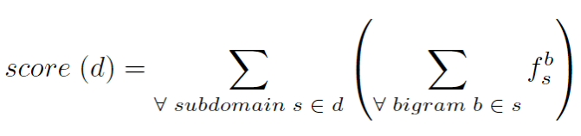

Proposed System
The scheme uses the bigram technique for the domain name analysis:
  It computes the bigram of the domain name; a bigram model may suffice to predict whether a domain name is a legitimate human readable domain
  The frequency value of a bigram b is pre-computed and stored in a Match-Action Table (MAT)
  Example: the bigrams of “google” are: “go”, “oo”, “og”, “gl”, “le”
  The lower the score, the more random the domain name
Where is the frequency of the bigram b in the subdomain s
$$f_{s}^{b}$$

Slide 13
Evaluation
Experimental setup
  Hundreds of GB of malware samples; 1,311 samples containing 50 DGA families¹
  We used samples that receive NXD responses containing domain names generated by DGAs¹
  The collected dataset was used to train ML models offline on a general-purpose CPU
  80% of data was used for training and 20% for testing
¹ D. Lohmann, “DGArchive.” [Online]. Available: https://tinyurl. com/yc6whwrc.

Slide 14
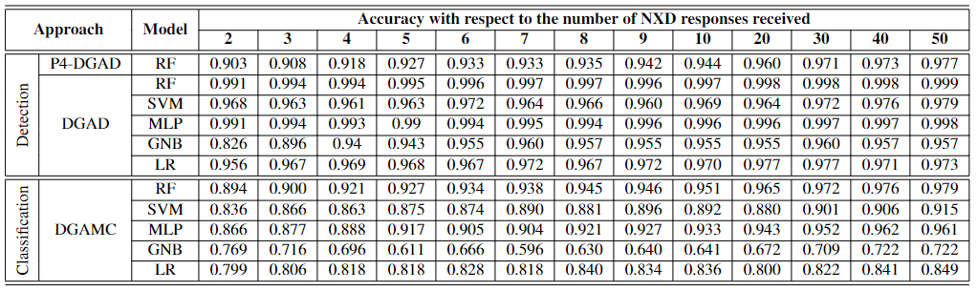
Evaluation
The evaluation reports the accuracy (ACC) of different ML classifiers during the first 50 NXD responses
  P4-DGAD RF (detection) is fully implemented in the data plane
  For detection, all algorithms have an ACC > 0.9 with four or more NXD responses
  For classification, the ACC of the proposed scheme is comparable to that of CPU-based schemes (with minimal control-plane intervention)
RF: Random Forest; SVM: Support Vector Machine; MLP: Multilayer perceptron; LR: Logistic Regression; GNB: Gaussian Naive Bayes
P4-DGAD: DGA detection algorithm runs fully in the data plane
DGAD: Detection algorithm runs in the control plane
DGAMC: Classifier algorithm runs in the control plane
Notes:
RF-DGAD vs P4-DGAD: The depth of the trees and the number of the trees are increased when computed in the control plane (much more resources). Therefore, the accuracy is improved.

Slide 15
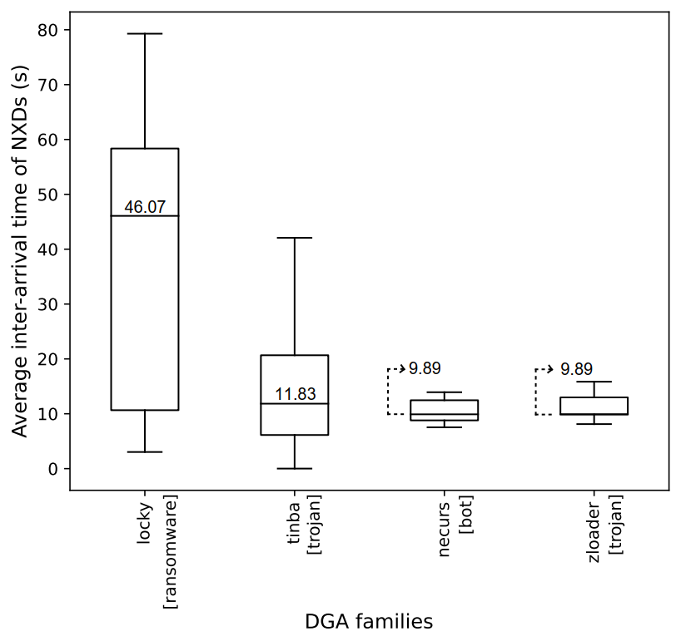
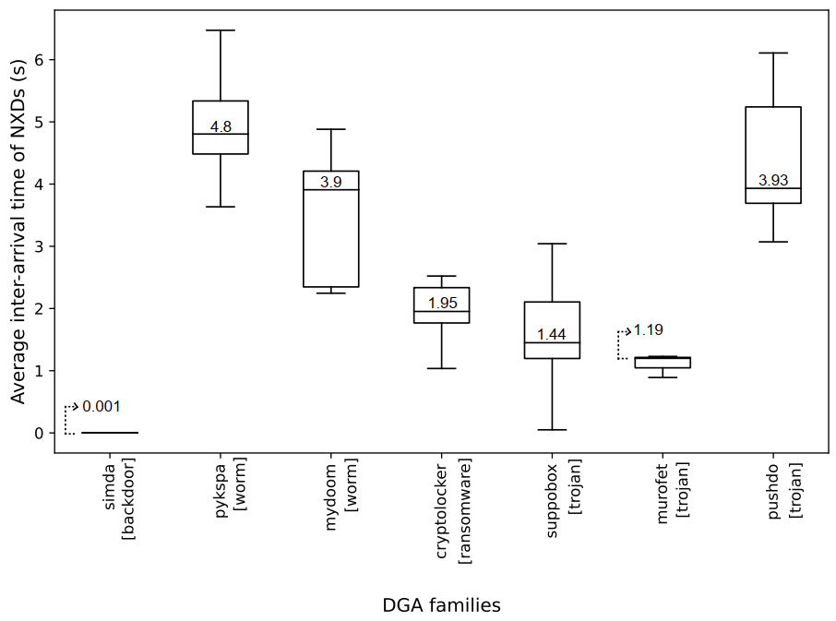
Evaluation
The scheme can accurately characterize traffic flows (traffic features)
Interarrival times between NXDs of DGA families with the largest number of samples

Slide 16
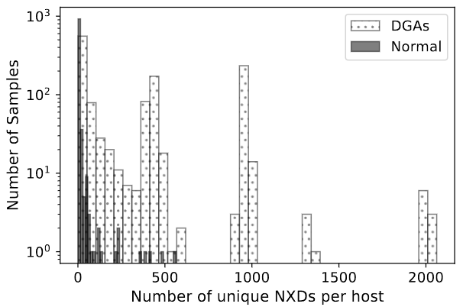
Evaluation
The scheme can accurately characterize traffic flows (traffic features)
  Normal (benign) hosts typically generates a few NXDs (at most)
Number of hosts
Number of different NXDs per host

Slide 17
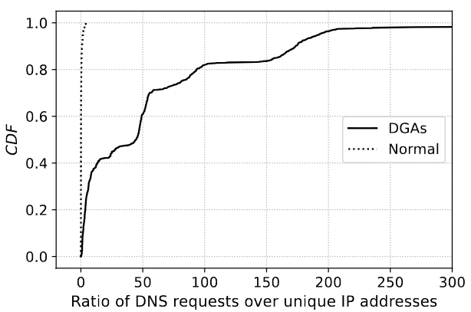
Evaluation
The scheme can accurately characterize traffic flows (traffic features)
  When a normal (benign) hosts queries a given domain, the DNS system returns a corresponding IP address (ratio of DNS requests to IP addresses is approximately 1)
  DGAs often query hundreds of domains; only few queries return an IP address (at best) (ratio of DNS requests to IP addresses > 1)

Slide 18
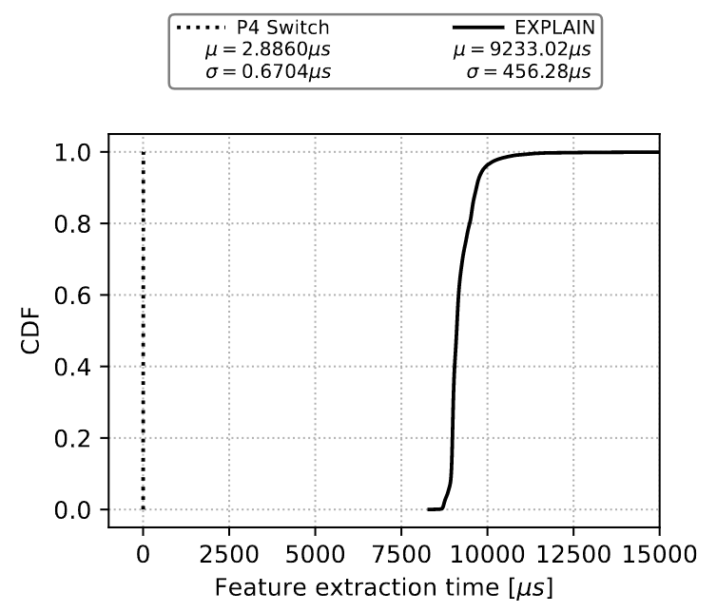
Evaluation
Comparison of the feature extraction time of the proposed approach vs EXPLAIN¹
  The proposed approach runs on the switch data plane
  EXPLAIN runs on a general-purposed CPU with 64 GB RAM, 2.9 GHz processor with eight cores
¹A. Drichel, N. Faerber, U. Meyer, “First step towards explainable DGA multiclass classification,” in the 16th International Conference on
Availability, Reliability and Security, pp. 1–13, 2021.

Slide 19
DEMO – High-resolution Measurements https://youtu.be/cWaWxsqVAgc

Slide 20

P4 PDP Switches based on Intel’s Tofino Chip - Demo

Slide 21
DEMO – DoS https://youtu.be/EGQHUdrQ80M

Slide 22
P4 PDP Switches based on Intel’s Tofino Chip - Demo

Slide 23
NSF Advanced Technological Education Project:
Cyber-con²: “Multi-sector Convergence to Advance the Preparation of Learners for OT and IT Cybersecurity Convergence Workforce”
July 1 2024 – June 30 2027

Slide 24
NSF ATE
Cyber-con²: “Multi-sector Convergence to Advance the Preparation of Learners for OT and IT Cybersecurity Convergence Workforce”

Slide 25
NSF ATE
Goal 1: Expand the Academic Cloud to support large-scale learning on OT/ICS and IT cybersecurity
  Develop and deploy virtual labs on OT/ICS cybersecurity
  Develop and deploy virtual labs on IT cybersecurity
Lib # | Lib Name | Sample Outcomes | CIE’s Pillar | Level
1, 2 | Intro to OT / ICS Cybersecurity (2 libraries) | Understand the fundamentals of PLCs used in critical infrastructures. Write basic apps with OpenPLC using Ladder diagrams. Describe the elements of a SCADA system. | Awareness. | Entry-level high school.
 |  |  | Awareness, Education. | Entry-level college.
3 | ICS Protocols (1 library) | Understand the Modbus Remote Terminal Unit (RTU) and Modbus over TCP. Implement a SCADA system with Modbus. Secure SCADA systems and protocols for ICS | Development, Current Infrastructure. | Intermediate-level college.
4 | Adv. Cybersecurity for OT / ICS (1 library) | Use passive and active discovery tools to map ICS devices. Launch C2 attacks against an ICS using Metasploit. Exploit the vulnerability of a SCADA/PLC system. | Development, Current Infrastructure. | Advanced-level college.
5 | Water Quality (WQ) Critical Infrastructure Models (1 library) | Explain how to model WQ within critical ICSs. Replay attacks to water distribution networks (WDNs). Characterize and analyze attacks on WDNs, including reconnaissance, DDoS, MITM. Develop mitigation algorithms for WDN attacks. | Development, Current Infrastructure. | Advanced-level college
CIE: Cyber Informed Engineering (national strategy): https://tinyurl.com/y3a8jntm

Slide 26
NSF ATE
Goal 1: Expand the Academic Cloud to support large-scale learning on OT/ICS and IT cybersecurity
  Develop and deploy virtual labs on OT/ICS cybersecurity
  Develop and deploy virtual labs on IT cybersecurity
Lib # | Lib Name | Sample Outcomes | Cert | Level
6, 7 | Intro to IT Cybersecurity (2 libraries) | Analyze and explain the types of attack surfaces. Execute malwares using real deployments and investigate their behavior. Analyze and characterize C2 communication used against IT / OT systems. | CompTIA Security+. | Entry-level college.
 |  |  | Cisco CCST Cyber. | Entry-level high school.
8 | Intro to IT Networks (1 library) | Analyze TCP sessions using a protocol analyzer. Perform network hardening. Use secure protocols for network management. | Cisco CCNA. | Entry-level college.
9 | Cybersecurity Operations (1 library) | Explain features of OS (Linux, Windows) used for cybersecurity analysis. Use tools and log files (e.g., PowerShell, syslog) to identify anomalies. Apply the security onion to protect systems. | Cisco CyberOps. | Intermediate-level college.
10 | Open-Source Intelligence (1 library) | Perform Internet scanning and probing events. Analyze log files using Suricata. Develop ML classifiers for malwares with Zeek. | NA | Intermediate-level college.
11, 12 | Threat Detection w/ NGFWs, I and II (2 libraries) | Develop and implement security and NAT policies. Implement IDS and IPS using an NGFW. Use deep packet inspection to identify applications and users. | PCCE (Technician). | Intermediate-level college.
 |  |  | PCNSA (engineer). | Advanced-level college.
13 | Cloud Security (1 library) | Understand virtual patching in the cloud. Set up and manage a cloud infrastructure using APIs. Be familiar with Azure and AWS toolsets. | AWS Cloud Foundations, AWS Sec. Foundations | Advanced-level college.
14, 15 | Fine-gained Telemetry w/ P4 (2 libraries) | Describe the architectures of P4 devices. Identify and block attacks in the data plane. Develop security apps with P4 switches and smart NICs. | NA (state-of-the-art, research). | Advanced-level college.

Slide 27
NSF ATE
Integration of virtual labs into high-school and college programs
Virtual lab libraries marked with a ribbon will be aligned with stackable industry certificates

Slide 28
NSF ATE
Goal 2: Develop an internship program on OT/ICS and IT cybersecurity
  Pre-internship seminars will help connect interns with organizations
  Internship enables students to acquire soft skills, teamwork, time management, and communication skills
Pre-internship Seminars
Internships
Spring and Fall semesters
(Monday-Wednesday-Friday)
Summer semester
(400 hours)

Slide 29

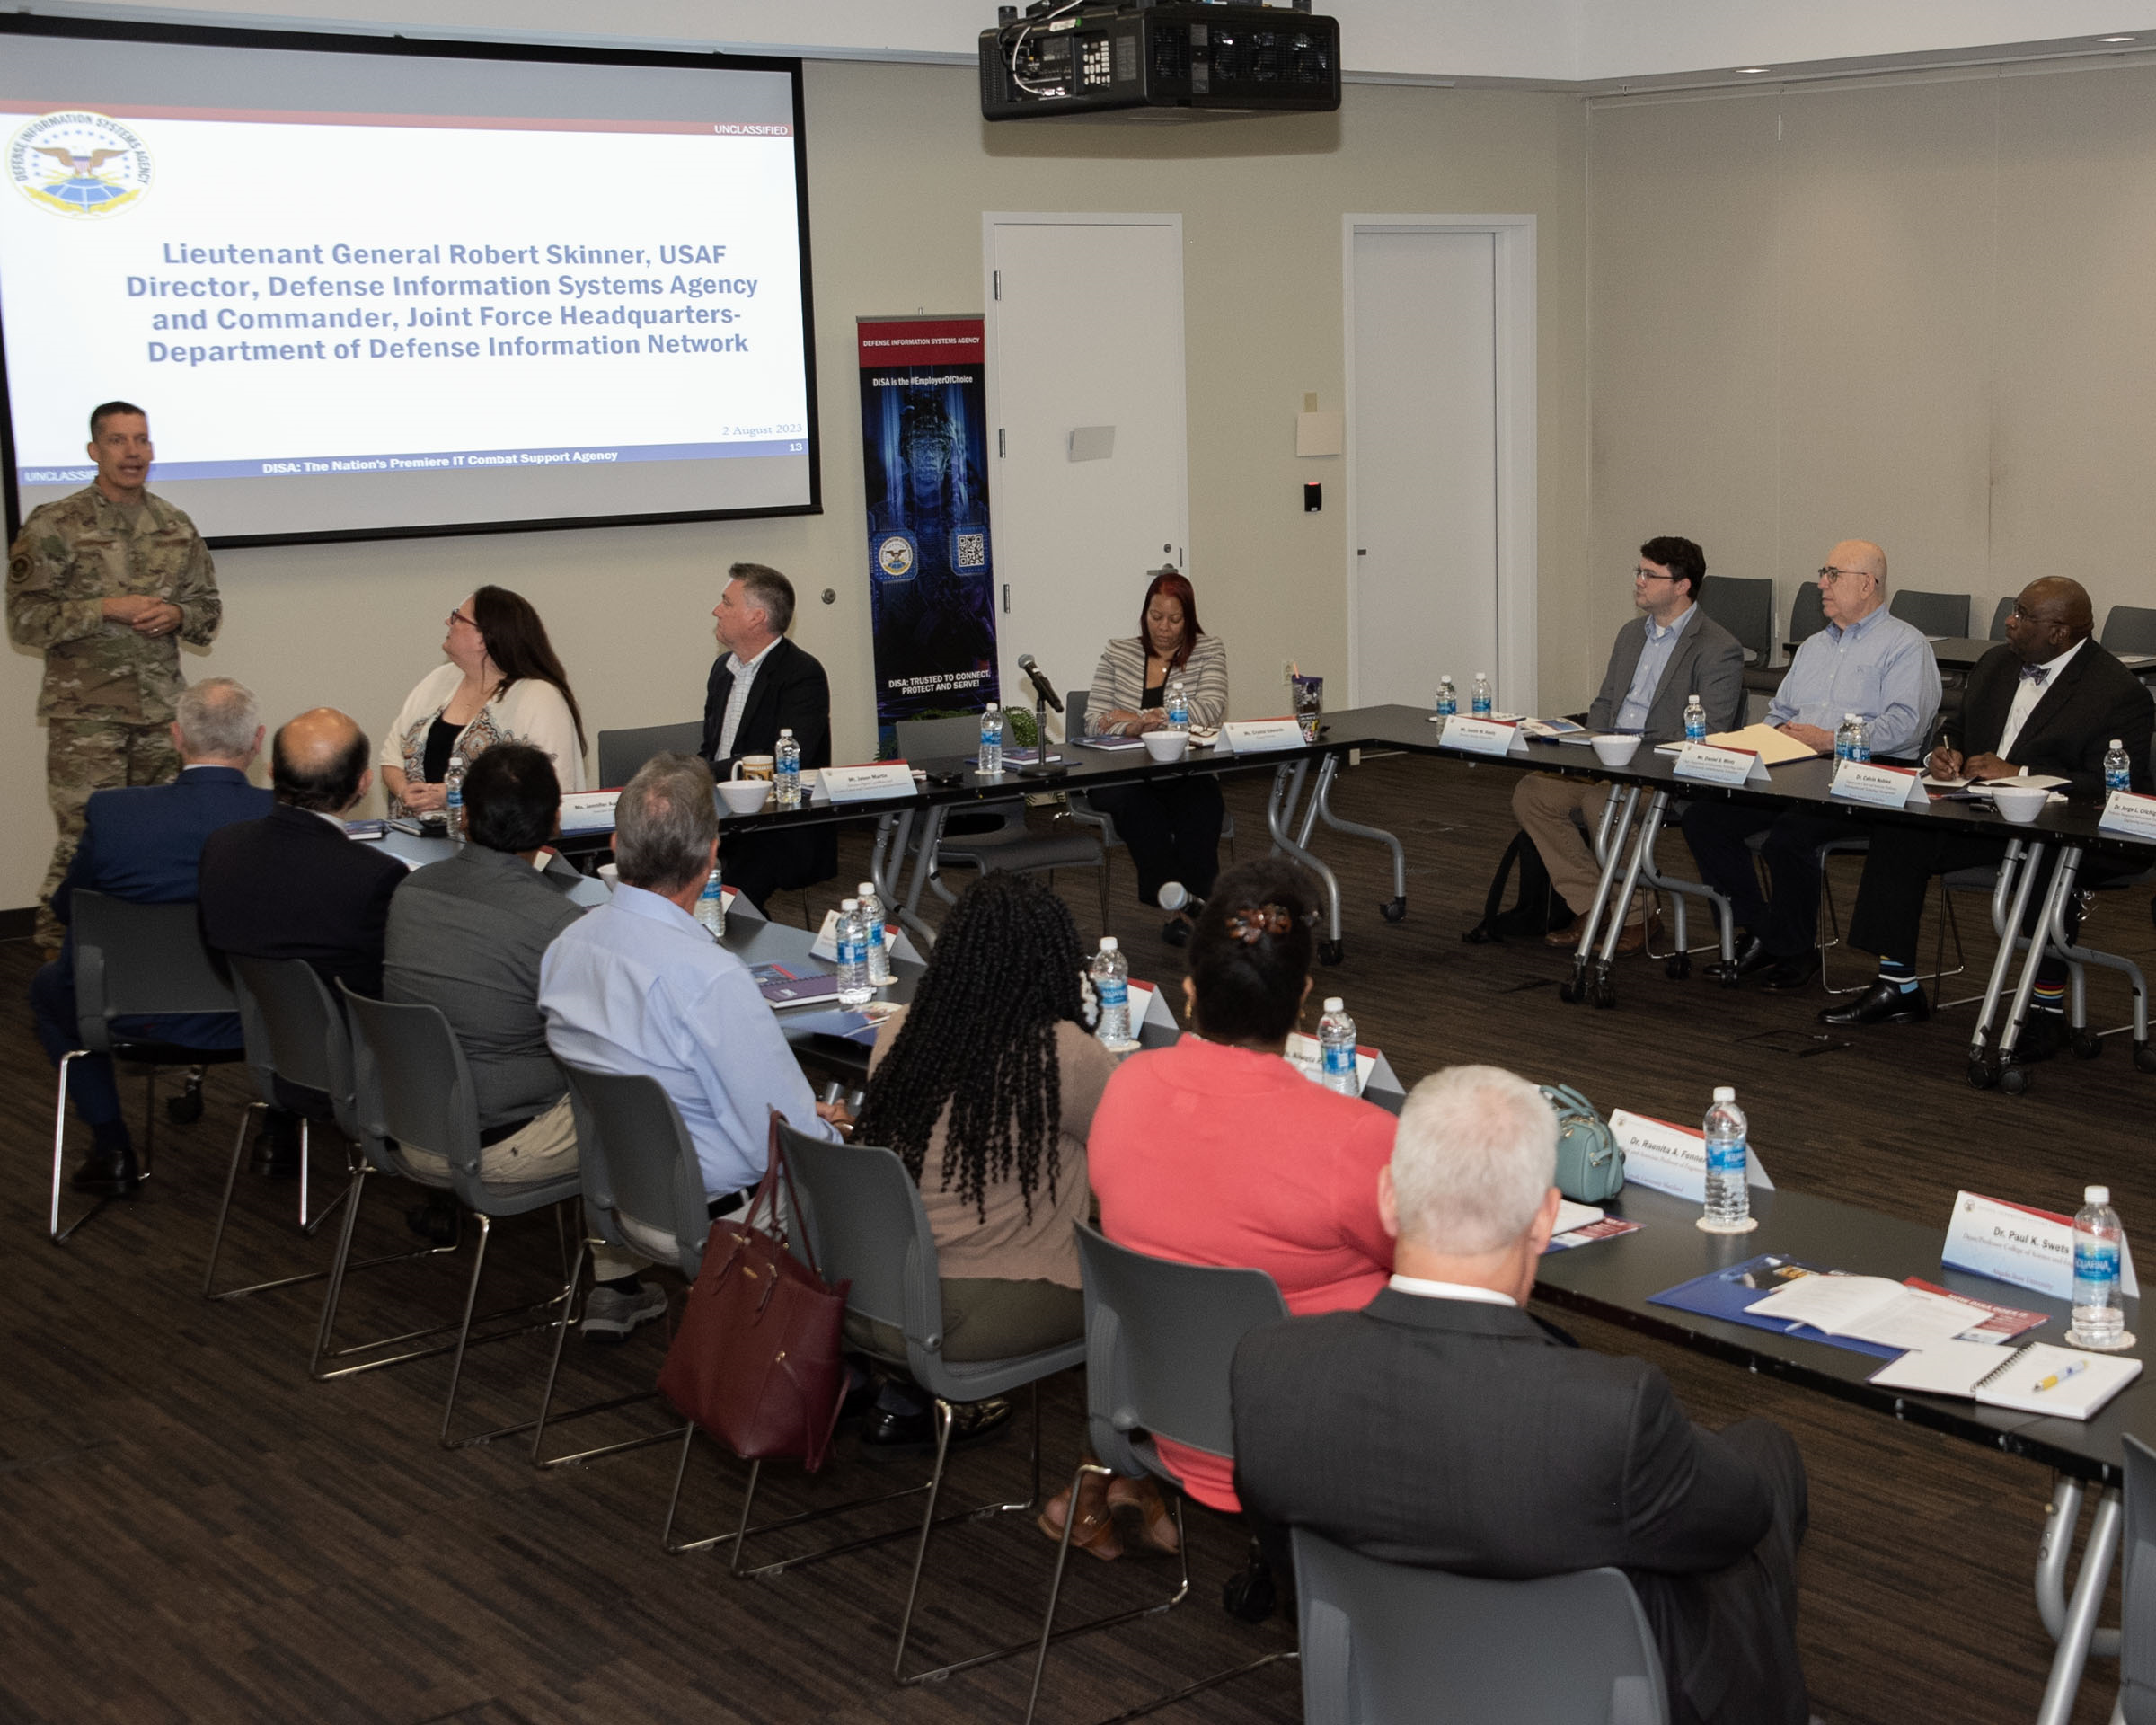








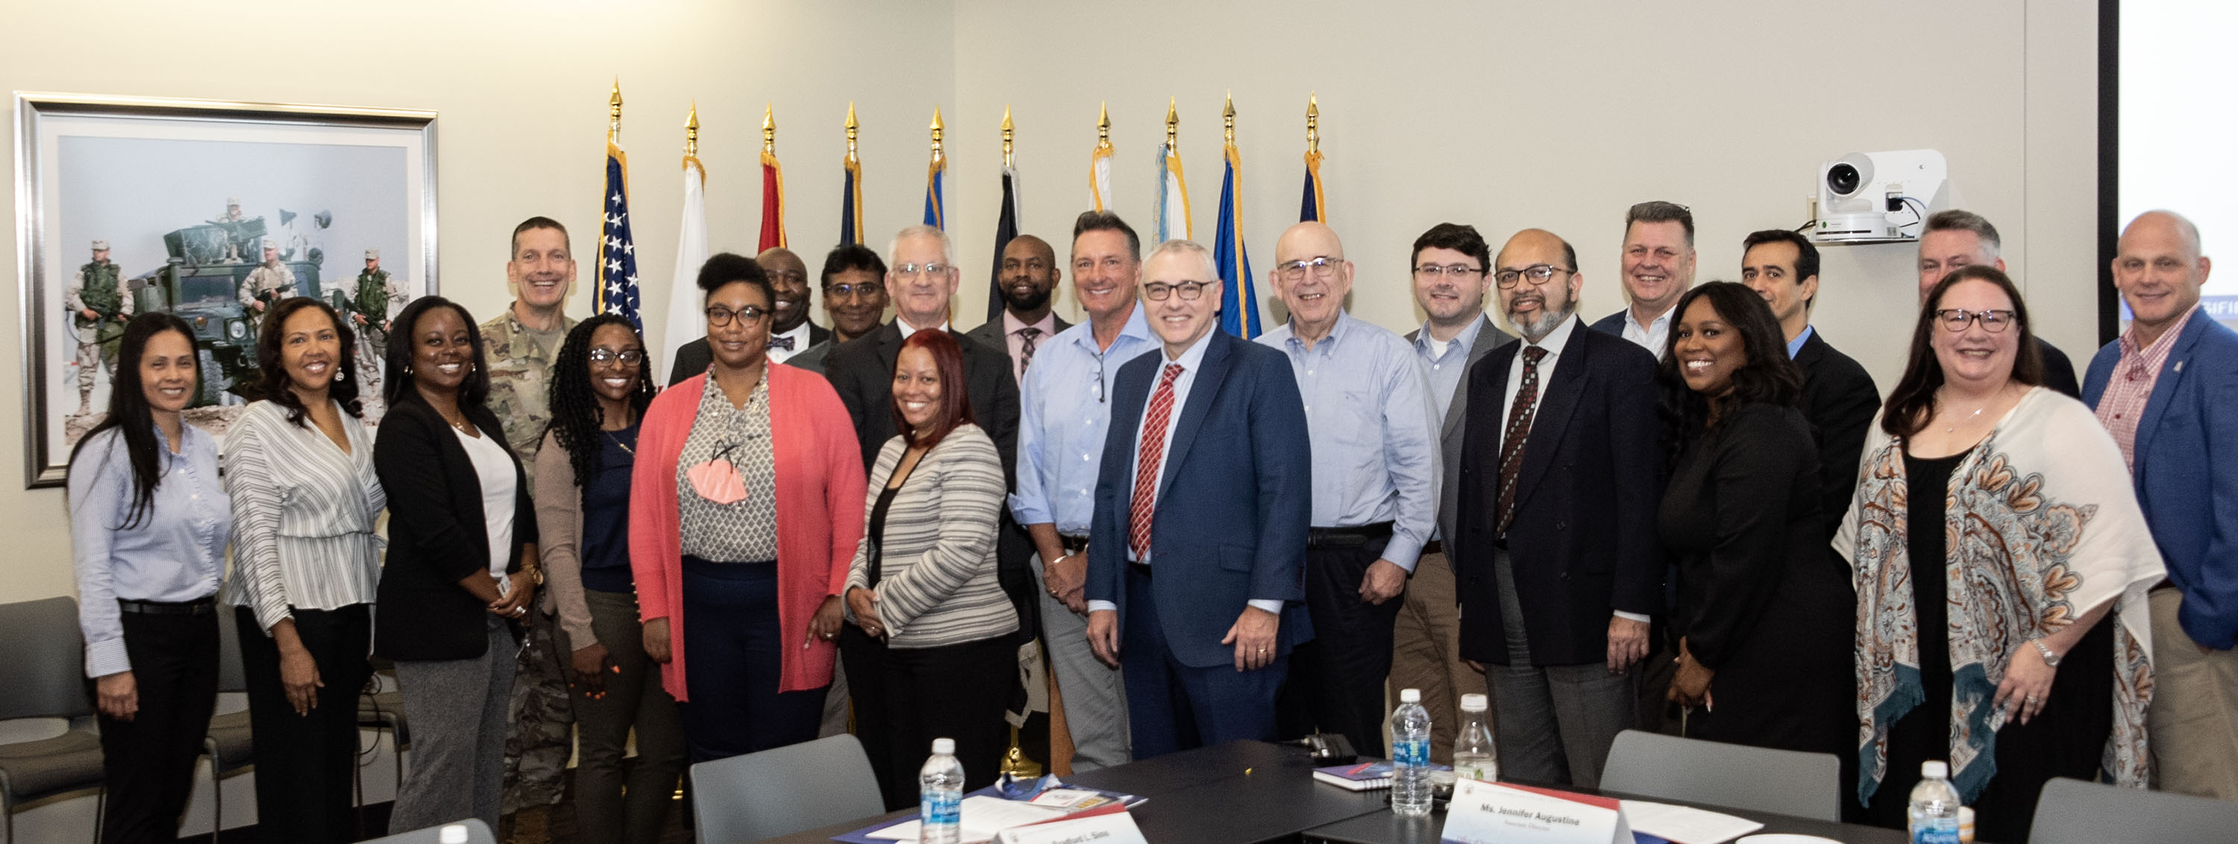
NSF ATE
Goal 2: Develop an internship program on OT/ICS and IT cybersecurity
  By the end of the Pre-internship Seminars, the goal is to secure 100+ paid internships each summer
Visit to the Defense Information Systems Agency (DISA)
August 2nd 2023 - Baltimore, MD

Slide 30
NSF ATE
Goal 3: Advance formal and informal communities for OT/ICS and IT cybersecurity training and education
 | Activity | Community | Subject / Libraries | Support Type
A | Academic courses (16-week – formal, supervised) | Colleges in the Carolinas | All college-level libraries | (1) Access to Academic Cloud; (2) Train instructors (train-the-trainer).
B | High school courses, 16+16- (formal, supervised) | High schools in the Carolinas | Intro to OT/ICS Cybersecurity | (1) Access to Academic Cloud; (2) Train instructors (train-the-trainer).
 |  |  | Intro to IT Cybersecurity and Intro to IT Networks
C | Third party academic courses (formal, unsupervised) | Other high schools, colleges, universities | All libraries | (1) Access to the Academic Cloud (unsupervised); (2) Train instructors (train-the-trainer).
D | Train-the-trainer courses (formal, supervised) | CSSIA, WASTC, SCC | All libraries | (1) Access to Academic Cloud; (2) Train instructors (train-the-trainer).
E | ICS courses (informal, unsupervised) | ICS COP | All OT / CCS cybersecurity libraries | (1) Access to Academic Cloud; (2) Train instructors (train-the-trainer).
F | IT tutorials (informal, unsupervised) | Internet2 and LBNL’s COP | All college-level IT cybersecurity libraries | (1) Access to Academic Cloud; (2) Training tutorials.

Slide 31
NSF ATE
Goal 3: Advance formal and informal communities for OT/ICS and IT cybersecurity training and education
 | Activity | Community | Subject / Libraries | Support Type
G | Self-paced training courses for military-connected personnel (informal, unsupervised) | CIAB, U.S. National Guard, NIWC | All college-level libraries | (1) Access to the Academic Cloud; (2) Courses to train military instructors (train-the-trainer).
H | FABRIC tutorials (informal, unsupervised) | FABRIC COP | Advanced programmable networks (smart NICs and P4 programmable switches) | (1) Access to Academic Cloud; (2) Co-located training tutorials to FABRIC community events.
I | Cybersecurity Competitions: DOE’s CyberForce and SC’s PCDC (informal, unsupervised) | High schools and colleges in the Carolinas | Libraries 1-2 for DOE’s CyberForce Competition, and libraries 6-8 for PCDC | (1) Access to Academic Cloud to high-school and college instructors and their students, participating in the competitions.

Slide 32

Office of Naval Research
“Preparing Cyber Warfare Professionals by Integration of Curriculum, Experiences, and Internships”
February 1 2023 – January 30 2026

Slide 33

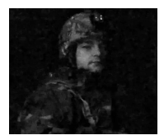
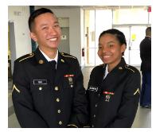
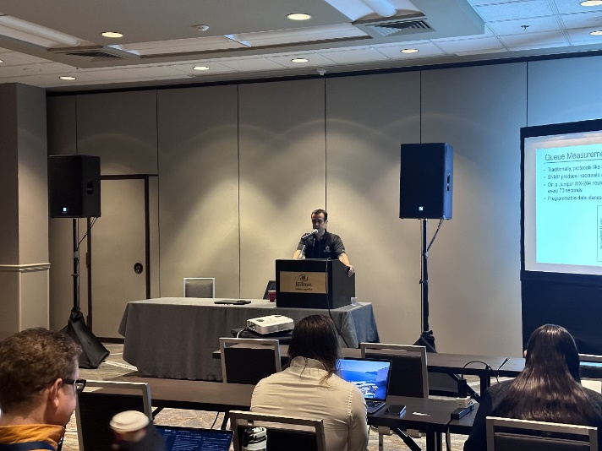
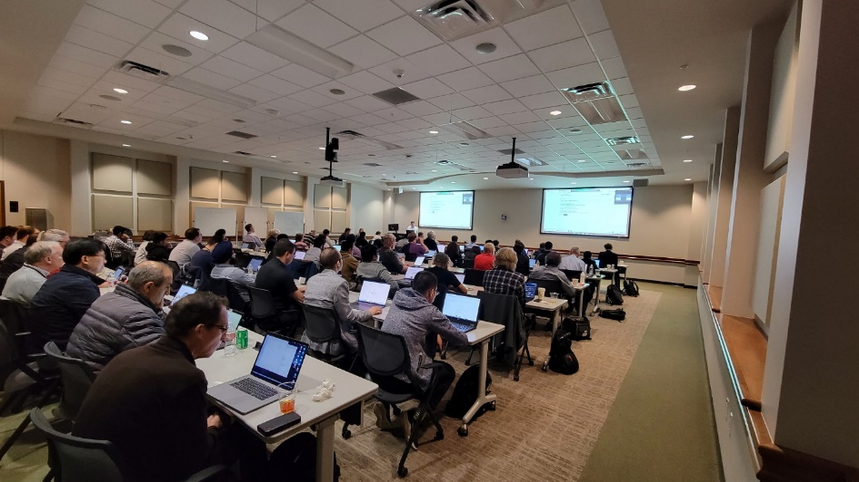
ONR Cyber
Goal 1: Advance formal and informal cyber communities
  Twelve-week C4ISR1 research experience (formal learning)
  Workshops and tutorials (informal learning)
Workshop on Security Applications with P4, FABRIC Community Workshop, Austin, TX, April 24, 2023 (with Texas Advanced Computing Center).
Workshop on Fine-grained Network Measurements with P4, Internet2 Technology Exchange Conference, Minneapolis, MN, Sep. 18, 2023 (with LBNL / ESnet).
1. C4ISR: Command, Control, Communications, Computers, Intelligence, Surveillance and Reconnaissance

Slide 34
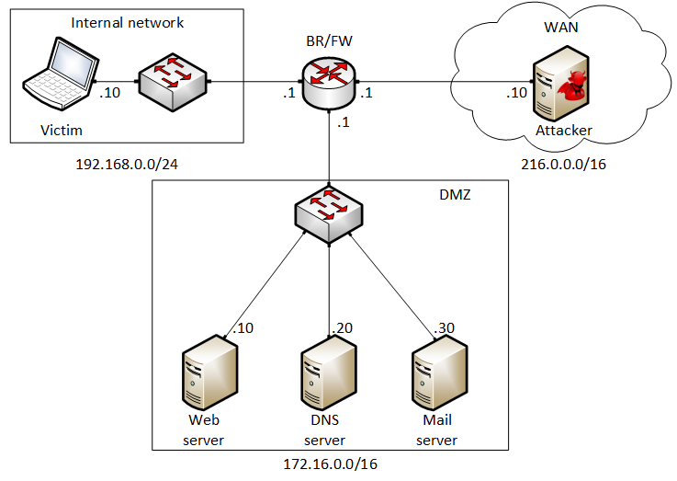
ONR Cyber
Goal 2: Expand the Academic Cloud
  Example: Lab library on “Fundamentals of Cybersecurity”
Lab 1: Reconnaissance: Scanning with NMAP, Vulnerability Assessment with OpenVAS
Lab 2: Remote Access Trojan (RAT) using Reverse TCP Meterpreter
Lab 3: Escalating Privileges and Installing a Backdoor
Lab 4: Collecting Information with Spyware: Screen Captures and Keyloggers
Lab 5: Social Engineering Attack: Credentials Harvesting and Remote Access through Phishing Emails
Lab 6: SQL Injection Attack on a Web Application
Lab 7: Cross-site Scripting (XSS) Attack on a Web Application
Lab 8: Denial of Service (DoS) Attacks: SYN/FIN/RST Flood, Smurf attack, and SlowLoris
Lab 9: Cryptographic Hashing and Symmetric Encryption
Lab 10: Asymmetric Encryption: RSA, Digital Signatures, Diffie-Hellman
Lab 11: Public Key Infrastructure: Certificate Authority, Digital Certificate
Lab 12: Configuring a Stateful Packet Filter using iptables
Lab 13: Online Dictionary Attack against a Login Webpage
Lab 14: Intrusion Detection and Prevention using Suricata
Lab 15: Packet Sniffing and Relay Attack
Lab 16: DNS Cache Poisoning
Lab 17: Man in the Middle Attack using ARP Spoofing
Lab 18: Understanding Buffer Overflow Attacks in a Vulnerable Application
Lab 19: Conducting Offline Password Attacks
  Border router implements policy rules to protect internal network

Slide 35
DEMO – Spyware https://youtu.be/x_7jsXsn_YU

Slide 36
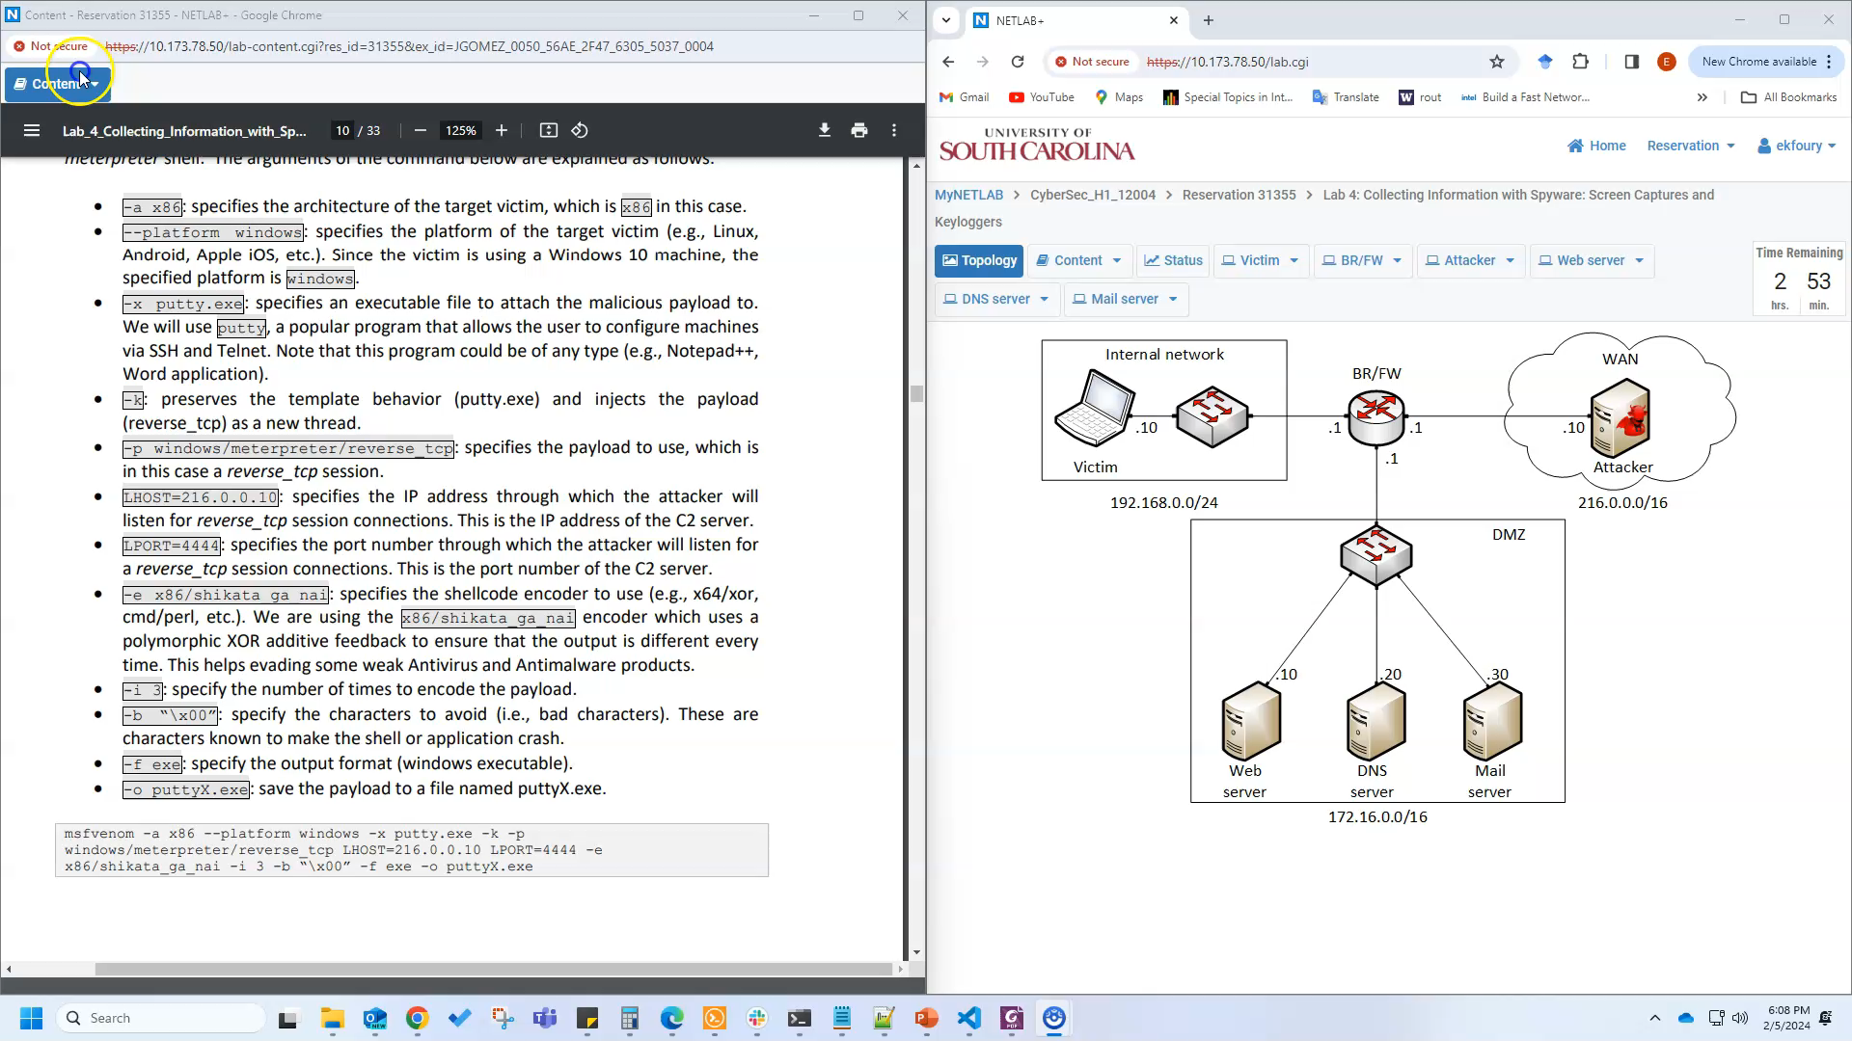
Demo

