Slide 1


A Cloud System for Teaching and Research on
P4 Programmable Data Plane
Elie Kfoury, Jose Gomez, Ali AlSabeh, Jorge Crichigno
College of Engineering and Computing
University of South Carolina
http://ce.sc.edu/cyberinfra
KNIT 5: A FABRIC Community Workshop
Northwestern University, Wieboldt Hall
September 20 – 22, 2022
Chicago, IL
Supported by NSF 2118311
“CyberTraining: Implementation: Small: Cybertraining on P4 Programmable Devices using an Online Scalable Platform”

Slide 2
Agenda
Motivation for virtual labs
Platform
Libraries
P4 Tofino Library
Topologies used by the research community
Conclusion

Slide 3
Motivation for Virtual Labs
IT curriculum should emphasize “learning IT core concepts with authentic practice¹”
  “It is not enough to simply attend courses and read books”
Disadvantages of physical labs
  Difficult to scale
  Expensive (space, maintenance, staff)
  Since COVID-19 emerged, the capacity of labs has been further reduced
1. Information Technology Curricula 2017, ACM/IEEE Joint Committee. Online: https://tinyurl.com/4nqqwa5m.

Slide 4
Motivation for Virtual Labs
The University of South Carolina (USC) (SC), the Network Development Group (NDG) (NC), and Stanly Community College (SCC) (NC) have deployed an Academic Cloud
  Virtual labs on P4, routing, high-speed networks (USC)
  Remote-access capability to lab equipment via Internet
  Shared resources (CPU, memory, storage) from four data centers
LMS: Learning Management System. LTI: Learning Tools Interoperability

Slide 5
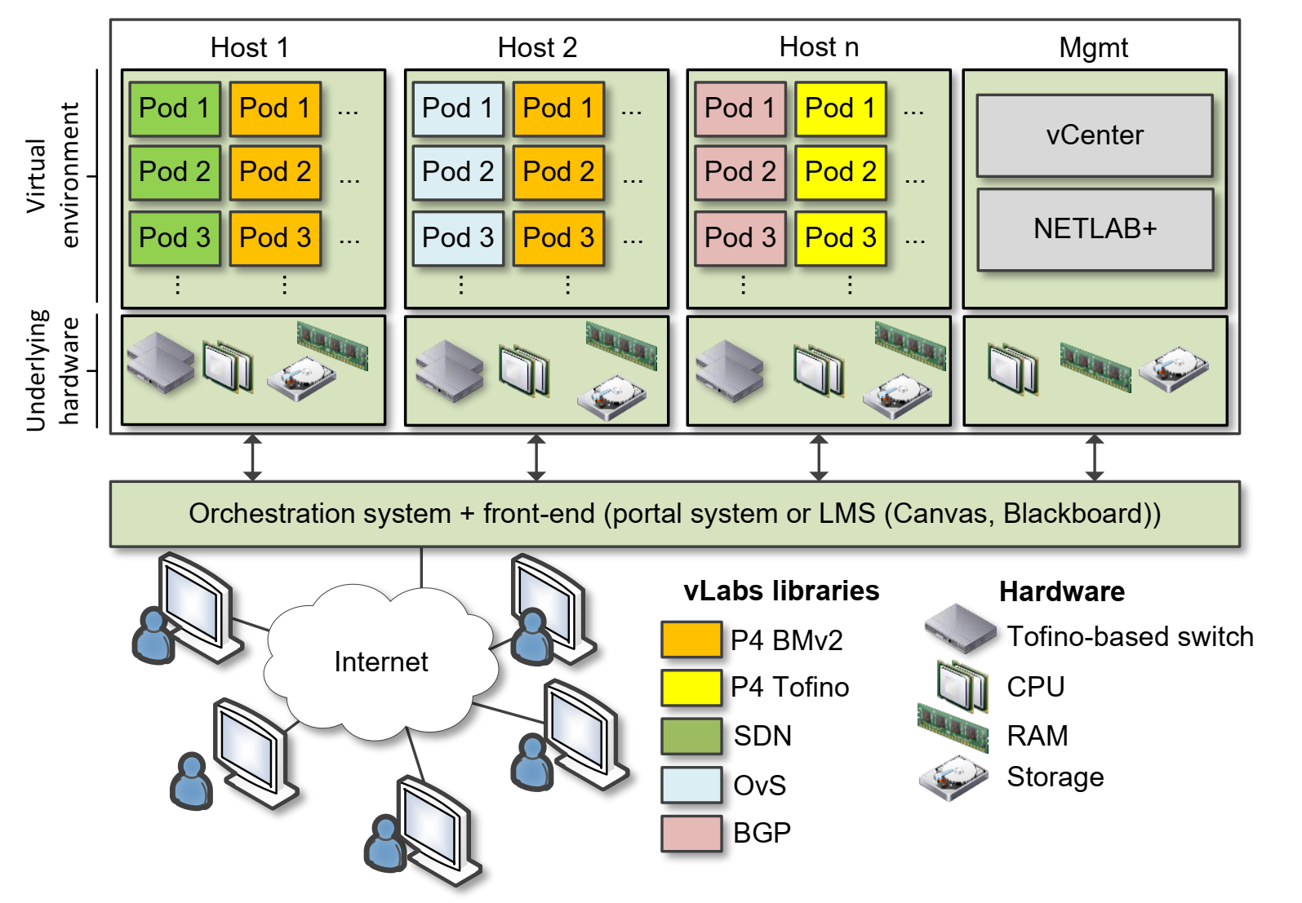
USC Data Center
Hosts 1-n store virtual machines (VMs) for virtual labs
Management server runs vCenter, Management Software (NETLAB+)
Partnership with Network Development Group (NDG)¹
Network Development Group (NDG). Online: https://netdevgroup.com

Slide 6
Libraries
A library consists of between 10-20 lab experiments
Each lab experiment includes a detailed, step by step manual
Once a learner completes all experiments, the learner acquires significant knowledge and hands-on expertise, and may earn an academic credential or certificate
Information about libraries are available at http://ce.sc.edu/cyberinfra/cybertraining.html

Slide 7
Library on Introduction to P4 with BMv2
Experiments
Lab 1: Introduction to Mininet
Lab 2: Introduction to P4 and BMv2
Lab 3: P4 Program Building Blocks
Lab 4: Parser Implementation
Lab 5: Introduction to Match-action Tables (Part 1)
Lab 6: Introduction to Match-action Tables (Part 2)
Lab 7: Populating / Managing Match-action Tables
Lab 8: Checksum Recalculation and Deparsing
Exercises
Exercise 1: Building a Basic Topology
Exercise 2: Compiling and Testing a P4 Program
Exercise 3: Parsing UDP and RTP
Exercise 4: Building a Simplified NAT
Exercise 5: Configuring Tables at Runtime
Exercise 6: Building a Packet Reflector

Slide 8
Library on P4 Applications, Stateful Elements, and Custom Packet Processing
Experiments
Lab 1: Introduction to Mininet
Lab 2: Introduction to P4 and BMv2
Lab 3: P4 Program Building Blocks
Lab 4: Defining and processing custom headers
Lab 5: Monitoring the Switch’s Queue using Standard Metadata
Lab 6: Collecting Queueing Statistics using a Header Stack
Lab 7: Measuring Flow Statistics using Direct and Indirect Counters
Lab 8: Rerouting Traffic using Meters
Lab 9: Storing Arbitrary Data using Registers
Lab 10: Calculating Packets Interarrival Time w/ Hashes and Registers
Lab 11: Generating Notification Messages from the Data Plane

Slide 9
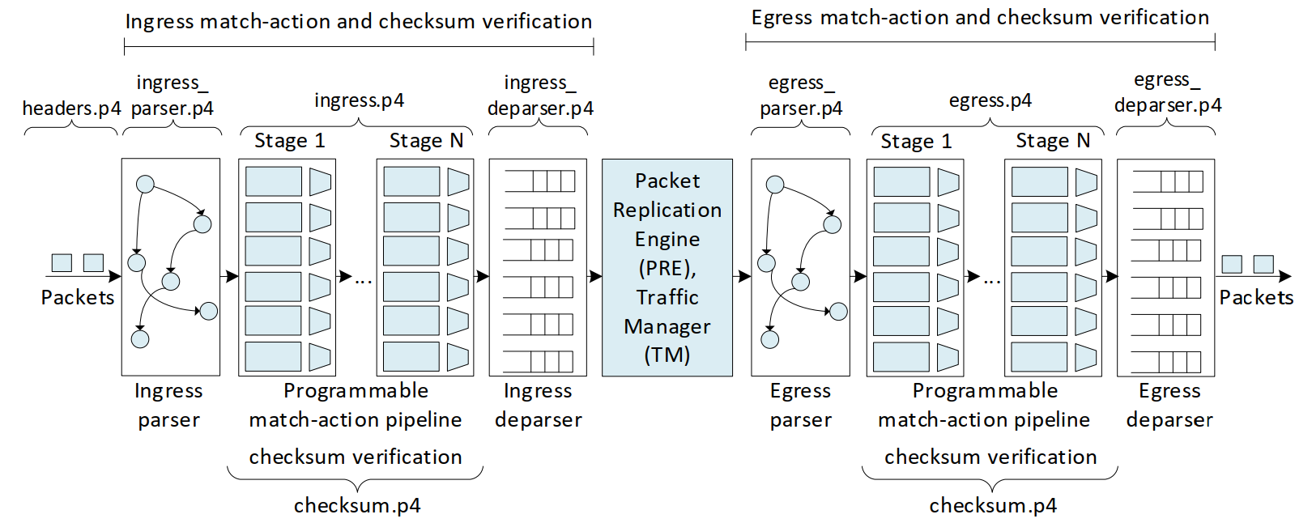
Library on P4 Programmable Data Plane with Tofino
Experiments
Lab 1: Introduction to P4 and Tofino
Lab 2: Introduction to P4 Tofino Software Development Environment
Lab 3: Parser Implementation
Lab 4: Introduction to Match-Action Tables
Lab 5: Populating and Managing Match-Action Tables at Runtime
Lab 6: Checksum Recalculation and Packet Deparsing

Slide 10
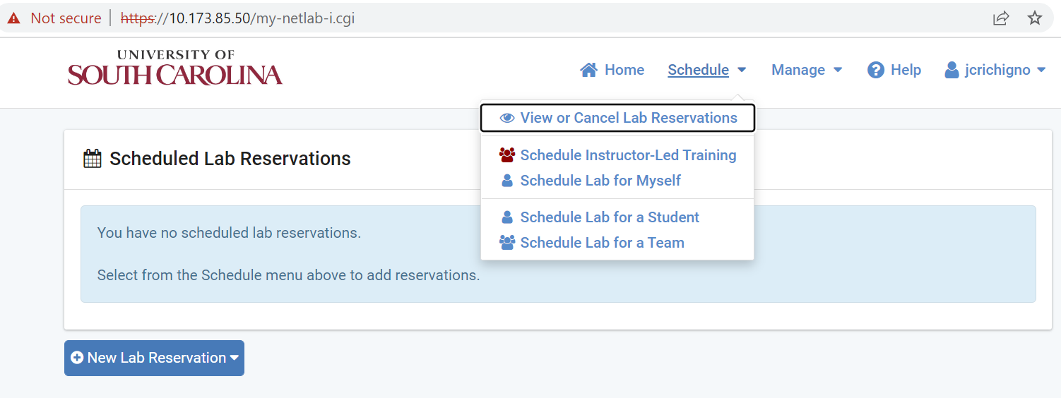
Library on P4 Programmable Data Plane with Tofino
https://netlab2.cec.sc.edu/

Slide 11
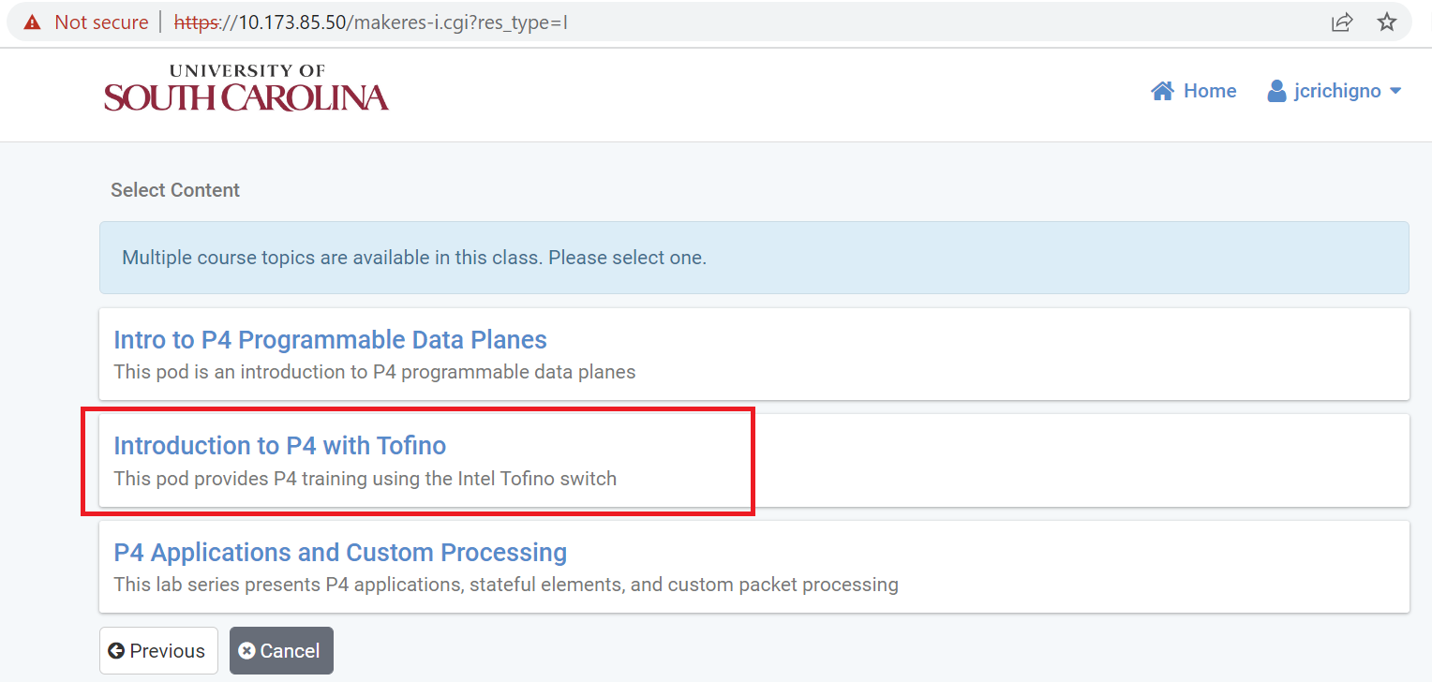
Library on P4 Programmable Data Plane with Tofino

Slide 12
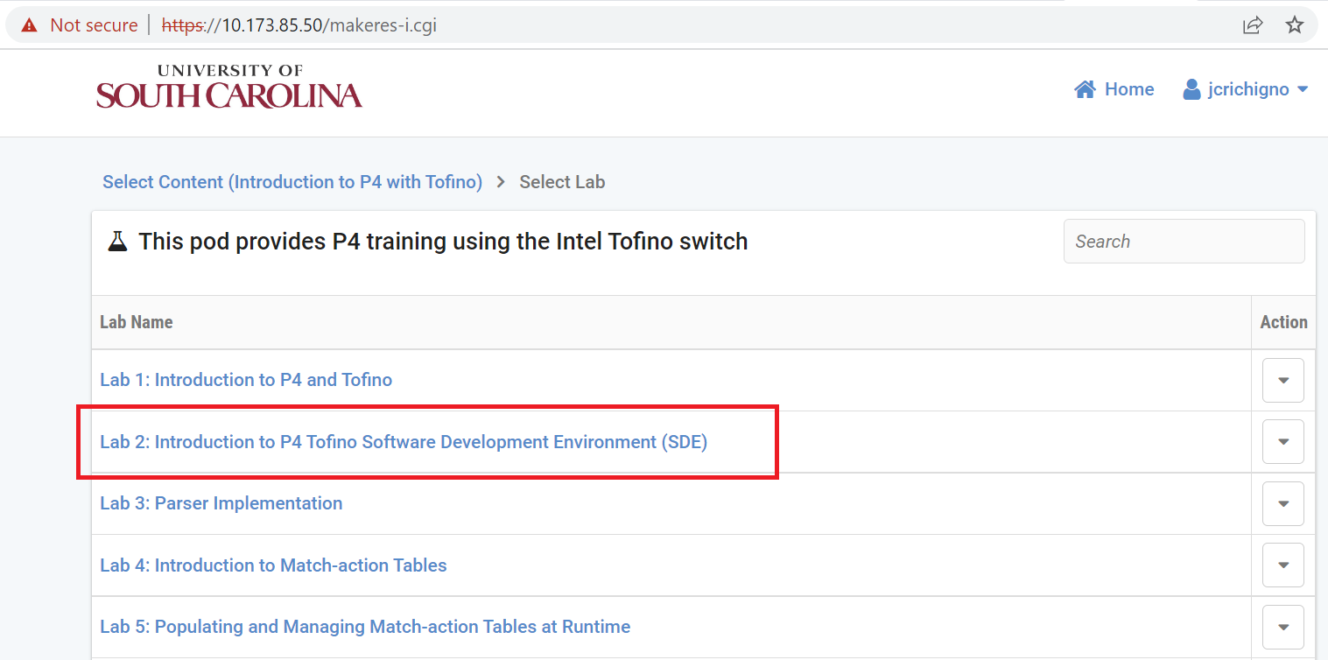
Library on P4 Programmable Data Plane with Tofino

Slide 13
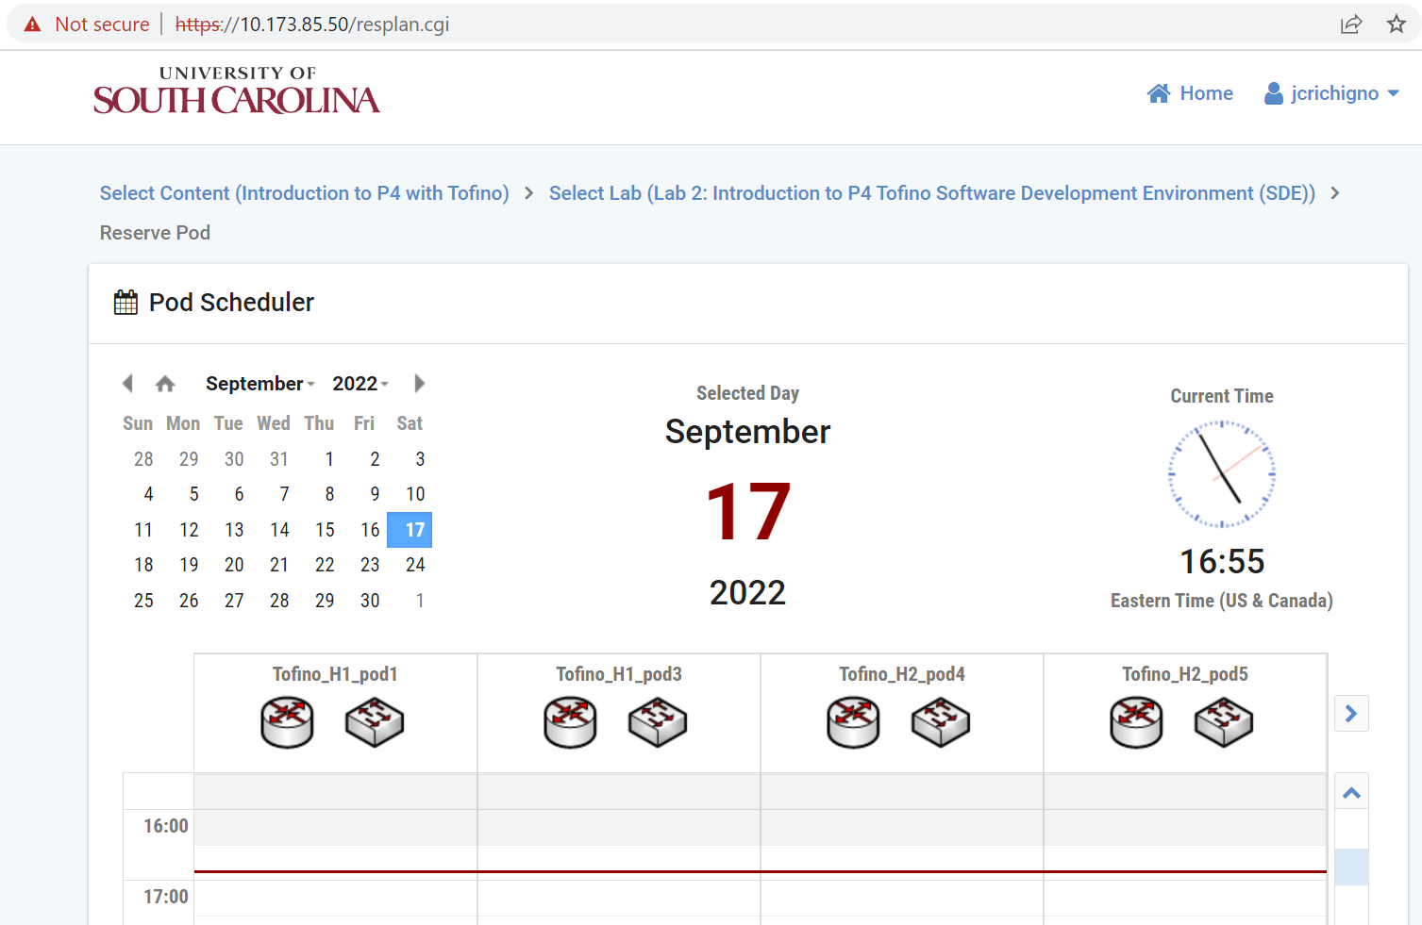
Library on P4 Programmable Data Plane with Tofino

Slide 14
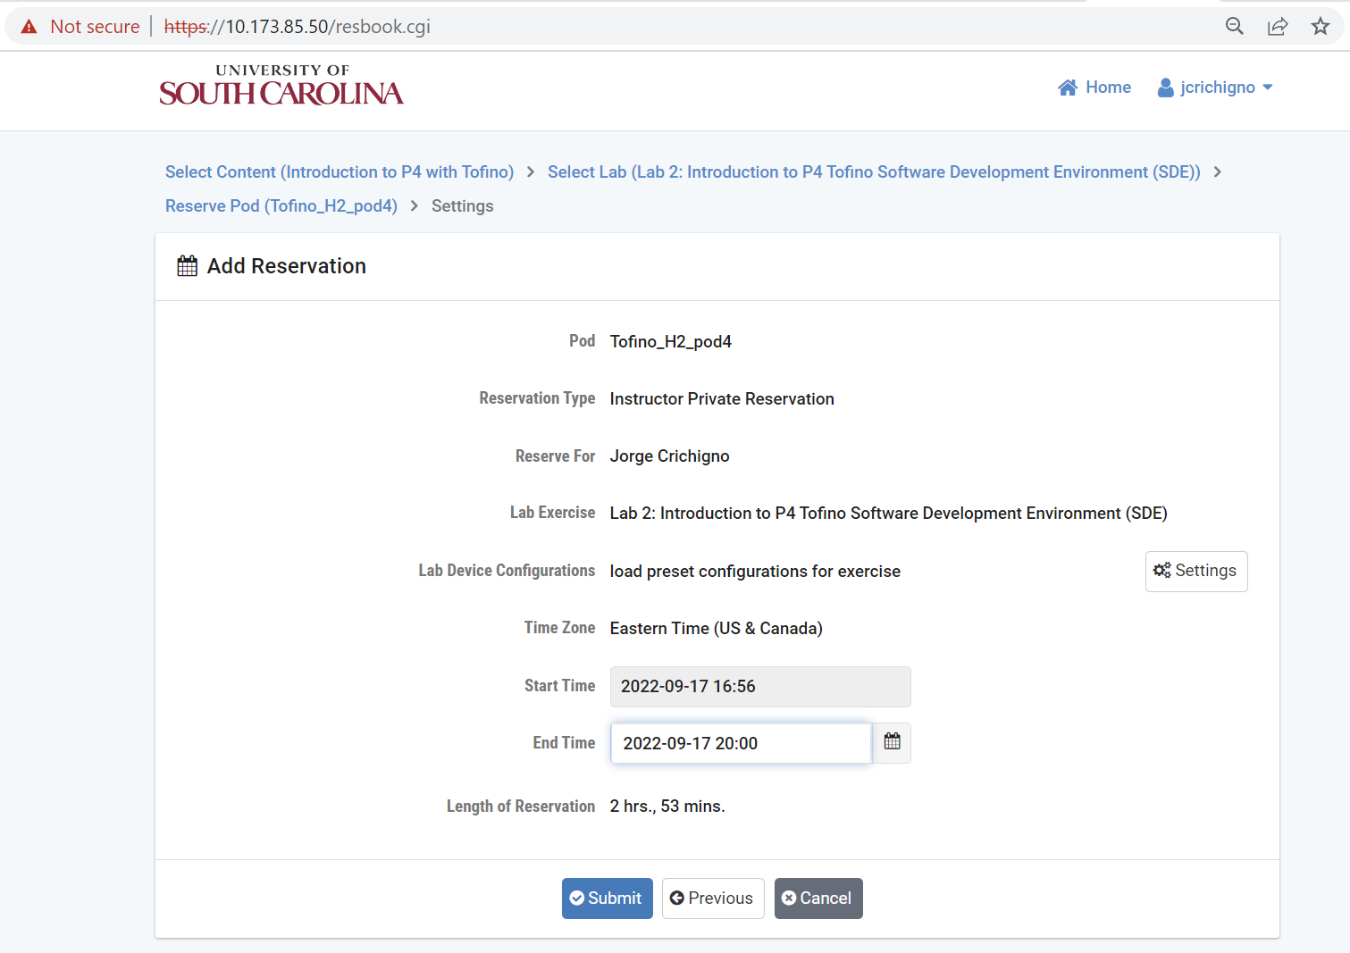
Library on P4 Programmable Data Plane with Tofino

Slide 15
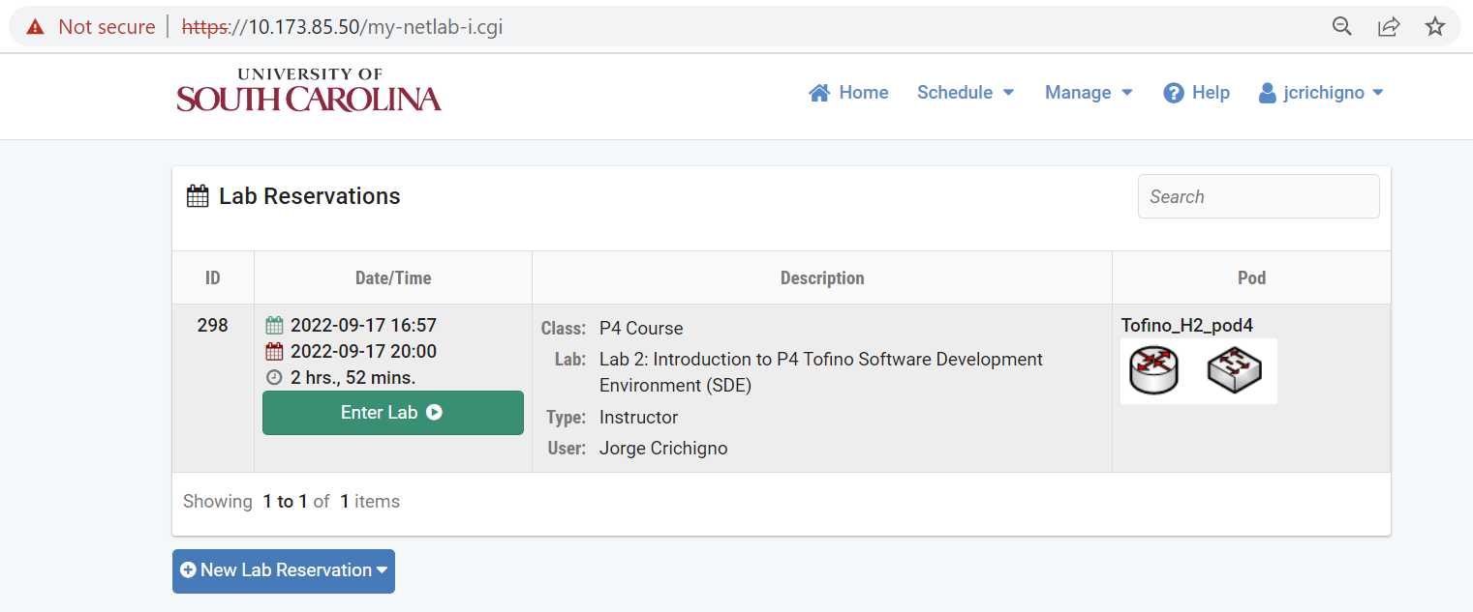
Library on P4 Programmable Data Plane with Tofino

Slide 16
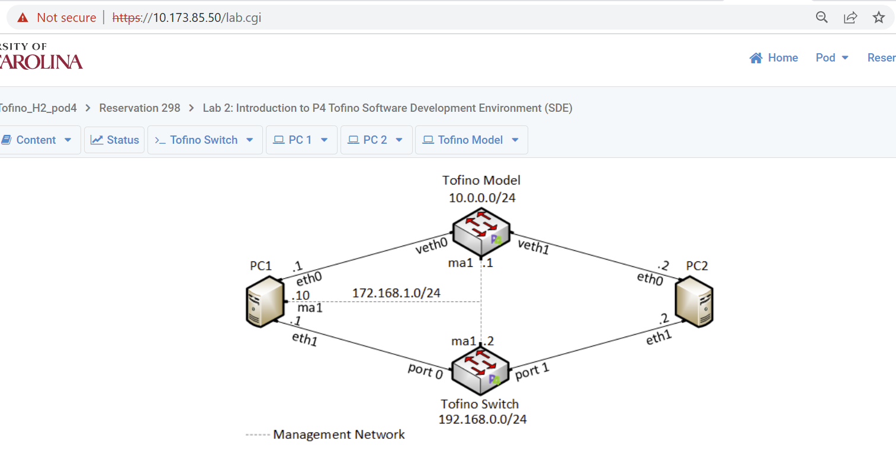
Library on P4 Programmable Data Plane with Tofino

Slide 17

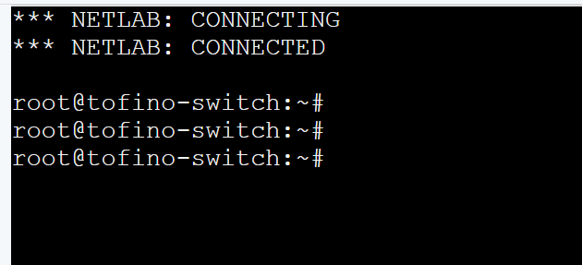
Library on P4 Programmable Data Plane with Tofino

Slide 18
Library on P4 Programmable Data Plane with Tofino
Topology complexity
  6.4 Tbps Tofino programmable switch
  Tofino model for debugging (trace execution in the data plane)
  Servers to send/receive data to/from the switch/other servers
  Multi-mode fiber
  QSFP28+ transceivers
  Open Network Linux (ONL) (control plane)
  Software Development Environment (SDE) from Intel (control plane)
  Sample P4 codes for each lab (data plane)
  Laboratory experiments with step-by-step directions (thousands of development hours)
Logistic challenges
  NDA with Intel, lawyers’ agreement
  Procurement process
  Physical hardware, rack space, data center, etc.
  Software tools, SDE, operating system, etc.

Slide 19
Literature Survey: Topologies used for Research
293 papers from 2014 to 2022
Determine the topologies that are commonly used by experimenters
Determine the devices that are used

Slide 20
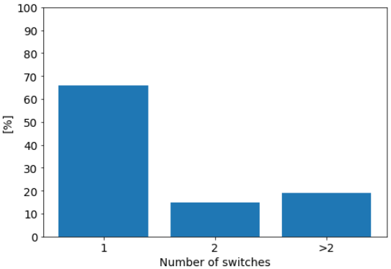
Literature Survey: Topologies used for Research
Number of switches

Slide 21
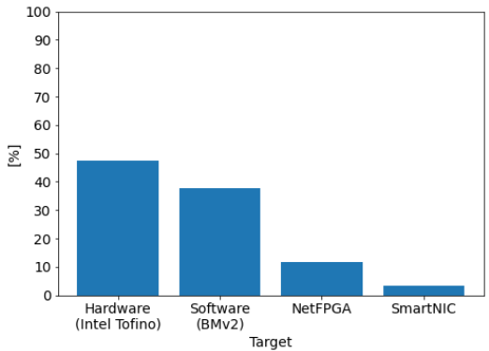
Literature Survey: Topologies used for Research
Targets

Slide 22
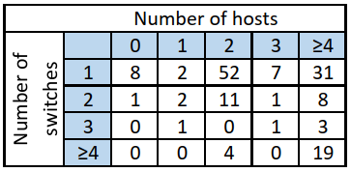
Literature Survey: Topologies used for Research
Number of switches and hosts

Slide 23
Literature Survey: Topologies used for Research
Papers that use a 2-host, 1-switch topology
Notes:
33% of the papers use

Slide 24
Literature Survey: Topologies used for Research
25% of the papers rely on virtualization to add end devices
Notes:
33% of the papers use

Slide 25
Literature Survey: Topologies used for Research
Topology supported by the current Tofino pod
Notes:
33% of the papers use

Slide 26
USC, UTSA, USF Research Work
“INC: In-Network Classification of Botnet Propagation at Line Rate”
“P4DDPI: Securing P4-Programmable Data Plane Networks via DNS Deep Packet Inspection”
“Dynamic Router's Buffer Sizing using Passive Measurements and P4 Programmable Switches”
“On Offloading Network Forensic Analytics to Programmable Data Plane Switches”
“Coarse Estimation of Bottleneck Router's Buffer Size for Heterogeneous TCP Sources”
“Offloading Media Traffic to Programmable Data Plane Switches”
“Towards a Unified In-Network DDoS Detection and Mitigation Strategy”
“Enabling TCP Pacing using Programmable Data Plane Switches”
“An Exhaustive Survey on P4 Programmable Data Plane Switches: Taxonomy, Applications, Challenges, and Future Trends”
“A Survey on TCP Enhancements using P4-programmable Devices”
“A Survey on Security Applications of P4 Programmable Switches and a STRIDE-based Vulnerability Assessment”

Slide 27
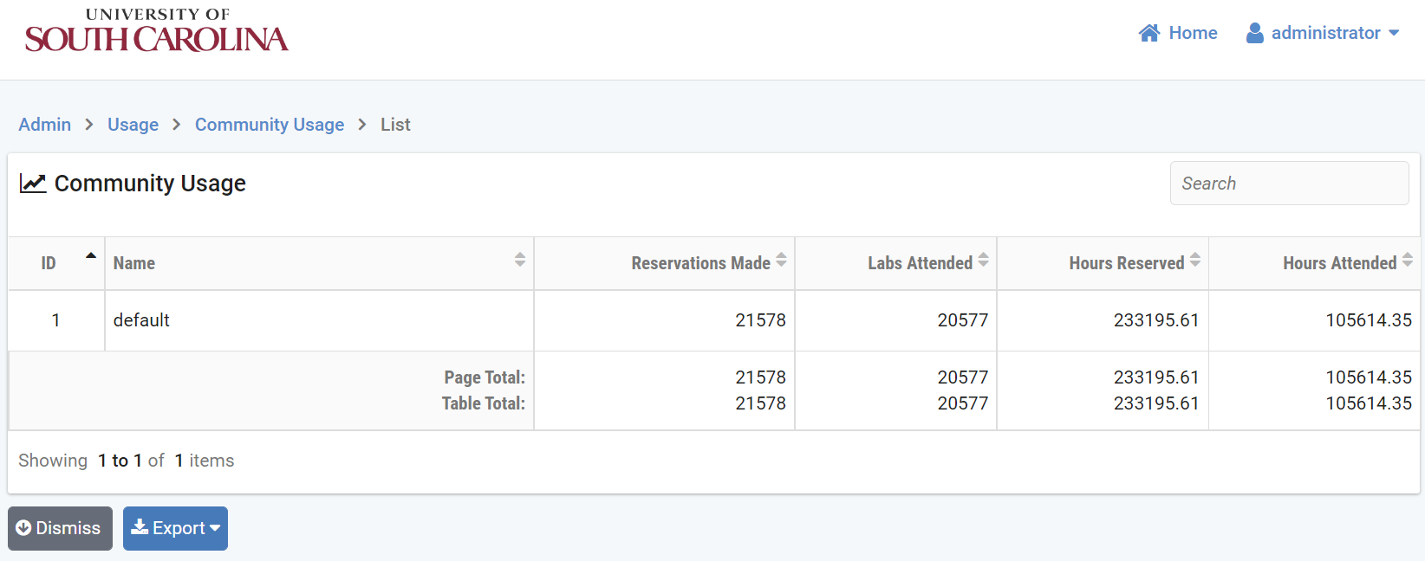
Conclusion
The primary use is of the platform is for teaching
The platform is used at USC, UTSA, and USF for research
  Time to research is shortened
  Scalable, cost efficient
  Resources are shared
Usage of the cloud by USC courses and research (2019-2022)

Slide 28
Conclusion
Future work includes exploring potential use cases when pods are connected via a wide-area network
  Visibility
  Accurate real-time measurements
  Data plane processing speed

Slide 29
Conclusion
Demo, as the time permits
Application examples in the Poster Presentation session
Thank you

Slide 30
Platform Features
Feature | Comments
Allocation of resources | Pod granularity
Custom pods | Easy to create custom pods
Cost | Cost-effective when used extensively
Presentation layer for pedagogy | Topology is graphically presented to the learner using a regular browser
Time sharing | Easy to implement time-sharing policies
IP addresses | Pods have the same topology / IP addresses (overlapping addresses w/o conflict)
Functional realism | Virtual labs have the same functionality as real IT hardware in a real deployment
Traffic realism | Devices generate/receive real, interactive network traffic to/from the Internet

Slide 31
Motivation for Virtual Labs
“The Missing Millions”(NSF report – Oct. 2021. https://tinyurl.com/5awhdazy)
What can be done to reach out those who are yet to be engaged in STEM workforce?
  “The present research computing and data ecosystems look impenetrable to many…”
  “Lower barriers to entry…”
  “Invest in CI and community laboratories at the edge, enabling broader and more diverse participation”
  “Explore investments in research computing … that are easily accessible (such as GUIs, …)

