Slide 1
Preparing Cyber Warfare Professionals by Integration of Curriculum, Experiences, and Internships
Project website: https://research.cec.sc.edu/cyberinfra/projects/ONR
Program Officer: Dr. Michael Simpson
Award # N00014-23-1-2245
Jorge Crichigno
University of South Carolina (USC)
April 4, 2024 - McNair Center
Columbia – SC
Notes:
All information provided in the following slides must be suitable for dissemination to the public and must not include any proprietary/confidential information.

Slide 2
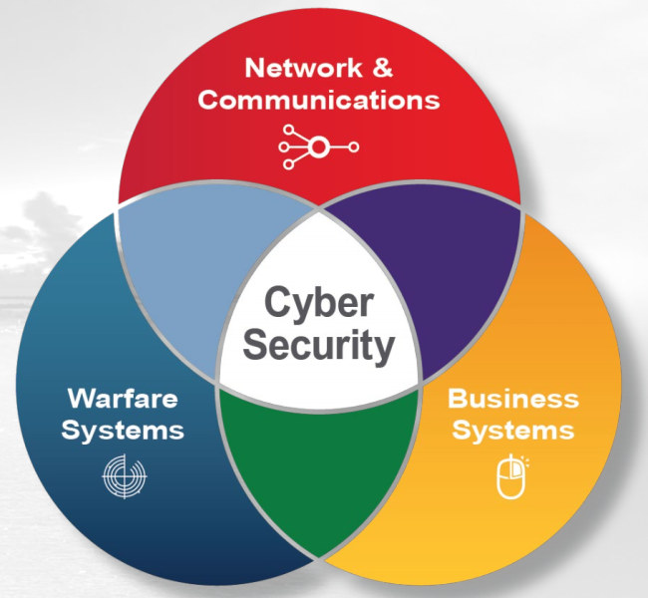
Motivation
A key element for the American military to help maintain superiority is the engineering support for information warfare
Challenges
  Shortage of professionals with cybersecurity skills
  Difficult to compete for the small number of cybersecurity professionals
  Lack of exposure to potential careers in the Navy and federal agencies
  Security clearance process may be time consuming
IT capability, Naval Information Warfare Systems Command¹
1. Naval Information Warfare Systems Command, Generic View. February 2022. URL: https://tinyurl.com/4pnpy44n
Notes:
Please circle the strategic priorities that apply.
1 Slide Maximum

Slide 3
Objectives
This project is helping address the shortage of skilled cyber-professionals opting for careers with the DoD
The project has three objectives:
    Advance formal and informal cyber communities and connect relevant organizations
    Develop a multi-state internship program, leveraging and strengthening the Naval Research Enterprise Internship Program (NREIP)
    Expand the Academic Cloud to support large-scale learning and research nationwide
Notes:
Please circle the strategic priorities that apply.
1 Slide Maximum

Slide 4
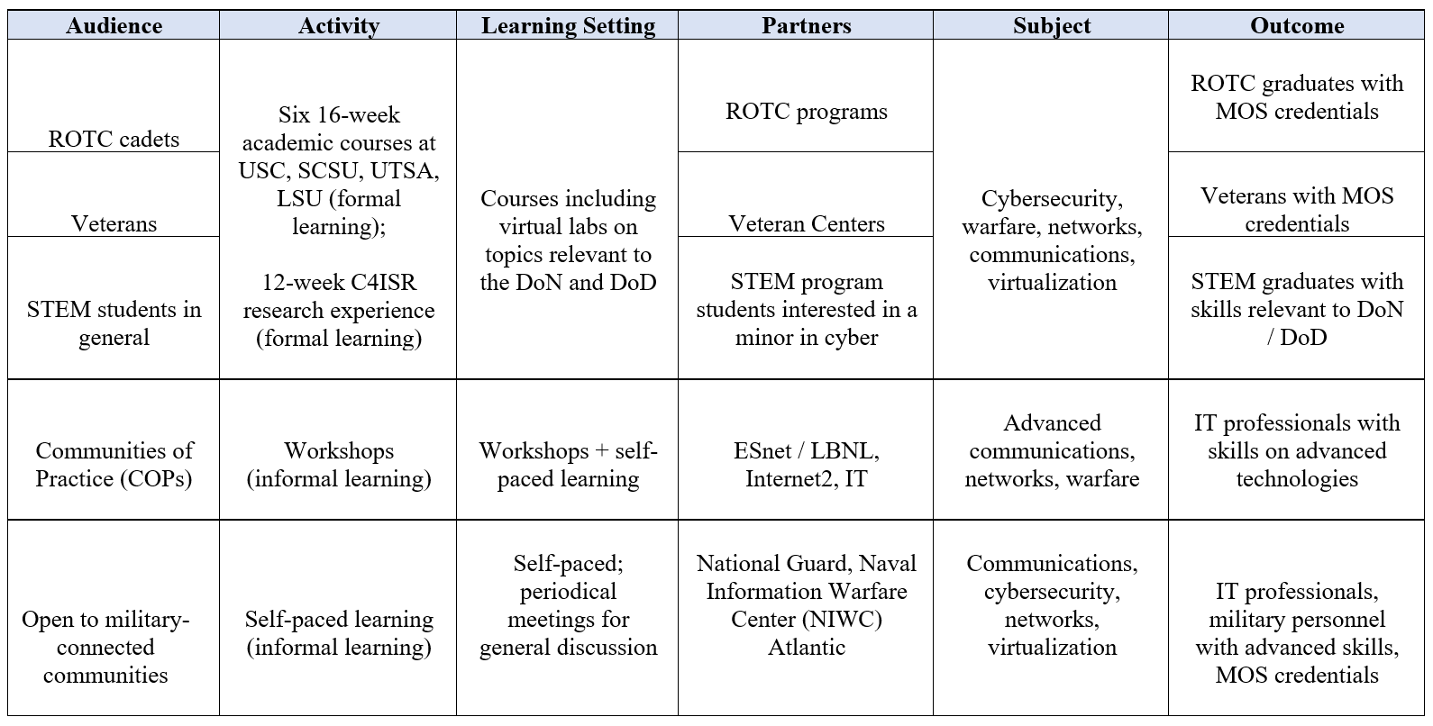
Formal and Informal Communities
Objective 1: Advance formal and informal cyber communities
MOS: Military Occupational Specialty
Notes:
C4ISR: Command, Control, Communications, Computers (C4) Intelligence, Surveillance and Reconnaissance (ISR).

Slide 5
Academic Courses
Objective 1: Advance formal and informal cyber communities
Formal academic courses at University of South Carolina (USC), University of Texas San Antonio (UTSA), and South Carolina State University (SCSU)
  Spring 2023:
      IT 493 IT Security (54 students, USC)
      IT 742 Enterprise Network Management (7 students, USC)
      IS 6953 Research Seminar (12 students, UTSA)
      IS 3033 Operating Systems (40 students, UTSA)
      CSM 188 Fundamentals of Cybersecurity (15 students, SCSU)
  Summer 2023:
      IT 493 IT Security (17 students, USC)
  Fall 2023:
      IT 445 Advanced Networking (65 students, USC)
      IT 493 IT Security (26 students, USC)
      CSM 188 – Fundamentals of Cybersecurity (17 students, SCSU)
      CSC 2362 - Intro to Cybersecurity and Defense (70 students, LSU)
      IS 3423 - Network Security (54 Students, UTSA)
Notes:
Approximately 400 students

Slide 6
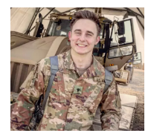
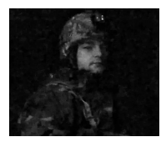
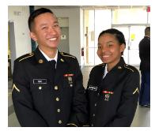
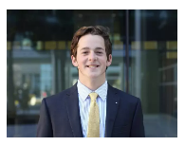
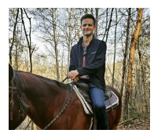
C4ISR Research Experience
Objective 1: Advance formal and informal cyber communities
Twelve-week C4ISR¹ research experience (formal learning)
  Between 50-75 undergraduates per year conducting research on cybersecurity at the University of South Carolina, South Carolina State University, UT San Antonio, LSU
1. C4ISR: Command, Control, Communications, Computers, Intelligence, Surveillance and Reconnaissance
Notes:
Ty: US Marine Corps – Washington DC
Jack Sadle: Signal Officer, Army Reserve
Matt Driver:

Slide 7
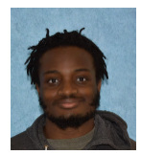
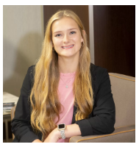
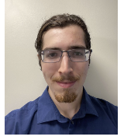
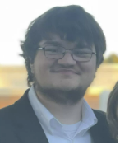
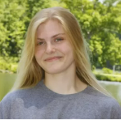
C4ISR Research Experience
Objective 1: Advance formal and informal cyber communities
Twelve-week C4ISR research experience (formal learning)
  Between 50-75 undergraduates per year conducting research on cybersecurity at the University of South Carolina, South Carolina State University, UT San Antonio, LSU
1. C4ISR: Command, Control, Communications, Computers, Intelligence, Surveillance and Reconnaissance
Notes:
Please circle the strategic priorities that apply.
1 Slide Maximum

Slide 8
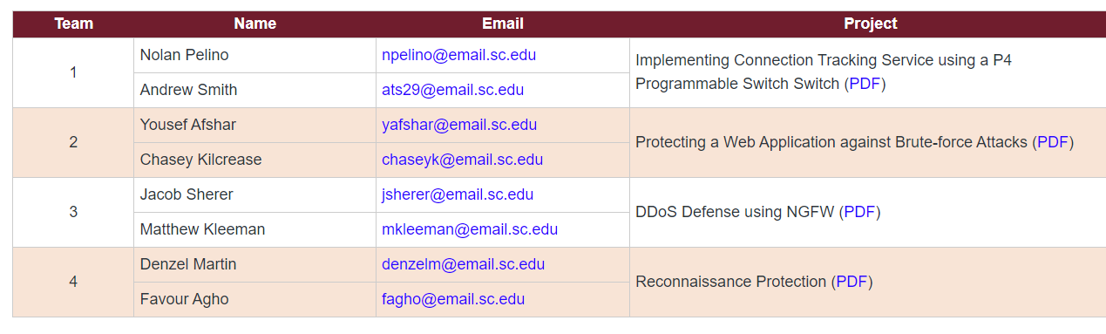
C4ISR Research Experience
Objective 1: Advance formal and informal cyber communities
Twelve-week C4ISR research experience (formal learning)
  Between 50-75 undergraduates per year conducting research on cybersecurity at the University of South Carolina, South Carolina State University, UT San Antonio, LSU
Notes:
Please circle the strategic priorities that apply.
1 Slide Maximum

Slide 9
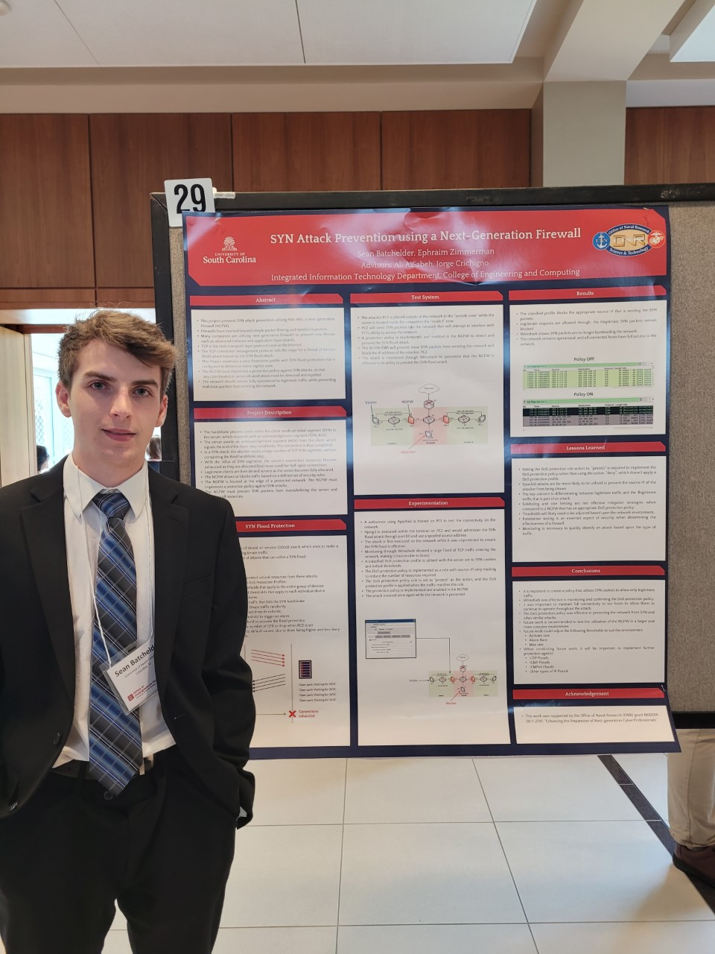
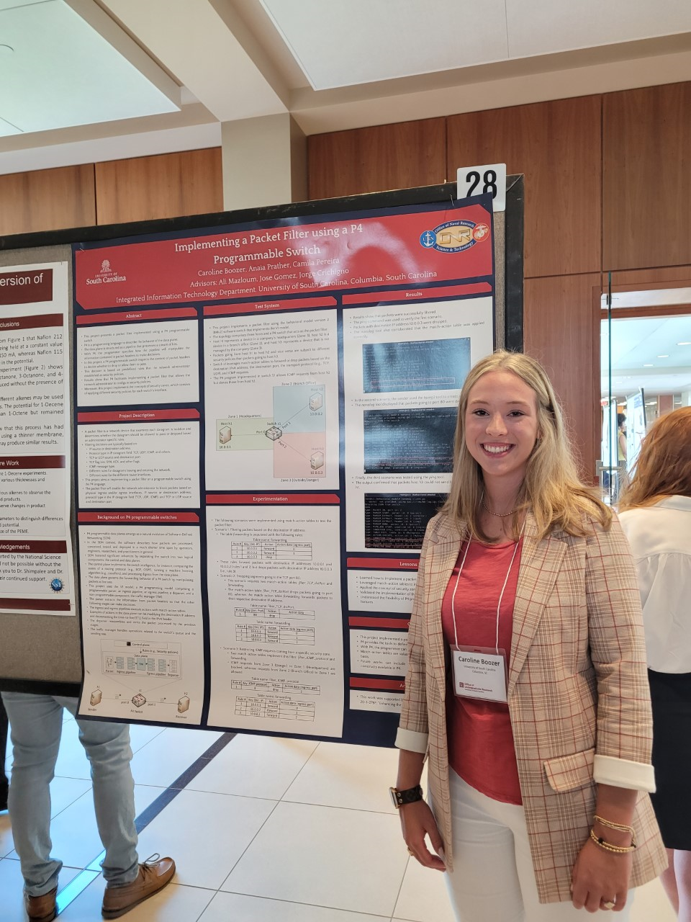
C4ISR Research Experience
Objective 1: Advance formal and informal cyber communities
Twelve-week C4ISR research experience (formal learning)
  Between 50-75 undergraduates per year conducting research on cybersecurity at the University of South Carolina, South Carolina State University, UT San Antonio, LSU
Summer Research Expo – University of South Carolina
Notes:
Please circle the strategic priorities that apply.
1 Slide Maximum

Slide 10
Workshops and Tutorials
Objective 1: Advance formal and informal cyber communities
Workshops and tutorials (informal learning)
 | Workshop / Tutorial | Date / Place | Website and Materials | Att.
1 | Workshop on IPv6 | Feb. 15-16, 2024, NYC, NY (8am-5pm) | https://tinyurl.com/mt45fasn | 35
2 | Workshop on Cybersecurity with P4 | Feb. 9, 2024, Tampa, FL (8am - 4pm) | https://tinyurl.com/ms229396 | 30
3 | Cybersecurity (Security+) and P4 Programmable Switches Workshop | Jan 4-5, 2024, San Jose, CA (8am-5pm) | https://tinyurl.com/yazac6n6 | 290
4 | Internet2 Technology Exchange Conference - Writing Fine-grained Measurements App with P4 Programmable Switches | Sep. 18, 2023, Minneapolis, MN (8am-12pm) | https://tinyurl.com/uw4t3nca | 20
5 | Internet2 Technology Exchange Conference - Hands-on Workshop on Science DMZs and Networking for All. Co-organizer: Minority Serving Cyberinfrastructure Consortium | Sep. 18, 2023, Minneapolis, MN (1-5pm) | https://tinyurl.com/3dje732n | 20
6 | Internet2 Technology Exchange Conference - Security Applications with P4 Programmable Switches | Sep. 18, 2023, Minneapolis, MN (1-5pm) | https://tinyurl.com/58p6yrf6 | 20
7 | Online Workshop on Cybersecurity | Jun. 17 –21, 2023, Online | https://tinyurl.com/yyrwjucj | 32
8 | FABRIC Community Workshop - Workshop on Security Applications with P4 | Apr. 24, 2023, Austin, TX (1-3pm) | http://tinyurl.com/2p8tcw8n | 70
 |  |  | TOTAL: | 517
Notes:
Please circle the strategic priorities that apply.
1 Slide Maximum

Slide 11
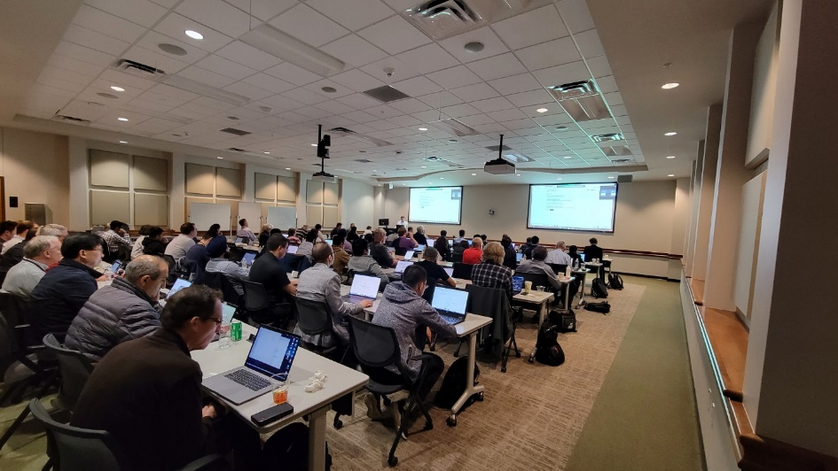
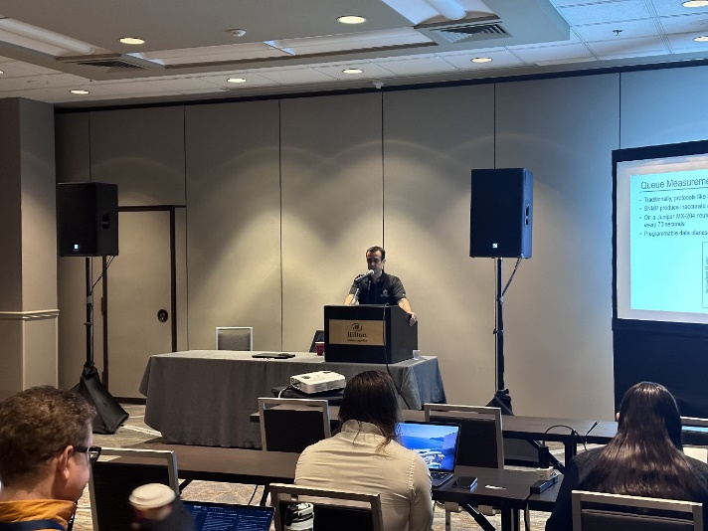
Workshops and Tutorials
Objective 1: Advance formal and informal cyber communities
Workshops (informal learning)
Workshop on Security Applications with P4, FABRIC Community Workshop, Austin, TX, April 24, 2023.
Workshop on Fine-grained Network Measurements with P4, Internet2 Technology Exchange Conference, Minneapolis, MN, Sep. 18, 2023.
Notes:
Please circle the strategic priorities that apply.
1 Slide Maximum

Slide 12
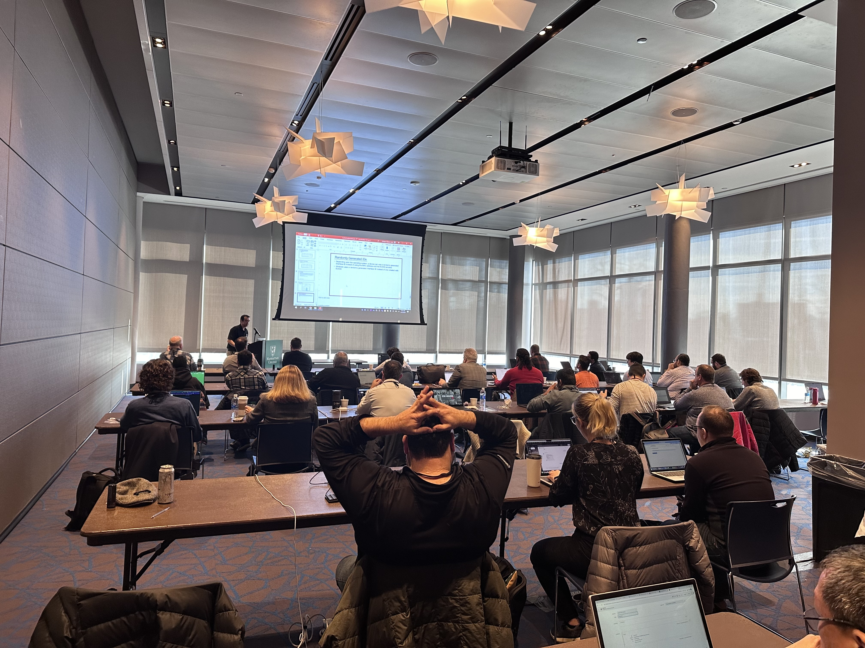
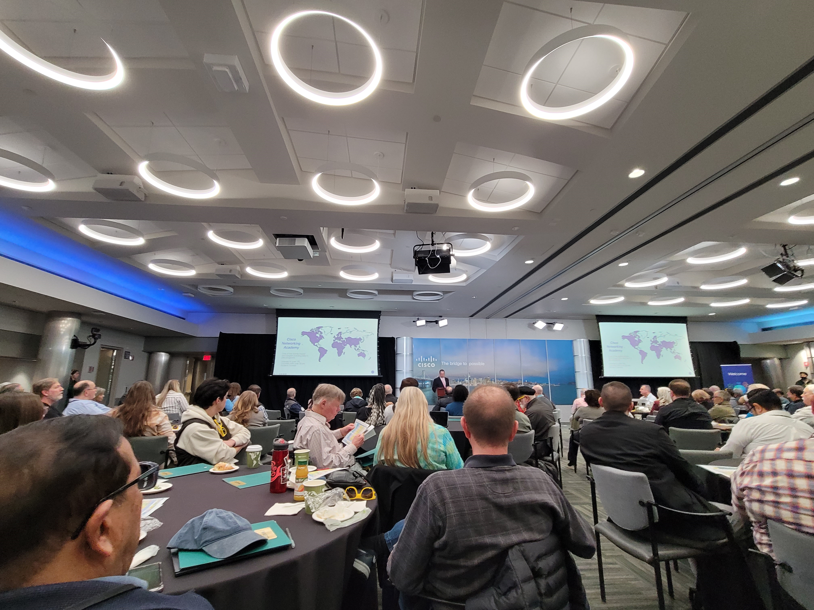
Workshops and Tutorials
Objective 1: Advance formal and informal cyber communities
Workshops (informal learning)
Workshop on IPv6 and Cybersecurity, New York State Research and Education Network, NYC, Feb. 15-16, 2024.
Workshop on Cybersecurity (Security+) and P4 Programmable Switches, San Jose, CA, Jan. 4-5, 2024
Notes:
Please circle the strategic priorities that apply.
1 Slide Maximum

Slide 13
Self-paced Learning
Objective 1: Advance formal and informal cyber communities
Training at the U.S. National Guard, National Guard Professional Education Center (PEC), Cyber and Information Advantage Battalion (CIAB)
  1. VMWare Virtualization Fundamentals (vSphere ICM 7), Apr. – Jun. 2023: 13 learners
  2. VMWare Virtualization Fundamentals (vSphere ICM 7), Jun. – Aug. 2023: 9 learners
  3. VMWare Virtualization Fundamentals (vSphere ICM 7), Sep. – Nov. 2023: 16 learners
  4. VMWare Virtualization Fundamentals (vSphere ICM 7), Oct. – Dec. 2023. : 2 learners
  5. VMware Virtualization Fundamentals (vSphere ICM 7), Feb. – Apr. 2024. : 8 learners
  TOTAL: 48 learners
Veterans Training in Cybersecurity (3-month course)
  Course on Next-generation Firewalls
    TOTAL: 25 Veterans
Notes:
Please circle the strategic priorities that apply.
1 Slide Maximum

Slide 14
Objective 2
Objective 2: Develop a multi-state internship program
Two components
  Pre-internship seminars: speakers from companies and agencies meet weekly with students and connect to them prior to the summer internships
  Internship: students work 400 hours (paid internship) on cybersecurity or related fields. Agencies include Savannah River National Laboratory (SRNL), Naval Information Warfare Center Atlantic (NIWC), SOCs, etc.
Pre-internship Seminars
Internships
Spring and Fall semesters
(Monday-Wednesday-Friday)
Summer semester
(400 hours)
Notes:
Please circle the strategic priorities that apply.
1 Slide Maximum

Slide 15
Objective 2
Objective 2: Develop a multi-state internship program
Features
  Students acquire soft skills, teamwork, time management, and communication skills while gaining additional employability skills
  For agencies requiring clearance security, starting the process prior to graduation will save time and open opportunities for students
  Students may even obtain interim secrecy clearance while completing the internships
Pre-internship Seminars
Internships
Spring and Fall semesters
(Monday-Wednesday-Friday)
Summer semester
(400 hours)
Notes:
Please circle the strategic priorities that apply.
1 Slide Maximum

Slide 16
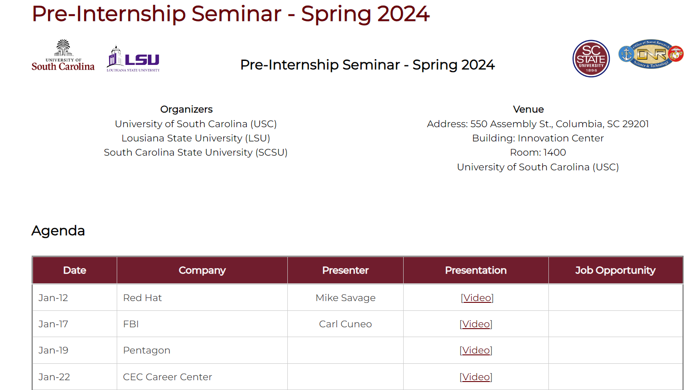
Pre-internship Seminar
Objective 2: Develop a multi-state internship program
https://research.cec.sc.edu/cyberinfra/ONR/internships
Notes:
Please circle the strategic priorities that apply.
1 Slide Maximum

Slide 17









Internship
Objective 2: Develop a multi-state internship program
By the end of the Pre-internship Seminars (Fall ’23 and Spring ’24), the goal is to secure 100+ paid internships
Students from USC, SCSU, and LSU will complete the internships during the Summer ‘24
Notes:
Please circle the strategic priorities that apply.
1 Slide Maximum

Slide 18
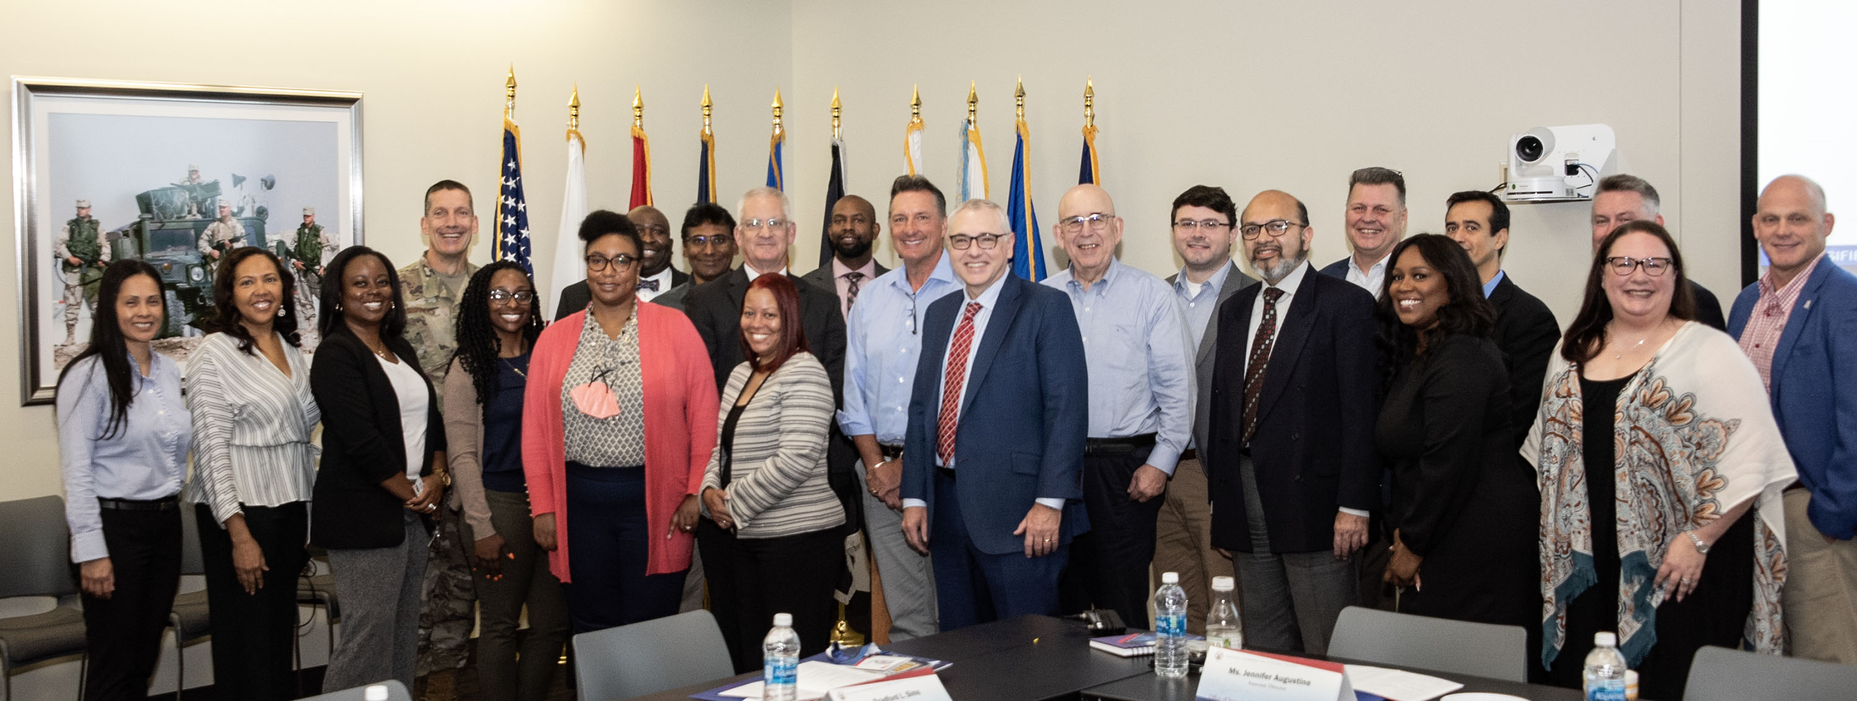
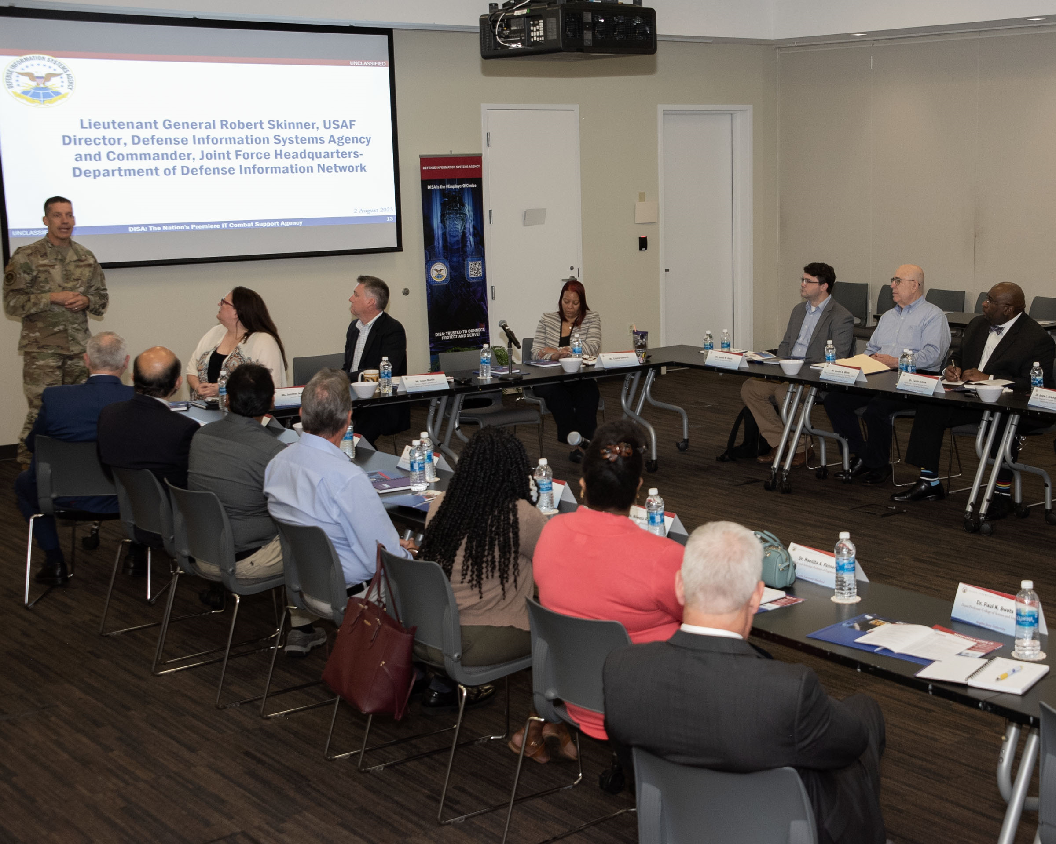
Internship
Objective 2: Develop a multi-state internship program
By the end of the Pre-internship Seminars (Fall ’23 and Spring ’24), the goal is to secure 100+ paid internships
Students from USC, SCSU, and LSU will complete the internships during the Summer ‘24
Visit to the Defense Information Systems Agency (DISA)
August 2nd 2023 - Baltimore, MD
Notes:
Please circle the strategic priorities that apply.
1 Slide Maximum

Slide 19
Objective 3
Objective 3: Expand the Academic Cloud
The Academic Cloud is a purpose-built distributed cloud system for education and research
Learners only require access to the Internet and to login into the system using a regular browser
It serves all the organizations involved in this project
Notes:
Please circle the strategic priorities that apply.
1 Slide Maximum

Slide 20
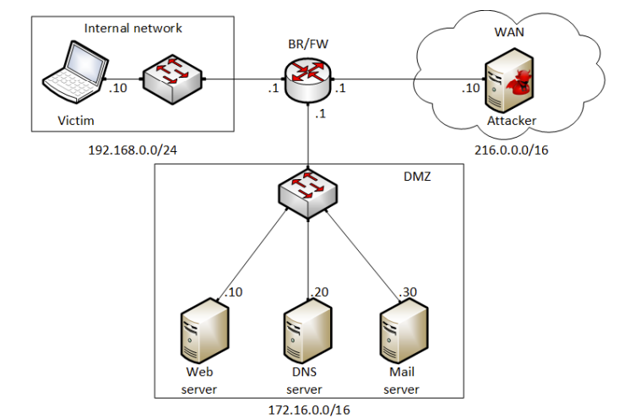
Virtual Lab Libraries
Objective 3: Expand the Academic Cloud
Virtual labs
  Systematic lab libraries that cover fundamentals of cybersecurity, networks, virtualization, C4ISR¹, and other topics
  It also prepares learners for DoD baseline certificate
  Guided virtual lab experiments + electronic booklet + exercises
The Academic Cloud is also used by other DARPA- and NSF-funded projects
1. C4ISR: Command, Control, Communications, Computers, Intelligence, Surveillance and Reconnaissance
Notes:
Please circle the strategic priorities that apply.
1 Slide Maximum

Slide 21
Virtual Lab Libraries
Objective 3: Expand the Academic Cloud
Demo – High Resolution Measurements on the Internet
https://youtu.be/cWaWxsqVAgc
Notes:
Please circle the strategic priorities that apply.
1 Slide Maximum

Slide 22

Virtual Lab Libraries
Notes:
Please circle the strategic priorities that apply.
1 Slide Maximum

Slide 23
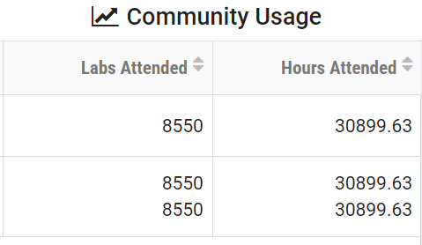
Academic Cloud Usage
Objective 3: Expand the Academic Cloud
The Academic Cloud supports Objectives 1 and 2
It serves multiple communities (formal and informal learning)
Community usage at USC alone –>
Feb. 1, 2023 – Jan. 31, 2024
Notes:
Usage:

Slide 24
Naval Relevance – Objective 1
The project increases engagement in areas related to C4ISR
    Communications and networks
    Cybersecurity operations and warfare
    Information technology
The project is training military-connected communities and professionals
    Veterans
    ROTC students
    Military personnel from the U.S. National Guard
The project is developing technology that is attractive to DoD
    The project team uses the P4 technology for rapid intrusion detection on a DARPA project (2024-2025)
    Undergraduate students actively participate in developing commercial and military applications
Notes:
Please circle the strategic priorities that apply.
1 Slide Maximum

Slide 25
Naval Relevance – Objective 2
Internships will provide learners the opportunity to apply skills on the job
Internships will focus on positions requiring skills on C4ISR
Some internships will be conducted at organizations that provide services to the Navy, and at national labs. E.g.,
      Naval Information Warfare Center Atlantic
      Savannah River National Laboratory
Notes:
Please circle the strategic priorities that apply.
1 Slide Maximum

Slide 26
Naval Relevance – Objective 3
The expanded Academic Cloud is currently used by colleges, agencies, NIWC, National Laboratories, communities of practice
      Naval Information Warfare Center Atlantic
      ESnet
      National Guard Professional Education Center (PEC), Cyber and Information Advantage Battalion (CIAB)
      Universities
New technology will be tested on the Academic Cloud, prior to the deployment on Pronto
Pronto is a DoD’s funded testbed: https://prontoproject.org/
Notes:
Please circle the strategic priorities that apply.
1 Slide Maximum

Slide 27
Preparing Cyber Warfare Professionals by Integration of Curriculum,
Experiences, and Internships
Jorge Crichigno – University of South Carolina https://research.cec.sc.edu/cyberinfra/projects/ONR
This project is helping address the shortage of skilled cyber-professionals opting for careers with the DoD
The project has three objectives:
Advance formal and informal cyber communities and connect relevant organizations
Develop a multi-state internship program, leveraging and strengthening the Naval Research Enterprise Internship Program (NREIP)
Expand the Academic Cloud to support large-scale learning and research nationwide
The project
Increases engagement in areas related to C4ISR
Trains military-connected communities and professionals in general on communications and networks, cybersecurity operations and warfare, IT
Partners with national laboratories and the Naval Information Warfare Center (NIWC) to develop new techniques for detecting cyber attacks
Creates a pipeline of cyber-professionals from college to Navy and military communities
Supports communities of practice related to the military by providing a training platform and material relevant to cybersecurity
Virtual lab libraries have been deployed in the Academic Cloud system, which supports several formal and informal communities
Multiple courses from four universities have incorporated material on C4ISR (formal community)
Undergraduate students conduct research on C4ISR
Learners nationwide are attending tutorials on cybersecurity covering the material developed in this project.
Military personnel are trained using the Academic Cloud. They include the U.S. National Guard, Cyber and Information Advantage Battalion (CIAB)
Veterans are trained on next-generation firewalls technology
Notes:
Include only information that is approved for public release

