Slide 1

Overview Cybersecurity
College of Engineering and Computing
University of South Carolina
Jorge Crichigno
Department of Integrated Information Technology
jcrichigno@cec.sc.edu
U.S. Army Fort Liberty
July 20, 2023

Slide 2
College of Engineering and Computing
The University of South Carolina is a National Center of Academic Excellence (CAE) for Cyber Defense Education (CAE-CDE), and a CAE for Research (CAE-R)
  Designation made by the National Security Agency (NSA)
  Computer Science and Engineering (CSE) is the primary unit
  IIT is the main department supporting CSE
The College of Engineering and Computing offers ABET Accredited Programs
  B. Sc. Computer Science (CSE)
  B. Sc. Information Technology (IIT)
  Multiple minors; e.g., Cybersecurity Operations, Networks (IIT)

Slide 3
Enhance the Preparation of Cybersecurity Professionals
Support: Office of Naval Research (ONR)
Purpose: cybersecurity - workforce development (undergraduates)
2020 – 2022

Slide 4
Preparing Cyber Warfare Professionals by
Integration of Curriculum, Experiences, and Internships
Supported by ONR, 2020 – 2022 ($250,000)
Goals:
  Develop a cybersecurity concentration within an academic minor in Information Technology.
  Establish an Undergraduate Research Program in Applied Cybersecurity.
  Deploy virtual equipment pods on a virtual platform, accessible over the Internet, to support and facilitate the research and teaching activities from anywhere, without compromising hands-on experiences.
  Establish meetings among industry, government, high schools, and higher-education institutions to enhance cybersecurity preparation.

Slide 5
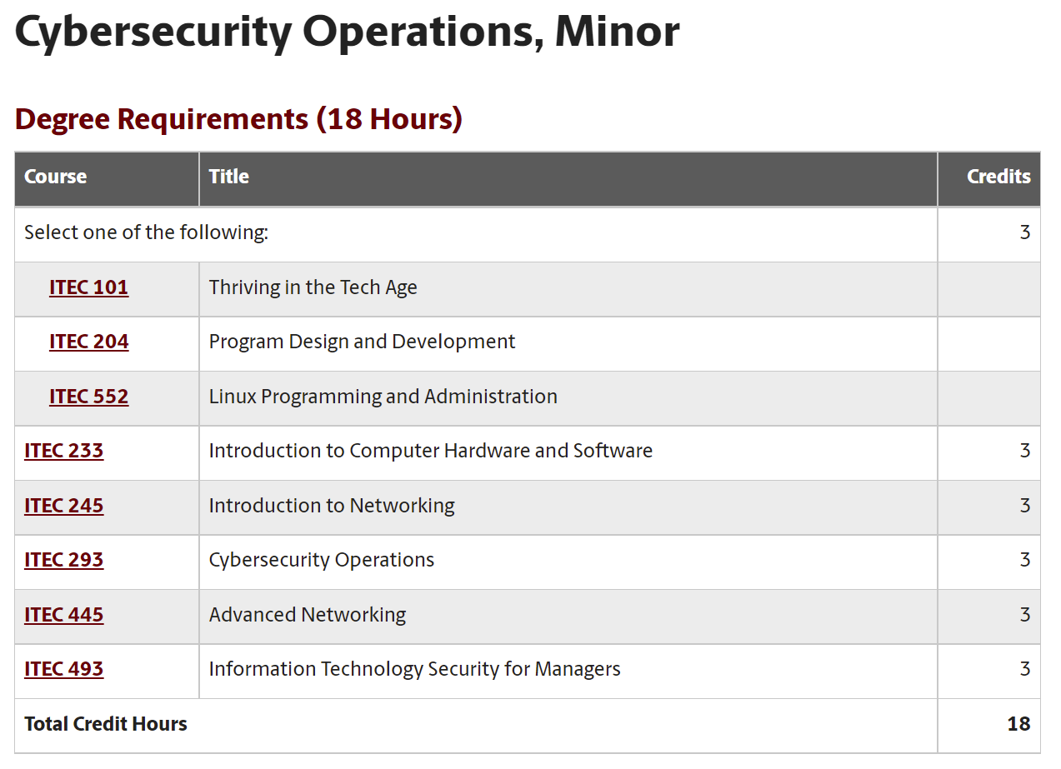
Project Overview
Goals:
1. Develop a cybersecurity concentration within an academic minor in Information Technology.
Minor in Cybersecurity Operations is now offered, starting Fall 2021.
Learners can obtain DoD’s 8570 approved certs (cyber, networks skills, 8/16-week course).
https://tinyurl.com/4mbj3z4k

Slide 6
Project Overview
Goals:
2. Establish an Undergraduate Research Program in Applied Cybersecurity (14 weeks).
The program has been established and supports between 10-12 students per semester.
Cadet | Branch | Name | Semester | Project
1 | Navy | Christian S | Spring 2021 | Application ID
2 | Army | Brendan C | Fall 2020 | Protection against Bruteforce Attacks with NGFW
3 | Army | Jack S | Fall 2020 | Mitigating Routing Hijacking Attacks
4 | Army | Matthew D | Fall 2020 | Mitigating Routing Hijacking Attacks
5 | Army | Chris N | Fall 2020 | Protection against Reconnaissance and Scan Attacks
6 | Army | Jack S | Spring 2021 | Policy-based Forwarding
7 | Army | Matthew D | Spring 2021 | Policy-based Forwarding
8 | Civilian | Keegan S | Fall 2020 | An open-source library for computer networks and cybersecurity
9 | Civilian | Dakota M | Fall 2020 | Distributed Denial of Service (DDoS) Protection with Next Generation Firewalls (NGFWs)
10 | Civilian | Lauren W | Fall 2020 | Protection against Bruteforce Attacks with NGFW
11 | Civilian | Josue H | Fall 2020 | Site to site VPN with NGFWs
12 | Civilian | Brian N | Fall 2020 | Distributed Denial of Service (DDoS) Protection with Next Generation Firewalls (NGFWs)
…

Slide 7
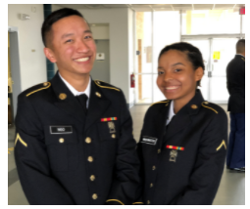
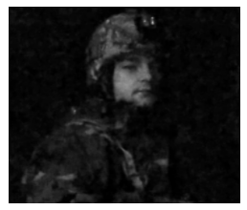


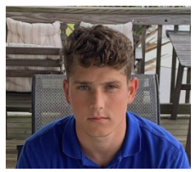

Project Overview
Goals:
2. Establish an Undergraduate Research Program in Applied Cybersecurity (14 weeks).
The program has been established and supports between 10-12 students per semester.
Chris Ngo
Jack Sadle
David Williams
Matt Driver
Christian Tsirlis
Ryan Tallent

Slide 8
Project Overview
Goals:
2. Establish an Undergraduate Research Program in Applied Cybersecurity (14 weeks).
The program has been established and supports between 10-12 students per semester.
Name | Position
Ty Love-Baker | 2nd Lt. at United States Marine Corps, DC
Dakota McDaniel | Security Analyst at Lowe’s – COO Pluto (Los Angeles, CA)
Lauren Waddell | IT Specialist, SC Department of Insurance (Columbia, SC)
Josue Hernandez | Security Service Specialist at IBM (Chicago, IL)
Kyle Radzak | Info. Security Specialist at Lowe's (Charlotte, NC)
Nathan Bohmer | Project Coordinator at Black Box Networks (Southport, NC)
Brad Wilson | IT Intern at SRNL – Now FT at SRNL (Aiken, SC)
Zach Fowler | IT at Blue Cross Blue Shield (Columbia, SC)
Nathan Long | Technology Analyst at AIG (Charlotte, NC)
Sam Kelley | IT Infrastructure Engineering (Wells Fargo, Chandler, AZ)
Brad Wilson, IT student
“The skills I learned during my ONR project were very similar to those skills needed to become part of the Networking/Perimeter team at Savannah River National Laboratory (SRNL) … My managers [at SRNL internship] were very pleased with my knowledge and experience with next generation firewalls. I was offered a full-time position contingent upon my graduation in May 2022”.
…

Slide 9
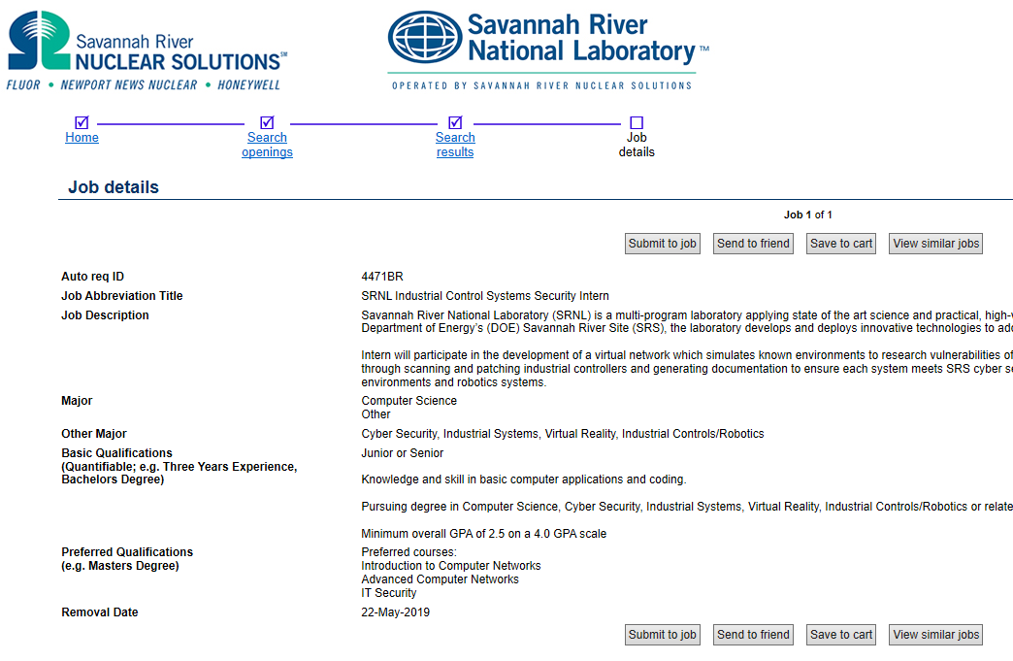
Project Overview
Goals:
2. Establish an Undergraduate Research Program in Applied Cybersecurity (14 weeks).
The program has been established and supports between 10-12 students per semester.

Slide 10
Project Overview
Goals:
Deploy virtual equipment pods on a virtual platform, accessible over the Internet, to support and facilitate the research and teaching activities from anywhere, without compromising hands-on.
  The cloud system supports education and research
  It was established by USC, Stanly Community College, and the Network Development Group (NDG) in 2019
  It is currently used by colleges, universities, the National Guard, and multiple agencies

Slide 11
Project Overview
Goals:
Establish meetings among industry, government, high schools, and higher-education institutions to enhance cybersecurity preparation.
  Lawrence Berkeley National Lab (LBNL)
  National Guard – Cyber & Information Advantage Battalion (CIAB)
  SANS institute (“girlsgocyber”)
  Multiple higher-ed institutions
  International Networks at Indiana
  Texas’ Lonestart Education and Research (TX)
  Florida Lambda Rail Research and Education Network (FL)
  Front Range GigaPop (CO)
  Great Plains Network (Midwest States)
  Internet2 (National)
  U.S. Army Cyber Center of Excellence (CCoE) (Signal School)

Slide 12
Project Overview
Goals:
Establish meetings among industry, government, high schools, and higher-education institutions to enhance cybersecurity preparation.
  Intel
  VMware
  Palo Alto Networks
  Juniper Networks
  Cisco Systems

Slide 13
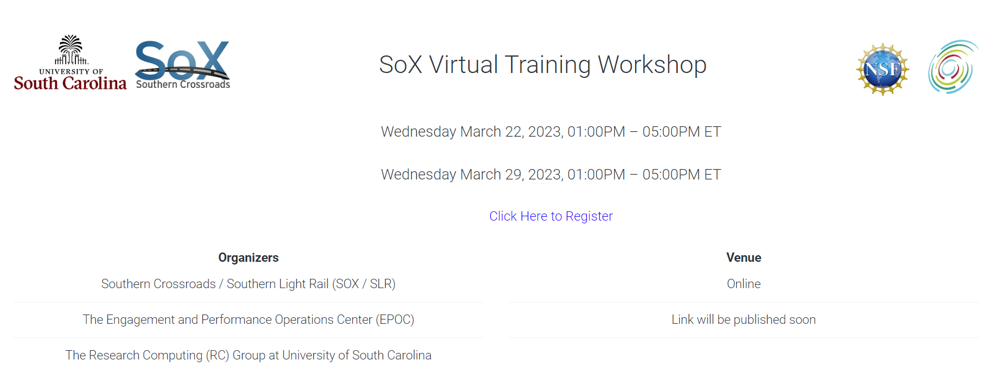
Project Overview
Goals:
Establish meetings among industry, government, high schools, and higher-education institutions to enhance cybersecurity preparation.

Slide 14
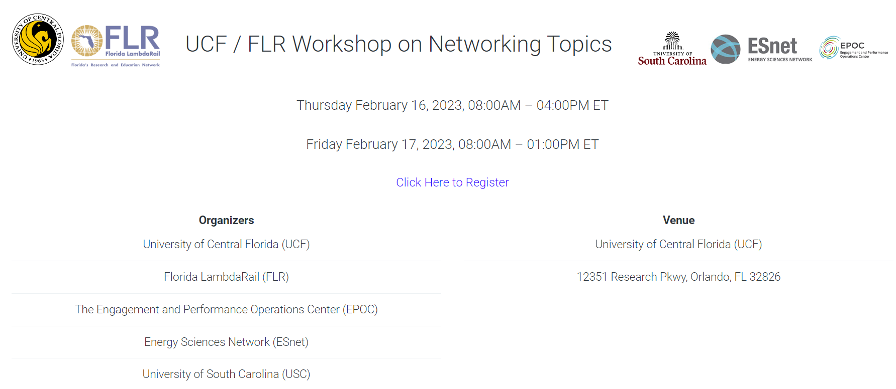
Project Overview
Goals:
Establish meetings among industry, government, high schools, and higher-education institutions to enhance cybersecurity preparation.

Slide 15

Project Overview
Goals:
Establish meetings among industry, government, high schools, and higher-education institutions to enhance cybersecurity preparation.

Slide 16
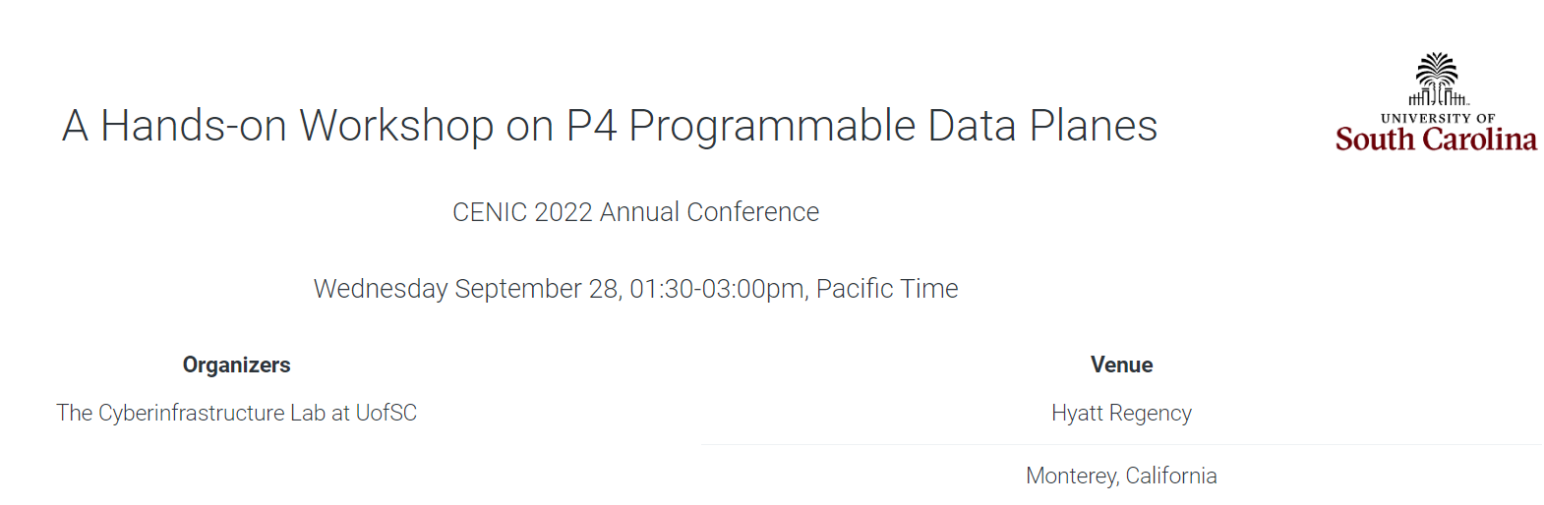
Project Overview
Goals:
Establish meetings among industry, government, high schools, and higher-education institutions to enhance cybersecurity preparation.

Slide 17
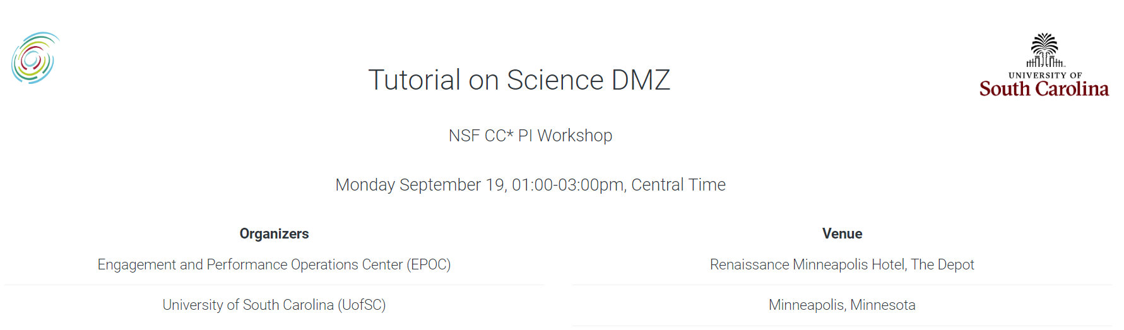
Project Overview
Goals:
Establish meetings among industry, government, high schools, and higher-education institutions to enhance cybersecurity preparation.

Slide 18
Preparing Cyber Warfare Professionals by
Integration of Curriculum, Experiences, and Internships
Support: Office of Naval Research (ONR)
Purpose: cyberwarfare - workforce development (undergraduates)
2023 - 2026

Slide 19
Preparing Cyber Warfare Professionals by
Integration of Curriculum, Experiences, and Internships
ONR, 2023 – 2026 ($600,000)
USC will become the hub for Cyber Warfare preparation
The project will have a national impact, targeting diverse audience
  ROTC cadets
  Veterans
  STEM students
  Communities of practice: Lawrence Berkeley National Laboratory (LBNL) and Internet2
  Self-paced learning material

Slide 20
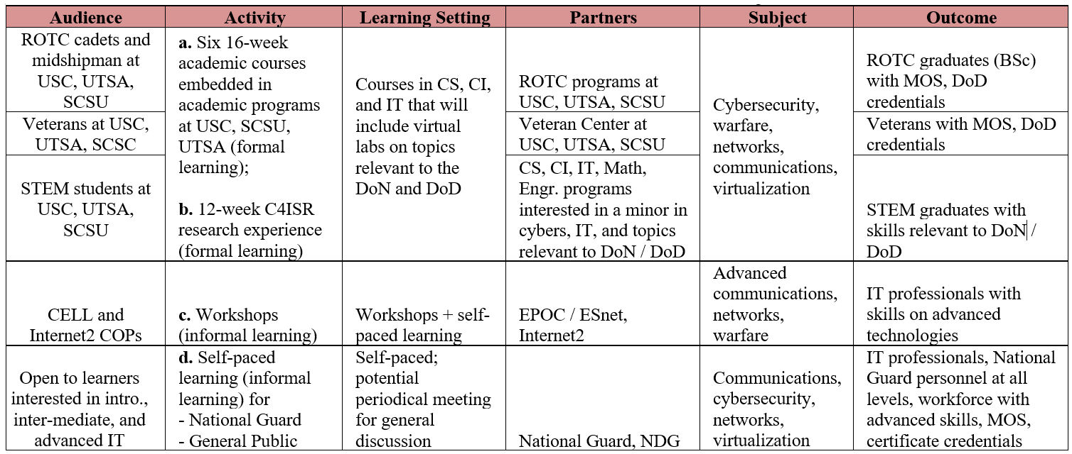
Preparing Cyber Warfare Professionals by
Integration of Curriculum, Experiences, and Internships
Objective 1: Advance formal and informal cyber communities and connect relevant organizations

Slide 21
Preparing Cyber Warfare Professionals by
Integration of Curriculum, Experiences, and Internships
Objective 2: Develop a multi-state internship program, leveraging and strengthening the Naval Research Enterprise Internship Program (NREIP)
  Common pre-internship seminars for USC, SCSU, and UTSA students (14-week long)
  Internships to be conducted during the summer – 400 hours
  Intel, Cisco, VMware, Palo Alto Networks will provide tools and platforms to prepare students for internships and full-time positions

Slide 22
Preparing Cyber Warfare Professionals by
Integration of Curriculum, Experiences, and Internships
Objective 3: Expand the Academic Cloud to support large-scale learning and research nationwide
  The cloud system supports education and research
  It was established by USC, Stanly Community College, and the Network Development Group (NDG) in 2019
  It is currently used by colleges, universities, the National Guard, and multiple agencies
Academic Cloud

Slide 23
Cybertraining on P4 Programmable Devices using an Online Scalable Platform with Physical and Virtual Switches and Real Protocol Stacks
Support: National Science Foundation
Purpose: advanced IT - workforce development (PhD students, IT professionals)
2021 - 2025

Slide 24

Cybertraining on P4 Programmable Devices
Funded by the National Science Foundation (NSF) ($500,000)
The project is developing hardware and software apps using P4 processors
Intel provides tools to program the P4 processors
The Cyberinfrastructure Lab at USC has unique capabilities on this technology: http://ce.sc.edu/cyberinfra/
USC training platform and material on P4 are now used across the country (ESnet, ASU, Northeastern, small businesses, campus IT professionals, etc.)
A DoD SBIR proposal has been recently submitted, to develop cybersecurity applications using P4 processors
P4 network processor

Slide 25

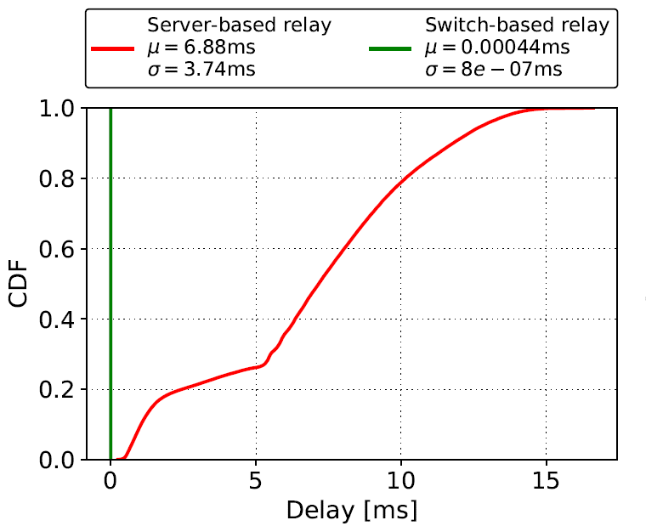
Cybertraining on P4 Programmable Devices
Objective: Increase and facilitate the adoption of P4 programmable devices nationwide
  Network processors provider granular visibility of events (nanosecond resolution)
  They can detect /process events much faster than general-purpose CPUs
  Collaboration / agreement with Intel
Application example: voice processing¹
 | Network Processor | General-purpose CPU
Cost | $6,000 | $ 10,000 - 25,000
Capacity | ~35M connections/chip | ~500 connections/core
Latency | 440 nanosec | Tens-hundreds of msec
¹E. Kfoury, J. Crichigno, E. Bou-Harb, V. Gurevich, “Offloading Media Traffic to Programmable Data Plane Switches,” IEEE ICC, June 2020.

Slide 26
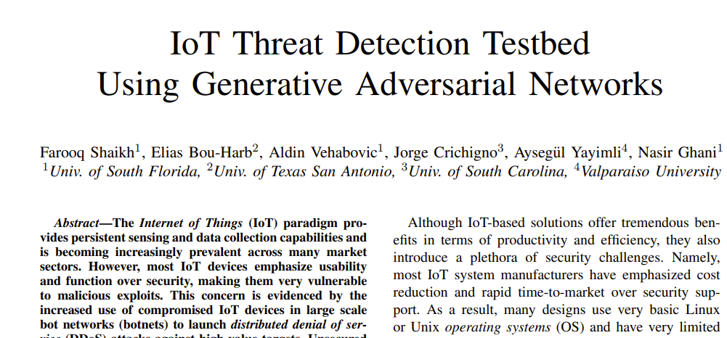
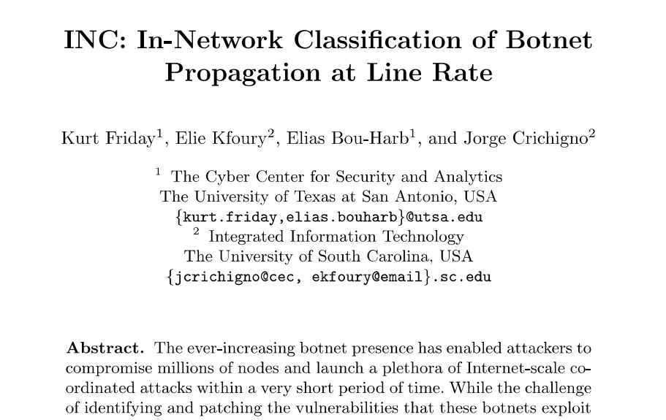
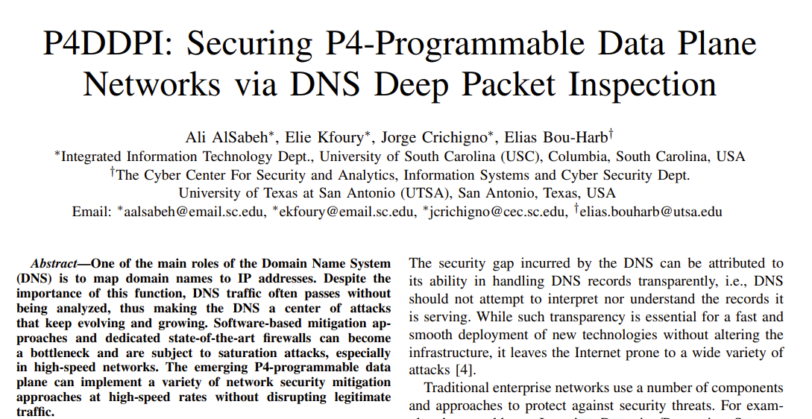
Cybertraining on P4 Programmable Devices
Objective: Increase and facilitate the adoption of P4 programmable devices nationwide

Slide 27
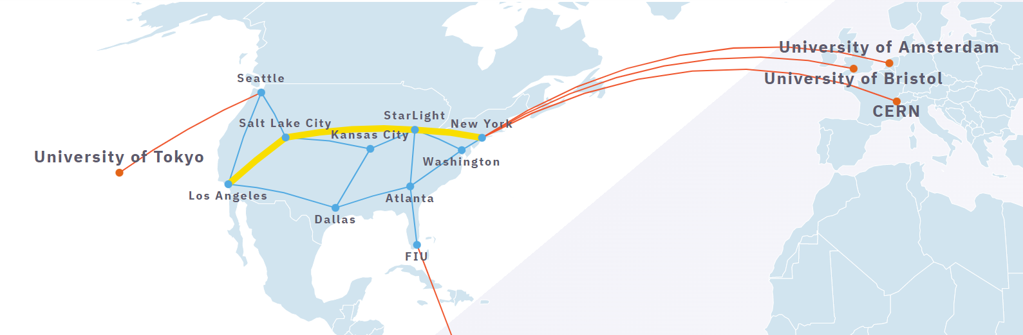
Cybertraining on P4 Programmable Devices
Objective: Increase and facilitate the adoption of P4 programmable devices nationwide
  Training material is used by the FABRIC community (FABRIC is a national infrastructure, >$20M investment by NSF) (https://whatisfabric.net/):
FABRIC

Slide 28
Building a Science DMZ for Data-intensive Research and Computation at the University of South Carolina
Support: National Science Foundation
Purpose: deploy a high-speed network at USC, connected to Internet2
Institution: USC
2019 - 2022

Slide 29
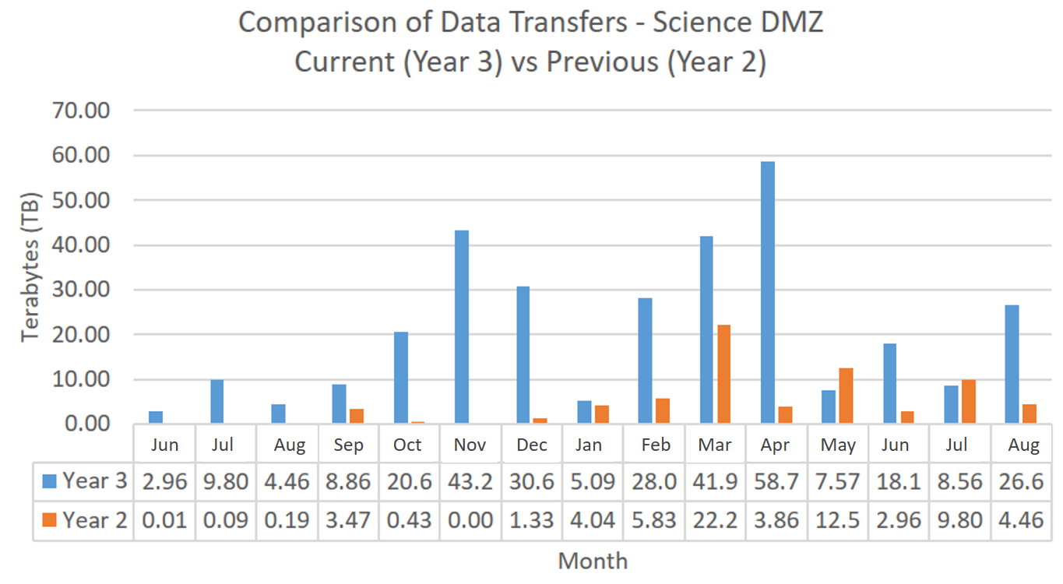
Building a Science DMZ
Funded by the National Science Foundation ($500,000)
The project developed a 100Gbps high-speed network (Science DMZ) connected to Internet2
The Science DMZ supports current research moving terabyte-scale data between USC and national labs (e.g., Argonne, Fermi, Oak Ridge, Savannah River, Los Alamos)
In the last 15 months, the increase of data transfers was over 300% with respect to the previous 15-month period
Peaks of up to 60TB per month
Year 3: 2021/2022
Year 2: 2021/2020

Slide 30
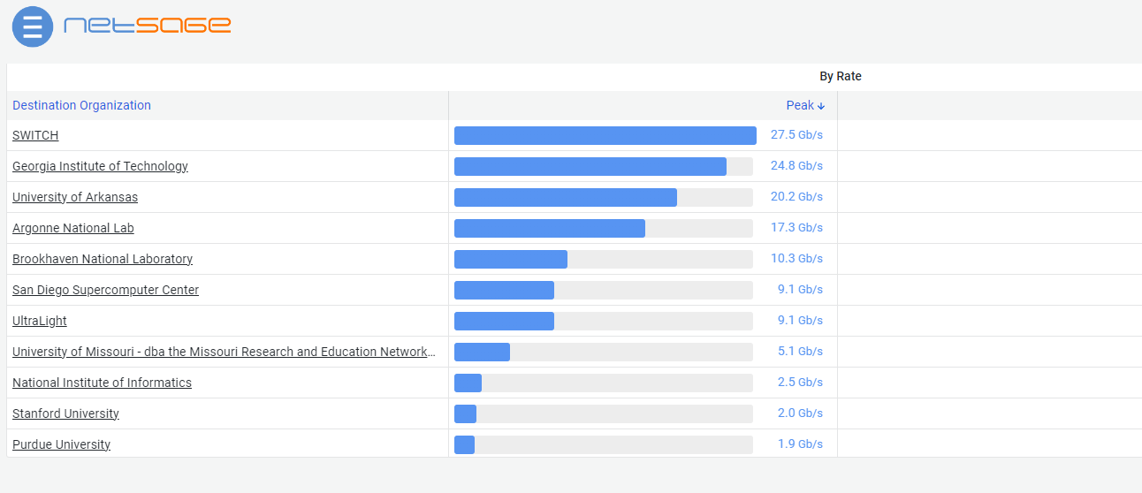
Building a Science DMZ
Prior to this project, data transfers to/from USC were below 5Gbps
High-speed data transfers enable new research on campus
Multiple colleges and departments have benefited from the new infrastructure
Example of flow rates from USC to collaborators using the new network (2022)

Slide 31

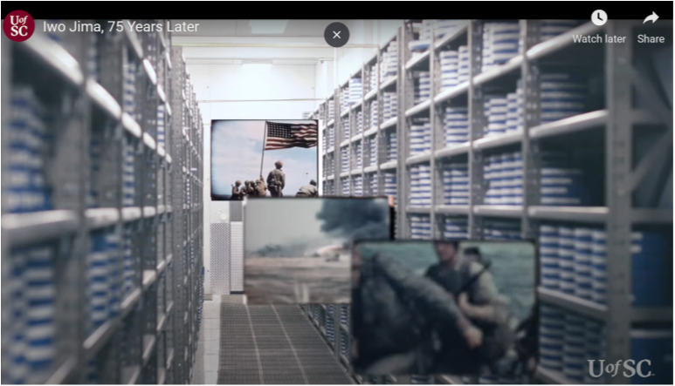
Building a Science DMZ
The infrastructure is also used by non-STEM units
Example: the USC’s Moving Image Research Collections (MIRC) library is digitizing films, in partnership with the U.S. Marine Corps History Division
The process requires high-speed data transfers and high-capacity storage (Science DMZ)

Slide 32
Multi-state Community College, University and Industry Collaboration to Prepare Learners for 21st Century Information Technology Jobs
Support: National Science Foundation
Purpose: Workforce Development at High School, Community College, and University Levels
Institution: USC
Collaborators: VMware, Palo Alto Networks, Cisco Systems, SRNL, Stanly Community College, SC Gov. HS
2019 - 2023

Slide 33

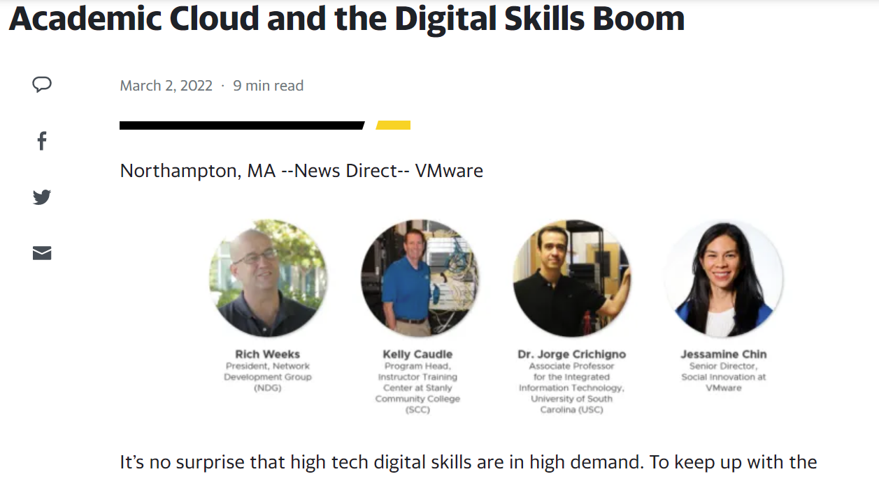
Multi-state Community College, University and Industry Collaboration
NSF-funded project ($600,000 / $300,000 for USC)
The project developed a multi-state distributed cloud to support teaching, research
The distributed cloud pools resources from SC and NC to serve institutions seamlessly
A 2+2+2 program (HS + College + University) was initiated
Stackable credentials are now available to students (A+, Cisco, Palo Alto, VMware)
Weeklong summer workshops are offered to prepare instructors on new technologies

Slide 34
Multi-state Community College, University and Industry Collaboration
Impact
  Pedagogical material is now available for highly recognized certificates (networks, cyber, virtualization)
  The project has trained over 100 instructors who are now teaching the material at their institutions
  The material has helped over 300 soldiers from the U.S. Army Cyber Signal School, 40+ ROTC cadets, over 1,000 students
  The material is also used in undergraduate and graduate courses

Slide 35
Summary – Collaborators

Slide 36
Summary
Collaborators | Purpose | Audience
Intel | Advanced training; technology used for DoD (Pronto project https://prontoproject.org/), NSF FABRIC project (https://whatisfabric.net/), PhD research | PhD level / advanced IT professional level
Cisco, VMware, Palo Alto Networks | Workforce development (industry certificates in cyber / networks). Certificates can be completed after one or more 8/16-week course | Undergraduates, veterans, STEM students, IT professionals
Cisco, VMware, Palo Alto Networks | USC trains military personnel who may want to obtain a DoD recognized credential – cybersecurity and networks | National Guard, ROTC, Fort Gordon
LBNL, ESnet, Internet2 | Advanced training in IT topics – networks and cybersecurity | IT professionals working on high-performance environments
Amazon | This is a new partnership. USC has access to training material on cloud computing (AWS). This trainings are in high demand | IT professionals, students at all level
SRNL, private companies, NIWC | Internships | Undergraduate students
Network Development Group | NDG is the leading organization in virtual training platforms. USC and NDG collaborate in multiple projects, such as deploying the Academic Cloud | Learners at all levels
Opex Systems | Business partner – DoD proposal has been recently submitted with this organization, to develop advanced applications for DoD | DoD

Slide 37
Impact of the Cyberinfrastructure Lab (2018 – 2022)
Audience | Purpose | # Learners
Military personnel | U.S. Army Cyber Center of Excellence (Fort Gordon). Training on cyber and IT (2019-2022) (approximately 150 per year) | 600
ROTC Cadets and Veterans | USC ROTC – USC Students. Training and research on cyber and IT for the military (approximately 20 per year) (2020-2022) (this number only included funded students) | 60
National Guard | National Guard – Training on cyber and IT (approximately 75 per year) (2021-2022) | 150
Undergraduate Students at USC | Undergraduate students who have used the Academic Cloud platform for course work (approximately 500 per year) (2018-2022) | 2,500
IT Professionals Nationally | Advanced training on IT. The audience includes high-skilled IT professionals working on national laboratories, campus networks, research and education networks (approx. 800 per year) (2019-2022) | 3,200
Learners* | Learners who access the Academic Cloud platform and pedagogical material (national impact): high school students, community college students, four-year undergraduate students, graduate students, IT professionals (approximately 100,000 per year) (2020-2022) | 300,000
* Platform deployed with the Network Development Group (NDG), Stanly Community College (SCC), and Idaho National Laboratory (INL). USC is the leading organization of the NSF-supported project

Slide 38
Impact of Additional Support
Organizations | Outcomes
Middle and High Schools | Enhance middle and high school instruction by providing them access to the Academic Cloud (virtual laboratory platform for hands-on activities) and pedagogical material for IT, cybersecurity Pipeline: align pedagogical material for high-school students to 100- and 200-level college courses / dual credit Prepare middle-school and high-school students for state and national cyber competitions Prepare students with entry-level IT credentials for the workforce
Technology Workers | Disseminate IT knowledge developed by USC by creating effective advanced hands-on training material Create partnerships to reskill workers: AWS, Cisco, VMware, Palo Alto Networks, Intel, Apple Coordinate with industry to reskill workers using professional tools and platforms be deployed in USC’s Academic Cloud Strengthen partnerships with Lawrence Berkeley National Lab / ESnet, Internet2, Research and Education Networks Prepare IT professionals with new skills on state-of-the-art technology
National Guard, U.S. Army Cyber Center of Excellence (CCOE) | Enhance the training and education of soldiers by providing them access to the Academic Cloud Train soldiers on Military Occupation Specialties (MOS) Improve CCOE, Cyber & Information Advantage Battalion (National Guard) curriculum on MOS Enable soldiers to attain MOS and advanced degrees
SBIR - DoD | Produce prototypes for cybersecurity, network apps that are easy to operate by soldiers Develop apps exploiting P4 network processors running on Pronto (DoD’s large-scale infrastructure, https://prontoproject.org/) Promote and support startups interested in developing P4 network processor applications

Slide 39
Impact of Additional Support
Organizations | Outcomes
Technical Colleges | Enhance instruction at technical colleges by providing them access to the Academic Cloud (virtual laboratory platform for hands-on activities) and pedagogical material for IT, cybersecurity Align pedagogical material to facilitate transition from 2-year to 4-year programs Enable students to attain industry stackable credentials while completing their degrees
Universities | Enhance instruction at universities by providing them access to the Academic Cloud Enable students to conduct advanced research on high-speed networks, cybersecurity, and other IT areas Strengthen partnership with federal agencies to continue accessing facilities (e.g., FABRIC national infrastructure (https://whatisfabric.net/) Enable students to attain degrees with high-market demand Enable student to attain stackable credentials and DoD’s approved certificates (relevant to ROC, veteran students, students applying to federal agencies and national laboratories)
SC Industry, state workers | Upskill and reskill state workers to reduce the widening supply-demand needs of cybersecurity / IT professionals Extend the agreements between USC and industry partners (Intel, Cisco System, Palo Alto Networks, VMware) to permit state workers to conduct self-paced training towards stackable credentials, using the Academic Cloud Promote innovation and build infrastructure capacity to attract IT talent Reduce the skills gap in IT and provide businesses with IT talent

