Slide 1

“Enhancing the Preparation of
Next-generation Cyber Professionals”
Jorge Crichigno
Department of Integrated Information Technology
College of Engineering and Computing
University of South Carolina
Cyber Talent Management Workshop and Discussion
October 26, 2021 - Columbia, SC

Slide 2
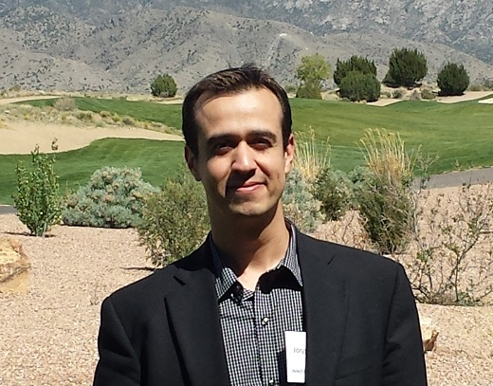


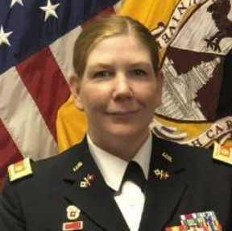
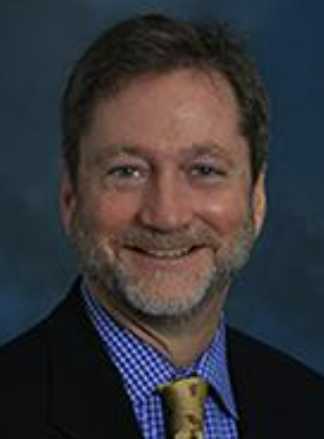
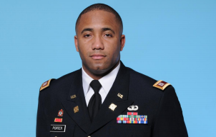

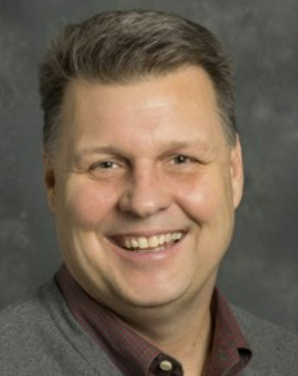
USC Team
Dr. Jorge Crichigno
(College of Engr. and Comp. Principal Investigator)
Jodi Salter
(ROTC, Walker Institute
Main Project Coordinator)
1LT Ebony Penton
(ROTC Command)
MAJ Christina Knight
(Former ROTC Command, Co-PI)
Dr. Robert Cox
(Faculty, Cyber Intelligence)
MAJ Jason Porter
(Former ROTC Command)
Dr. John Gerdes
(College of Engr. and Comp.)
Anthony Dillon
(Internships)

Slide 3
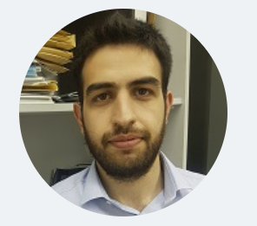

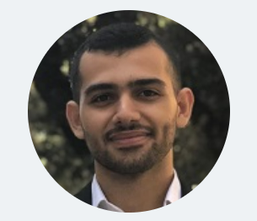

USC Team
Elie Kfoury
(Graduate Student)
Jose Gomez
(Graduate Student)
Ali AlSabeh
(Graduate Student)
Shahrin Sharif
(Graduate Student)

Slide 4
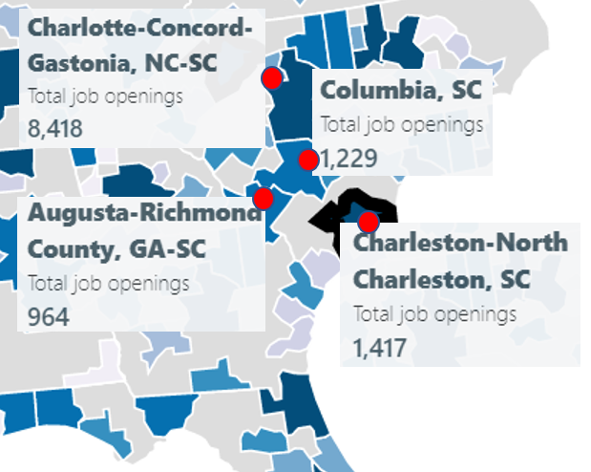
Project Overview
Project title: “Enhancing the Preparation of Next-generation Cyber Professionals”
Funding agency: Office of Naval Research
Period: July 22, 2020 – May 31, 2022
“U.S. Air Force’s cyber warfare operations is only 46 percent filled”
“The Pentagon is hoping to hire 8,300 cyber positions starting this year (2018)”
J. Lynch, “Inside the Pentagon’s Struggle to Build the Cyber Force,” Oct. 29, 2018. URL: https://tinyurl.com/yyelqomp.
Cybersecurity job openings in four metro areas near Columbia, SC

Slide 5
Project Overview
Goals:
1. Develop a minor in Cybersecurity Operations, aligned with the Cyber Intelligence program.
2. Establish an Undergraduate Research Program in Applied Cybersecurity.
3. Deploy virtual equipment pods on a virtual platform, accessible over the Internet, to support and facilitate research and teaching activities from anywhere, without compromising hands-on experiences.
4. Establish meetings among industry, government, high schools, and higher-education institutions to enhance cybersecurity preparation.

Slide 6
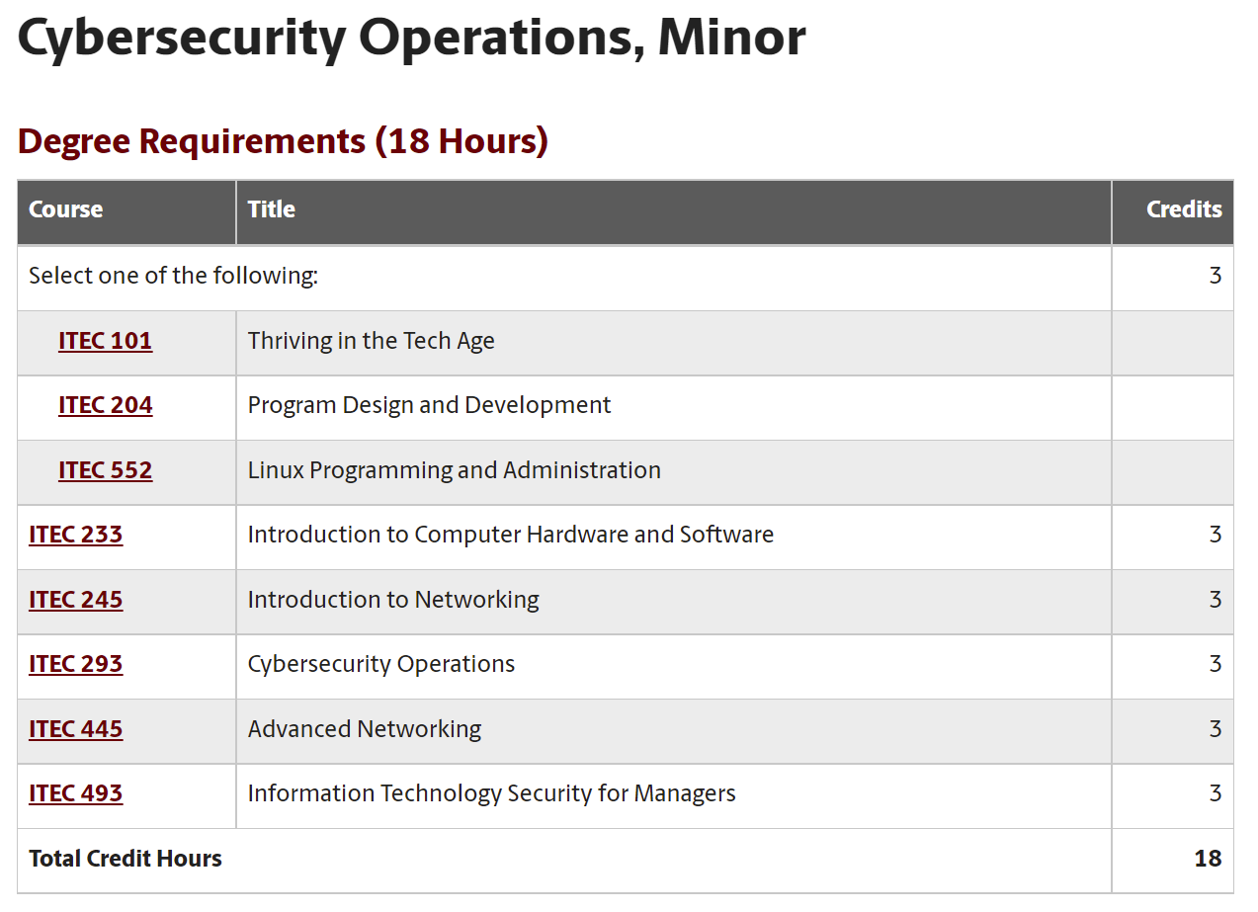
Project Overview
Goals:
1. Develop a minor in Cybersecurity Operations, aligned with the Cyber Intelligence program.
Status: minor in Cybersecurity Operations is now offered, starting Fall 2021.
https://tinyurl.com/4mbj3z4k

Slide 7
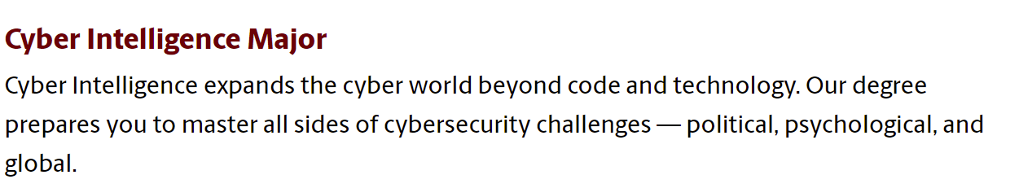
Project Overview
Goals:
1. Develop a minor in Cybersecurity Operations, aligned with the Cyber Intelligence program.
Status: Cyber Intelligence major includes courses of the Cybersecurity Operations minor.
https://tinyurl.com/4x566mpu

Slide 8
Project Overview
Goals:
2. Establish an Undergraduate Research Program in Applied Cybersecurity.
Status: the program has been established. It supports between 10-12 students per semester ($4K).
Cadet | Branch | Name | Semester | Project
1 | Navy | Christian S | Spring 2021 | Application ID
2 | Army | Brendan C | Fall 2020 | Protection against Bruteforce Attacks with NGFW
3 | Army | Jack S | Fall 2020 | Mitigating Routing Hijacking Attacks
4 | Army | Matthew D | Fall 2020 | Mitigating Routing Hijacking Attacks
5 | Army | Chris N | Fall 2020 | Protection against Reconnaissance and Scan Attacks
6 | Army | Jack S | Spring 2021 | Policy-based Forwarding
7 | Army | Matthew D | Spring 2021 | Policy-based Forwarding
8 | None | Keegan S | Fall 2020 | An open-source library for computer networks and cybersecurity
9 | None | Dakota M | Fall 2020 | Distributed Denial of Service (DDoS) Protection with Next Generation Firewalls (NGFWs)
10 | None | Lauren W | Fall 2020 | Protection against Bruteforce Attacks with NGFW
11 | None | Josue H | Fall 2020 | Site to site VPN with NGFWs
12 | None | Brian N | Fall 2020 | Distributed Denial of Service (DDoS) Protection with Next Generation Firewalls (NGFWs)

Slide 9
Project Overview
Goals:
2. Establish an Undergraduate Research Program in Applied Cybersecurity.
Status: the program has been established. It supports between 10-12 students per semester ($4K).
Cadet | Branch | Name | Semester | Project
13 | None | Kyle R | Fall 2020 | Protection against Reconnaissance and Scan Attacks
14 | None | Ryan T | Fall 2020 | IPsec VPN with Routers
15 | None | Nathan B | Fall 2020 | Site to site VPN with NGFWs
16 | None | Bryson L | Spring 2021 | External Dynamic List
17 | None | Ryan T | Spring 2021 | IPsec VPN with Next Generation Firewalls
18 | None | Brad W | Spring 2021 | Application ID
19 | None | Zach F | Spring 2021 | External Dynamic List
20 | None | Nathan L | Spring 2021 | Geoblocking
21 | None | Ty L | Spring 2021 | Geoblocking
22 | Army | Tucker B | Fall 2021 | Preventing Attacks on UDP / UDP abuses
23 | None | Collins K | Fall 2021 | Preventing Attacks on UDP / UDP abuses

Slide 10
Project Overview
Goals:
2. Establish an Undergraduate Research Program in Applied Cybersecurity.
Status: the program has been established. It supports between 10-12 students per semester ($4K).
Cadet | Branch | Name | Semester | Project
24 | Air Force | Jeremy G | Fall 2021 | Protecting Networks Against BGP Hijacking
25 | None | Hannah G | Fall 2021 | Protecting Networks Against BGP Hijacking
26 | None | Cameron M | Fall 2021 | Understanding TCP SYN Attacks
27 | None | Jesse L | Fall 2021 | Understanding TCP SYN Attacks

Slide 11
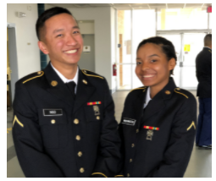
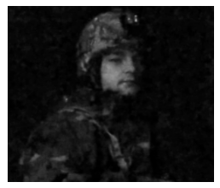
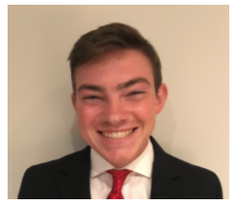
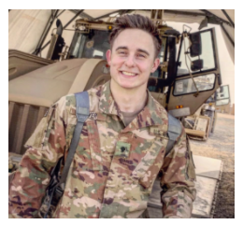
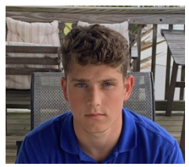
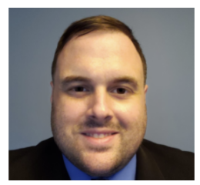
Project Overview
Goals:
2. Establish an Undergraduate Research Program in Applied Cybersecurity.
Status: the program has been established. It supports between 10-12 students per semester.
Chris (ROTC)
Jack (ROTC)
Brendan (ROTC)
ROTC cadets and veterans
Matt
(ROTC)
Christian
(ROTC)
Ryan
(Navy)

Slide 12
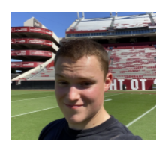
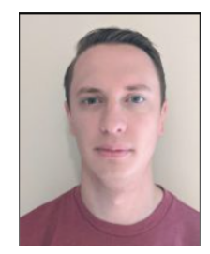
Project Overview
Goals:
2. Establish an Undergraduate Research Program in Applied Cybersecurity.
Status: the program has been established. It supports between 10-12 students per semester.
Tucker
(ROTC)
Jeremy (Air Force)
ROTC cadets and veterans

Slide 13
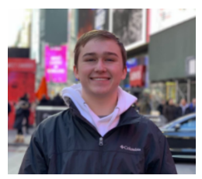

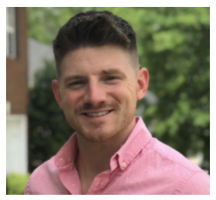
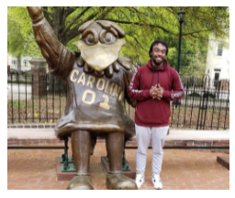
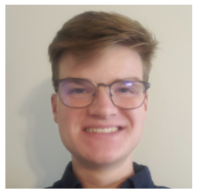
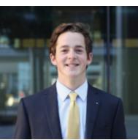
Project Overview
Goals:
2. Establish an Undergraduate Research Program in Applied Cybersecurity.
Status: the program has been established. It supports between 10-12 students per semester.
Dakota
Keegan
Brian
CS, IT, CI students
Ty
Brad
Bryson

Slide 14
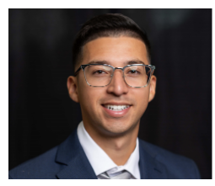
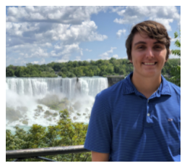
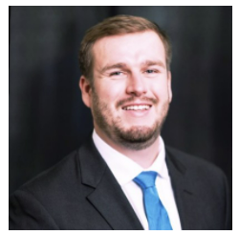
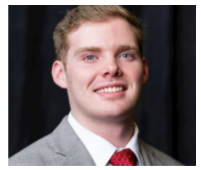
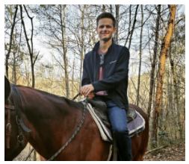

Project Overview
Goals:
2. Establish an Undergraduate Research Program in Applied Cybersecurity.
Status: the program has been established. It supports between 10-12 students per semester.
Josue
Nate
Zach
CS, IT, CI students
Kyle
Lauren
Nathan

Slide 15
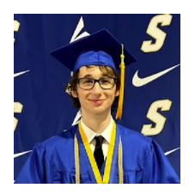
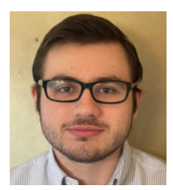
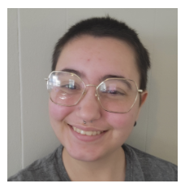
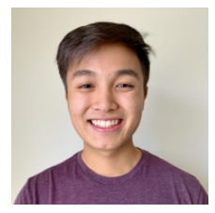
Project Overview
Goals:
2. Establish an Undergraduate Research Program in Applied Cybersecurity.
Status: the program has been established. It supports between 10-12 students per semester.
Cameron
Hannah
Jesse
CS, IT, CI students
Collins

Slide 16
Project Overview
Goals:
2. Establish an Undergraduate Research Program in Applied Cybersecurity.
Status: the program has been established. It supports between 10-12 students per semester.
Jack, ROTC
Brad, IT student
“During my semesters conducting research under ONR, I learned many valuable skills that would help me improve my chances at becoming a Cyber Operations Officer in the United States Army. The skills I learned during this period carried over into internships with 3rd Special Forces Group Cyber Effects Cell, as well as the Army Cyber Institute at West Point. Understanding the vulnerabilities with routing protocols greatly improved my value as a member of a research team examining malware and phishing attacks…”
Currently senior student, employed with UofSC’s IT and at the 359th Theater Tactical Signal Brigade, Headquarters Company.
“I learned vital cybersecurity skills, such as creating policies with Application Identification rules, generating traffic to ensure security policies are operating appropriately, and reading logs to understand where traffic is traversing the network. The skills I learned during my ONR project were very similar to those skills needed to become part of the Networking/Perimeter team at Savanna River National Laboratory (SRNL), which protects the internal network… My managers [at SRNL internship] were very pleased with my knowledge and experience with next generation firewalls. As a result of my experience with ONR and previous internship at SRNL I was offered a full-time position contingent upon my graduation in May 2022”.
Currently senior student.

Slide 17
Project Overview
Goals:
2. Establish an Undergraduate Research Program in Applied Cybersecurity.
Status: the program has been established. It supports between 10-12 students per semester.
Name | Position
Ty | 2nd Lt. at U. S. Marine Corps, DC
Dakota | Information Security Analyst at Lowe's
Lauren | IT Specialist, SC Department of Insurance
Josue | Technical Solution Specialist at IBM
Kyle | IT Specialist at Lowe's Companies
Nathan | Project Coordinator at Black Box Networks
Brad | IT Intern Savannah River National Lab
Zach | IT Intern at Blue Cross Blue Shield
Nathan | Technology Analyst at AIG
…

Slide 18
Project Overview
Goals:
Deploy virtual equipment pods on a virtual platform, accessible over the Internet, to support and facilitate the research and teaching activities from anywhere, without compromising hands-on.
Status: private cloud for teaching and research in cyber at UofSC. Live traffic, scalable.

Slide 19
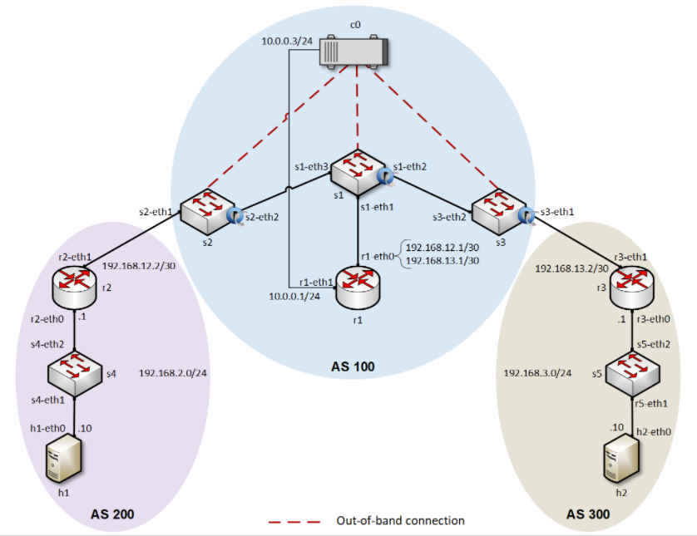
Project Overview
Goals:
Deploy virtual equipment pods on a virtual platform, accessible over the Internet, to support and facilitate the research and teaching activities from anywhere, without compromising hands-on.
Status: private cloud for teaching and research in cyber at UofSC. Live traffic, scalable.

Slide 20
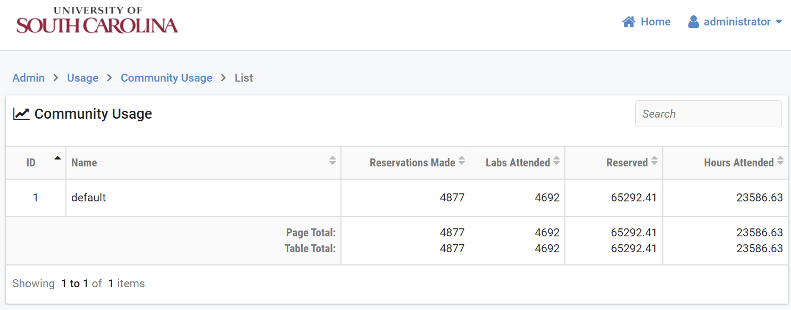
Project Overview
Goals:
3. Deploy virtual equipment pods on a virtual platform, accessible over the Internet, to support and facilitate the research and teaching activities from anywhere, without compromising hands-on.
Status: private cloud for teaching and research in cyber at UofSC. Live traffic, scalable.
Use of the virtual platform at the University of South Carolina between Oct. 1, 2020 – Sep. 30, 2021.

Slide 21
Project Overview
Goals:
3. Deploy virtual equipment pods on a virtual platform, accessible over the Internet, to support and facilitate the research and teaching activities from anywhere, without compromising hands-on.
Status: we expanded the platform and made it available to other institutions, establishing agreements with government, high schools, and other higher-education institutions (NSF support ~$1M).
  Berkeley National Lab
  SANS institute (“girlsgocyber”)
  Multiple higher-ed institutions
  International Networks at Indiana
  Texas’ Lonestart Education and Research
  U.S. Army Cyber Center of Excellence (CCoE)

Slide 22
Project Overview
Goals:
Establish meetings among industry, government, high schools, and higher-education institutions to enhance cybersecurity preparation.
Status: agreements with industry partners (Cisco, Palo Alto, VMware, Intel) which provide professional tools and platforms. Also, they provide a pathway to additional certifications.
95% of the more than 345,000 job listings for Information Security Analyst request professional certification.
M. Tannian, W. Coston, “The Role of Professional Certifications in Computer Occupations,” Communications of the ACM, Oct. 2021.
Notes:
ACM: Association for Computing Machinery

Slide 23
Project Overview
Goals:
Establish meetings among industry, government, high schools, and higher-education institutions to enhance cybersecurity preparation.
Status: the program incorporates preparation for DoD’s approved baseline credentials¹ for Information Assurance Technical (IAT) positions, Cybersecurity Service Provider (CSSP) Analyst, and CSSP Incident Responder.
Cybersecurity courses with content for DoD’s Approved 8750 baseline certifications
Course | IAT 1-2 | CSSP Analyst | CSSP Incident Responder | Security Plus | NICE Framework Objectives
Intro to Computer Security |  |  |  | P | P
Cybersecurity Operations |  | P | P |  | P
Intro to Networks | P | P | P |  | P
IT Security for Managers |  |  |  | P | P
Advanced Networks | P | P | P |  | P
NICE: National Initiative for Cybersecurity Education
¹Department of Defense (DoD) Cyber Workforce Management Program Website. https://tinyurl.com/55t7sdnm

Slide 24
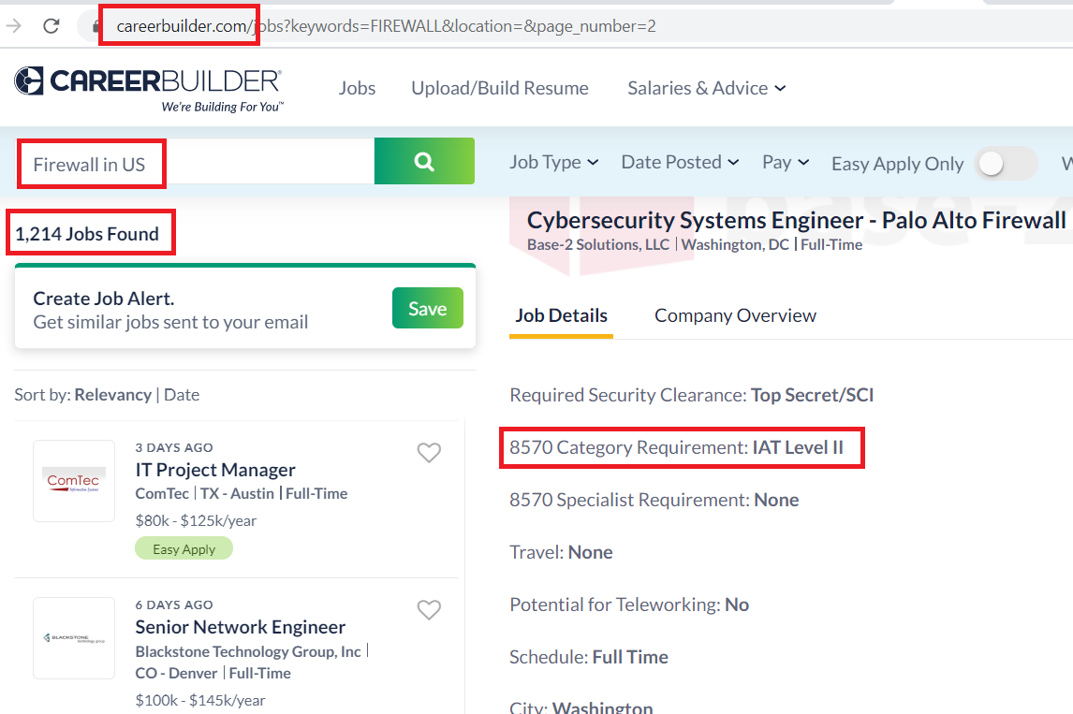
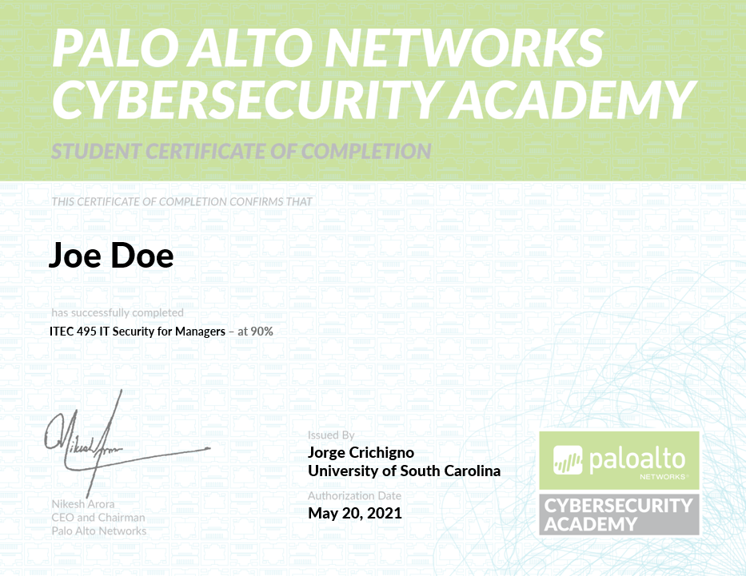
Project Overview
Goals:
Establish meetings among industry, government, high schools, and higher-education institutions to enhance cybersecurity preparation.
Status: the program incorporates preparation for DoD’s approved baseline credentials for Information Assurance Technical (IAT) positions, Cybersecurity Service Provider (CSSP) Analyst, and CSSP Incident Responder.
Additional credentials
Job search

Slide 25
Project Overview
USC’s application to NSF Cybersecurity Scholarship Program currently under review
~$3M project
Activities include internships and industry-sponsored capstone projects for CI, IT, and CS students
Other organizations
  ESnet / Berkeley National Lab
  Savannah River National Lab
  Idaho National Lab
  UCAR
  SC Department of Administration
  U.S. Army CCOE
  SC Chamber of Commerce
  Multiple private companies

