Slide 1


Volumetric DDoS Attack Detection and Mitigation
using P4-DPDK
Samia Choueiri, Ali Mazloum, Sergio Elizalde, Elie F. Kfoury, Jorge Crichigno
University of South Carolina, USA
IEEE International Black Sea Conference on Communications and Networking
23-26 June 2025
Chisinau, Moldova

Slide 2
Agenda
Background on packet processing acceleration
Introduction to Data Plane Development Kit (DPDK) and P4-DPDK
Proposed system
Evaluation
Conclusion

Slide 3
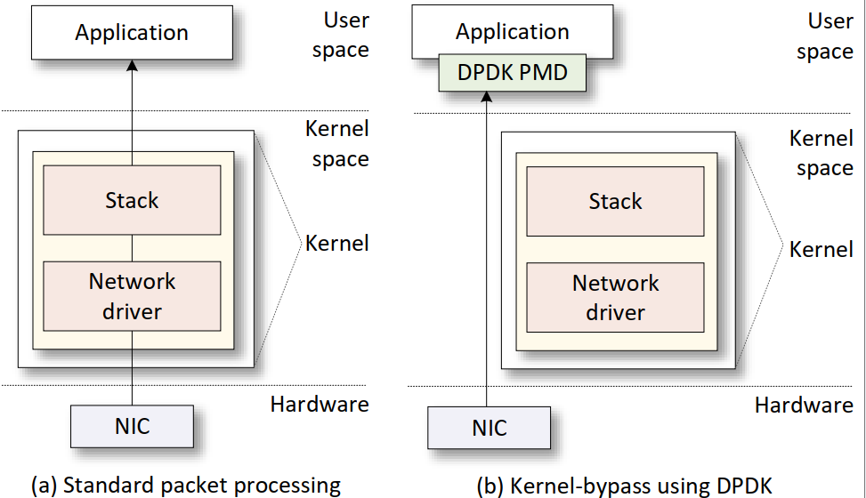
Standard Packet Processing
The Network Interface Card (NIC) driver pre-allocates kernel memory buffers where the packets are stored.
The NIC driver pre-allocate the transmit (TX) and receive (RX) ring buffer in the memory.
The ring buffers store the packet buffer pointer and its length.
The NIC copies the packet to the location using Direct Memory Access (DMA).
The NIC triggers an interrupt.
End device

Slide 4
Kernel-Bypass Packet Processing using DPDK
Bypassing the kernel is a solution to avoid kernel overheads and accelerate packet processing.
DPDK is a set of optimized libraries for processing packets in the user space while bypassing the kernel.
DPDK uses Poll Mode Drivers (PMD) which constantly poll the NICs for new packets to avoid overheads resulting from interrupts.

Slide 5
Using P4 Programming for DPDK
DPDK
DPDK may be complex to program. It requires knowledge of DPDK libraries
DPDK requires many lines of code to implement a packet processing pipeline
Adding features and modifying a large may become complex
P4-DPDK
Combining P4 with DPDK enables programmers to write packet processing apps and obtain high performance
P4-DPDK optimizes the size of the code compiled into a DPDK programmable pipeline
P4 quickly adapts and deploys new network functions to the data plane
P4: Programming Protocol-Independent Packet Processors
Notes:
Bosshart et al., P4: Programming Protocol-Independent Packet Processors, ACM Computer Communication Review, Vol. 44, Issue 3, 2014
DPDK (Data Plane Development Kit) was created by Intel in 2010 and made available under a permissive open-source license. The open-source community was established at DPDK.org in 2013

Slide 6
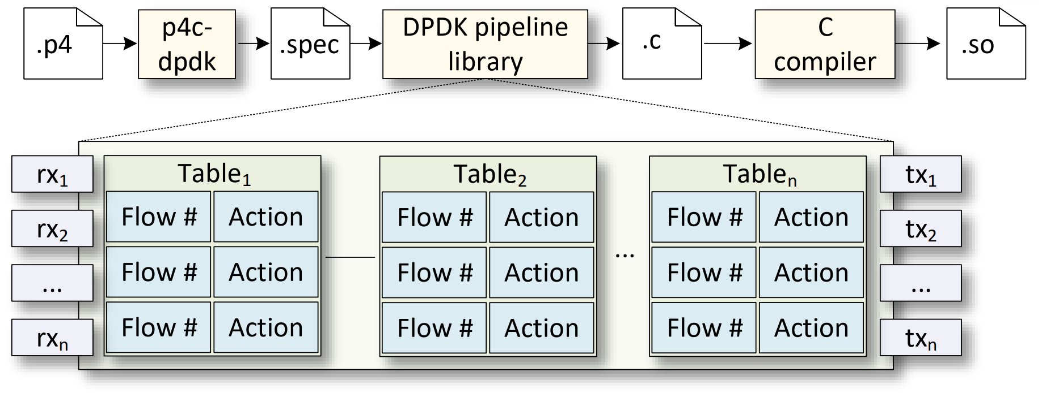
The P4-DPDK Workflow
The system is implemented in P4 using the Portable NIC Architecture (PNA).
The P4 code consists of all packet processing functions, including customized code.
The p4c-dpdk compiler accepts the P4 code as input and generates a representation file (.spec file) that aligns with the DPDK software switch pipeline.
The DPDK libraries are used to build the pipeline that consists of three main components;
Input ports
Match action tables
Output ports
Notes:
dynamically linked shared object libraries

Slide 7
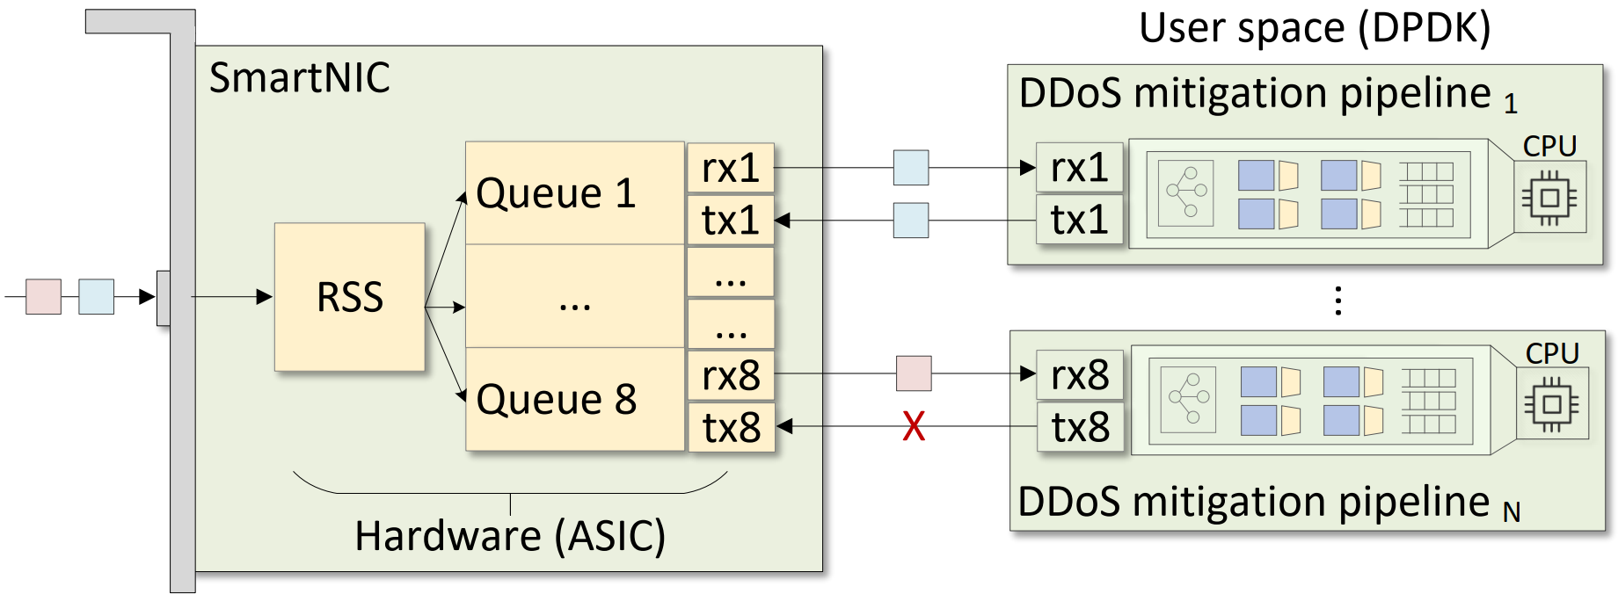
Proposed System Architecture
The NIC can distribute packets across multiple CPU cores using the Receive Side Scaling (RSS).
RSS uses hashing for load balancing.
Core affinity allows binding packet processing to a specific CPU core.
The DPDK pipelines implement the DDoS attack detection and mitigation algorithm.

Slide 8
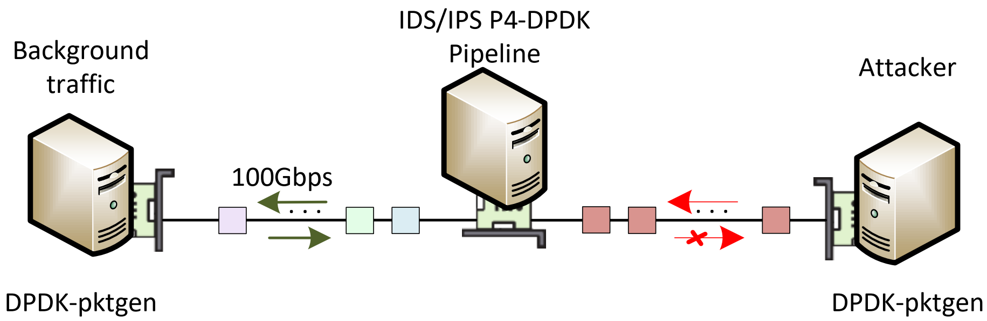
Experiment Topology
The topology consists of three nodes, equipped with an NVIDIA ConnectX-6 NIC (100Gbps). Nodes are deployed on FABRIC¹.
DPDK-pktgen² is used to generate background and attack traffic.
The P4-DPDK pipeline reflects the processed background traffic.
A detected attack is mitigated as soon as it is identified.
I. Baldin et al., Fabric: A national-scale programmable experimental network infrastructure”, IEEE Internet Computing, Vol. 23, Issue 6, 2019.
https://pktgen-dpdk.readthedocs.io/en/latest/

Slide 9
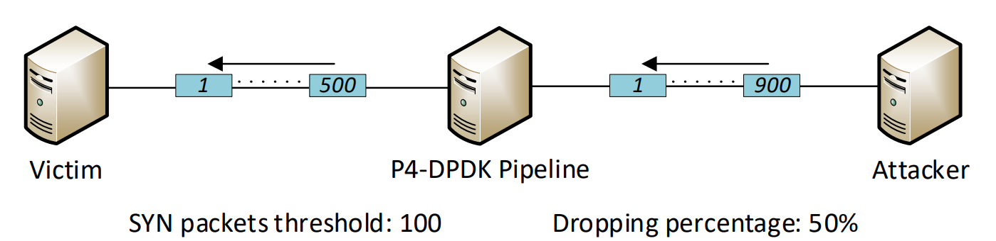

Methodology of the Work
Scenario 1
Detection method: Total packet count thresholding using register counters.
Mitigation methods: Reducing the number of processed packets by a certain percentage.
Attacks: SYN Flood, SYN-ACK Flood, ACK Flood, UDP Flood
P$rocessed packets=threshold+\frac{(dropping percentage ∗number of packets above threshold)}{100}$
$$100+\frac{(50∗800)}{100}=500$$

Slide 10
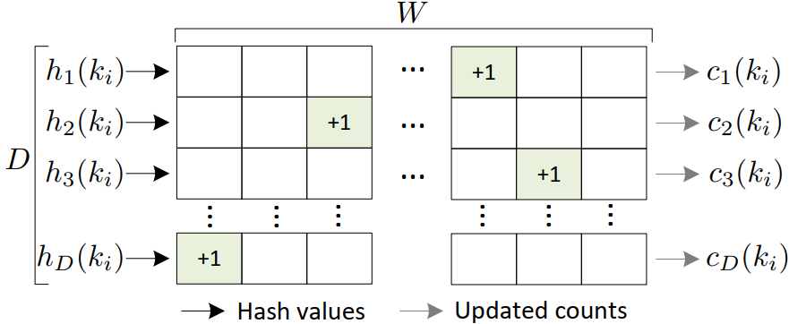
Methodology of the Work
Scenario 2
Detection method: Per-flow packet count monitoring using the Count-min Sketch (CMS) data structure.
Mitigation methods: Blacklisting flows identified as attackers.
Attacks: Heavy Hitter, ICMP Flood
D: Depth (# of hash functions)
W: With (# of flows)
i: Packet index, between 0-N
k_{i}: ID of a flow, using i^{th} packet info.
c_{d} (k_{i} ): estimated # of packets of flow k_{i}, using hash function d, after processing packet i
Notes:
Elefant transfer. We are tracking connection

Slide 11
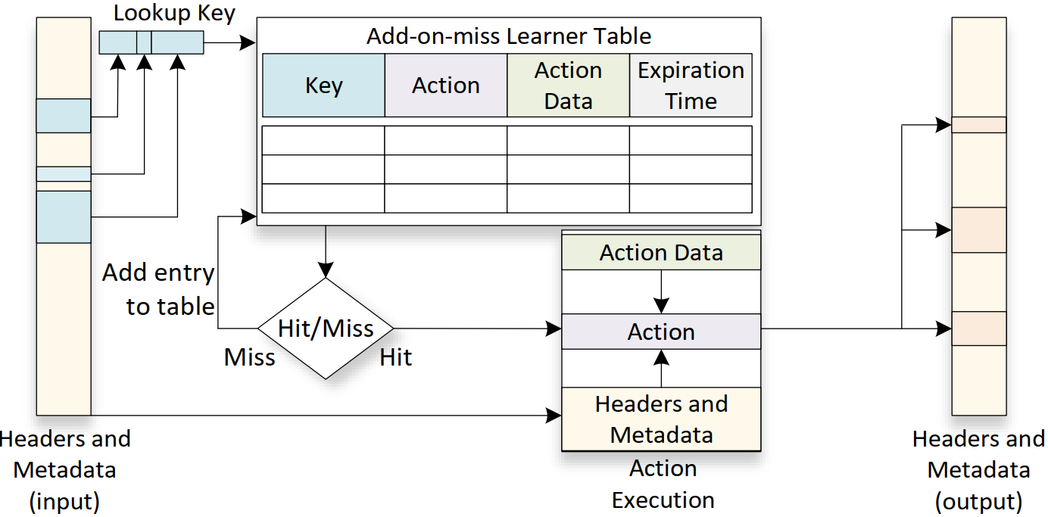
Methodology of the Work
Scenario 3
Detection method: Connection tracking using the add-on-miss match-action tables.
Mitigation methods: Blocking flows that do not belong to a previously established connection.
Attacks: FIN Flood

Slide 12

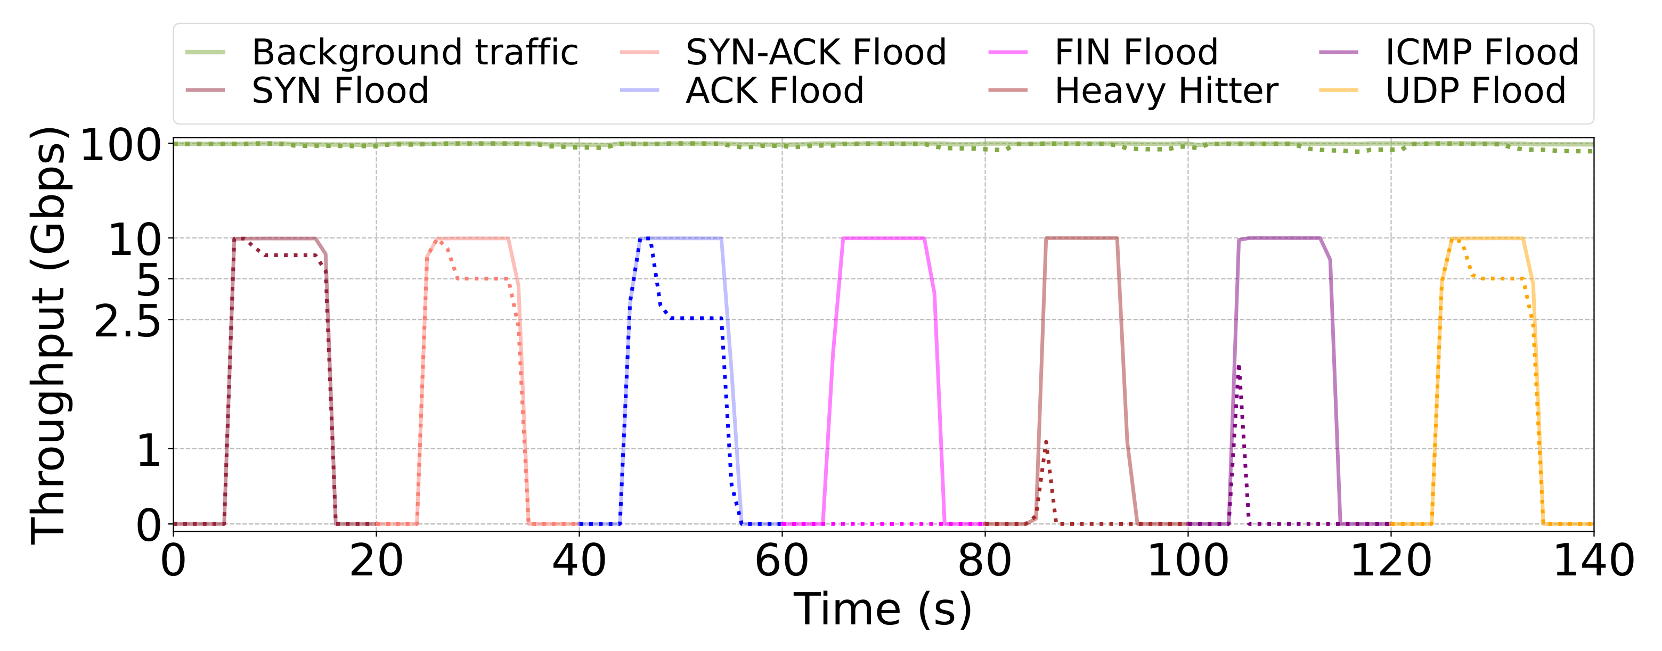
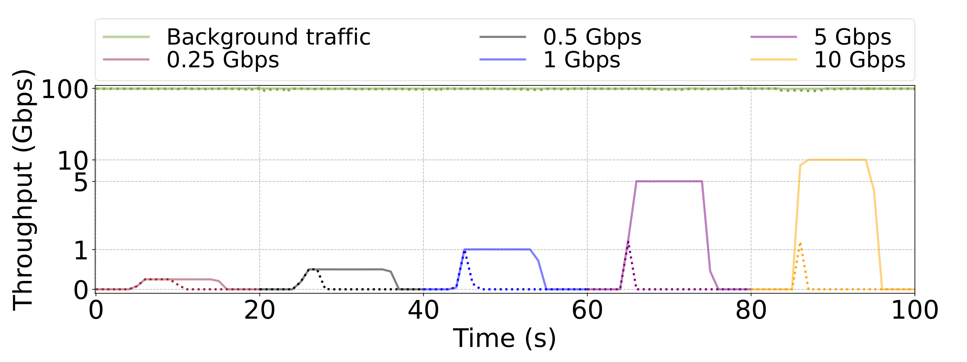
Performance Results
Attack | Threshold | Drop
SYN | 1M | 25%
SYN-ACK | 1M | 50%
ACK | 1M | 75%
FIN | NA | NA
HH | 100K | NA
ICMP | 200K | NA
UDP | 1M | 50%
DDoS w/ high-rate traffic (100Gbps)
Four CPU cores
Thresholds and drop rates can be adjusted
Detection and mitigation of simultaneous DDoS attacks
Detection and mitigation of heavy hitters from different flows and rates
Notes:
In these experiments, we are demonstrating the capability of the system to detect and mitigate multiple attacks with different approaches. We used different thresholds and drop rates to show that these parameters can be adjusted based on the use case. We implement the self-adjusting threshold in a subsequent paper.
Attack | Threshold | Drop Percentage
SYN | 1M | 25%
SYN-ACK | 1M | 50 %
ACK | 1M | 75%
FIN | N/A | N/A
HH | 100K | N/A
ICMP | 200K | N/A
UDP | 1M | 50%

Slide 13
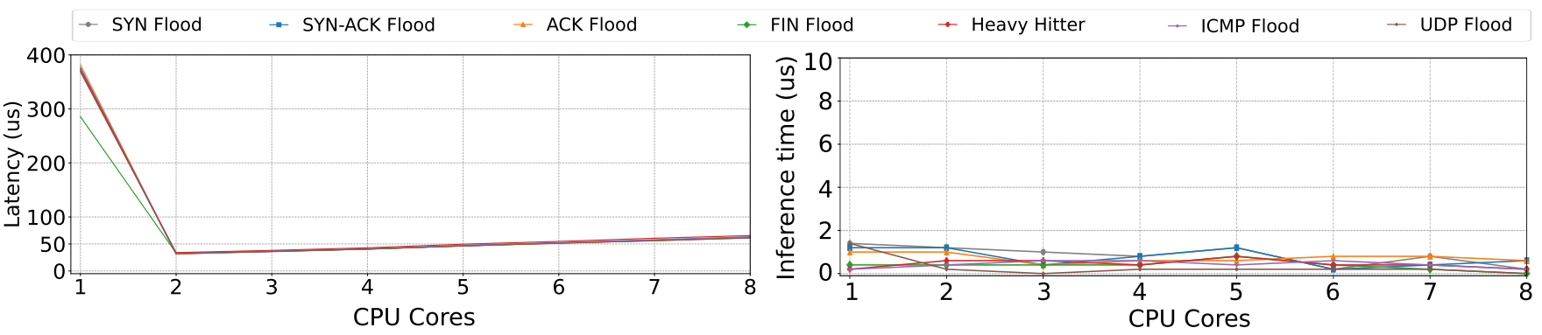
Latency and Inference Time in the P4-DPDK Pipeline
The latency is measured as the lifetime of legitimate packets as they reach the NIC, undergo processing in the pipeline, and leave the NIC.
The inference time is the time the system takes to detect an attack in any of the operating pipelines.
The latency and inference time measurements are collected as the pipeline processes the legitimate flows while it mitigates the different attacks.

Slide 14
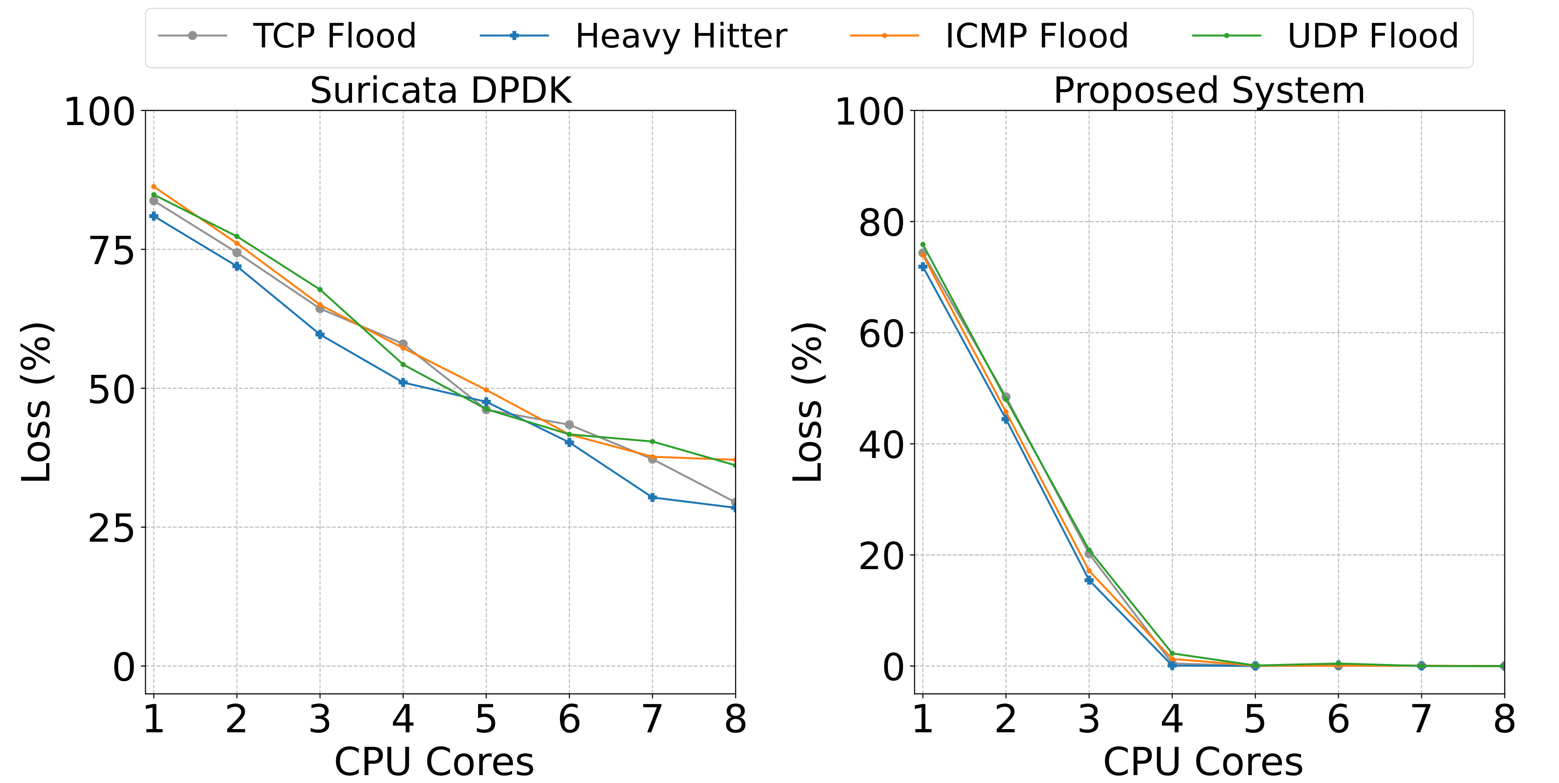
Performance Comparison Against Suricata DPDK
This experiment compares the performance of the proposed system against Suricata, an open-source Intrusion Detection System (IDS) / Intrusion Prevention System (IPS).
The proposed system produces higher performance than Suricata DPDK, which results on lower packet losses.

Slide 15

Project Demo

Slide 16
Conclusion
This paper presents a packet-processing scheme for end devices.
The scheme enables programmers to write applications using a high-level language (P4) and obtain high performance (DPDK).
The paper showcases the ability of the system to detect DDoS attacks while maintaining the following performance measures:
High throughput (100 Gbps)
Low latency (< 60 µs)
Low inference time (< 2 µs)
Low Packet loss (0%)

Slide 17


Cybertraining Material
Information about lab libraries is available at https://research.cec.sc.edu/cyberinfra/cybertraining
Programmable data plane devices
P4-DPDK Security
Introduction to P4-DPDK
Cybersecurity Apps with P4 Programmable Data Planes
P4 Programmable Data Planes: Applications, Stateful Elements, Custom Packet Processing
Intro to P4 Programmable Switches
Intro to P4 Programmable Switches with Intel’s Tofino
P4 Monitoring Applications
Traditional Protocols
Software-defined Networking (SDN)
Open vSwitch
Network Tools and Protocols
Introduction to IPv6
Open Shortest Path First (OSPF)
Introduction to BGP
MPLS and Advanced BGP
Cybersecurity, Management, and Science DMZs
Zeek IDS/IPS
Cybersecurity Fundamentals
perfSONAR 5
P4-perfSONAR
Network Management Tools
High-speed Networks: A Tutorial

Slide 18


Acknowledgement
This work was supported by the U.S. National Science Foundation (NSF), under awards 2417823, 2346726, and 2403360. The authors would also like to acknowledge the FABRIC team.

Slide 19

For additional information, please refer to
https://research.cec.sc.edu/cyberinfra/
Email: {choueiri, amazloum, elizalds, ekfoury}@email.sc.edu, jcrichigno@cec.sc.edu

