Slide 1


Ph.D. Dissertation Defense
Leveraging Programmable Switches to Enhance the
Performance of Networks: Active and Passive Deployments
Elie Kfoury
Integrated Information Technology Department
College of Engineering and Computing
19 May 2023
Committee Members:
- Dr. Elias Bou-Harb
- Dr. Robert Brookshire
- Dr. John Gerdes
- Dr. Neset Hikmet
Advisor:
- Dr. Jorge Crichigno

Slide 2
Agenda
Non-programmable Networks
Software-defined Networking (SDN)
P4 Programmable Switches
Performance Issues in Networks Today
Proposed System: Dynamic Buffer Sizing- Stanford
Proposed System: P4BS
Proposed System: P4CCI
Proposed System: Media Offloading
Proposed Architecture: P4Tune
Conclusion

Slide 3
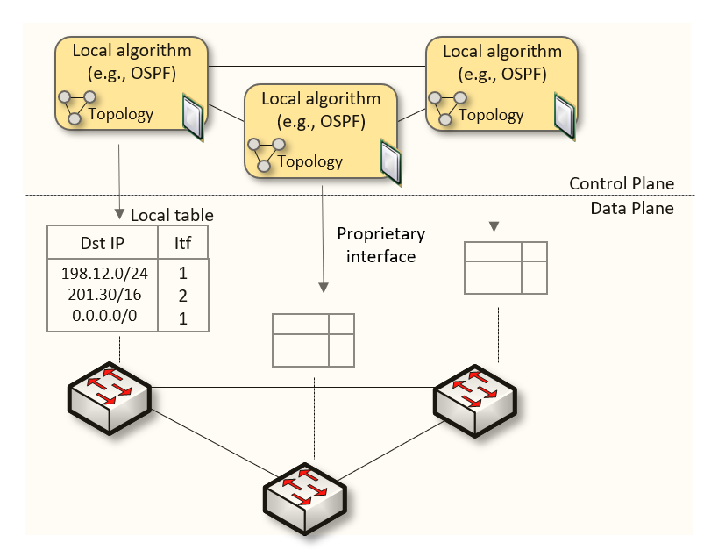
Non-programmable Networks
Since the explosive growth of the Internet in the 1990s, the networking industry has been dominated by closed and proprietary hardware and software
The interface between control and data planes has been historically proprietary
  Vendor dependence: slow product cycles of vendor equipment, no innovation from network owners
  A router is a monolithic unit built and internally accessed by the manufacturer only
Notes:
This is the way that we’ve been doing netwowrking
This is used in curriculum (Cisco)
The figure shows switches
Switches/routers are used interchangeably
The box contains the control plane and the data plane together.
The router is a monolithic unit, and only the vendor has access to its internals

Slide 4
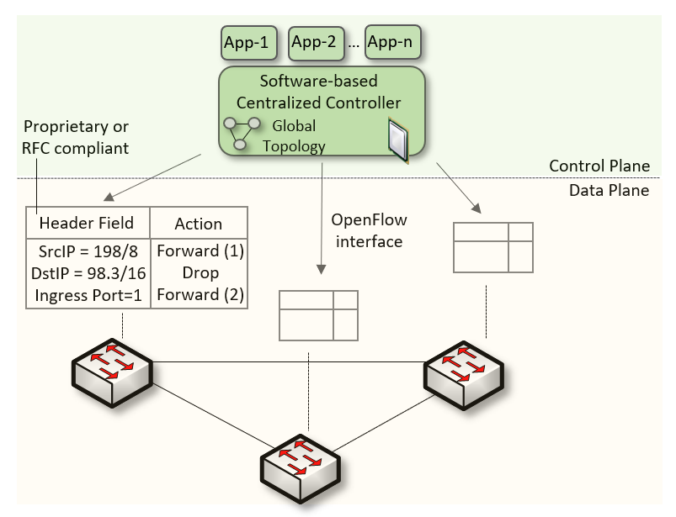
Software-defined Networking (SDN)
Protocol ossification has been challenged first by SDN
SDN explicitly separates the control and data planes, and implements the control plane intelligence as a software outside the switches
The function of populating the forwarding table is now performed by the controller
Notes:
In early 2010 there was a disruption in the network industry
Group of researhers coming from Stanford (same group that came up with P4)
SDN explicitly separates the control plane and the data plane
This model enables the CP intelligence to be implemented as software outside the switches
The population of tables is performed by a controller
CP -> CPU
DP -> ASIC

Slide 5
SDN Limitation
SDN is limited to the OpenFlow specifications
  Forwarding rules are based on a fixed number of protocols / header fields (e.g., IP, Ethernet)
The data plane is designed with fixed functions (hard-coded)
  Functions are implemented by the chip designer
Notes:
SDN has limitations:
With SDN, we can create rules and push down those rules to the DP, but the rules are limited to fixed number of header fields
I cannot create my own protocol with my header fields, I can’t
Example: VXLAN
Took years
Can be easy if the DP is programmable
The DP has fixed functions
Implemented by the chip designer and we cannot modify that

Slide 6
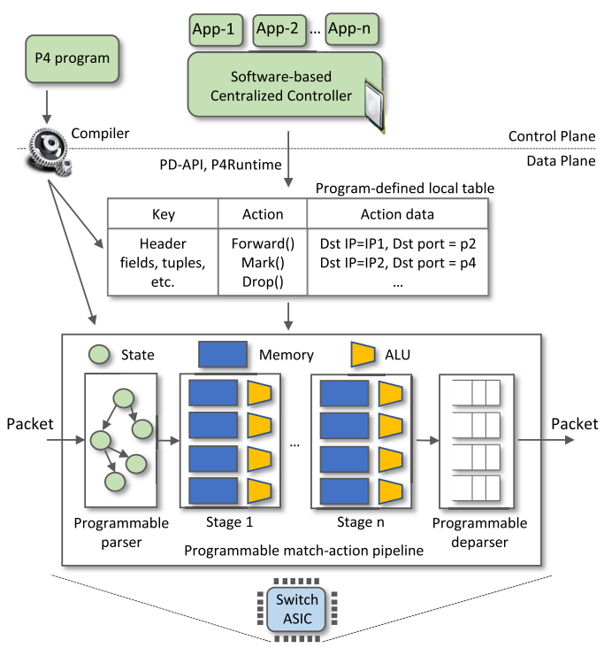

P4 Programmable Switches
P4¹ programmable switches permit a programmer to program the data plane
  Define and parse new protocols
  Customize packet processing functions
  Measure events occurring in the data plane with
  high precision
  Offload applications to the data plane
Programmable Data Planes (PDPs)
1. P4 stands for stands for Programming Protocol-independent Packet Processors
Notes:
-

Slide 7
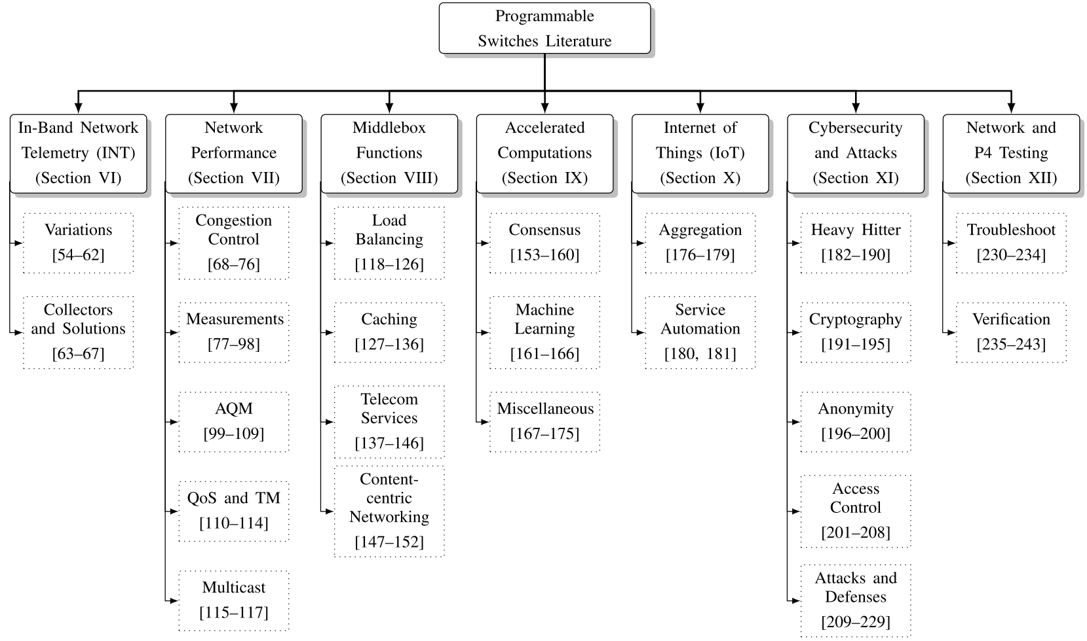
PDPs Applications
Notes:
- P4 switches are being used in a variety of domains
We performed a comprehensive review on the different applications implemented in programmable data plane switches
We identified the gap

Slide 8
Performance Issues in Networks Today
Three main issues affecting the performance of networks today:
  Networks are dominated by under/over buffered routers/switches

Slide 9
Performance Issues in Networks Today
Three main issues affecting the performance of networks today:
  Networks are dominated by under/over buffered routers/switches
  Routers/switches configured with best-effort quality of service (heterogeneous traffic being mixed without any QoS measures)

Slide 10
Performance Issues in Networks Today
Three main issues affecting the performance of networks today:
  Networks are dominated by under/over buffered routers/switches
  Routers/switches configured with best-effort quality of service (heterogeneous traffic being mixed without any QoS measures)
  CPU-based middlebox servers inducing latency and jitter and not keeping up with high traffic rates

Slide 11
Performance Problem #1:
Under/over Buffered Networks

Slide 12
Buffer Size Problem
Routers and switches have a memory referred to as packet buffer
The size of the buffer impacts the network performance
  Large buffers → TCP keeps the buffer full → excessive delays, Bufferbloat
Buffer
Bottleneck link
Senders
200ms
Delay > 200ms
Receivers
Router
Notes:
Despite the improvements brought by P4 switches, the majority of nowadays networks are still using legacy devices

Slide 13
Buffer Size Problem
Routers and switches have a memory referred to as packet buffer
The size of the buffer impacts the network performance
  Large buffers → TCP keeps the buffer full → excessive delays, Bufferbloat
  Small buffers → packet drops → sender slows down → low link utilization
Buffer
Bottleneck link
Drop
Senders
1ms
Delay ~ 1ms
Receivers
Router
Notes:
Despite the improvements brought by P4 switches, the majority of nowadays networks are still using legacy devices

Slide 14



Buffer Sizing Rules: BDP
General rule-of-thumb¹: bandwidth-delay product (older rule)
  $B=C⋅RTT$
  $C$ is the capacity of the link and $RTT$ is the average round-trip time
Example: $C=1Gbps$with $RTT=50ms$→ $B=6MB$
Bottleneck link
$$1Gbps$$
Senders
6MB
Receivers
Router
$$RTT = 50ms$$
1. C. Villamizar and C. Song. High performance TCP in ansnet. ACM Computer Communications Review, 24(5):45–60, 1994 199
Notes:
Despite the improvements brought by P4 switches, the majority of nowadays networks are still using legacy devices

Slide 15


Buffer Sizing Rules: Stanford
Stanford rule¹: smaller buffers are enough to get full link utilization
  $B = \frac{C ∗RTT}{√N}$
  $N$ is the number of long (persistent over time) flows traversing the link
  Example: $C=1Gbps$with $RTT=50ms$and 100 flows → $B=0.6MB$
Bottleneck link
$$N =100$$
$$1Gbps$$
Senders
0.6MB
Receivers
Router
$$RTT = 50ms$$
1. Appenzeller, Guido, Isaac Keslassy, and Nick McKeown. "Sizing router buffers." ACM SIGCOMM Computer Communication Review 34.4 (2004)
Notes:
Despite the improvements brought by P4 switches, the majority of nowadays networks are still using legacy devices

Slide 16
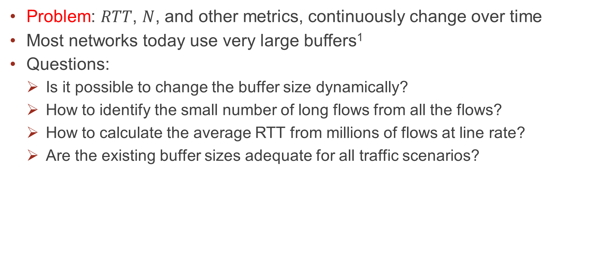
Buffer Size Rules
Problem: $RTT$, $N$, and other metrics, continuously change over time
Most networks today use very large buffers¹
Questions:
  Is it possible to change the buffer size dynamically?
  How to identify the small number of long flows from all the flows?
  How to calculate the average RTT from millions of flows at line rate?
  Are the existing buffer sizes adequate for all traffic scenarios?
1. McKeown, Nick, Guido Appenzeller, and Isaac Keslassy. "Sizing router buffers (redux)." ACM SIGCOMM Computer Communication Review (2019)
Notes:
Despite the improvements brought by P4 switches, the majority of nowadays networks are still using legacy devices

Slide 17
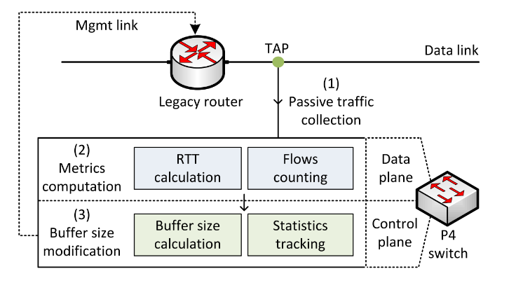

Proposed System
The buffer size is dynamically modified and set to $B = \frac{C ∗RTT}{√N}$
$$(N)$$

Slide 18

Proposed System
The buffer size is dynamically modified and set to $B = \frac{C ∗RTT}{√N}$
  Copy of the traffic is forwarded to a programmable switch using TAPs
$$(N)$$

Slide 19

Proposed System
The buffer size is dynamically modified and set to $B = \frac{C ∗RTT}{√N}$
  Copy of the traffic is forwarded to a programmable switch using TAPs
  The programmable switch identifies and track buffer sizing metrics
$$(N)$$

Slide 20

Proposed System
The buffer size is dynamically modified and set to $B = \frac{C ∗RTT}{√N}$
  Copy of the traffic is forwarded to a programmable switch using TAPs
  The programmable switch identifies and track buffer sizing metrics
  The programmable switch modifies the legacy router’s buffer size
$$(N)$$

Slide 21

Proposed System
The buffer size is dynamically modified and set to $B = \frac{C ∗RTT}{√N}$
  Copy of the traffic is forwarded to a programmable switch using TAPs
  The programmable switch identifies and track buffer sizing metrics
  The programmable switch modifies the legacy router’s buffer size
$$\frac{C ∗RTT}{√N}$$
$$(N)$$

Slide 22
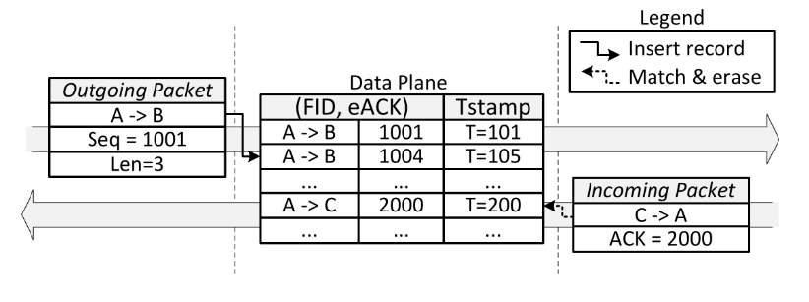
RTT Calculation
Relate the TCP sequence (SEQ) and acknowledgement (ACK) numbers¹
The RTT is calculated as the time difference between the two packets
¹Chen, Xiaoqi, et al. "Measuring TCP round-trip time in the data plane." Workshop on Secure Programmable Network Infrastructure. 2020.

Slide 23
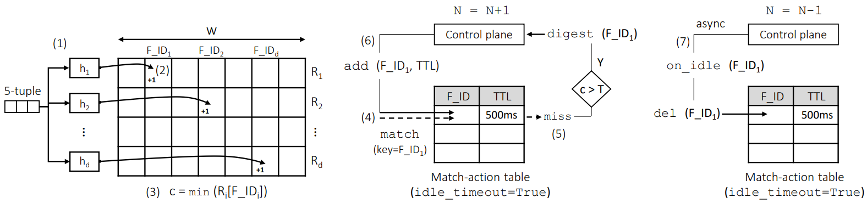
Long Flows Counting
The Count-Min Sketch (CMS) is used to store the counts of the flows

Slide 24
Long Flows Counting
The Count-Min Sketch (CMS) is used to store the counts of the flows
If the minimum exceeds a predefined threshold, the flow is identified as long

Slide 25
Long Flows Counting
The Count-Min Sketch (CMS) is used to store the counts of the flows
If the minimum exceeds a predefined threshold, the flow is identified as long
Table timeouts are used to evict flows

Slide 26
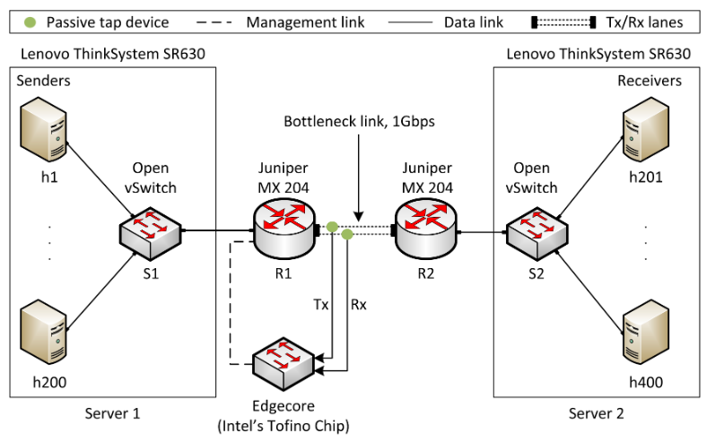
Implementation and Evaluation
Topology and experimental setup
Different congestion control algorithms¹
iPerf3
Default buffer size of the router is 200ms²
Wedge100BF-32X, ASIC chip (Intel’s Tofino)
¹Mishra et al. “The great Internet TCP congestion control census,” ACM on Measurement and Analysis of Computing Systems, 2019
²N. McKeown et al. “Sizing router buffers (redux),” ACM SIGCOMM Computer Communication Review, vol. 49, no. 5

Slide 27
Implementation and Evaluation
Two scenarios are considered:
    Default buffer size on the router, without any dynamic modification
    P4 switch measures and modifies the buffer size of the router

Slide 28
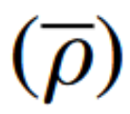


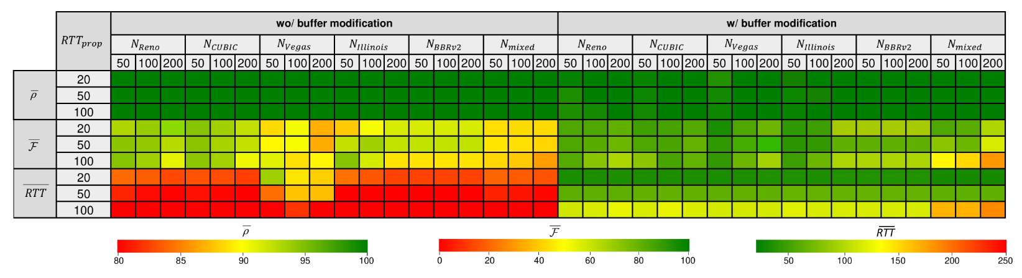
Results
Various number of long flows, CCAs, and propagation delays
Average link utilization
Average fairness index
Average RTT

Slide 29
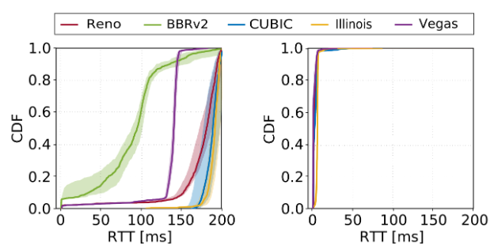
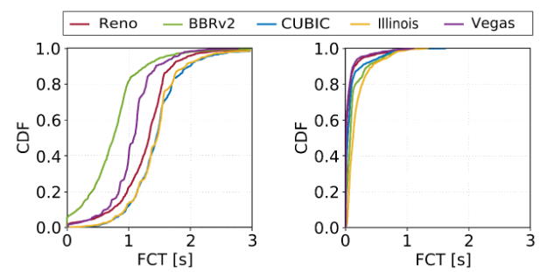
Results
Performance of short flows sharing the bottleneck with long flows
1000 short flows are arriving according to a Poisson process
Flow size distribution resembles a web search workload (10KB to 1MB)
Background traffic: 200 long flows, propagation delay = 50ms
wo/ buffer modification
w/ buffer modification
wo/ buffer modification
w/ buffer modification

Slide 30
Discussions
The proposed system improved:
  The FCT and the RTT of short flows
  The fairness and the RTT of long flows
However, packet loss rates increased
The buffer size assumes Additive Increase Multiplicative Decrease flows

Slide 31
Design Goals
Dynamic adaptation to heterogeneous traffic
Service-level Agreement (SLA) compliance
Smooth integration in existing networks
Extensibility

Slide 32
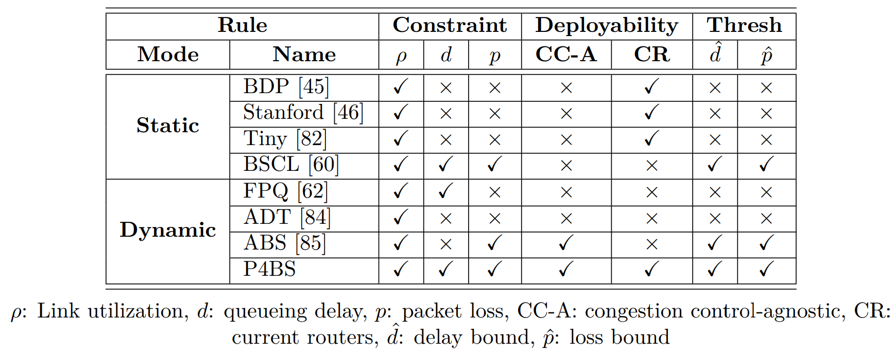
Design Goals
Dynamic adaptation to heterogeneous traffic
Service-level Agreement (SLA) compliance
Smooth integration in existing networks
Extensibility

Slide 33
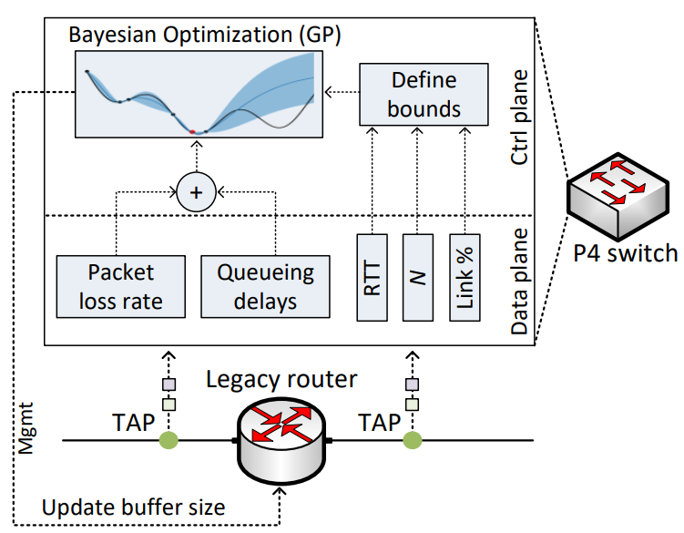
Proposed System
The buffer size is dynamically modified
A P4 switch is deployed passively to compute:
  Number of long flows
  Average RTT
  Queueing delays ← New
  Packet loss rates ← New
  Link utilization ← New

Slide 34
Proposed System
The buffer size is dynamically modified
A P4 switch is deployed passively to compute:
  Number of long flows
  Average RTT
  Queueing delays ← New
  Packet loss rates ← New
  Link utilization ← New
The control plane sequentially searches for a buffer that minimizes delays and losses
The searching algorithm is Bayesian Optimization (BO) with Gaussian Processes

Slide 35
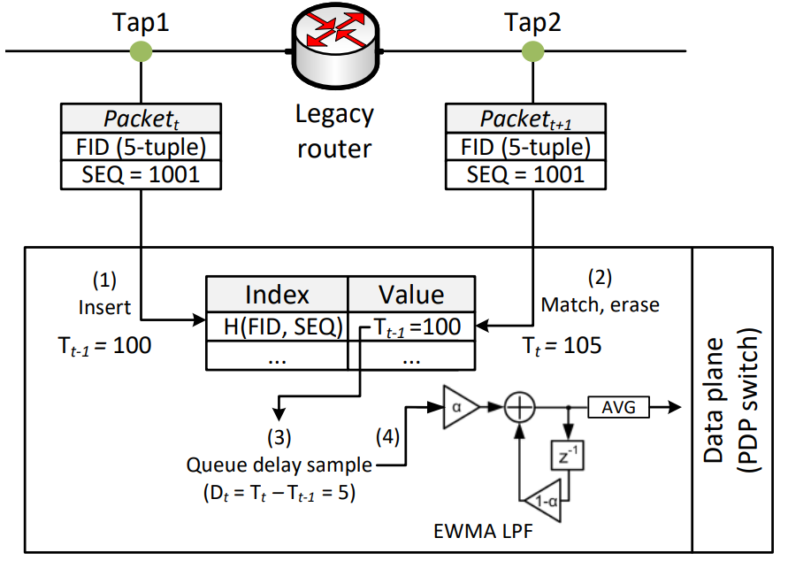
Queue Delay Calculation
The queueing delay is calculated by leveraging the precise timer of the hardware switch (nanosecond resolution)
The queueing delay sample is fed to an Exponentially Weighted Moving Average (EWMA)

Slide 36
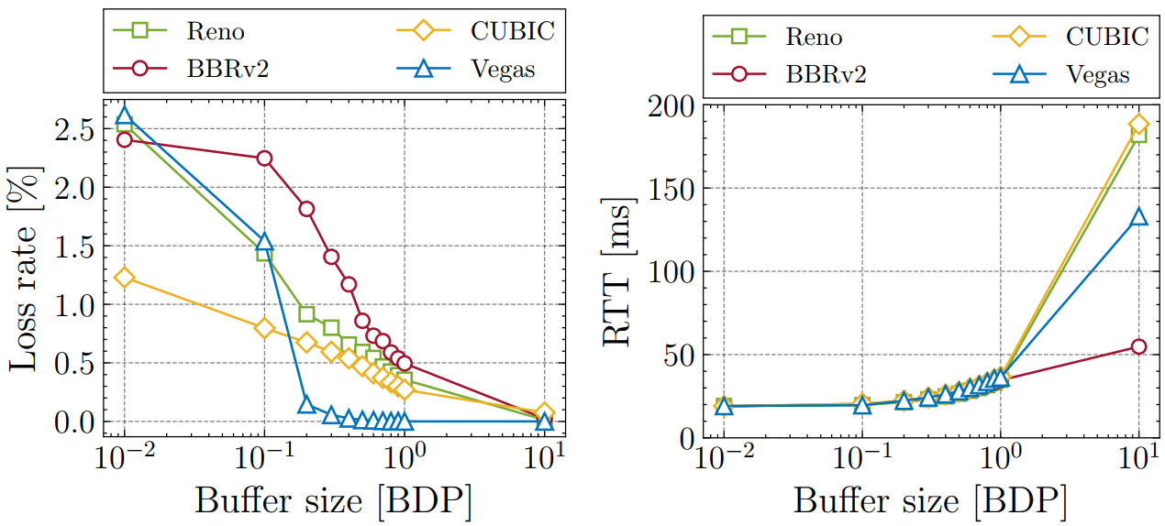
Impact of Buffer on Loss and Delay
Intrinsic relationship between packet loss/delay and buffer
Increasing the buffer → packet loss decreases, delay increases

Slide 37
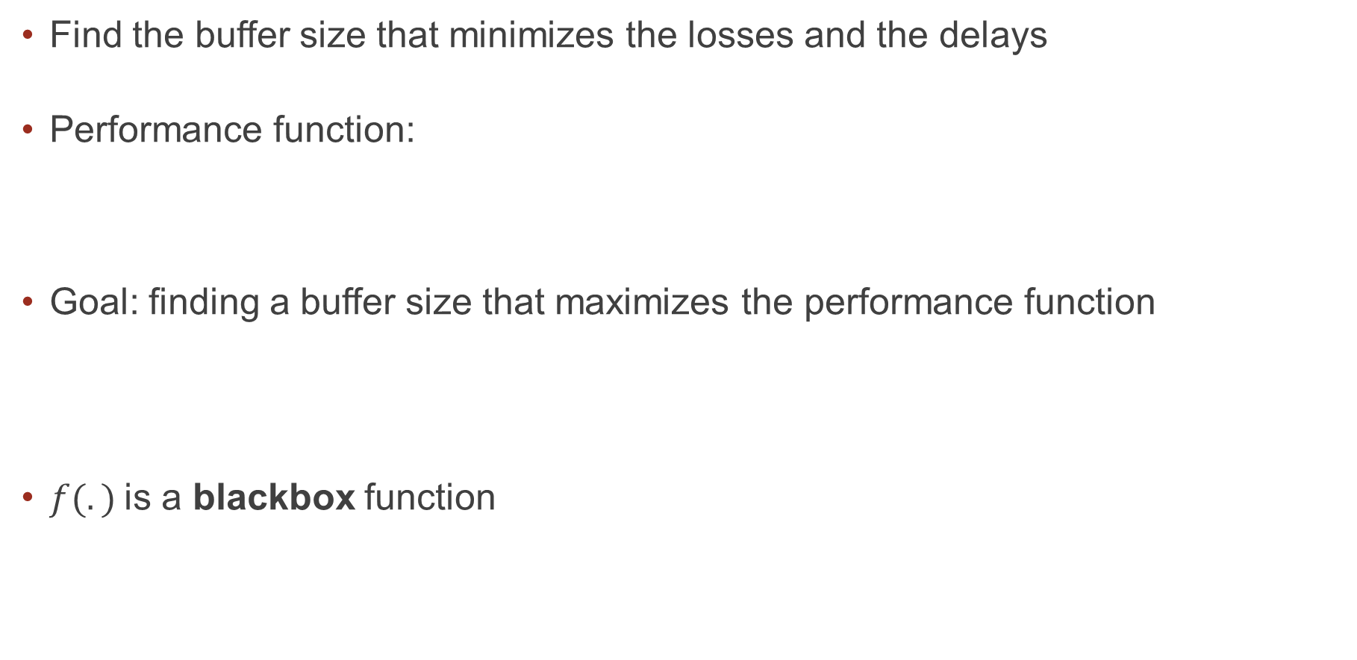



Goal
Find the buffer size that minimizes the losses and the delays
Performance function:
Goal: finding a buffer size that maximizes the performance function
$f(.)$is a blackbox function
$$\sum_{i=1}^{2}{w_{i}=1{, w}_{i}∈[0, 1]}$$
$$f(.) = − [ w_{1}f_{1} (.) + w_{2}f_{2}(.) ]$$
Packet loss
Queueing delay
$$x^{∗}=\arg{\max_{x∈X}{f(x)}{ }}$$
Notes:
functional form for f is not available

Slide 38
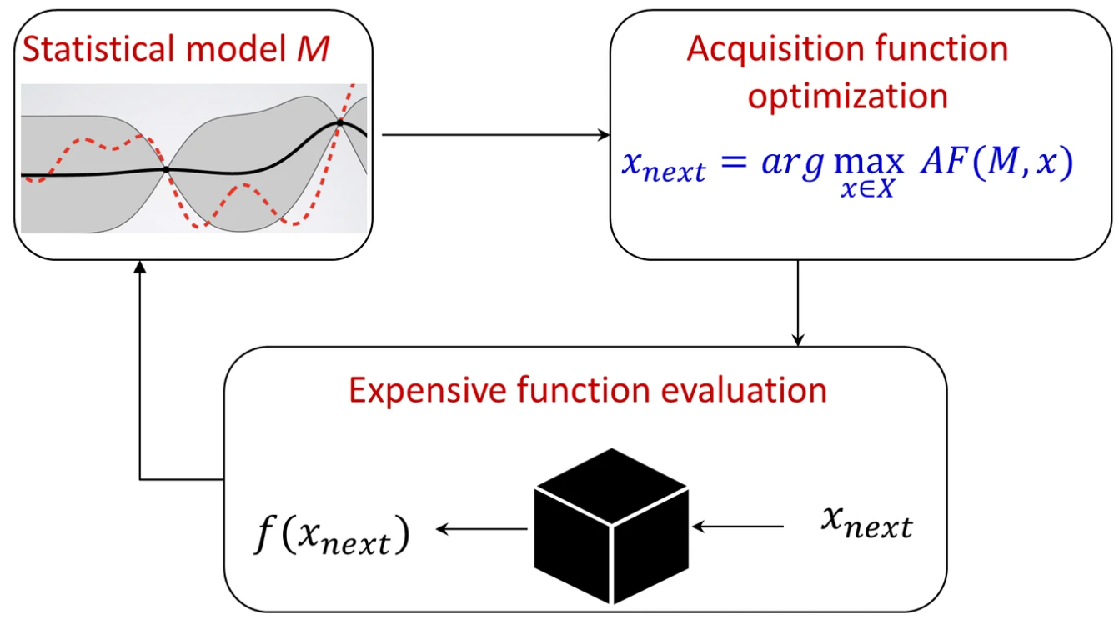
Bayesian Optimization
Efficiently optimize expensive black-box functions
Build a surrogate statistical model and use it to search the space
Replace expensive queries with cheaper queries
Use uncertainty of the model to select expensive queries
Notes:
We want to minimize the total number of trials
We build a surrogate model from the experimental data and we use it to intelligently search the space
The idea is we replace the expensive queries to the blackbox functions with cheaper queries to the surrogate statistical model
We use both the predictions and the uncertainty of the model while selecting which experiment to perform next
This is a typical BO loop:
The are three comppnents:
1- The statistical model that can make predictions on unknown inputs and produce uncertainty estimates
This gets fed as an input to an acquisition function which tells us what is the utility of a value
One we have ssuch utility, we can pick the one that has the highest utility
We pass it to the Blackbox functions to know which query is next
The statistical model is updated using the new observation
We repeat until the max budget is exhausted or we converged

Slide 39
Bayesian Optimization
Efficiently optimize expensive black-box functions
Build a surrogate statistical model and use it to search the space
Replace expensive queries with cheaper queries
Use uncertainty of the model to select expensive queries
Gaussian process
Expected Improvement
Notes:
We want to minimize the total number of trials
We build a surrogate model from the experimental data and we use it to intelligently search the space
The idea is we replace the expensive queries to the blackbox functions with cheaper queries to the surrogate statistical model
We use both the predictions and the uncertainty of the model while selecting which experiment to perform next
This is a typical BO loop:
The are three comppnents:
1- The statistical model that can make predictions on unknown inputs and produce uncertainty estimates
This gets fed as an input to an acquisition function which tells us what is the utility of a value
One we have ssuch utility, we can pick the one that has the highest utility
We pass it to the Blackbox functions to know which query is next
The statistical model is updated using the new observation
We repeat until the max budget is exhausted or we converged

Slide 40

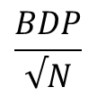
Shrinking the Search Space
Deployed buffer
Maximum tolerated delay
Excluded region
Search space
$$f(x)$$
$$\frac{BDP}{√N}$$
$$BDP$$
Buffer size ($x$)

Slide 41
Shrinking the Search Space
Deployed buffer
Maximum tolerated delay
Excluded region
Search space
Loss > 0 ?
$$f(x)$$
$$\frac{BDP}{√N}$$
$$BDP$$
Buffer size ($x$)

Slide 42
Shrinking the Search Space
Deployed buffer
Maximum tolerated delay
Excluded region
Search space
Loss > 0 ? No
$$f(x)$$
$$\frac{BDP}{√N}$$
$$BDP$$
Buffer size ($x$)

Slide 43

Shrinking the Search Space
Deployed buffer
Maximum tolerated delay
Excluded region
Search space
Loss > 0 ? Yes
$$f(x)$$
$$\frac{BDP}{√N}$$
$$BDP$$
Buffer size ($x$)

Slide 44

Shrinking the Search Space
Deployed buffer
Maximum tolerated delay
Excluded region
Search space
Loss > 0 ? No
$$f(x)$$
$$\frac{BDP}{√N}$$
$$BDP$$
$$2BDP$$
Buffer size ($x$)

Slide 45
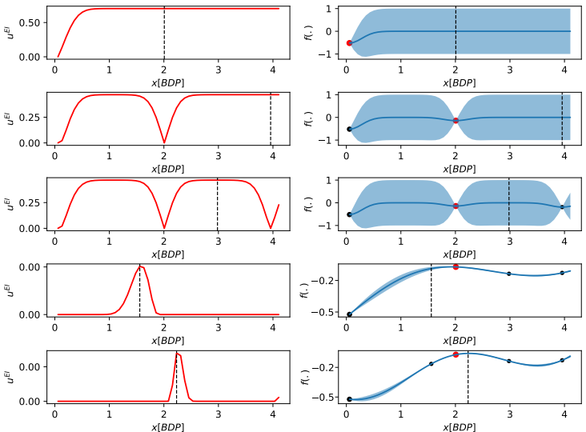

Searching Example
500 long flows
Cubic CCA
$C = 2.5Gbps$

Slide 46
Searching Example
500 long flows
Cubic CCA
$C = 2.5Gbps$

Slide 47
Searching Example
500 long flows
Cubic CCA
$C = 2.5Gbps$

Slide 48
Searching Example
500 long flows
Cubic CCA
$C = 2.5Gbps$

Slide 49
Searching Example
500 long flows
Cubic CCA
$C = 2.5Gbps$

Slide 50
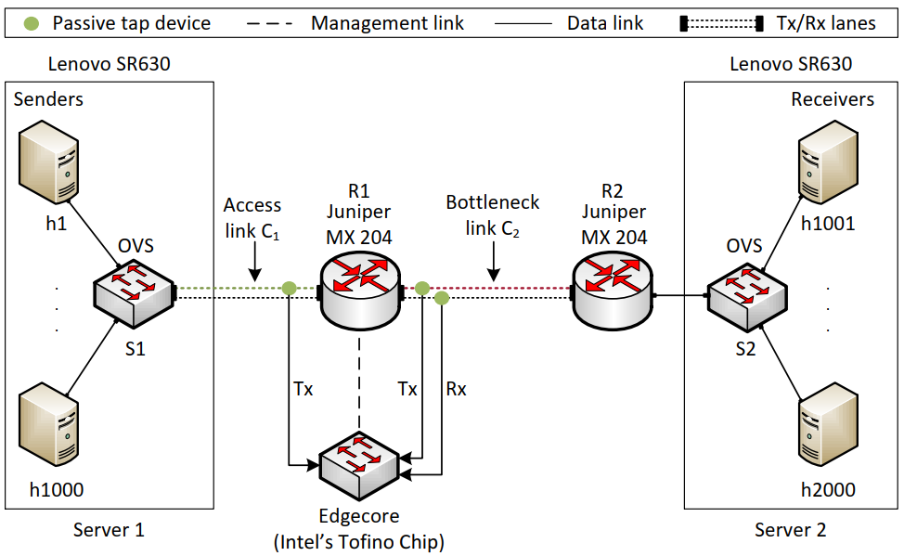
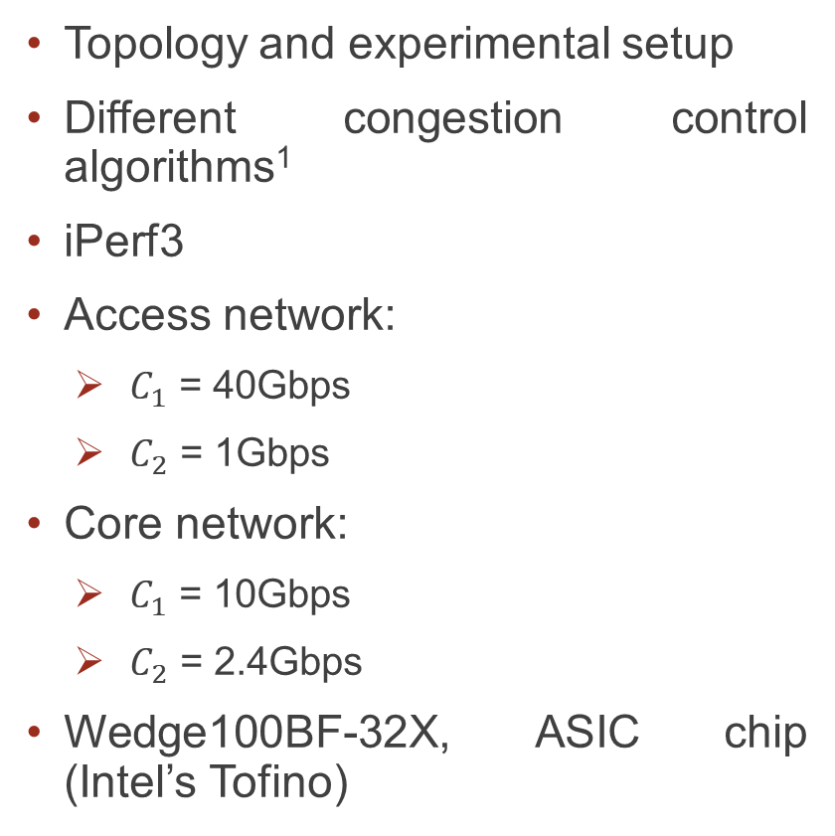
Implementation and Evaluation
Topology and experimental setup
Different congestion control algorithms¹
iPerf3
Access network:
  $C_{1}$ = 40Gbps
  $C_{2}$ = 1Gbps
Core network:
  $C_{1}$ = 10Gbps
  $C_{2}$ = 2.4Gbps
Wedge100BF-32X, ASIC chip (Intel’s Tofino)
¹Mishra et al. “The great Internet TCP congestion control census,” ACM on Measurement and Analysis of Computing Systems, 2019

Slide 51
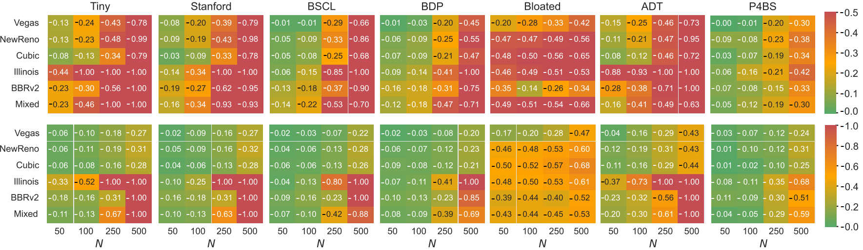

Results
Average $f(.)$ over the test duration (higher/green is better)
Top heatmaps: access network
Bottom heatmaps: core network
The Mixed scenario combines multiple congestion control algorithms

Slide 52
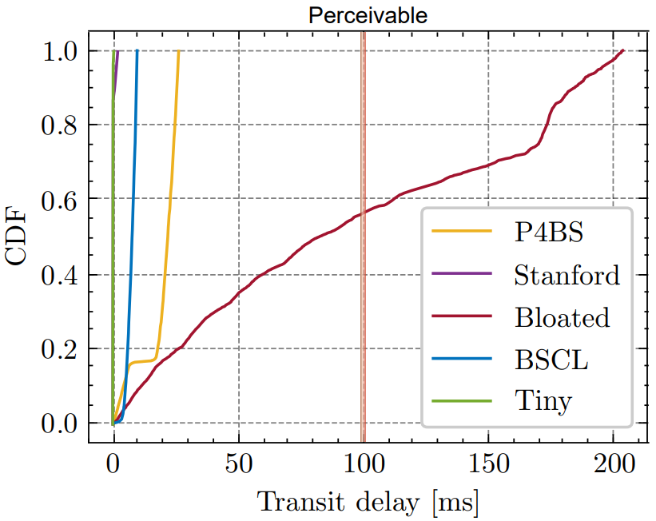
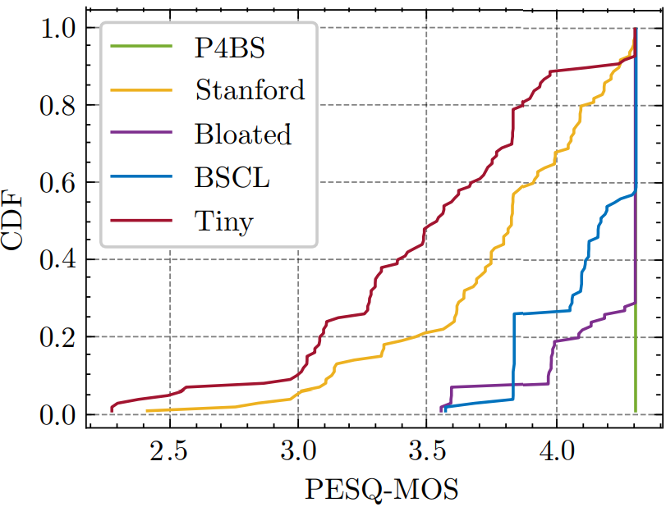
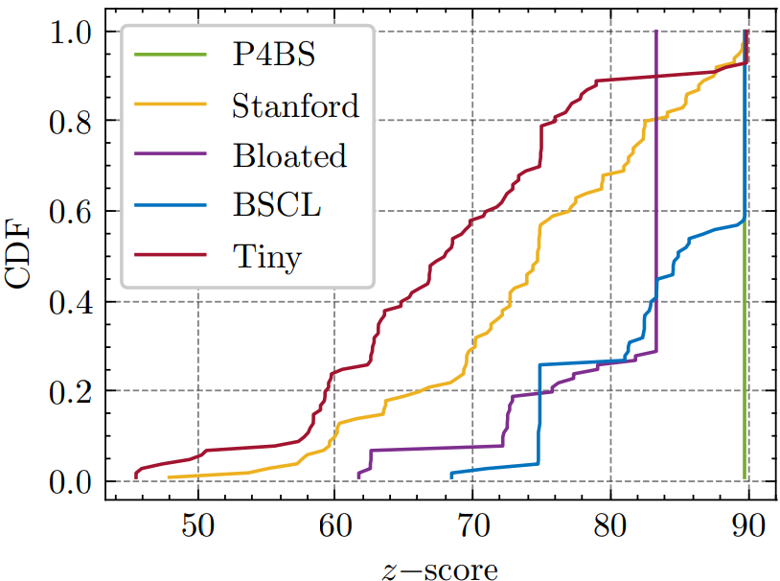
Results (VoIP)
100 VoIP calls playing 20 reference speech samples (G.711.a)
PESQ compares an error-free audio signal to a degraded one (higher is better)
The z-score considers both the delay and the PESQ (higher is better)

Slide 53
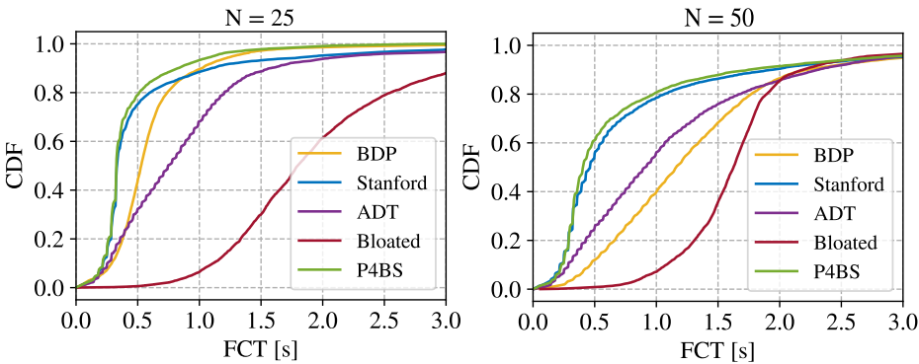
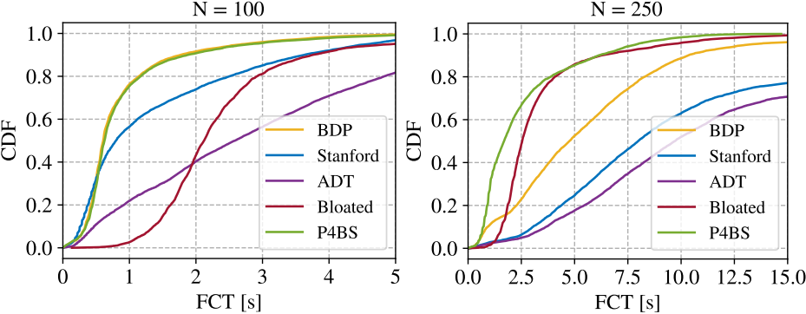
Results (Web Browsing)
Web browsing traffic
Background traffic is generated
  The sizes of the web pages are in the range [15KB, 2.5MB]

Slide 54
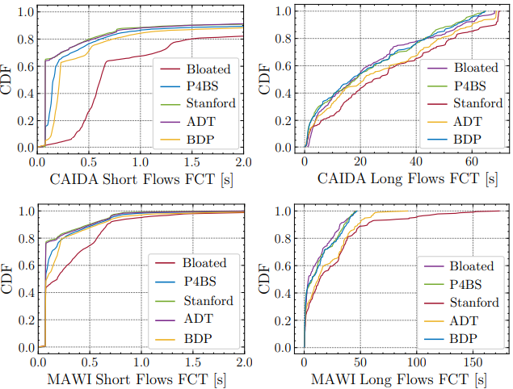
Results (Real Traces)
Real traces
Center for Applied Internet Data Analysis (CAIDA) traces from Equinix NYC
MAWI traces from Widely Integrated Distributed Environment (WIDE)
P4BS found a balance such that:
  The FCT of long flows is close to that of the bloated buffer
  The FCT of short flows is close to that of the Stanford buffer

Slide 55
Performance Problem #2:
Heterogeneous Traffic in Switches/Routers

Slide 56
TCP Traditional Congestion Control
The principles of window-based CC were described in the 1980s¹
Traditional CC algorithms follow the additive-increase multiplicative-decrease (AIMD) form of congestion control
1. V. Jacobson, M. Karels, Congestion avoidance and control, ACM SIGCOMM Computer Communication Review 18 (4) (1988).

Slide 57
BBR: Model-based CC
TCP Bottleneck Bandwidth and RTT (BBR) is a rate-based congestion-control algorithm¹
BBR represented a disruption to the traditional CC algorithms:
  is not governed by AIMD control law
  does not the use packet loss as a signal of congestion
At any time, a TCP connection has one slowest link bottleneck bandwidth (btlbw)
1. N. Cardwell et al. "BBR v2, A Model-based Congestion Control." IETF 104, March 2019.

Slide 58
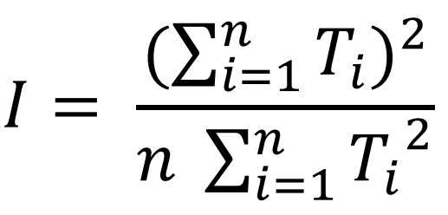
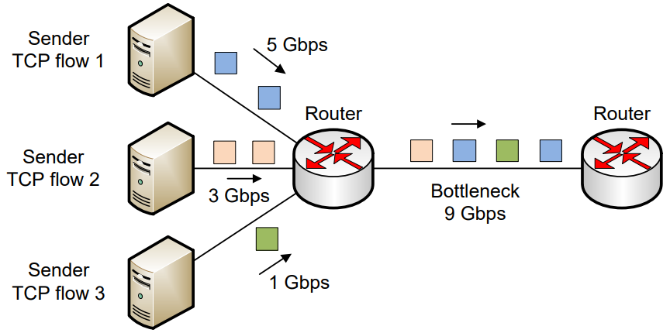
Fairness
Fairness: how fair is the capacity of the link being divided among the competing flows
Jain’s fairness index:

Slide 59
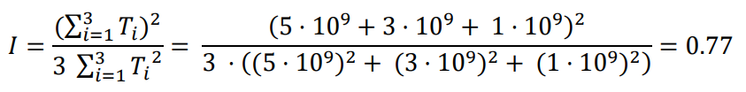
Fairness
Fairness: how fair is the capacity of the link being divided among the competing flows
Jain’s fairness index:

Slide 60
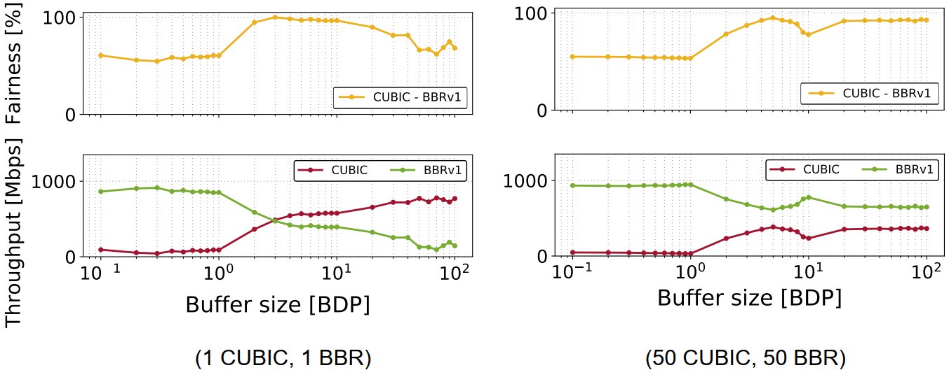
Fairness
The fairness between flows belonging to different CCAs is often low
E.g., the fairness among Cubic and BBR flows¹

Slide 61
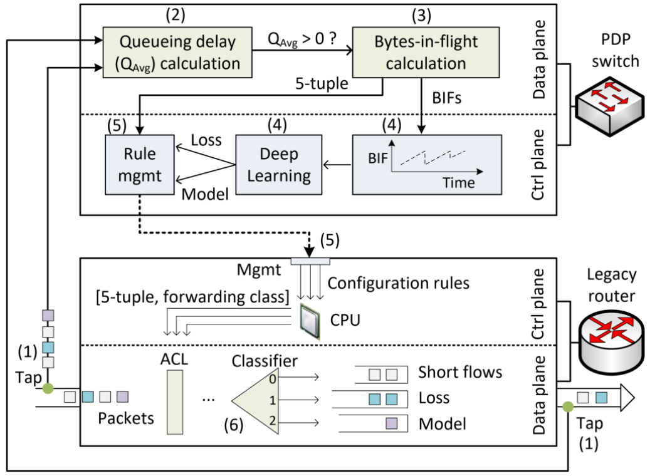
Proposed System
Passive PDPs for congestion control algorithm (CCA) identification at line rate

Slide 62
Proposed System
Passive PDPs for congestion control algorithm (CCA) identification at line rate

Slide 63
Proposed System
Passive PDPs for congestion control algorithm (CCA) identification at line rate

Slide 64
Proposed System
Passive PDPs for congestion control algorithm (CCA) identification at line rate

Slide 65
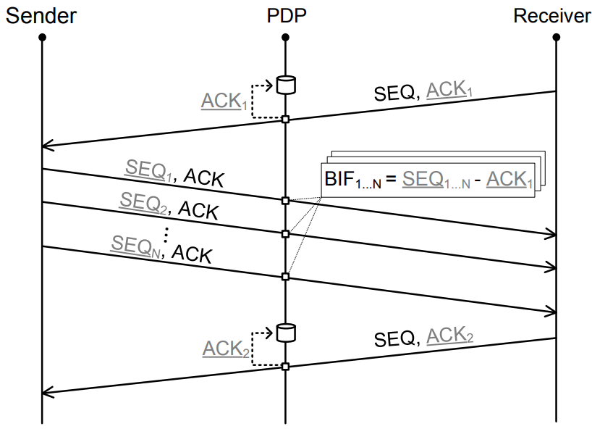
Bytes-in-flight Calculation
Bytes-in-flight (BIF) is the amount of data sent but not yet acknowledged
BIF is correlated to the TCP congestion window

Slide 66
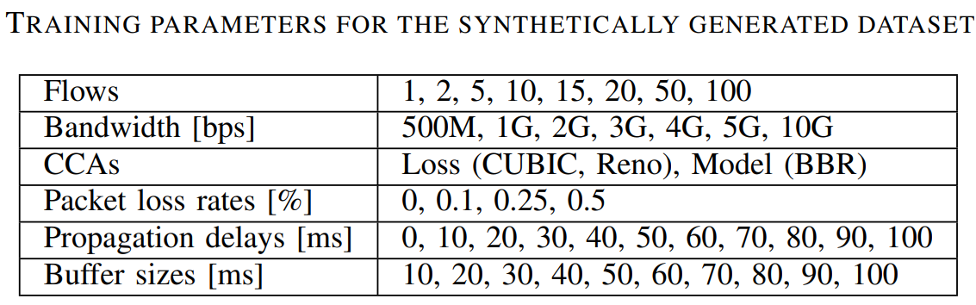
Model Training
The model is trained on CAIDA’s traffic for two minutes
The model is also trained with synthetically generated traffic

Slide 67
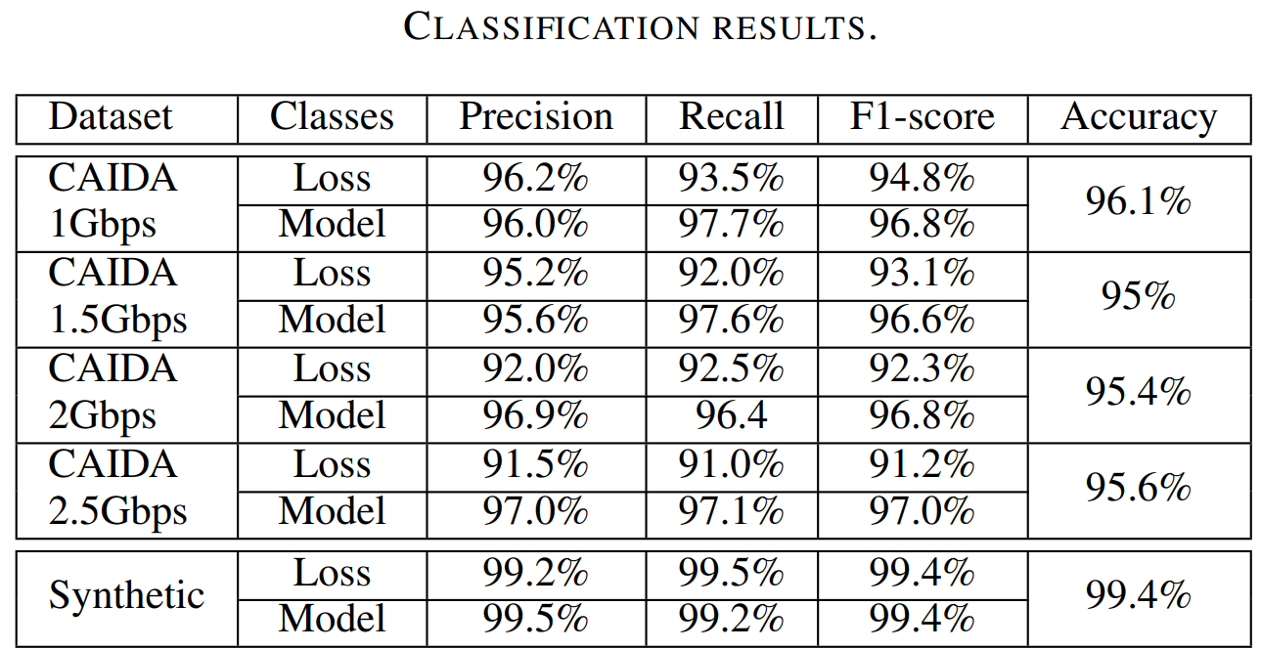
Model Testing
The model was tested against 10 minutes of traffic from the remaining CAIDA dataset
The bottleneck bandwidth was configured to 1Gbps, 1.5Gbps, 2Gbps, and 2.5Gbps
Results outperformed the state-of-the-art CCA identification systems

Slide 68
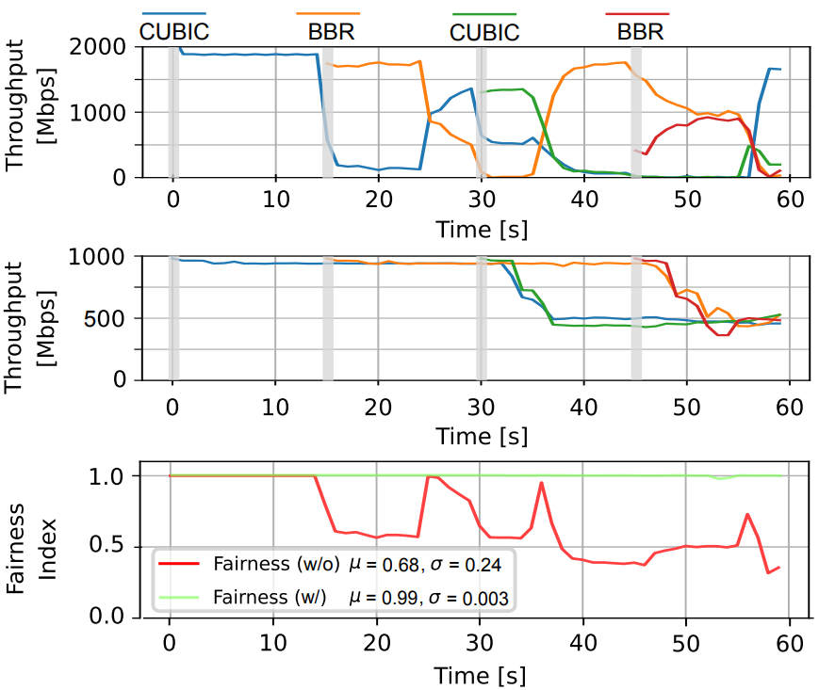
Fairness Evaluation
Alternating flows joining every 15 seconds
The system promptly identifies the CCA and assigns the flow
Fairness is ~ 100%

Slide 69
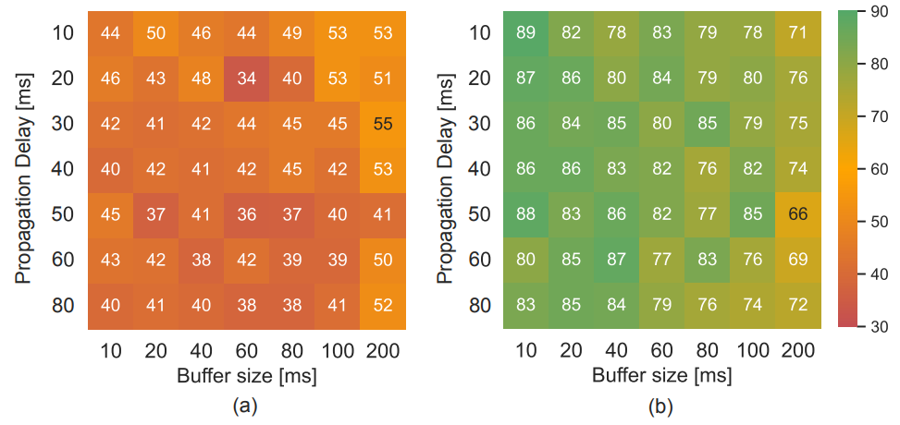
Fairness Evaluation
10 long flows started at the same time, with alternating CCAs
  Flow1 uses CUBIC, Flow2 uses BBR, Flow3 uses CUBIC, etc.
Various propagation delays and various router buffer sizes are used
Without separation
With separation

Slide 70

Flow Completion Time (Short Flows)
100 long flows (50% Cubic, 50% BBR) are generated over a bottleneck link of 3Gbps
The queue size for the “w/o separation” scenario is 200ms
10,000 short flows, whose inter-connection times are generated from an exponential distribution with a mean of one second, are initiated

Slide 71
Performance Problem #3:
CPU-based Middleboxes Processing Packets

Slide 72
Voice over IP Use Case
Signaling protocol (e.g., SIP) initiates, maintains, and terminates multimedia sessions between endpoints
  User agent client (UAC)
  User agent server (UAS)
Media protocol (e.g., RTP) transports real-time data, such as audio and video
Notes:
Despite the improvements brought by P4 switches, the majority of nowadays networks are still using legacy devices

Slide 73
Voice over IP Use Case
Communicating parties are often behind a Network Address Translation (NAT)
Since they do not have public IP addresses, they cannot communicate directly

Slide 74
Voice over IP Use Case
The most common solution is to use a relay server
The server allocates ports to be used to receive RTP traffic on behalf of both users

Slide 75
Voice over IP Use Case
The most common solution is to use a relay server
The server allocates ports to be used to receive RTP traffic on behalf of both users
Latency, jitter, packet loss

Slide 76
Proposed System
Emulate the behavior of the relay server using programmable switch
The switch parses packets and modifies headers to relay the traffic
P4 switch
Line rate
Low deterministic latency
Low jitter
Notes:
Despite the improvements brought by P4 switches, the majority of nowadays networks are still using legacy devices

Slide 77
Implementation and Evaluation
OpenSIPS, an open source implementation of a SIP server
RTPProxy, a high-performance relay server for RTP streams
SIPp: an open source SIP traffic generator that can establish multiple concurrent sessions and generate media (RTP) traffic
Iperf3: traffic generator used to generate background UDP traffic
Edgecore Wedge100BF-32X: programmable switch
Edgecore w/
Tofino Chip
Intel Xeon
4 cores, 2.20GHz
Intel Xeon
4 cores, 2.20GHz
Notes:
Despite the improvements brought by P4 switches, the majority of nowadays networks are still using legacy devices

Slide 78
Implementation and Evaluation
Two scenarios are considered:
  “Server-based relay”: relay server is used to relay media between end devices
  “Switch-based relay”: the switch is used to relay media
UAC (SIPp) generates 900 media sessions, 30 per second
The test lasts for 300 seconds
G.711 media encoding codec (160 bytes every 20ms)
Notes:
Despite the improvements brought by P4 switches, the majority of nowadays networks are still using legacy devices

Slide 79

Results
Delay contributions of the switch and the relay server
Notes:
Despite the improvements brought by P4 switches, the majority of nowadays networks are still using legacy devices

Slide 80

Results
Delay variation: the absolute value of the difference between the delay of two consecutive packets
  Analogous to jitter, as defined by RFC 4689
Notes:
Despite the improvements brought by P4 switches, the majority of nowadays networks are still using legacy devices

Slide 81

Results
Loss rate: number of packets that fail to reach the destination
  Calculation is based on the sequence number of the RTP header
Notes:
Despite the improvements brought by P4 switches, the majority of nowadays networks are still using legacy devices

Slide 82

Results
Mean Opinion Score (MOS): estimation of the quality of the media session
  A reference quality indicator standardized by ITU-T
  Maximum for G.711 is ~4.4
Notes:
Despite the improvements brought by P4 switches, the majority of nowadays networks are still using legacy devices

Slide 83

Results
CPU usage: the percentage of the CPU’s capacity used by the relay server
Notes:
Despite the improvements brought by P4 switches, the majority of nowadays networks are still using legacy devices

Slide 84

Resource Consumption
The prototype is implemented in two different scenarios:
  On top of the baseline switch program (switch.p4): implements various features including Layer 2/3 functionalities, ACL, QoS, etc.
  Standalone implementation
Additional hardware resources used when the solution is deployed on top of switch.p4 and as a standalone program

Slide 85
Resource Consumption
The prototype is implemented in two different scenarios:
  On top of the baseline switch program (switch.p4): implements various features including Layer 2/3 functionalities, ACL, QoS, etc.
  Standalone implementation
 | Programmable Switch | General-purpose CPU
Cost | $6,000 | $ 10,000 - 25,000
Capacity | Million connections per switch | ~500 connections per core
Latency | 400 nanoseconds | Tens to hundreds of milliseconds
Additional hardware resources used when the solution is deployed on top of switch.p4 and as a standalone program

Slide 86
Architecture for Incremental Deployment of PDPs

Slide 87
Proposed Architecture

Slide 88
Proposed Architecture
Notes:
Despite the improvements brought by P4 switches, the majority of nowadays networks are still using legacy devices

Slide 89
Proposed Architecture
Notes:
Despite the improvements brought by P4 switches, the majority of nowadays networks are still using legacy devices

Slide 90
Proposed Architecture
Notes:
Despite the improvements brought by P4 switches, the majority of nowadays networks are still using legacy devices

Slide 91

Detecting DNS Amplification with P4
CAIDA traffic replayed
> 10Gbps DNS amplification attack generated
Attack was mitigated in < 1s

Slide 92

Conclusion
Contributions:
  Improving the QoS by dynamically sizing the buffer
  Improving the QoS and fairness through traffic classification and separation
  Scaling and optimizing media’s QoS by offloading packet processing from CPUs to PDP
  Fostering PDP adoption by proposing a passive PDP deployment architecture
Future work:
  Deploying and testing the systems on FABRIC, a US-based nation-wide testbed
  Exploring network programmability on SmartNICs
Notes:
Despite the improvements brought by P4 switches, the majority of nowadays networks are still using legacy devices

Slide 93

Selected Publications
Book:
  J. Crichigno, E. Kfoury, E. Bou-Harb, N. Ghani, "High-Speed Networks: A Tutorial (Practical Networking)", Springer International Publishing, December 2021
Journals:
  E. Kfoury, J. Crichigno, and E. Bou-Harb. P4BS: Leveraging Passive Measurements from P4 Switches to Dynamically Modify a Router’s Buffer Size, submitted to IEEE Transactions on Network and Service Management, 2023.
  E. Kfoury, J. Crichigno, and E. Bou-Harb. P4Tune: Enabling Programmability in Non-Programmable Networks, IEEE Communications Magazine, 2023.
  E. Kfoury, J. Crichigno, and E. Bou-Harb. An Exhaustive Survey on P4 Programmable Data Plane Switches: Taxonomy, Applications, Challenges, and Future Trends. IEEE Access, 2021.
  E. Kfoury, J. Gomez, J. Crichigno, and E. Bou-Harb. An Emulation-based Evaluation of TCP BBRv2 Alpha for Wired Broadband. Elsevier Computer Communications, 2020.
  E. Kfoury, J. Gomez, J. Crichigno, E. Bou-Harb, and D. Khoury. Decentralized Distribution of PCP Mappings Over Blockchain for End-to-End Secure Direct Communications. IEEE Access, 2019
  E. Kfoury, J. Crichigno, E. Bou-Harb, "P4CCI: P4-based Online TCP Congestion Control Algorithm Identification for Traffic Separation", IEEE International Conference on Communications (ICC), Rome, Italy, June 2023.
Conferences
  E. Kfoury, J. Crichigno, E. Bou-Harb, G. Srivastava, "Dynamic Router’s Buffer Sizing using Passive Measurements and P4 Programmable Switches", IEEE Global Communications Conference (GLOBECOM), Madrid, Spain, December 2021.
  E. Kfoury, J. Crichigno, E. Bou-Harb, V. Gurevich, “Offloading Media Traffic to Programmable Data Plane Switches,” IEEE International Conference on Communications (ICC), Dublin, Ireland, June 2020.
  E. Kfoury, J. Crichigno, E. Bou-Harb, D. Khoury, G. Srivastava, "Enabling TCP Pacing using Programmable Data Plane Switches", 42nd International Conference on Telecommunications and Signal Processing (TSP), Budapest, Hungary, July 2019
  E. Kfoury, D. Khoury, A. AlSabeh, J.Gomez, J. Crichigno, E. Bou-Harb, "A Blockchain-based Method for Decentralizing the ACME Protocol to Enhance Trust in PKI", 43rd International Conference on Telecommunications and Signal Processing (TSP), Milan, Italy, July 2020

Slide 94

Acknowledgement
Thanks to the National Science Foundation (NSF)
This work was supported by NSF, Office of Advanced Cyberinfrastructure (OAC), awards 1925484, 1829698, 1907821, and 2118311

Slide 95
Thank you!
Questions?

Slide 96

Results
Long flows with different emulated propagation delays
100 long flows, divided into four groups of each 25 flows each
Each group starts three minutes after the other
CUBIC congestion control algorithm
wo/ buffer modification
w/ buffer modification

Slide 97
Time Series Preparation and Deep Learning
BIF values are pushed to the control plane of the PDP switch during congestion
A time series is constructed
Two pre-processing steps:
  Outliers Rejection: z-score method, which uses the MAD (Median Absolute Deviation), is used
  Normalization: The time series is preprocessed using z-normalization
Fully Convolutional Neural Networks (FCNs) used to classify the univariate time series

Slide 98

Flow Completion Time (Long Flows)
10 long flows started at the same time, with alternating CCAs
  Flow1 uses CUBIC, Flow2 uses BBR, Flow3 uses CUBIC, etc.
Each flow transfers a 500MB file
In a fair network with a bottleneck of 2Gbps and 10 active flows:
  Each flow is transferring at 200Mbps
  FCT = 500MB / 200Mbps = 20s

Slide 99
Middlebox Devices
RFC 3234¹ defines middlebox as a device that performs functions other than the standard functions of an IP router
Legacy middleboxes are designed and implemented by manufacturers
Examples:
  Network address translators (NAT)
  Firewalls
  Intrusion Detection Systems (IDS)
  Proxy servers (e.g., VoIP relay server)
Legacy middleboxes are limited to the functions provided by the manufacturers
  Expensive
  Difficult to upgrade
  Function-specific
¹Carpenter, Brian, and Scott Brim. Middleboxes: Taxonomy and issues. RFC 3234, February 2002.

Slide 100
Performance Issues of Middleboxes
The trend lately has been moving towards implementing middleboxes in servers
Network Function Virtualization (NFVs)
While this shift accelerated innovation, it induced performance issues (e.g., delay, jitter)
  Operating systems’ scheduling delays
  Interrupt processing latency
  Other low-level OS functions

Slide 101

PDP Challenges
Notes:
Despite the improvements brought by P4 switches, the majority of nowadays networks are still using legacy devices

Slide 102
P4 Switches Deployment Challenges
Data plane programmability knowledge by operators
  Operators only configure legacy devices (e.g., modify routing configuration, updating ACL)
  Programming P4 targets is complex¹
Cost of replacing the existing infrastructure
  Significant costs, time, and efforts spent in building the network and the existing equipment
  Replacing these devices with P4 switches would incur significant costs
Vendor support
  The support in legacy devices is readily available
  P4 switches are whiteboxes, with little to no support from vendors
Network disruption
  P4 programs might be potential sources of packet-processing error
  Bugs can lead to network disruption, affecting the availability of the services
¹ The switch.p4 program, which contains the standard switch capabilities, has more than 10³⁰ control paths
Notes:
Despite the improvements brought by P4 switches, the majority of nowadays networks are still using legacy devices

