Slide 1
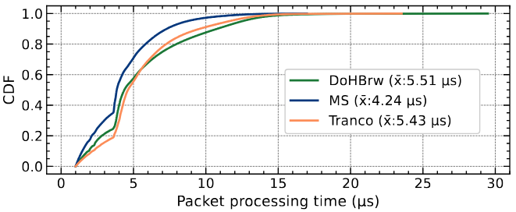
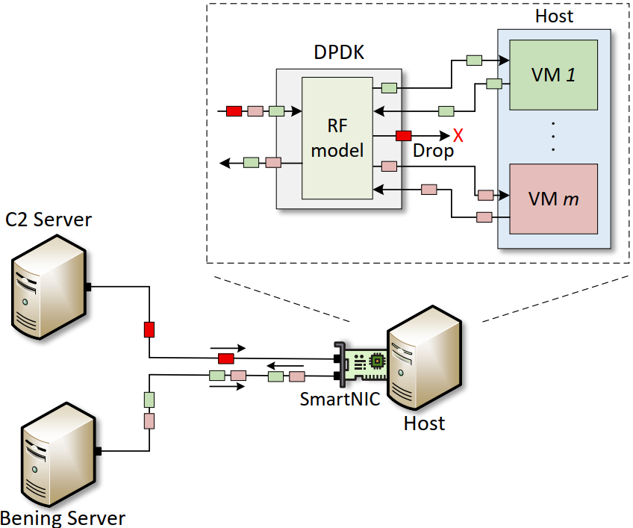
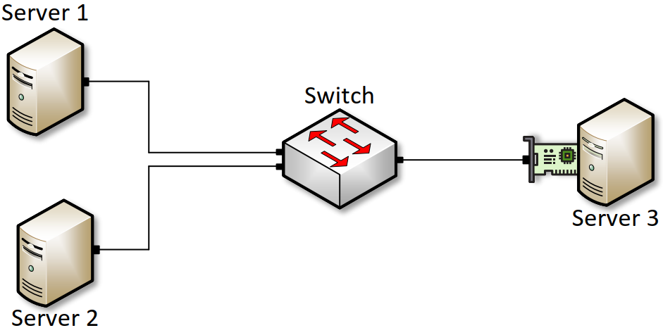
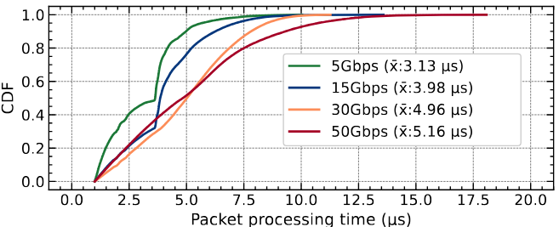
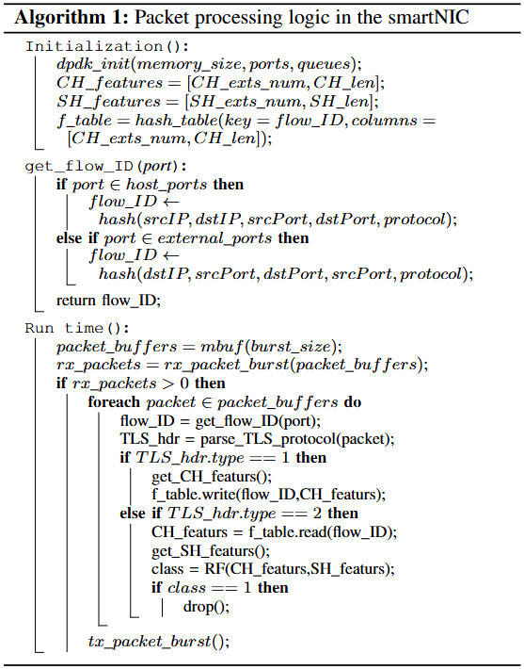
Offloading Encrypted C2 Traffic Mitigation to
DPDK
Ali Mazloum, Samia Choueiri, Sergio Elizalde, Elie Kfoury, Jorge Crichigno
University of South Carolina, Columbia, South Carolina
Abstract
PROPOSED SYSTEM
Experimental Topology
Processing latency
Command and control (C2) traffic increasingly adopts the Transport Layer Security (TLS) protocol
Traditional detection methods relying on deep packet inspection (DPI) are becoming ineffective
Machine learning (ML) classifiers offer a promising alternative by identifying encrypted C2 traffic without inspecting payload
Data plane development kit (DPDK) is a software acceleration technique that enhances the packet processing efficiency
This project leverages DPDK to implement random forest (RF) classifier for encrypted C2 detection
The system achieves 99.9% accuracy on publicly available datasets while sustaining 50Gbps throughput with minimal processing overhead
The DPDK application filters encrypted C2 traffic destined for the host
It deploys an RF model that operates on features from the Client Hello and Server Hello packets
The topology consists of three servers connected by a switch
The first server replies the TLS traces, the second server generate background traffic using Pktgen, and the last server runs the DPDK application
DPDK is running as a single thread with one RX queue and one TX queue
CDF of packet processing latency with different datasets
MS dataset achieved the shortest average processing time of 4.24 microseconds (μs)
DoHBrw has an average packet processing time of 5.51 μs
Tranco has an average packet processing time of 5.43 μs
CDF of packet processing latency with different datasets
Background
Datasets
Transport Layer Security (TLS)
TLS protocol is a cryptographic standard that secures network communication by encrypting data exchanged between clients and servers
TLS operates in two primary phases: the handshake phase and the data transfer phase
During the handshake phase, the client and server negotiate security parameters
These parameters are communicated through TLS extensions in the Client Hello and Server Hello packets
Once the encryption parameters are agreed upon, a secure channel is established
In the data transfer phase, all communication occurs through this encrypted channel
Data Plane Development Kit (DPDK)
DPDK is a framework that enables high-performance packet processing by providing a suite of libraries and drivers that bypass the traditional kernel networking stack
By operating in userspace, DPDK allows applications to directly access NIC hardware, significantly improving packet processing efficiency
This direct access facilitates advanced functionalities such as fast packet parsing, filtering, and forwarding, making DPDK a powerful tool for implementing specialized networking and security applications
DPDK improves packet processing efficiency by leveraging kernel bypass and zero-copy techniques
All datasets used to evaluate the performance of the pro-posed system are publicly available. The used datasets are:
DoHBrw: This dataset is used as a source for both benign and C2 traces. The malicious C2 traces were generated with DNS tunneling tools
MS: This dataset is used as a source for C2 traces. It was generated using Metasploit and the Python implementation of Meterpreter
Tranco: This dataset is used as a source for benign traces. It was collected by browsing websites listed in the Tranco ranking generated on January 28, 2024
Implementation
Pktgen is used to generate background traffic of rates 5Gbps, 15Gbps, 30Gbps, and 50Gbps
The packet processing time increases with the increase in background traffic rate
The average packet processing times for 5Gbps, 15Gbps, 30Gbps,and 50Gbps, are 3.13 μs, 3.98 μs, 4.96 μs, and 5.16 μs, respectively
Classifier Performance
Conclusion and Lessons Learned
This paper introduced an approach that implements an RF classifier using DPDK, leveraging only four TLS hand-shake features to detect encrypted C2 traffic in real-time
The system is evaluated on publicly available datasets and achieved an accuracy higher than 99.9%
Experiments showed that the DPDK application is capable of processing at least 50Gbps and with an average packet processing latency of 5.16 μs
Discussion: The selected set of features complies with JA3. JA3 is a method for fingerprinting TLS connections based on the characteristics of their handshake. It is important to note that the fingerprint of a malicious tool is related to the behavior of the tool. Changing the behavior of a malicious tool to alter its fingerprint requires redesigning the tool.
Acknowledgement
This work was supported by the National Science Foundation (NSF), Award 2346726 and 2403360.

