Slide 1


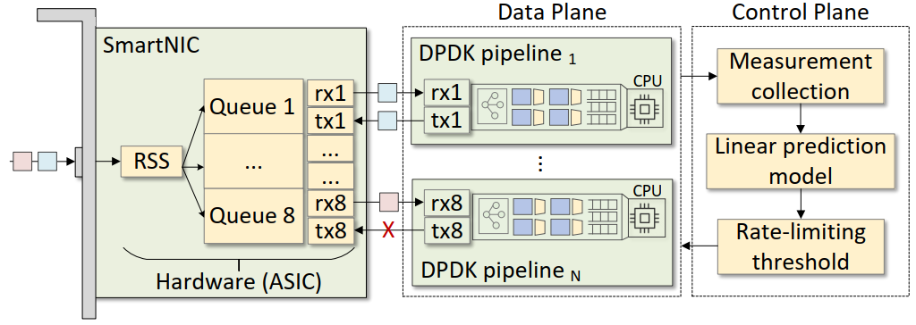
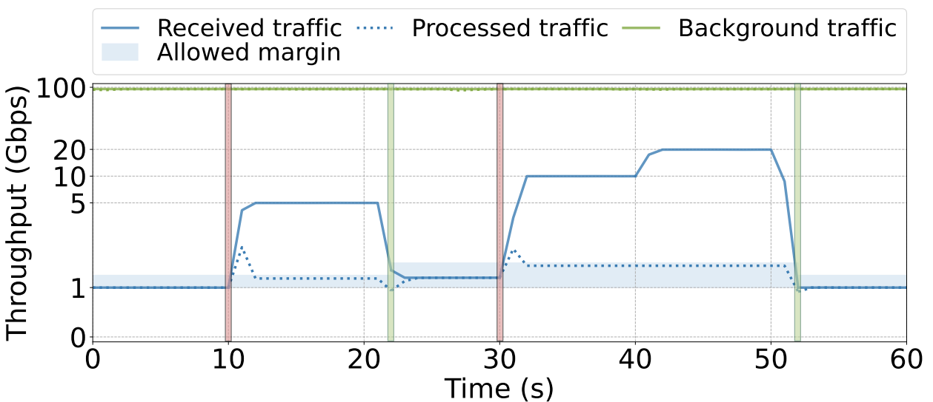
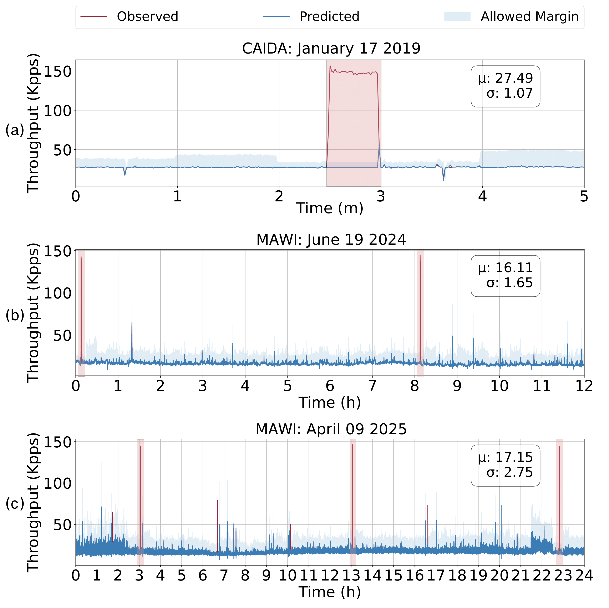
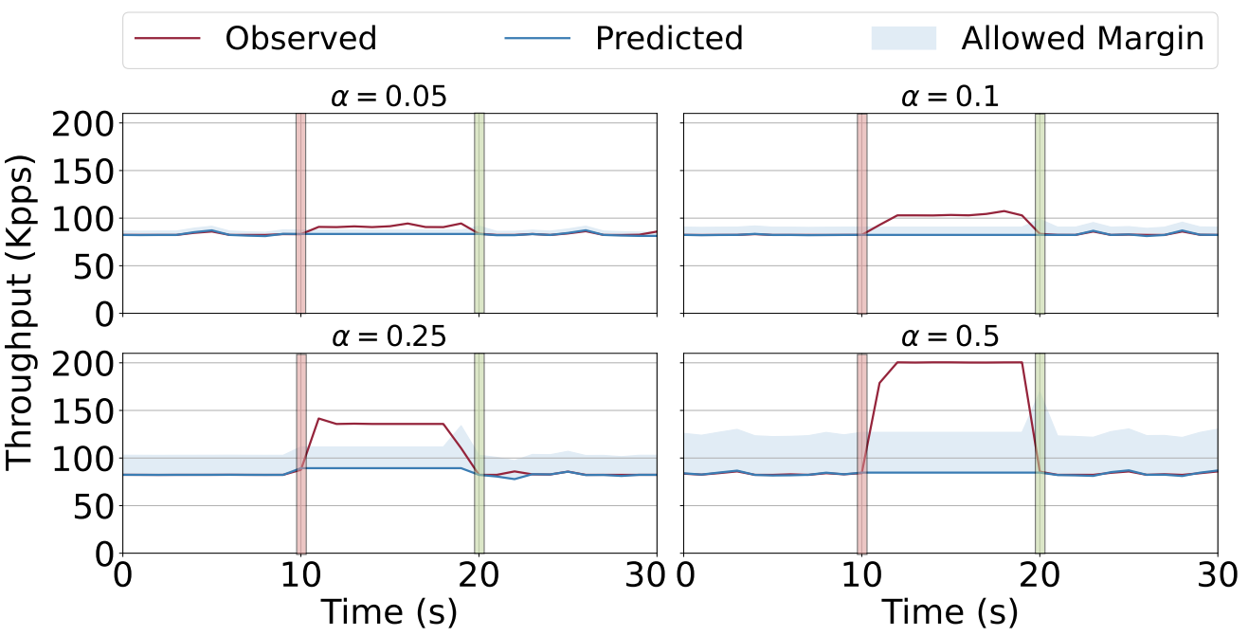
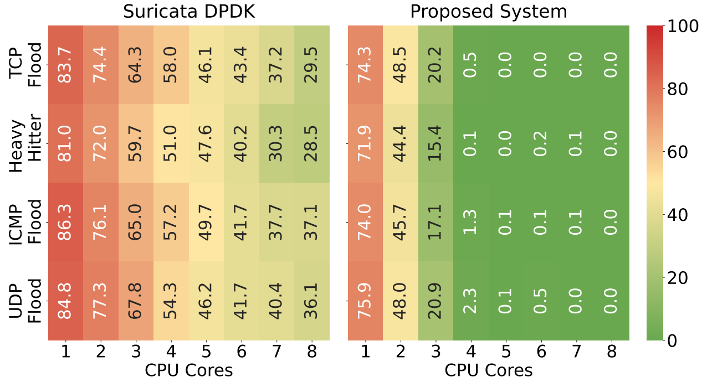
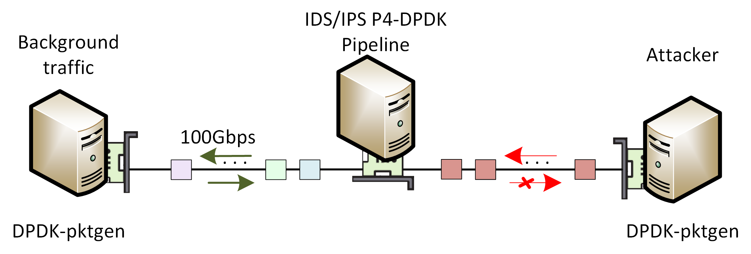
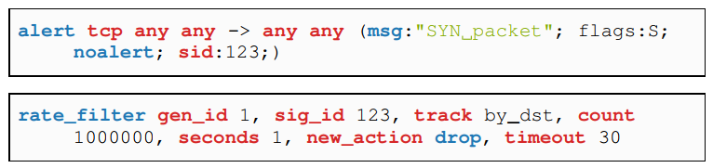


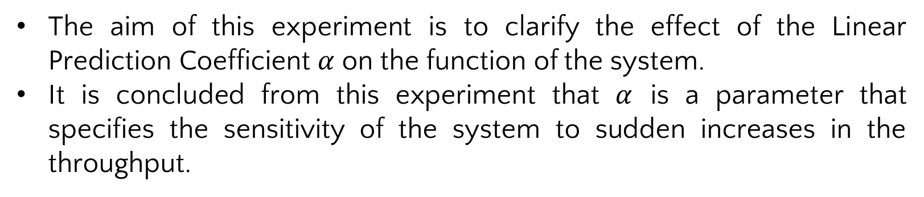
Detection and Mitigation of Volumetric DDoS
Attacks using Adaptive Rate-Limiting in P4-DPDK
Samia Choueiri, Ali Mazloum, Sergio Elizalde, Elie Kfoury, Jorge Crichigno
University of South Carolina, Columbia, South Carolina
Abstract
System Architecture
Rate-limiting Based on Linear Prediction
Adaptability of the System with Real-traffic
Distributed Denial of Service (DDoS) attacks continue to pose serious risks to modern network infrastructures.
Traditional hardware solutions offer high performance but lack flexibility for cloud and virtualized deployments.
Software-based solutions provide flexibility but often suffer from performance bottlenecks in kernel-level packet processing.
The proposed system implements an adaptive DDoS detection and mitigation framework built on P4-DPDK, operating entirely in user space for high-speed, line-rate packet processing.
The system integrates a Linear Prediction Model (LPM) in the control plane to detect the attack and a P4-based pipeline for efficient mitigation directly within the data plane.
Model hyperparameters are tuned with an optimization algorithm to maximize detection accuracy and responsiveness.
The system is evaluated in a testbed environment with real traffic.
The results show that the proposed system effectively detects and mitigates DDoS attacks while maintaining high throughput and low latency, even at a high traffic rate approaching 100Gbps.
The SmartNIC uses Receive Side Scaling (RSS) to distribute the load across the pipelines in the CPU cores.
The P4 language with the Portable NIC Architecture (PNA) is used to implement the algorithm and the DPDK pipeline is compiled and loaded on the CPU cores of the host.
For the detection, measurements are collected and used by the LPM to set a rate-limiting threshold for the mitigation.
The system starts by detecting the normal behavior of the system based on the benign traffic received in the first 10 seconds.
In the tenth second, a flood is detected. While the received traffic is above the allowed range, the system only processes a number of packets that matches the allowed range.
The attack is claimed to be finished when the flood traffic drops below the allowed range as demonstrated in the twentieth second.
The system promptly mitigated the detected attack while 100Gbps of background traffic was processed using four CPU cores.
This experiment evaluates the system with open-source real traffic captured from different datasets.
A SYN flood attack dataset to check if the system will correctly detect the floods.
The traces are processed by calculating the observed number of SYN packets per second and the observations are considered by the LPM.
The optimization model is invoked periodically to calculate and update the optimal value of $k$ and $α$ based on the observed traffic and uses the updated values for the newly received traffic.
All flood attacks were correctly identified as attacks (highlighted in red).
The accuracy of the proposed system remains above 99.99%.
P4-DPDK DDoS attack detection system architecture.
Related Work
Methodology
Detection and mitigation of a flood attack using the LPM.
DDoS defenses over P4 programmable data planes:
• Existing approaches typically use probabilistic data structures to track flows' statistics at scale, such as MV-Sketch [1], POSEIDON [2], and Jaqen [3]. These approaches require infrastructure upgrades, introducing additional cost and complexity.
DDoS defenses over DPDK:
  • Using DPDK, significant performance gains have been shown in DDoS applications [4,5]. They are typically implemented in general-purpose programming languages, which limits the expressiveness and flexibility offered by P4.
  [1] Tang et. al., “A fast and compact invertible sketch for network-wide heavy flow detection,” 2020.
  [2] Zhang et. al., “Poseidon: mitigating volumetric DDoS attacks with programmable switches,” 2020
  [3] Liu et. al., “Jaqen: A {High-Performance}{Switch-Native} approach for detecting and mitigating volumetric {DDoS} attacks with programmable switches,” 2021
  [4] Basat et. al., “Volumetric hierarchical heavy hitters,” 2018
  [5] Scherrer et. al., “LOFT: an efficient and scalable algorithm for detecting overuse flows,” 2021
The aim of this experiment is to clarify the effect of the Linear Prediction Coefficient $α$ on the function of the system.
It is concluded from this experiment that $α$ is a parameter that specifies the sensitivity of the system to sudden increases in the throughput.
The aim is to predict the upcoming element of $\hat{x}$ by calculating the average of the differences of the observations and adding it to the last observation $x_{k}$ :
$\hat{x}=\frac{1}{k−1}\sum_{i=1}^{k−1}{\left(x_{i+1}−x_{i}\right)+x_{k}}$
The system checks for a DDoS attack by calculating the error ratio of the predicted value of $\hat{x}$to the next observed value $x$ as follows: $e=\frac{\hat{x}}{x}$
If $e<(1−α)$, a flood is detected.
To mitigate the attack, a number of packets $x_{allowed}$ is set for rate limiting:
$$x_{allowed}=\hat{x}∗(1−α)$$
The LPM has two hyperparameters which are tuned and optimized:
• $α$ : Linear prediction coefficient
• $k$: Number of past samples used for prediction
$$\min_{α,k}({\frac{1}{T}\sum_{t=1}^{T}{\left|x_{t}−{\hat{x}}_{t}\right|}−\frac{1}{α}+βk)}$$
Subject to $0<α<1, k≥3, ∀e>1−α$
Behavior of the proposed system with different values of $α$.
Evaluation with real traffic from different datasets and DDoS attack data.
Experiment Topology
Conclusion and Lessons Learned
Packet-loss in P4-DPDK vs. Suricata-DPDK
The Intrusion Detection System (IDS) / Intrusion Prevention System (IPS) also reflects the processed packets.
The attacker simulates DDoS attacks.
All servers are on the same FABRIC site.
DPDK-pktgen is used to generate traffic.
Detecting flood attacks is effective, even in the presence of background traffic with high rates (up to 100Gbps).
The proposed system adapts to varying traffic patterns using real datasets.
P4-DPDK outperforms Suricata-DPDK in terms of packet loss during attack scenarios.
The experiment involves implementing seven DDoS attack mitigations through specified Suricata rules.
To evaluate the performance of our system, we measured the packet loss in the processed background traffic while the network was under various DDoS attacks, and the P4-DPDK pipeline was detecting and mitigating the attacks.
Packet loss decreases with more CPU cores and four cores are sufficient to eliminate the performance penalty.
Acknowledgement
Experiment topology.
This work was supported by the National Science Foundation (NSF), Award 2346726, and 2403360.
Packet loss in Suricata-DPDK (a) and the proposed system (b) while
mitigating DDoS attacks.
Suricata rule and configuration to mitigate a SYN flood attack.

