Slide 1
Implementing a Packet Filter using a P4 Programmable Switch
Gabriella Pinto and Cameron McDuffie
Advisors: Ali Mazloum and Jose Gomez
Department of Integrated Information Technology
University of South Carolina
April 22nd, 2022

Slide 2
Agenda
Purpose
Introduction
Project Description
Background
Implementation
Conclusion
Notes:
For the agenda of our presentation, we will cover the purpose of this project, introduce the topic, describe our goal, provide background information and explain our solution. Finally, we will conclude with a demonstration.

Slide 3
Purpose
Understand Software Defined Networking
Understand the P4 language
Understand the BMv2 architecture
Implement a packet filter
Notes:
The goal of this project was to implement a packet filter on a programmable switch, using the P4 language. The packet filter enables the administrator of the network to block packets based on physical ingress and/or egress interfaces, IP source or destination address, protocol type in IP datagram field, and TCP or UDP source and destination port.

Slide 4
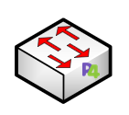
Introduction
P4
Mininet
Topology Creation
Filtering Decisions
Executing commands at runtime
Notes:
There were a lot of prerequisites to complete before tackling the subject of our project. To begin with, an intermediate concept of networking had to be established. We had to understand the structure of ethernet frames and IP packets in detail, as we used fields from these to code the filtering decisions. The biggest learning curve of this project was learning the language known as P4. This is a language that allows the writer to tell network devices what to do. In short, instead of a manufacturer hard coding a processor in a mass-produced switch, we are coding a programmable switch of our own. We then had to create a topology to test our filtering decisions with. Finally, we had to establish the specific commands to execute at runtime in order to test our code. These concepts will be explained in more detail later.

Slide 5
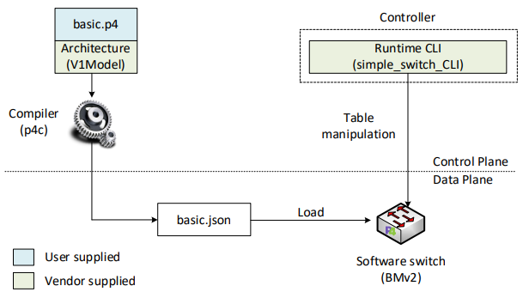
Background
Traditional Switches
Hard coded chips that have a predetermined instruction set
Manufacturer decides what the device will do
Software Switches (BMV2)
Software code and architecture
Full control over the entire device
Notes:
In networking, traditional switches have predetermined instruction sets from the factory. This is an efficient way to mass produce networking devices but doesn’t give the user full control over everything. BMV2 switches are open source, allowing the user to have full control over every aspect of the switch- everything from arrival to departure.

Slide 6
Project Description
Program, compile, and run a P4 program on a programmable switch
Block or forward packets based on certain criteria
Creating a passive (stateless) firewall, ACL
Notes:
To complete this project, we studied a series of labs that helped us gain a better understanding of P4 programming. Through these simulations, we learned how to program, compile, and run a P4 program on a software switch and also how to block or forward packets based on certain criteria . In this project, we were focused on blocking TCP, UDP, and ICMP by filtering by protocol.

Slide 7
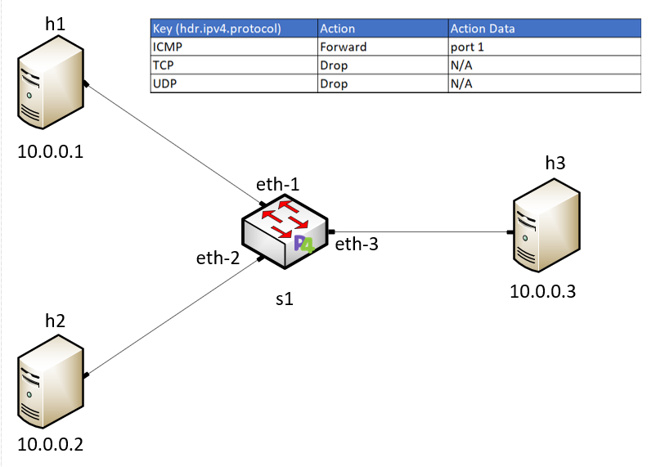
Implementation
Topology
Headers
Parsing
Tables
Runtime
Notes:
The first step in our project was to program the switch using P4.
To do so, we defined the packet headers’ and directed how the switch should process those headers. By doing this, we are defining the pipeline sequence according to the V1Model architecture.
We then defined the drop and forward actions that would execute depending on the criteria of the packet.
The drop action causes the packet to be dropped at the end of the ingress processing. The forward action accepts the port and the destination MAC address as input. This parameter is inserted by the control plane and updated in the packet during the ingress processing. After that, we coded the parser which de-encapsulates the headers, converting the original packet into a parsed representation of the packet. Then we verified the checksum. Afterwards, we specified the ingress block and the egress block, and we recomputed the checksum. Finally, we specified the deparser. Next, we compiled the program and pushed it to the switch.
The next step was to configure the switch by starting the switch daemon and mapping the logical interfaces to Linux interfaces. We then loaded the rules to the switch and initiated the nano log client to display the switch logs. While in the CLI, we used various runtime commands for different filtering decisions. Then we made the terminals listen for incoming packets and sent packets from other hosts. Finally, to verify that we were blocking the specified packets, we used Wireshark.

Slide 8
Results
Filter successfully drops or forwards based on the rules populated from the control plane
Solution is fully customizable
Why does this matter?
Future research and projects
Notes:
Our solution has been proven to work. We can filter packets based on the rules populated from the control plane. Not only does our solution work, but it is written to allow expansion for other datagram protocols and can utilize runtime commands to change filtering decisions at the click of a button. Now why does this project matter? We learned exactly how a switch handles packets, from the header to the payload. Learning how to implement simple filtering decisions is the foundation for creating real world solutions. Concepts such as TCP congestion control or devices such as NGFWs can be achieved with software defined networking. These goals are possible topics for future research and would greatly benefit the networking industry, effectively creating benefits for businesses that implement this technology.

