Slide 1




SoX Virtual Training Workshop
Hands-on Session 1: Essentials of BGP, EBGP, IBGP
Ali AlSabeh, Jorge Crichigno
University of South Carolina
http://ce.sc.edu/cyberinfra
Southern Crossroads (SoX)
The Engagement and Performance Operations Center (EPOC)
University of South Carolina (USC)
Online
March 29th, 2023

Slide 2
SoX Virtual Training Workshop
Webpage with PowerPoint presentations:
http://ce.sc.edu/cyberinfra/sox_workshop_2023.html
Hands-on sessions: to access labs for the hands-on sessions, use the following link:
https://netlab.cec.sc.edu/
Username: email used for registration
Password: nsf2023

Slide 3
Border Gateway Protocol Lab Series
Lab experiments
  Lab 1: Introduction to Mininet
  Lab 2: Introduction to Free Range Routing (FRR)
  Lab 3: Introduction to BGP
  Lab 4: Configure and verify EBGP
  Lab 5: BGP Authentication
  Lab 6: Configure BGP with Default Route
  Lab 7: Using AS_PATH BGP Attribute
  Lab 8: Configuring IBGP and EBGP Sessions, Local Preference, and MED
  Lab 8.1: Configuring OSPF, IBGP and EBGP Sessions, Local Preference, and MED
  Lab 8.2: Configuring IBGP and EBGP Sessions, Local Preference, and MED
  Lab 9: IBGP, Next Hop and Full Mesh Topology
  Lab 10: BGP Route Reflection
  Lab 11: Configuring BGP Local Preference and AS_PATH Prepending
  Lab 11.1: Configuring BGP Local Preference and AS_PATH Prepending

Slide 4
Organization of the Lab Manuals
Each lab starts with a section Overview
  Objectives
  Lab topology
  Lab settings: passwords, device names
  Roadmap: organization of the lab
Section 1
  Background information of the topic being covered (e.g., fundamentals of BGP)
  Section 1 is optional (i.e., the reader can skip this section and move to lab directions)
Section 2… n
  Step-by-step directions

Slide 5
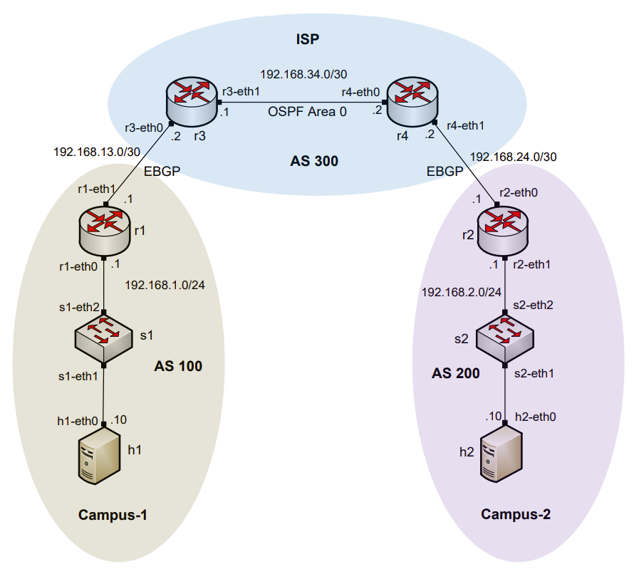
AS, IGP, EGP
Routers are organized into Autonomous Systems (ASes or ASs)
What is an AS (RFC 1771)?
What is an Interior Gateway Protocol (IGP)?
What is an Exterior Gateway Protocol (EGP)?
“A set of routers under the single technical administration, using an IGP and common metrics to route packets within the AS, and using an EGP to route packets to other ASs.”
A routing protocol used to exchange routing information within an AS (e.g., RIP, OSPF)
A routing protocol used to exchange routing information between AS

Slide 6
BGP Route Advertisements within an AS
BGP advertisements from an AS to another is referred to as External BGP (EBGP)
BGP advertisements within an AS is referred to as internal BGP (IBGP)

Slide 7
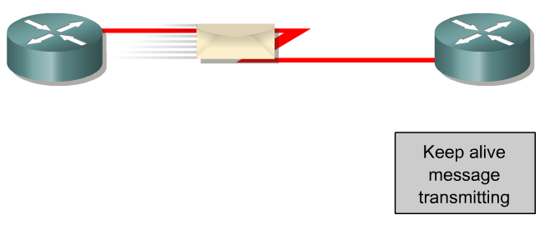
BGP – Best Path
The main goal is to provide interdomain routing
BGP selects one path as the best path
It places the selected path in its routing table and propagates the path to its neighbors
Is this the best path? Does it meet the path selection criteria? If so, add to routing table.
BGP Update
BGP Table
Routing Table
Network
Network
Rick Graziani, “Implementing Cisco IP Routing,” Cisco Press, 2015

Slide 8
Lab 1: Introduction to Mininet

Slide 9
What is Mininet?
A virtual testbed capable of recreating realistic scenarios
It enables the development, testing of network protocols
Inexpensive solution, real protocol stack, reasonably accurate

Slide 10
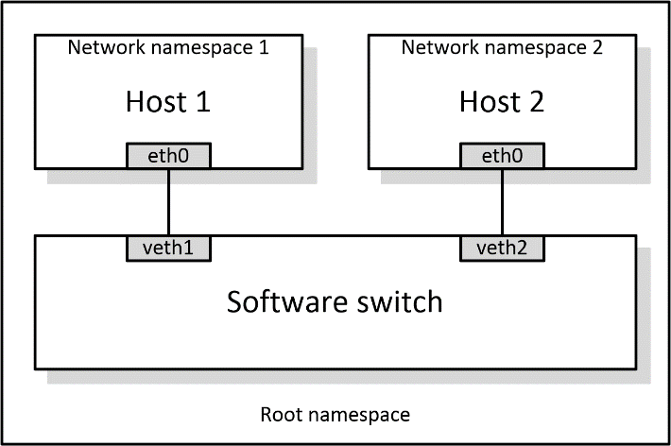
What is Mininet?
Mininet nodes are network namespaces
  Each node has different / separate virtual interfaces, routing tables
Nodes use the underlying protocol stack of the host device
Nodes are connected via virtual Ethernet (veth) links, which behave as Ethernet links

Slide 11
Lab 2: Introduction to FRR

Slide 12
What is FRR?
FRR is an open source routing protocol stack¹
It provides similar routing capabilities to other vendors
It runs natively on Linux and other platforms
  ¹FRRouting website, https://frrouting.org

Slide 13
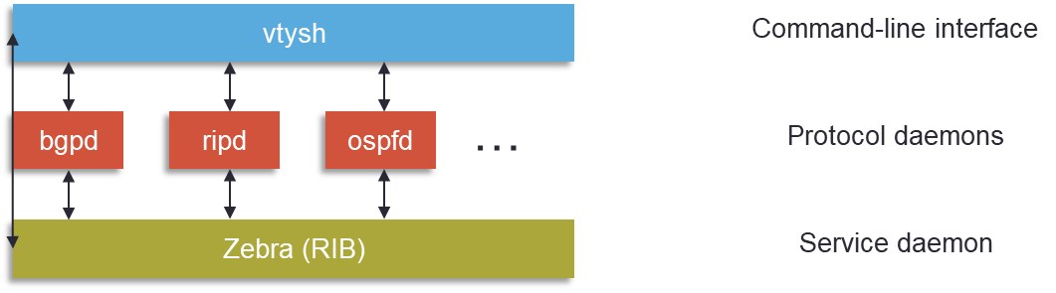
What is FRR?
The configuration is similar to other vendors
  Command-line shell and configuration file
Protocols are implemented as independent processes
Zebra is the process that controls the routing information base (RIB)

Slide 14
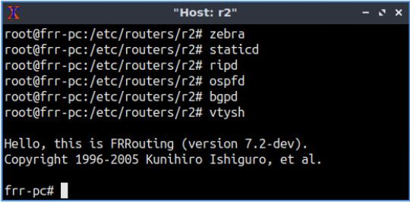
FRR and Mininet Integration
Mininet provides network emulation, allowing all network software at any layer to be simply run as is
The set of commands provided by FRR are inherited and can be run using Mininet’s command-line interface

Slide 15
Lab 3: Introduction to BGP

Slide 16
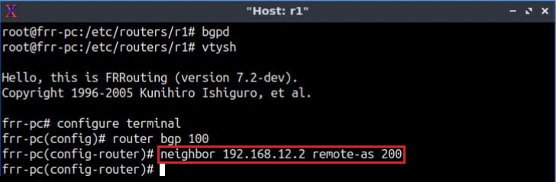
Lab Topology
Establish BGP neighborhood
Router r1

Slide 17
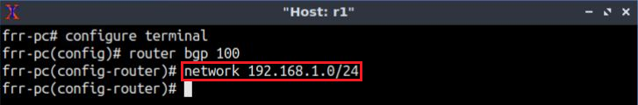
Lab Topology
Advertise a network in BGP
Router r1

Slide 18
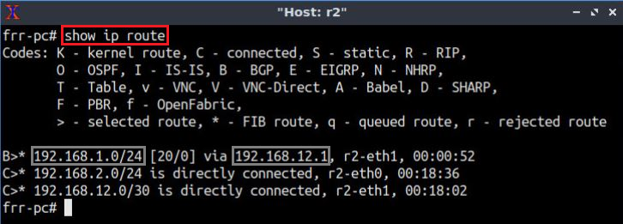
Lab Topology
Routing table: lists the routes learned from different routing protocols
Router r2
18

Slide 19
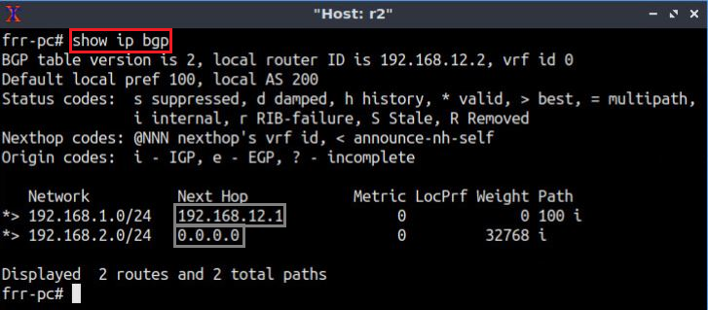
Lab Topology
BGP table: it lists the routes learned from BGP routing protocol
Router r2

