Slide 1





UCF / FLR Workshop on Networking Topics
Session 1: iPerf3, TCP Buffers, Science DMZ Motivation and Impact of Packet Loss
Jorge Crichigno, Elie Kfoury
University of South Carolina
http://ce.sc.edu/cyberinfra
University of Central Florida (UCF)
Florida LambdaRail (FLR)
The Engagement and Performance Operations Center (EPOC)
Energy Sciences Network (ESnet)
University of South Carolina (USC)
Orlando, Florida
February 16th, 2023

Slide 2
Workshop on Networking Topics
Webpage with PowerPoint presentations:
http://ce.sc.edu/cyberinfra/workshop_2023_feb.html
Hands-on sessions: to access labs for the hands-on sessions, use the following link:
https://netlab.cec.sc.edu/
Username: email used for registration
Password: nsf2023

Slide 3
NTP Lab Series
Lab experiments
Lab 1: Introduction to Mininet
Lab 2: Introduction to iPerf
Lab 3: WANs with latency, Jitter
Lab 4: WANs with Packet Loss, Duplication, Corruption
Lab 5: Setting WAN Bandwidth with Token Bucket Filter (TBF)
Lab 6: Traditional TCP Congestion Control (HTCP, Cubic, Reno)
Lab 7: Rate-based TCP Congestion Control (BBR)
Lab 8: Bandwidth-delay Product and TCP Buffer Size
Lab 9: Enhancing TCP Throughput with Parallel Streams
Lab 10: Measuring TCP Fairness
Lab 11: Router’s Buffer Size
Lab 12: TCP Rate Control with Pacing
Lab 13: Impact of Maximum Segment Size on Throughput
Lab 14: Router’s Bufferbloat
Lab 15: Hardware Offloading on TCP Performance
Lab 16: Random Early Detection
Lab 17: Stochastic Fair Queueing
Lab 18: Controlled Delay (CoDel) Active Queue Management
Lab 19: Proportional Integral Controller-Enhanced (PIE)
Lab 20: Classifying TCP traffic using Hierarchical Token Bucket (HTB)

Slide 4
Organization of the Lab Manuals
Each lab starts with a section Overview
  Objectives
  Lab topology
  Lab settings: passwords, device names
  Roadmap: organization of the lab
Section 1
  Background information of the topic being covered (e.g., fundamentals of perfSONAR)
  Section 1 is optional (i.e., the reader can skip this section and move to lab directions)
Section 2… n
  Step-by-step directions

Slide 5
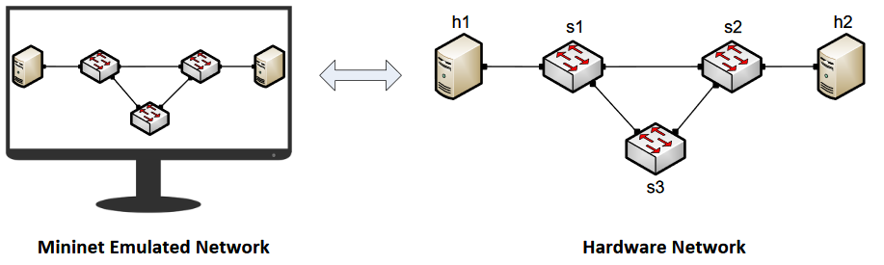
Mininet
Mininet provides network emulation opposed to simulation, allowing all network software at any layer to be simply run as is
Mininet’s logical nodes can be connected into networks
Nodes are sometimes called containers, or more accurately, network namespaces
Containers consume sufficiently few resources that networks of over a thousand nodes have been created, running on a single laptop

Slide 6
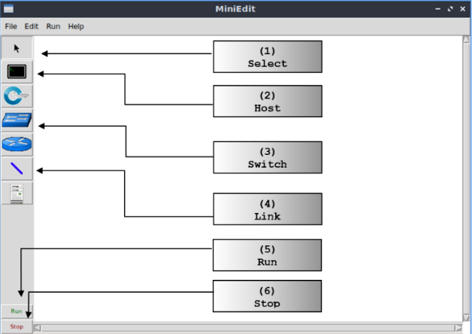
MiniEdit
MiniEdit is a simple GUI network editor for Mininet

Slide 7
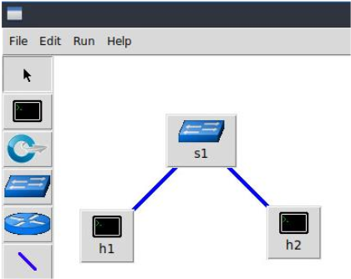
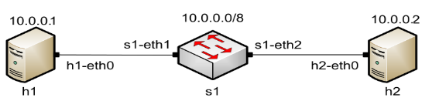
MiniEdit
To build Mininet’s minimal topology, two hosts and one switch must be deployed

Slide 8
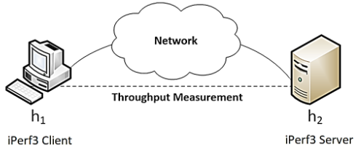
iPerf3
iPerf3 is a real-time network throughput measurement tool
It is an open source, cross-platform client-server application that can be used to measure the throughput between the two end devices
Measuring throughput is particularly useful when experiencing network bandwidth issues such as delay, packet loss, etc.

Slide 9
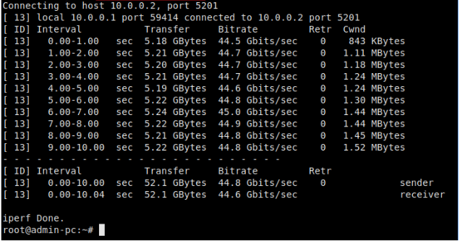
iPerf3
iPerf3 can operate on TCP, UDP, and SCTP, unidirectional or bidirectional way
In iPerf3, the user can set client and server configurations via options and parameters
iPerf3 outputs a timestamped report of the amount of data transferred and the throughput measured

Slide 10
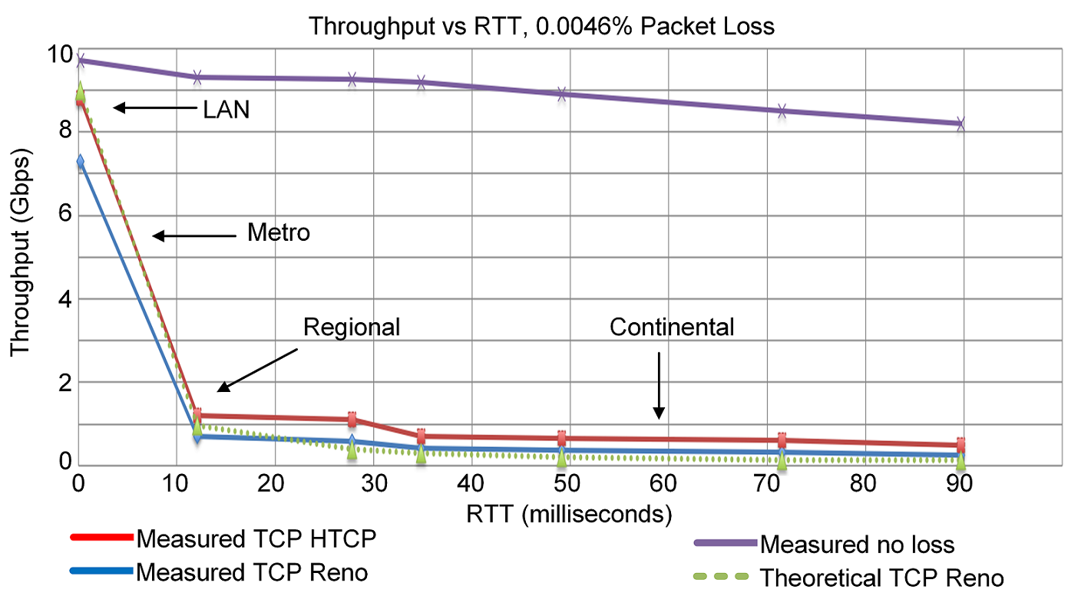
TCP Traditional Congestion Control
The principles of window-based CC were described in the 1980s¹
Traditional CC algorithms follow the additive-increase multiplicative-decrease (AIMD) form of congestion control
1. V. Jacobson, M. Karels, Congestion avoidance and control, ACM SIGCOMM Computer Communication Review 18 (4) (1988).

Slide 11
BBR: Model-based CC
TCP Bottleneck Bandwidth and RTT (BBR) is a rate-based congestion-control algorithm¹
BBR represented a disruption to the traditional CC algorithms:
  is not governed by AIMD control law
  does not the use packet loss as a signal of congestion
At any time, a TCP connection has one slowest link bottleneck bandwidth (btlbw)
1. N. Cardwell et al. "BBR v2, A Model-based Congestion Control." IETF 104, March 2019.

Slide 12
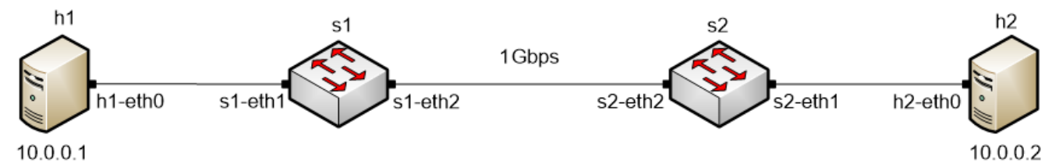
TCP Buffer Size
In many WANs, the round-trip time (RTT) is dominated by the propagation delay
To keep the sender busy while ACKs are received, the TCP buffer must be:
Traditional congestion controls:
BBRv1 and BBRv2:
TCP buffer size ≥ 2BDP
TCP buffer size must be considerable larger than 2BDP

Slide 13
Lab 7: Understanding Rate-based TCP Congestion Control (BBR)

Slide 14
Lab Goal and Topology
Deploy emulated WANs in Mininet
Modify the TCP congestion control algorithm in Linux using sysctl tool
Compare the performance of TCP Reno and TCP BBR in high-throughput high-latency networks
  Without 30ms propagation delay
  With 30ms propagation delay
Demonstrating the impact of packet loss on the throughput of TCP
Lab topology:

Slide 15
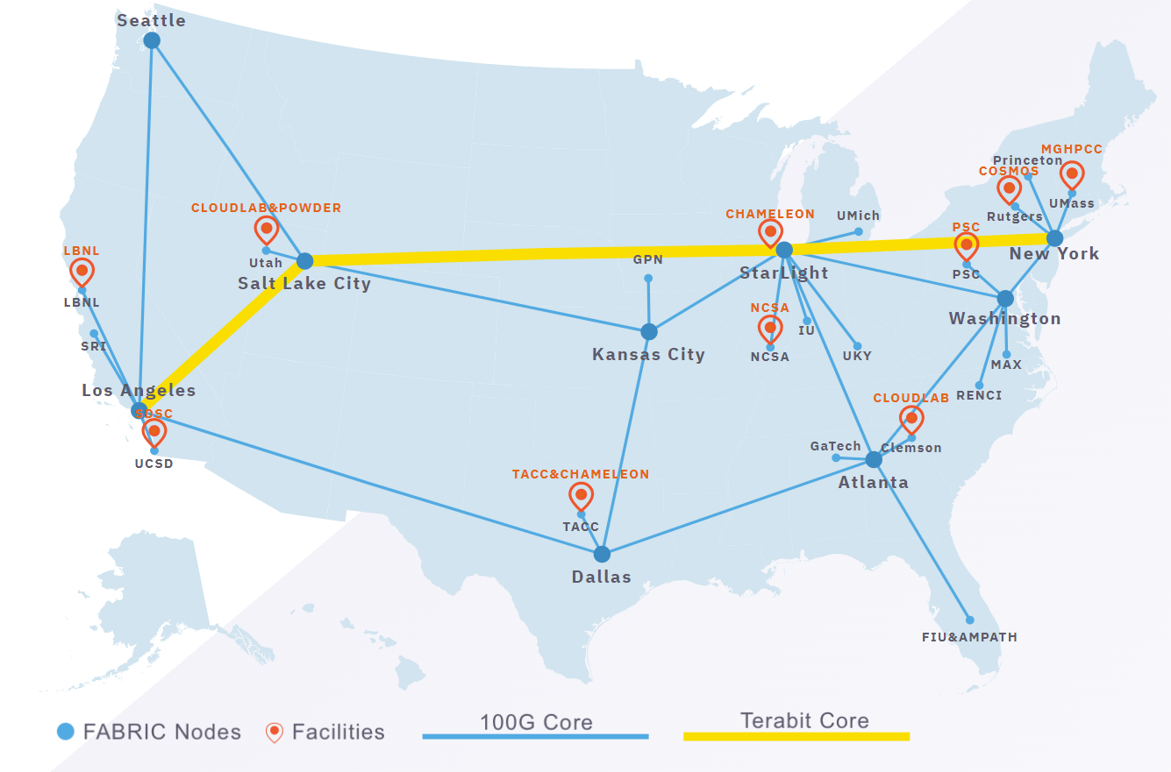
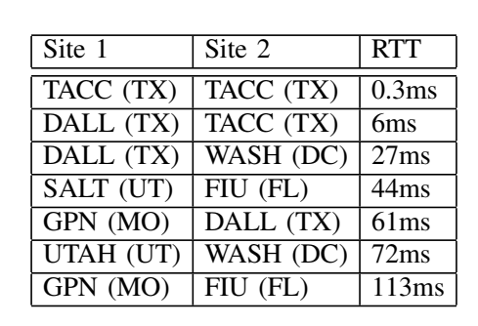
Additional Slides
BBR performance on FABRIC
Performance measurements for a single flow, 0.0046% packet loss rate

Slide 16
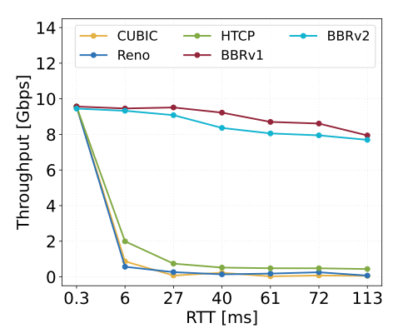
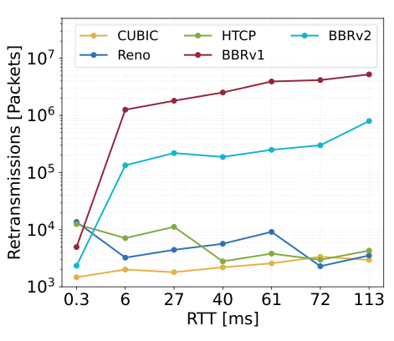
Additional Slides
BBR performance on FABRIC
Performance measurements for a single flow, 0.0046% packet loss rate

Slide 17
BDP
Bandwidth = 1Gbps
RTT = 30ms
BDP (bytes) = 3,750,000 bytes
BDP (MB) = 3.57MB

