Slide 1





UCF / FLR Workshop on Networking Topics
Session 2: Essentials of BGP, EBGP, IBGP
Jorge Crichigno, Jose Gomez
University of South Carolina
http://ce.sc.edu/cyberinfra
University of Central Florida (UCF)
Florida LambdaRail (FLR)
The Engagement and Performance Operations Center (EPOC)
Energy Sciences Network (ESnet)
University of South Carolina (USC)
Orlando, Florida
February 16th, 2023

Slide 2
Border Gateway Protocol Lab Series
Lab experiments
Lab 1: Introduction to Mininet
Lab 2: Introduction to Free Range Routing (FRR)
Lab 3: Introduction to BGP
Lab 4: Configure and verify EBGP
Lab 5: BGP Authentication
Lab 6: Configure BGP with Default Route
Lab 7: Using AS_PATH BGP Attribute
Lab 8: Configuring IBGP and EBGP Sessions, Local Preference, and MED
Lab 8.1: Configuring OSPF, IBGP and EBGP Sessions, Local Preference, and MED
Lab 8.2: Configuring IBGP and EBGP Sessions, Local Preference, and MED
Lab 9: IBGP, Next Hop and Full Mesh Topology
Lab 10: BGP Route Reflection
Lab 11: Configuring BGP Local Preference and AS_PATH Prepending
Lab 11.1: Configuring BGP Local Preference and AS_PATH Prepending

Slide 3
Organization of the Lab Manuals
Each lab starts with a section Overview
  Objectives
  Lab topology
  Lab settings: passwords, device names
  Roadmap: organization of the lab
Section 1
  Background information of the topic being covered (e.g., fundamentals of BGP)
  Section 1 is optional (i.e., the reader can skip this section and move to lab directions)
Section 2… n
  Step-by-step directions

Slide 4
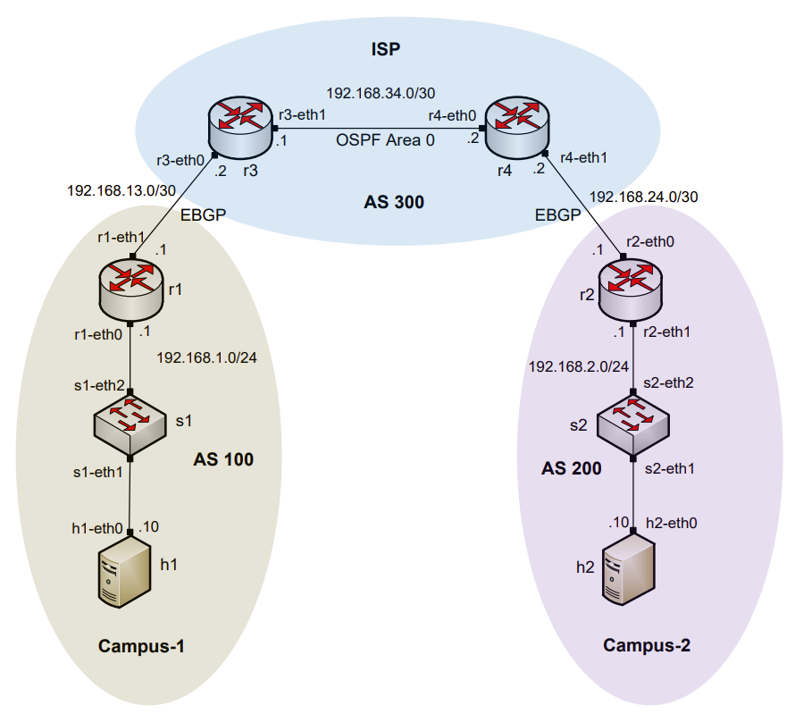
AS, IGP, EGP
Routers are organized into Autonomous Systems (ASes or ASs)
What is an AS (RFC 1771)?
What is an Interior Gateway Protocol (IGP)?
What is an Exterior Gateway Protocol (EGP)?
“A set of routers under the single technical administration, using an IGP and common metrics to route packets within the AS, and using an EGP to route packets to other ASs.”
A routing protocol used to exchange routing information within an AS (e.g., RIP, OSPF)
A routing protocol used to exchange routing information between AS

Slide 5
BGP Route Advertisements within an AS
BGP advertisements from an AS to another is referred to as External BGP (EBGP)
BGP advertisements within an AS is referred to as internal BGP (IBGP)

Slide 6
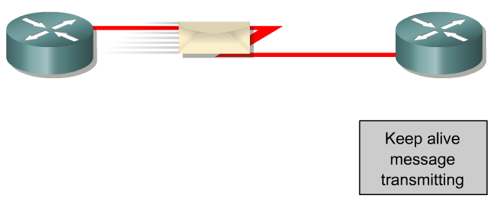
BGP – Best Path
The main goal is to provide interdomain routing
BGP selects one path as the best path
It places the selected path in its routing table and propagates the path to its neighbors
Is this the best path? Does it meet the path selection criteria? If so, add to routing table.
BGP Update
BGP Table
Routing Table
Network
Network
Rick Graziani, “Implementing Cisco IP Routing,” Cisco Press, 2015

Slide 7
Lab 3: Introduction to BGP

Slide 8
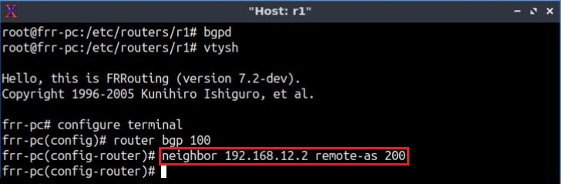
Lab Topology
Establish BGP neighborhood
Router r1

Slide 9
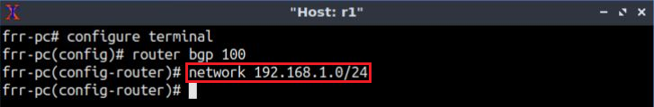
Lab Topology
Advertise a network in BGP
Router r1

Slide 10
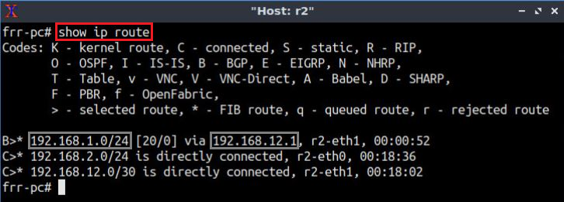
Lab Topology
Routing table: lists the routes learned from different routing protocols
Router r2
10

Slide 11
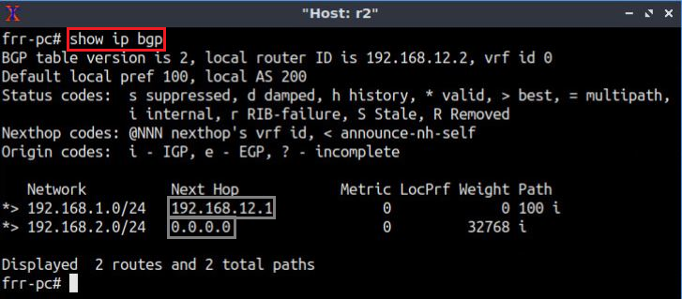
Lab Topology
BGP table: it lists the routes learned from BGP routing protocol
Router r2

