Slide 1
SoX Virtual Training Workshop
Hands-on Session 2: Using Local Preference and AS_PATH attributes
Ali AlSabeh, Jorge Crichigno
University of South Carolina
http://ce.sc.edu/cyberinfra
Southern Crossroads (SoX)
The Engagement and Performance Operations Center (EPOC)
University of South Carolina (USC)
Online
March 29th, 2023

Slide 2
SoX Virtual Training Workshop
Webpage with PowerPoint presentations:
http://ce.sc.edu/cyberinfra/sox_workshop_2023.html
Hands-on sessions: to access labs for the hands-on sessions, use the following link:
https://netlab.cec.sc.edu/
Username: email used for registration
Password: nsf2023

Slide 3
Lab 11: Configuring Local Preference and AS_PATH Prepending

Slide 4
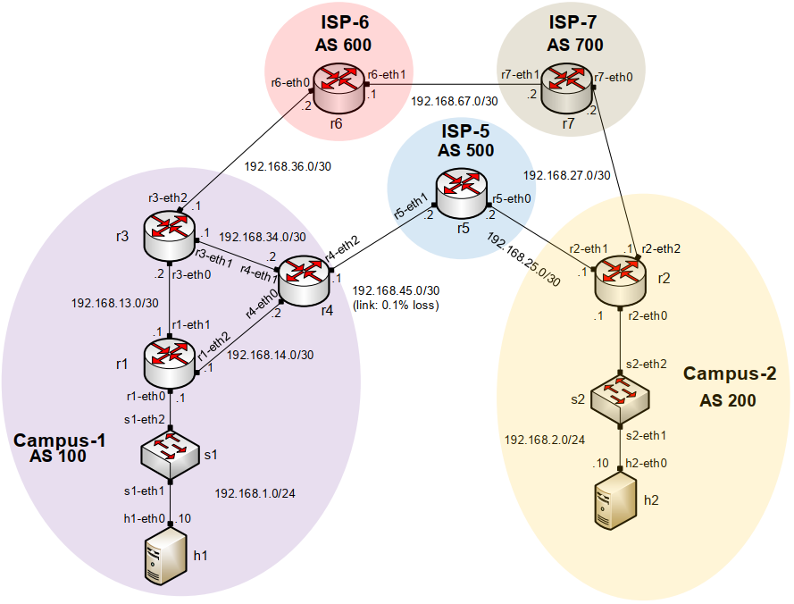
Lab Topology
All links have a capacity of 10Gbps
Link r4-r5 has a packet loss rate = 0.1%
Configure LOCAL_PREF on r3 and r4 to route traffic out of AS 100 via r3
Set AS_PATH prepending on r4 so that traffic into AS 100 occurs via AS 600

Slide 5
Lab Topology
Configure LOCAL_PREF in routers r3 (150) and r4 (125) (higher is better)
Outbound traffic via r3

Slide 6
Lab Topology
Configure AS_PATH prepending on router r4 to influence router r2 to use the long path
Inbound traffic from AS 200 via r3

Slide 7
Additional Slides - Lab 8: Configuring IBGP and EBGP Sessions, Local Preference, and MED

Slide 8
Lab Topology
Configure IBGP within AS 200
Configure EBGP between AS 100 and AS 200
Configure LOCAL_PREF and MED attributes to favor the primary link over the secondary one
Primary link
Secondary link

Slide 9
Lab Topology
Local_PREF attribute configuration on routers r2 and r3
Configure a route-map
Set the LOCAL_PREF attribute
Assign the route-map to the BGP neighbor
Primary link
Secondary link

Slide 10
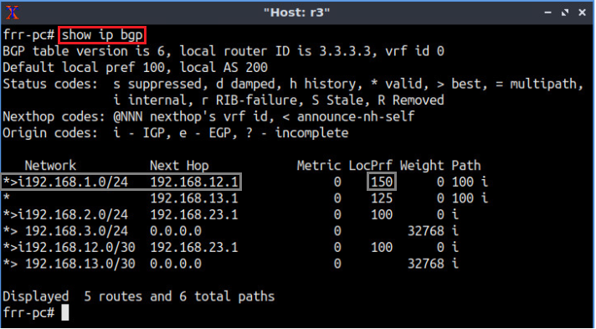
Lab Topology
BGP table of router r3 after configuring the LOCAL_PREF attribute
Primary link
Secondary link

Slide 11
Lab Topology
MED attribute configuration on routers r2 and r3
Configure a route-map
Set the MED attribute
Assign the route-map to the BGP neighbor
Primary link
Secondary link

Slide 12
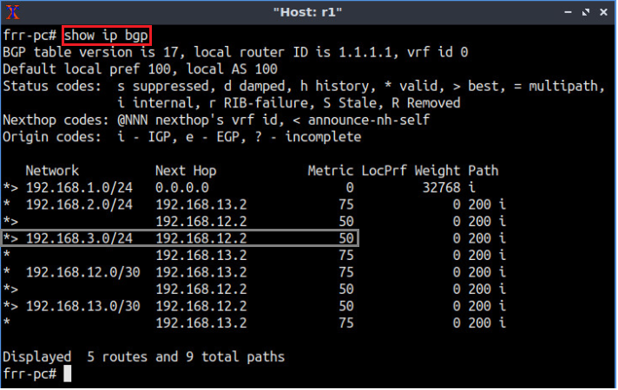
Lab Topology
BGP table of router r1 after configuring the MED attribute
Primary link
Secondary link

