Slide 1
UCF / FLR Workshop on Networking Topics
Session 3: Routing using BGP Attributes
Jorge Crichigno, Ali AlSabeh
University of South Carolina
http://ce.sc.edu/cyberinfra
University of Central Florida (UCF)
Florida LambdaRail (FLR)
The Engagement and Performance Operations Center (EPOC)
Energy Sciences Network (ESnet)
University of South Carolina (USC)
Orlando, Florida
February 16th, 2023

Slide 2
BGP – Best Path
Prefer the path with highest weight (configured locally; set to 0 (default) for routes not originated by the router)
If weights are the same, prefer the path with highest local preference (set to 100 by default)
If the local preferences are the same, prefer the path that was originated by BGP running on the router or redistributed from an Interior Gateway Protocol (IGP)
If no route was originated, prefer the path with the shortest AS_PATH
If the paths have the same AS_PATH length, prefer the path with the lowest origin type (IGP is lower than Exterior Gateway Protocol (EGP), and EGP is lower than Incomplete)
If the origin codes are the same, prefer the path with the lowest MED attribute (set to 0 by default)
If the paths have the same MED, prefer the External path (EBGP) over the Internal path (IBGP)
If the paths are still the same, prefer the path through the closest IGP neighbor (lowest IGP metric)
If both paths are external, prefer the path that was received first (oldest one)
If the paths are still the same, prefer the path from the BGP router with the lowest router ID
If the router ID is the same for multiple paths, prefer the path with the lowest IP address
Rick Graziani, “Implementing Cisco IP Routing,” Cisco Press, 2015

Slide 3
BGP – Best Path
Without route manipulation, the most common reason for path selection is Step 4
If no route was originated, prefer the path with the shortest AS_PATH
If multiple paths have the same number of autonomous systems to traverse, the second most common decision point is Step 7
If the paths have the same MED, prefer EBGP over IBGP
Rick Graziani, “Implementing Cisco IP Routing,” Cisco Press, 2015

Slide 4
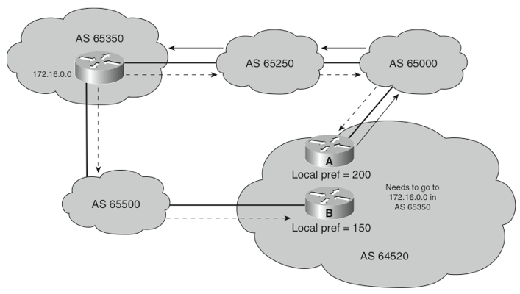
The Local Preference Attribute
Indicates to routers in the AS which path is preferred to exit the AS (higher is better)
AS 64520 receives updates about network 172.16.0.0 from two directions:
via AS 65500 (65500, 65350)
via AS 65000 (65000, 65250, 65350)
Local preference:
On Router A for network 172.16.0.0 is 200
On Router B for network 172.16.0.0 is 150
Local preference information is exchanged within AS 64520 via IBGP
All traffic in AS 64520 addressed to network 172.16.0.0 is sent to Router A as an exit point from AS 64520
172.16.0.0
My Local Preference is higher, so I am the preferred exit point.
IBGP
Rick Graziani, “Implementing Cisco IP Routing,” Cisco Press, 2015

Slide 5
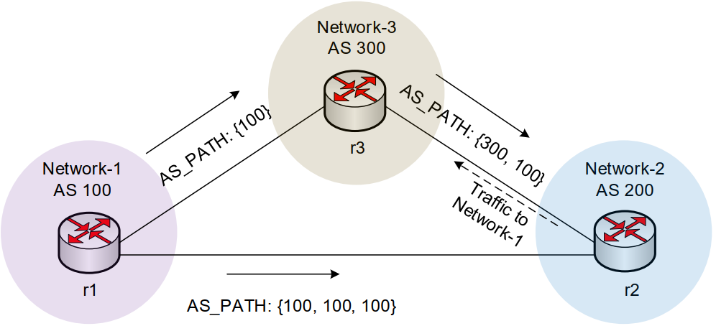
The AS_PATH Attribute
The AS_PATH attribute includes all the ASes that need to be traversed to reach a destination
When there are multiple paths to the same destination, BGP prefers the path with the lowest number of ASes
Prepending is sometimes used to deprioritize a route by artificially increasing the AS-PATH length attribute
NOTE: AS_PATH prepending in an excessive manner may lead a route to become vulnerable to disruption or misdirection; it may incentivize ASes to choose another origin if one were to suddenly appear by mistake or not¹.
1. D. Madoury, “Excessive BGP AS-PATH prepending is a self-inflicted vulnerability,” Jul. 2019. URL: https://tinyurl.com/bdh2c86a.

Slide 6
Lab 11: Configuring Local Preference and AS_PATH Prepending

Slide 7
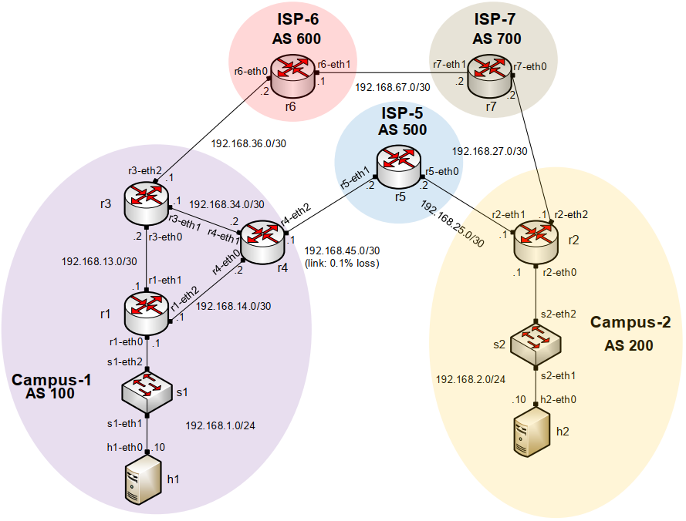
Lab Topology
All links have a capacity of 10Gbps
Link r4-r5 has a packet loss rate = 0.1%
Configure LOCAL_PREF on r3 and r4 to route traffic out of AS 100 via r3
Set AS_PATH prepending on r4 so that traffic into AS 100 occurs via AS 600

Slide 8
Lab Topology
Configure LOCAL_PREF in routers r3 (150) and r4 (125) (higher is better)
Outbound traffic via r3

Slide 9
Lab Topology
Configure AS_PATH prepending on router r4 to influence router r2 to use the long path
Inbound traffic from AS 200 via r3

Slide 10
Additional Slides

Slide 11
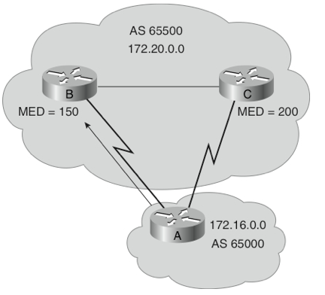
The MED Attribute
Indicates to external neighbors the preferred path into an AS
By default, a router compares the MED only for paths from neighbors in the same AS. Lowest Wins!
MED is sent to EBGP peers:
Those routers propagate the MED within their AS
But do not pass it on to the next AS
172.20.0.0
Rick Graziani, “Implementing Cisco IP Routing,” Cisco Press, 2015

Slide 12
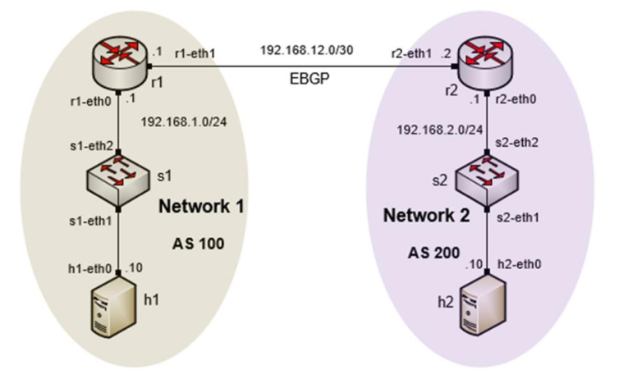
Origin Attribute
A well-known mandatory attribute
Defines the origin of the path information
The origin attribute can be one of three values:
IGP (“i”)
The route is interior to the originating AS
Normally when the network command is used
EGP (“e”)
The route is learned via EGP
EGP is legacy and no longer supported
Incomplete (“?”)
The route’s origin is unknown / some other means
It usually occurs when a route is redistributed into BGP
BGP table router r1
Rick Graziani, “Implementing Cisco IP Routing,” Cisco Press, 2015

Slide 13
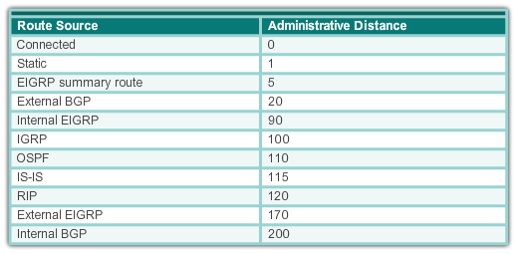
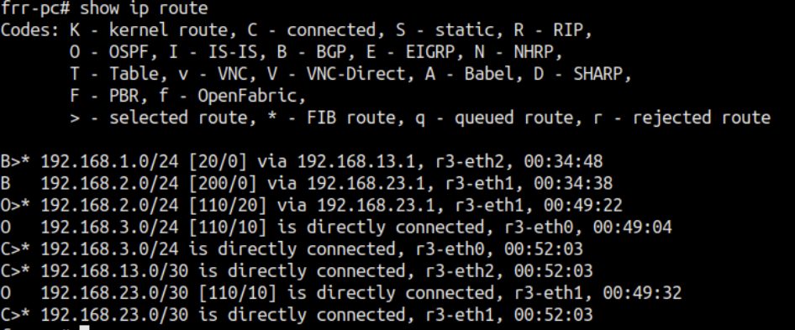
Administrative Distance
A router may run multiple routing protocols / static routes
If BGP and OSPF are configured on a router, both protocols may provide different best paths (analogous to google-maps and mapquest)
How does the router know which protocol to choose?
The route with lower Administrative Distance is installed in the routing table
Rick Graziani, “Implementing Cisco IP Routing,” Cisco Press, 2015

Slide 14
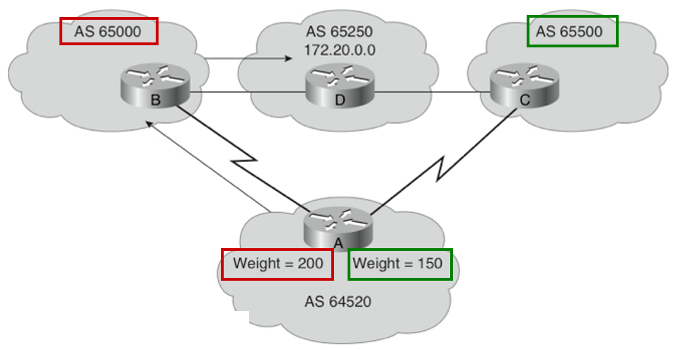
The Weight Attribute - For “Outbound Route”
Configured locally and not propagated to any other routers (higher is better)
This is a vendor-specific attribute – Cisco supports it
Juniper has a different mechanism to achieve a similar result
Weight takes precedence over Local Preference
Value from 0 to 65535; default is 32768
Default is 0 for routes not originated by this router
Rick Graziani, “Implementing Cisco IP Routing,” Cisco Press, 2015

Slide 15
The Weight Attribute - For “Outbound Route”
Router A has two ways to reach 172.20.0.0
via Router B (AS 65000)
via Router C (AS 65500)
Router A is configured to set the weight of updates coming from:
Router B to 200
Router C to 150
Weight for Router B is higher, so Router A uses Router B as a next hop to reach 172.20.0.0
Rick Graziani, “Implementing Cisco IP Routing,” Cisco Press, 2015

Slide 16
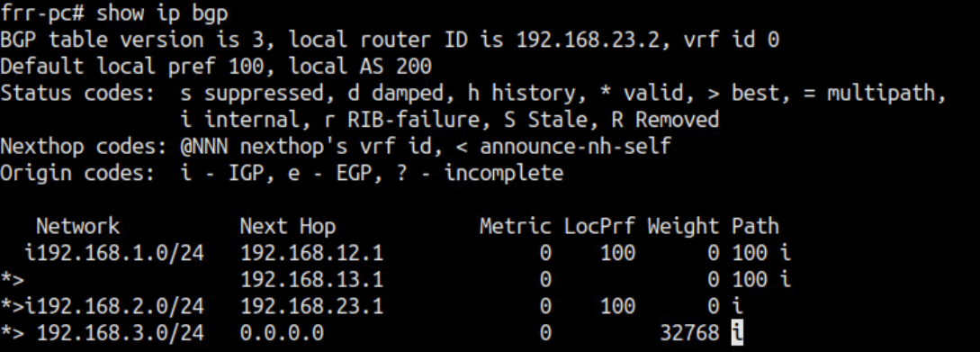
BGP Table
Internal version number of the table
This number is incremented whenever the table changes

Slide 17
Status Code
Code | Meaning
s | Table entry is suppressed
d | Table entry is dampened
h | Table entry history
* | Table entry is valid
> | Table entry is the best entry to use for this network
i | Table entry was learned via an internal BGP session
r | Table entry is a RIB-failure
S | Table entry is stale
= | Table entry has multipath to use for this network
b | Table entry has a backup path to use for this network
x | The table entry has a best external route to use for this network
Displayed at the beginning of each line in the table
Notes:
AS 2 and AS 3 buy transit service from AS 1

Slide 18
Lab 8.2: Configuring IBGP and EBGP Sessions, Local Preference, and MED

Slide 19
Lab Topology
Configure IBGP within AS 300
Configure EBGP between AS 100 and AS 300 and between AS 200 and 300
Configure LOCAL_PREF and MED attributes to favor the primary link over the secondary one
Primary link
Secondary link

Slide 20
Lab Topology
LOCAL_PREF attribute configuration on routers r3 and r4
Configure a route-map
Set the LOCAL_PREF attribute
Assign the route-map to the BGP neighbor
Primary link
Secondary link

Slide 21
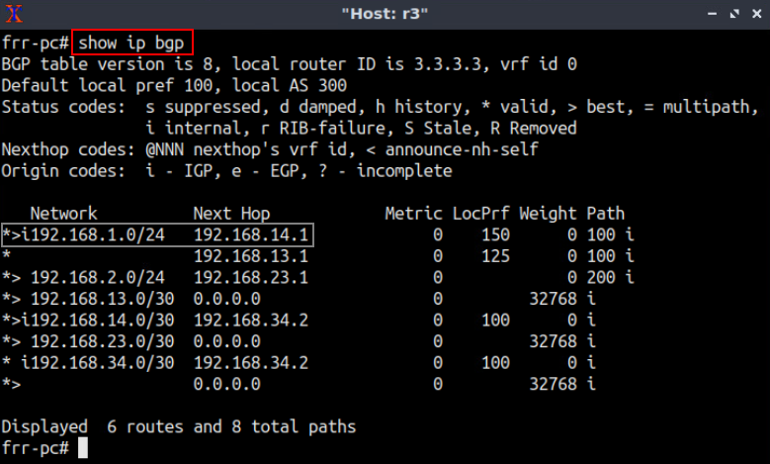
Lab Topology
BGP table of router r3 after configuring the LOCAL_PREF attribute
Primary link
Secondary link

Slide 22
Lab Topology
MED attribute configuration on routers r3 and r4
Configure a route-map
Set the MED attribute
Assign the route-map to the BGP neighbor
Primary link
Secondary link

Slide 23
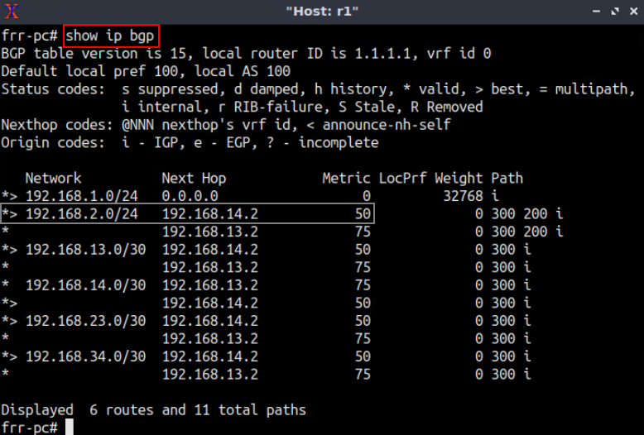
Lab Topology
BGP table of router r1 after configuring the MED attribute
Primary link
Secondary link

