Slide 1
UCF / FLR Workshop on Networking Topics
Session 4: Basics of perfSONAR
Jorge Crichigno, Jose Gomez
University of South Carolina
http://ce.sc.edu/cyberinfra
University of Central Florida (UCF)
Florida LambdaRail (FLR)
The Engagement and Performance Operations Center (EPOC)
Energy Sciences Network (ESnet)
University of South Carolina (USC)
Orlando, Florida
February 17th, 2023

Slide 2
perfSONAR Lab Series
Lab experiments
Lab 1: Configuring Admin. Information Using perfSONAR Toolkit GUI
Lab 2: PerfSONAR Metrics and Tools
Lab 3: Configuring Regular Tests Using perfSONAR GUI
Lab 4: Configuring Regular Tests Using pScheduler CLI Part I
Lab 5: Configuring Regular Tests Using pScheduler CLI Part II
Lab 6: Bandwidth-delay Product and TCP Buffer Size
Lab 7: Configuring Regular Tests Using a pSConfig Template
Lab 8: perfSONAR Monitoring and Debugging Dashboard
Lab 9: pSConfig Web Administrator
Lab 10: Configuring pScheduler Limits

Slide 3
Organization of the Lab Manuals
Each lab starts with a section Overview
Objectives
Lab topology
Lab settings: passwords, device names
Roadmap: organization of the lab
Section 1
Background information of the topic being covered (e.g., fundamentals of perfSONAR)
Section 1 is optional (i.e., the reader can skip this section and move to lab directions)
Section 2… n
Step-by-step directions

Slide 4
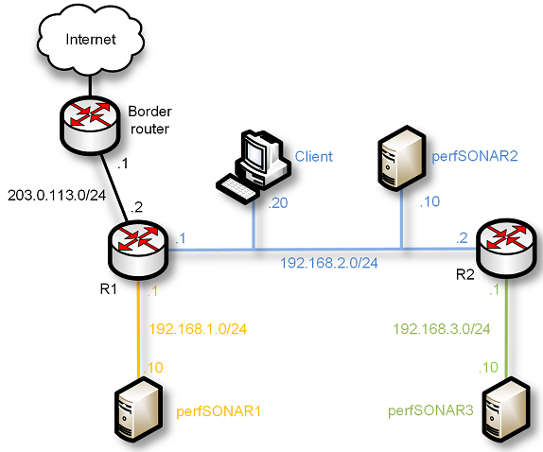
Pod Design
perfSONAR Toolkit + Central Management
PWA
perfSONAR Toolkit
perfSONAR installation options

Slide 5
Lab 4: Configuring Regular Tests using pScheduler CLI

Slide 6
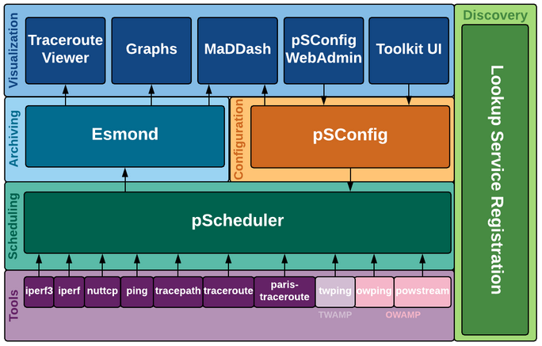
The pScheduler Command
The pScheduler coordinates, executes, and optionally stores network measurements (e.g., latency, packet loss rate, throughput)
Lab topology
perfSONAR layers

Slide 7
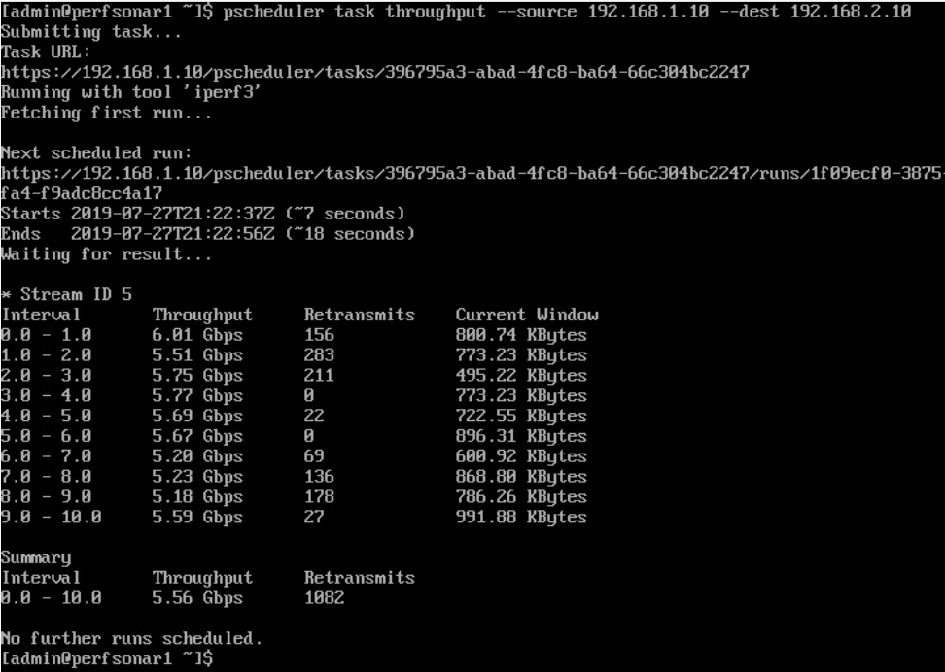
The pScheduler Command
The pScheduler command creates new tasks.
Lab topology
Throughput task

