Slide 1
UCF / FLR Workshop on Networking Topics
Hands-on Session 5: SDN Concepts,
Controllers, Flow Tables
Jorge Crichigno, Ali AlSabeh
University of South Carolina
http://ce.sc.edu/cyberinfra
University of Central Florida (UCF)
Florida LambdaRail (FLR)
The Engagement and Performance Operations Center (EPOC)
Energy Sciences Network (ESnet)
University of South Carolina (USC)
Orlando, Florida
February 17th, 2023

Slide 2
Lab 6: Introduction to OpenFlow

Slide 3
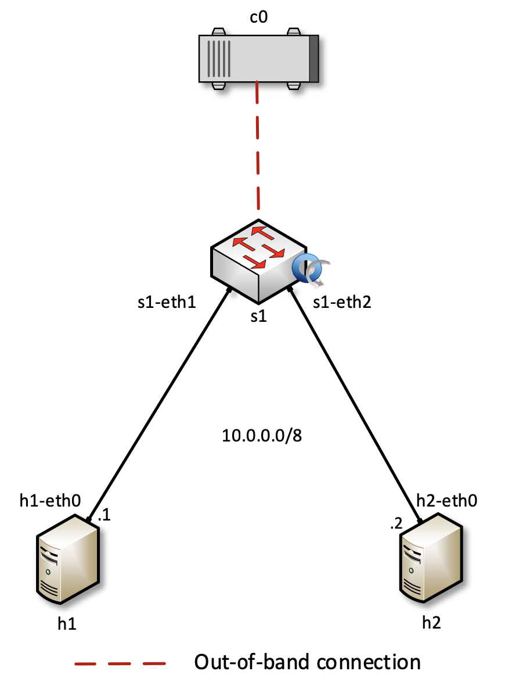
Lab 6: Introduction to OpenFlow
The topology consists of:
The Open Network Operating System (ONOS) controller, an open source SDN controller
Open Virtual Switch (OVS) device; OVS is an open source SDN switch
Hosts, serving as the end-users
Activities include
Configure OpenFlow switches using ovs-ofctl
Run ONOS controller and activate some of its applications
Inspect the flow entries installed by the activated ONOS applications
Inspect the communication between the controller and the switch

Slide 4
Activating the OpenFlow Application
Add flows using ovs-ofctl
Show the flow table using ovs-ofctl

Slide 5
Activating the OpenFlow Application
Activate ONOS applications
Show the flow entries installed by ONOS applications

Slide 6
Activating the OpenFlow Application
Capture and Inspect the communication (PACKET_IN and PACKET_OUT messages) between the controller and the switch using Wireshark

Slide 7
Additional Slides

Slide 8
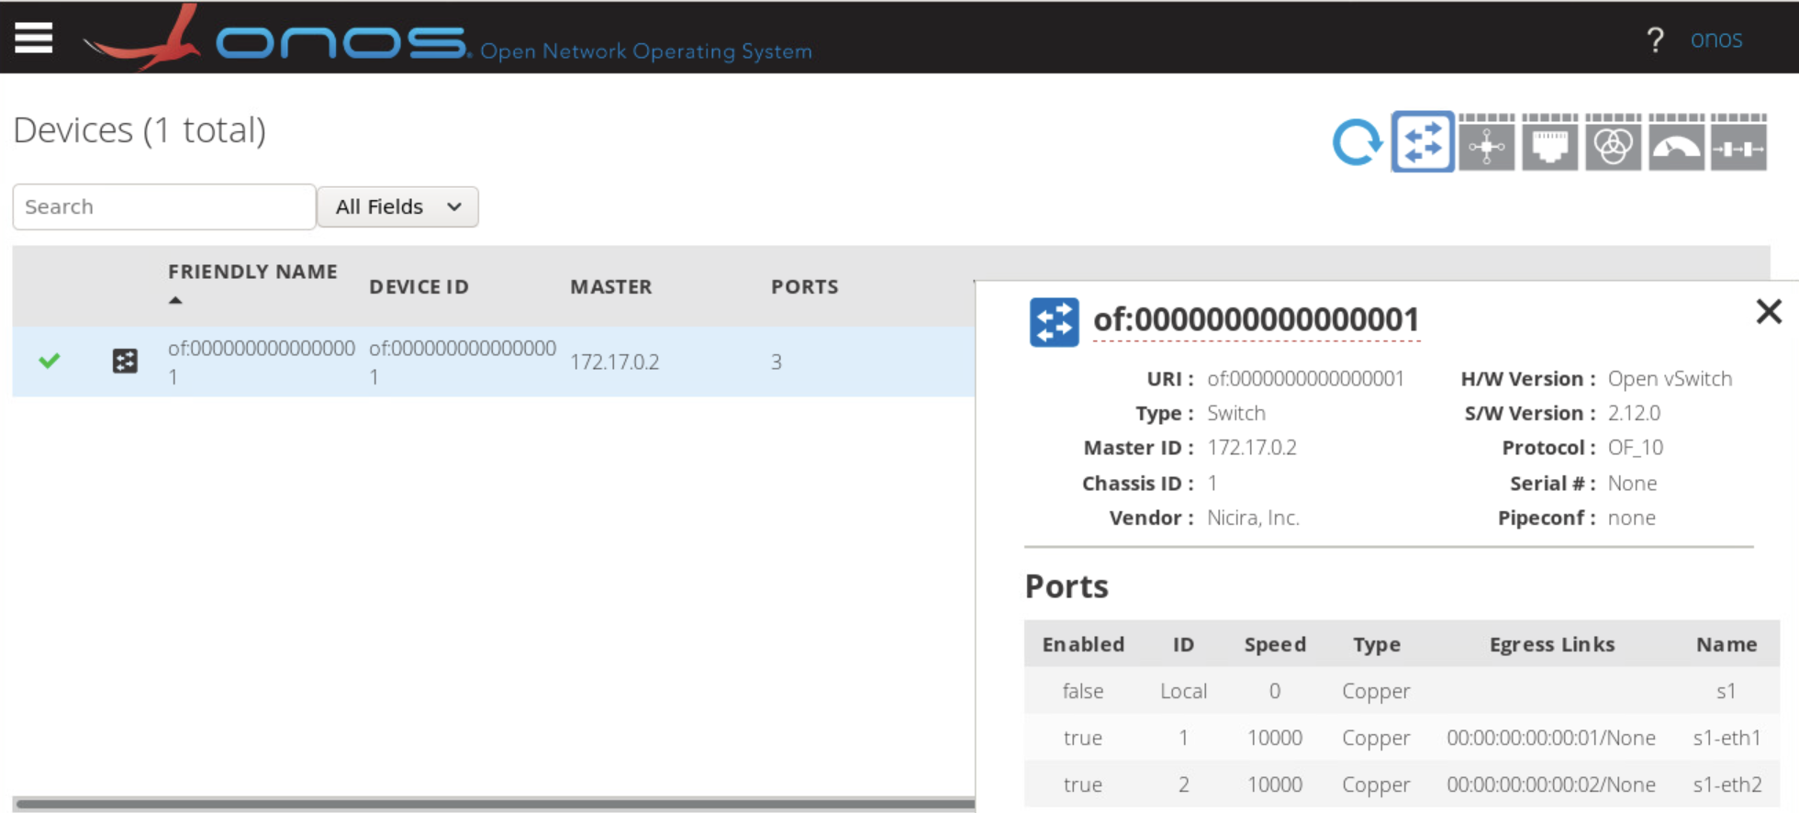
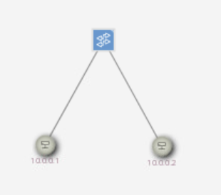
ONOS GUI
Devices
Topology (ONOS GUI view)

Slide 9
Workshop on Networking Topics
Webpage with PowerPoint presentations:
http://ce.sc.edu/cyberinfra/workshop_2023_feb.html
Hands-on sessions: to access labs for the hands-on sessions, use the following link:
https://netlab.cec.sc.edu/
Username: email used for registration
Password: nsf2023

