Slide 1




Hands-on Workshop on Network Technologies
Hands-on session 1: Essentials of BGP, EBGP, IBGP
Lab 3 - BGP Lab Series
Ali AlSabeh¹, Jorge Crichigno²
¹University of South Carolina Aiken (USCA)
²University of South Carolina (USC)
https://research.cec.sc.edu/cyberinfra/
Tuesday, Jul 22, 2025
Online

Slide 2
Lab Series: Border Gateway Protocol
Lab experiments
  Lab 1: Introduction to Mininet
  Lab 2: Introduction to Free Range Routing (FRR)
  Lab 3: Introduction to BGP
  Lab 4: Configure and verify EBGP
  Lab 5: BGP Authentication
  Lab 6: Configure BGP with Default Route
  Lab 7: Using AS_PATH BGP Attribute
  Lab 8: Configuring IBGP and EBGP Sessions, Local Preference, and MED
  Lab 8.1: Configuring OSPF, IBGP and EBGP Sessions, Local Preference, and MED
  Lab 9: IBGP, Next Hop and Full Mesh Topology
  Lab 10: BGP Route Reflection
  Lab 11: Configuring BGP Local Preference, and AS_PATH Prepending
  Lab 11.1: Configuring BGP Local Preference, and AS_PATH Prepending
  Lab 12: Hot Potato Routing and BGP LOCAL_PREF Attribute
  Lab 13: Configuring Local Preferences on a Per Route Basis

Slide 3
Organization of the labs
Each lab starts with a section Overview
  Objectives
  Lab topology
  Lab settings: passwords, device names
  Roadmap: organization of the lab
Section 1
  Background information of the topic being covered (e.g., fundamentals of BGP)
  Section 1 is optional (i.e., the reader can skip this section and move to lab directions)
Section 2… n
  Step-by-step directions

Slide 4
Other Lab Libraries
Cybersecurity
Virtual Labs on Cybersecurity Tools and Applications
Virtual Labs on Zeek Intrusion Detection and Prevention Systems

Slide 5
Other Lab Libraries
SDN and P4 Programmable Data Plane Switches
Cybersecurity Applications on P4 Programmable Data Planes
P4 Programmable Data Planes: Applications, Stateful Elements, and Custom Packet Processing
P4 Programmable Data Plane Switches based on BMv2
P4 Programmable Data Plane Switches based on Intel’s Tofino Chip
Introduction to Software Defined Networking (SDN)
Introduction to P4-DPDK

Slide 6
Other Lab Libraries
Routing and Switching
Open Shortest Path First (OSPF)
Introduction to Border Gateway Protocol (BGP)
MPLS and Advanced BGP Topics
Open vSwitch (OvS)

Slide 7
Other Lab Libraries
Network Monitoring and Management
Network Management Tools (Netflow, IPFix, sFlow)
Introduction to perfSONAR
PerfSONAR 5.0
P4-perfSONAR Lab Series

Slide 8
Other Lab Libraries
Network Fundamentals
Network Tools and Protocols (NTP)
Introduction to IPv6

Slide 9
Introduction to BGP
Lab activities are described in Lab 3, BGP Lab Series

Slide 10
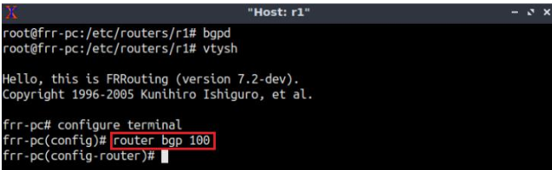
Lab Topology
Enable the BGP process
Router r1

Slide 11
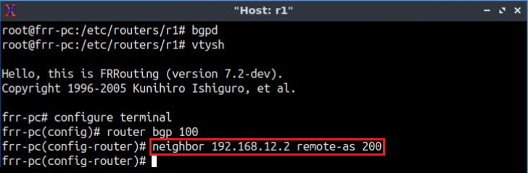
Lab Topology
Establish BGP neighborhood
Router r1

Slide 12
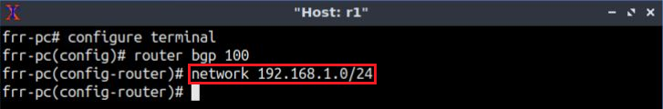
Lab Topology
Advertise a network in BGP
Router r1

Slide 13
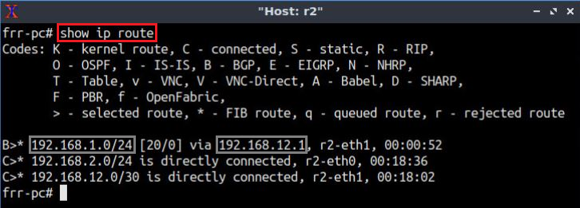
Lab Topology
Routing table: lists the routes learned from different routing protocols
Router r2

Slide 14
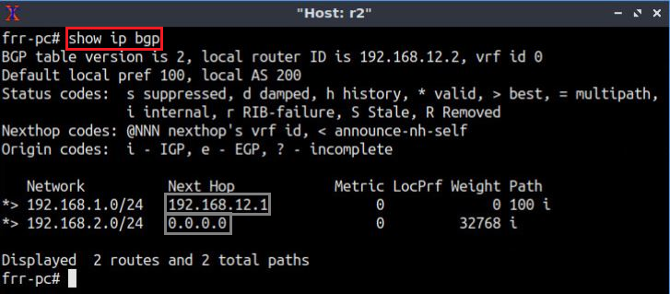
Lab Topology
BGP table: lists the routes learned from BGP routing protocol
Router r2

Slide 15
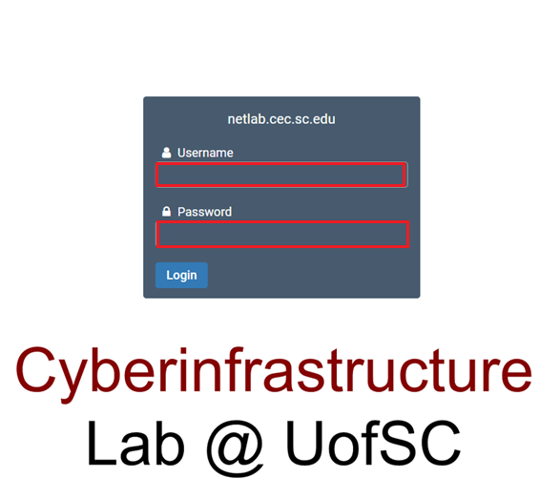
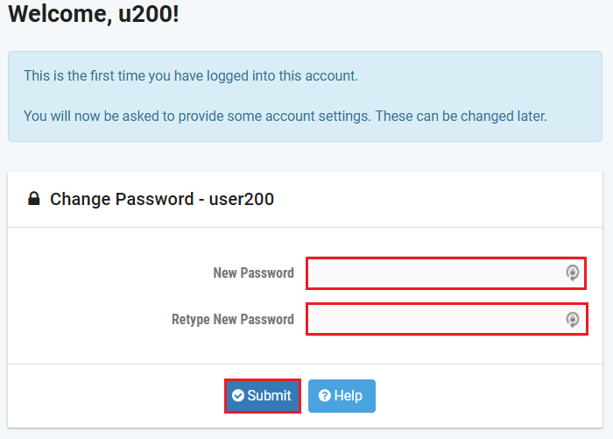
Accessing the Platform
Please use the following link to access the platform: https://netlab.cec.sc.edu/
Login using the following credentials:
Username: email used for registration
Temporary Password: nsf-2025

Slide 16
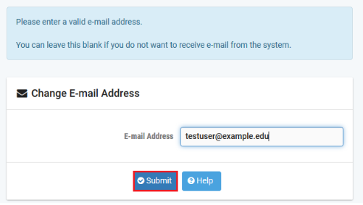
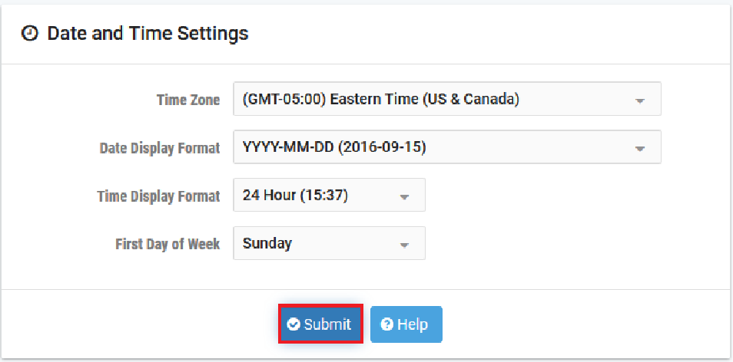
Accessing the Platform
Please use the following link to access the platform: https://netlab.cec.sc.edu/
Login using the following credentials:
Username: email used for registration
Temporary Password: nsf-2025

Slide 17
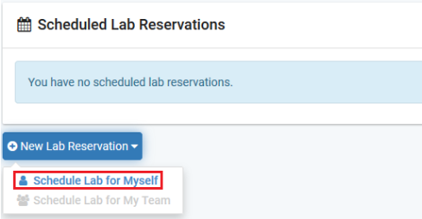
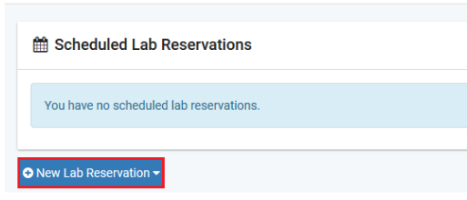
Accessing the Platform
Click on New Lab Reservation
Click on Schedule Lab for Myself

Slide 18
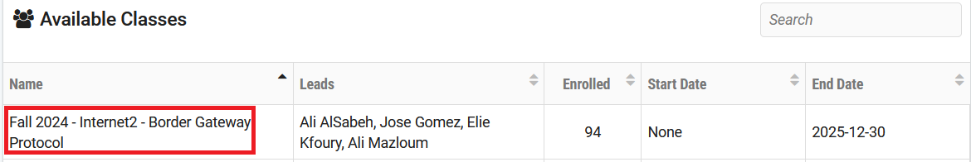
Accessing the Platform
Select the course
For this session, we will use “Introduction to BGP”

Slide 19
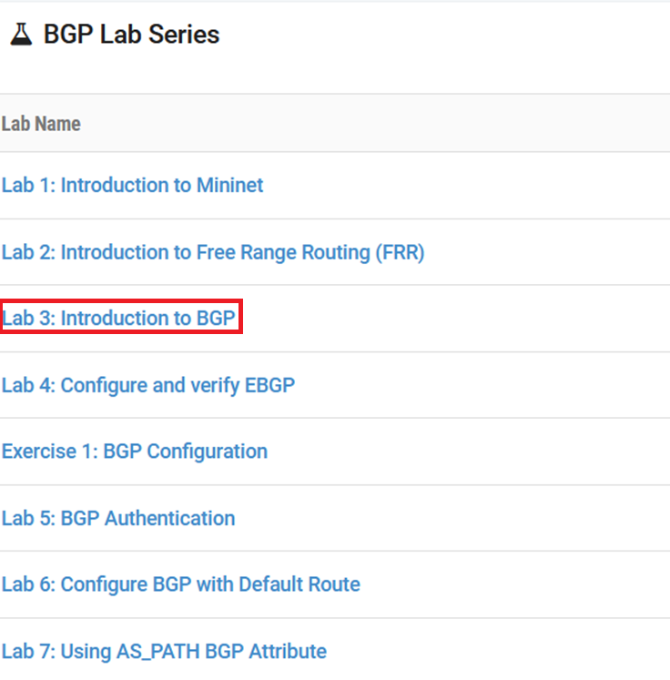
Accessing the Platform
Select the Lab
For this session, we will run:
  Lab 3: Introduction to BGP

Slide 20
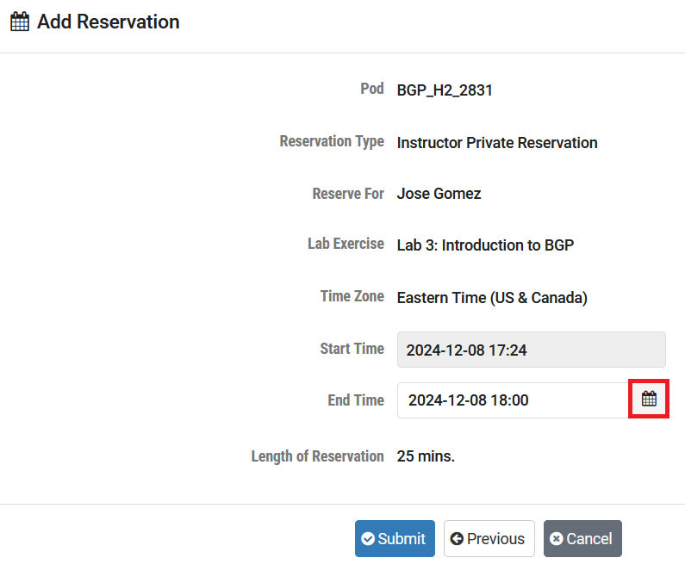
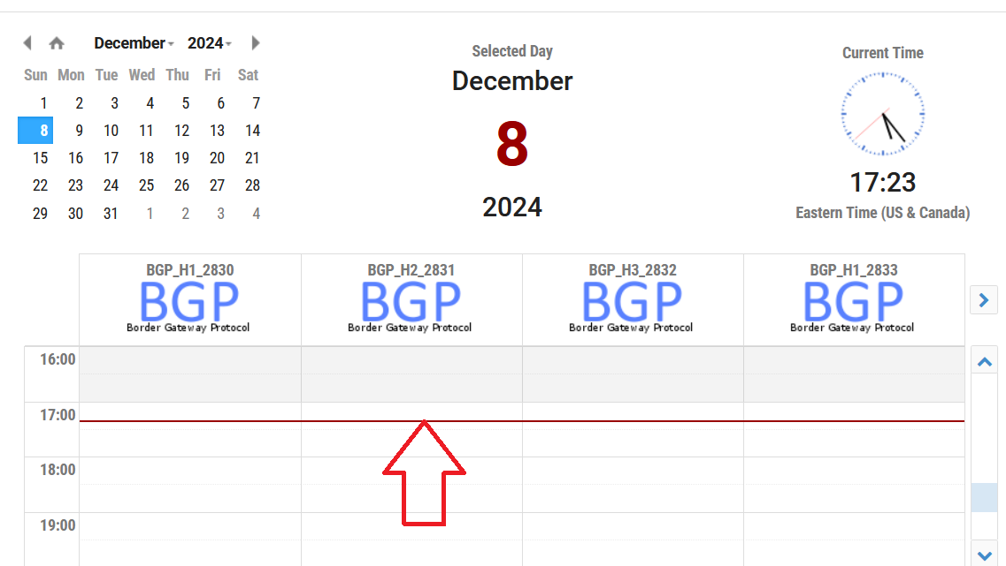
Accessing the Platform
Select the next available POD and allocate time

Slide 21
Accessing the Platform
We will use the NETLAB virtual platform:
URL: https://netlab.cec.sc.edu/
Username: email used for registration
Temporary Password: nsf-2025

