Slide 1




Hands-on Workshop on Network Technologies
Hands-on session 2: IPv6 Static Routing Configuration
Lab 7 - IPv6 Lab Series
Jose Gomez¹, Jorge Crichigno²
¹Fort Lewis College (FLC)
²University of South Carolina (USC)
https://research.cec.sc.edu/cyberinfra/
Tuesday, Jul 15, 2025
Online

Slide 2
Lab 7: IPv6 Static Routing Configuration

Slide 3
Lab Topology
The topology consists of:
  Two hosts in different networks, connected to their respective routers
Configure static routes so that the hosts can reach each other

Slide 4


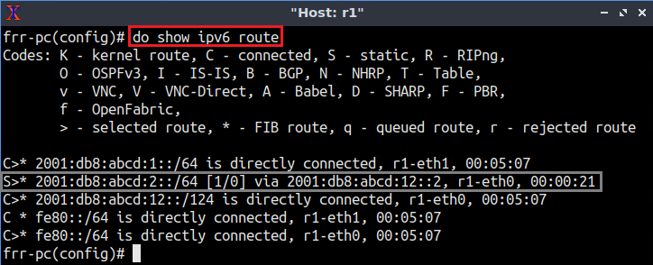
IPv6 Static Configuration
Enable static routing daemon
Add static route to network 2001:db8:abcd:2::/64
Observe routing table

Slide 5
Accessing the Platform
We will use the NETLAB virtual platform:
URL: https://netlab.cec.sc.edu/
Username: <email address used for the registration>
Temporary Password: nsf-2025

