Slide 1
“SoX Virtual Training Workshop”
Organized by
Southern Crossroads / Southern Light Rail (SOX / SLR)
The University of South Carolina (USC)
ESnet and The Engagement and Performance Operations Center (EPOC)
Jorge Crichigno – University of South Carolina
March 22 and March 29, 2023
Online

Slide 2
Workshop Goals
Help CI engineers, operational staff, managers, researchers, and students build upon their existing knowledge of CI and high-speed networks
Enable data movement for the purposes of research and education
Provide training material for workforce development

Slide 3
Website
http://ce.sc.edu/cyberinfra/sox_workshop_2023.html

Slide 4
Agenda
Day 1: March 22, 2023
Time (ET) (pm) | Topic | Presenter
01:00 PM - 01:05 | Welcome - SoX | Cas D'Angelo (SOX), Jason Zurawski (EPOC), Jorge Crichigno (USC)
01:05 PM - 01:50 PM | Infrastructure for the Campus Network (e.g., Science DMZ, elements, perfSONAR) | Jason Zurawski (EPOC)
01:50 PM - 02:30 PM | Hands-on Session 1: Introduction to perfSONAR, GUI, basic overview | Jose Gomez (USC)
02:30 PM - 02:45 PM | Break
02:45 PM - 03:30 PM | The value of end-to-end measurements: using perfSONAR remote commands, measuring throughput, packet loss against nodes on the Internet | Doug Southworth (TACC)
03:30 PM - 04:30 PM | Hands-on Session 2: perfSONAR Monitoring and Debugging Dashboard | Jose Gomez (USC)
04:30 PM – 05:00 PM | Closing Remarks

Slide 5
Agenda
Day 2: March 29, 2023
Time (ET) (pm) | Topic | Presenter
01:00 PM - 01:05 PM | Welcome - SoX | Cas D'Angelo
01:05 PM - 01:50 PM | BGP and Research and Education Networks (RENs) | Jason Zurawski (EPOC)
01:50 PM - 02:30 PM | Hands-on Session 1: Essentials of BGP, EBGP, IBGP | Ali AlSabeh (USC)
02:30 PM - 02:45 PM | Break
02:45 PM - 03:30 PM | Overview of BGP attributes to route packets: AS-PATH, Local Preference, MED | Jorge Crichigno
03:30 PM - 04:30 PM | Hands-on Session 2: using Local Preference and MED attributes | Ali AlSabeh (USC)
04:30 PM – 05:00 PM | Closing Remarks
01:00 PM - 01:05 PM | Welcome - SoX | Cas D'Angelo
01:05 PM - 01:50 PM | BGP and Research and Education Networks (RENs) | Jason Zurawski (EPOC)

Slide 6
Lab Libraries
perfSONAR
Introduction to BGP
Introduction to P4 Programmable Switches - BMv2
Advanced Topics on P4 Programmable Switches - BMv2
P4 Programmable Switches - Tofino
Network Operating Systems: ONL, SONIC, Stratum
Software Defined Networking (SDN)
Open vSwitch (OvS)
Network Tools and Protocols (NTP)
Introduction to OSPF
MPLS and Advanced BGP Topics
Zeek/Bro
Cybersecurity Tools and Applications
See http://ce.sc.edu/cyberinfra/cybertraining.html for details.
Contact information: gomezgaj@email.sc.edu.

Slide 7
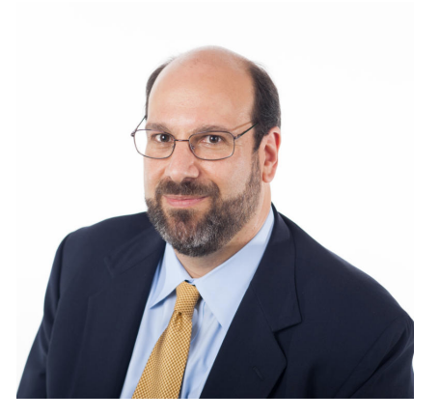
Organizers
Cas D'Angelo is the Associate Vice President and Chief Operating Officer at Georgia Tech, and President of SoX. Cas' role is leading and identifying resources for services and infrastructure. Cas is a Georgia Tech Electrical Engineering alumnus and is a 20 plus year veteran in Georgia Tech Information Technology. Cas also is the president of Southern Light Rail/Southern Crossroads (www.sox.net), a distributed gigapop supporting research and education institutions in the southeastern United States.

Slide 8
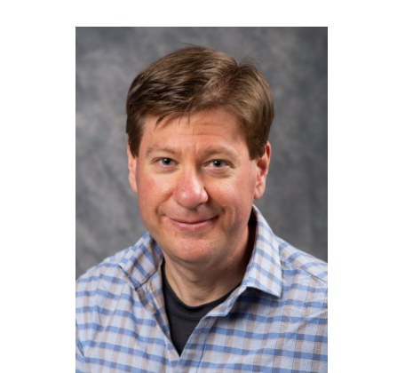
Organizers
Jason Zurawski is a Science Engagement Engineer at the Energy Sciences Network (ESnet) in the Scientific Networking Division of the Computing Sciences Directorate of the Lawrence Berkeley National Laboratory. He is a founding member of several open-source software developments, including perfSONAR, OWAMP, OSCARS, and others. He is also the coauthor of multiple research papers related to high-performance computing, including the original Science DMZ paper of 2013. Before joining ESnet, he worked for the University of Delaware and Internet2.

Slide 9
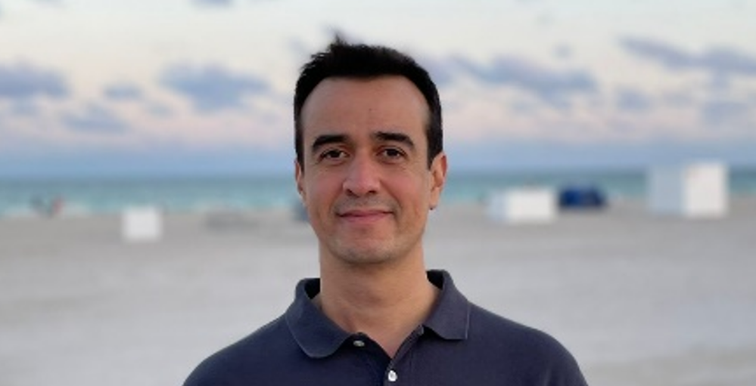
Organizers
Jorge Crichigno is a Professor in the College of Engineering and Computing at the University of South Carolina (USC) and the director of the Cyberinfrastructure Lab at USC. He has over 15 years of experience in the academic and industry sectors. Dr. Crichigno’s research focuses cyber-training and P4 programmable switches, implementation of high-speed networks, network security, TCP optimization, and IoT devices.

