Slide 1





Lab 2: Calculating Packets Interarrival
Times using Hashes and Registers
Samia Choueiri, Elie Kfoury
University of South Carolina (USC)
https://research.cec.sc.edu/cyberinfra
University of South Carolina (USC)
The Engagement and Performance Operations Center (EPOC)
Minority Serving - Cyberinfrastructure Consortium (MS-CC)
Hands-on Workshop on Science DMZ and P4-DPDK
Thursday, April 17, 2025.

Slide 2
Calculating Packets Interarrival Times using
Hashes and Registers
Lab activities are described in Lab 5, P4-DPDK Security lab series

Slide 3
Interarrival Times
The Interarrival time (IAT) is the time between two consecutive packets belonging to the same flow
IAT₁
IAT₂
IAT₃
…
t₁
t₂
t₃
t₄
…
t_{n}

Slide 4
Hashing in P4
The Interarrival time (IAT) is the time between two consecutive packets belonging to the same flow
A flow can be identified by its 5-tuple fields:
Source IP address
Destination IP address
Source port
Destination port
Protocol

Slide 5
IAT Calculation in P4
Hash
(5-tuple)
Packet

Slide 6
IAT Calculation in P4
Flow ID | Last pkt timestamp
0x1234 | t₁
Hash
(5-tuple)
Packet
Index

Slide 7
IAT Calculation in P4
Flow ID | Last pkt timestamp
0x1234 | t₁ t₂
Hash
(5-tuple)
Packet
Index
IAT = t₂ - t₁

Slide 8
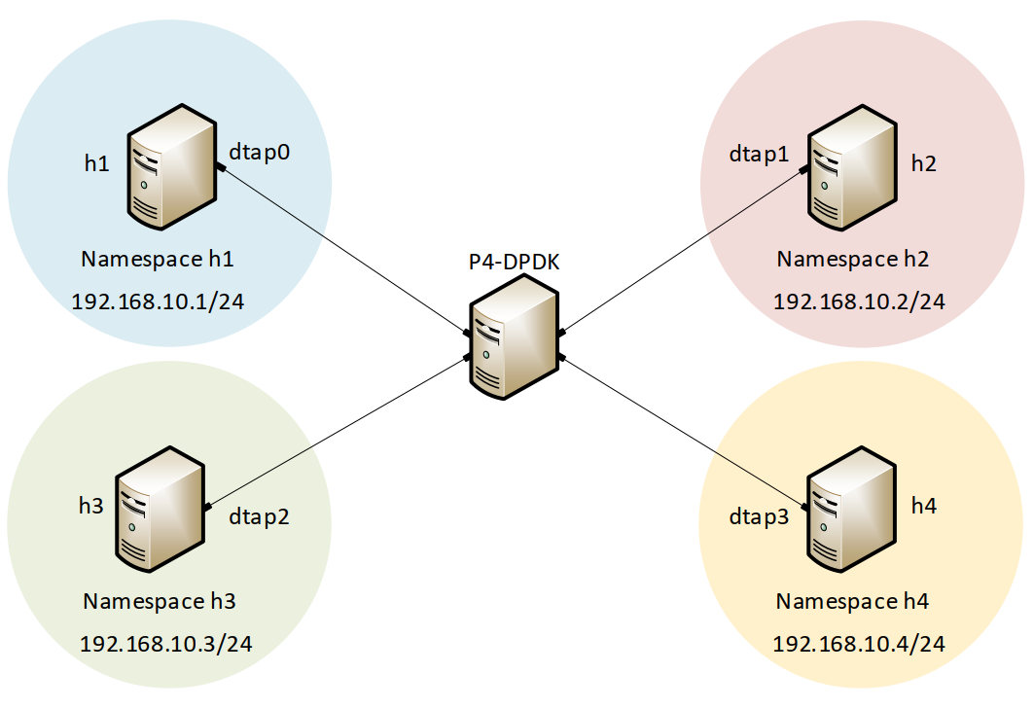
Lab Topology and Objectives
Four network namespaces, h1, h2, h3 and h4 are linked to the the P4-DPDK pipeline
The hosts h1 and h3 send packets with a custom header (interarrival)
A flow is identified by the source and destination IP of the packet
The P4-DPDK pipeline computes the IAT and inserts its value into the custom header
Hosts h2 and h4 receive packets from hosts h1 and h3, respectively
The IATs are shown on hosts h2 and h4
Header:
interarrival
IPv4
Ethernet

Slide 9
Accessing the Platform
URL: https://netlab.cec.sc.edu/
Username: <Email address used for registration>
Temporary Password: nsf-2025

