Slide 1


Real-Time Flow Measurements and Telemetry Collection using
RDMA and P4 Programmable Data Planes
Elie Kfoury, Ali Mazloum, Jose Gomez, Ali AlSabeh, Jorge Crichigno
University of South Carolina, USA
GMI-AIMS-5
14 February 2025
San Diego Supercomputer Center

Slide 2
Network Telemetry
Network telemetry provides valuable insights on the network
These insights can be used for a variety of tasks:
  Traffic engineering
  Performance troubleshooting
  Anomaly detection
  Resource planning
Telemetry can be classified as:
  Device-based (e.g., SNMP)
  Flow-based (e.g., NetFlow)

Slide 3
Traditional Telemetry Methods
Telemetry can be classified as:
  Device-based (e.g., SNMP)
Kfoury, E., Crichigno, J., & Bou-Harb, E. (2023). P4BS: Leveraging Passive Measurements from P4 Switches to Dynamically Modify a Router’s Buffer Size. IEEE Transactions on Network and Service Management.

Slide 4
Telemetry Information is Hard to Find
“I visited Switch 1 @780ns,
Switch 9 @1.3µs, Switch 12 @2.4µs”
1
“Which path did my packet take?”
# | Rule
1
2
3
…
75 | 192.168.0/24
…
“In Switch 1, I followed rules 75 and 250. In Switch 9, I followed rules 3 and 80. ”
2
“Which rules did my packet follow?”
Reproduced from N. McKeown. Tech Field Day - Why Does the Internet Need a Programmable Forwarding Plane

Slide 5
Telemetry Information is Hard to Find
3
“How long did my packet queue at each switch?”
“Delay: 100ns, 200ns, 19740ns”
Queue
4
“Who did my packet share the queue with?”
Time
Reproduced from N. McKeown. Tech Field Day - Why Does the Internet Need a Programmable Forwarding Plane

Slide 6
Telemetry Information is Hard to Find
3
“How long did my packet queue at each switch?”
“Delay: 100ns, 200ns, 19740ns”
Aggressor flow!
Queue
4
“Who did my packet share the queue with?”
Time
Reproduced from N. McKeown. Tech Field Day - Why Does the Internet Need a Programmable Forwarding Plane

Slide 7
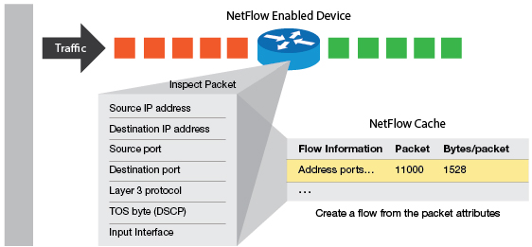
Traditional Telemetry Methods
Telemetry can be classified as:
  Device-based (e.g., SNMP)
  Flow-based (e.g., NetFlow)

Slide 8
Traditional Telemetry Methods
Telemetry can be classified as:
  Device-based (e.g., SNMP)
  Flow-based (e.g., NetFlow)
What if we want to measure RTT over the flow’s lifetime

Slide 9
Traditional Telemetry Methods
Telemetry can be classified as:
  Device-based (e.g., SNMP)
  Flow-based (e.g., NetFlow)
What if we want to measure RTT over the flow’s lifetime
What if we want to measure packet inter-arrival times

Slide 10
Traditional Telemetry Methods
Telemetry can be classified as:
  Device-based (e.g., SNMP)
  Flow-based (e.g., NetFlow)
What if we want to measure RTT over the flow’s lifetime
What if we want to measure packet inter-arrival times
What if we want to measure bytes-in-flight

Slide 11
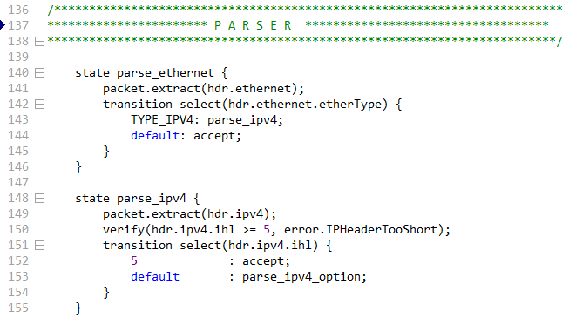
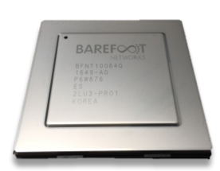
P4 Programmable Switches
P4¹ programmable switches permit programmers to program the data plane
Programmable switch
P4 code
Programmable chip
1. P4 stands for stands for Programming Protocol-independent Packet Processors
Notes:
A programmer can program the ASIC (application-specific integrated circuit)

Slide 12
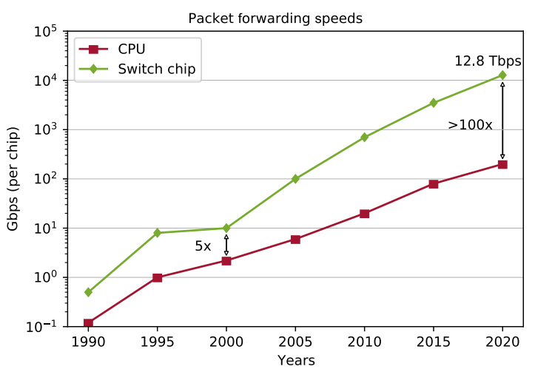
P4 Programmable Switches
P4¹ programmable switches permit programmers to program the data plane
  Customize packet processing functions
  Measure events occurring in the data plane with
  high precision
  Offload applications to the data plane
  Per-packet custom processing
Reproduced from N. McKeown. NetDev 0x14 - Creating an End-to-End Programming Model for Packet Forwarding. Available: https://www.youtube.com/watch?v=fiBuao6YZl0&t=631s

Slide 13
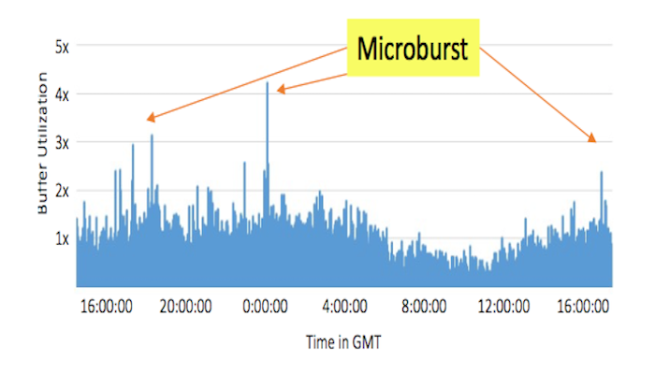
P4 Programmable Switches
P4¹ programmable switches permit programmers to program the data plane
  Customize packet processing functions
  Measure events occurring in the data plane with
  high precision
  Offload applications to the data plane
  Per-packet custom processing
Chen, Xiaoqi, et al. "Fine-grained queue measurement in the data plane." Proceedings of the 15th International Conference on Emerging Networking Experiments And Technologies (CoNEXT). 2019.

Slide 14
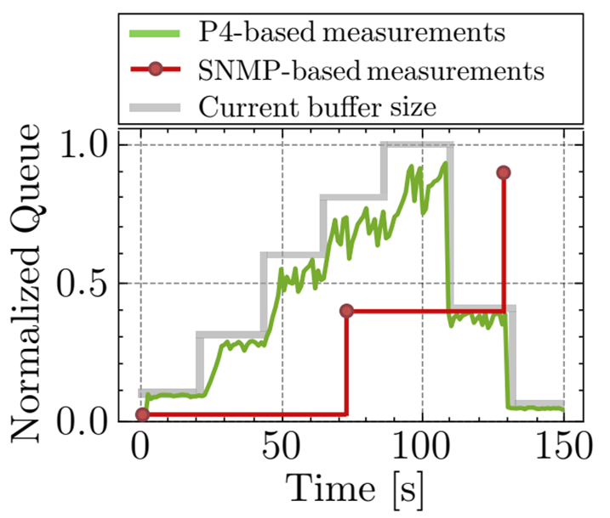
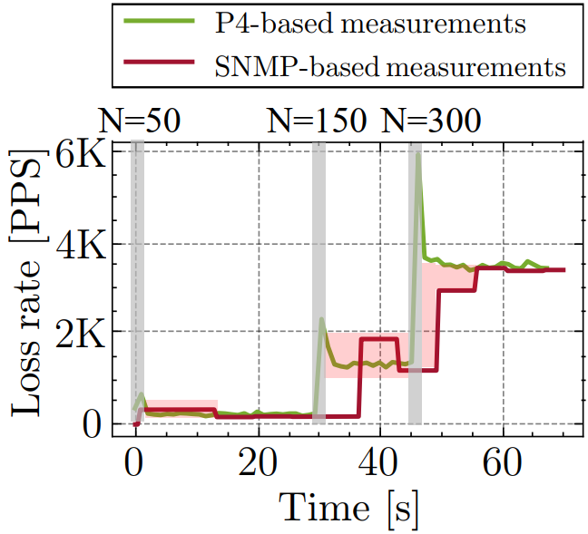
P4-based Device Telemetry
Telemetry can be classified as:
  Device-based (e.g., SNMP)
  Flow-based (e.g., NetFlow)
50 / 150 / 300 flows enter the network
Kfoury, E., Crichigno, J., & Bou-Harb, E. (2023). P4BS: Leveraging Passive Measurements from P4 Switches to Dynamically Modify a Router’s Buffer Size. IEEE Transactions on Network and Service Management.

Slide 15
Inband Network Telemetry
Add: SwitchID, Arrival Time,
Queue Delay, Matched Rules, …
Original Packet
Log, Analyze
Replay
Visualize
Reproduced from N. McKeown. Tech Field Day - Why Does the Internet Need a Programmable Forwarding Plane

Slide 16
Telemetry Collection Issues
Telemetry generates a large amount of data (reports)
Collectors are not able to keep up with the high rates
CPU processing the reports becomes the bottleneck
Packets will be dropped → less insights

Slide 17
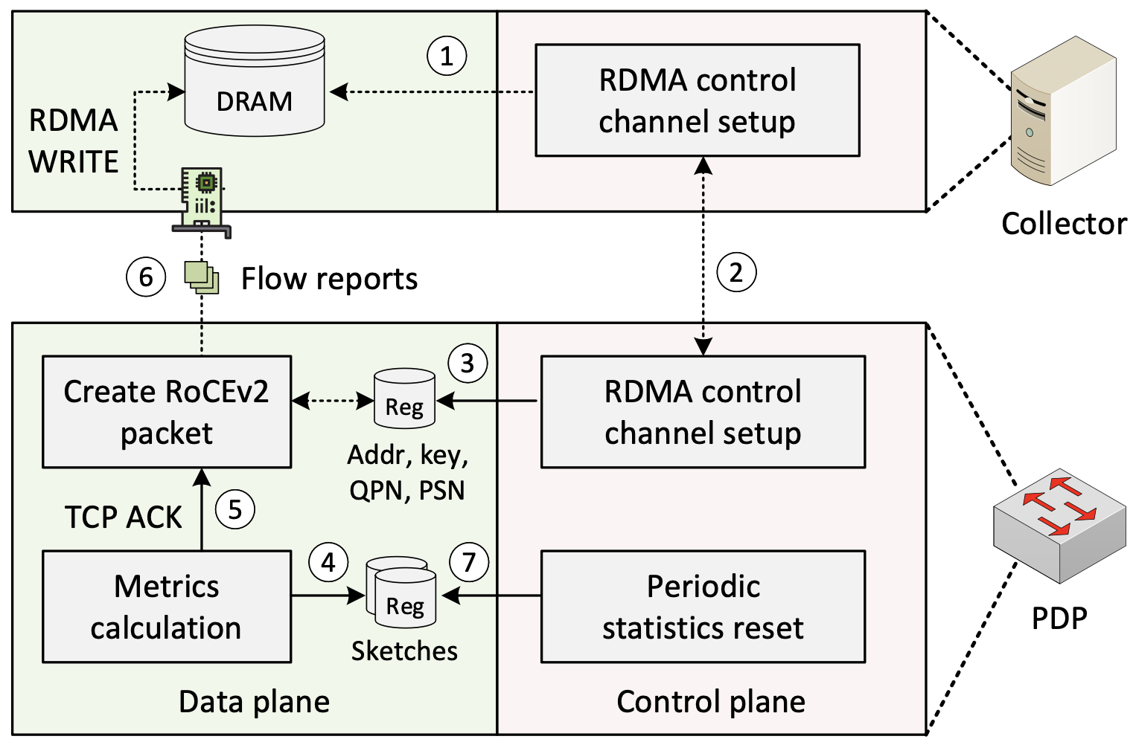
Proposed System
The system leverages P4 switches to compute telemetry and flow-level metrics at line rate
The switch then creates and sends reports using RDMA (RoCEv2) to a collector

Slide 18
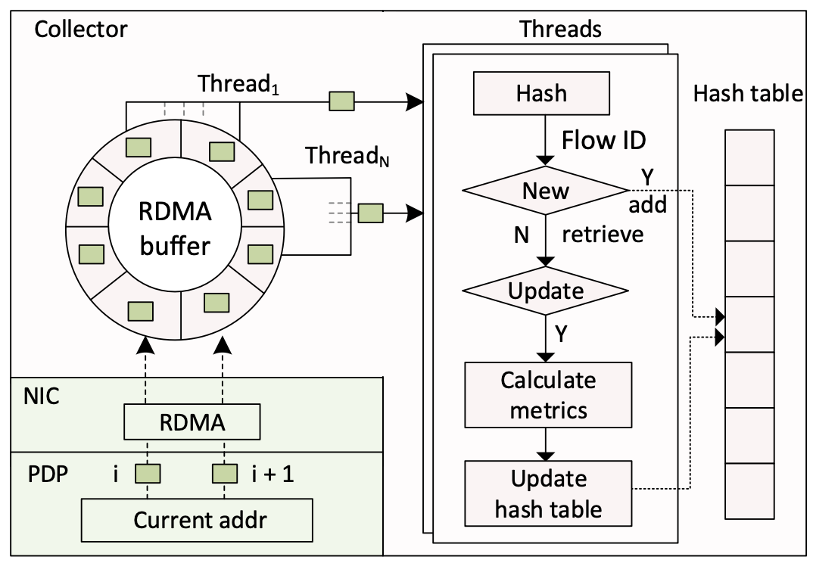
Proposed System
The collector initializes threads that continuously iterate over fixed-size segments in the allocated buffer
Each thread parses its reports and updates a global hash table that tracks the metrics for all flows

Slide 19
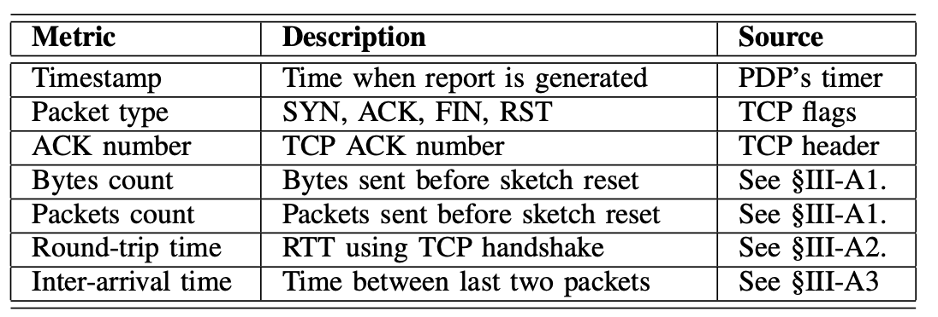
Metrics Computation
The system calculates per-flow metrics
Some metrics computed exclusively by the data plane
Others derived by the collector using the metrics produced by the data plane
Raw metrics extracted/calculated by the data plane

Slide 20
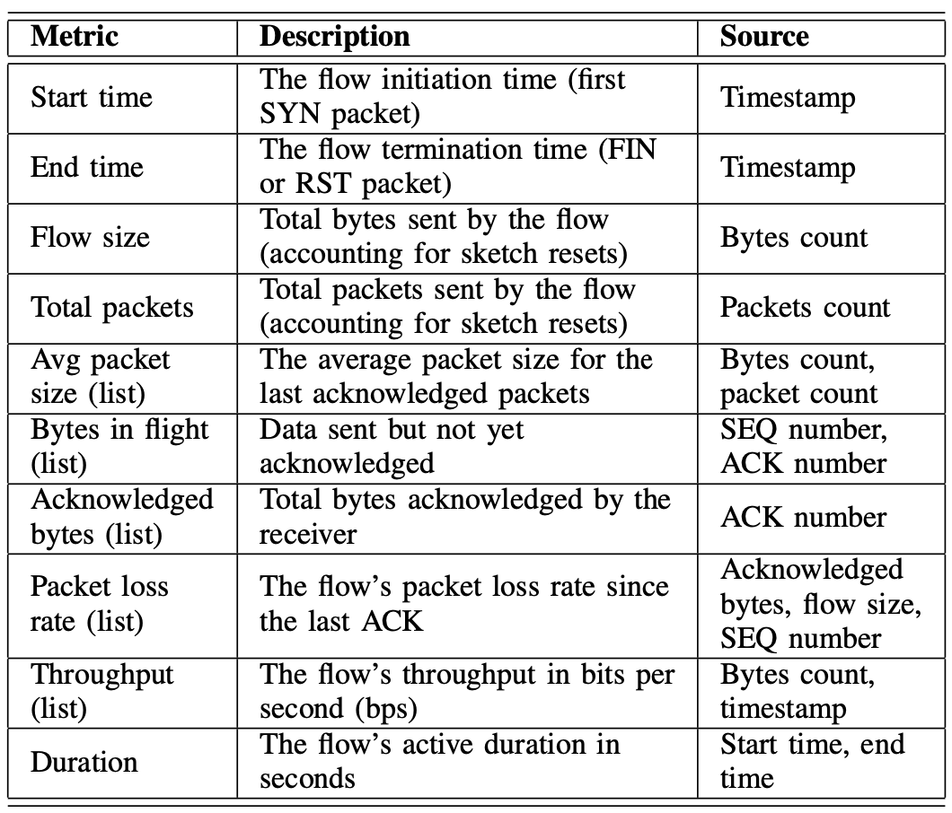
Metrics Computation
The system calculates per-flow metrics
Some metrics computed exclusively by the data plane
Others derived by the collector using the metrics produced by the data plane
Derived metrics computed at the collector

Slide 21
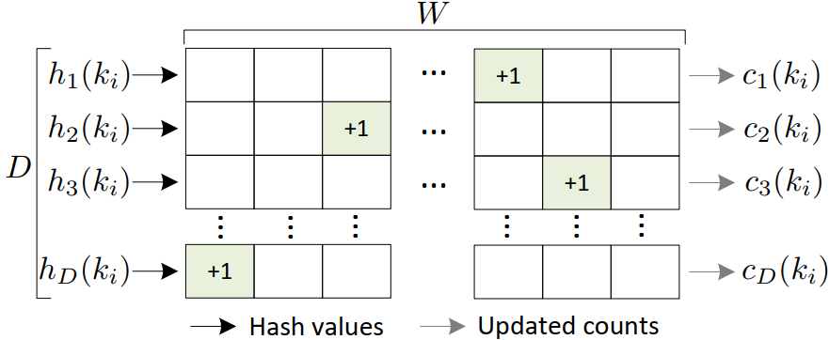
Tracking Flows at Scale
The Count-Min Sketch (CMS) algorithm is used to track flows
CMS uses multiple hash functions
A hash function takes as input the 5-tuple, which is used to identify a flow
D: Depth (# of hash functions)
W: Width (# of cells in each array)
i: Packet index, between 0-N
k_{i}: ID of a flow, using i^{th} packet info.
c_{d} (k_{i} ): estimated # of packets of flow k_{i}, using hash function d, after processing packet i

Slide 22
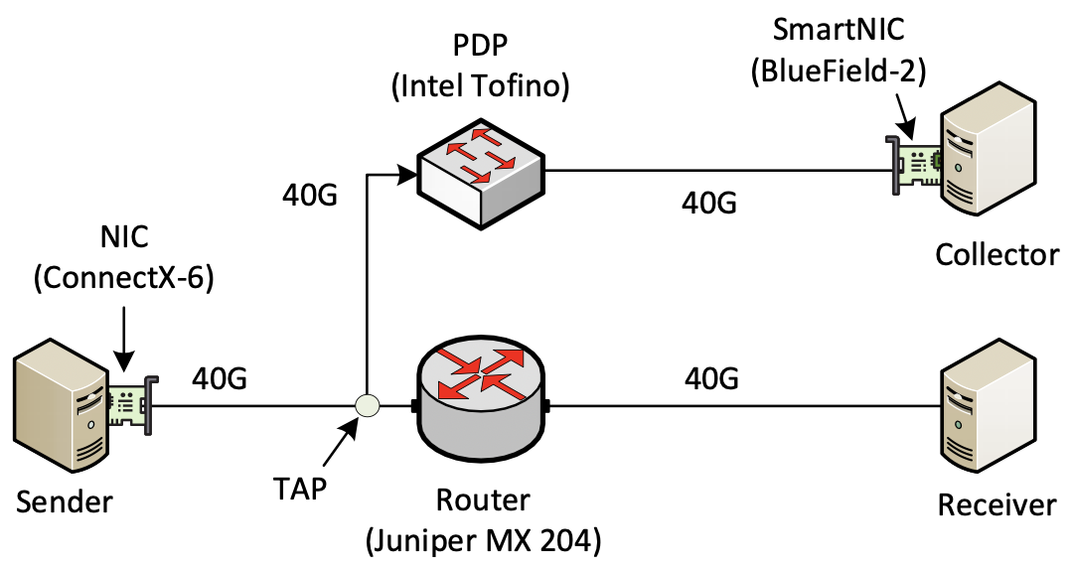
Experiment Topology
The sender and receiver are connected to a legacy router (Juniper MX 204)
An optical tap forwards all the packets to a P4 switch (Intel Tofino)
The collector is connected to the P4 switch through an RDMA-capable SmartNIC (NVIDIA BlueField-2)
Notes:
https://portal.fabric-testbed.net/

Slide 23
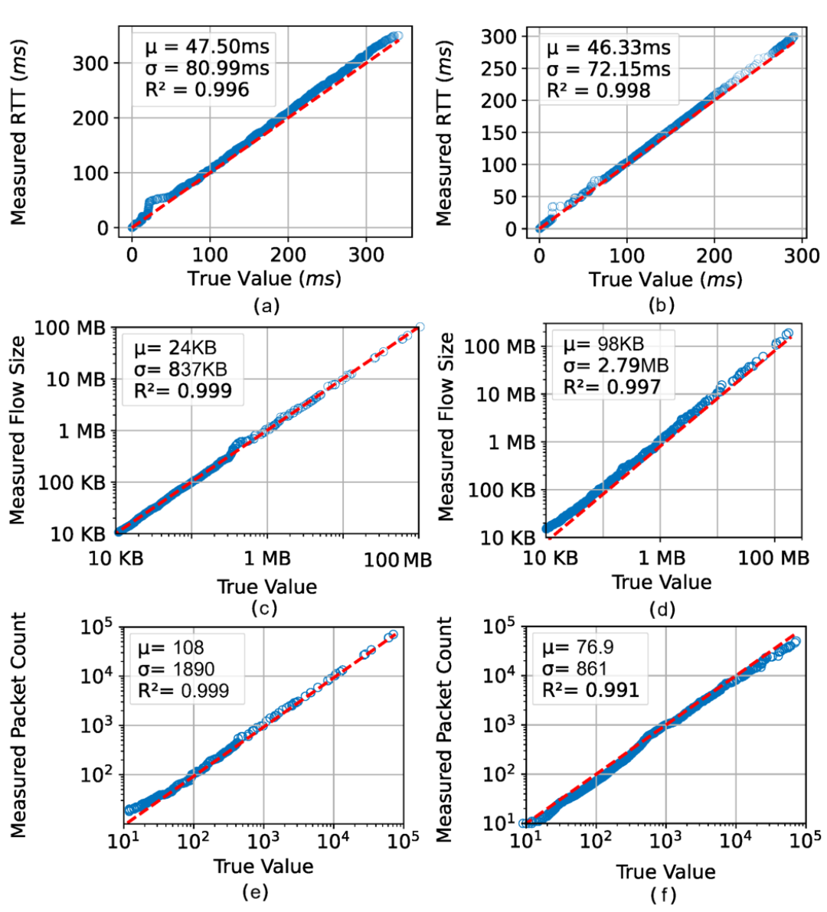
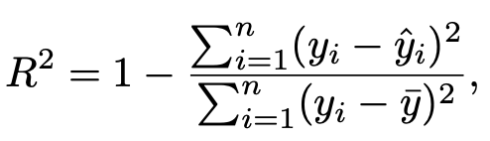
Measurements Accuracy with Real Traces
Traces are obtained from Measurements and Analyses on the WIDE Internet (MAWI)
Average rate is 2989 Mbps
Coefficient of determination (R2) is used to quantify how close the measured values are from real values
Notes:
https://portal.fabric-testbed.net/

Slide 24
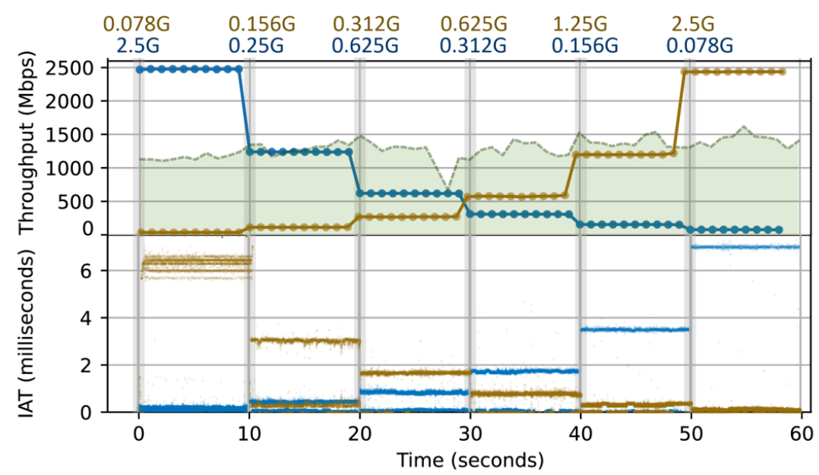
System Responsiveness to Flow Dynamics
The high-rate trace is replayed while simultaneously starting two iPerf3 flows
The gray striped bars indicate periods when the rates change
Rate limiting is controlled via the Linux TC queue disciplines (tc qdisc) only for the iPerf3 flows
Notes:
https://portal.fabric-testbed.net/

Slide 25
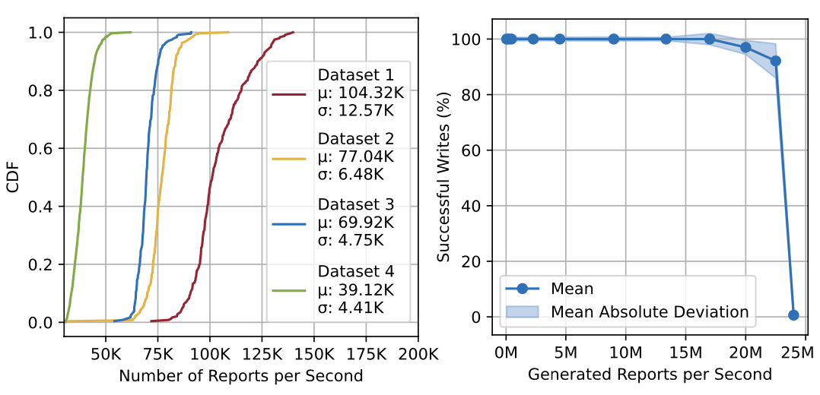
Reporting Rate Throughput
The report count varies based on the nature of the trace
A trace with many data transfers will have more ACKs, leading to more reports
Average number of reports in MAWI traces is in the O(100K)
The system can write ~20 million reports per second
Notes:
https://portal.fabric-testbed.net/

Slide 26
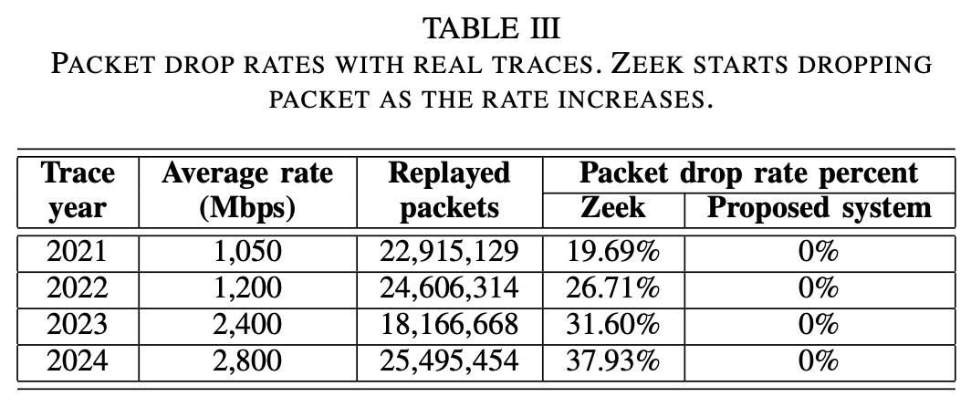
Comparison with Zeek NSM
Zeek Network Security Monitor (NSM) is a widely used network monitoring system
Zeek can summarize connection statistics observed in a network
The system is compared against Zeek using the same threading configuration (4 CPU cores)
As the packet rate increases, Zeek experiences growing packet losses due
Notes:
https://portal.fabric-testbed.net/

Slide 27


Acknowledgement
This work was supported by the U.S. National Science Foundation (NSF), under awards 2346726, 2417823, and 2403360
The authors would also like to acknowledge the FABRIC team.

